Slide 1
Skyrmions Trajectory Prediction
Experiments Plan

Slide 2
Content
The problem
Possible solutions
Regularised Least Square Model
Feed Forward Neural Network (FNN)
Recurrent Neural Network (RNN)
LSTM
Observer LSTM
Observer FNN
Reservoir Computing RNN
Plan

Slide 3
Problem
Aim: to predict skyrmions trajectories using a ML model agnostic of the underlying physics equations
We want to investigate several Neural Network architectures
We want to analyse the effect of varying number of skyrmions, shape of the ferromagnet, temperature, etc. on the behaviour of the system

Slide 4
Possible Solutions
Regularised Least Square Model
Feed Forward Neural Network (FNN)
Recurrent Neural Network (RNN)
LSTM
Observer LSTM
Observer FNN
Reservoir Computing RNN

Slide 5
The Data
Input data is given as frames of the simulation of skyrmions movement
Each frame if a list of vectors [x, y, z] representing the spins
We want the output to be a frame or a series of frames representing the position(s) of the skyrmion(s) given some initial conditions

Slide 6
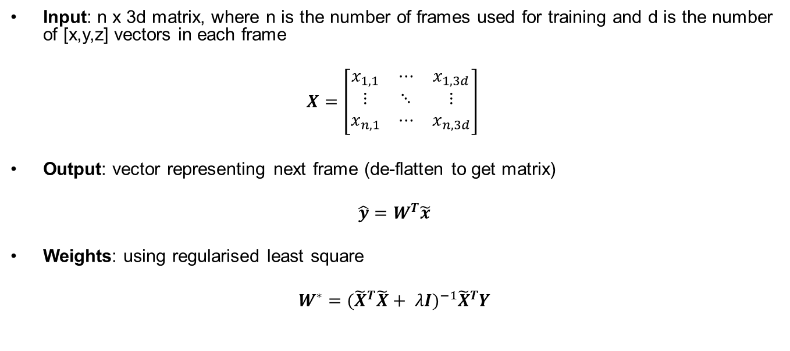
Regularised Least Square Model
Input: n x 3d matrix, where n is the number of frames used for training and d is the number of [x,y,z] vectors in each frame
$$X=\left[\begin{matrix}x_{1,1} & ⋯ & x_{1,3d} \\ ⋮ & ⋱ & ⋮ \\ x_{n,1} & ⋯ & x_{n,3d}\end{matrix}\right]$$
Output: vector representing next frame (de-flatten to get matrix)
$$\hat{y}=W^{T}\tilde{x}$$
Weights: using regularised least square
$$W^{∗}={{(\tilde{X}}^{T}\tilde{X}+ λI)}^{−1}{\tilde{X}}^{T}Y$$

Slide 7
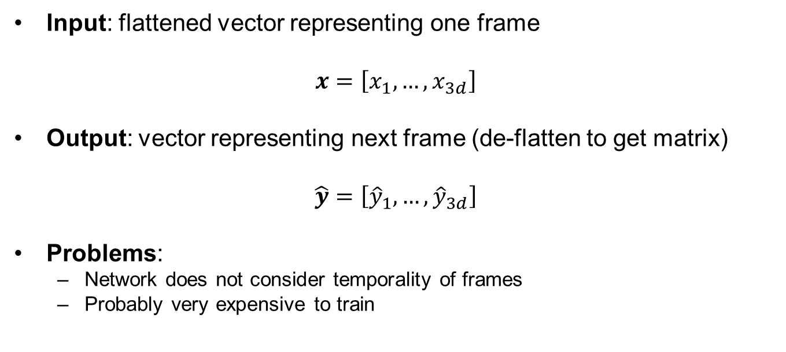
Feed Forward Neural Network
Input: flattened vector representing one frame
$$x=\left[x_{1}, …, x_{3d}\right]$$
Output: vector representing next frame (de-flatten to get matrix)
$$\hat{y}=\left[{\hat{y}}_{1}, …, {\hat{y}}_{3d}\right]$$
Problems:
Network does not consider temporality of frames
Probably very expensive to train

Slide 8
Recurrent Neural Network
Input: sequence of frames (time series)
At each recurrence, feed into the RNN the next frame and the result of the previous recurrence computation until the input sequence is exhausted
Output: predicted next frame(s)
Problem: short term memory, i.e. the network gives less and less important to frames in the past (vanishing gradient when back-propagating)
But, are frames far in the ‘past’ really important to predict the trajectories?

Slide 9
LSTM
Input: same as RNN, but we have a LSTM unit instead of simple RNN
Output: predicted next frame(s)
This solves the short term memory problem of simple RNNs, BUT it is more computationally demanding
Note: both simple RNN and LSTM might start deviating from ground truth, hence making the training inefficient (could be solved with Observer)

Slide 10
OLSTM (or ORNN)
Set up is similar to standard LSTM
Solves problem of deviating prediction by having an observer ‘check’ that the prediction is not too distant from the ground truth

Slide 11
OFNN
Set up is similar to FNN, but solves the same problem as OLSTM

Slide 12
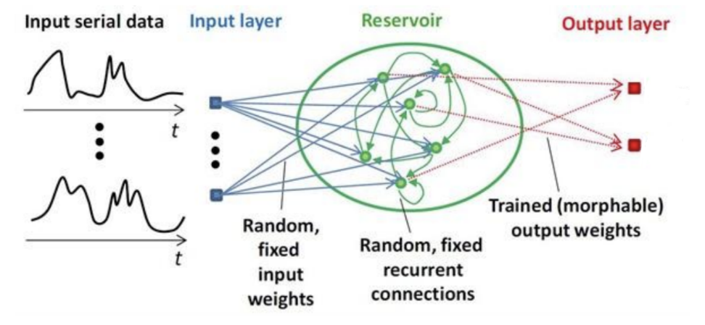
Reservoir Computing RNN
We train the output weights of the network
Faster to train compared to LSTM

Slide 13
Experiments Plan Timeline
Regularised Least Square
RNN
LSTM
OLSTM
RC RNN
FNN
OFNN

