Slide 1
Golang Training 1 – Basics, Syntax, Data Structures
Calvin Lei-Cramer
May 2025

Slide 2
Training format?
Notes:
Our training format will be four lessons.
After each lesson I will release exercises you can complete to practice and reinforce the ideas.
The exercises will be released as a github repo which will also include these slides.
After a certain amount of time I will release reference solutions.

Slide 3
What are we covering today?
Variables, data types, functions, maps, loops, arrays, slices, structs, new(), make(), enums, switch

Slide 4
What is Golang Exactly?
2009 started by Google engineers Robert Griesemer, Rob Pike, Ken Thompson (yes that Ken)
Simple syntax, small language specification (opposite of C++ & Swift)
Compiled → $ go build ; ./my-module
Statically typed. No automatic type conversions / promotions.
Garbage collected. No need to worry about lifetime or freeing objects.
No OOP. Functional (interfaces, structs).
Basically C but modern and more strict, plus interfaces and more nice things
Notes:
Ken Thompson original author of UNIX
Statically typed → all types known at compile time.
Golang is strict with types. No automatic conversion of types done like in C.

Slide 5
Language Versions
1.24 (2025 Feb, we’re using this) – generic type aliases
1.23
1.22
1.21 – min, max, clear
1.20
1.19
1.18 (2022 March) – Generics, any (biggest change)
Extremely conservative changes
Notes:
Golang is very hesitant to add any changes. Things move very slowly.

Slide 6
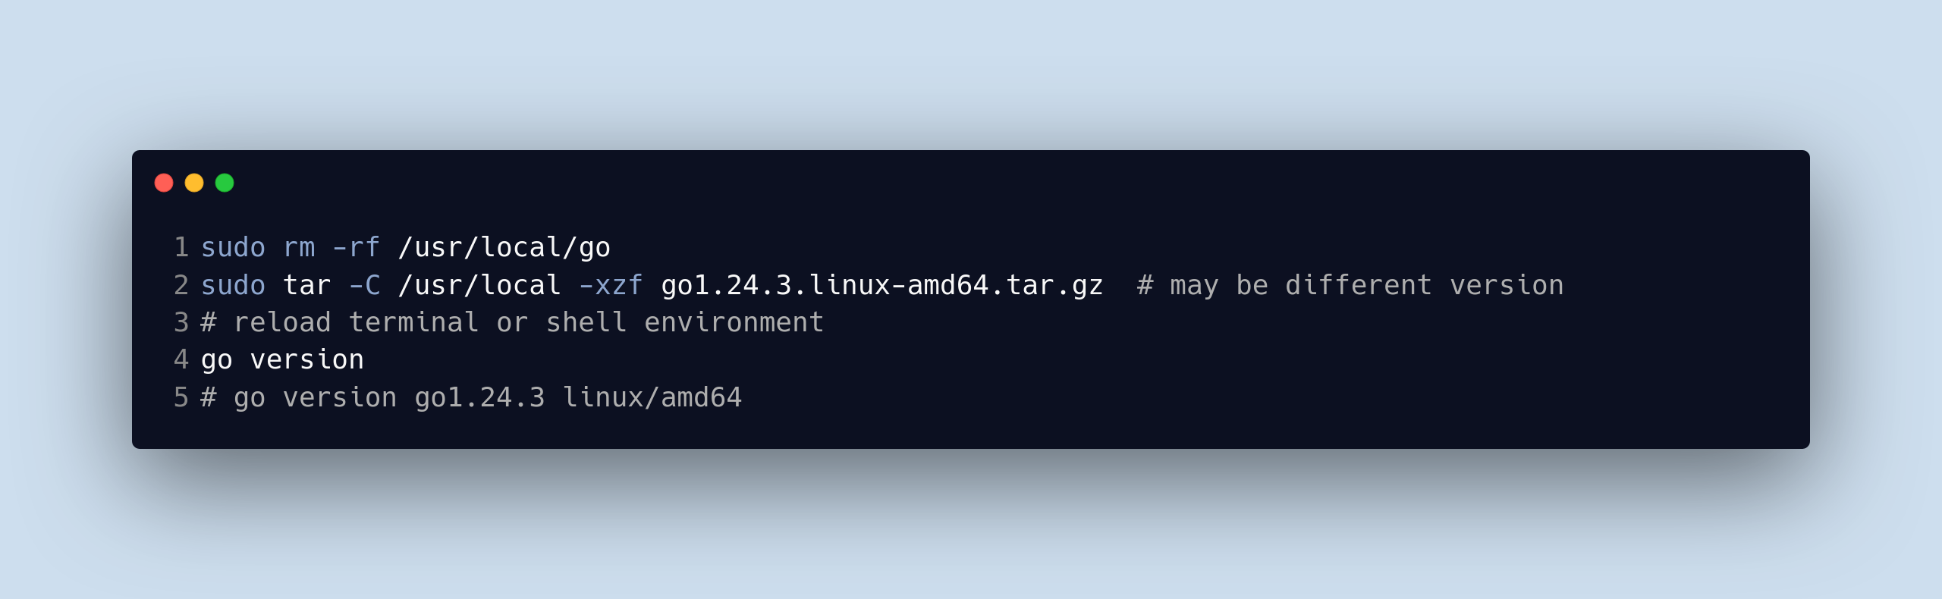
How to Install
1. Download from https://go.dev/dl/

Slide 7
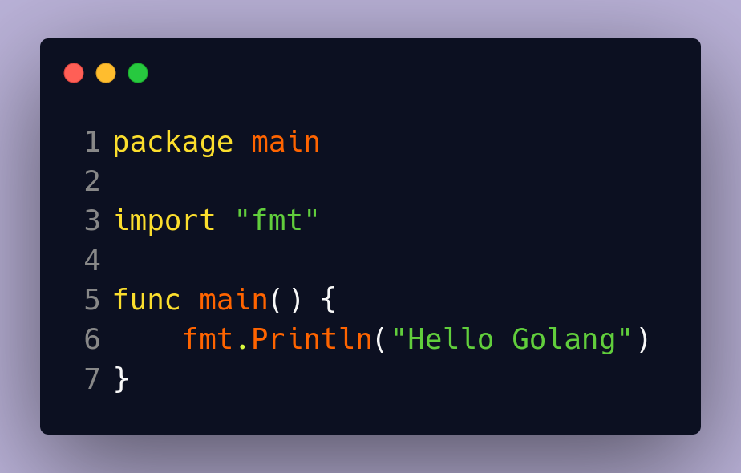

Hello World
Main.go
Follow along locally,
or use https://play.golang.com/

Slide 8
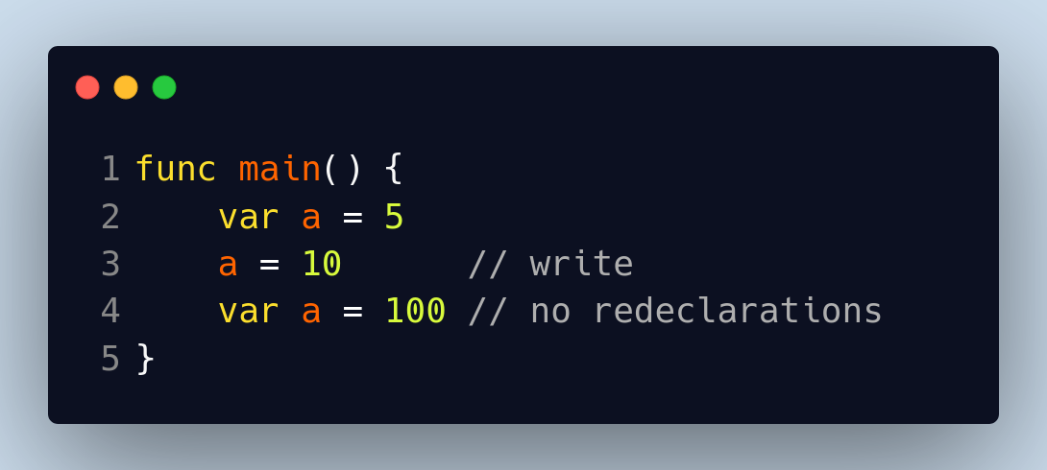
Variables
Use = to specify type and for globals
Re-declaring variables is error
Unused variables is error
The compiler is your friend

Slide 9
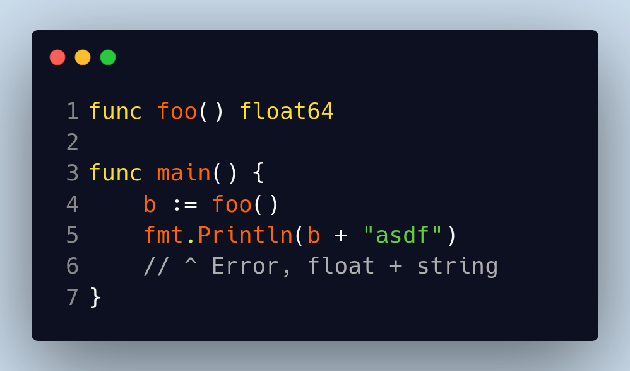
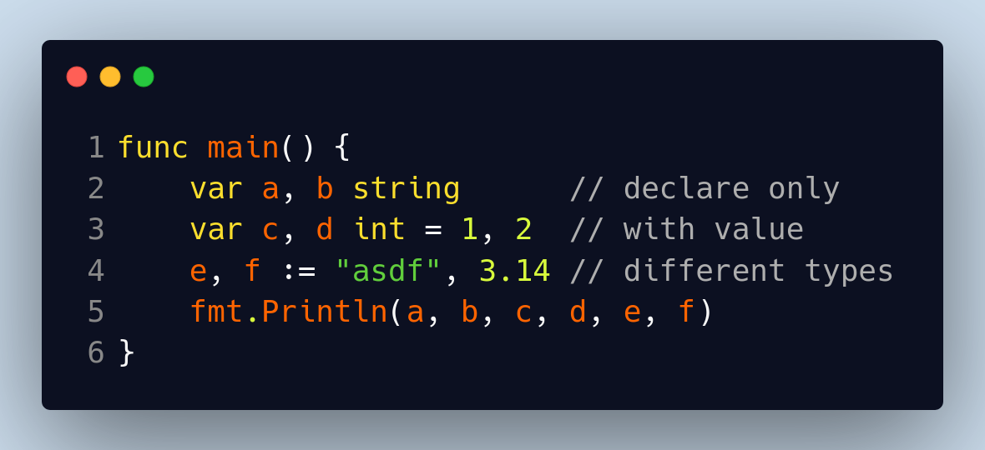
Variables (2)
Use := for brevity, let Golang do type inferrence like C++ auto
Multiple declarations at once

Slide 10
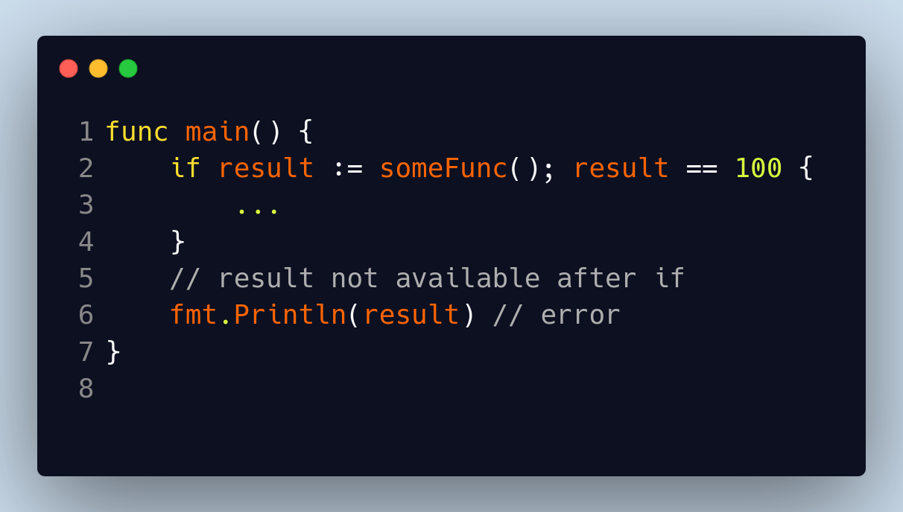
Short declarations
“Short” declaration scopes variables to if
Also can use with for (init statement) and switch
condition
declaration

Slide 11
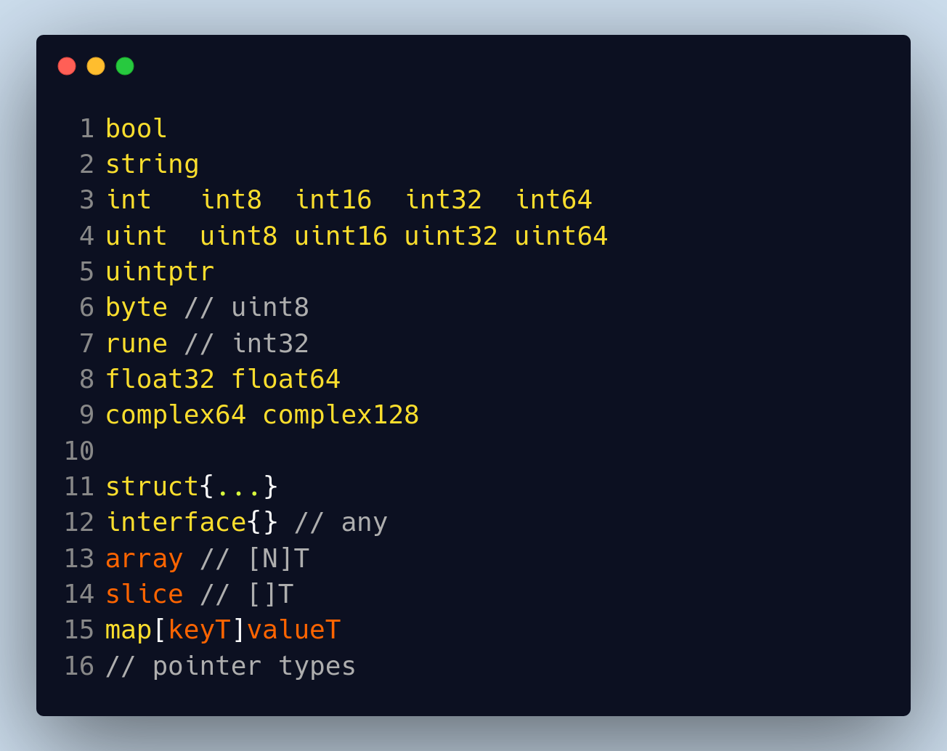
Data Types
Very few

Slide 12
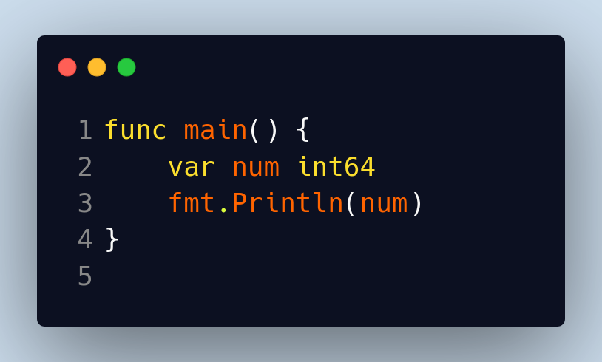
Zero Values
What will be printed?
Integers → 0
Floats → 0.0
Boolean → false
Strings → “”
Interface, slice, channel, map, pointers, functions → nil
Array, struct → zero value for each member

Slide 13
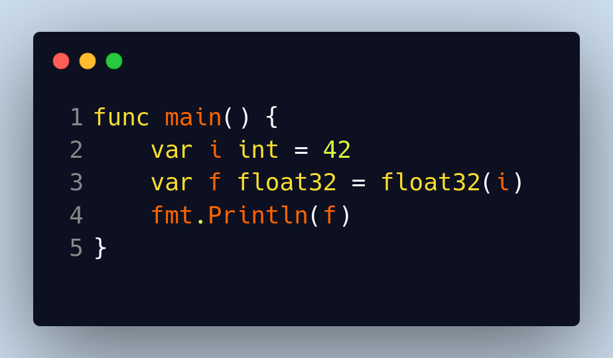
Converting Between Data Types
T(v) converts v to T
strconv package Atoi() Itoa() for strings ↔ integer

Slide 14
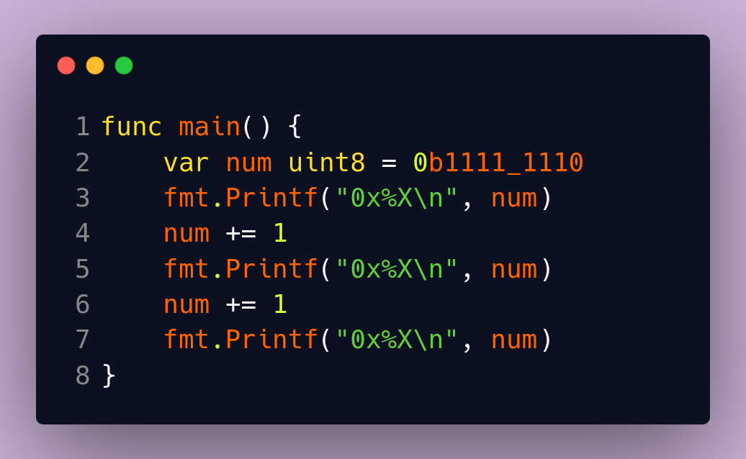
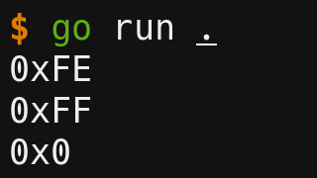
What happens if we try to break things?
Integer overflow
Wrap!

Slide 15
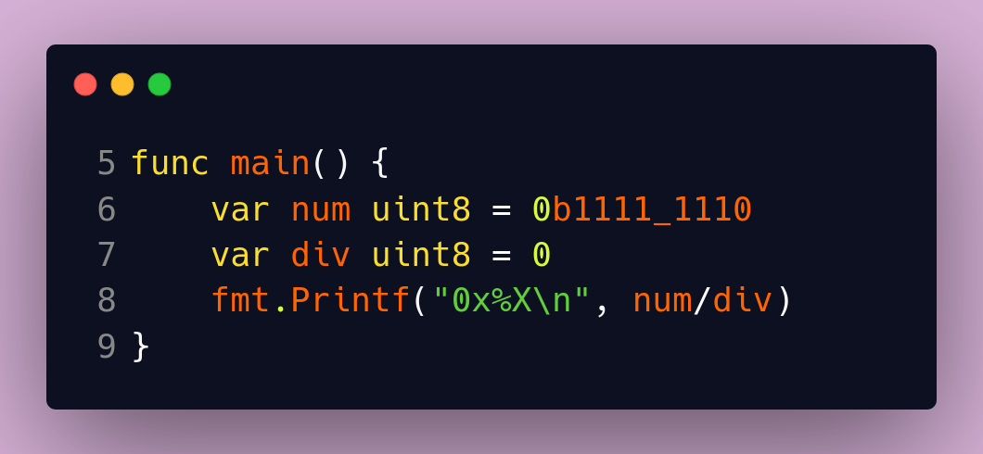
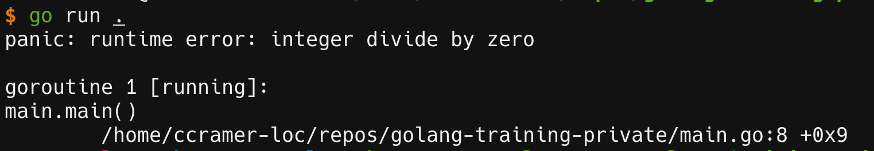
What happens if we try to break things?
Divide by zero
Learn about panics later

Slide 16
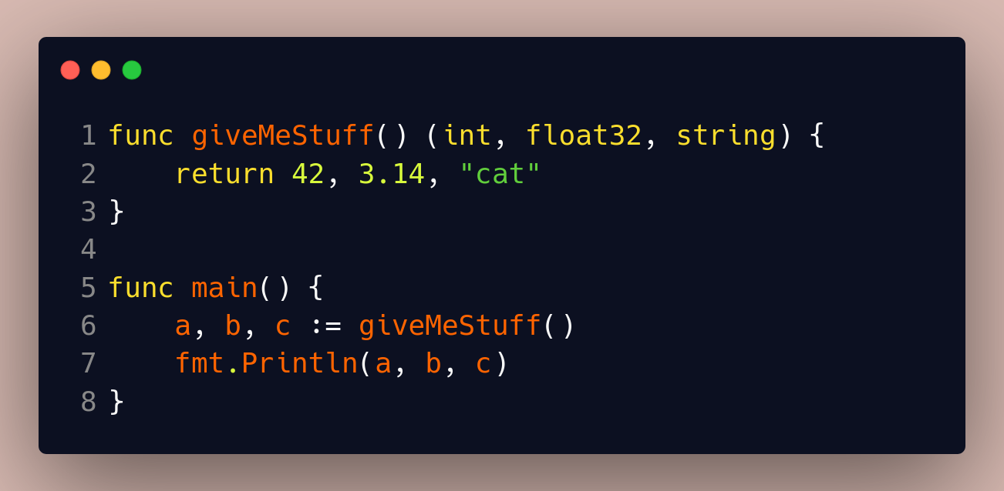
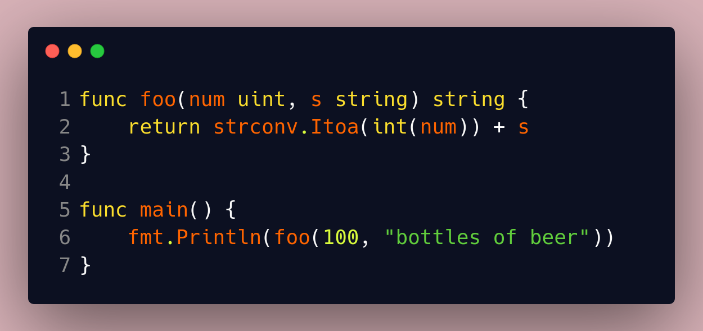
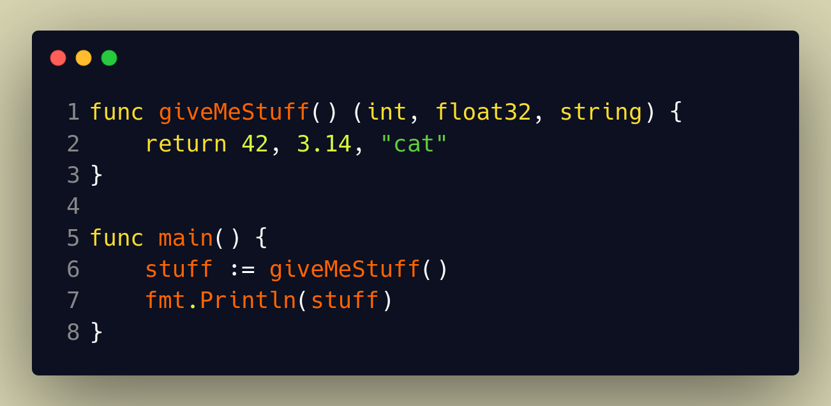
Functions (not methods)
Simple
Multiple return
Multiple return collect whole response
./main.go:12:11: assignment mismatch: 1 variable but giveMeStuff returns 3 values
NOT LIKE PYTHON TUPLE

Slide 17
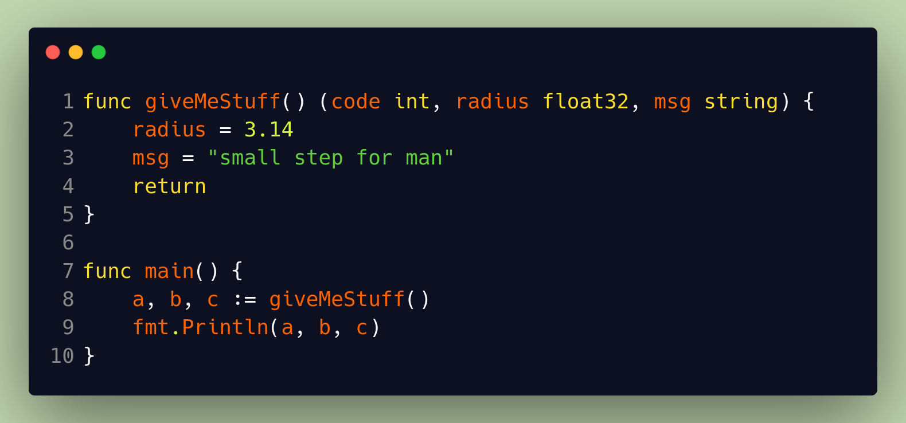
Functions more
Named / naked return (important for later)
Variables declared and initialize to zero value
REQUIRED to add “naked return”

Slide 18
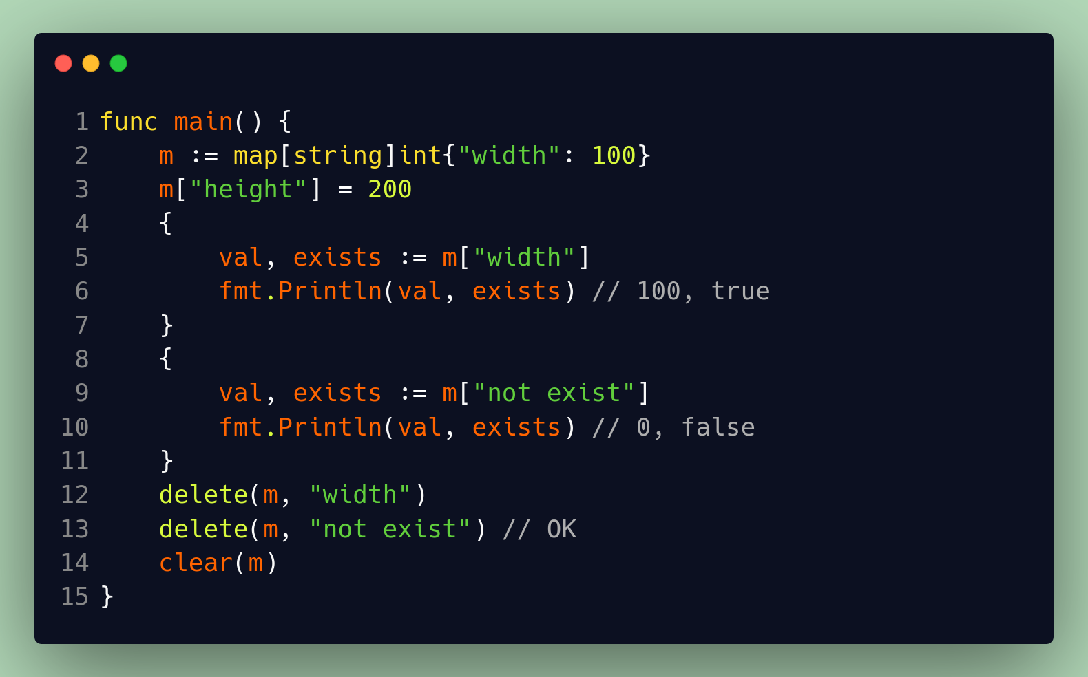
Maps
Create, Add, Check key exists, Delete key, clear
Arbitrary scoping

Slide 19
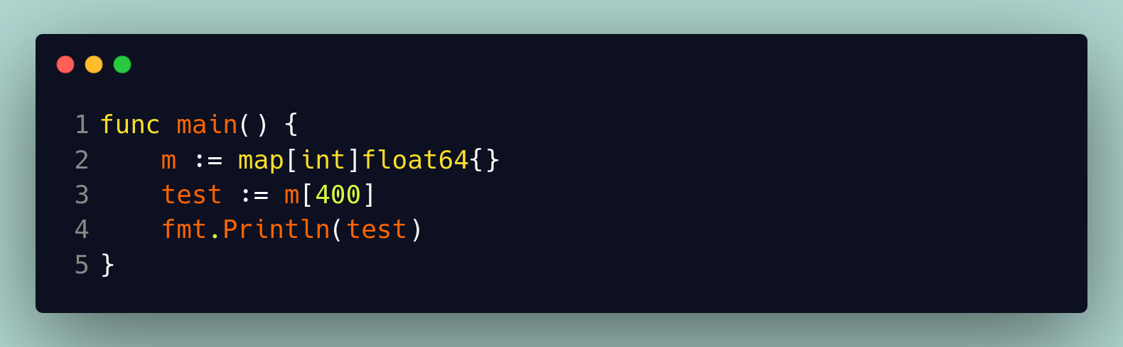
Maps – be careful!
Prints 0!
What happens here?
Compiler error?
Runtime panic?

Slide 20
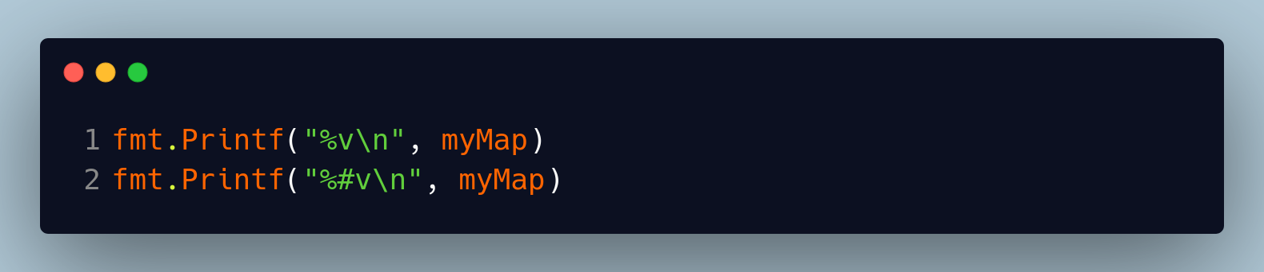
Helpful debugging
Print (%v, %#v)
map[inst:{500} 40:foo 3.14:0xc000098040]
map[interface {}]interface {}{"inst":main.MyStruct{member:500}, 40:"foo", 3.14:(*int)(0xc000098040)}

Slide 21
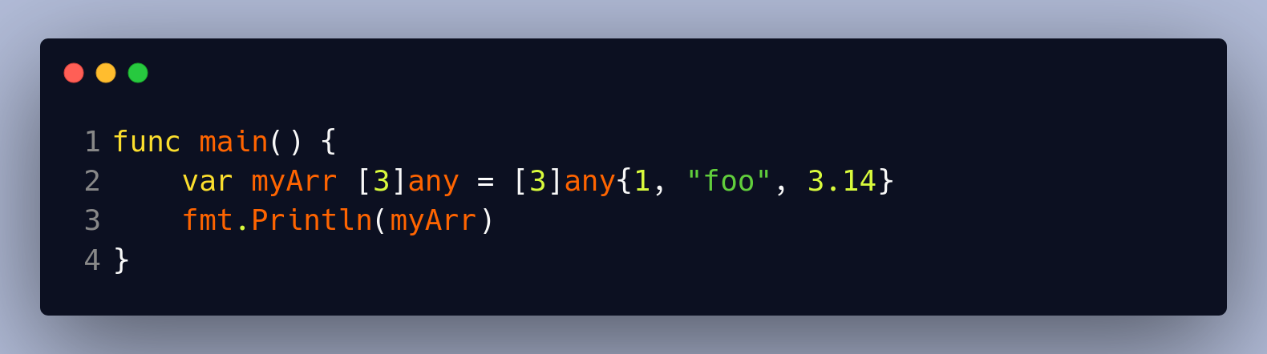
Arrays and Slices
Array – fixed sized sequence of elements of the same type
Size is included in type → [10]int != [20]int
Notes:
Can’t make functions which handles arrays of any size.

Slide 22
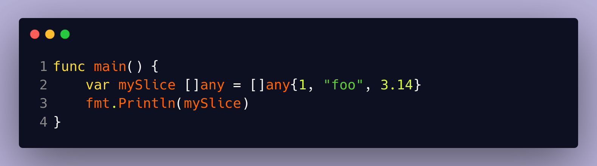
Arrays and Slices
Slice – range of contiguous elements, pointing to underlying array that actually holds the data
Slice is “view” on an array
Forget about arrays, just use slices.
Slices offer dynamically-sized array features like pythons List
No size means slice

Slide 23
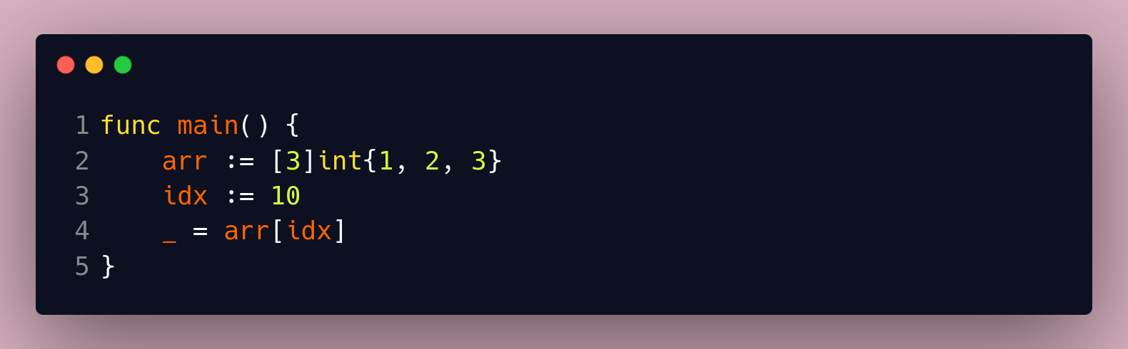
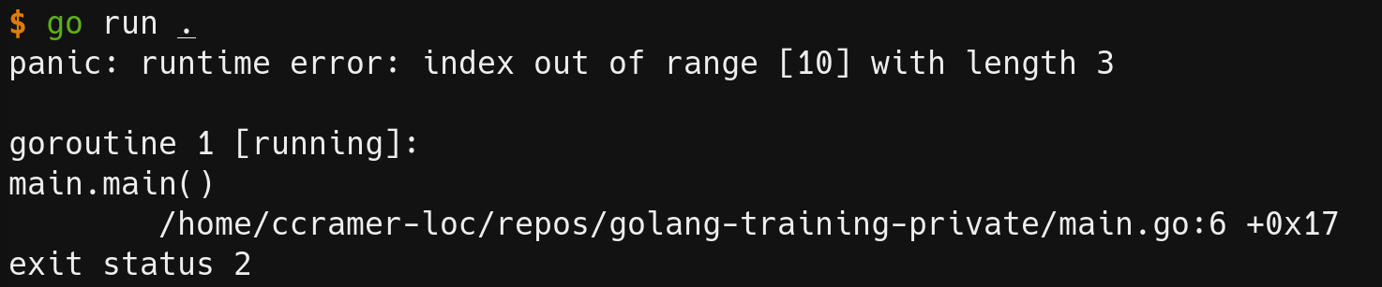
Let’s Cause Errors!
Index out of bounds, what happens?
Out of bounds!
Notes:
Both array and slice panic

Slide 24
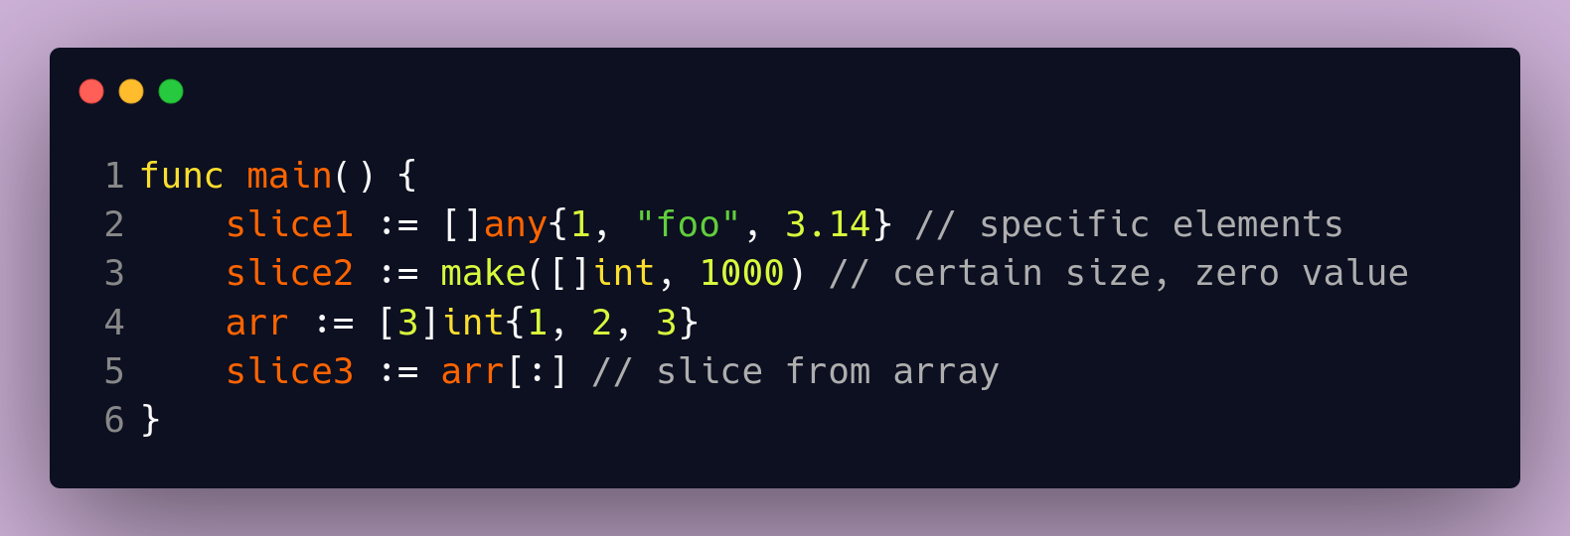
Create Slices
Different ways to construct slices → direct, make(), from array

Slide 25
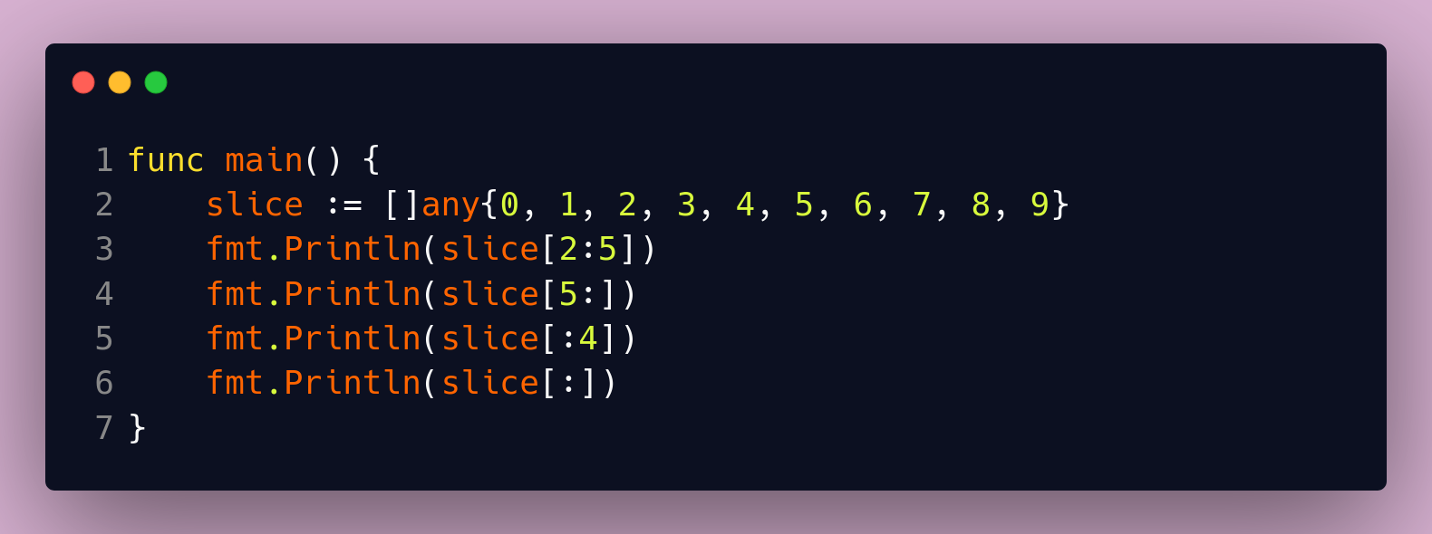
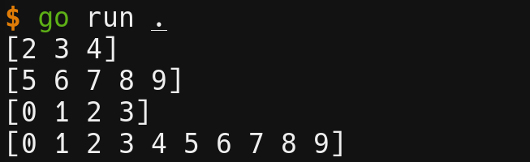
Slice Expression
Slice expression [:] syntax:
foo[low:high]
foo[:high]
foo[low:]
Similar to python but without negative indexing
Notes:
Low is inclusive
High is exclusive
Omitting high will default to length of slice
Omitting low will default to 0

Slide 26
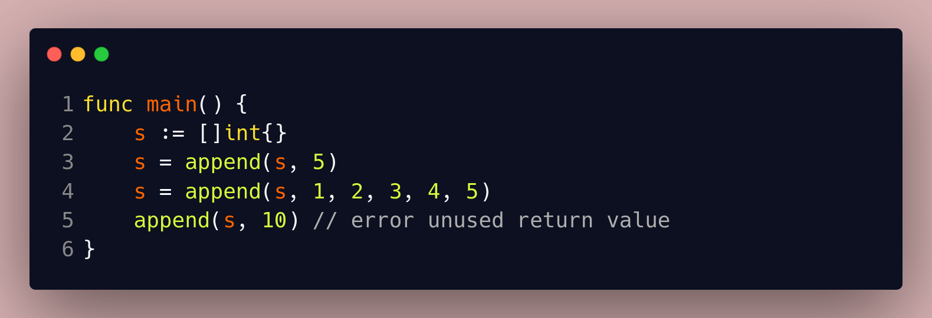
Slice Operations
Append
Multiple items at once
Append is a global function, not a function on slice type

Slide 27
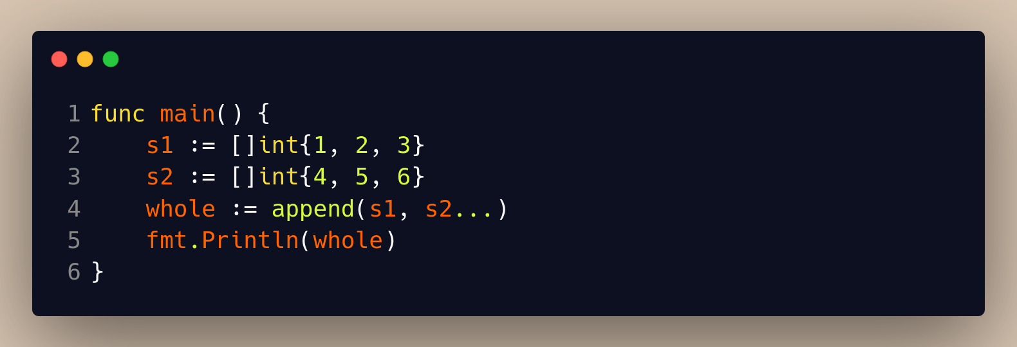
Slice Operations
Concatenate two slices
func append(slice []Type, elems ...Type) []Type
Variadic functions (later)
Notes:
Use the append() function again
Append takes any number of arguments, which is what the dot dot dot syntax is

Slide 28
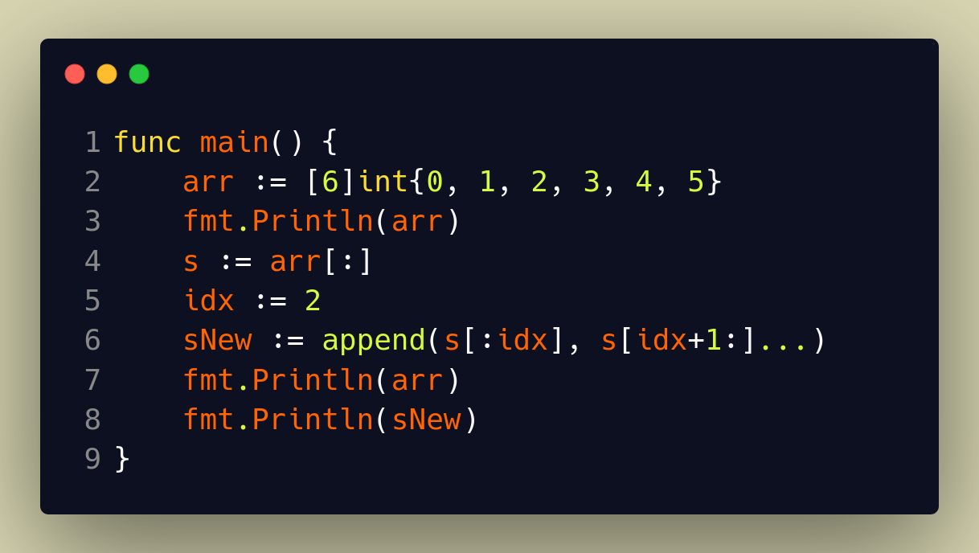
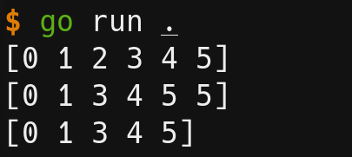
Slice Operations
Remove elements
Underlying array
Notes:
USE SLICING, NOT DIRECT WAY TO REMOVE ELEMENTS LIKE POP()
See underlying array does not change size

Slide 29
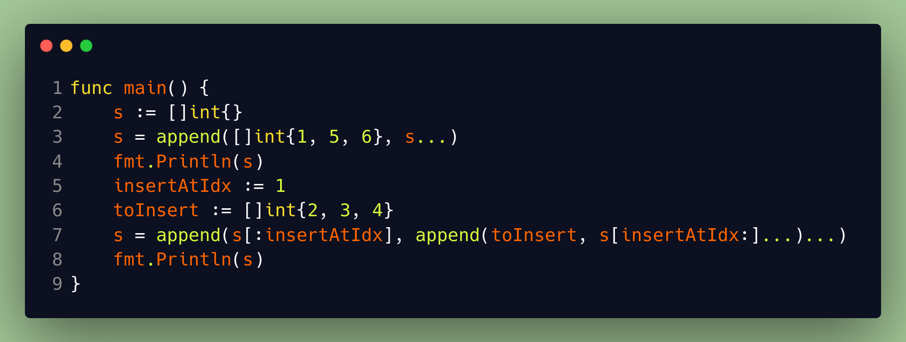
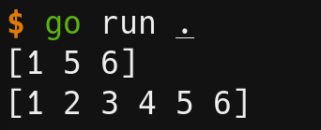
Slice Operations
Insert multiple elements (start, middle)
Whoa! Why need multiple append()?
Notes:
Append is needed multiple times because ‘…’ is only allowed once per function call.

Slide 30
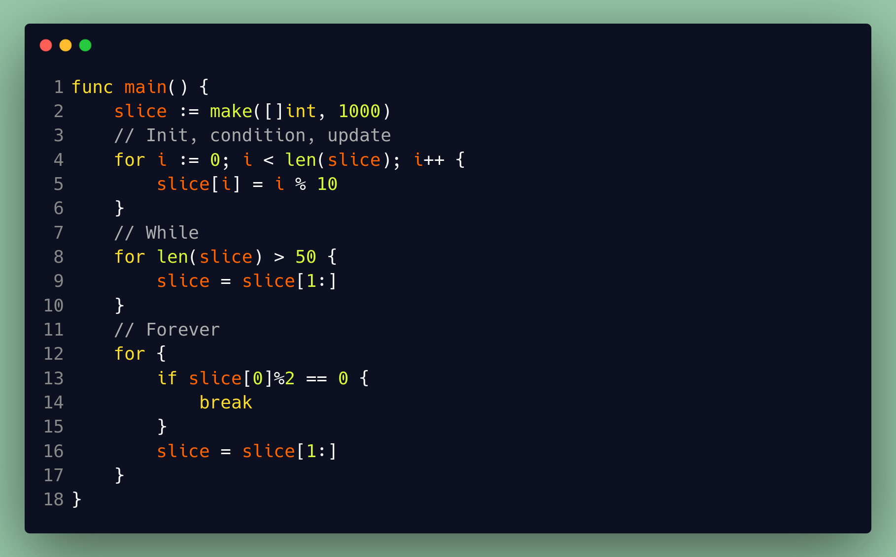
Loops
Notes:
Only loop in golang is FOR

Slide 31
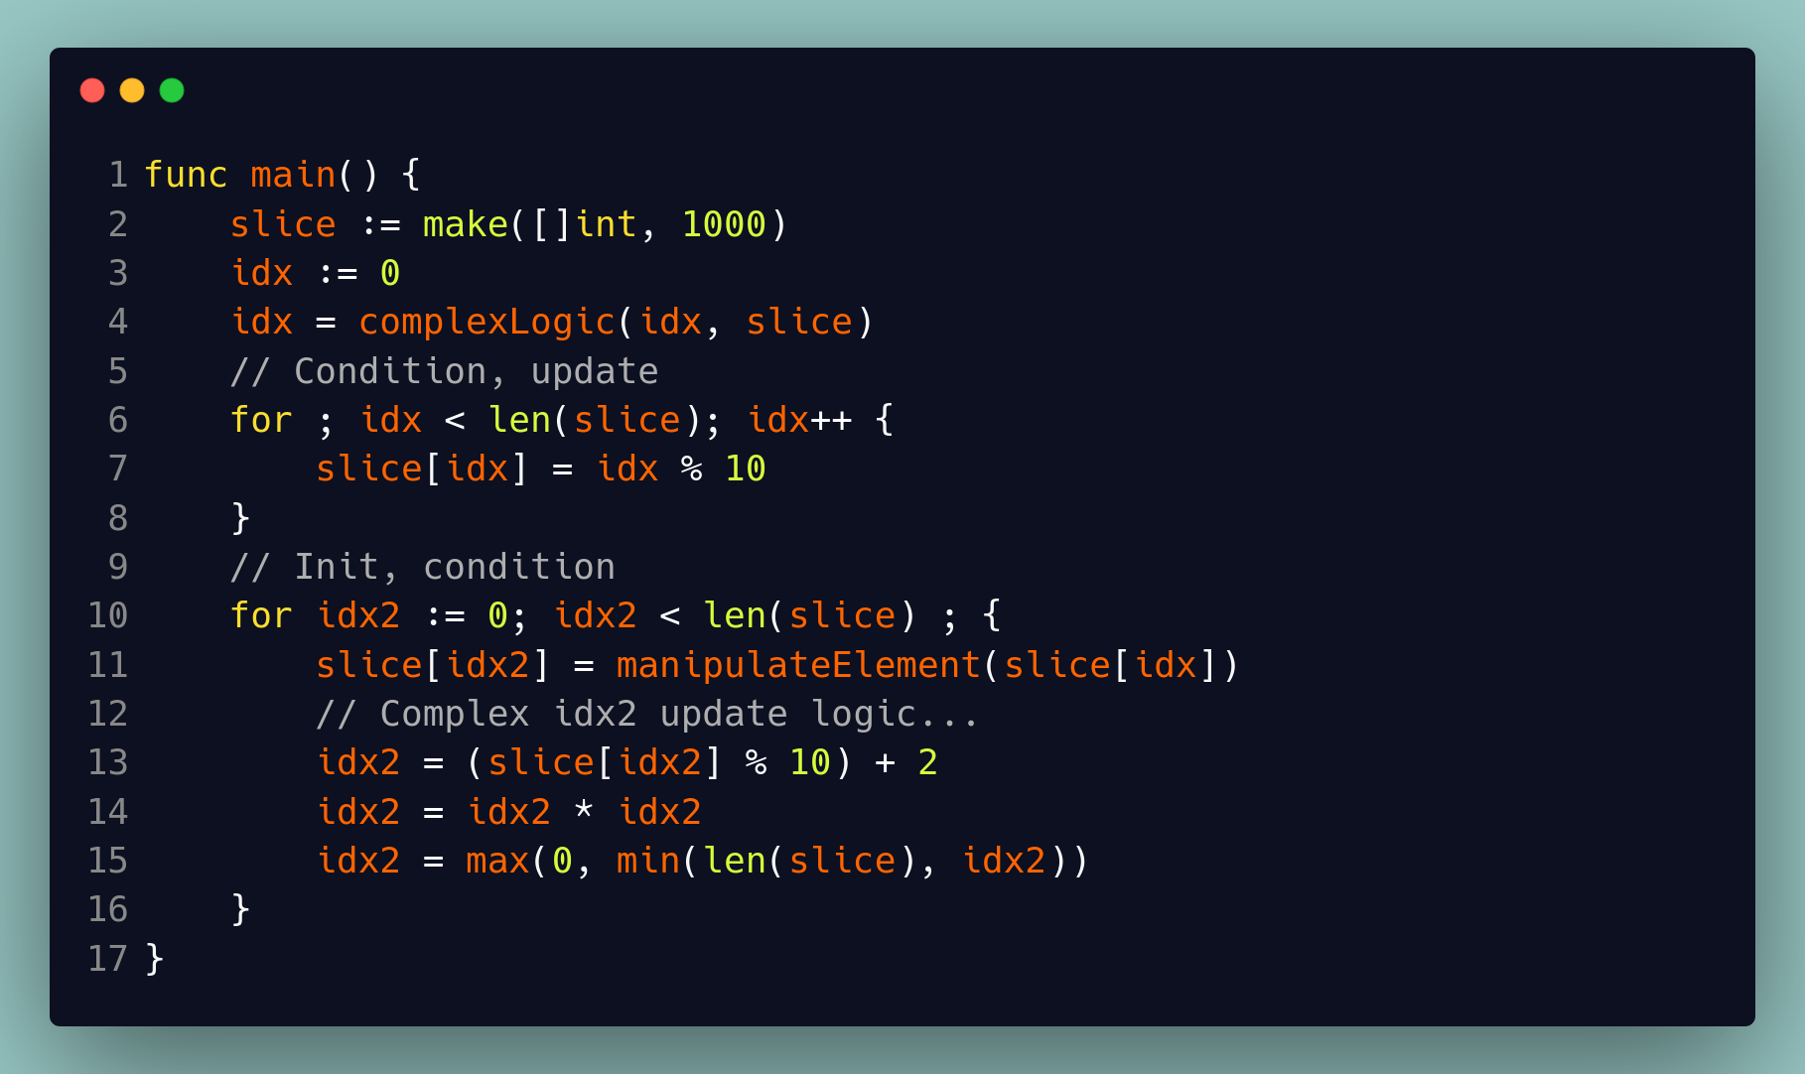
Loops
Optional init and update

Slide 32
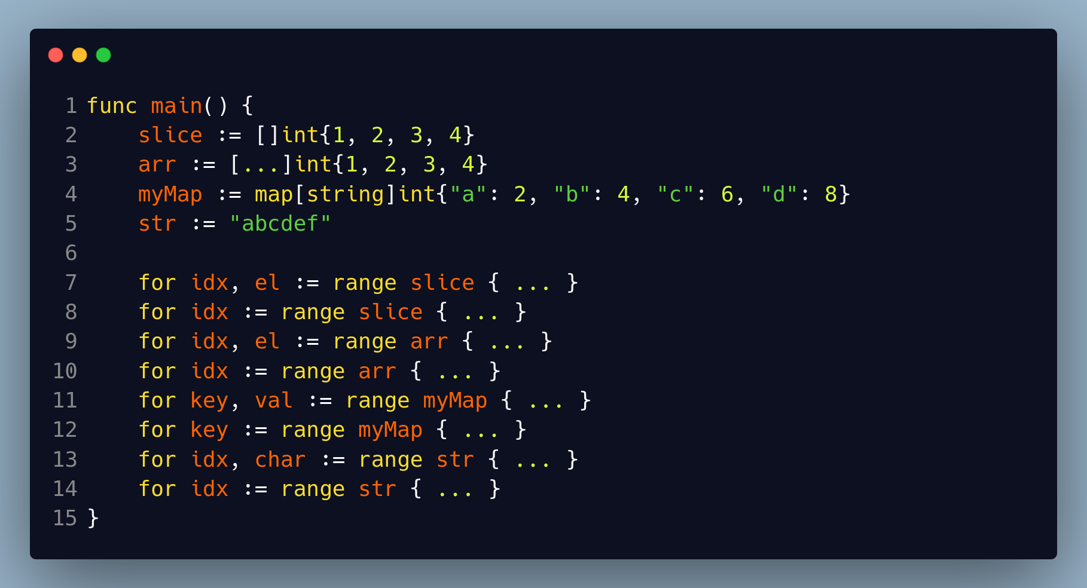
Loops Range - Iterator
Range(val) → slice, array, map, string, channel
Different meaning based on datatype
Optional second parameter
Notes:
Range is an iterator helper
Array […] is sugar for size of array

Slide 33
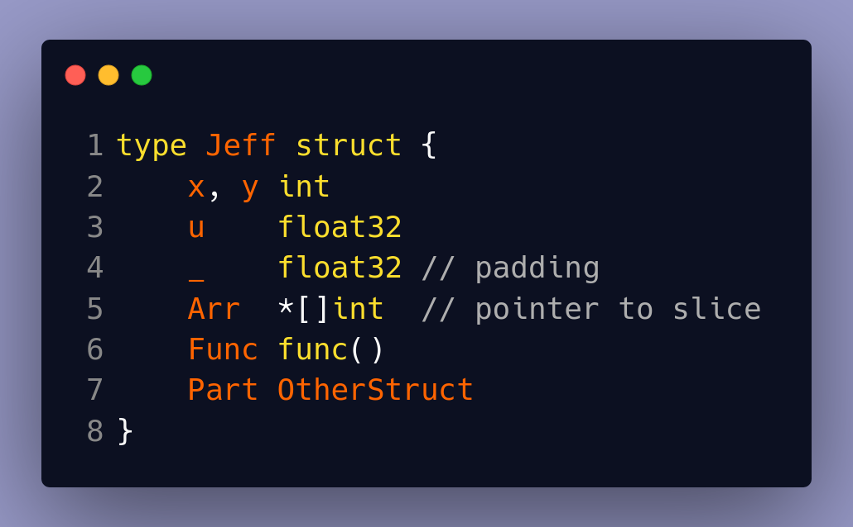
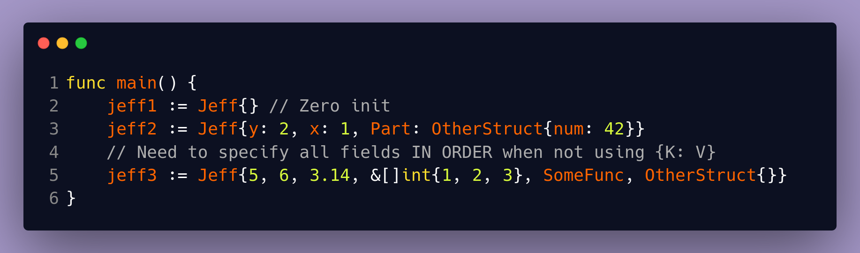
Structs
Structs are simply a collection of fields. A bunch of data.
How to instantiate structs?
“jeff2” method is best

Slide 34
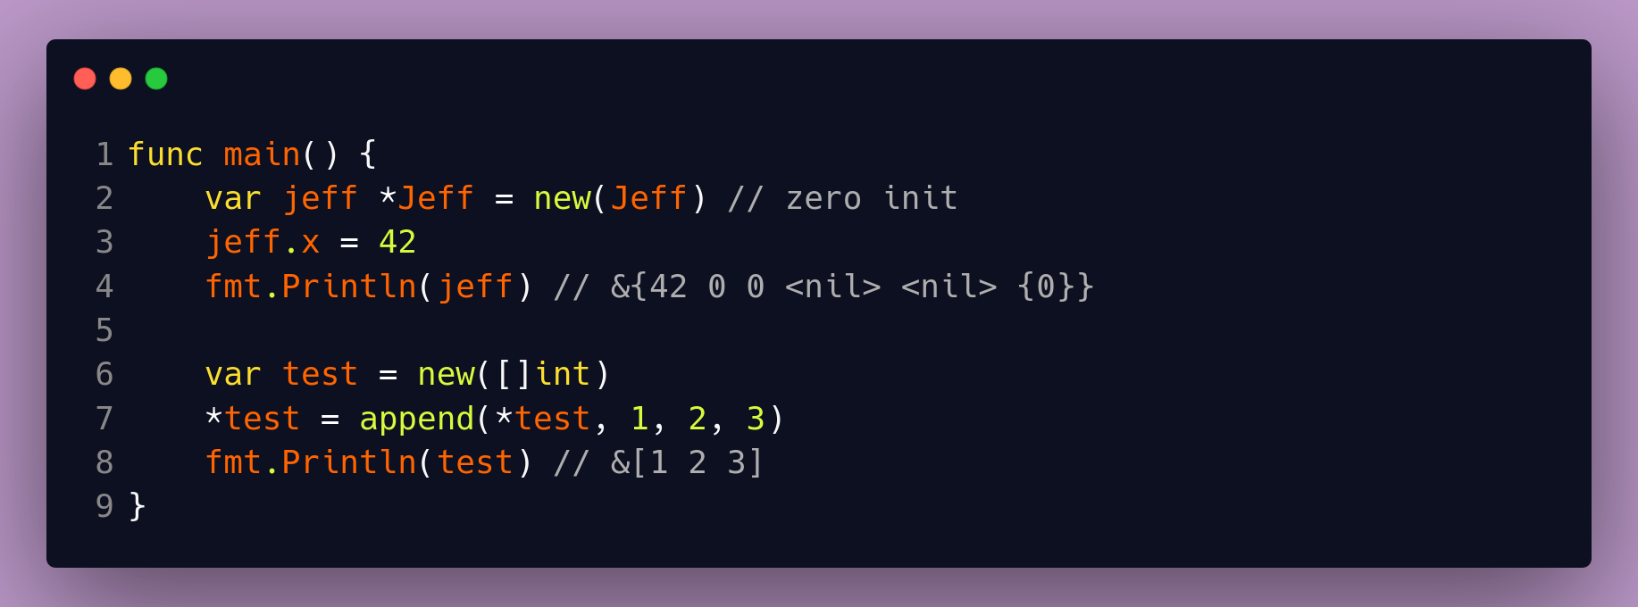
new() vs make()
func new(Type) *Type
func make(t Type, size ...int) Type
  Slice → make([]V, size) ← we saw this before
  Map → make(map[K]V, size) ← really don’t need to use this
  Channel → we’ll see this later
  Can ONLY be used to create three types
Notes:
Both allocate storage
Both zero-init storage
Difference is that new() returns pointer, make() returns value.
And make() can ONLY be used with slice, map, channel

Slide 35
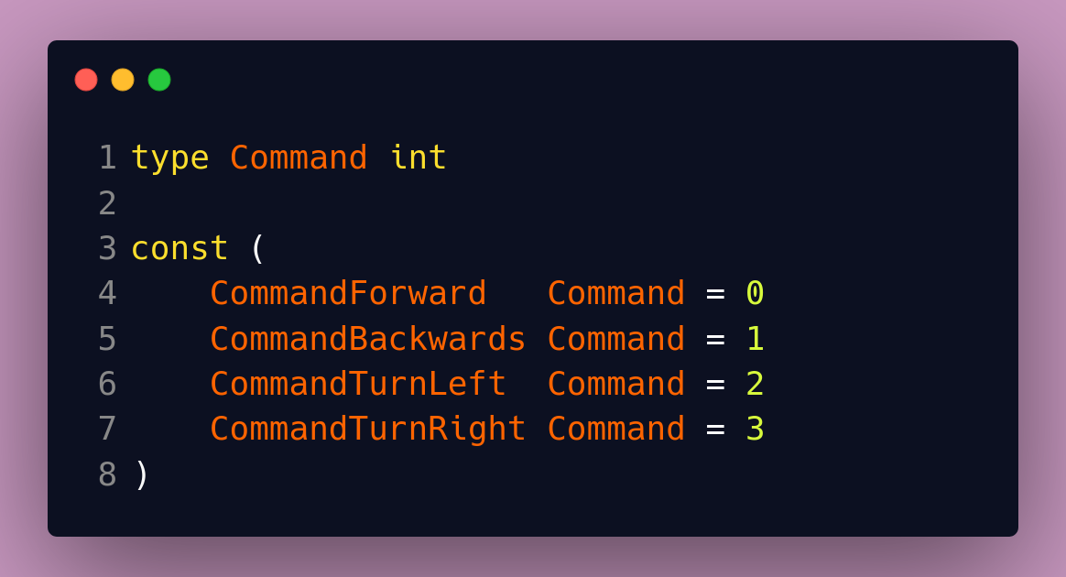
Enums
Enums are just constants → usually integer, string

Slide 36
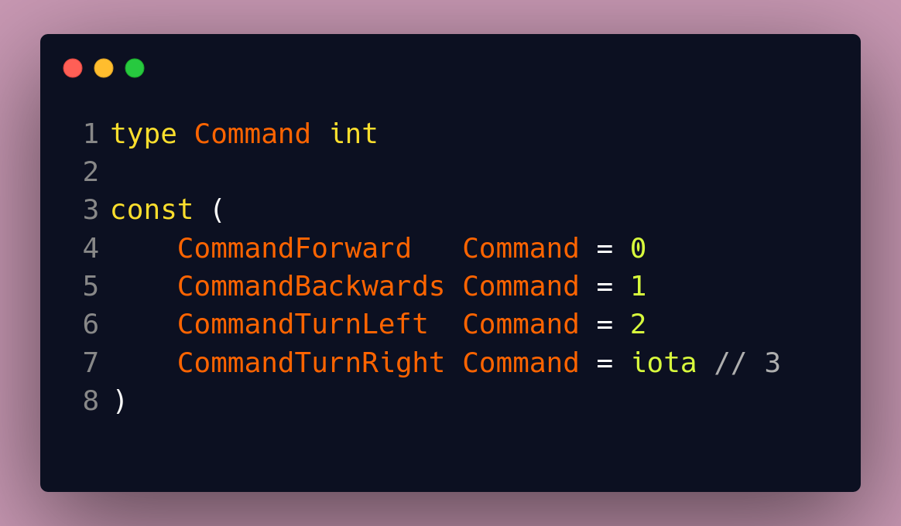
Enums
Iota – index of the expression in the const declaration, starting at 0

Slide 37
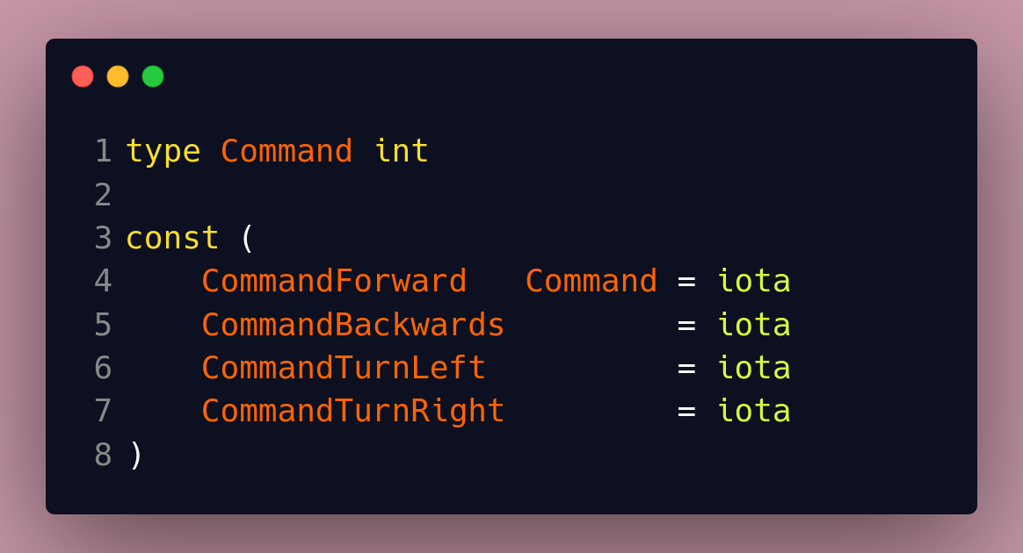
Enums
Const declarations only need type once

Slide 38
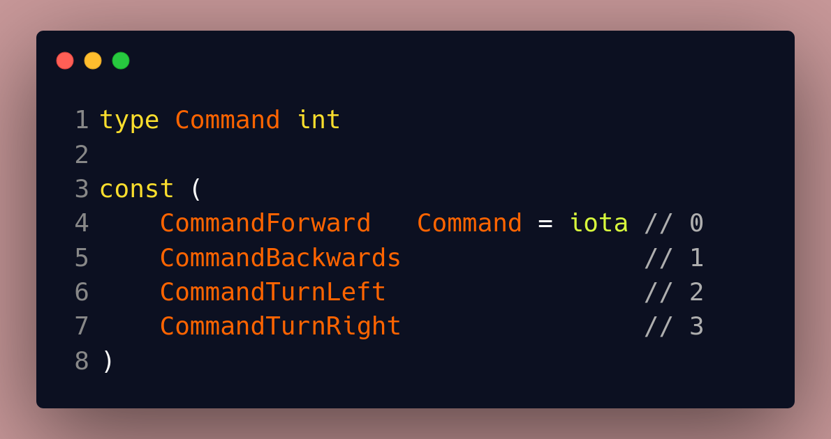
Enums
Implicit repetition → empty expression repeats (copy pastes) last non-empty expression

Slide 39
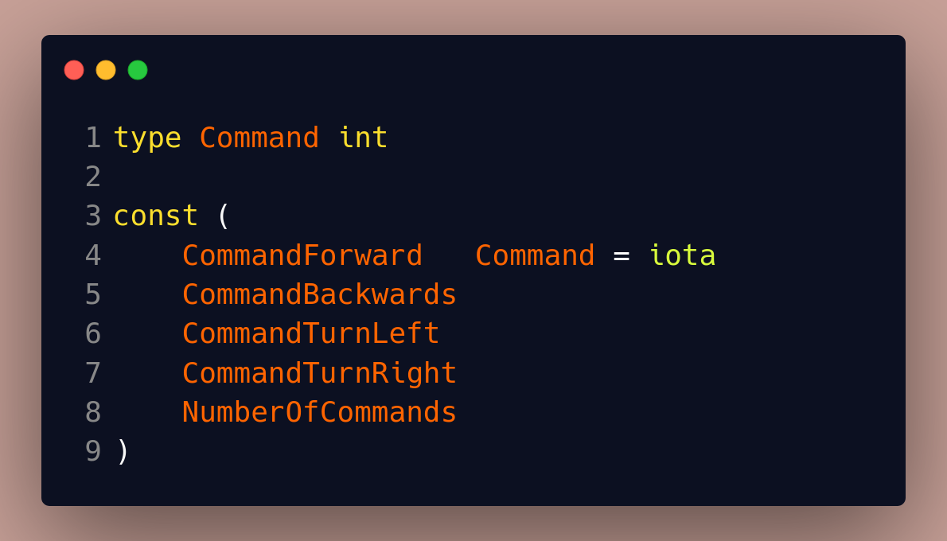
Enums
Number of enums idiom (last element)

Slide 40
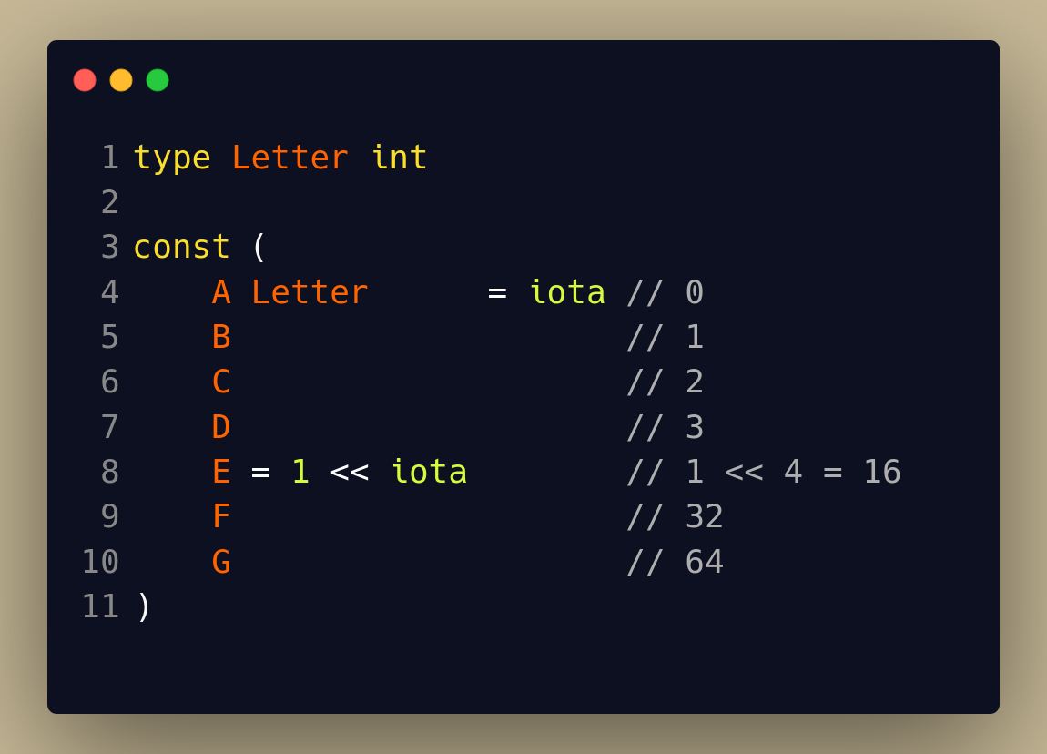
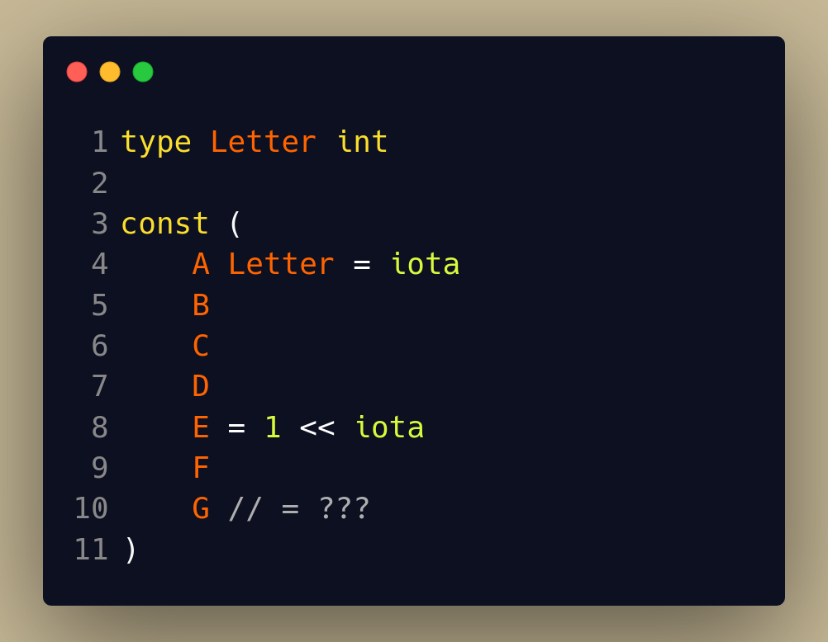
Enums
What value does G have?

Slide 41
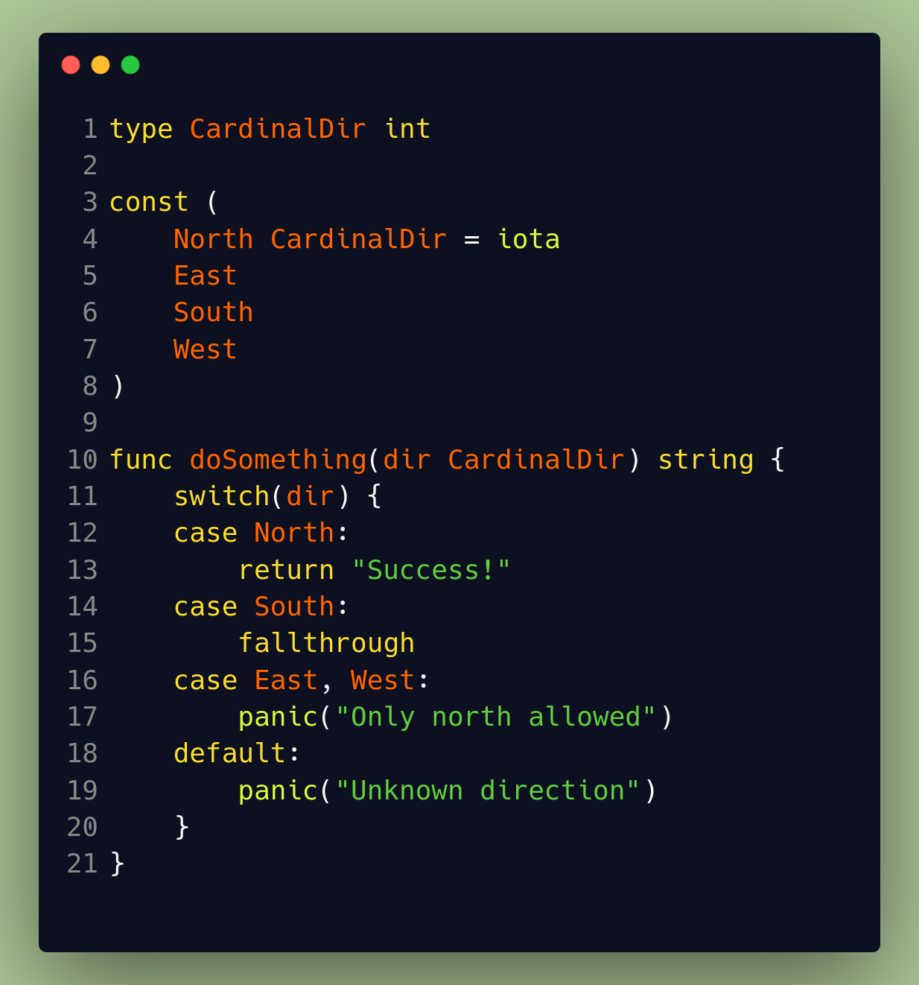
Switch statements
Simple
Fallthrough opt-in
Break implied, but can be used manually
Default optional
Non-exhaustive (unlike Rust)

Slide 42
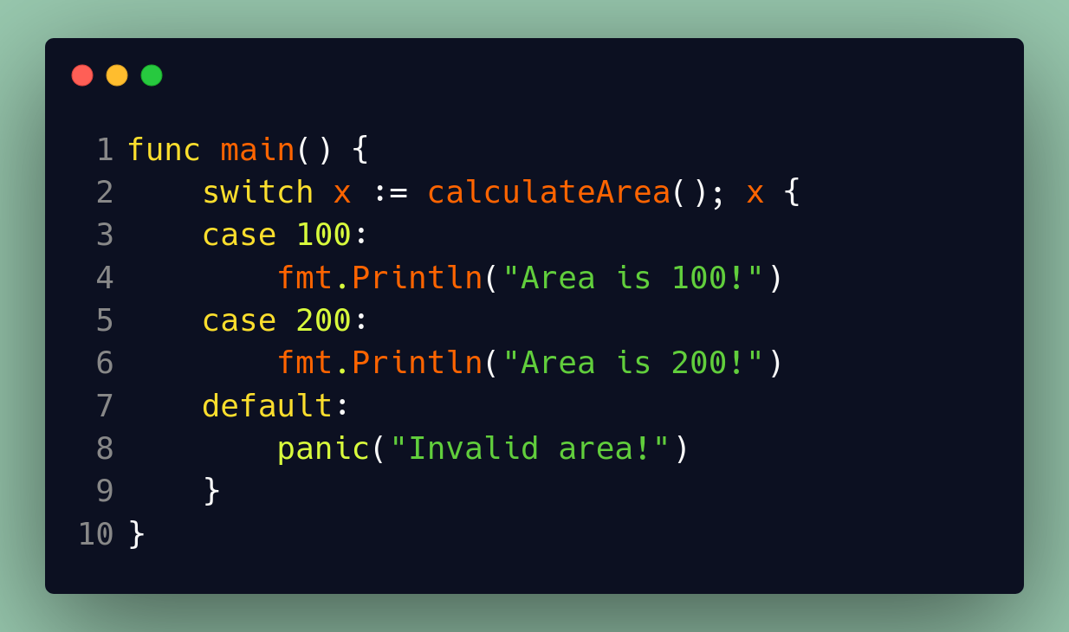
Switch statements
Short assignment statement

Slide 43
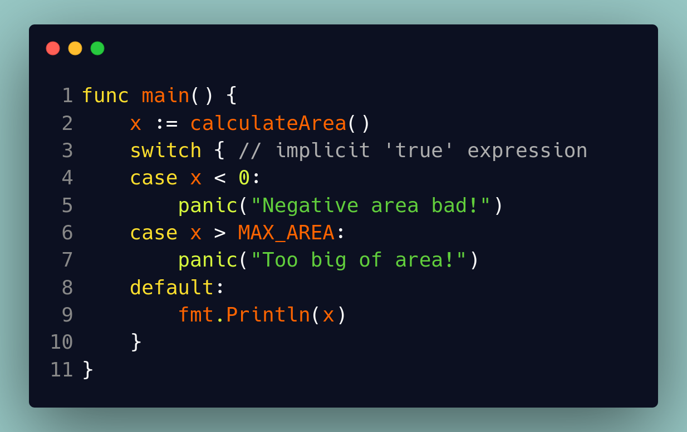
Switch statements
Naked switch → switch true
Complicated case expressions

Slide 44
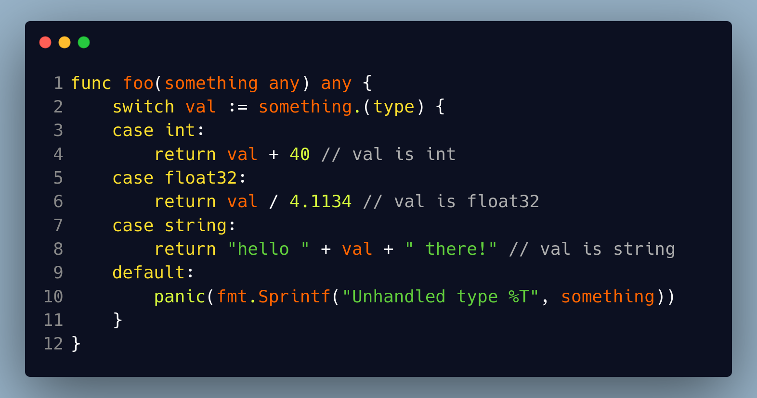
Switch statements
Type switch → check underlying type of variable
switch something.(type) { … }

Slide 45

Practice!
https://github.com/calvincramer/golang-training-1

