Slide 1
Golang Training 2 – Intermediate, Functional Mindset
Calvin Lei-Cramer

Slide 2
What are we covering today?
Defer, pointers and references, methods and receivers, interfaces, OOP, packages / modules, labels

Slide 3
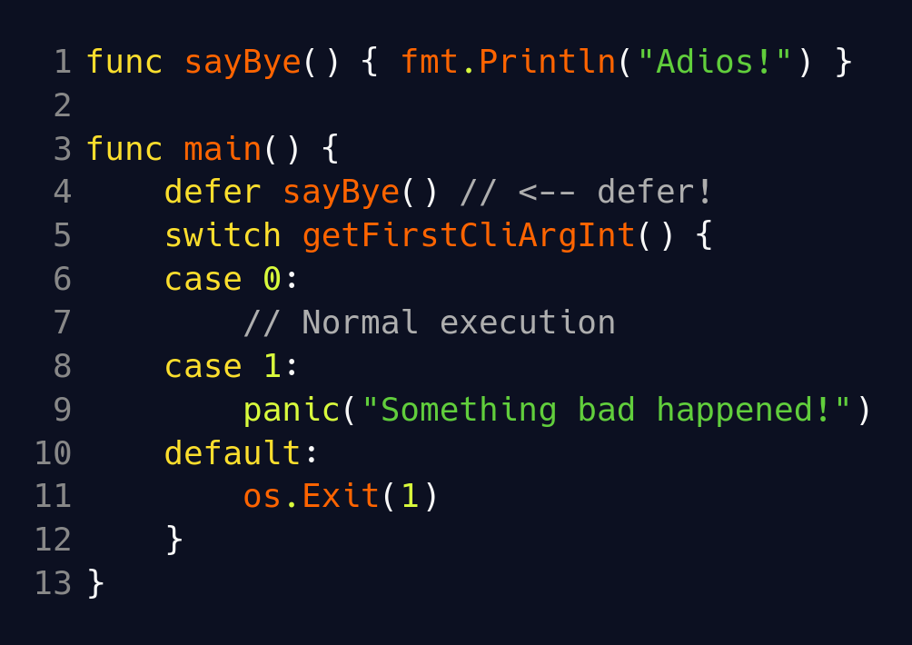
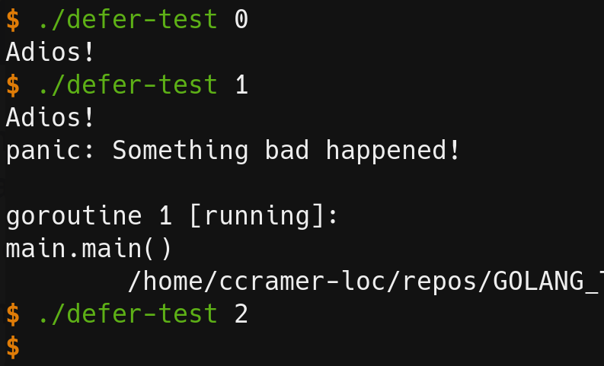
Defer
What is defer?
executes a function call when function returns for any¹ reason
¹ Except for exiting program with os.Exit(). Terms and conditions apply.

Slide 4
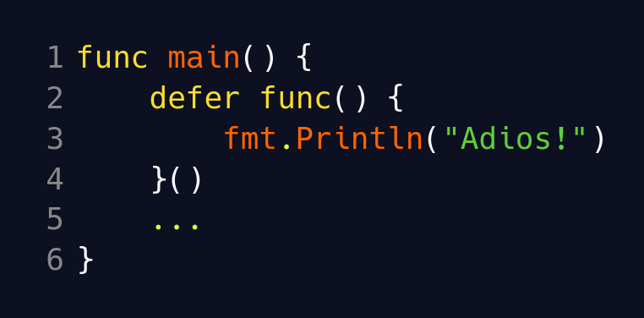
Defer
Idiomatic defer → first class functions (more on this later)

Slide 5
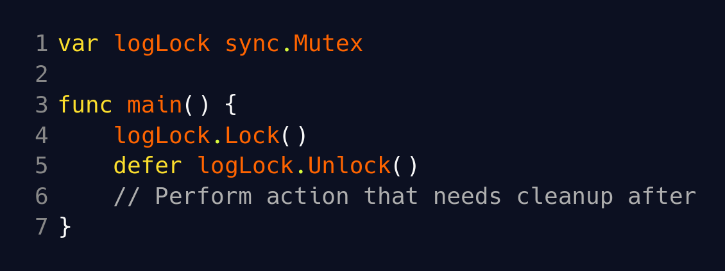
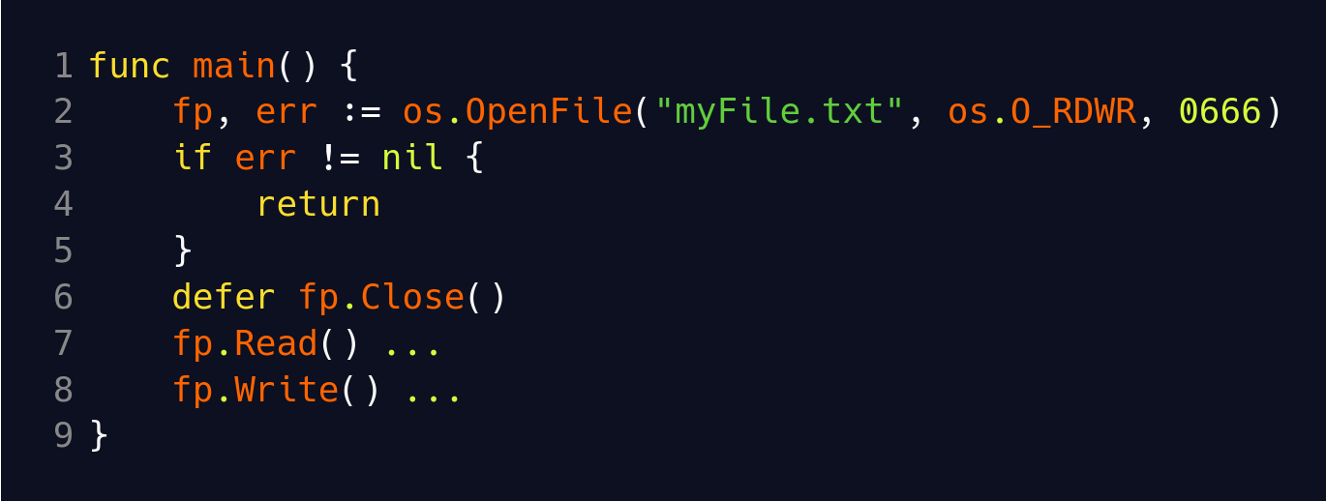
Defer
Why use? → cleanup code (use with panic in next lesson)

Slide 6
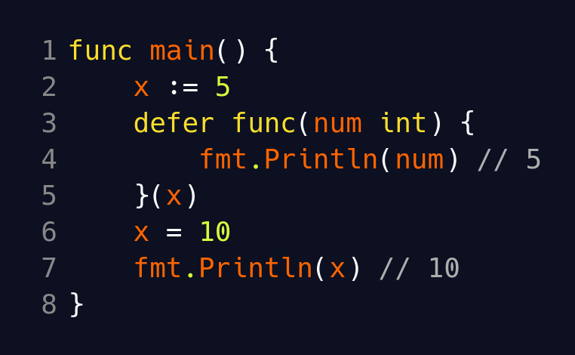
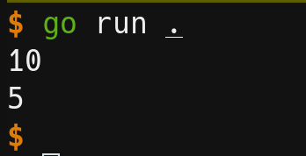
Defer
Defer call arguments?

Slide 7
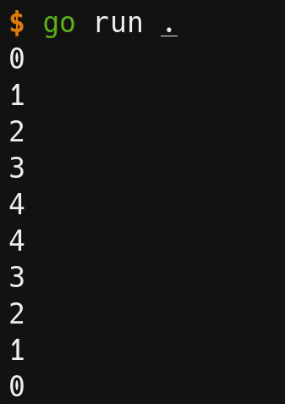
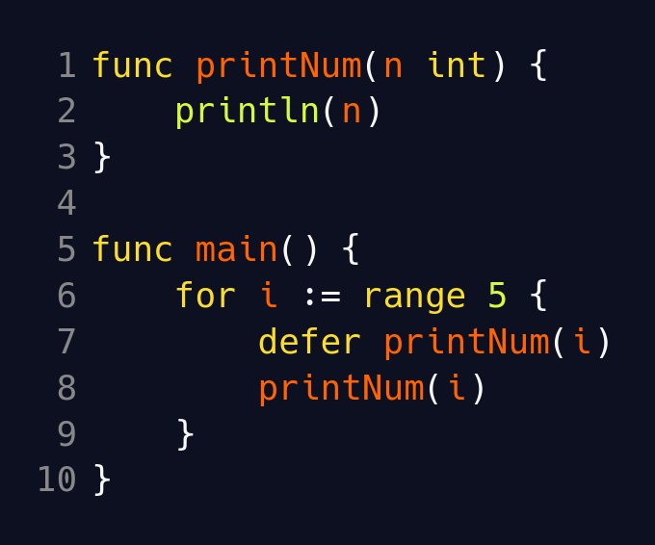
Defer
Multiple defers?
Executes in stack / LIFO order

Slide 8
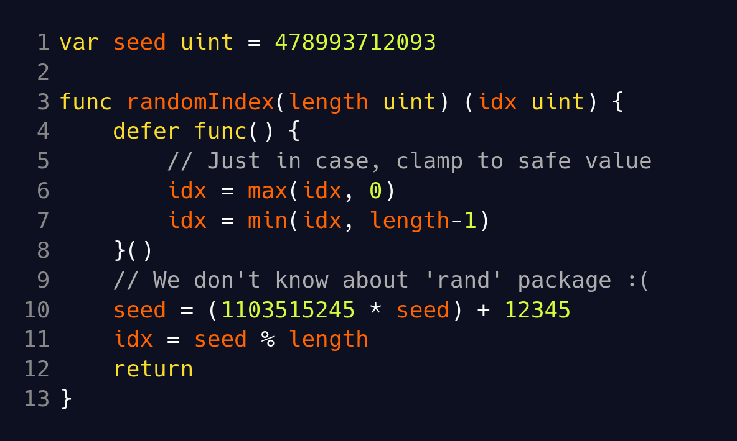
Defer
Named return values → able to modify return variables
Will be helpful for later!

Slide 9
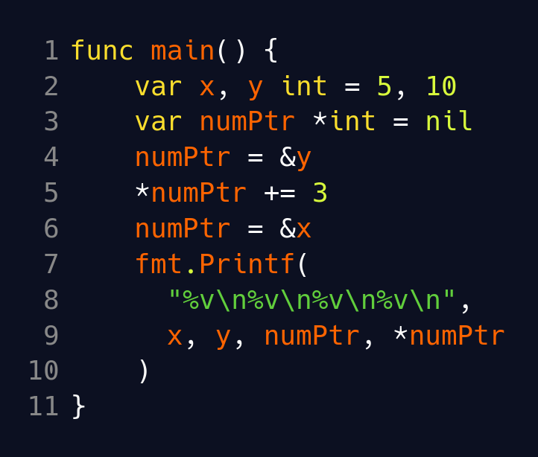
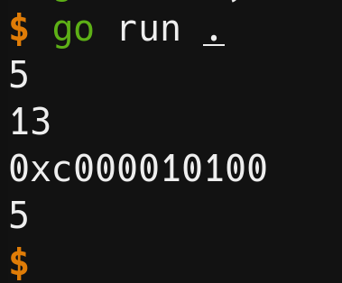
Pointers and References
‘&’ and ‘*’ like C++

Slide 10
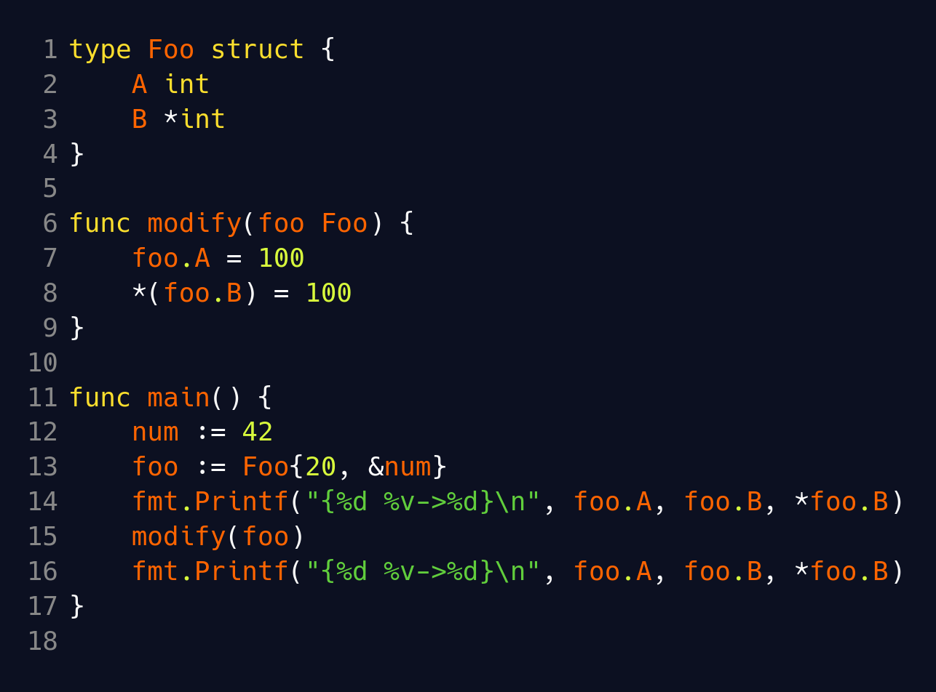
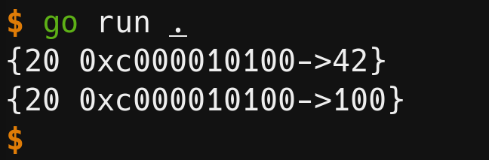
Pointers and References
Pass by value, pass by reference?
What types are passed by value, and by reference?
  By reference → pointers, functions, slice, map, channel
  By value → arrays, structs, ints, floats, booleans, everything else
Notes:
Technically everything is pass by value, since pointer addresses are passed by value.
SOME THINGS ARE AUTOMATICALLY PASSED AS POINTERS. SOME THINGS ARE AUTOMATICALLY PASSED AS VALUES (COPIED)

Slide 11
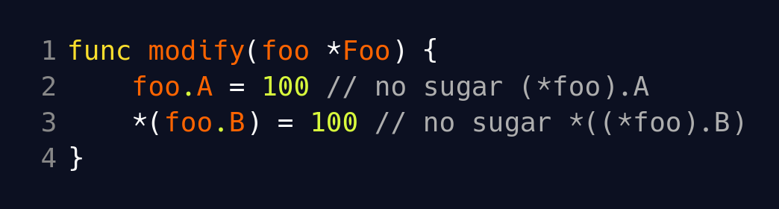
Pointers and References
No pointer arithmetic
‘unsafe’ package if you dare
Automatic dereferencing sugar → (*x).f === x.f
  Most of the time you don’t need to care if using pointer or raw value.

Slide 12
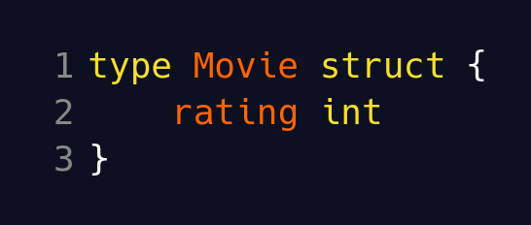
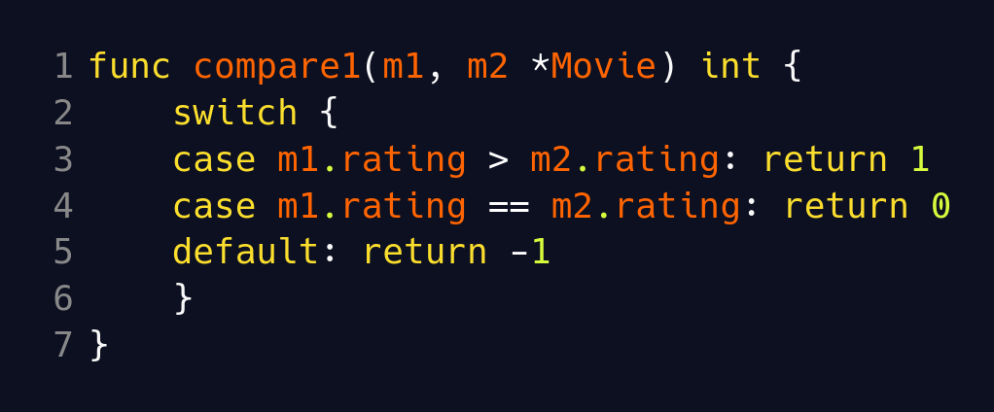
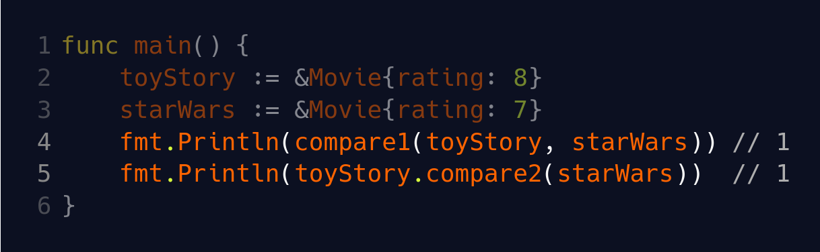
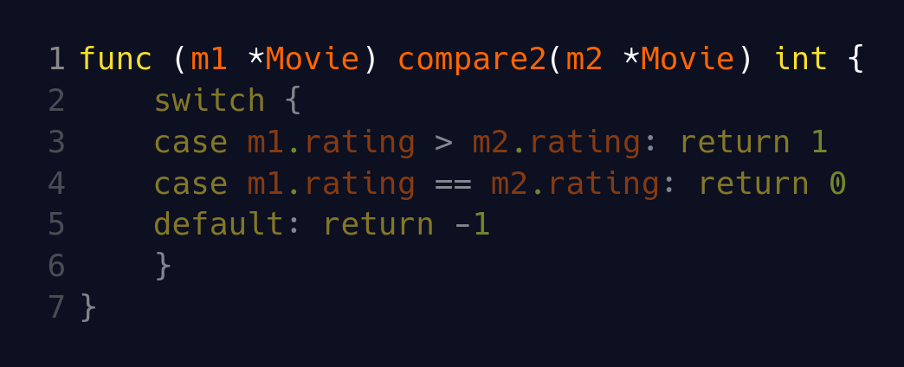
Methods and Receivers
Goal: compare two movies, return 1, 0, -1
What are methods? Example
And Receivers?
Why it matters? → Binds the function to the type
Notes:
A method is just a function with a receiver
A receiver is simply the first argument.

Slide 13
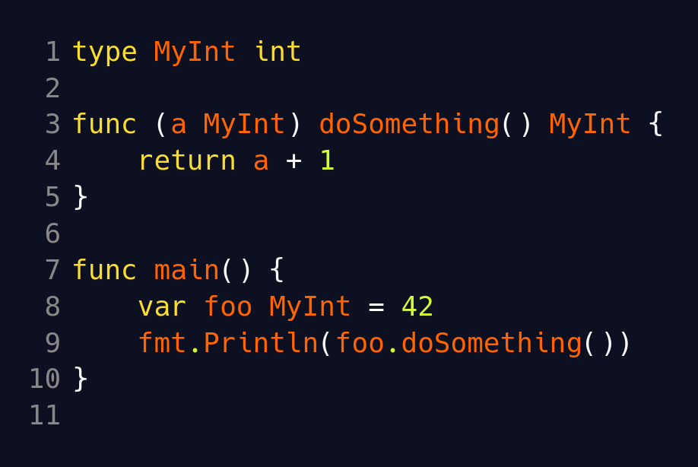
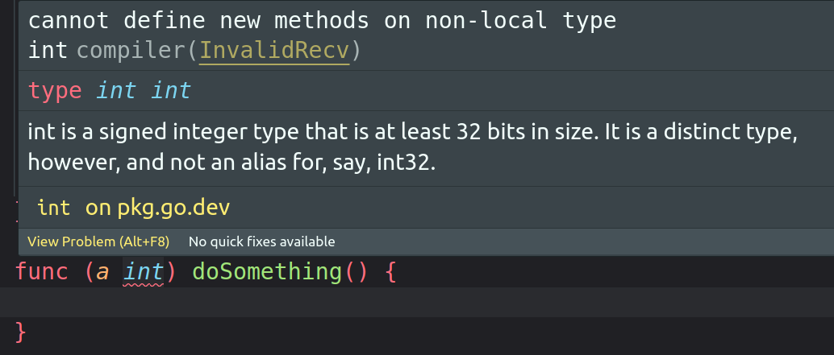
Methods and Receivers
Limitation → can’t add methods to external types
Solution → type “alias”
Type alias → type Foo = Bar
New type → type Foo Bar

Slide 14
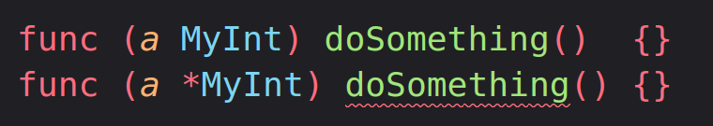
Methods and Receivers
Difference between T and *T receivers
Same thing as pass by value / reference from before
Limitation → need to choose between T and *T for a single function. (No function overriding/overloading in Golang)
./main.go:37:17: method MyInt.doSomething already declared at ./main.go:33:16
Notes:
Recommend to always use pointer receivers, unless you’ve got a really good reason otherwise.

Slide 15
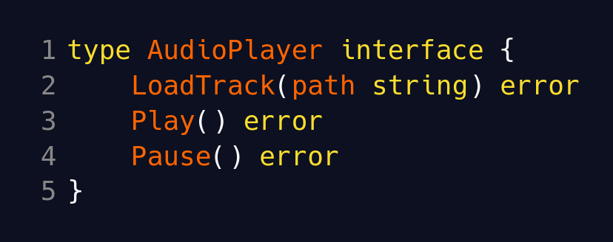
Interfaces
What are interfaces?
“interface type” → a set of function signatures

Slide 16
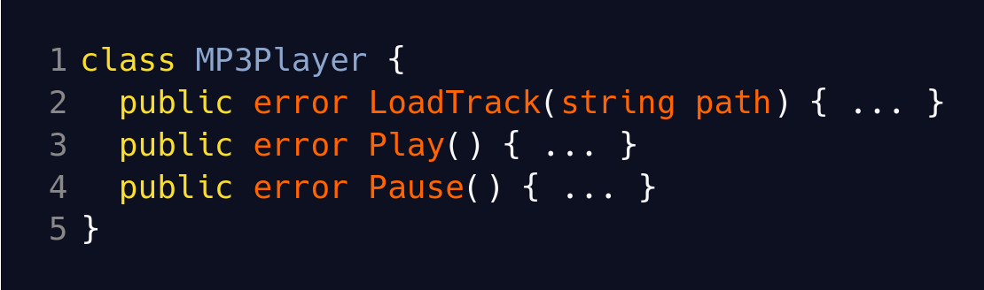
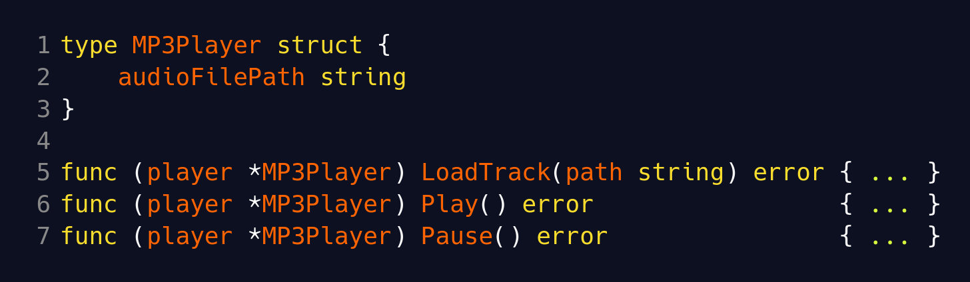
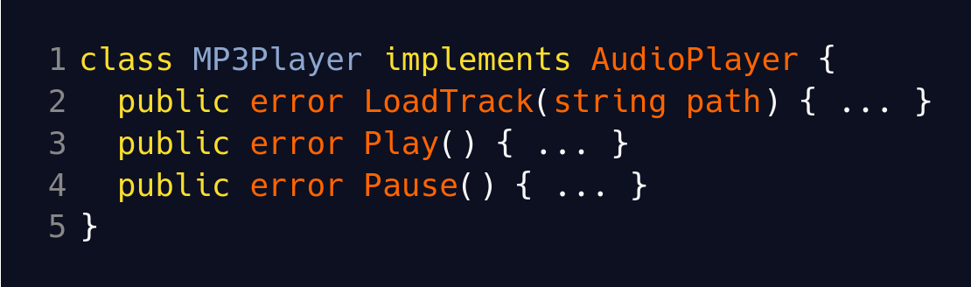
Interfaces
How to implement / satisfy and interface (implicit vs explicit)
“interface value” → any value that implements the functions
Java
Golang

Slide 17
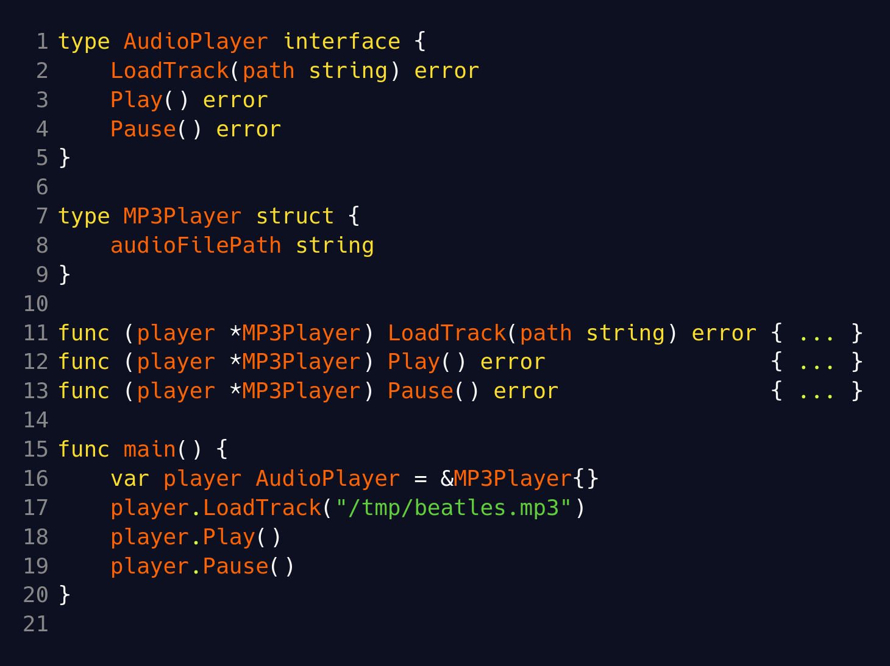
Interfaces
Let’s actually use it now

Slide 18
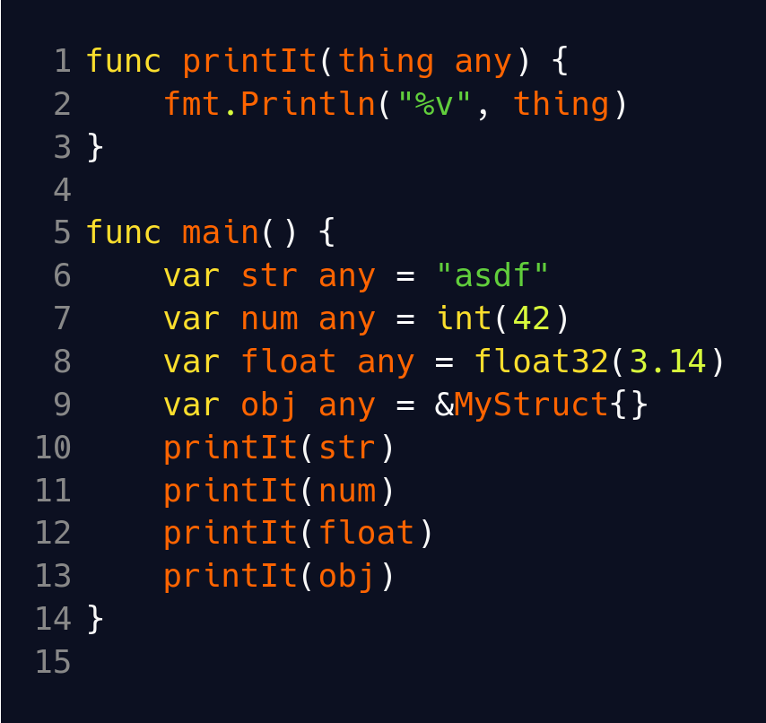
Interfaces
Interface{} / any
What type implements the 0 functions of interface{}?
Everything satisfies it!
See this a lot when working with ‘encoding/json’ package

Slide 19
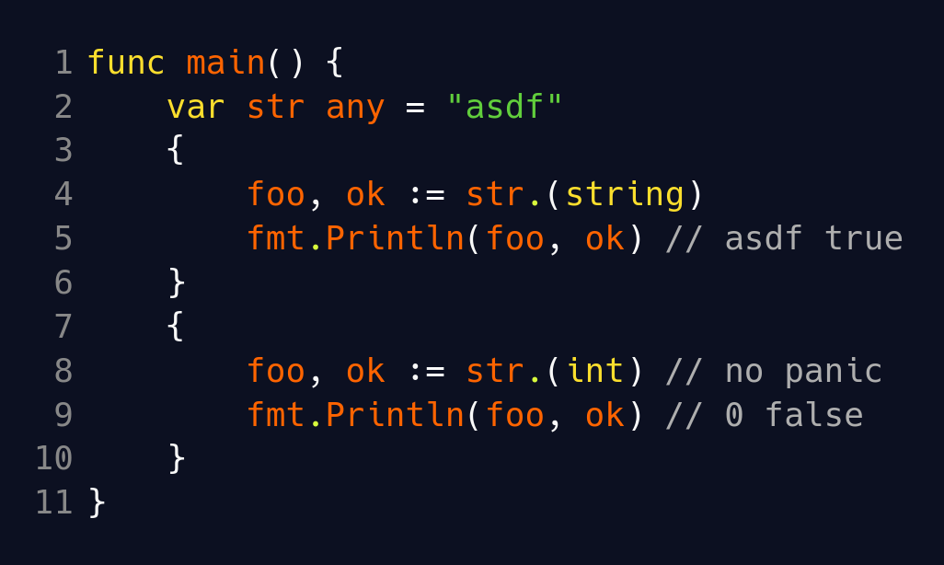
Type Assertions
Type assertions → from many to one
val.(T)
newVal, ok := val.(T)
Why use? Need to satisfy type checker at compile time.
Notes:
Type assertions check that the value is of type T.
Fails if value is nil!
How does Go know if val is of type T? Usually it means that val implements T interface.
Panic if fails! Or not if accept OK arg.
NewVal will be zero value of type on failure.

Slide 20
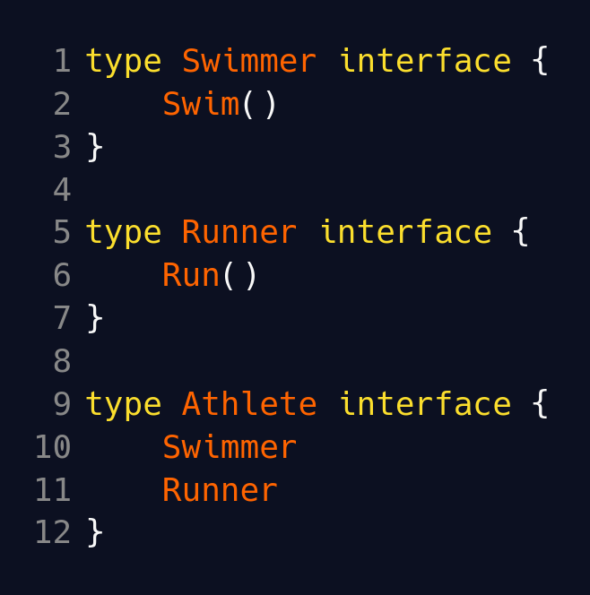
Interfaces
Interface embedding → combine interfaces together
Composability → reuse interfaces! Keep them as small as possible.

Slide 21
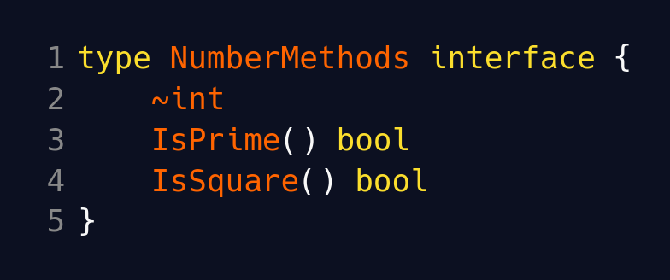
Interfaces
Approximation constraint ~T
~T = all types whose underlying type is T
Interfaces can have arbitrary types too, not just functions!
Useful to open up internal constraints to external use
WARNING: non “basic” interfaces
Notes:
Interfaces are considered “not basic” if they contain something else other than function definitions.
Non-basic interface have RESTRICTIONS. Non-basic interfaces need to be used in type constraints (will see more of this in generics).

Slide 22
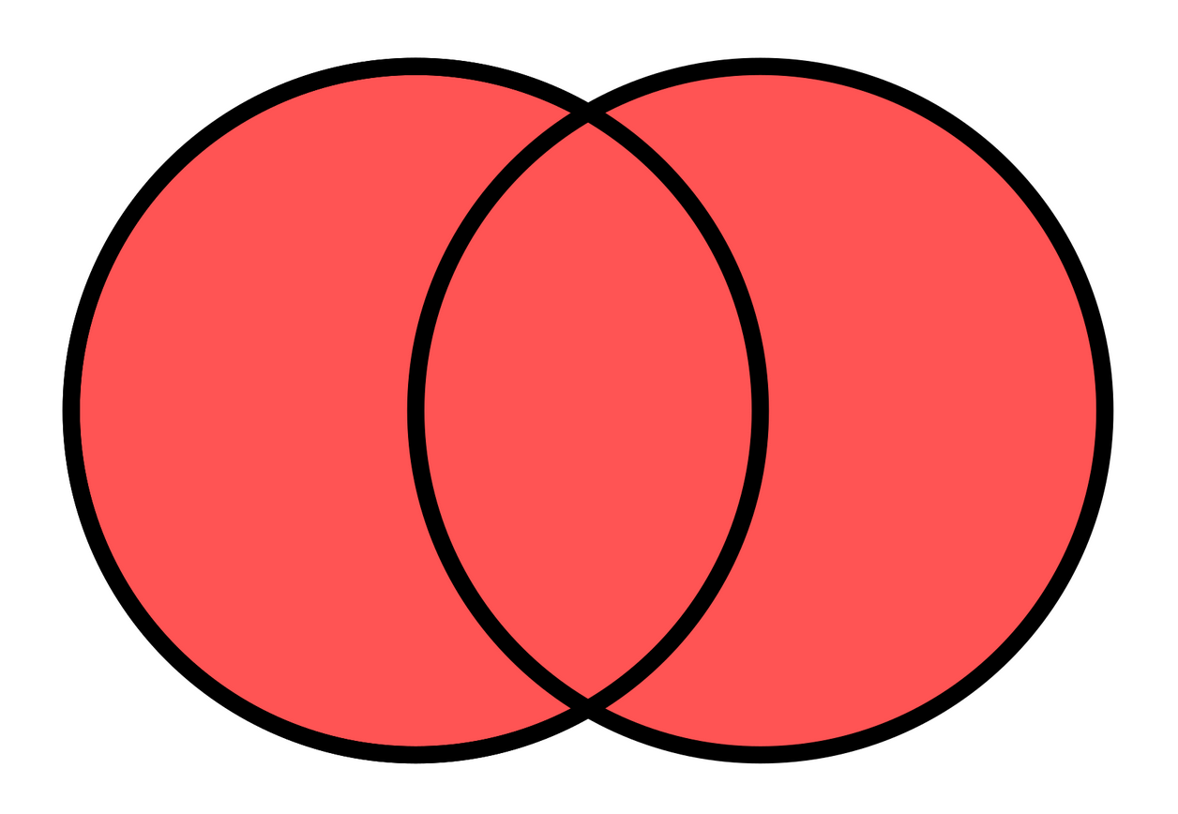
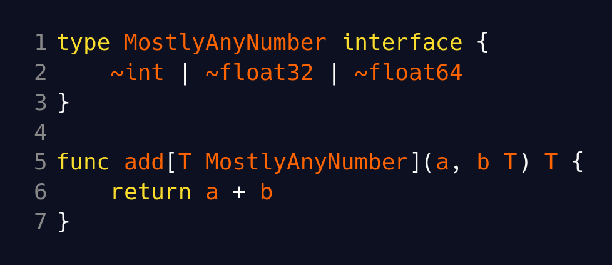
Interfaces
Union type sets → this or that
Non-basic interface → need to use in “type constraints”
Covering generics later

Slide 23
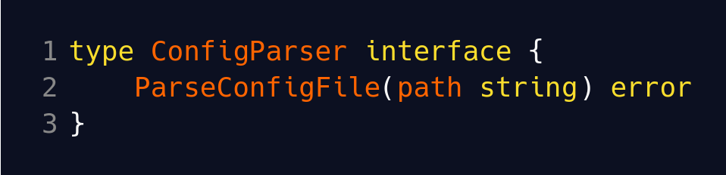
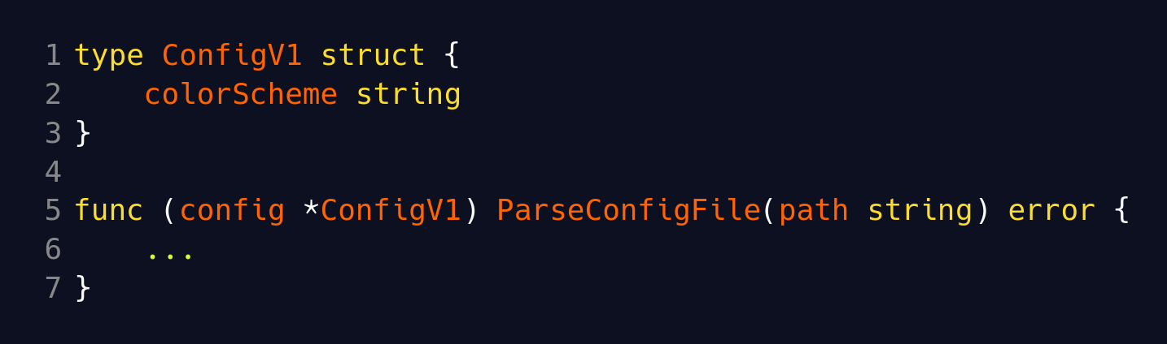
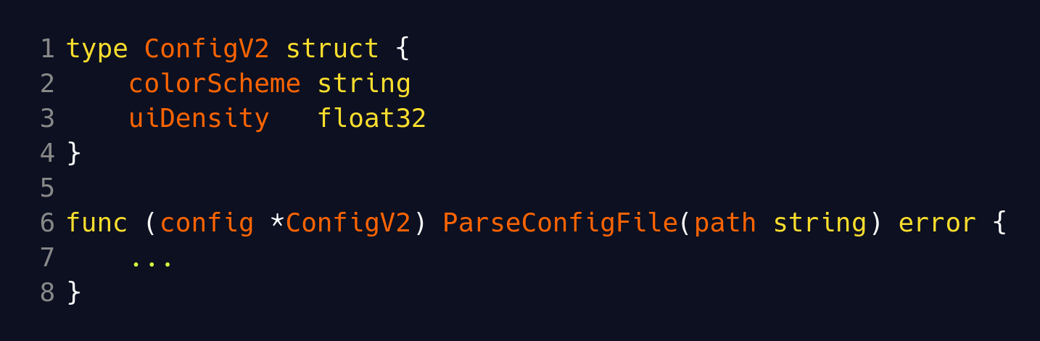
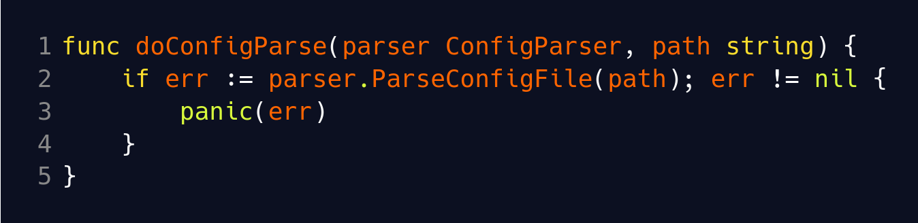
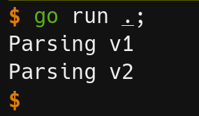
OOP In Golang
How do we get polymorphism? Normally with subclasses.
…
Notes:
Achieve polymorphism by using interfaces where underlying type can be anything that satisfies the interface.

Slide 24
OOP In Golang
Subtype polymorphism
  different behavior based on type
  Interface vs class / subclass
Parametric polymorphism
  same function used for multiple types → generics (next lesson)
Ad-hoc polymorphism in Golang → no function overloading, no operating overloading
Use struct and interface embedding to mimic inheritance of data
Notes:
Golang achieves polymorphism is different ways.
Golang’s polymorphism looks different than class-based polymorphism.
Subtype polymorphism is achieved with interfaces and multiple implementations.
Parametric polymorphism is achieved with generics which we’ll cover later.
Use struct and interface embedding to “inherit” data.

Slide 25
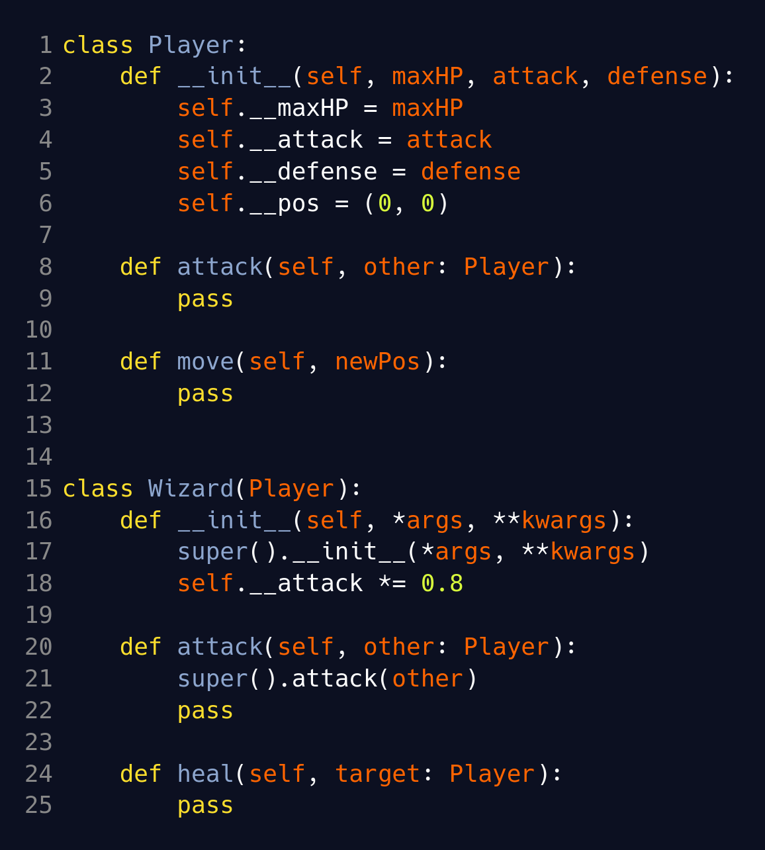
OOP In Golang Example
Base class
  Data
  2 functions
Child class
  Has base data and functions
  Modifies base data
  Overrides 2 parent fu

Slide 26
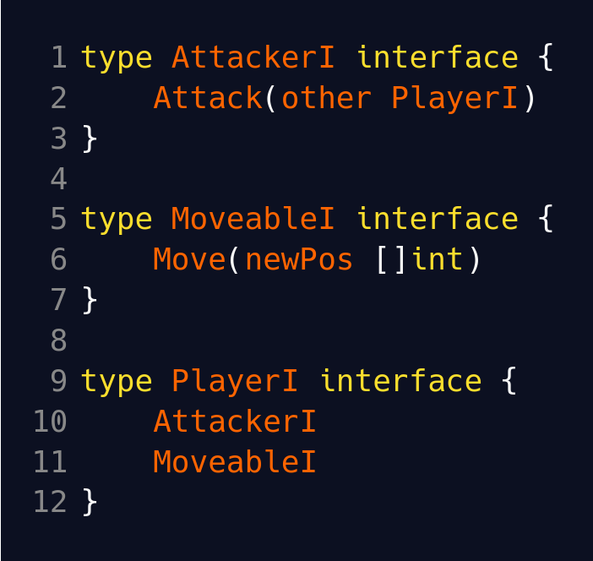
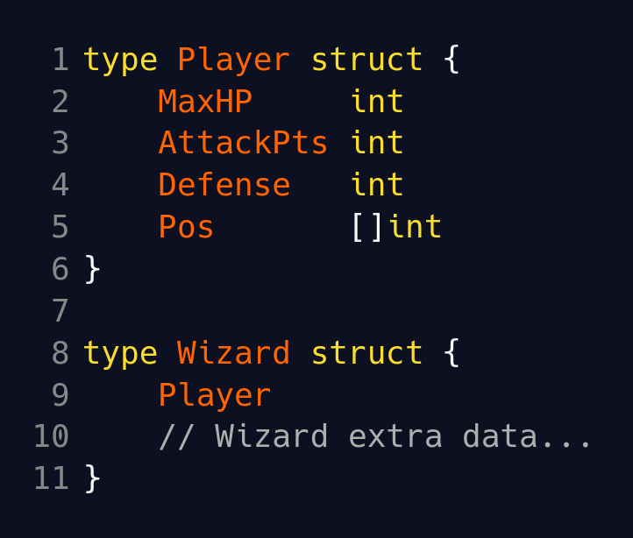
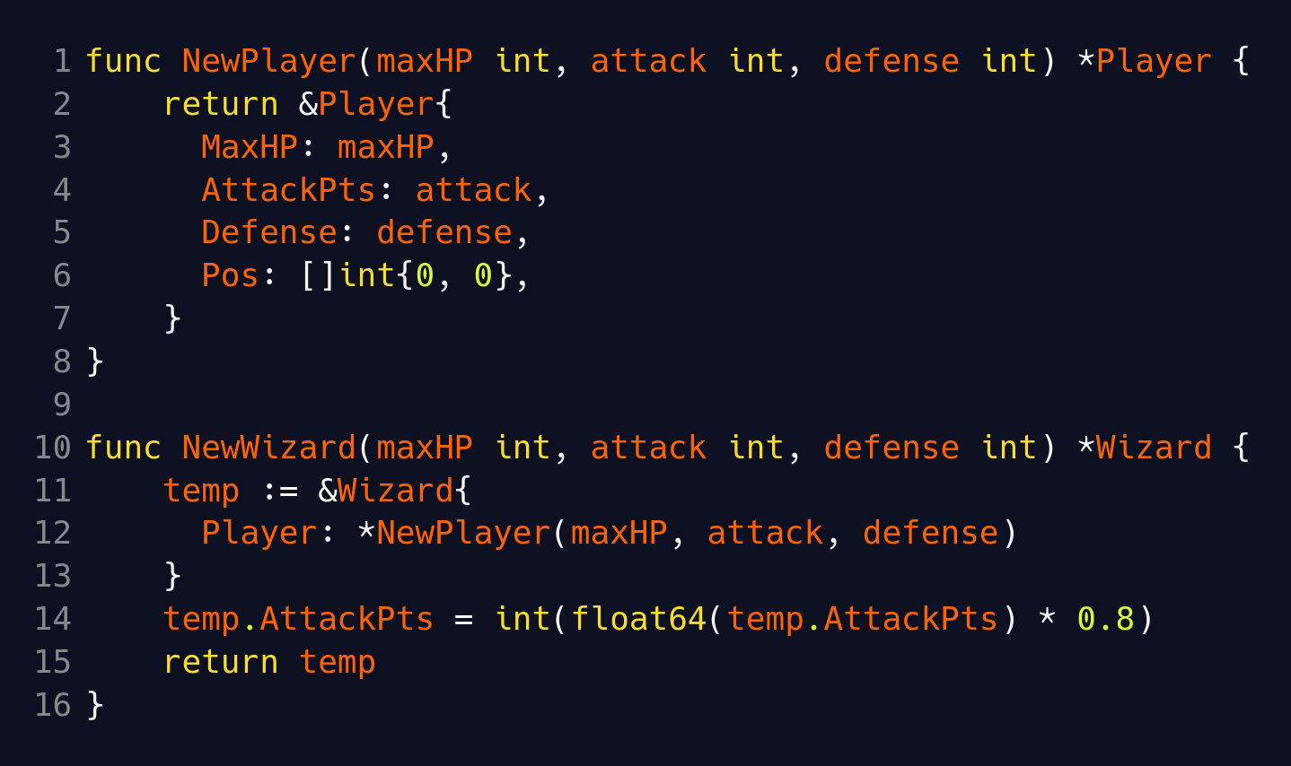
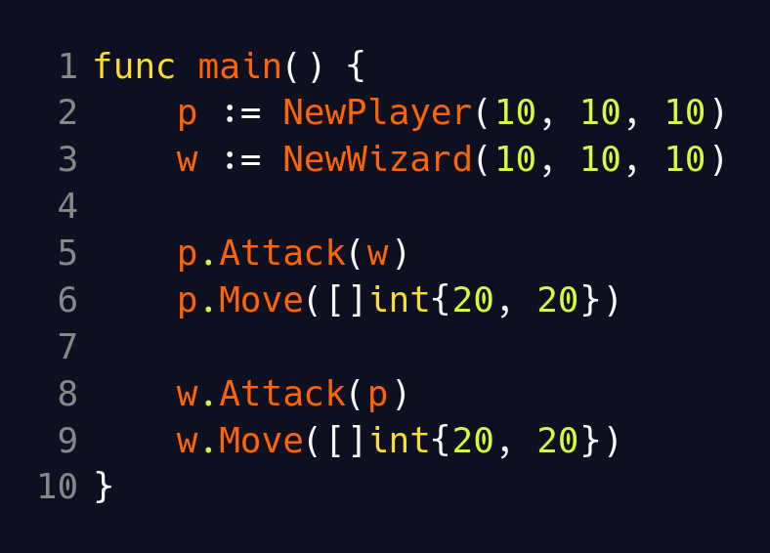
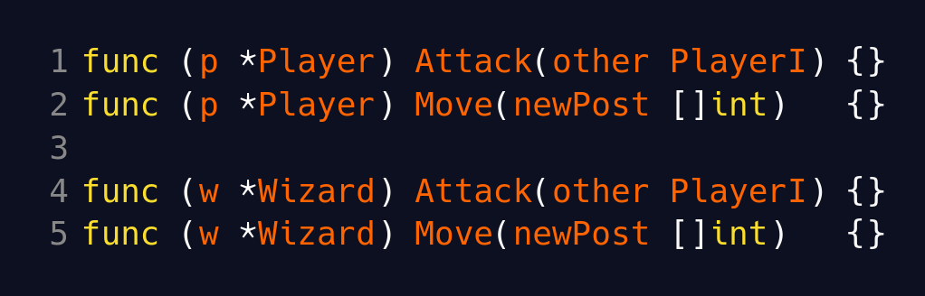
OOP In Golang Example
Constructor idiom:
func NewThing(…) *Thing
Functions
Data
Constructors
Implementation (stub

Slide 27
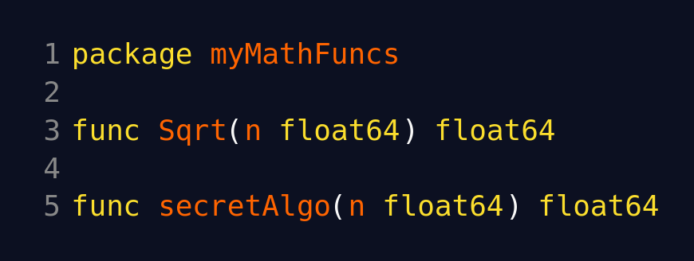
Packages / Modules
Package → collection of go file in same directory
Module → collection of packages with go.mod file at root
Workspace → work with multiple modules at same time with go.work file
package <packageName> ← must be first line in every file
Public / private things
Notes:
Public and private are at the PACKAGE level
Within a package, everything in that package is available to itself.
Public functions, structs, struct fields, interfaces, interface methods START WITH CAPITAL LETTER
Everything else is “private” to the package

Slide 28
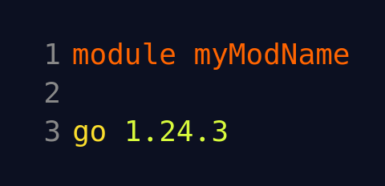
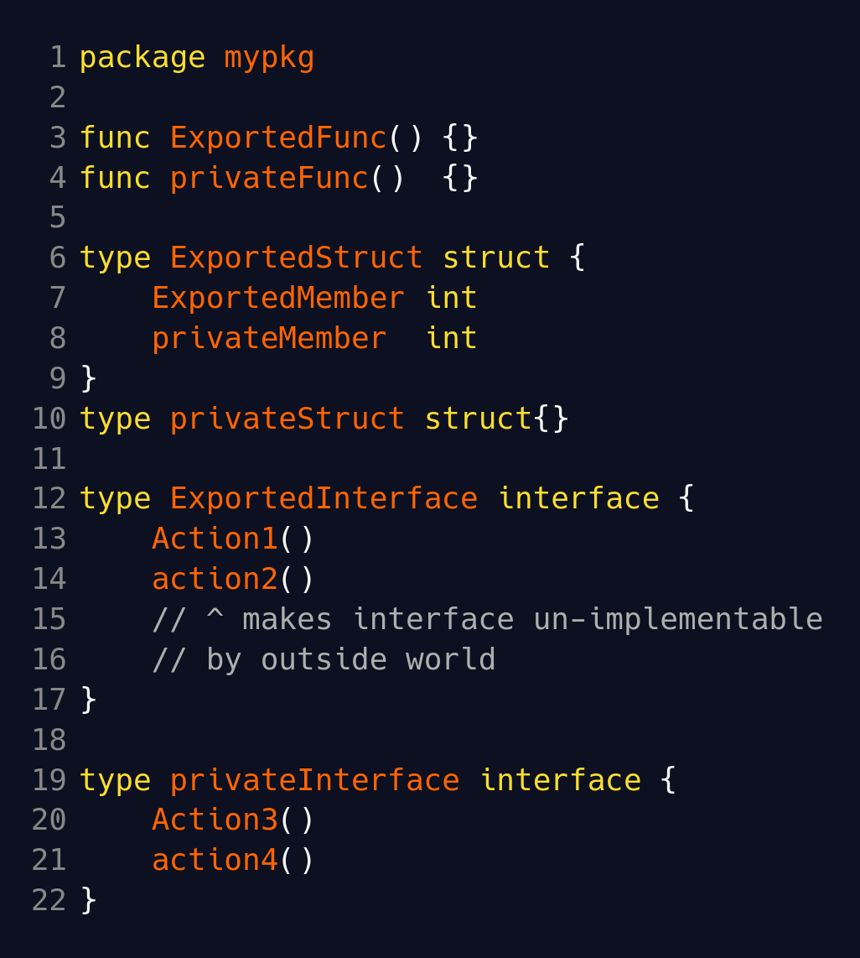
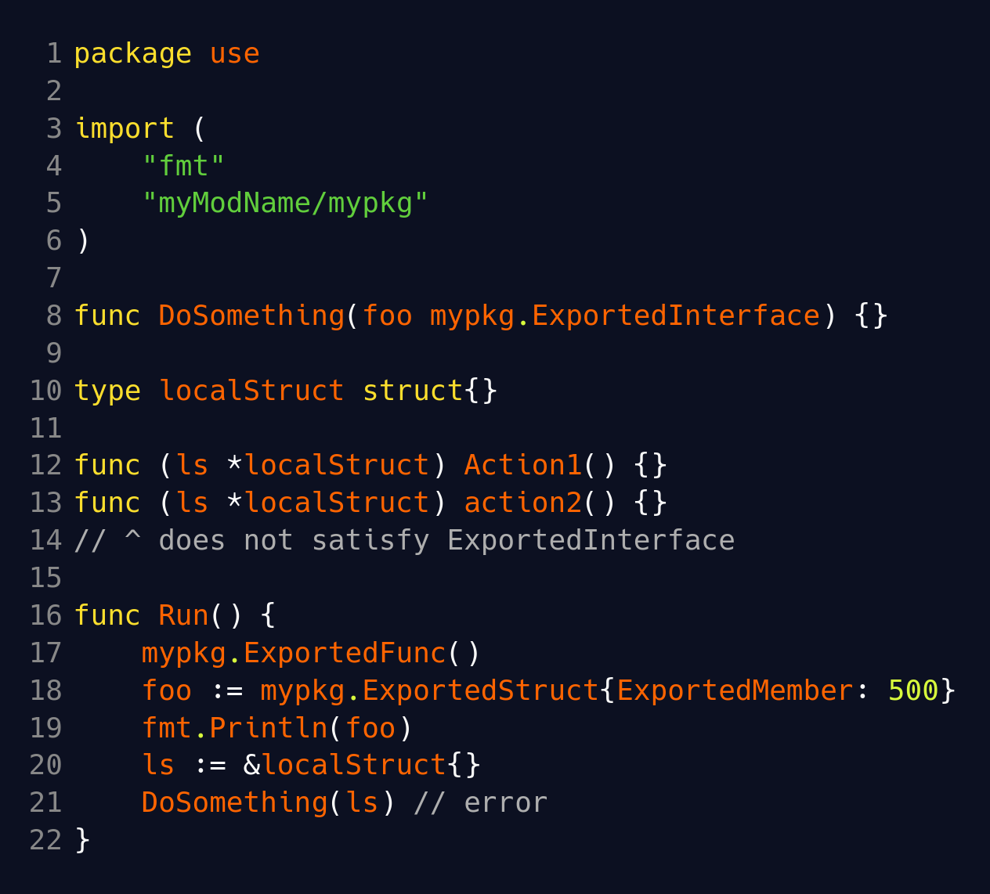
Packages / Modules
<root>/go.mod
<root>/mypkg/stuff.go
<root>/usepkg/use.go
Notes:
Exported interfaces should always have each function be exported too.

Slide 29
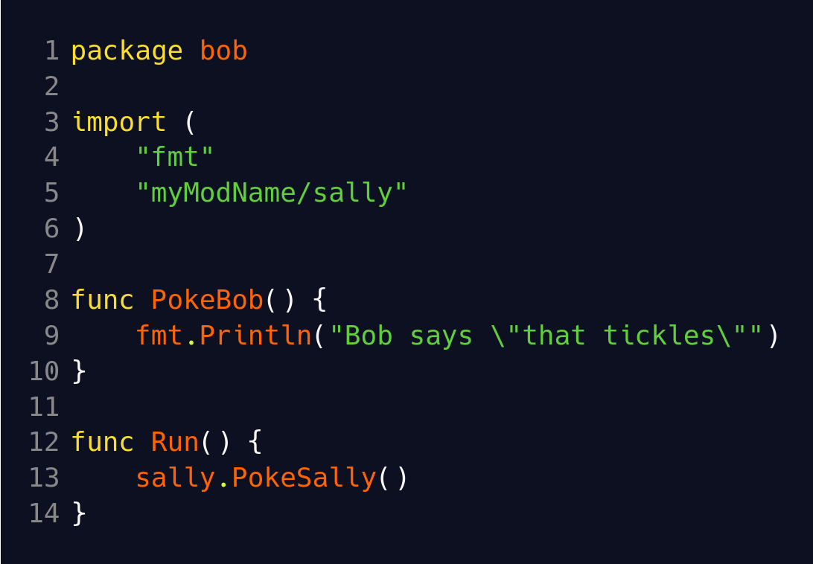
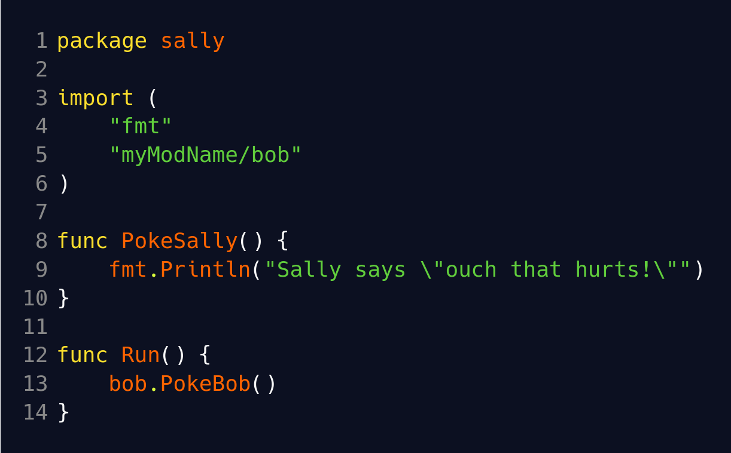

Packages / Modules
Circular import? Better than python?
Notes:
Compile time error! A little better than python

Slide 30
Packages / Modules etc
Create module → go mod init <module name>
Single file no module → go run <file>
func init() {…} → called once when package in initialized
Install third party module → go get github.com/google/uuid
  Automatically updates go.mod
Not covered → publishing modules, versioning

Slide 31
Jumping to Labels
goto label, break label, continue label
Break to label works with ‘for’, ‘switch’, ‘select’
Goto label (and Golang rules for goto)
  Goto is considered less harmful in Golang
  CANNOT jump to a place where new variables are in scope
  CANNOT jump into a scope the ‘goto’ is not apart of
  Therefore CANNOT jump outside of function

Slide 32

Jumping to Labels
Notes:
Example for break

Slide 33

Practice!
https://github.com/calvincramer/golang-training-2

