Slide 1
Training 3 - Concurrency
Calvin Lei-Cramer
May 2025

Slide 2
What are we covering today?

Slide 3
Panic! Recover.
What are panics actually? Are they exceptions?
What triggers panics?
  Array index out of bounds
  Divide by zero
  Calling panic()
  Nil pointer deference
  Type assertion (without using ‘ok’ second return value) failing
Notes:
On a panic, all DEFERRED functions in current function executed.
Then the caller of the current function has its DEFERRED functions called.
If panic is not handled in deferred functions then it will cause program to terminate.
Panics and exceptions are SIMILAR in how they are INVOKED, but Golang and other language are different in how you are allowed to HANDLE exceptions, and where normal execution can RECOVER from.

Slide 4
Panic! Recover.
How to recover (defer recover())
Named return values, defer, recover()
Pattern to actually recover NORMAL EXECUTION FLOW

Slide 5
Golang Idioms
Error handling (by error, not by exception)
Short if statements (in switch)
Defer
Context
Goroutines

Slide 6
Goroutines
What are goroutines?
Concurrency model, address space
Goroutine vs main thread (what happens when you don’t want for goroutines when exiting)
Handling syncronization via sync primitives
Channels
Sync.WaitGroup

Slide 7
Channels
What are channels?
Read and write to channel example
Unbuffered
Buffered
Select on multiple channels

Slide 8
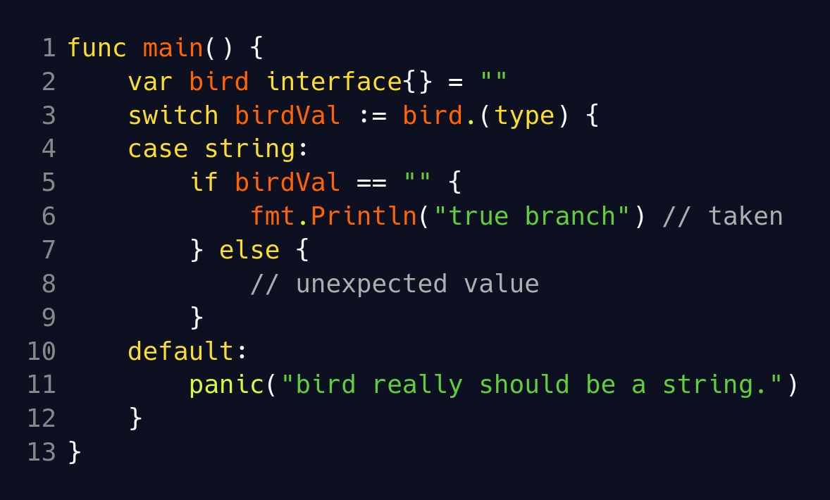
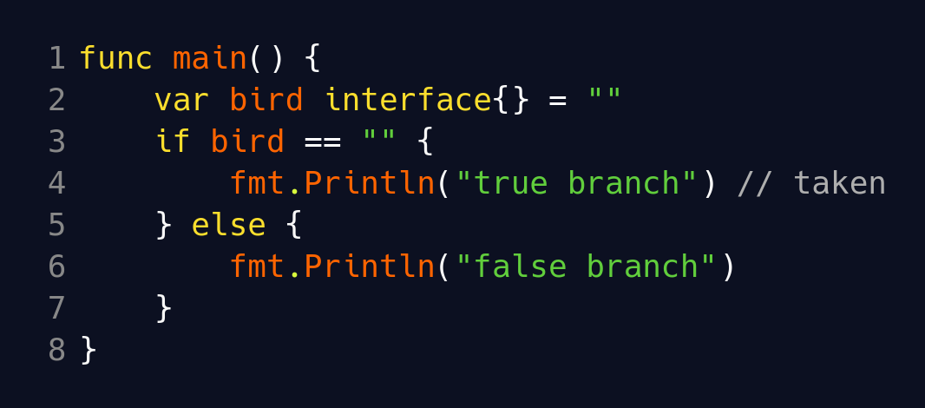
Runtime Type Comparison
Runtime check of type first, if types not equal then always false, otherwise do regular comparison

Slide 9

Practice!
https://github.com/calvincramer/golang-training-3

