Slide 1
Performant Python
Calvin Loveland

Slide 2
About Me

Slide 3
Why?
Python is great
Python is slow

Slide 4
How?
PROFILING
ALWAYS BE PROFILING
Optimizing →Profiling

Slide 5
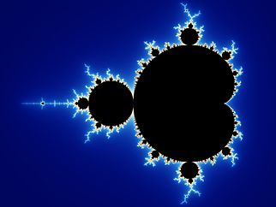

The Problem
Mandelbrot set
Simple code
Computationally difficult
Pretty

Slide 6
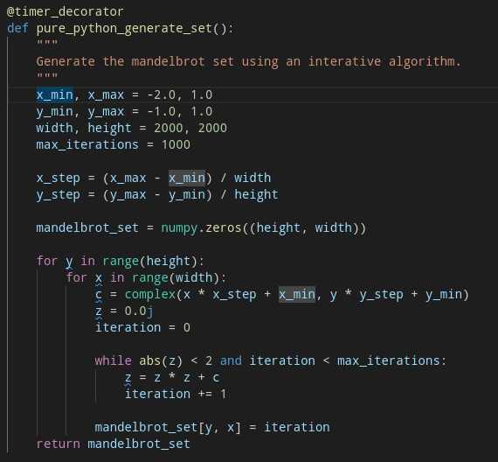
Python Code
Not efficient in any way
Easy to write
Easy to read
Very slow
4MP Image (2000x2000)
208 Seconds

Slide 7
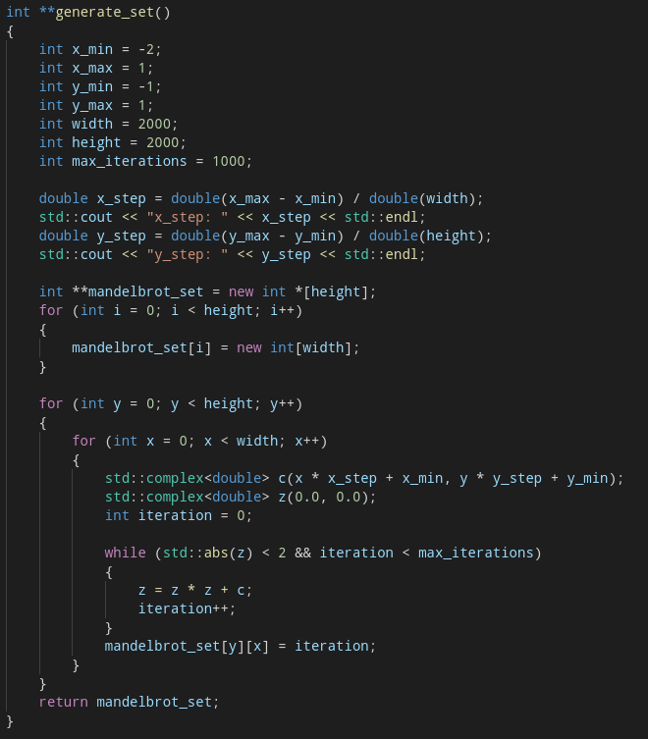
Cpp Code
Essentially the same code
Fast
4MP Image (2000x2000)
7.9 Seconds
Over 25 times faster!!

Slide 8
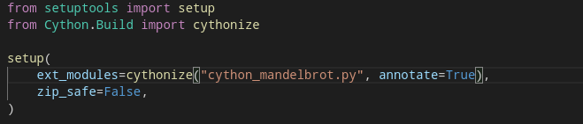
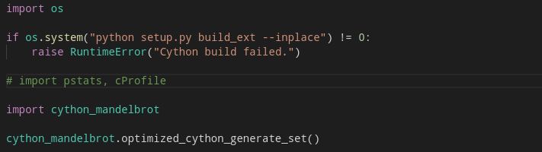
Cython
An optimising static compiler
Just compile your python module
A little faster
4MP Image (2000x2000)
149 Seconds

Slide 9
More Cython
An optimising static compiler
Just compile your python module
A little faster
4MP Image (2000x2000)
149 Seconds

