Slide 1
Asynchronous Testing Nordic Testing Days – June 2022
- Blanché Carstens
- Calvin Moore

Slide 2

A few of the most popular South African greetings:
Hello
Heita. Pronounced hay-tah
Howzit. Pronounced how-zit
Goeie Dag
Aweh
Sawubona
Sanibonani
Molo
Dumela
Dumelang

Slide 3
Attention, attention, we have a few things to mention
git clone:

Slide 4
What the purpose of async
To allow for a wait between when a function that is called to when the data/response of that function is returned.
A process that allows applications to start lengthy tasks while still being responsive to other events before its finished that task.

Slide 5
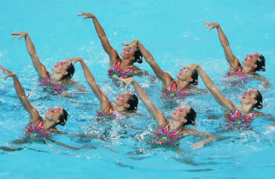
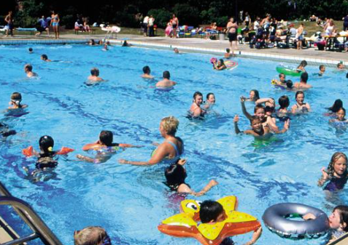

Synchronous vs Asynchronous vs Concurrent
Must follow order
Free flow
Multitasking x 2

Slide 6
Asynchronous use cases
To interact with APIs
Slow down an application’s UX by creating delays in a user’s activity.
Code that must respond to events
To improve an application performance and responsiveness when you have a dependency on long running processes

Slide 7
Examples of async functionality
When loading a picture to Instagram, you don’t have to wait for the picture to finish uploading in order to continue using the app.
Liking a picture on Instagram
Getting long lists information on a website

Slide 8
Rabbit MQ
1-Producer
2-Broker
RabbitMQ
3-Consumer
1 - Producers create messages and send them to the Queues
2 – Brokers are the Message Queues
3 – Consumer are Applications that connect to these queues and regularly read the messages & wait for them to be processed

Slide 9

Rabbit Demo

Slide 10
Benefits queuing messages
Allows quick responses from Web servers
Allows for mass distribution of a message to multiple consumers
Load balancing between workers

Slide 11
Good for
Not so good
Tasks that may take a while; high iteration
Simplicity

Slide 12
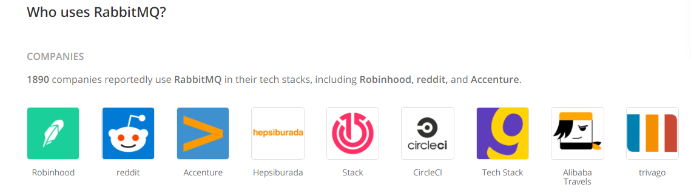

Companies using asynchronous functionality

Slide 13
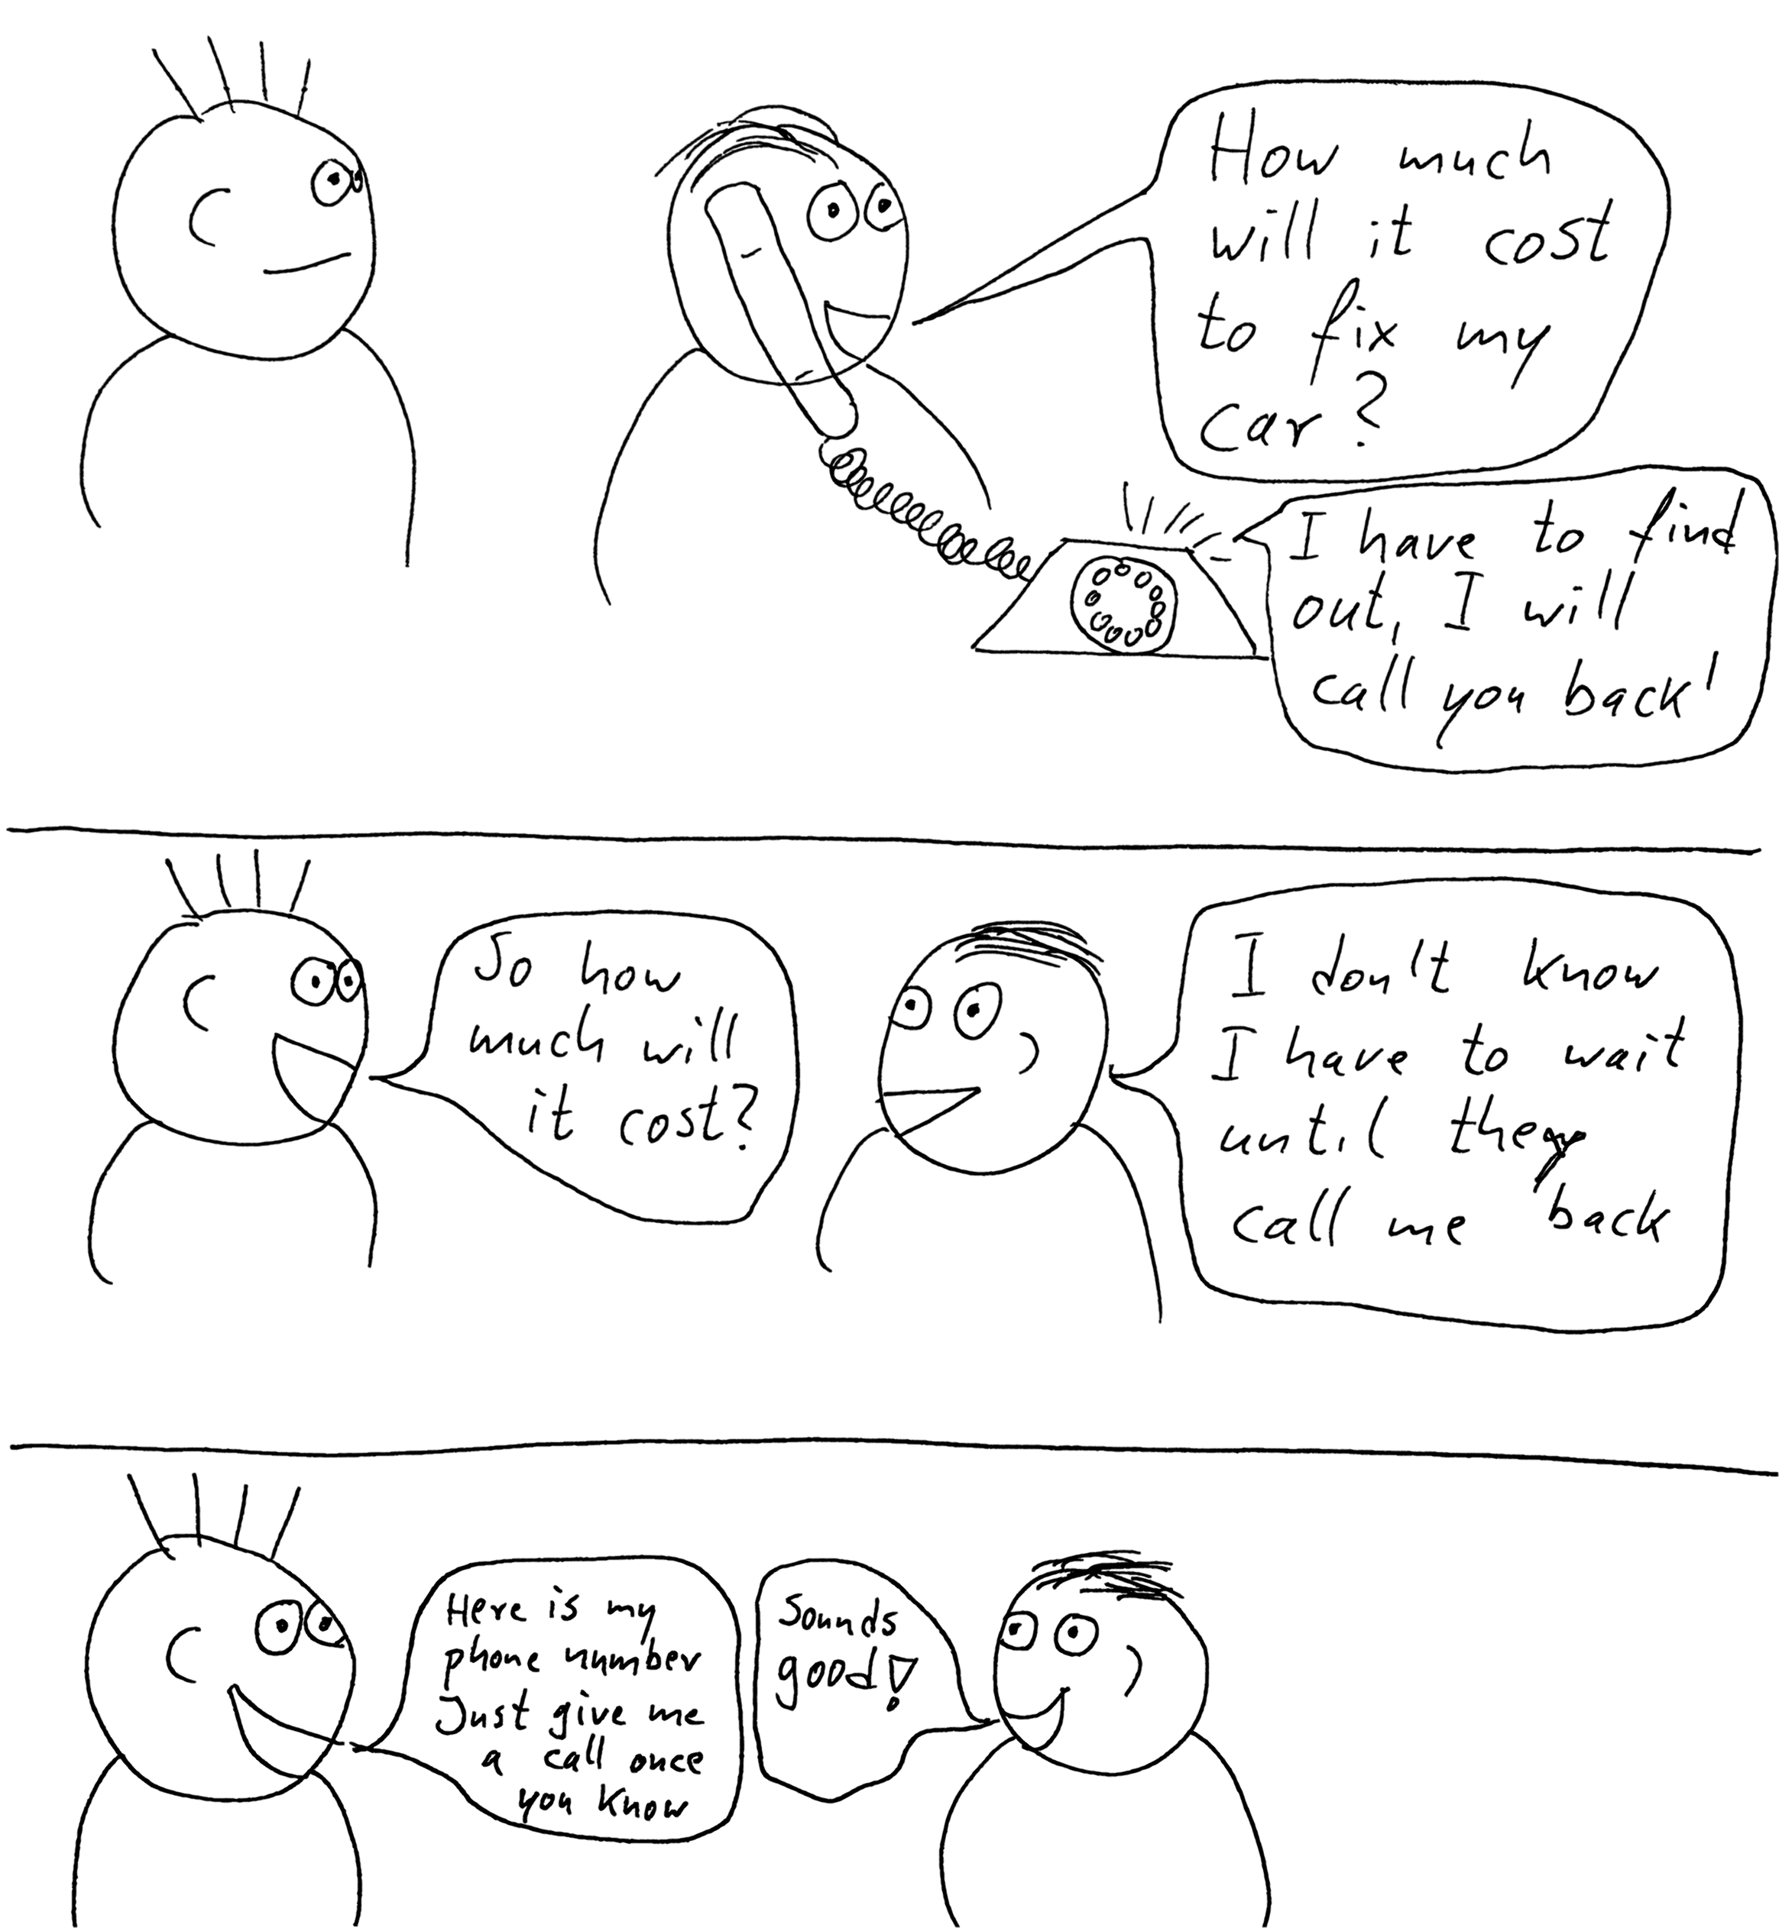
Callbacks

Slide 14
Callback code example

Slide 15
The make-up the repo
Project
Node.js
node modules
--tests--
LIB
Rabbit Mq
Docker-compose
package.json
Package-lock.json

Slide 16

Workshop Time

Slide 17
Wrapping up!

Slide 18
Questions & Thank you!

