Slide 1

Asynchronous Testing Nordic Testing Days – June 2022
Blanché Carstens
Calvin
Moore
Notes:
Blanche (little from Calvin)

Slide 2

A few of the most popular South African greetings:
Hello
Heita. Pronounced hay-tah
Howzit. Pronounced how-zit
Goeie Dag
Aweh
Sawubona
Sanibonani
Molo
Dumela
Dumelang
Notes:
Blanche

Slide 3
Attention, attention, we have a few things to mention
git clone:
Notes:
Blanche

Slide 4
What the purpose of async
To allow for a wait between when a function that is called to when the data/response of that function is returned.
A process that allows applications to start lengthy tasks while still being responsive to other events before its finished that task.
Notes:
Calvin

Slide 5



Synchronous vs Asynchronous vs Concurrent
Must follow order
Free flow
Multitasking x 2
Notes:
Calvin

Slide 6
Asynchronous use cases
Add telephone vs sms pic @blanche
To interact with APIs
Slow down an application’s UX by creating delays in a user’s activity.
Code that must respond to events
To improve an application performance and responsiveness when you have a dependency on long running processes
Notes:
Calvin

Slide 7
Examples of async functionality
When loading a picture to Instagram, you don’t have to wait for the picture to finish uploading in order to continue using the app.
Liking a picture on Instagram
Getting long lists information on a website
Notes:
(merged into previous)

Slide 8

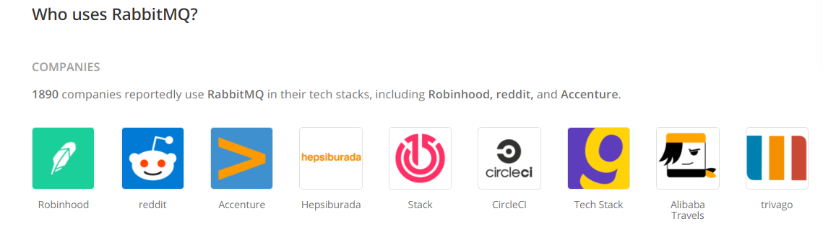
Companies using asynchronous functionality
Notes:
Calvin

Slide 9
Rabbit MQ
1-Producer
2-Broker
RabbitMQ
3-Consumer
1 - Producers create messages and send them to the Queues
2 – Brokers are the Message Queues
3 – Consumer are Applications that connect to these queues and regularly read the messages & wait for them to be processed
Notes:
Blanche

Slide 10

Rabbit Demo
Notes:
Blanche

Slide 11
Benefits queuing messages
Allows quick responses from Web servers
Allows for mass distribution of a message to multiple consumers
Load balancing between workers
Tasks that may take a while; high iteration
Notes:
Blanche

Slide 12
Good for
Not so good
Tasks that may take a while; high iteration
Simplicity
Notes:
Merged into previous

Slide 13
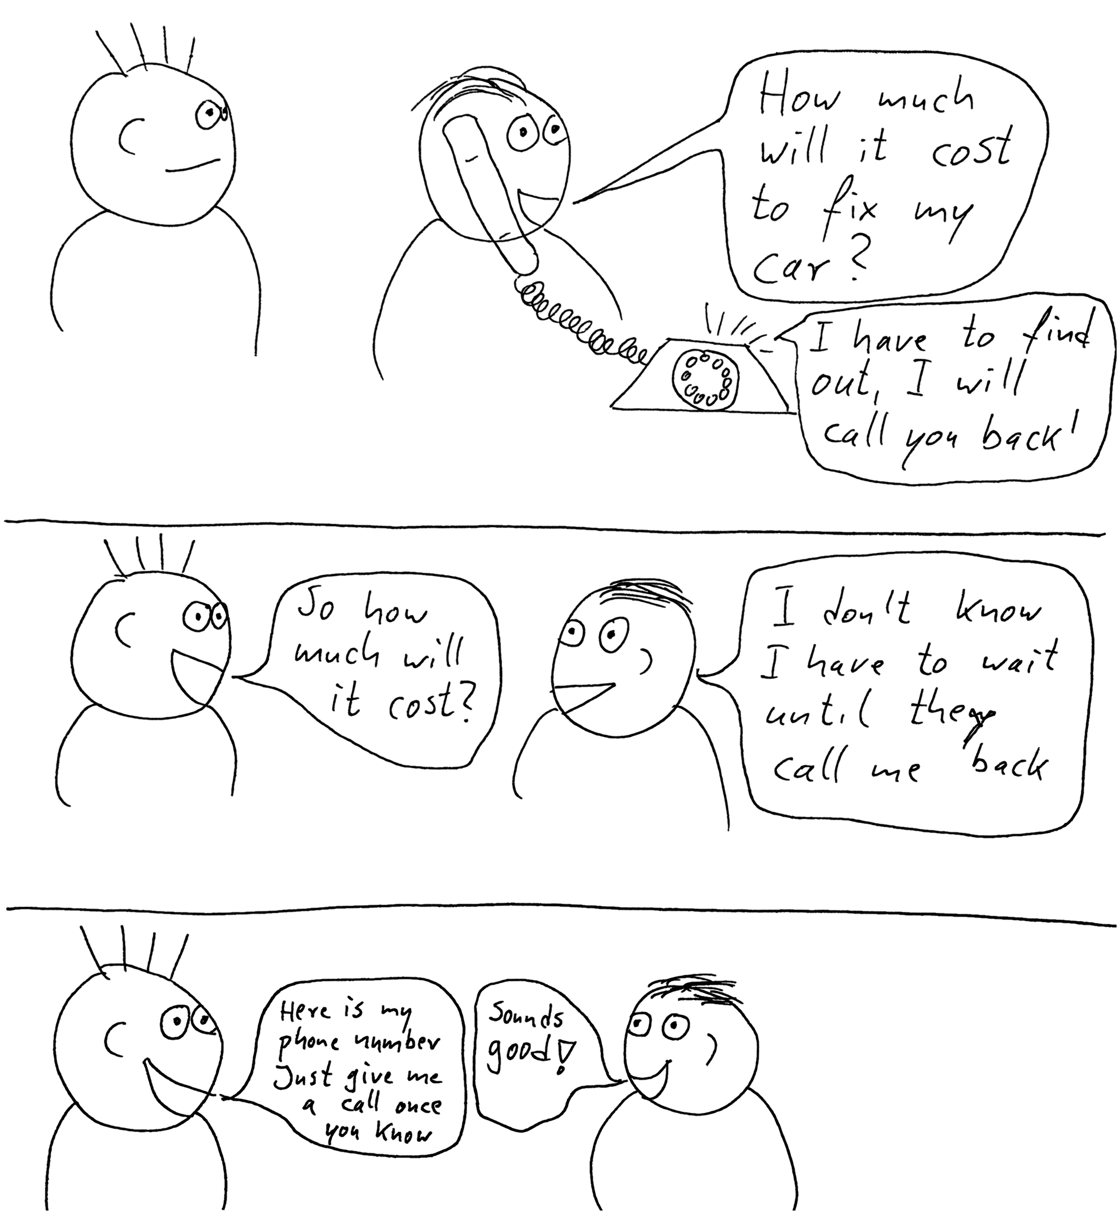
Callbacks
Notes:
Calvin

Slide 14
The make-up the repo
Project
Node.js
node modules
--tests--
LIB
Rabbit Mq
Docker-compose
package.json
Package-lock.json
Notes:
Calvin

Slide 15

Workshop Time
Notes:
Blanche start with first two and then Calvin with second two.

Slide 16
Wrapping up!

Slide 17
Questions & Thank you!

