Slide 1

Asynchronous Testing Nordic Testing Days – June 2022
Blanché
Carstens
Calvin
Moore
Notes:
Blanche (little from Calvin)

Slide 2

A few of the most popular South African greetings:
Hello
Heita. Pronounced hay-tah
Howzit. Pronounced how-zit
Goeie Dag
Aweh
Sawubona
Sanibonani
Molo
Dumela
Dumelang
Notes:
Blanche

Slide 3
Attention, attention, we have a few things to mention
git clone
Internet access
Docker
Docker-compose
Notes:
Blanche

Slide 4
What the purpose of async
To allow for a wait between when a function that is called to when the data/response of that function is returned.
A process that allows applications to start lengthy tasks while still being responsive to other events before its finished that task.
Notes:
Calvin
Before we jump into testing async systems you might ask why bother creating async systems in the first place? Lets be honest – if, by design, an application could respond after an entire day its going to make your tests take impractical to execute. It just makes everything harder. This is true. But even with this in mind its still worth it under certain conditions.
Consider an application that might periodically go offline for batch processing – you don’t want everything dependent on that application to go offline. Instead, your application could accept the request and say this will be processed at some point in the future when the application comes back online. This way you put a layer of resilience between two applications.
Consider an application that needs to throttle how fast it handles requests. Asynchronous messaging also helps here. And the message broker allows this queue of work to survive application restarts.

Slide 5



Synchronous vs Asynchronous vs Concurrent
Must follow order
Free flow
Multitasking x 2
Notes:
Calvin
Another worthy consideration is what are we NOT talking about today? Often asynchronous messaging is associated with concurrency and parallelism. While systems can use these concepts to deal with asynchronous messaging the focus of this presentation is not on that.
<<Define concepts not in use>>

Slide 6

Asynchronous use cases
To interact with APIs
Code that must respond to events
To improve an application performance and responsiveness when you have a dependency on long running processes
When loading a picture to Instagram, you don’t have to wait for the picture to finish uploading in order to continue using the app
Liking a picture on Instagram
Getting long lists information on a website
Notes:
Calvin
For those Instagram influencers out there I’m sure this is not unfamiliar to you – when uploading a big video to Instagram you can continue browsing the site even while its being uploaded. Your phone accepts a response saying the request will be processed at some point soon – then you can carry on.
Or perhaps something everyone can appreciate – a phone call is inherently synchronous. While a wats app is inherently asynchronous – your phone accepts a response saying the message has been delivered. Hopefully that pretty girl will respond at some point…

Slide 7
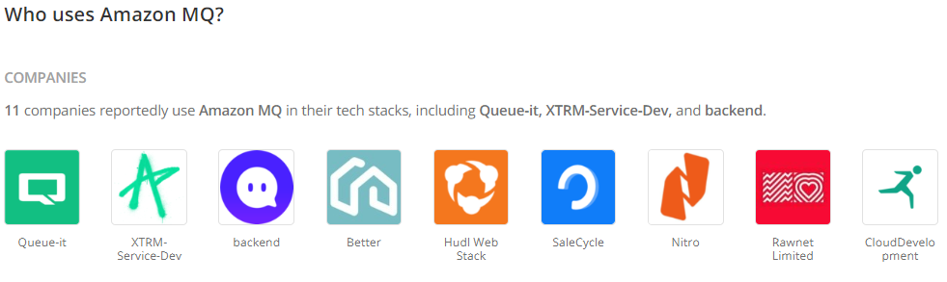
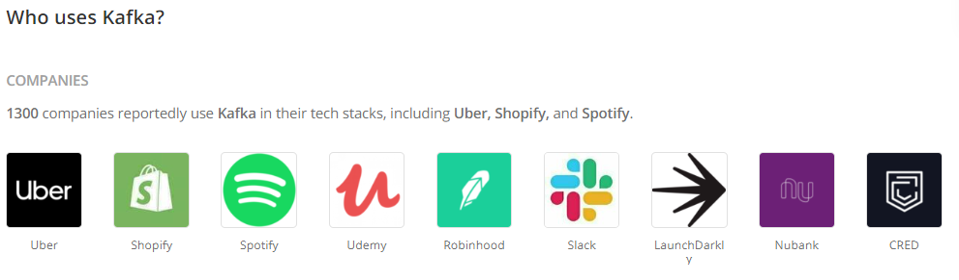
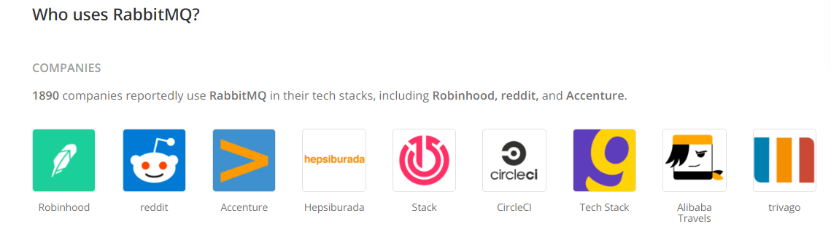
Companies using asynchronous functionality
RabbitMQ
Amazon MQ
Kafka
Apache ActiveMQ
Google Cloud Pub/Sub
Notes:
Calvin
There are a few popular asynchronous messaging systems in the industry. If you using any one of these you are in good company. For the purpose of today’s workshop we will be using RabbitMQ. It’s a very popular, simple and easy to use system.

Slide 8
Rabbit MQ
1-Producer
2-Broker
RabbitMQ
3-Consumer
1 - Producers create messages and send them to the Queues
2 – Brokers are the Message Queues
3 – Consumer are Applications that connect to these queues and regularly read the messages & wait for them to be processed
Notes:
Blanche
Focus on the how – not so much the why.

Slide 9

Rabbit Demo
Notes:
Blanche
Mention no installation requirements for the purpose of this workshop as we will be using a dockerised instance.

Slide 10
Benefits of queuing messages
Allows quick responses from Web servers
Allows for mass distribution of a message to multiple consumers
Load balancing between workers
Tasks that may take a while; high iteration
Tasks that may take a while; high iteration
Simplicity
Notes:
Blanche
Duplicate work?

Slide 11
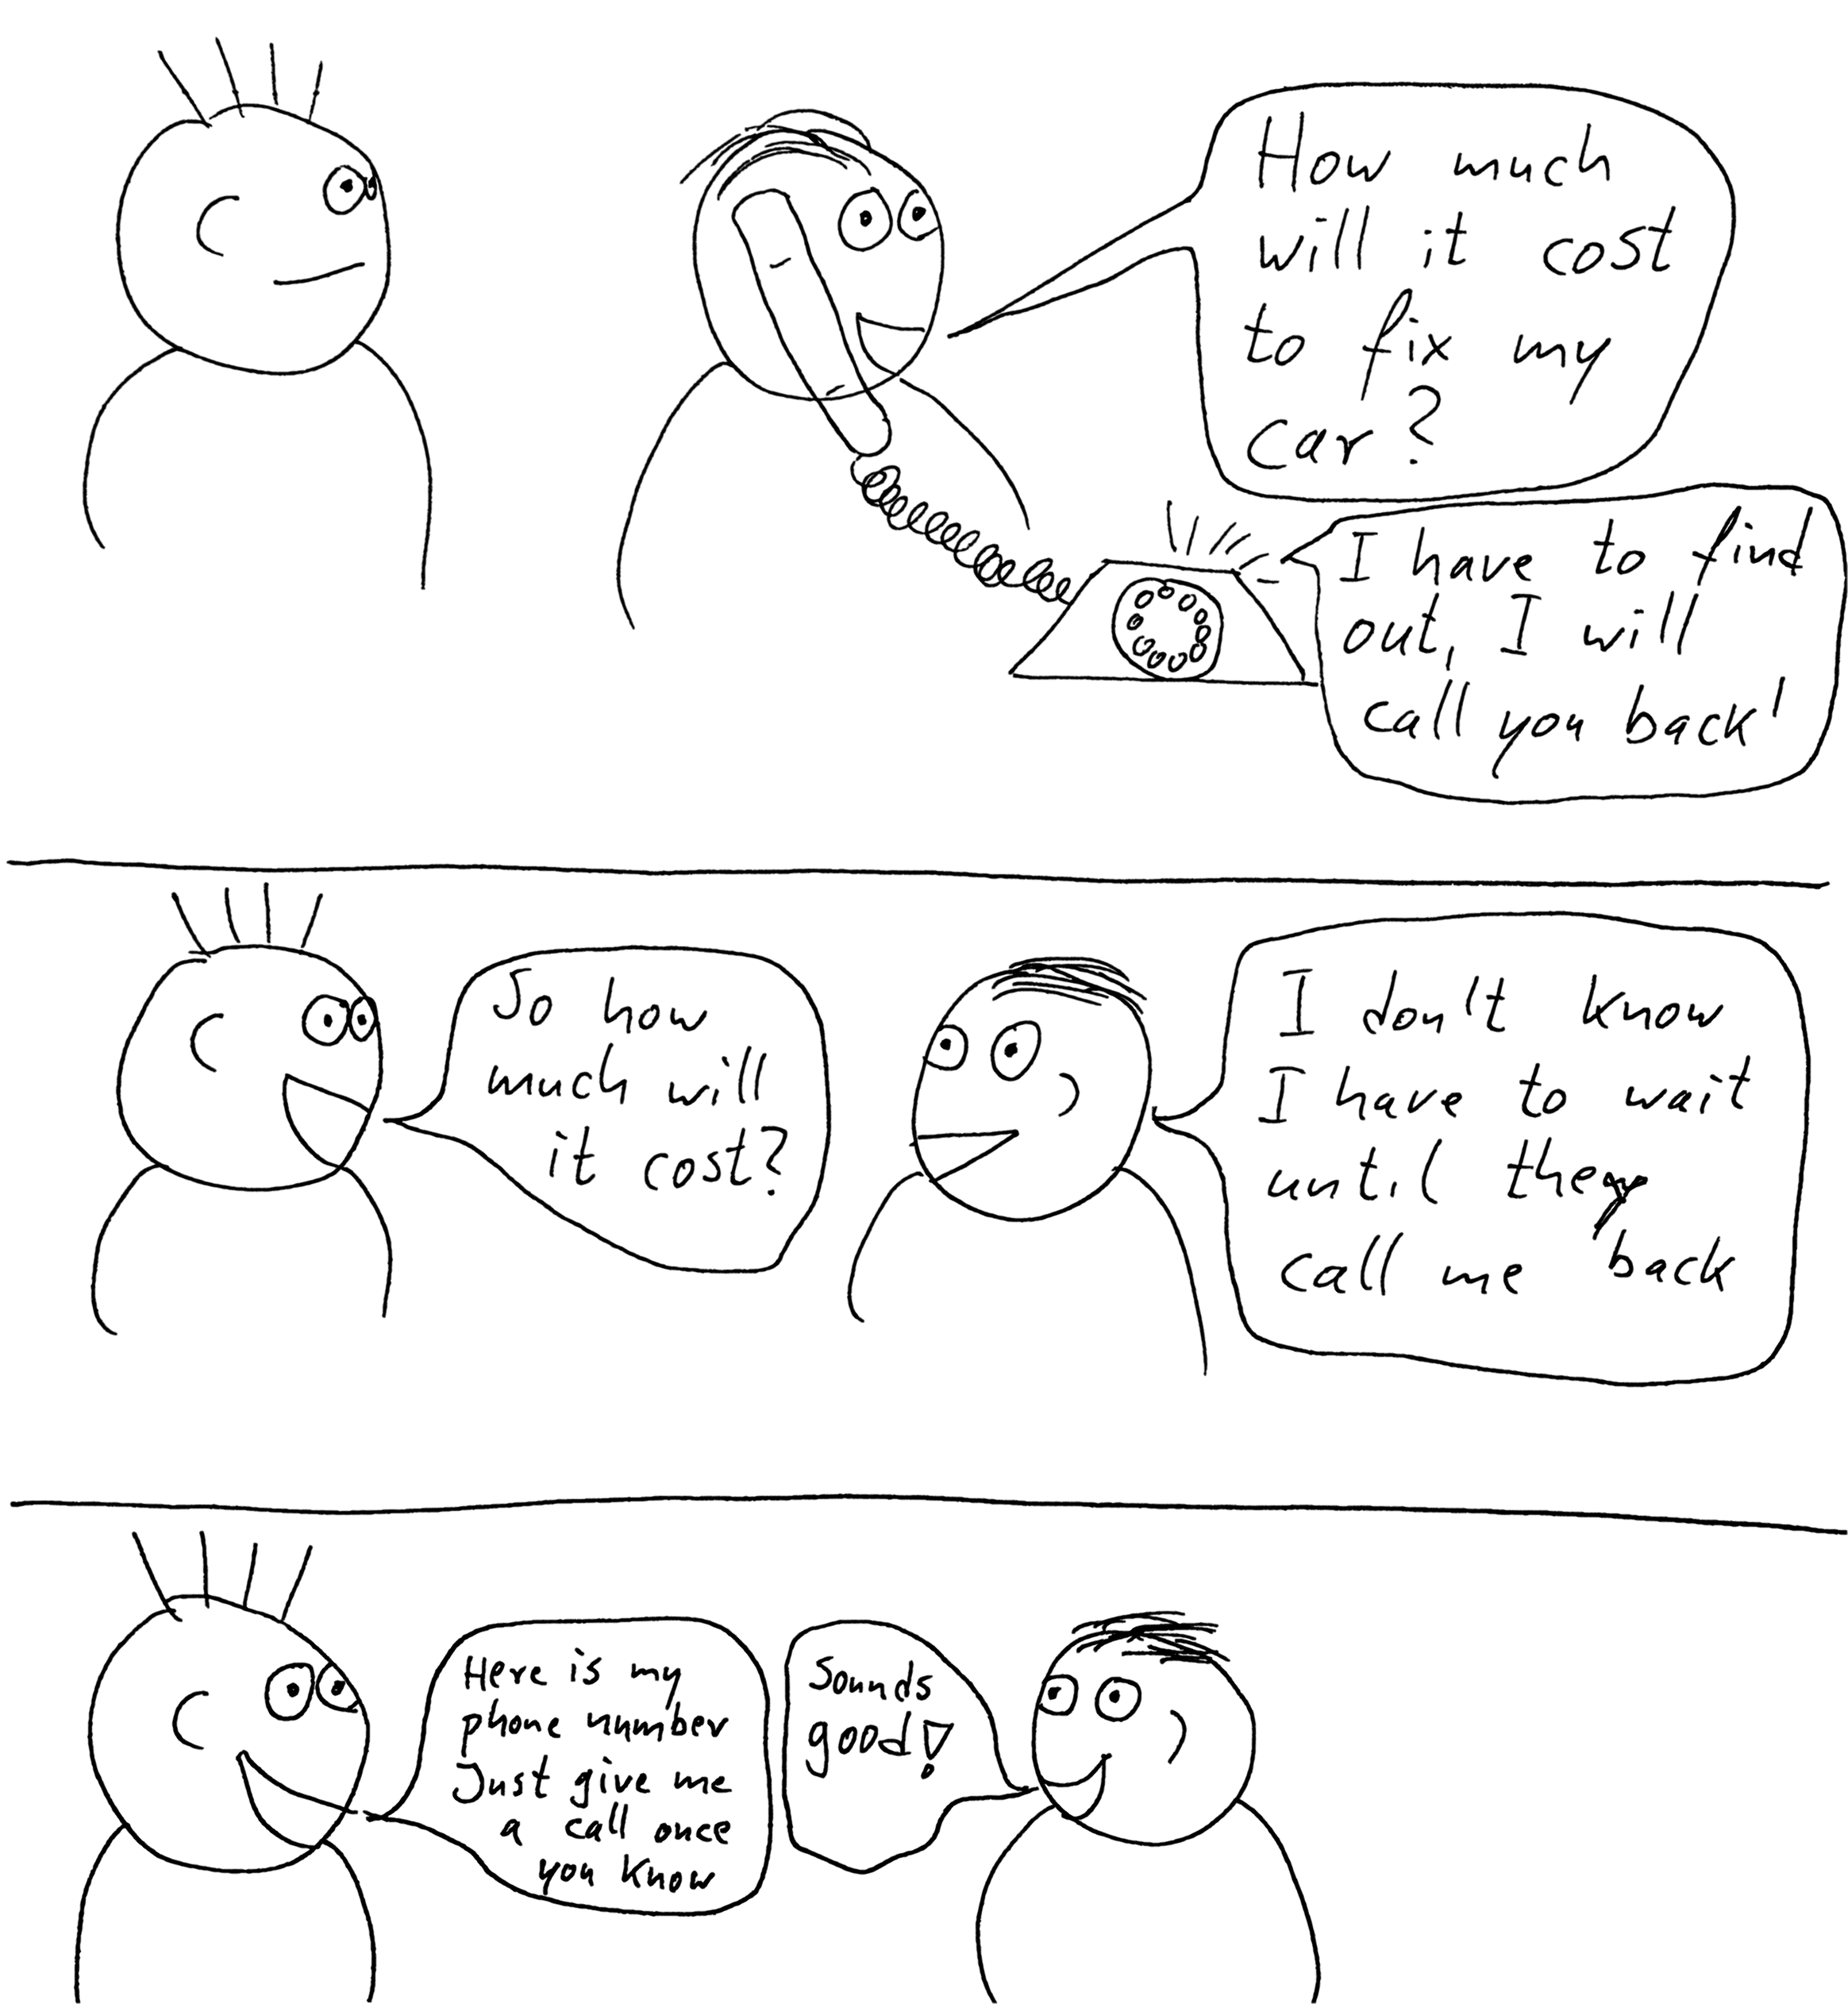
Main () {
setupCallback(doSomething)
}
doSomething(message) {
process(message)
}
Callbacks
Main () {
doSomething(message => process(message))
}
Notes:
Calvin
As in this picture – we can do something when we receive a callback and not before
Animate code to appear sexy (like Calvin) ~Blanche’s words.

Slide 12
The make-up of the repo
Project
Node.js
node modules
--tests--
LIB
Rabbit Mq
Docker-compose
package.json
Package-lock.json
Notes:
Blanche
Calvin’s speech for Blanche:
Before we jump into the workshop lets just take some time to familiarise ourselves with the code repository we will be using for the demo. Hopefully by now you all have the repo cloned locally so lets take a look:
Tests – self descriptive. You will notice all the test code is written in Javascript using the Jest testing framework. This was chosen because again its simple and easy to use allowing us to focus on the subject matter of this workshop rather than fiddling around with frameworks.
Lib – custom code designed to make this workshop easier to reason on
Rabbitmq – configuration designed to get a rabbitmq instance up and running easily. As Blanche mentioned for the workshop we are using a dockerised rabbitmq instance – this ensures no one has any installation issues.
Package.json, package-lock.json, and .babelrc installs libraries we need such as Jest and in particular amqplib. This is the client library which will allow our tests to interact with the rabbitmq server.
Docker-compose – this is how we are constructing our testing environment. Two containers will be started up – one for the rabbitmq server and another for the Javascript tests to execute from.

Slide 13


Workshop Time
Notes:
Blanche start with first two and then Calvin with second two.

Slide 14

Wrapping up!

Slide 15


Slide 16


