Slide 1


Asynchronous Testing Nordic Testing Days – June 2022
Blanché
Carstens
Calvin
Moore
Notes:
Blanche (little from Calvin)

Slide 2

A few of the most popular South African greetings:
Hello
Heita. Pronounced hay-tah
Howzit. Pronounced how-zit
Goeie Dag
Aweh
Sawubona
Sanibonani
Molo
Dumela
Dumelang
Notes:
Blanche

Slide 3
Attention, attention, we have a few things to mention
git clone
Internet access
Docker
Docker-compose
Notes:
Blanche

Slide 4
What the purpose of async
To allow for a wait between when a function that is called to when the data/response of that function is returned.
A process that allows applications to start lengthy tasks while still being responsive to other events before its finished that task.
Notes:
Calvin
Before we jump into testing asynchronous systems you might ask why bother creating an asynchronously executing system in the first place? I’m not sure if anyone here has already tried their hand at this in the workplace but if, by design, an application can respond anywhere between milliseconds and a day its going to make your tests take an impractical amount of time to execute. Asynchronous systems just makes everything harder. This is true. But for certain situations this extra complexity is still worth it.
Consider an application that periodically runs a long running batch process like a nightly batch at any major bank in the world. Typically, while a big batch job like that is being processed that application cannot process any additional instructions until the batch is finished. Reads work perfectly well because they are not side affecting but altering the data is where the problems occur. In this scenario you could just take the application offline such that any incoming transactions would be rejected or fail. Alternatively, something could be implemented such that this application accepts instructions promising to process them at some point in the future when the application comes back online. This ability to queue up incoming requests for processing later is normally implemented using an asynchronous message brokering system. What's interesting is a side affect of putting this message brokering system in the middle is that you have now put a layer between your application and its consumers improving resilience for when things go wrong.
A second very common use case for asynchronous message brokers is when an application needs to throttle how fast it handles requests. Instead of an application being forced to handle requests whenever consumers initiate a transaction the process can be flipped on its head. Instead, the application can pull new work off its queue of transactions whenever it is ready – for example when its finished processing the previous transaction.

Slide 5



Synchronous vs Asynchronous vs Concurrent
Concurrency
Parallelism
Multitasking
Notes:
Calvin
Another worthy consideration is what are we NOT talking about today. Often asynchronous messaging is associated with a few related concepts:
Concurrency and Parallelism: Defined as the execution of multiple instructions at the same time.
Multitasking: Defined as multiple users using a single processor by time sharing resources.
These are all concepts I am sure everyone has heard about. While systems typically make use of one or more of these concepts to work with asynchronous messaging the focus of this workshop is on testing the asynchronous systems and not how they are implemented.

Slide 6

Asynchronous use cases
To interact with APIs
Code that must respond to events
To improve an application performance and responsiveness when you have a dependency on long running processes
When loading a picture to Instagram, you don’t have to wait for the picture to finish uploading in order to continue using the app
Liking a picture on Instagram
Getting long lists information on a website
Notes:
Calvin
OK so that’s a whole bunch of theory but let's get down to brass tax – real world examples that you and I can see with our own eyes:
For those Instagram influencers out there I’m sure this is not unfamiliar to you – when uploading a big video to Instagram you can continue browsing the site even while its being uploaded. This is done through the magic of asynchronous processing. Behind the scenes your phone has sent the image to the Instagram servers and received a response saying they promise to process the photo at some point soon. While this processing is happening, you can go about your business.
Or perhaps something everyone can appreciate even more at a human level – a phone call is inherently synchronous. You dial someone and they must pick up the phone within a reasonable amount of time otherwise your phone call goes unanswered. While wats app or sms is inherently asynchronous – your phone accepts a response saying the message has been delivered. Hopefully that pretty girl will respond at some point…

Slide 7
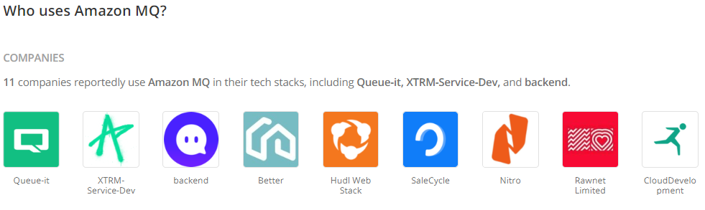
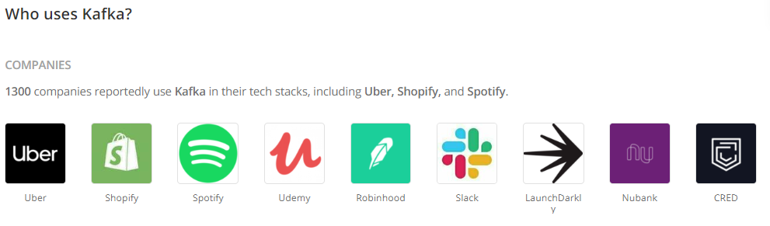
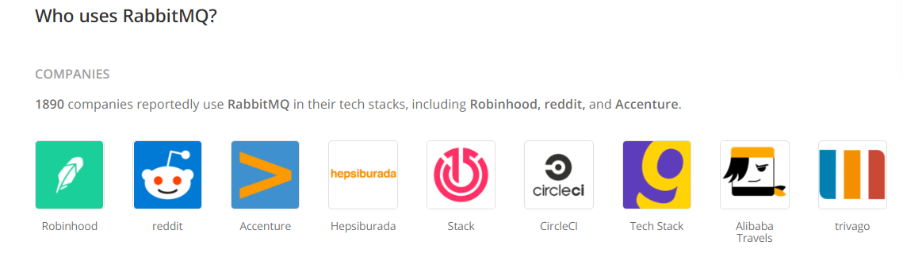
Companies using asynchronous functionality
RabbitMQ
Amazon MQ
Kafka
Apache ActiveMQ
Google Cloud Pub/Sub
Notes:
Calvin
For the purpose of today’s workshop, we will be using an asynchronous message broker to demonstrate testing asynchronous systems. Particularly the broker called RabbitMQ. This is a widely used message broker in the industry and Blanche and I can personally testify to its robustness and ease of use in the real world. This is what we use at Allan Gray to process millions of messages a day.
But RabbitMQ is by no means the only message broker system available. If you work in the AWS ecosystem you might already be familiar with Amazon MQ. Another very popular system is Kafka which brings its own unique flavour. And then there is Apache ActiveMQ and Google Cloud Pub/Sub to name another few. Rest assured if you using any one of these you are in good company.
While this workshop demonstrates how to test around RabbitMQ and uses RabbitMQ clients the testing principles we discuss here today apply no matter what provider you use. They all use the same concepts and work using identical principles.

Slide 8
Rabbit MQ
1-Producer
2-Broker
RabbitMQ
3-Consumer
1 - Producers create messages and send them to the Queues
2 – Brokers are the Message Queues
3 – Consumer are Applications that connect to these queues and regularly read the messages & wait for them to be processed
Notes:
Blanche
Focus on the how – not so much the why.

Slide 9

Rabbit Demo
Notes:
Blanche
Mention no installation requirements for the purpose of this workshop as we will be using a dockerised instance.

Slide 10
Benefits of queuing messages
Allows quick responses from Web servers
Allows for mass distribution of a message to multiple consumers
Load balancing between workers
Tasks that may take a while; high iteration
Tasks that may take a while; high iteration
Simplicity
Notes:
Blanche
Duplicate work?

Slide 11
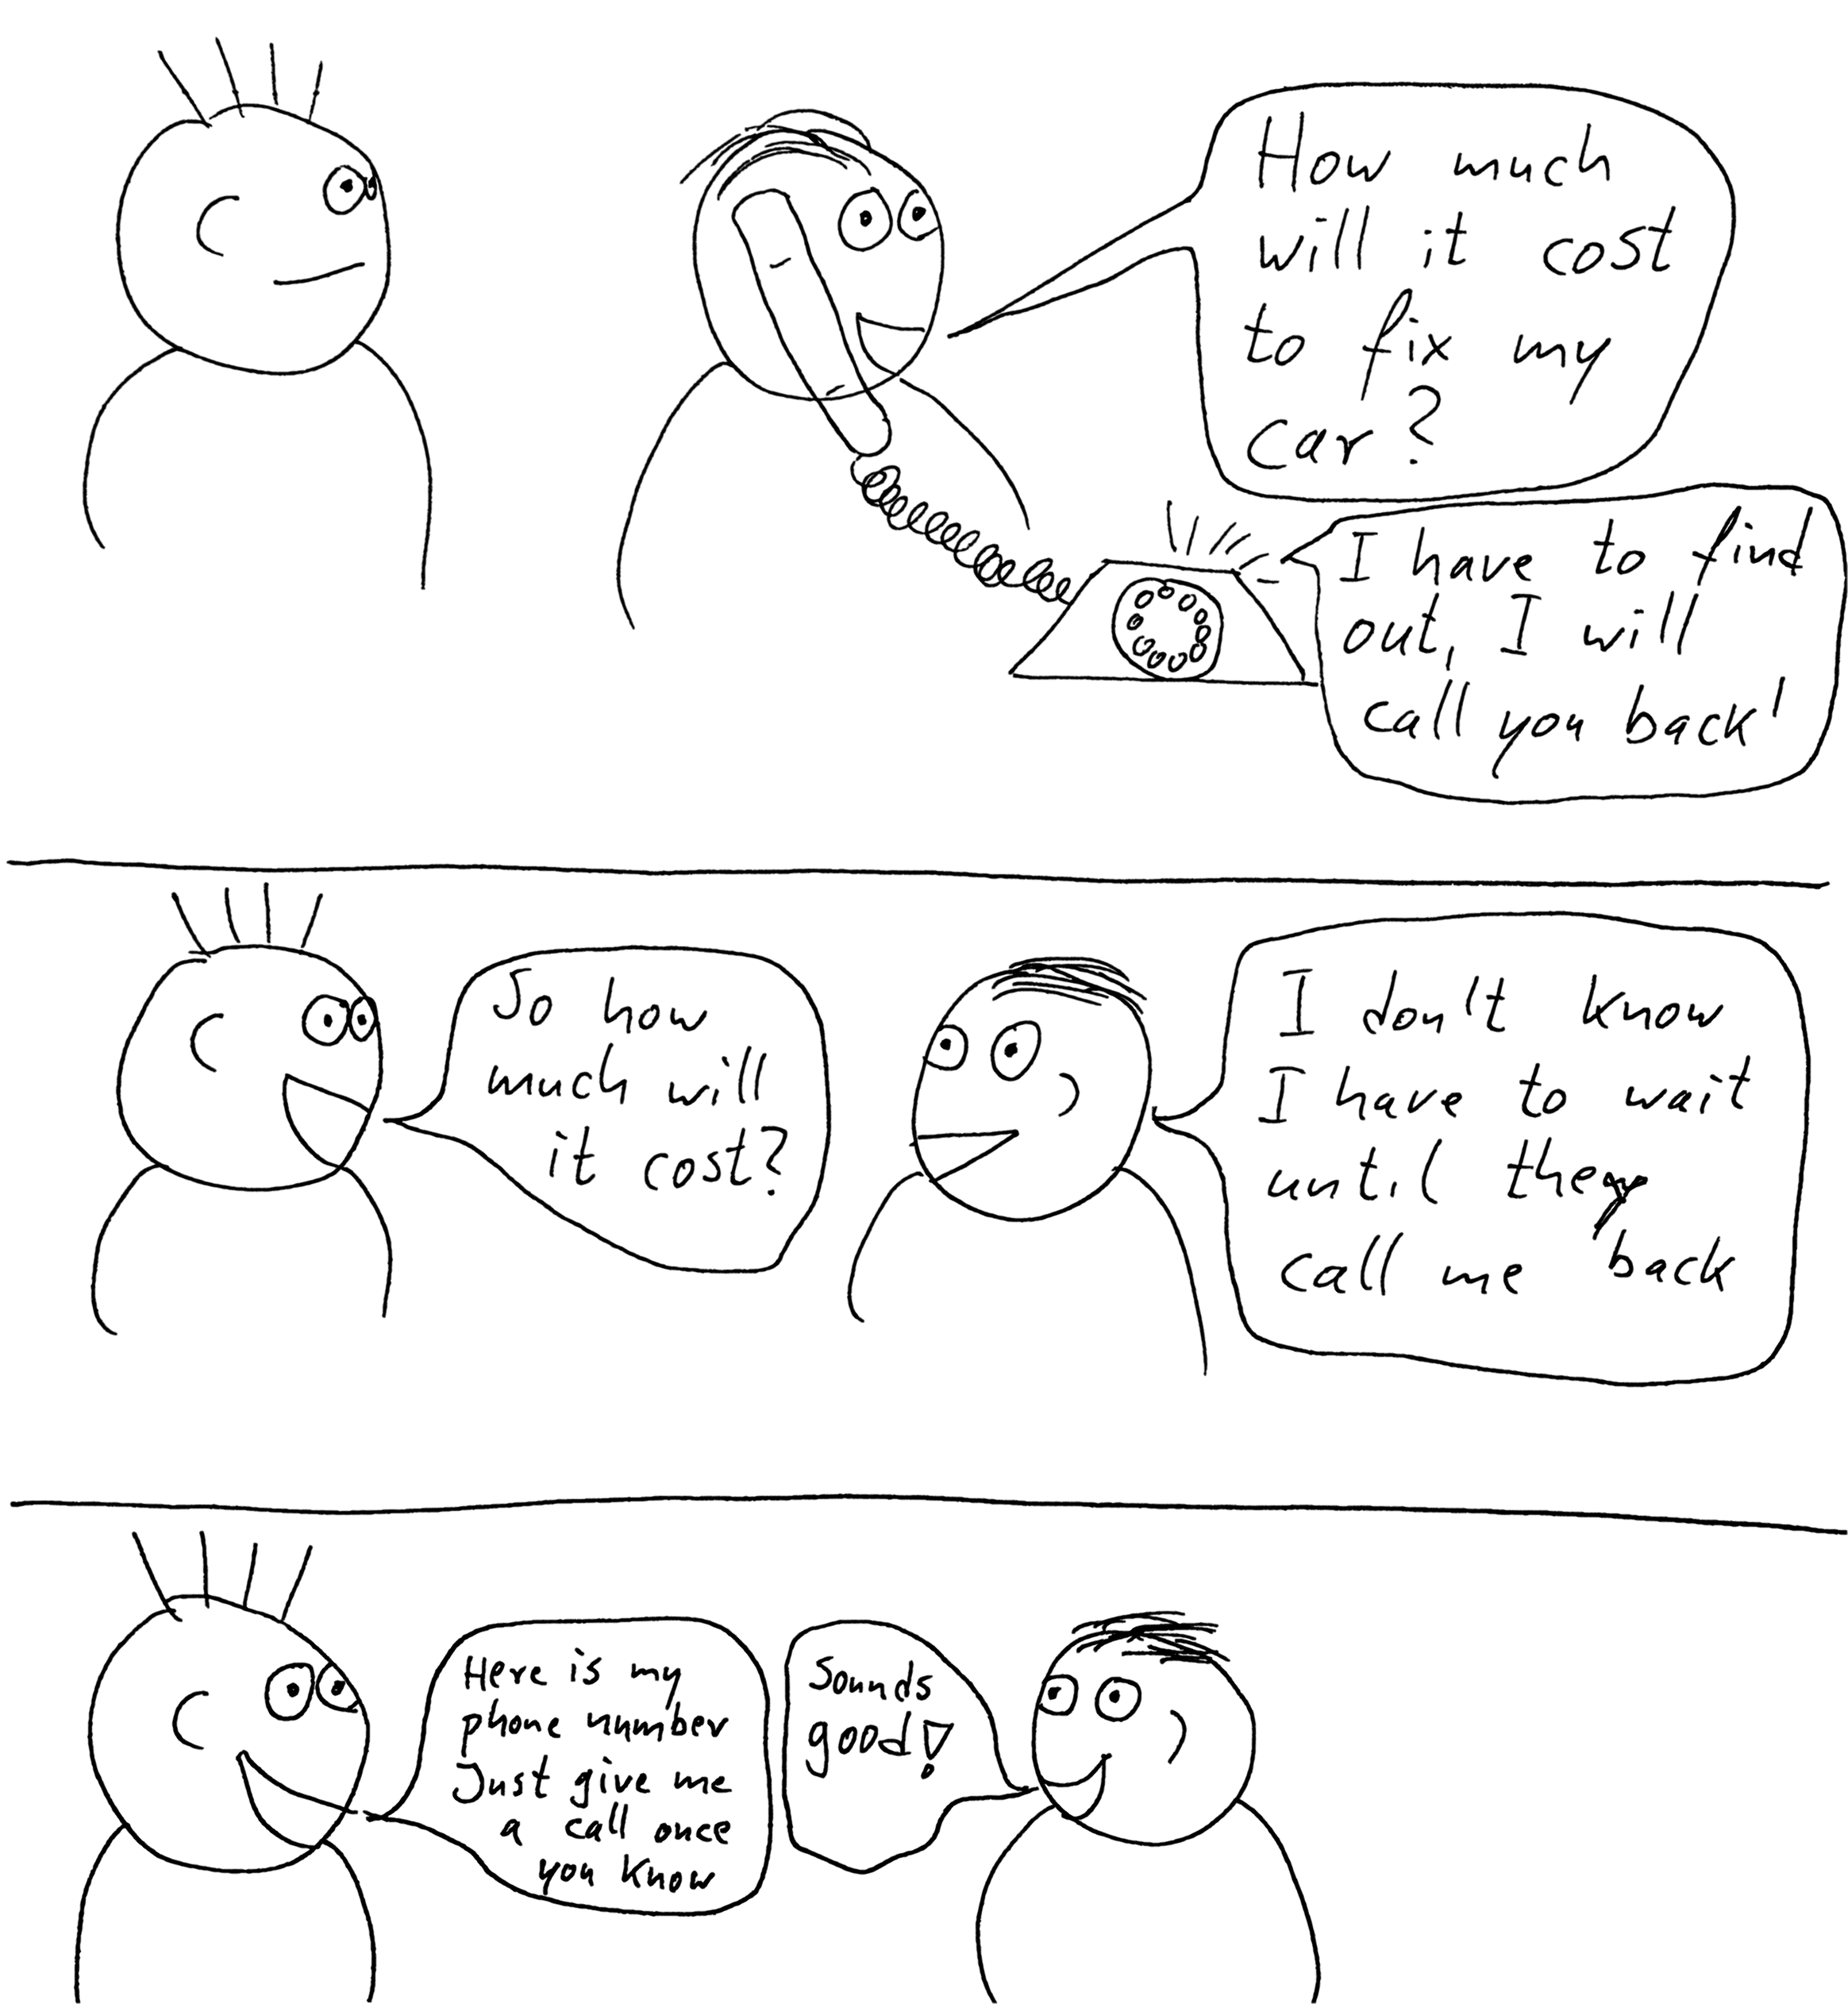
Main () {
setupCallback(doSomething)
}
doSomething(message) {
process(message)
}
Callbacks
Main () {
doSomething(message => process(message))
}
Notes:
Calvin <<want to present on this in the workshop section>>
Before we start diving into the code there is one last concept we need to cover – callbacks…
As in this picture – we can do something when we receive a callback and not before
Animate code to appear sexy (like Calvin) ~Blanche’s words.

Slide 12
The make-up of the repo
Project
Node.js
node modules
--tests--
LIB
Rabbit Mq
Docker-compose
package.json
Package-lock.json
Notes:
Blanche
Calvin’s speech for Blanche:
Before we jump into the workshop lets just take some time to familiarise ourselves with the code repository we will be using for the demo. Hopefully by now you all have the repo cloned locally so lets take a look:
Tests – self descriptive. You will notice all the test code is written in Javascript using the Jest testing framework. This was chosen because again its simple and easy to use allowing us to focus on the subject matter of this workshop rather than fiddling around with frameworks.
Lib – custom code designed to make this workshop easier to reason on
Rabbitmq – configuration designed to get a rabbitmq instance up and running easily. As Blanche mentioned for the workshop we are using a dockerised rabbitmq instance – this ensures no one has any installation issues.
Package.json, package-lock.json, and .babelrc installs libraries we need such as Jest and in particular amqplib. This is the client library which will allow our tests to interact with the rabbitmq server.
Docker-compose – this is how we are constructing our testing environment. Two containers will be started up – one for the rabbitmq server and another for the Javascript tests to execute from.

Slide 13


Workshop Time
Notes:
Blanche start with first two and then Calvin with second two.

Slide 14

Wrapping up!

Slide 15


Slide 16


