Slide 1
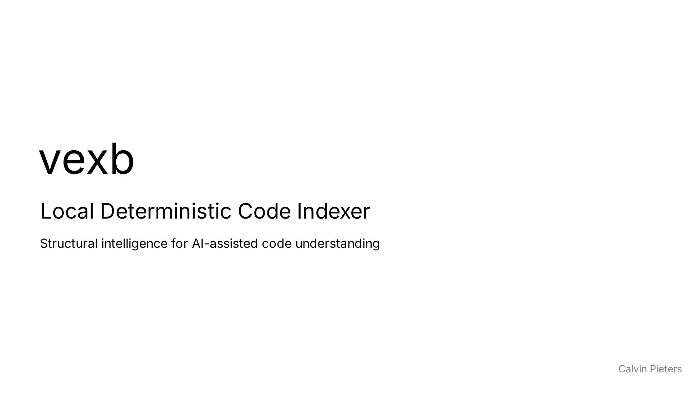
Notes:
Opening slide — introduce the project name and tagline.

Slide 2
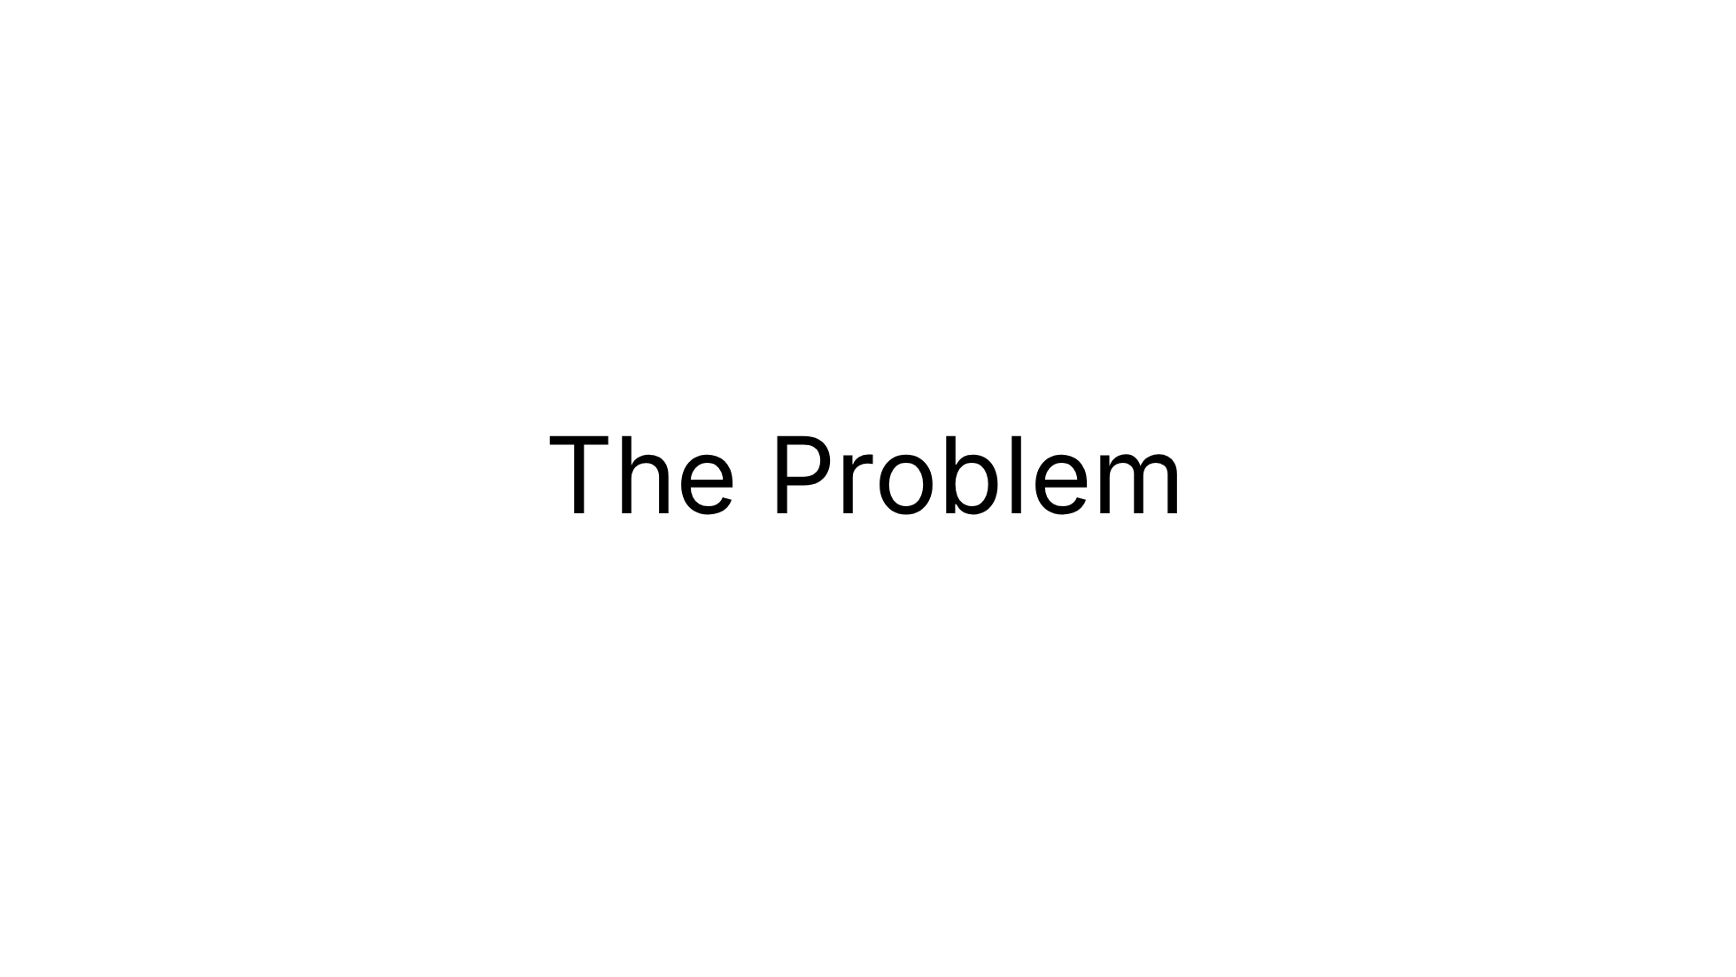

Slide 3

Notes:
Set up the problem space. Each point builds on the last — from raw capability gaps to the nuanced problem of intent-aware context selection.

Slide 4

Notes:
Set up the problem space. Each point builds on the last — from raw capability gaps to the nuanced problem of intent-aware context selection.

Slide 5
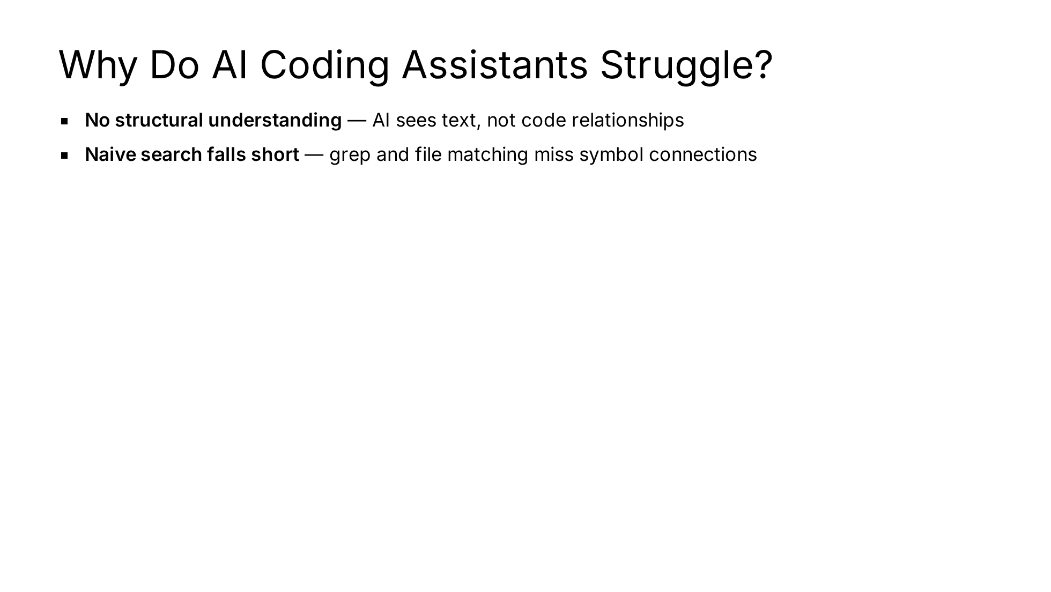
Notes:
Set up the problem space. Each point builds on the last — from raw capability gaps to the nuanced problem of intent-aware context selection.

Slide 6
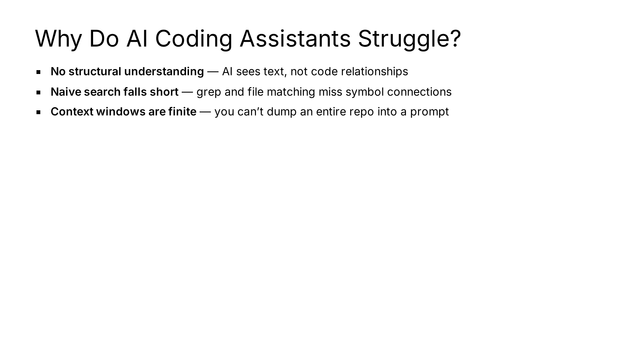
Notes:
Set up the problem space. Each point builds on the last — from raw capability gaps to the nuanced problem of intent-aware context selection.

Slide 7
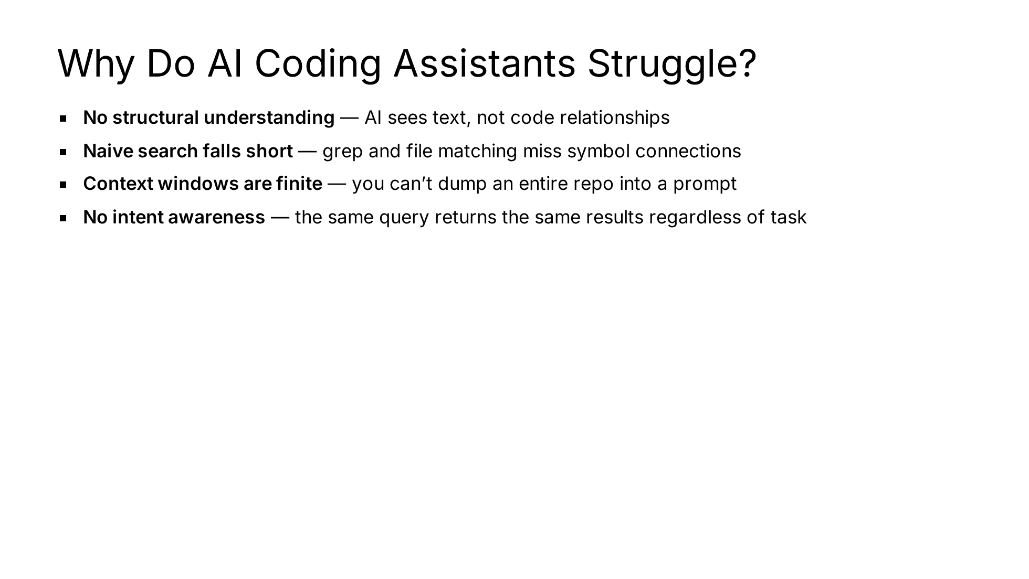
Notes:
Set up the problem space. Each point builds on the last — from raw capability gaps to the nuanced problem of intent-aware context selection.

Slide 8
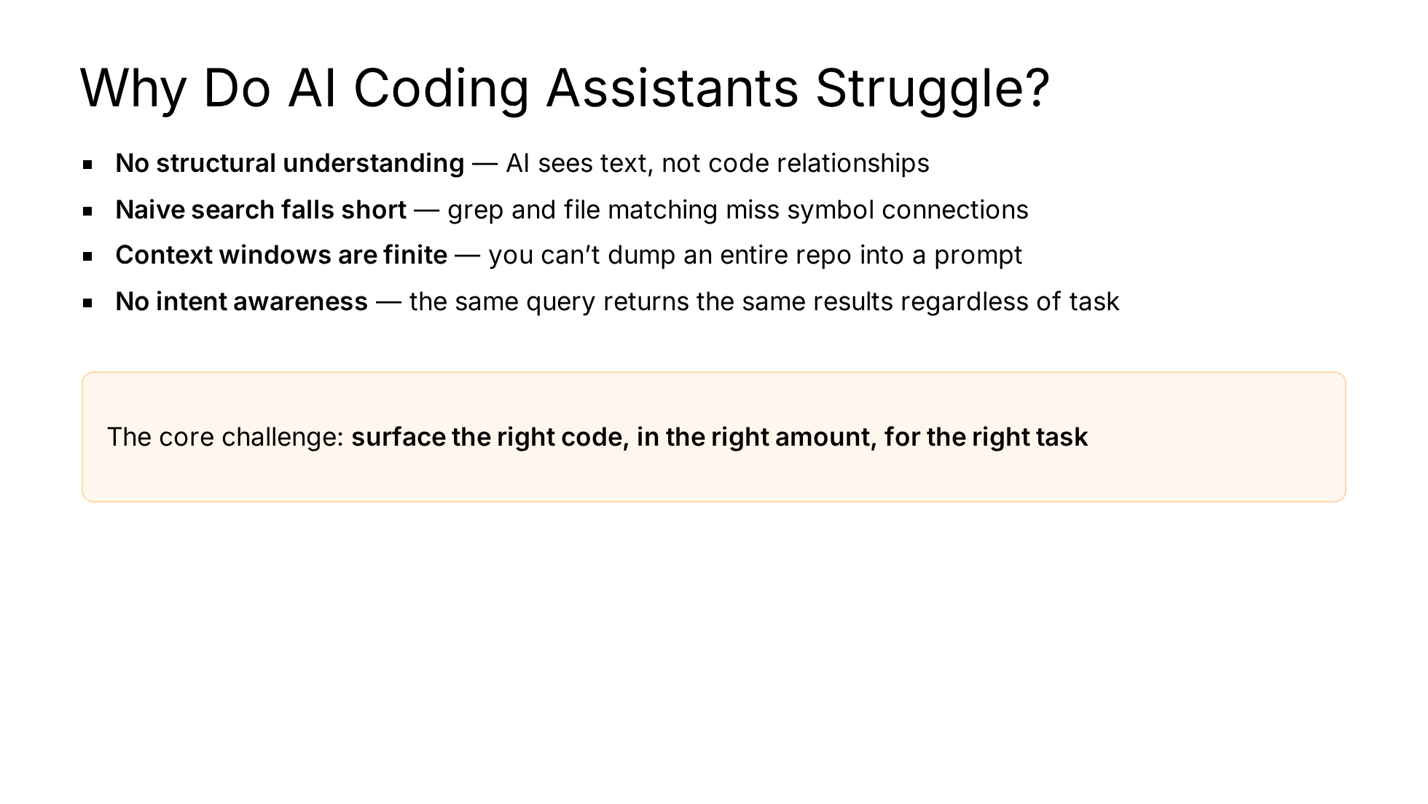
Notes:
Set up the problem space. Each point builds on the last — from raw capability gaps to the nuanced problem of intent-aware context selection.

Slide 9
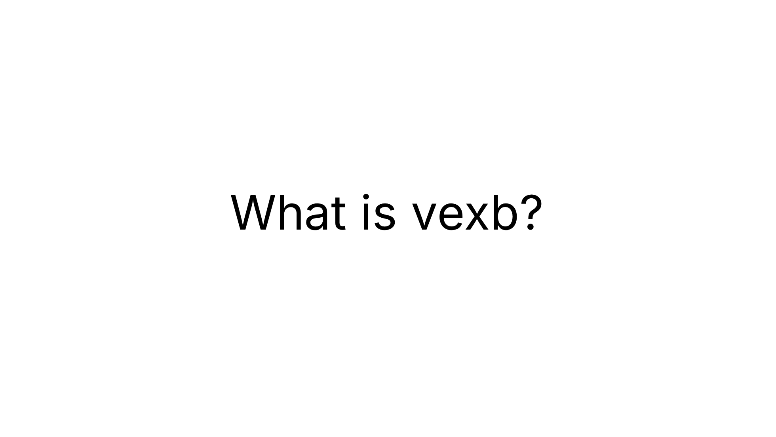

Slide 10
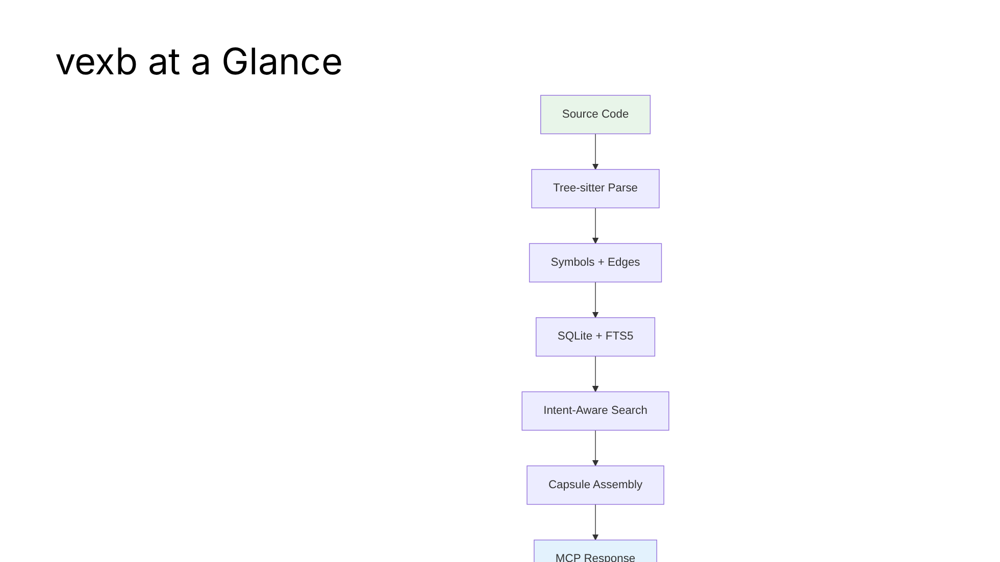
Notes:
High-level overview — what it does and the data flow at a glance.

Slide 11
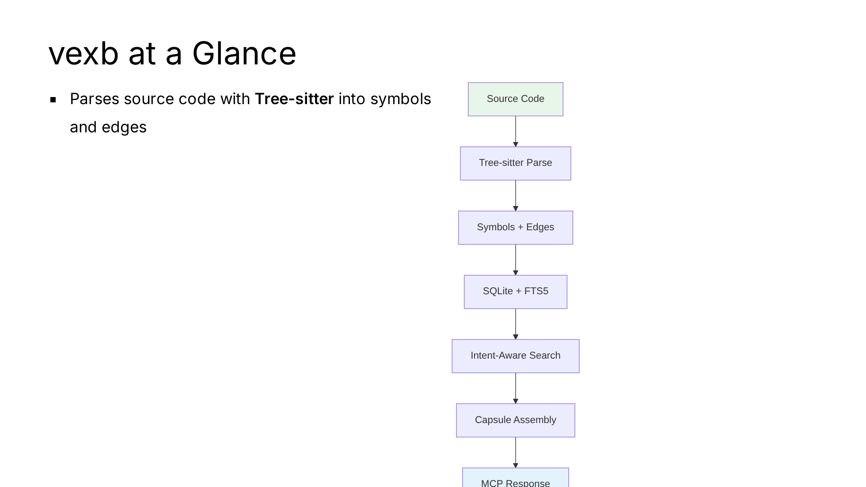
Notes:
High-level overview — what it does and the data flow at a glance.

Slide 12
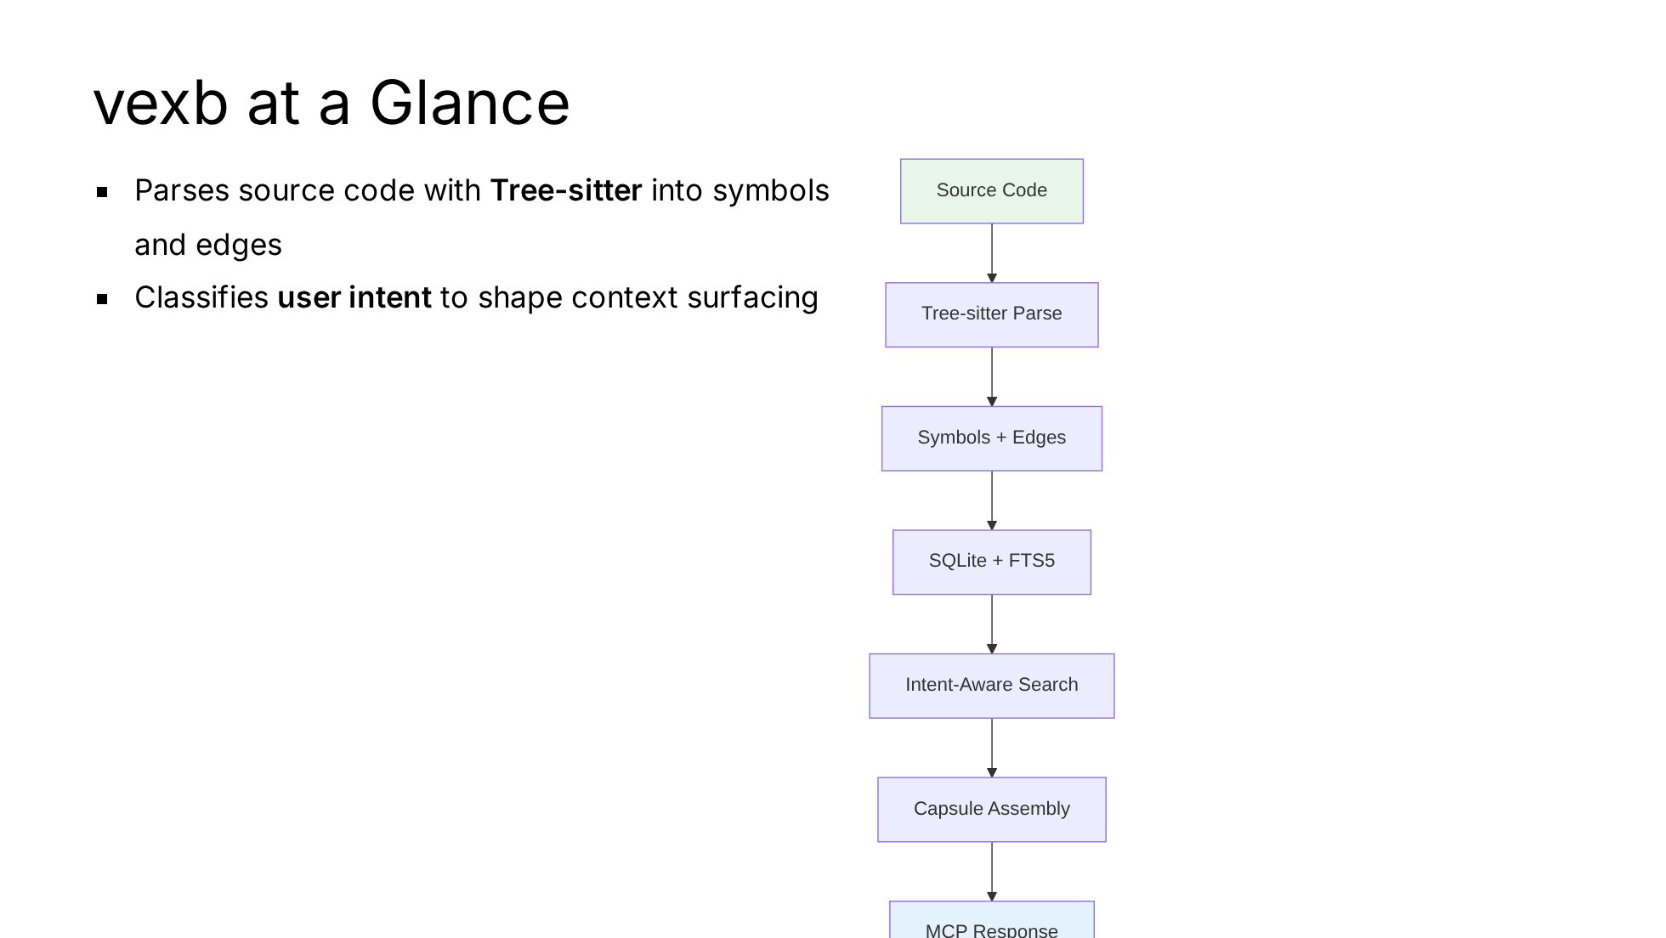
Notes:
High-level overview — what it does and the data flow at a glance.

Slide 13
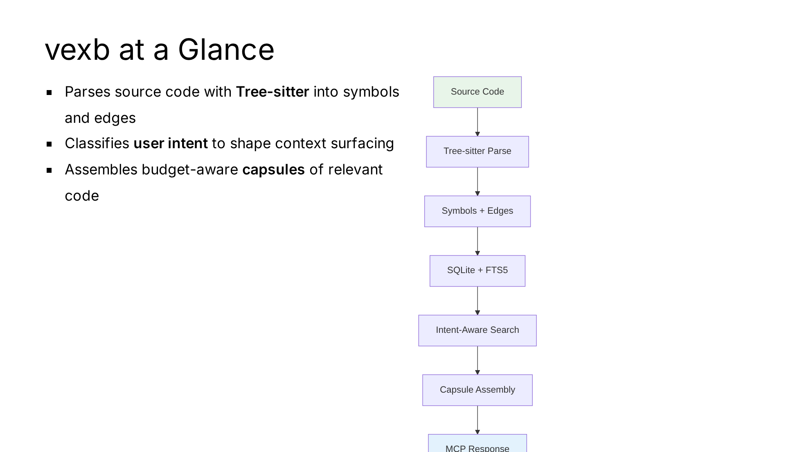
Notes:
High-level overview — what it does and the data flow at a glance.

Slide 14
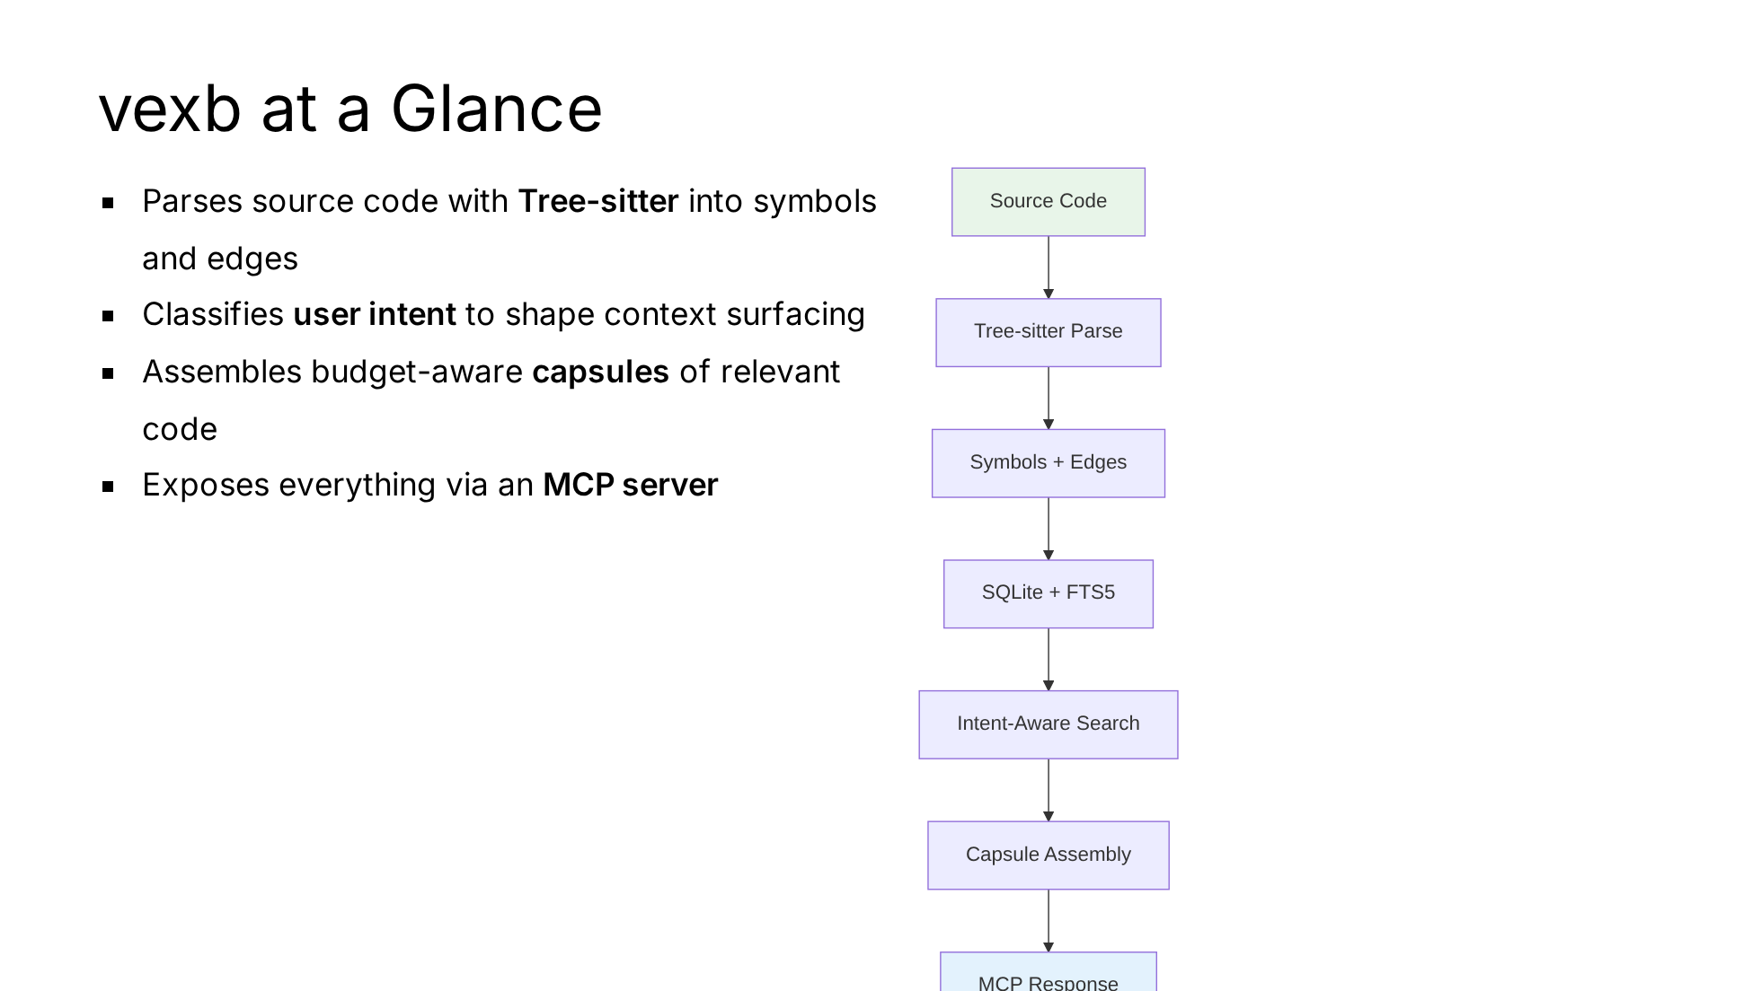
Notes:
High-level overview — what it does and the data flow at a glance.

Slide 15

Notes:
The five pillars that every design decision comes back to.

Slide 16
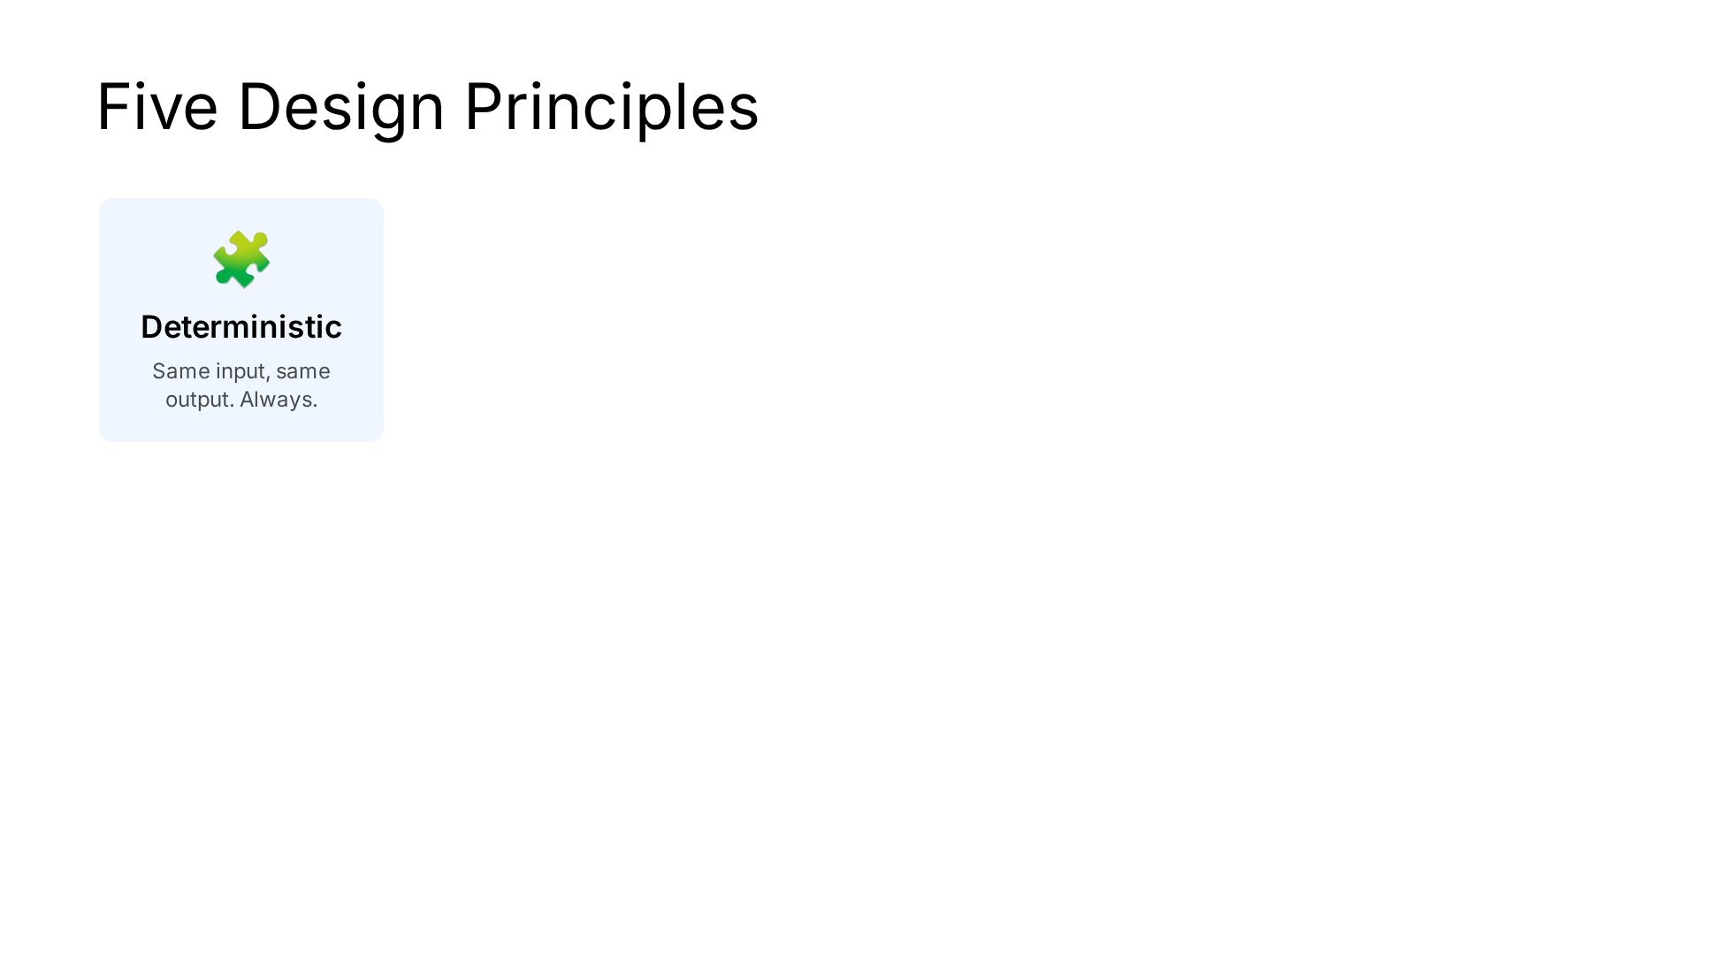
Notes:
The five pillars that every design decision comes back to.

Slide 17
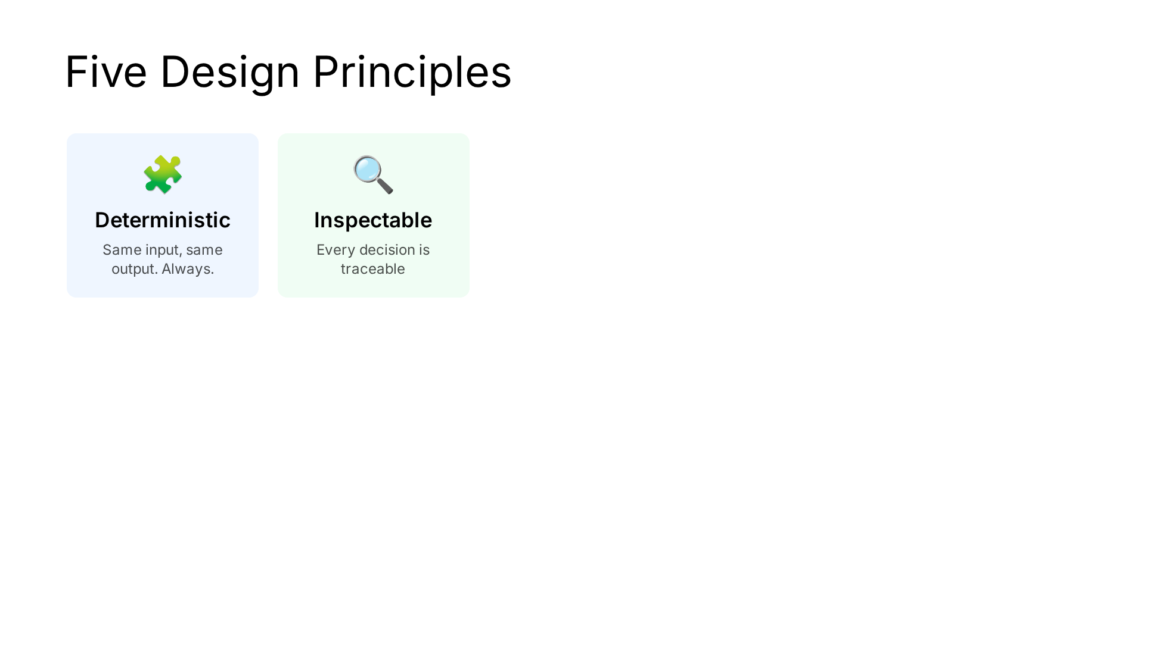
Notes:
The five pillars that every design decision comes back to.

Slide 18
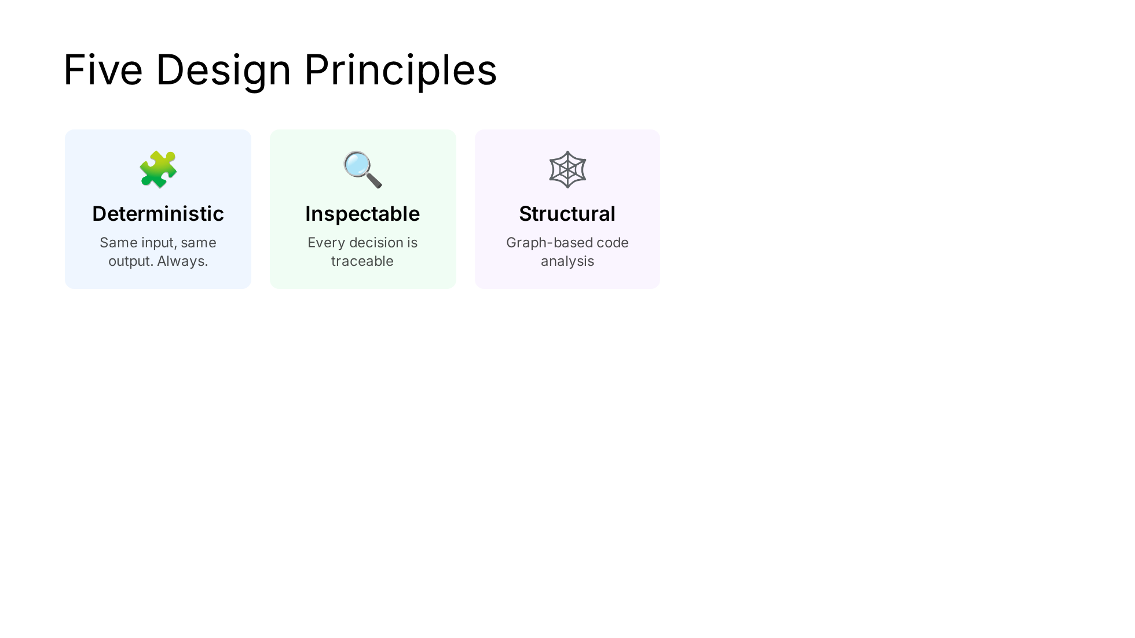
Notes:
The five pillars that every design decision comes back to.

Slide 19
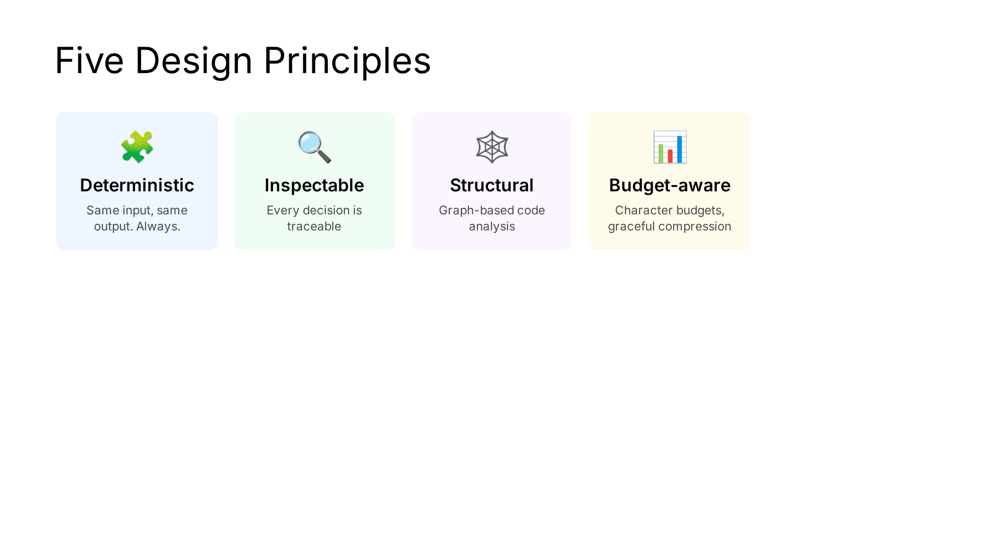
Notes:
The five pillars that every design decision comes back to.

Slide 20
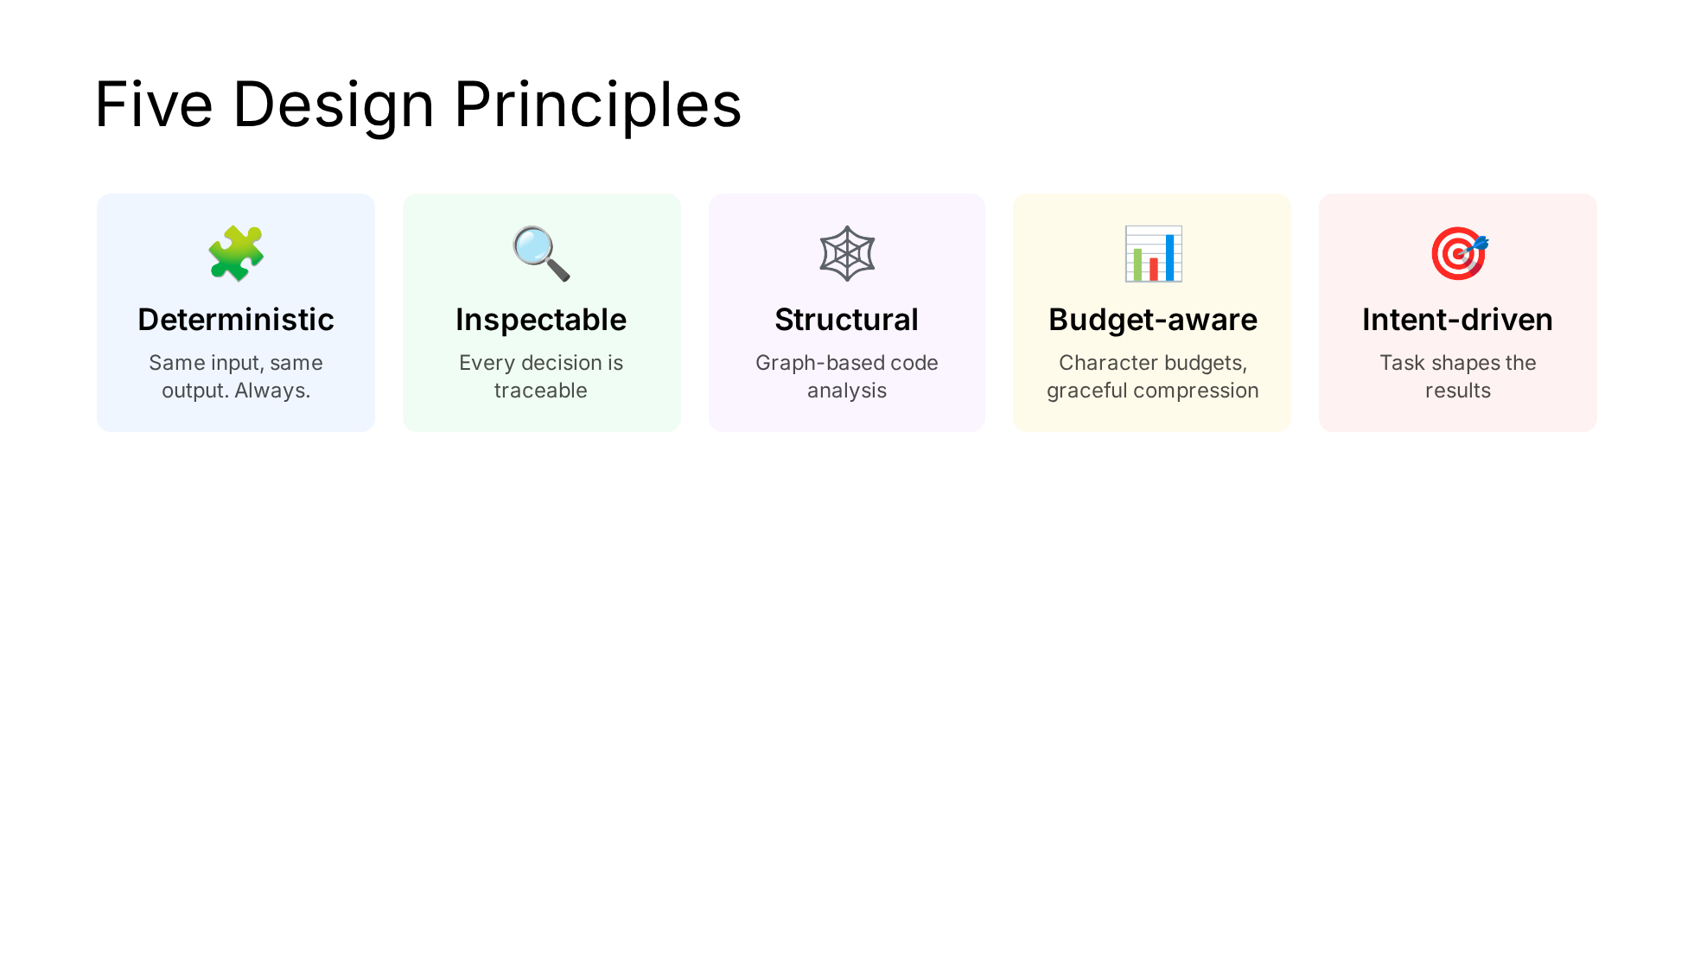
Notes:
The five pillars that every design decision comes back to.

Slide 21
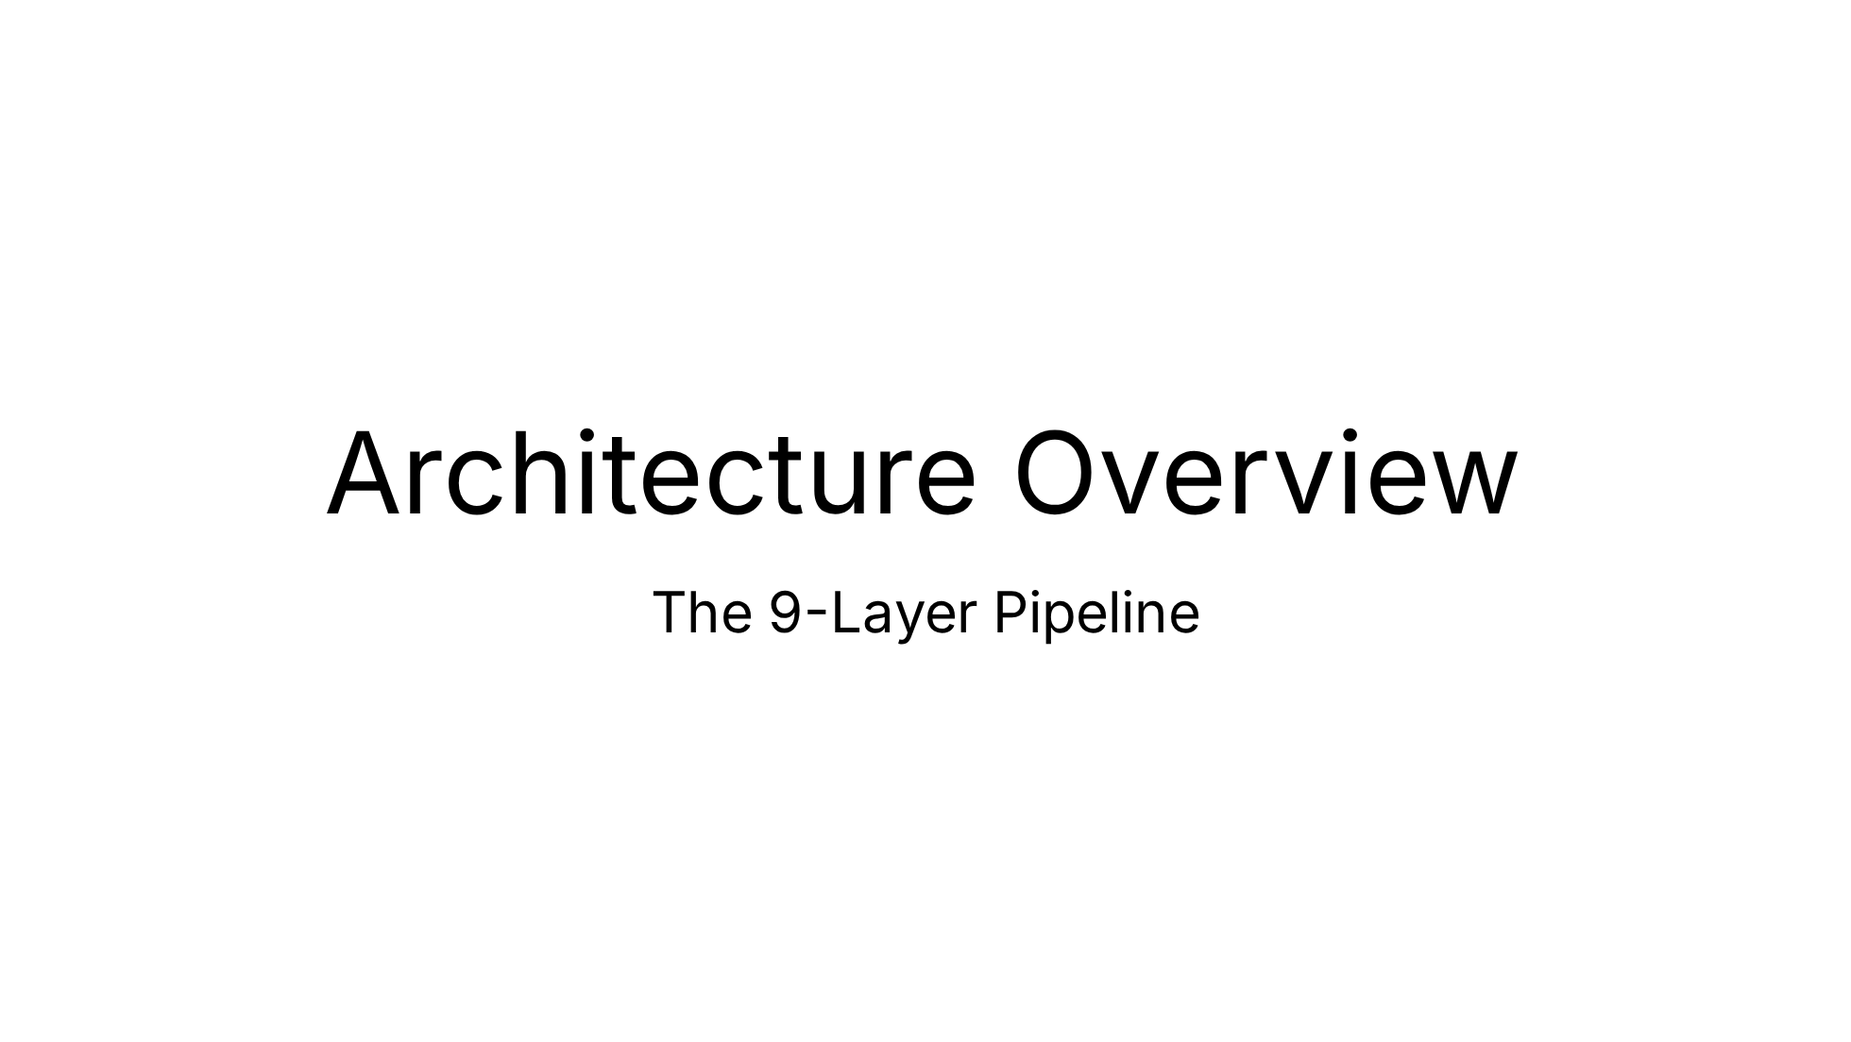

Slide 22
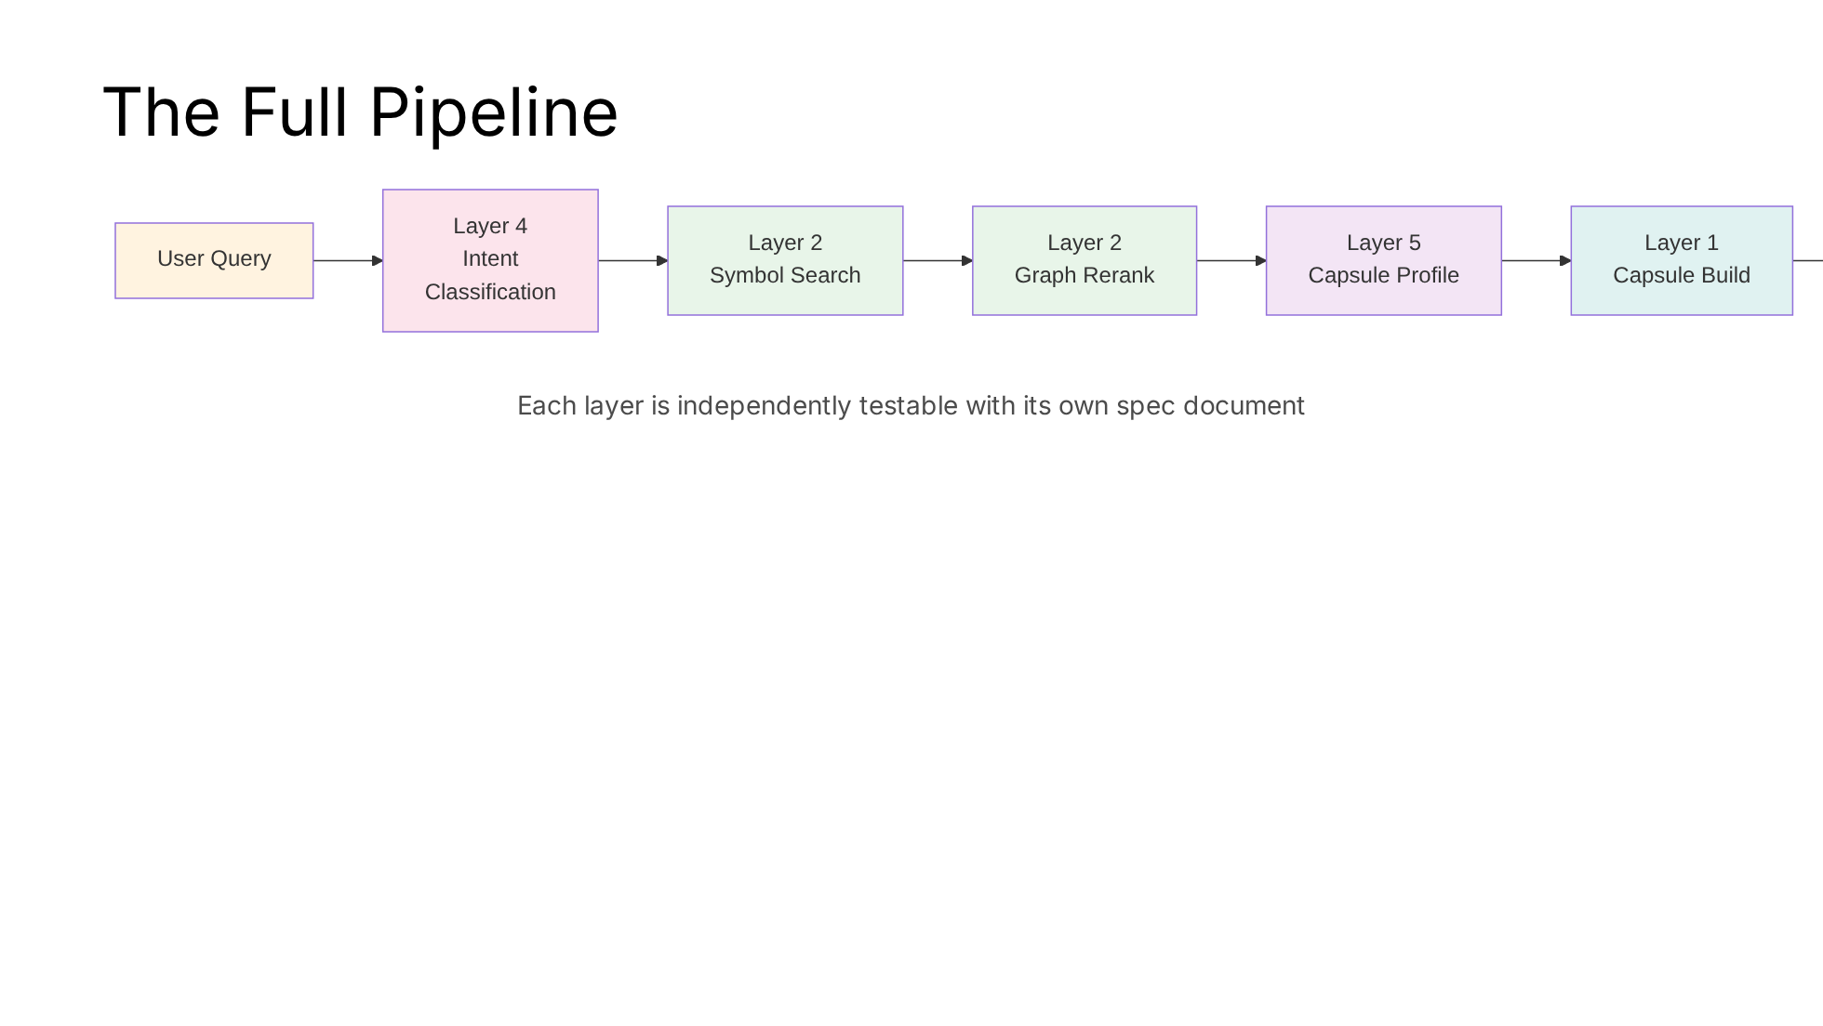
Notes:
The pipeline flows left to right. Note: layer numbers don't match execution order — they reflect the order they were built.

Slide 23
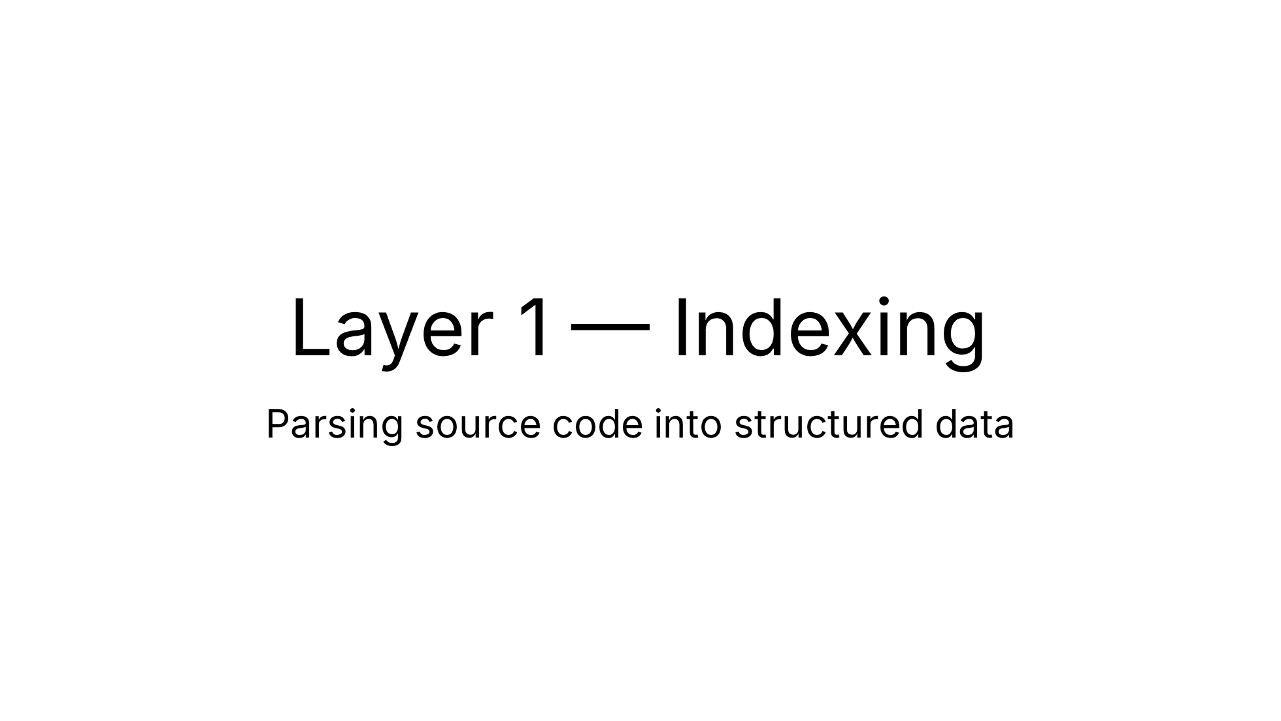

Slide 24
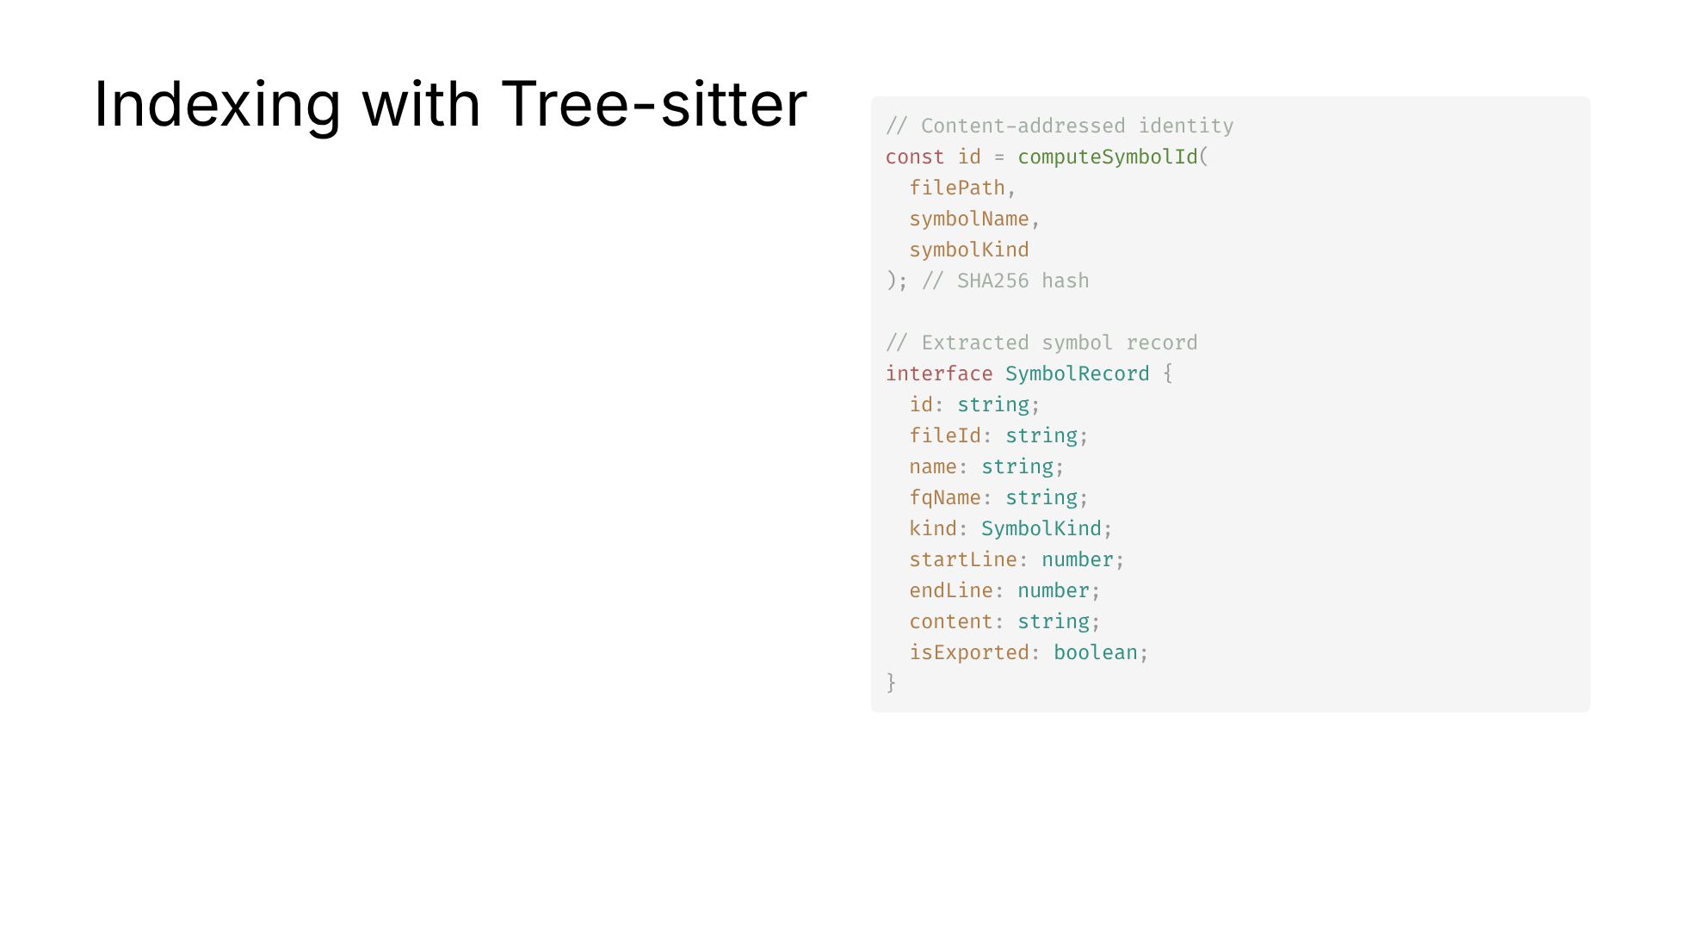
Notes:
Tree-sitter gives us incremental, error-tolerant parsing. Content-addressed IDs mean the same code always produces the same identity — crucial for diffing and caching.

Slide 25
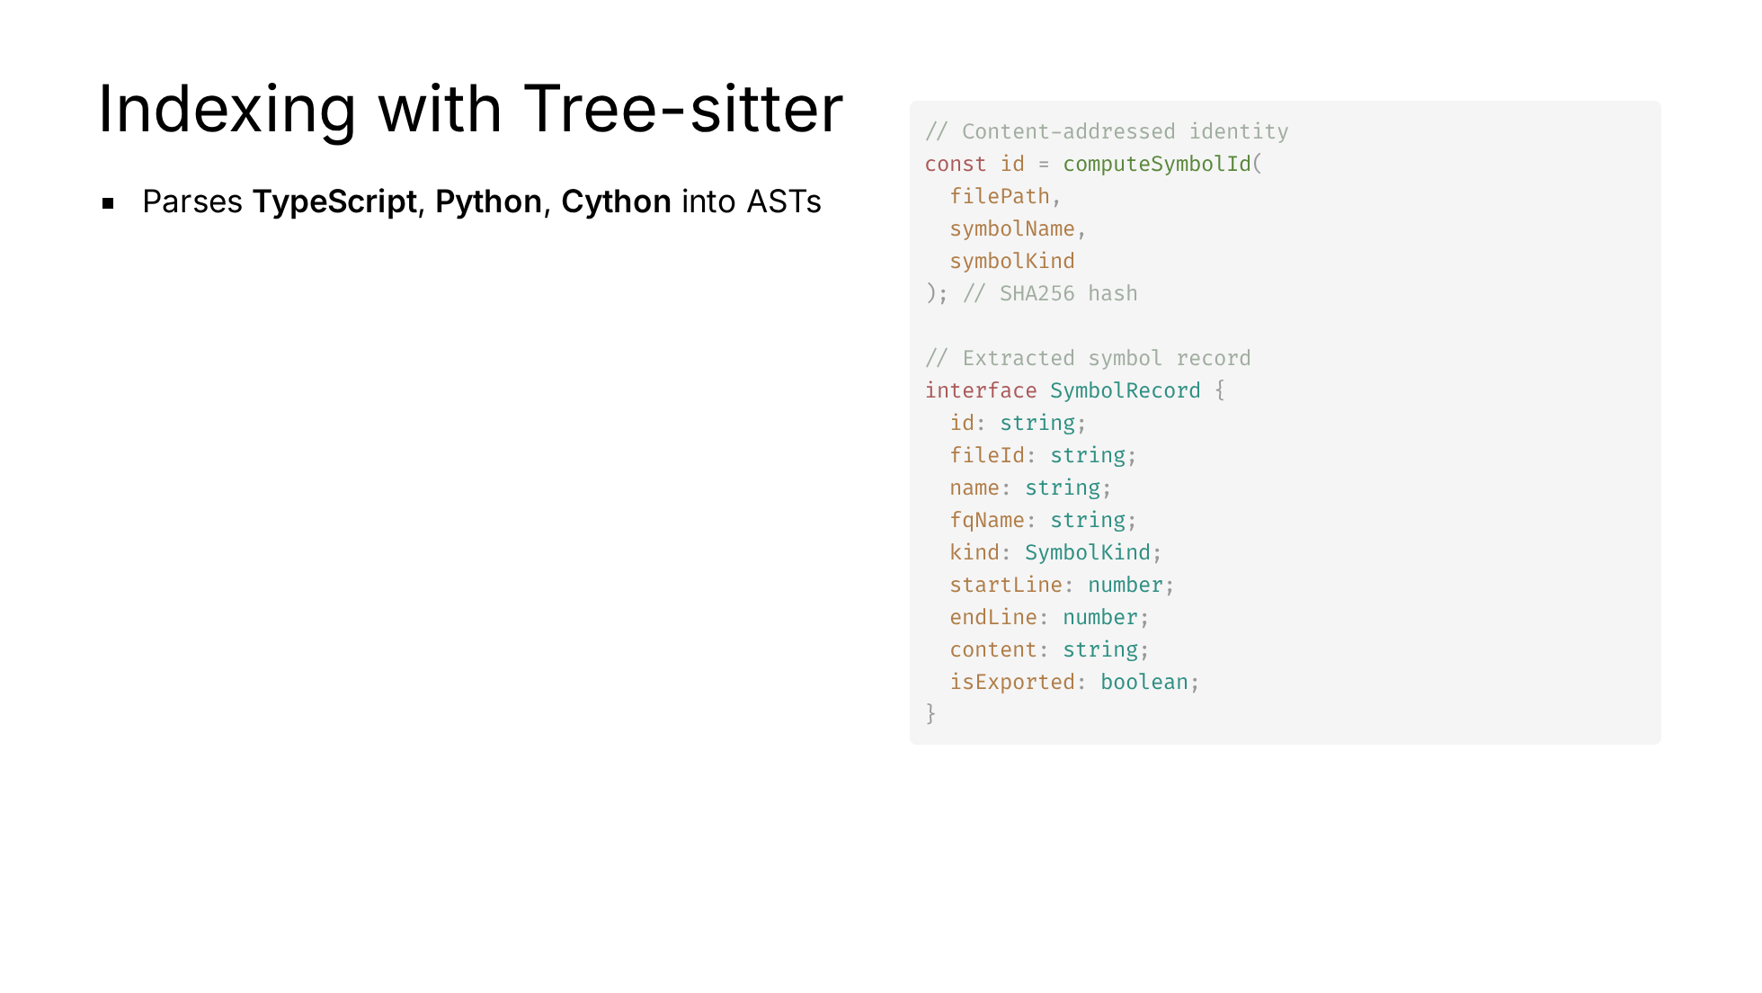
Notes:
Tree-sitter gives us incremental, error-tolerant parsing. Content-addressed IDs mean the same code always produces the same identity — crucial for diffing and caching.

Slide 26
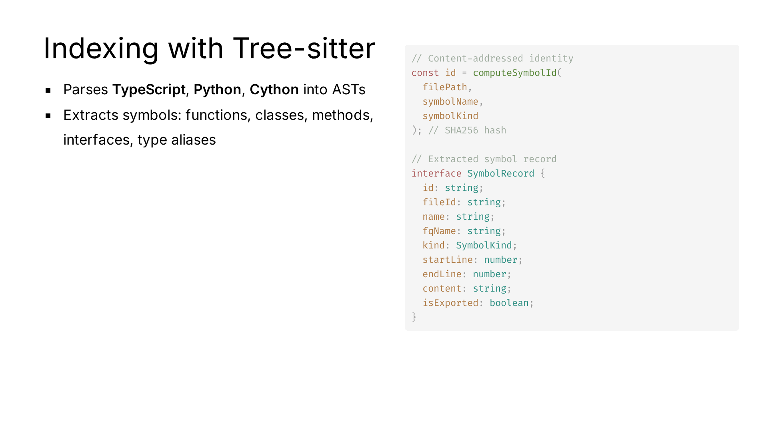
Notes:
Tree-sitter gives us incremental, error-tolerant parsing. Content-addressed IDs mean the same code always produces the same identity — crucial for diffing and caching.

Slide 27
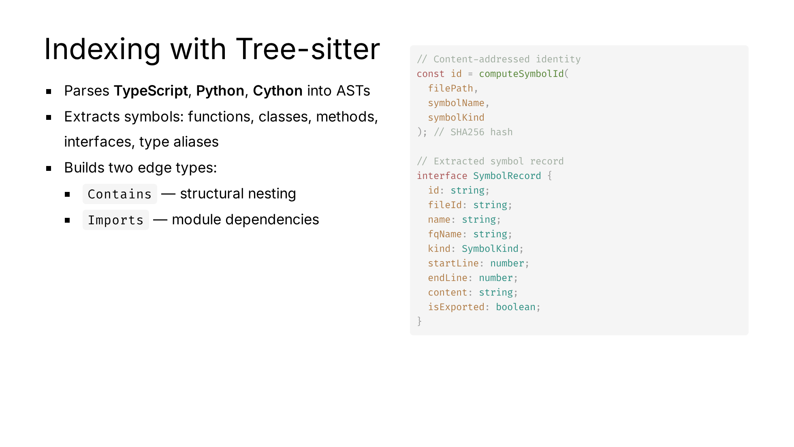
Notes:
Tree-sitter gives us incremental, error-tolerant parsing. Content-addressed IDs mean the same code always produces the same identity — crucial for diffing and caching.

Slide 28
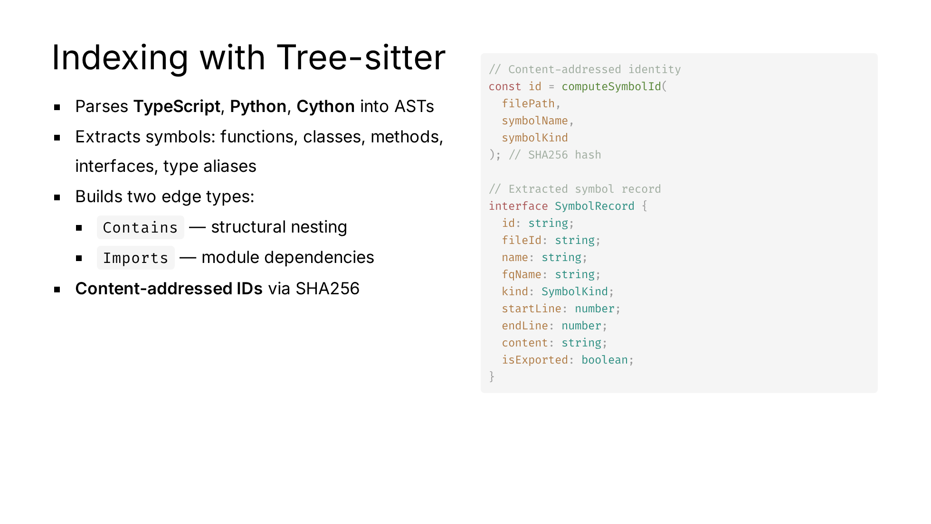
Notes:
Tree-sitter gives us incremental, error-tolerant parsing. Content-addressed IDs mean the same code always produces the same identity — crucial for diffing and caching.

Slide 29
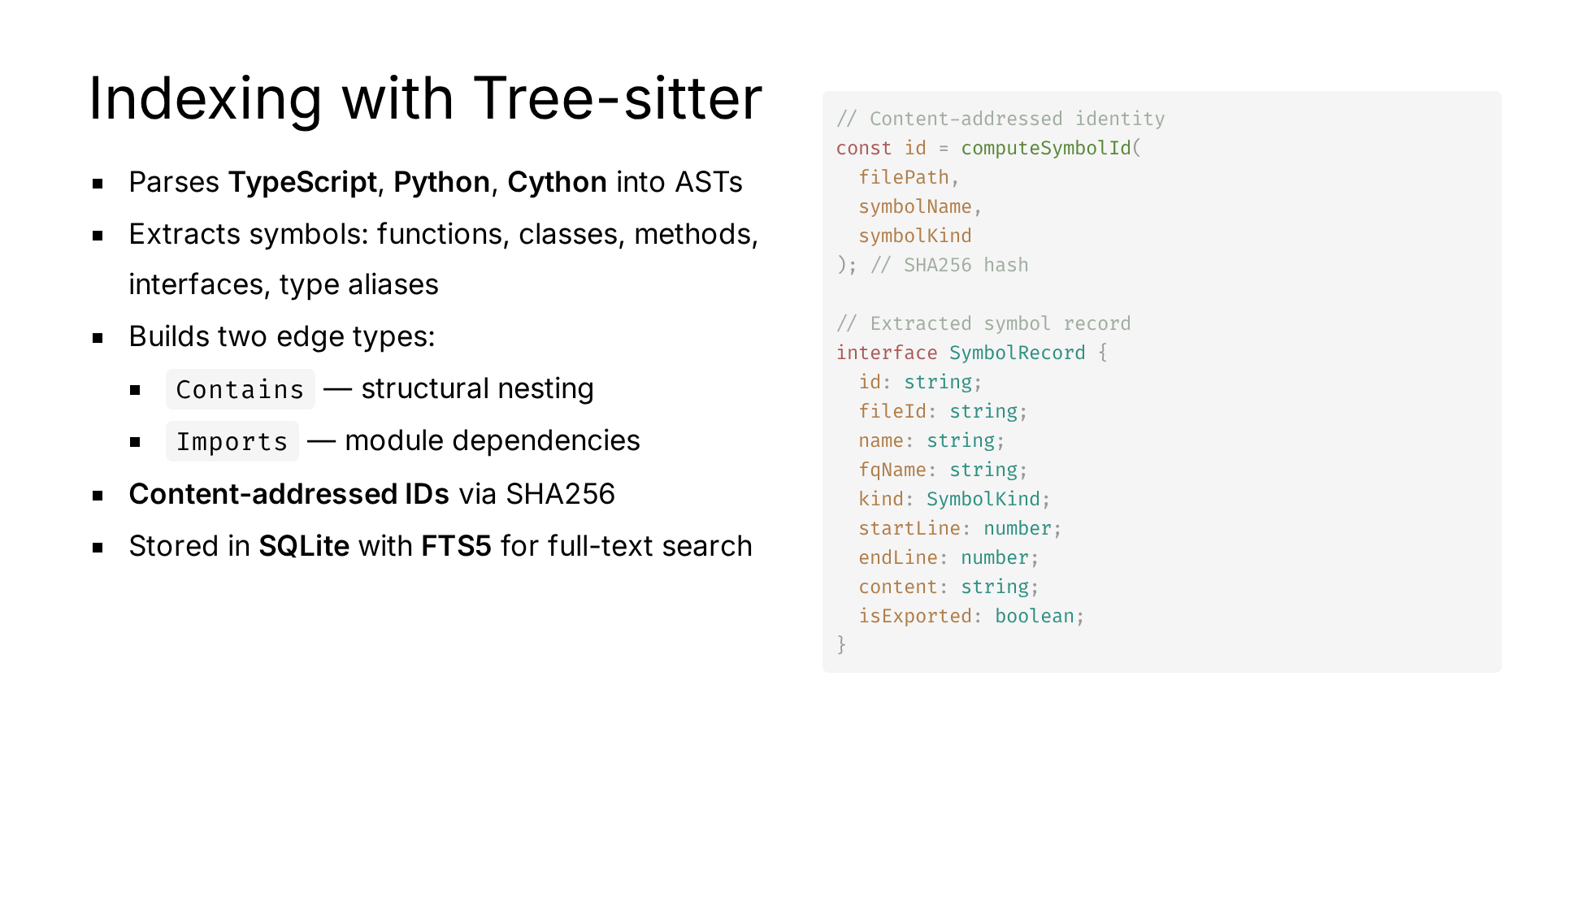
Notes:
Tree-sitter gives us incremental, error-tolerant parsing. Content-addressed IDs mean the same code always produces the same identity — crucial for diffing and caching.

Slide 30
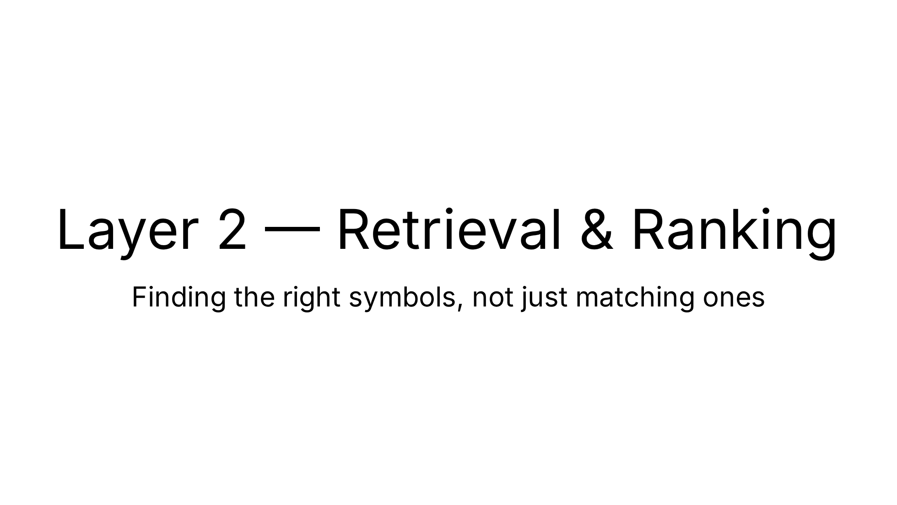

Slide 31

Notes:
The two-stage approach: first find candidates via text matching, then rerank using structural graph relationships. This is what makes vexb structure-aware.

Slide 32
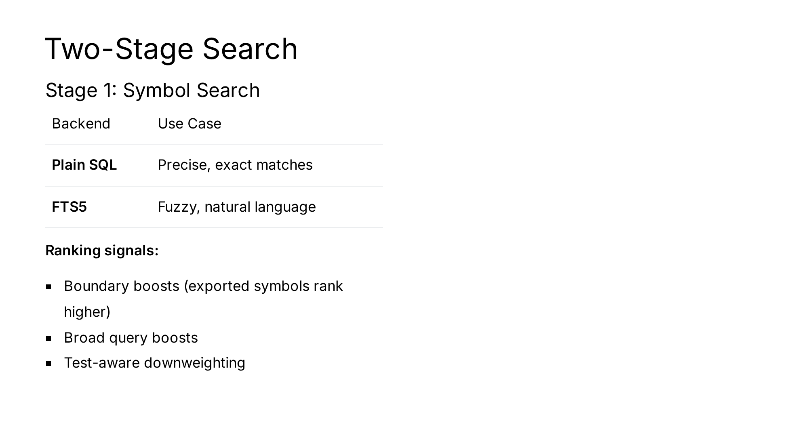
Notes:
The two-stage approach: first find candidates via text matching, then rerank using structural graph relationships. This is what makes vexb structure-aware.

Slide 33
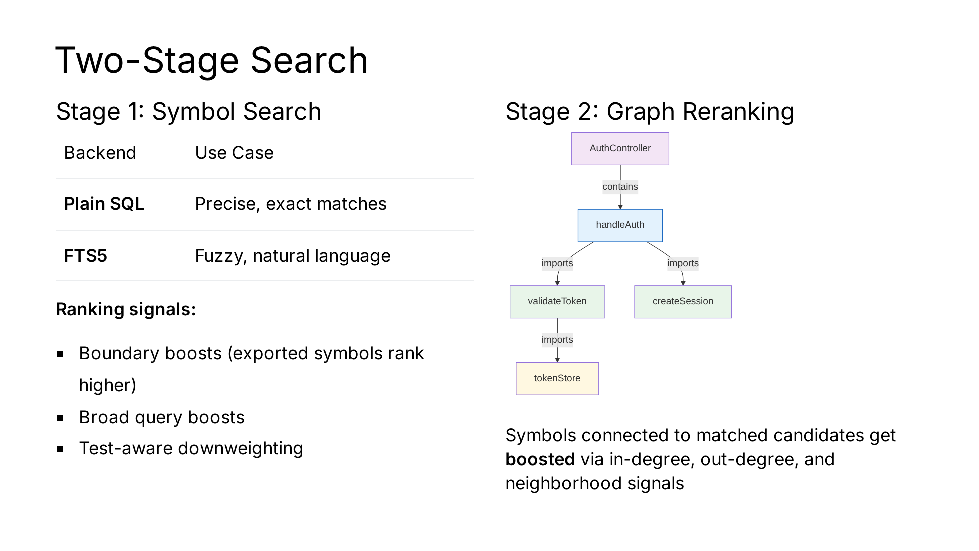
Notes:
The two-stage approach: first find candidates via text matching, then rerank using structural graph relationships. This is what makes vexb structure-aware.

Slide 34
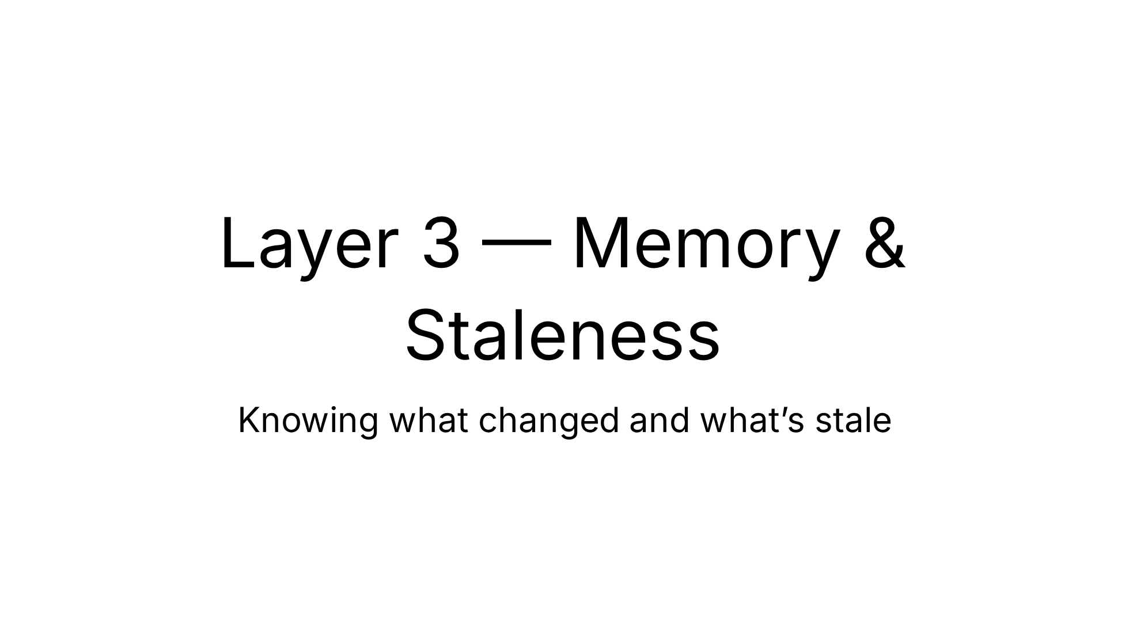

Slide 35
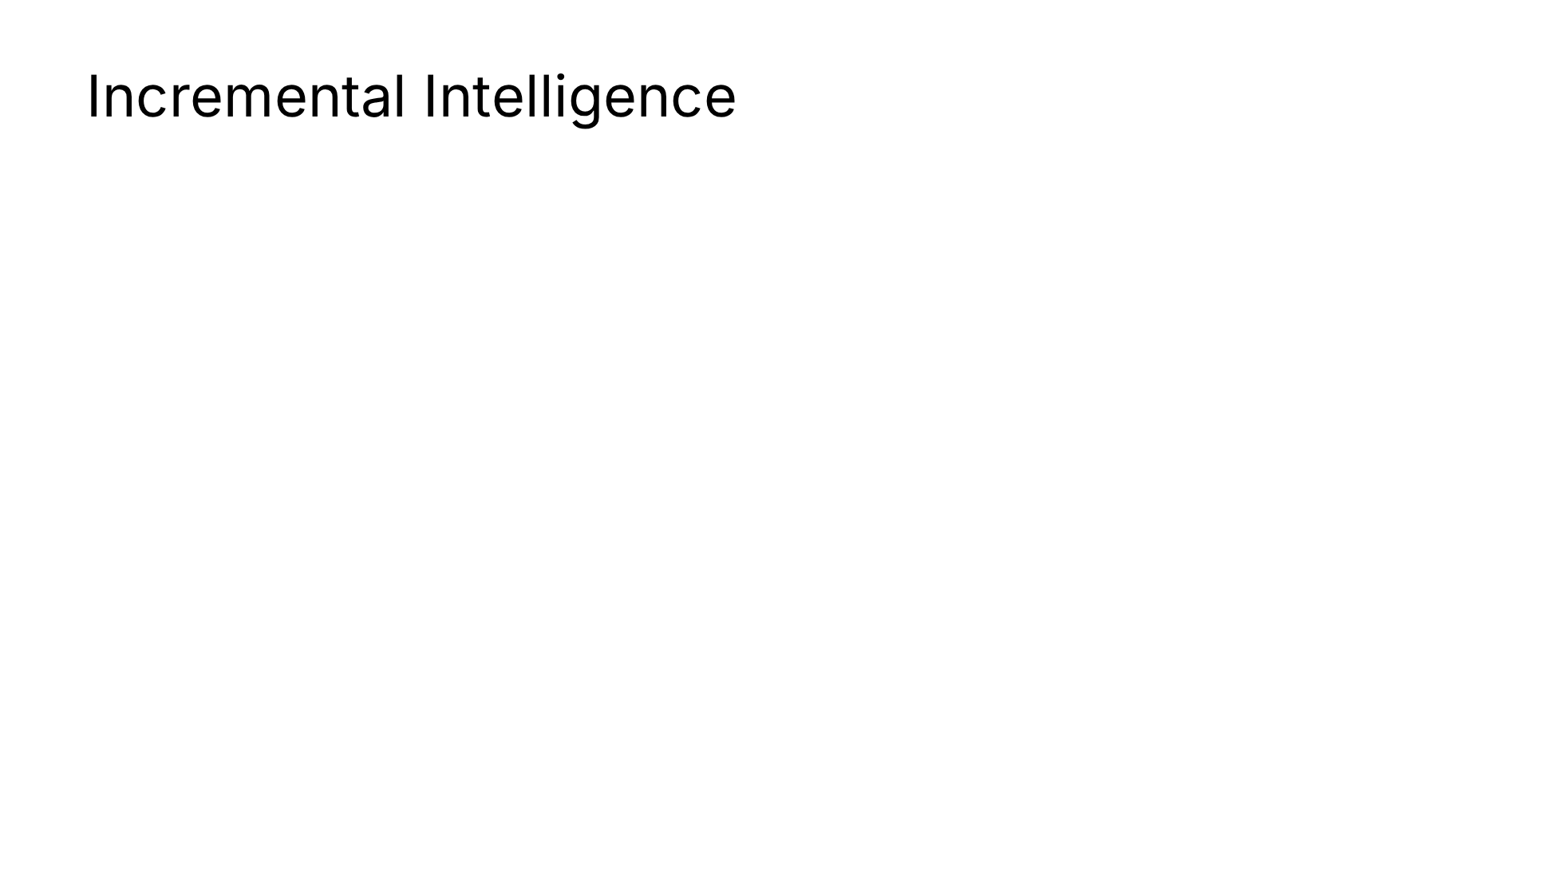
Notes:
Staleness tracking avoids rebuilding capsules when nothing relevant has changed — a significant efficiency win for large repos.

Slide 36
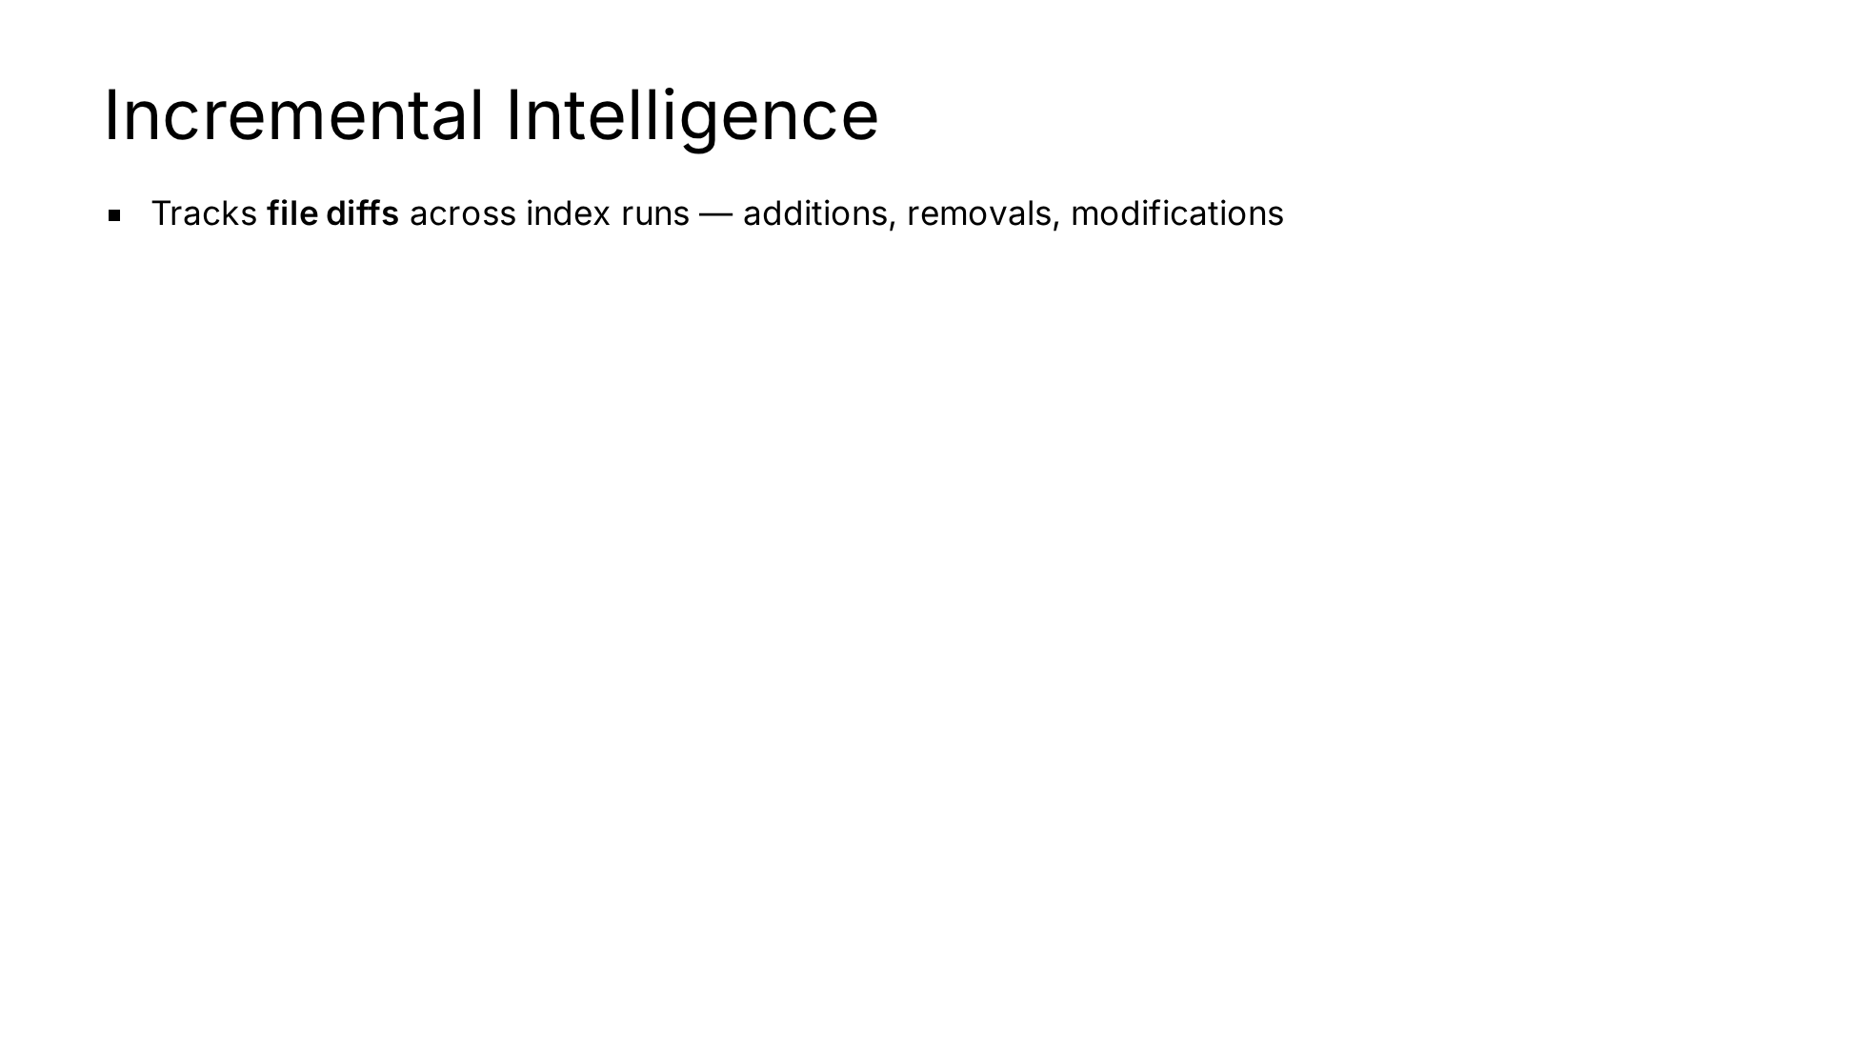
Notes:
Staleness tracking avoids rebuilding capsules when nothing relevant has changed — a significant efficiency win for large repos.

Slide 37
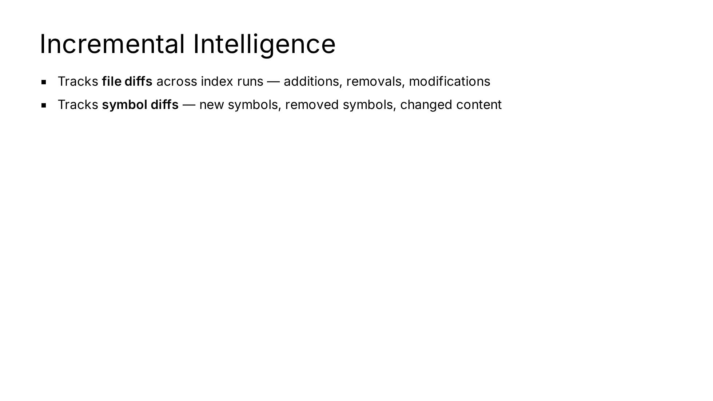
Notes:
Staleness tracking avoids rebuilding capsules when nothing relevant has changed — a significant efficiency win for large repos.

Slide 38
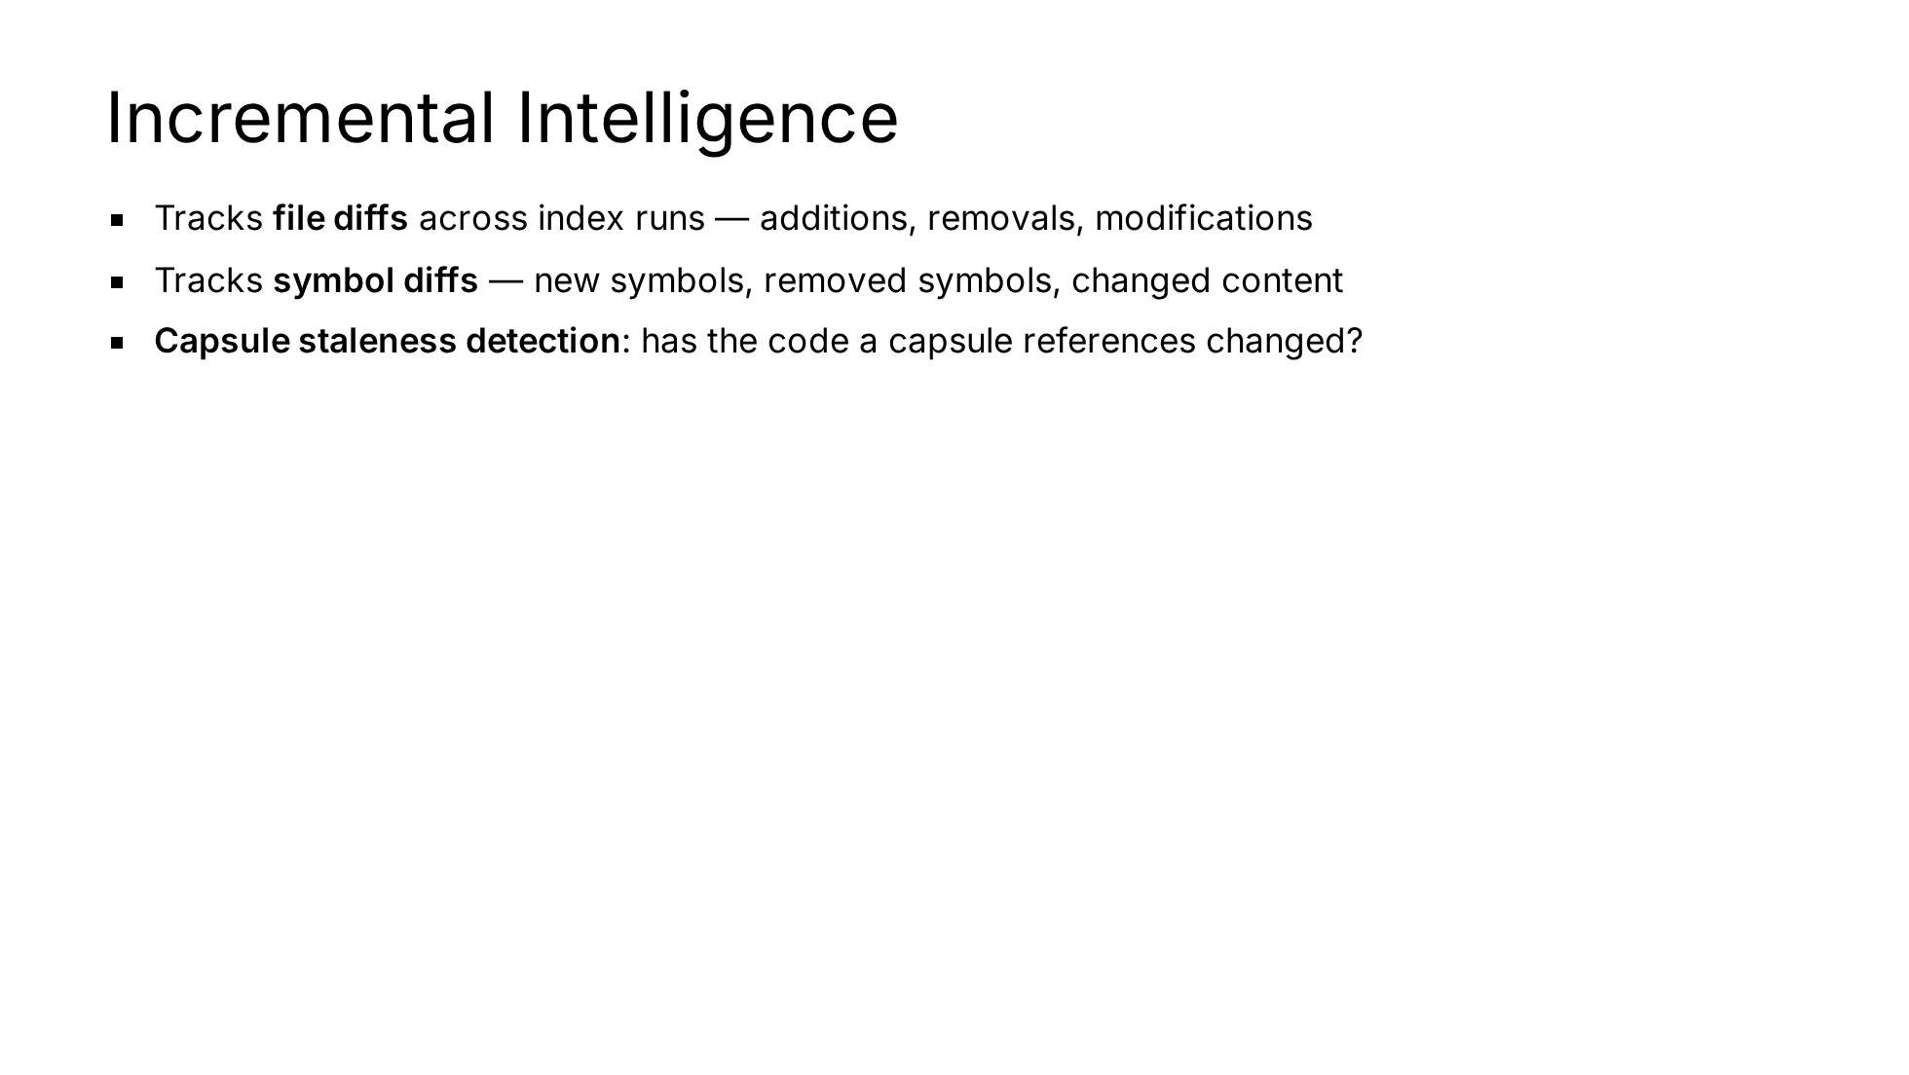
Notes:
Staleness tracking avoids rebuilding capsules when nothing relevant has changed — a significant efficiency win for large repos.

Slide 39
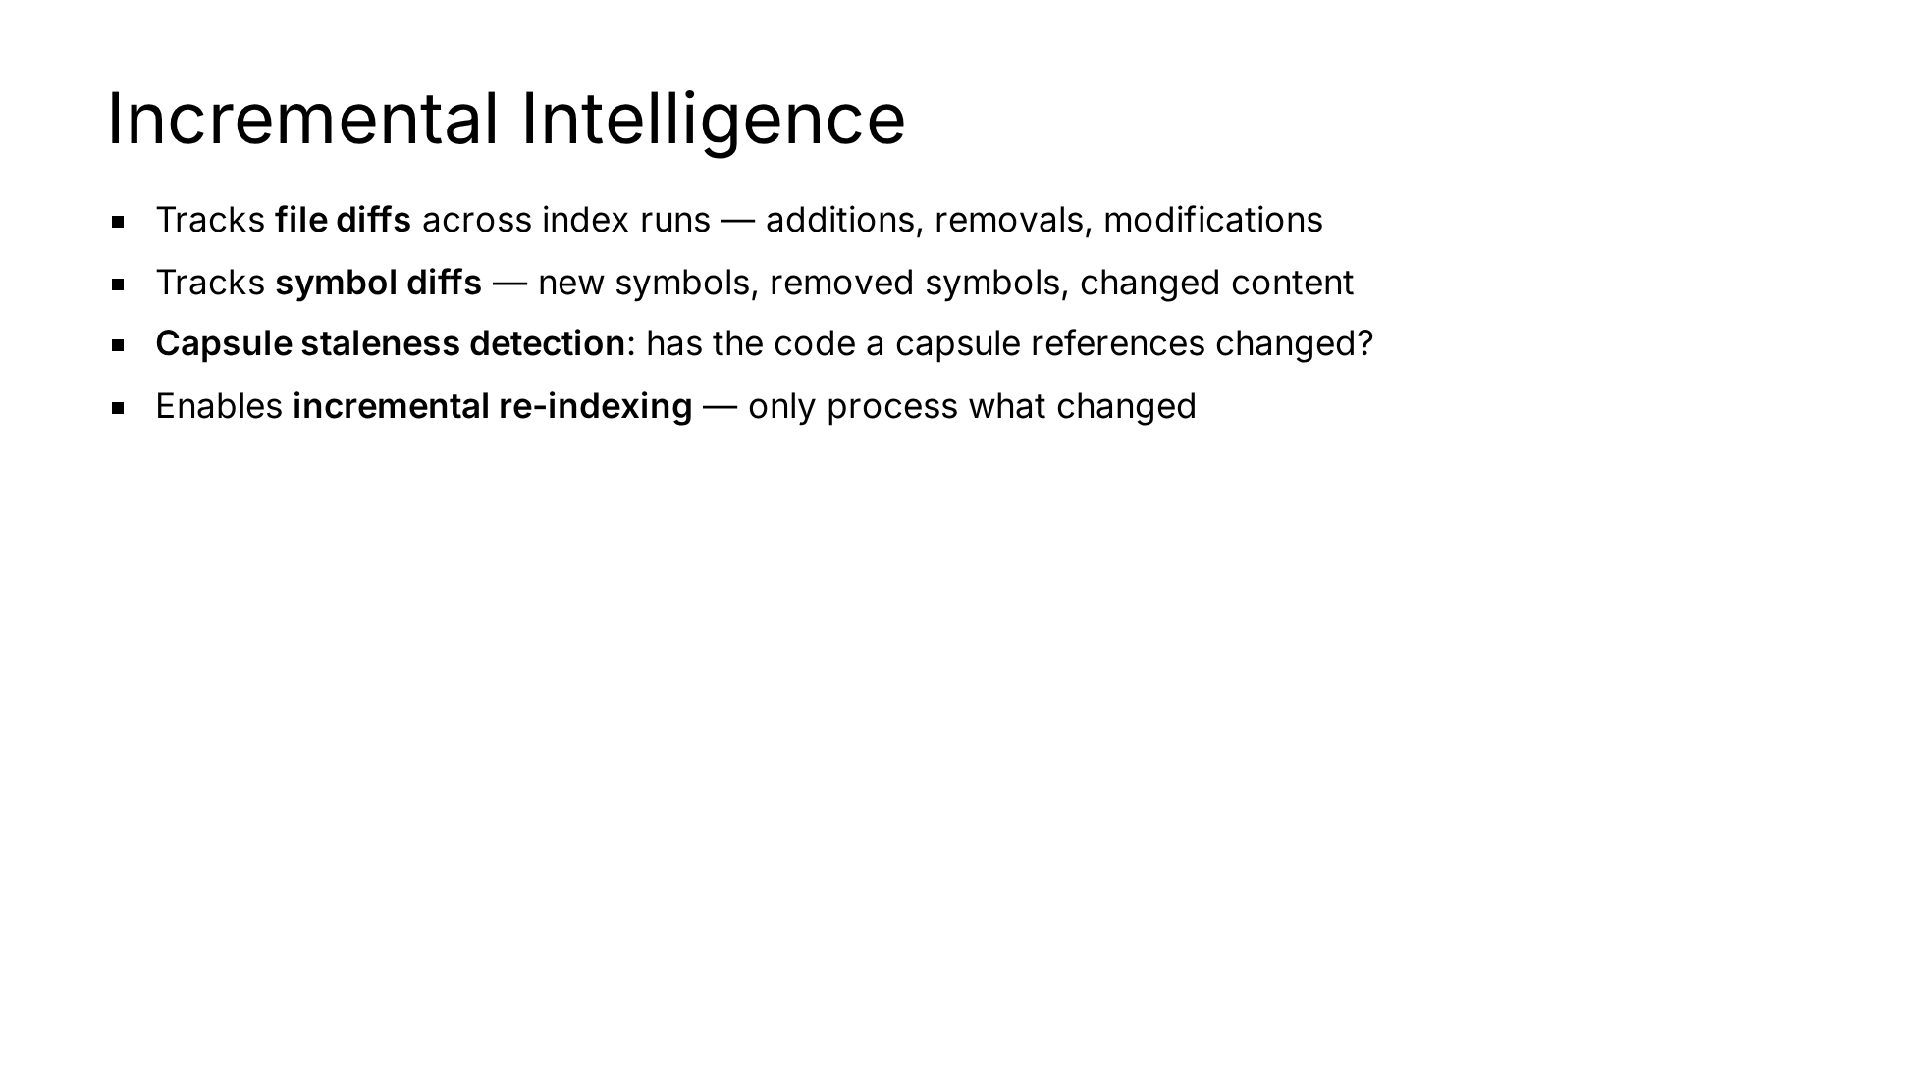
Notes:
Staleness tracking avoids rebuilding capsules when nothing relevant has changed — a significant efficiency win for large repos.

Slide 40
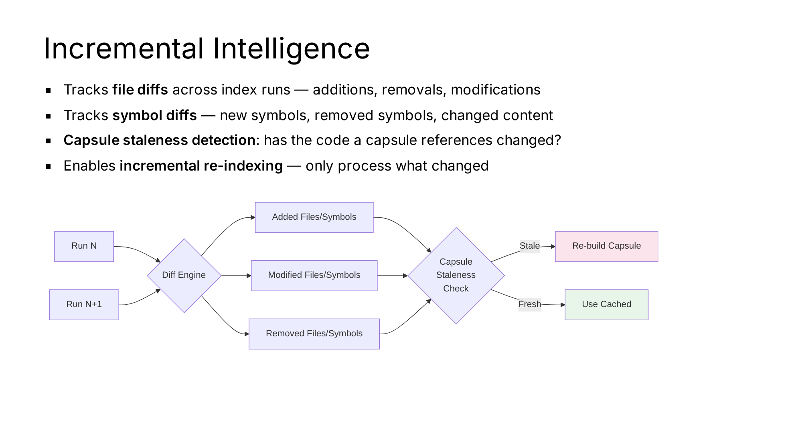
Notes:
Staleness tracking avoids rebuilding capsules when nothing relevant has changed — a significant efficiency win for large repos.

Slide 41
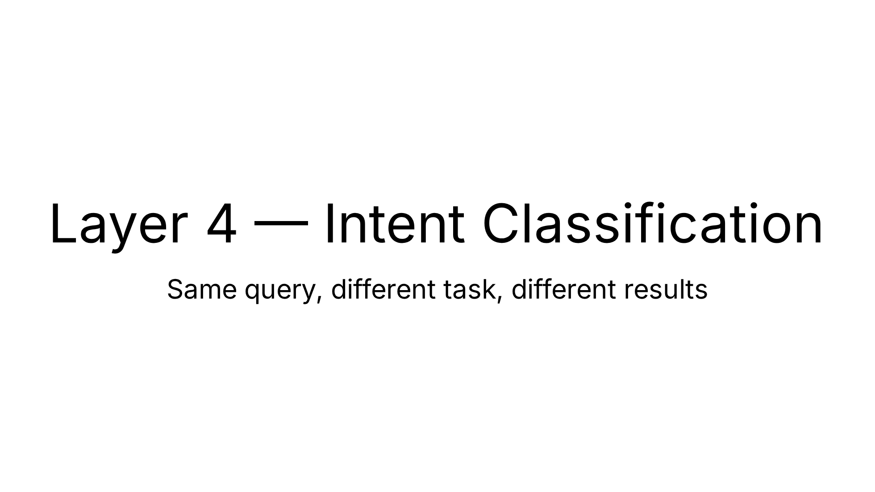

Slide 42
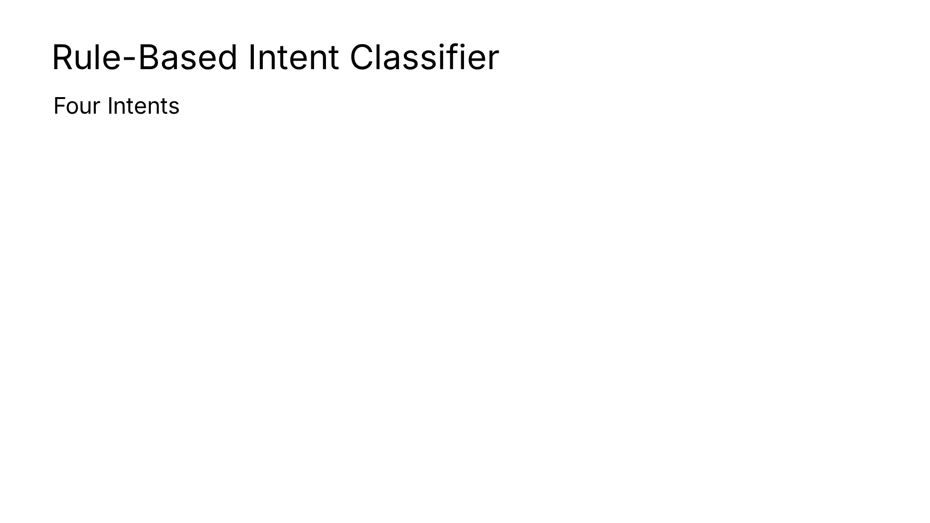
Notes:
This is one of vexb's most distinctive design choices — intent shapes everything downstream. No ML means this runs in microseconds.

Slide 43
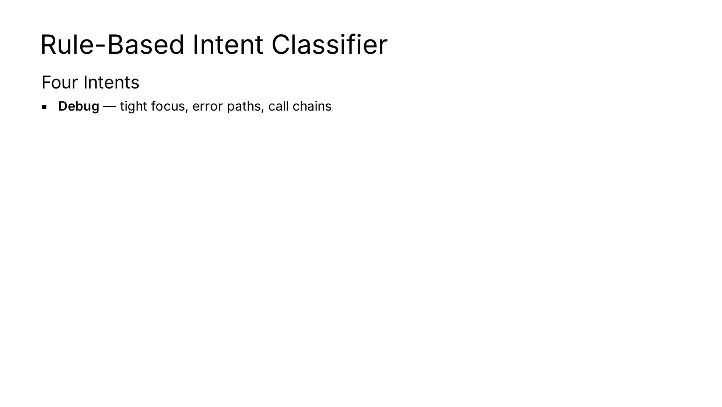
Notes:
This is one of vexb's most distinctive design choices — intent shapes everything downstream. No ML means this runs in microseconds.

Slide 44
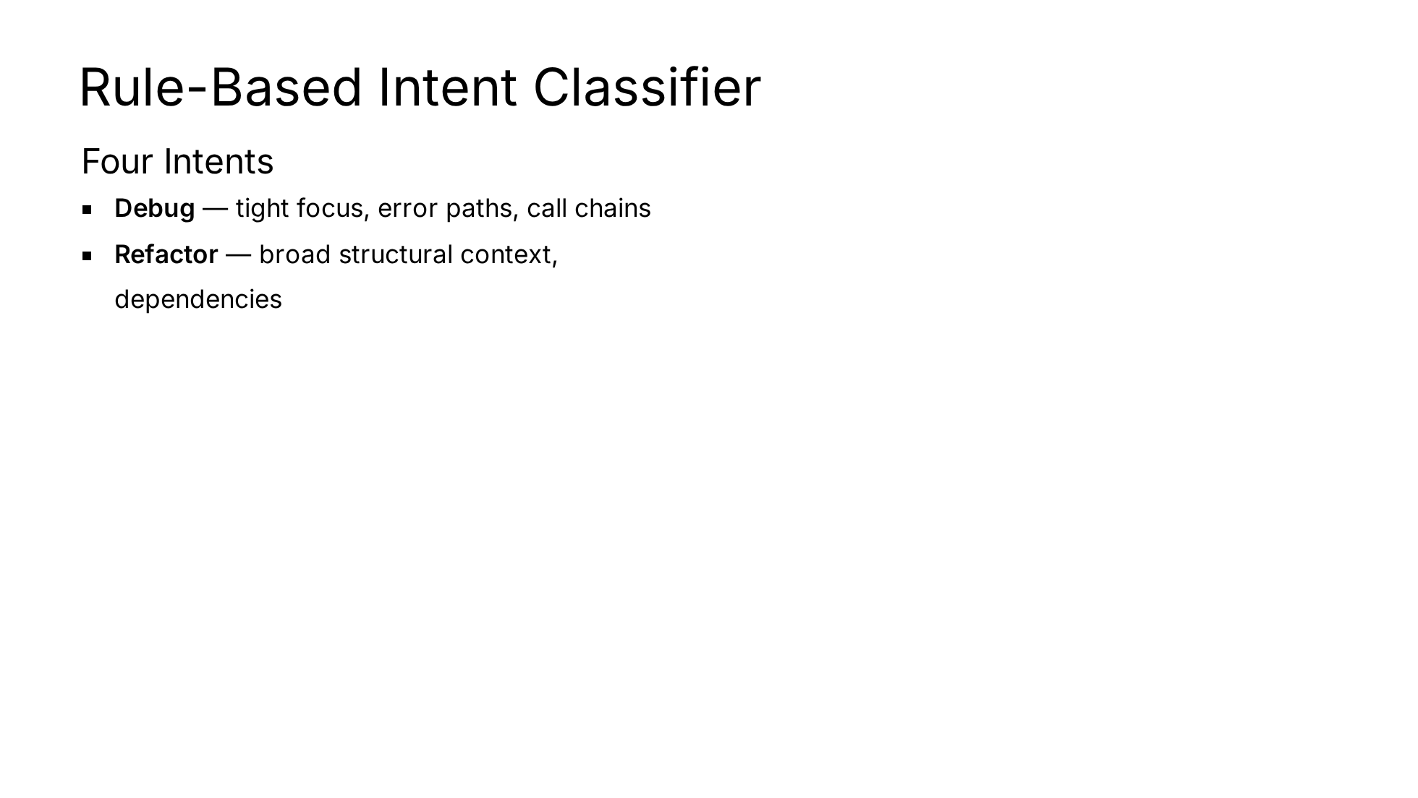
Notes:
This is one of vexb's most distinctive design choices — intent shapes everything downstream. No ML means this runs in microseconds.

Slide 45
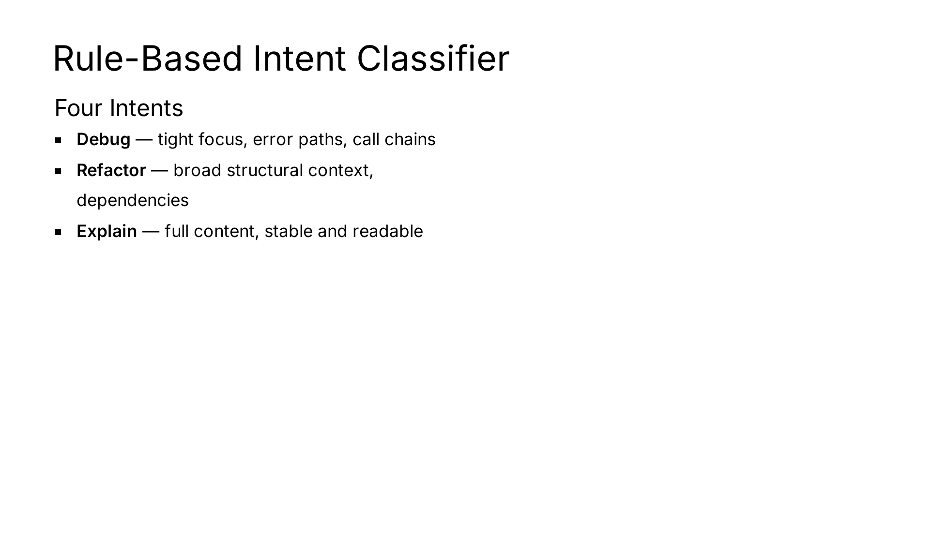
Notes:
This is one of vexb's most distinctive design choices — intent shapes everything downstream. No ML means this runs in microseconds.

Slide 46
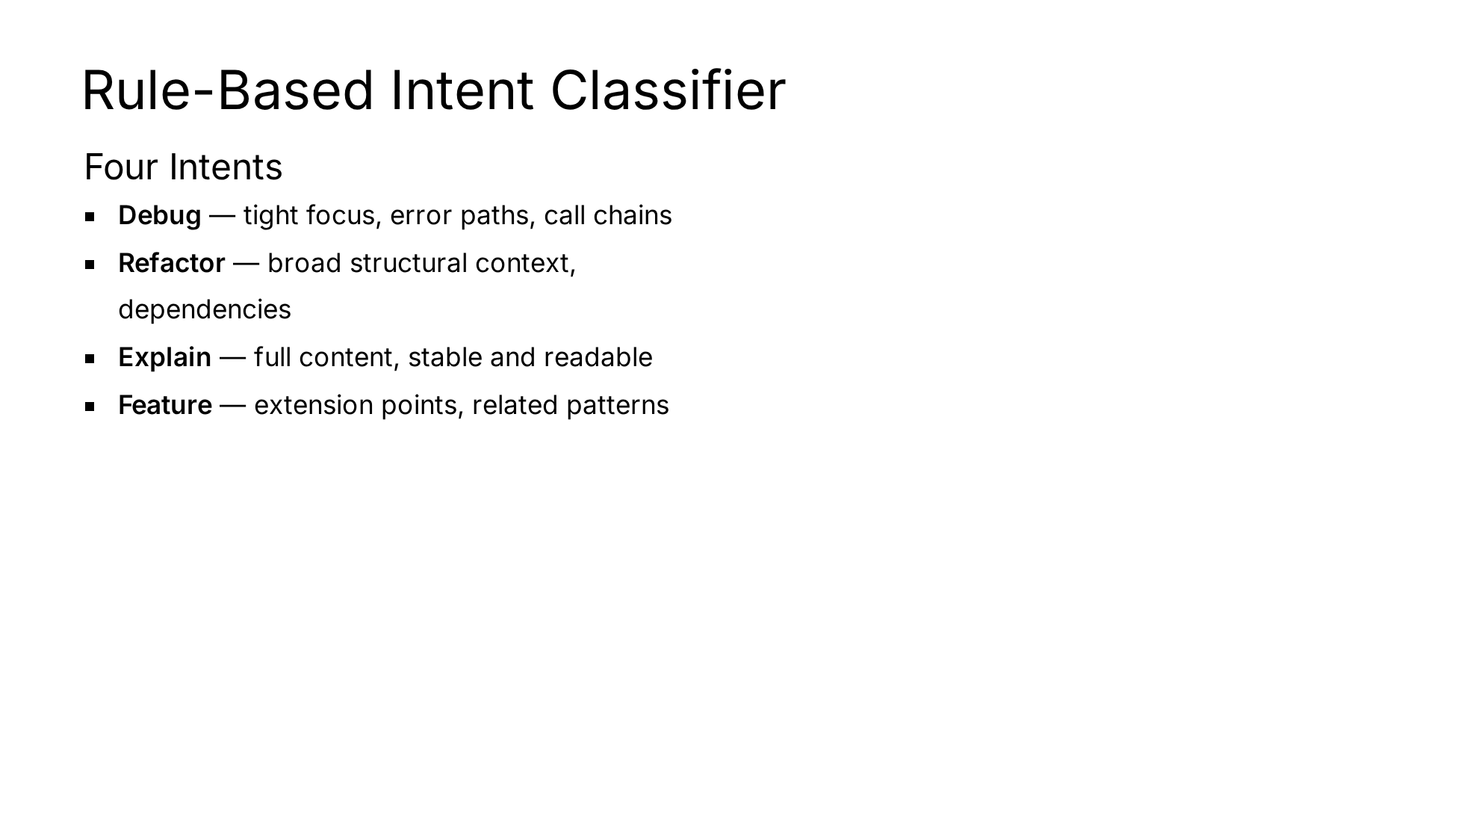
Notes:
This is one of vexb's most distinctive design choices — intent shapes everything downstream. No ML means this runs in microseconds.

Slide 47
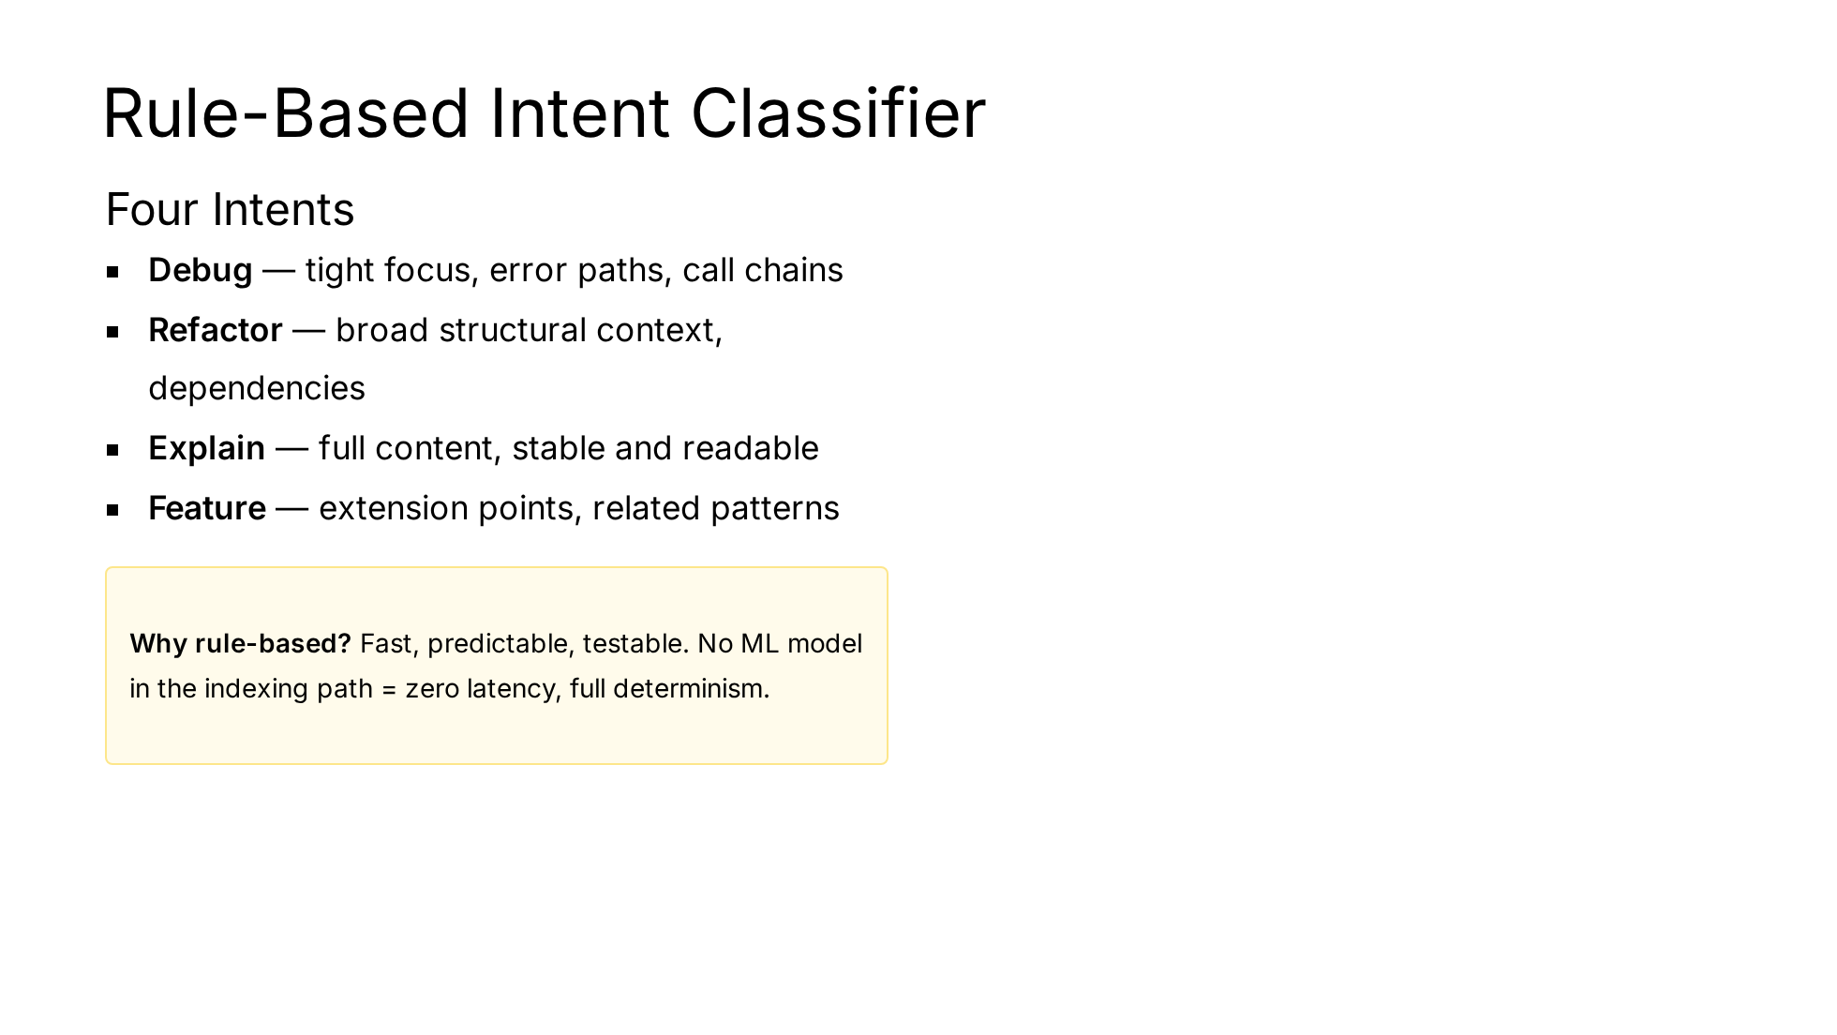
Notes:
This is one of vexb's most distinctive design choices — intent shapes everything downstream. No ML means this runs in microseconds.

Slide 48
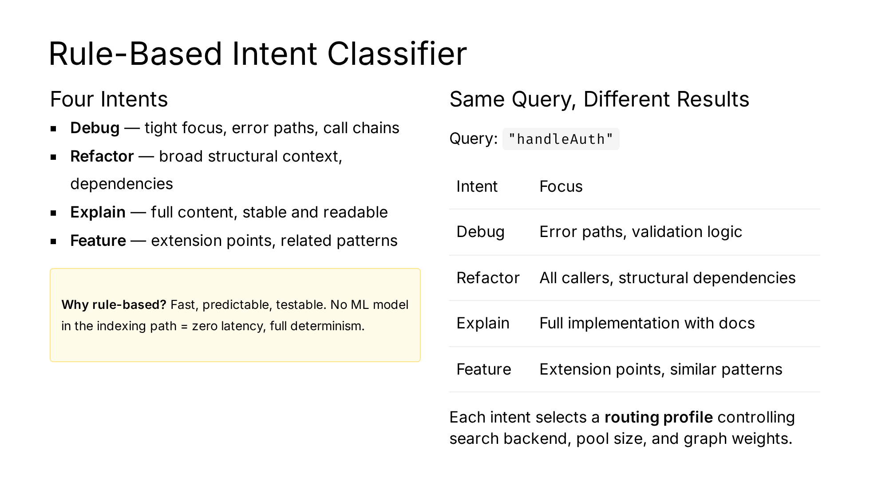
Notes:
This is one of vexb's most distinctive design choices — intent shapes everything downstream. No ML means this runs in microseconds.

Slide 49
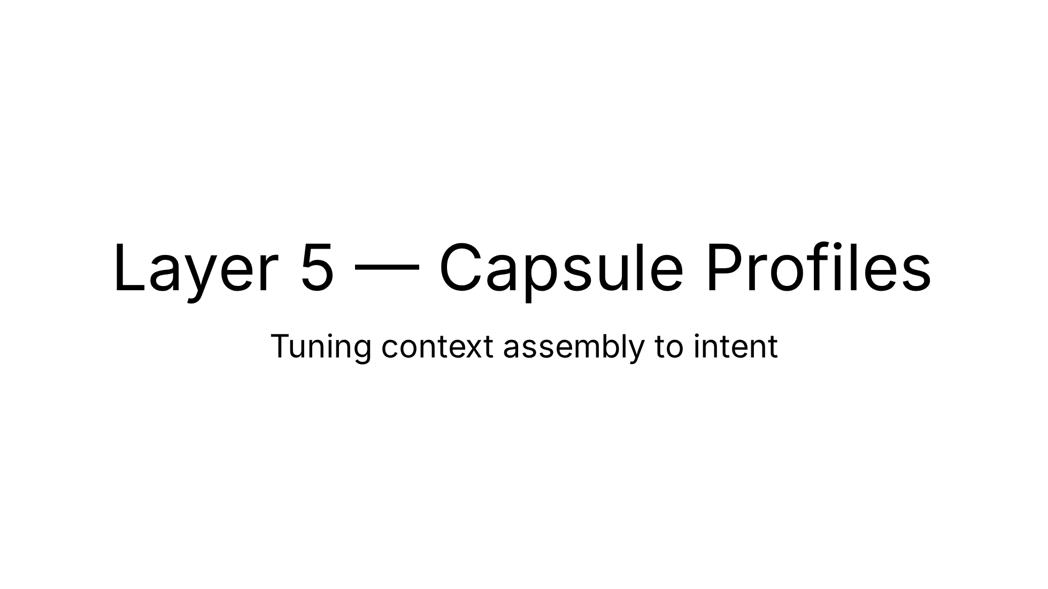

Slide 50
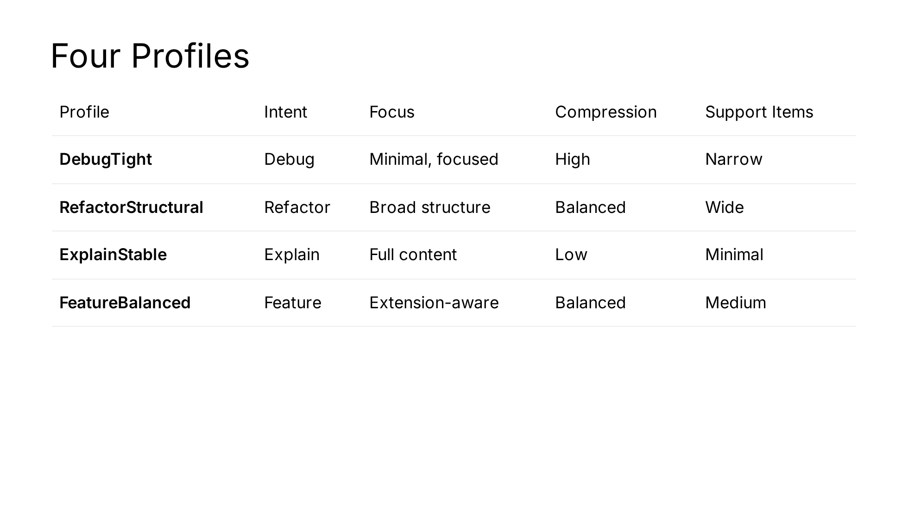
Notes:
Profiles are the bridge between intent classification and capsule assembly — they translate "what kind of task" into "how to build context."

Slide 51
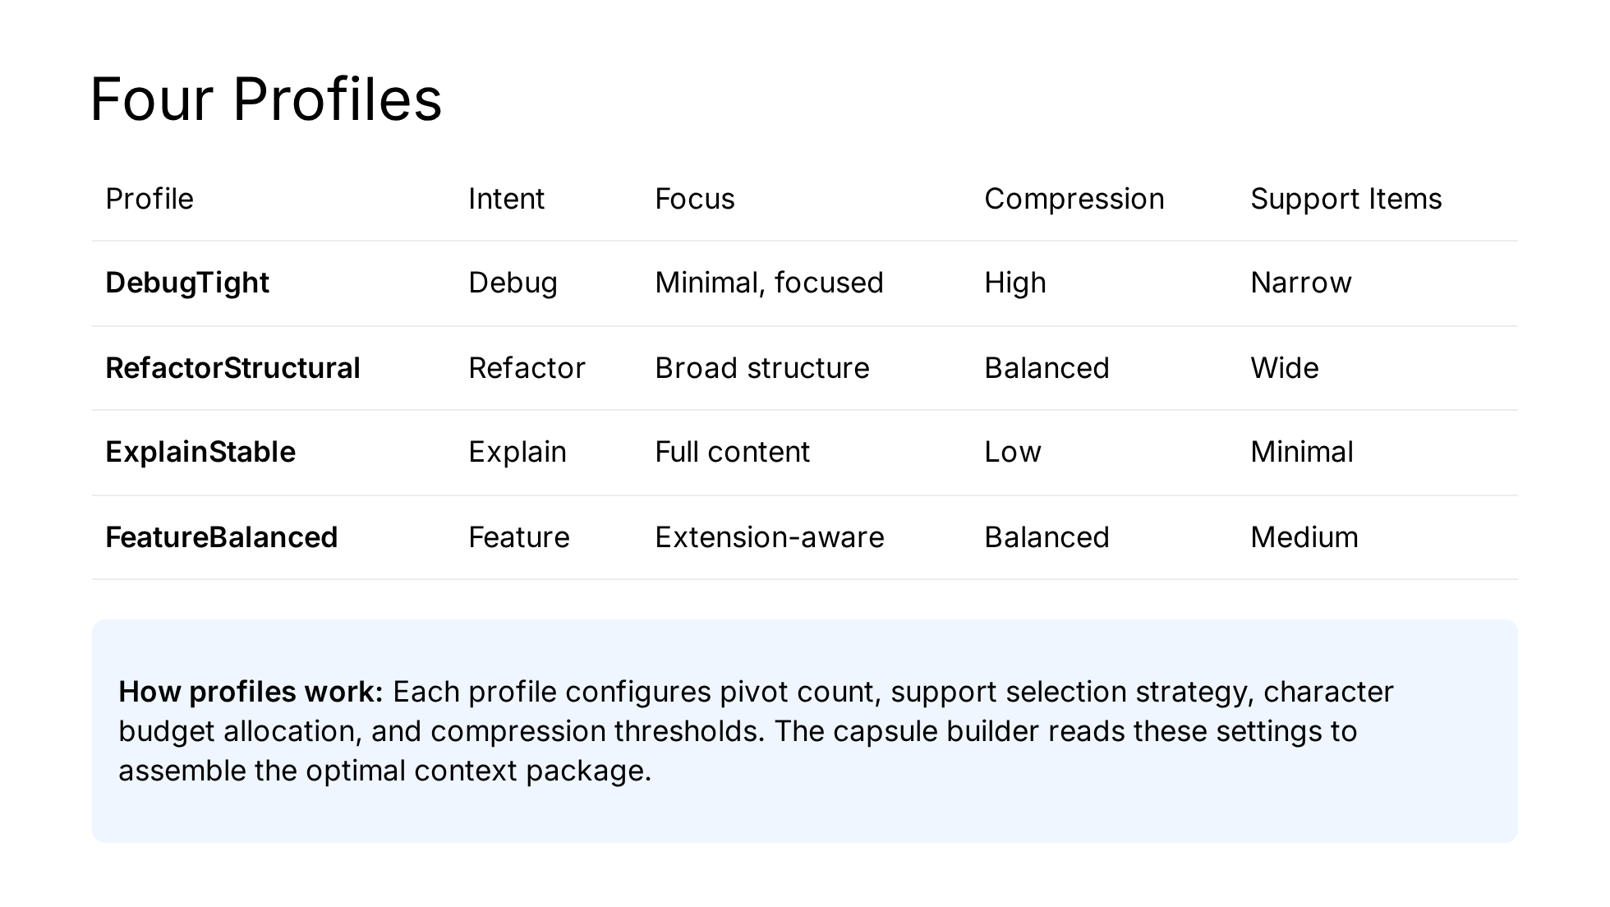
Notes:
Profiles are the bridge between intent classification and capsule assembly — they translate "what kind of task" into "how to build context."

Slide 52
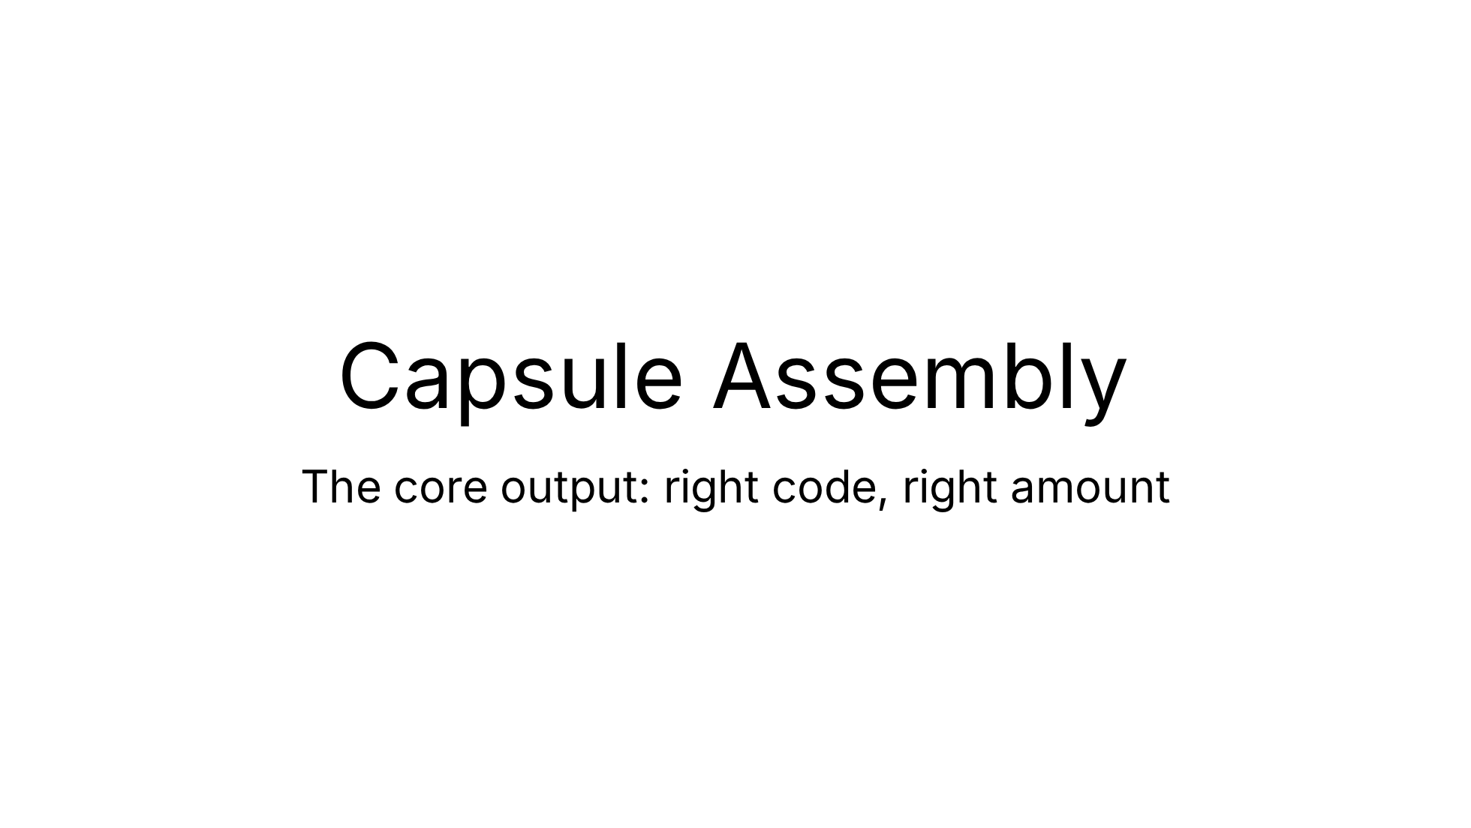

Slide 53
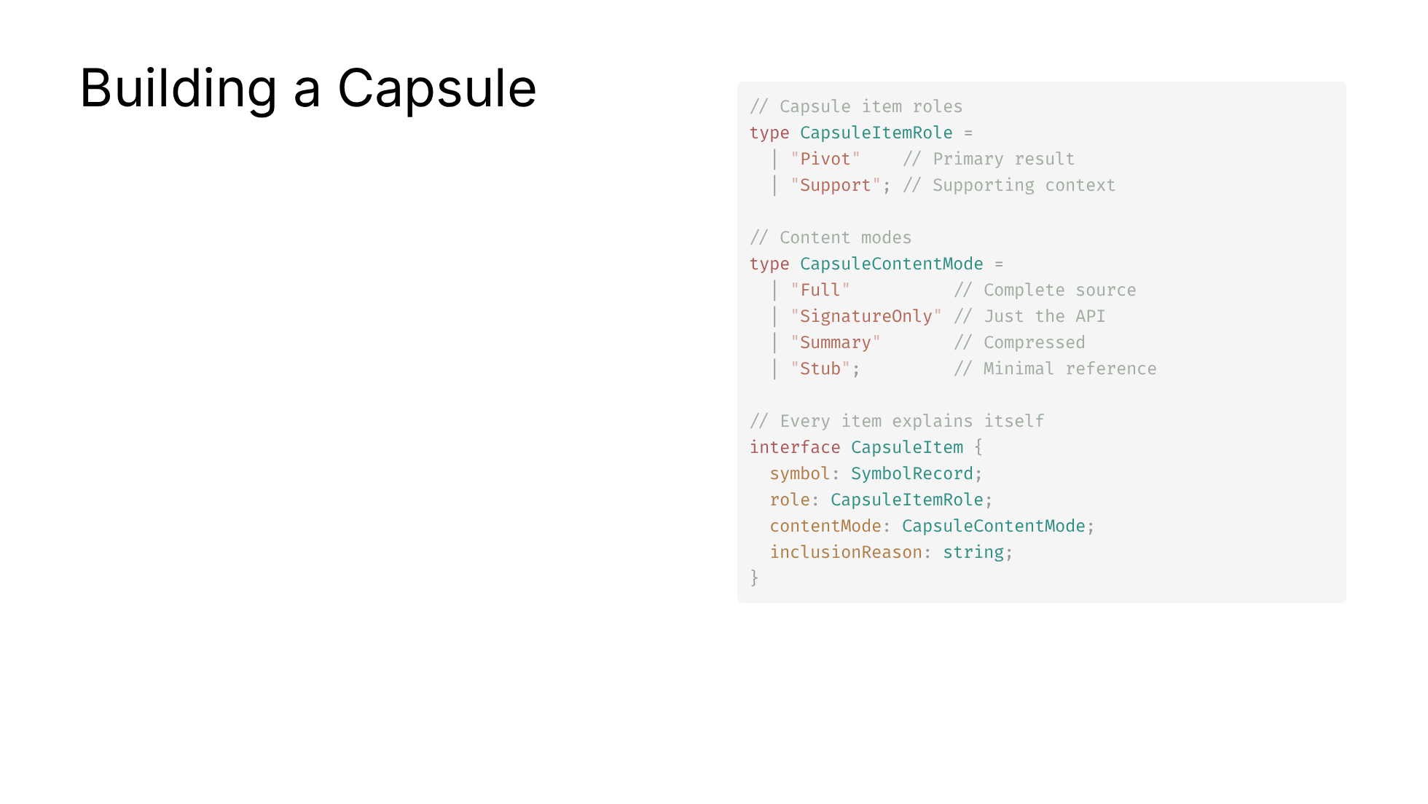
Notes:
The capsule is vexb's core output artifact. Graceful degradation means you always get useful context even under tight budgets.

Slide 54
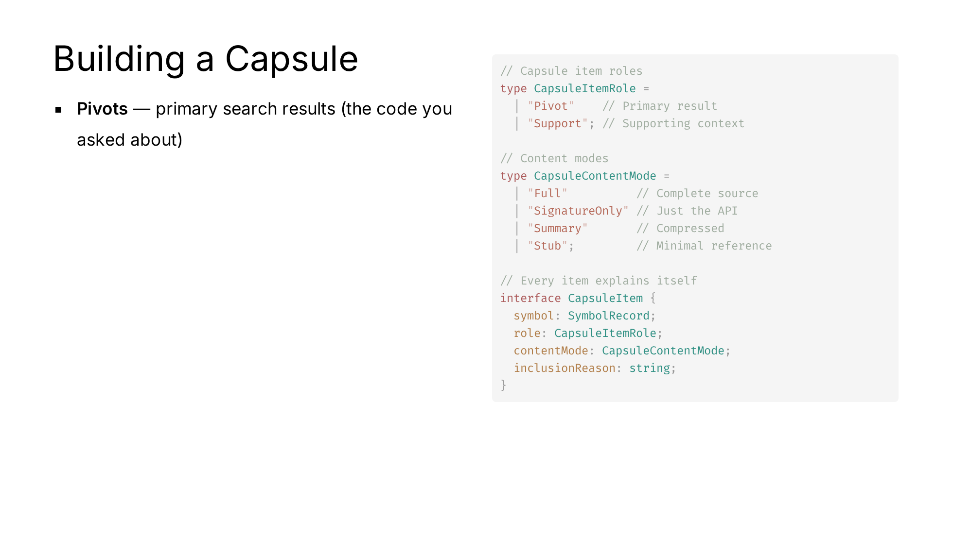
Notes:
The capsule is vexb's core output artifact. Graceful degradation means you always get useful context even under tight budgets.

Slide 55

Notes:
The capsule is vexb's core output artifact. Graceful degradation means you always get useful context even under tight budgets.

Slide 56

Notes:
The capsule is vexb's core output artifact. Graceful degradation means you always get useful context even under tight budgets.

Slide 57

Notes:
The capsule is vexb's core output artifact. Graceful degradation means you always get useful context even under tight budgets.

Slide 58

Notes:
The capsule is vexb's core output artifact. Graceful degradation means you always get useful context even under tight budgets.

Slide 59


Slide 60

Notes:
This is what gives vexb session continuity — it remembers what happened and surfaces relevant history when you come back to the same code.

Slide 61

Notes:
This is what gives vexb session continuity — it remembers what happened and surfaces relevant history when you come back to the same code.

Slide 62

Notes:
This is what gives vexb session continuity — it remembers what happened and surfaces relevant history when you come back to the same code.

Slide 63

Notes:
This is what gives vexb session continuity — it remembers what happened and surfaces relevant history when you come back to the same code.

Slide 64

Notes:
This is what gives vexb session continuity — it remembers what happened and surfaces relevant history when you come back to the same code.

Slide 65

Notes:
This is what gives vexb session continuity — it remembers what happened and surfaces relevant history when you come back to the same code.

Slide 66

Notes:
This is what gives vexb session continuity — it remembers what happened and surfaces relevant history when you come back to the same code.

Slide 67


Slide 68

Notes:
The handoff payload is what makes vexb composable — any downstream tool or agent gets structured, trustworthy context with full provenance.

Slide 69

Notes:
The handoff payload is what makes vexb composable — any downstream tool or agent gets structured, trustworthy context with full provenance.

Slide 70

Notes:
The handoff payload is what makes vexb composable — any downstream tool or agent gets structured, trustworthy context with full provenance.

Slide 71

Notes:
The handoff payload is what makes vexb composable — any downstream tool or agent gets structured, trustworthy context with full provenance.

Slide 72

Notes:
The handoff payload is what makes vexb composable — any downstream tool or agent gets structured, trustworthy context with full provenance.

Slide 73

Notes:
The handoff payload is what makes vexb composable — any downstream tool or agent gets structured, trustworthy context with full provenance.

Slide 74


Slide 75

Notes:
The MCP server is vexb's integration surface — it exposes every capability as a tool that AI assistants can call.

Slide 76

Notes:
The MCP server is vexb's integration surface — it exposes every capability as a tool that AI assistants can call.

Slide 77

Notes:
The MCP server is vexb's integration surface — it exposes every capability as a tool that AI assistants can call.

Slide 78

Notes:
The MCP server is vexb's integration surface — it exposes every capability as a tool that AI assistants can call.

Slide 79

Notes:
The MCP server is vexb's integration surface — it exposes every capability as a tool that AI assistants can call.

Slide 80

Notes:
The MCP server is vexb's integration surface — it exposes every capability as a tool that AI assistants can call.

Slide 81

Notes:
The MCP server is vexb's integration surface — it exposes every capability as a tool that AI assistants can call.

Slide 82

Notes:
The MCP server is vexb's integration surface — it exposes every capability as a tool that AI assistants can call.

Slide 83

Notes:
The MCP server is vexb's integration surface — it exposes every capability as a tool that AI assistants can call.

Slide 84

Notes:
The MCP server is vexb's integration surface — it exposes every capability as a tool that AI assistants can call.

Slide 85

Notes:
The MCP server is vexb's integration surface — it exposes every capability as a tool that AI assistants can call.

Slide 86

Notes:
The MCP server is vexb's integration surface — it exposes every capability as a tool that AI assistants can call.

Slide 87

Notes:
The minimal dependency footprint is intentional — vexb is designed to be trustworthy and self-contained.

Slide 88

Notes:
The minimal dependency footprint is intentional — vexb is designed to be trustworthy and self-contained.

Slide 89


Slide 90

Notes:
These four choices together create a system you can trust — deterministic, explainable, and efficient.

Slide 91

Notes:
These four choices together create a system you can trust — deterministic, explainable, and efficient.

Slide 92

Notes:
These four choices together create a system you can trust — deterministic, explainable, and efficient.

Slide 93

Notes:
These four choices together create a system you can trust — deterministic, explainable, and efficient.

Slide 94

Notes:
These four choices together create a system you can trust — deterministic, explainable, and efficient.

Slide 95

Notes:
The architecture is designed for extension — adding a new language is a parser + grammar, everything downstream just works.

Slide 96

Notes:
The architecture is designed for extension — adding a new language is a parser + grammar, everything downstream just works.

Slide 97

Notes:
The architecture is designed for extension — adding a new language is a parser + grammar, everything downstream just works.

Slide 98

Notes:
The architecture is designed for extension — adding a new language is a parser + grammar, everything downstream just works.

Slide 99

Notes:
The architecture is designed for extension — adding a new language is a parser + grammar, everything downstream just works.

Slide 100

Notes:
The architecture is designed for extension — adding a new language is a parser + grammar, everything downstream just works.

Slide 101


Slide 102


