Slide 1

Lecture 2: Android Concepts
Topics: Framework, Components, Intent
Date: Jan 24, 2017

Slide 2
References (study these)
http://source.android.com/source/index.html
http://source.android.com/devices/index.html
http://developer.android.com/guide/components/fundamentals.html
http://developer.android.com/training/basics/intents/sending.html
http://developer.android.com/guide/components/intents-filters.html
http://developer.android.com/training/camera/photobasics.html
Notes:
-Source
Linux-based
Android was started by a group of companies called the OHA (Open Handset Alliance)
Android Open Source Project is led by Google and maintains the Android Compatibility Program
View Android as a product, not a distribution

Slide 3
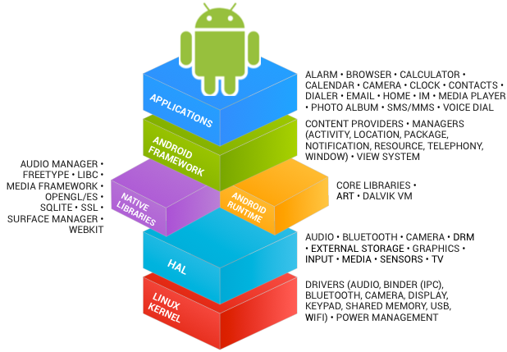
Android Stack
Notes:
The Kernal’s job is to talk to the hardware.
The driver to talk to the hardware is a C-program.
We can use an NDK to call C code from Android Java code
Java is multi-platform. When .java is compiled, it complies into byte code that runs on a VM tailored to the device
-Dalvik VM is the android VM where the java runs
-Android frame work is Java framework
-Use HAL to use the camera service

Slide 4
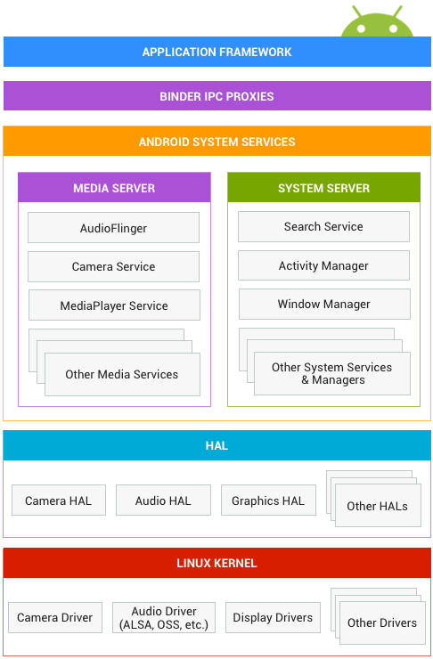
Android Interfaces and Architecture
Notes:
Processes talk to each other using Binder IPC proxy
There is a proxy behind every server

Slide 5
Application Fundamentals
Android SDK tools compile your code (along with data and resource files) into an APK.
Each app lives in its own security sandbox:
Android OS is a multi-user Linux system.
Each app is like a different user (unique user ID).
Every app runs in its own Linux process.
Each process has its own virtual machine (VM).
Android starts/terminates the process based on the need for an app's components to be executed.
Notes:
APK – product package. ZIP file
Each app needs its own security sandbox. They are WELL encapsulated. They run on VMs
Apps cannot interfere with each other in any way
Totally isolated from each other

Slide 6
App Components
Activity
Service
Content Provider
Broadcast Receiver
Activity
Activity
Activity
Service
Content
Provider
Activity
Broadcast Receiver
Broadcast Receiver
Broadcast Receiver
An Example APP
Notes:
Apps will generally have one of each

Slide 7
App Components
Activity
Service
Content Provider
Broadcast Receiver
Activity
APP from Lab 1

Slide 8
The Manifest File
AndroidManifest.xml – Must declare all the app components in this file.
This file also contains:
Permissions
API Level (min and target)
HW/SW features used
Other API libraries
Notes:
Adding new activities, you must define another xml tag to the android manifest file

Slide 9
The Manifest File
<service> elements for services
<receiver> elements for broadcast receivers
<provider> elements for content providers
<activity> elements for activities
Activities, services, and content providers that you include in your source but do not declare in the manifest are not visible to the system and, consequently, can never run.
Broadcast receivers can be either declared in the manifest or created dynamically in code (as BroadcastReceiver objects) and registered with the system by calling registerReceiver().
Notes:
Things not declared in manifest will not work****

Slide 10
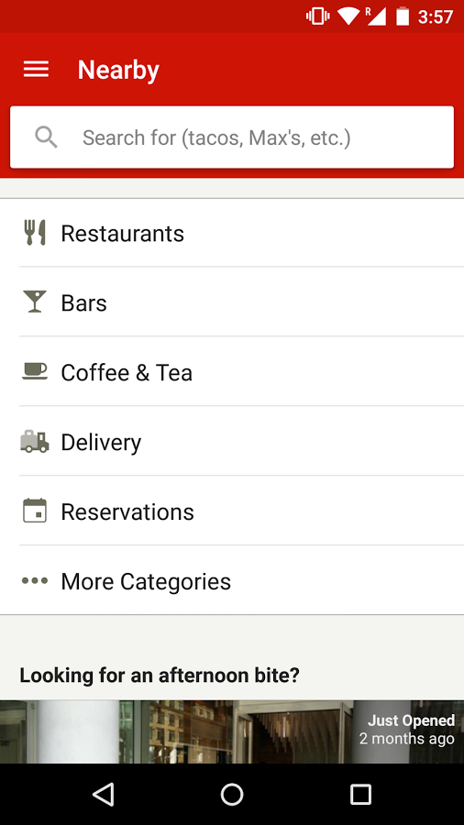
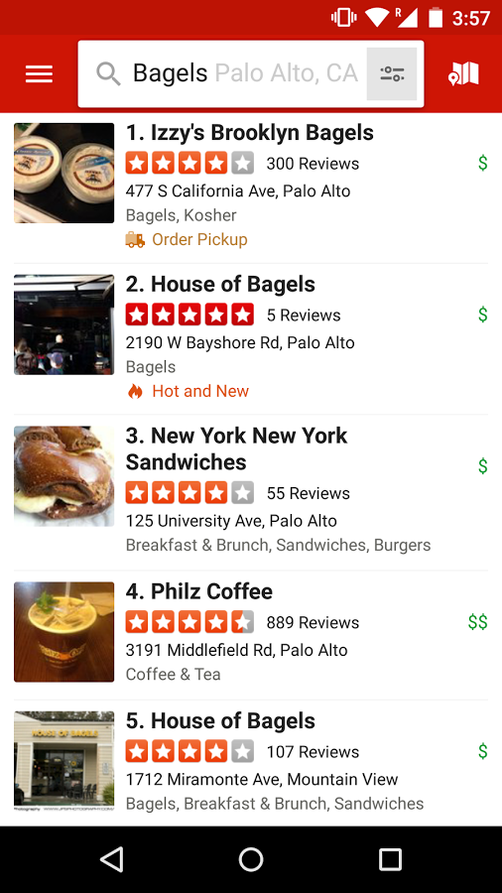
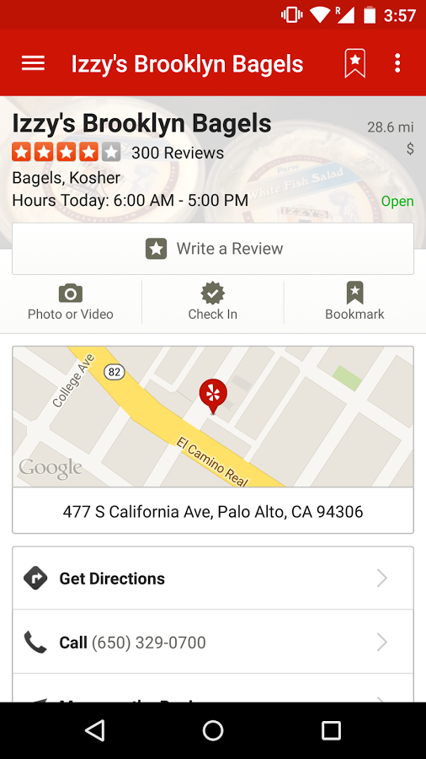
Activity
An activity represents a single screen with a user interface.
Notes:
Three activities here

Slide 11
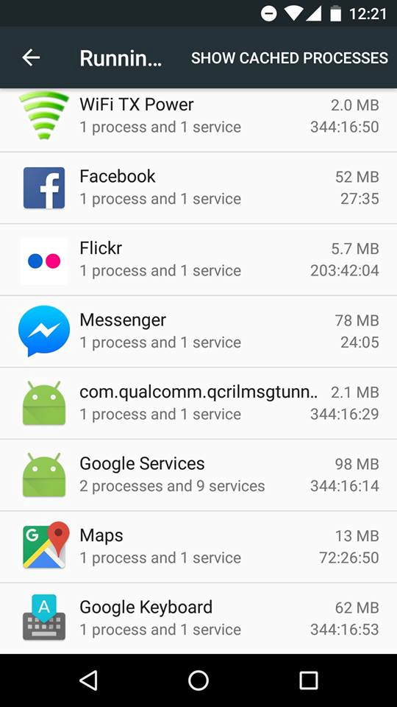
Service
Runs in the background to perform long running operations or do some work for remote processes.
A service DOES NOT provide a user interface.
Settings>Developer Options>Running Services
Notes:
Any app that talks to something in the background is running a service

Slide 12
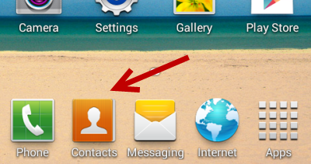
Content Provider
A content provider manages a shared set of app data.
Other apps can query or even modify the data.
You can store the data in the file system, an SQLite database, on the web, or any other persistent storage location your app can access.
Notes:
How do you get contacts in your phone? There is a content provider who gives all of your contact information
If using something with persistent data, it’s a good idea to clear content provider

Slide 13
Broadcast Receiver
A broadcast receiver is a component that responds to system-wide broadcast announcements.
Originate from the system—the battery is low, or a picture was captured.
Initiated by an App – download completed.
Broadcast receivers don't display a user interface, they may create a status bar notification.
Notes:
Receives messages… Sys will send messages to every service that the battery is low.

Slide 14
Multiple Entry Points
One component can start another component
Another
App
Activity
Activity
Activity
User
Service
Content
Provider
Activity
Another
App
Broadcast Receiver
Broadcast Receiver
Broadcast Receiver
Another
App
An Example APP
Notes:
Your app can be entered by different points by different entities
Another app can start your activity

Slide 15
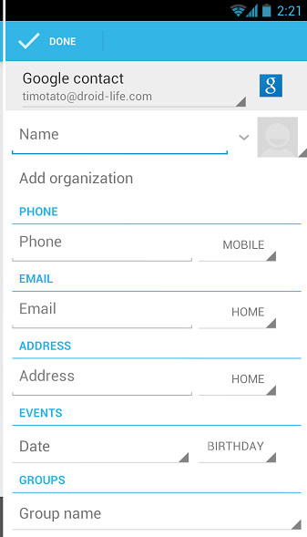
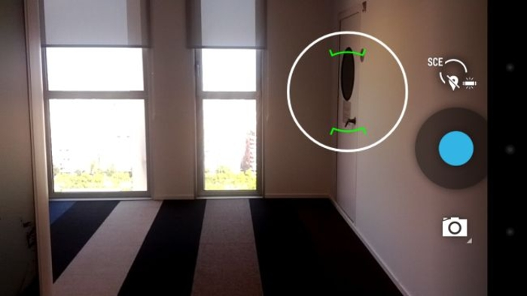
Example
One component can start another component
Notes:
Camera and contacts are entirely different

Slide 16
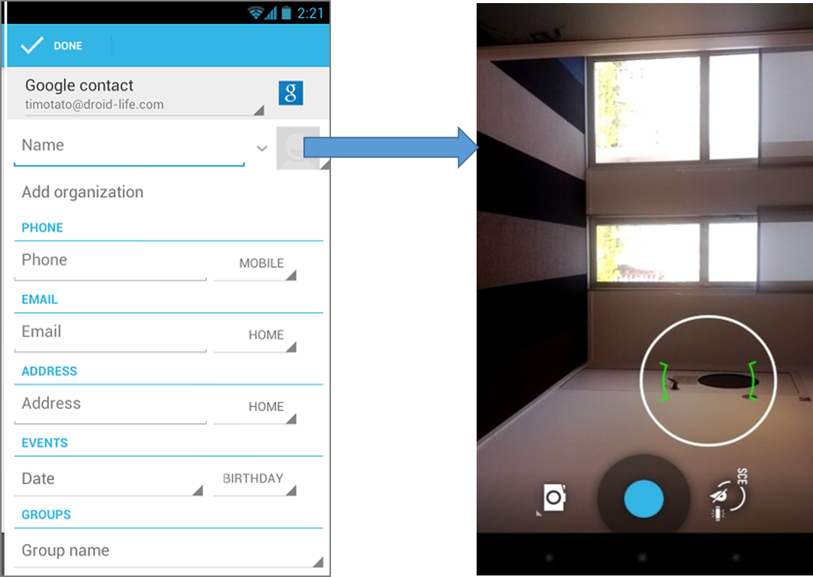
“Intent”: Activating components
Three of the four component types—activities, services, and broadcast receivers—are activated by an asynchronous message called an intent.
Intents bind individual components to each other at runtime.
Intent

Slide 17
“Intent”: Activating Component
You can start an activity (or give it something new to do) by passing an Intent to startActivity() or startActivityForResult() (when you want the activity to return a result).
You can start a service (or give new instructions to an ongoing service) by passing an Intent to startService(). Or you can bind to the service by passing an Intent to bindService().
You can initiate a broadcast by passing an Intent to methods like sendBroadcast(), sendOrderedBroadcast(), or sendStickyBroadcast().
You can perform a query to a content provider by calling query() on a ContentResolver.

Slide 18
Explicit Intents
Explicit – using the component’s class name.
Activity1
Intent x = new Intent(this, Activity2.class);
startActivity(x);
Activity2
Notes:
Intent – first class name (this), then other one
EXPLICIT INTENTS are not popular

Slide 19
Explicit Intent Example – with data
We want to switch to an Activity and pass some data to it.
Intent X = new Intent(this, Activity2.class);
X.setData(“some Uri”);
startActivity(X);
To access the data in the other Activity:
“getIntent().getData()”

Slide 20
Practice
We want to pass strings between Activities:
Create Activity1 (add a button)
Create Activity2 (add a textview)
Send Intent from Activity1 to Activity2
Send Intent with Data
Notes:
An intent is a synchronous message that an activity can pass from one activity to another. One activity can trigger another.
Intent needs to be created in activity one. It is created with some data in activity. Often feed it with some explicit data from activity one.
Explicit Intent
Starts component with the CLASS NAME of the activity to start
Implicit intent
do not name a specific class but rather a general action to be performed, which allows another component from another app to take care of it. Asks the OS to send a broadcast message if one of the apps can handle it
How to get results back

Slide 21
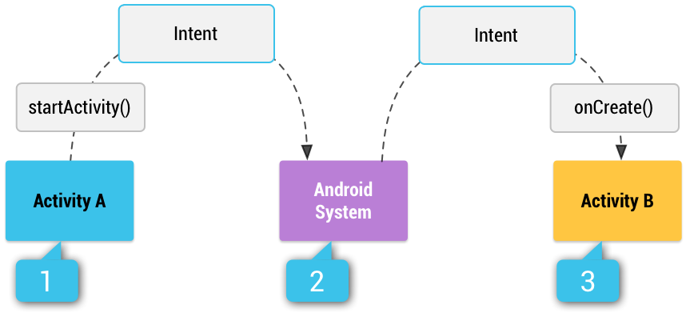
Implicit Intents
Implicit – using some reserved keywords.
You provide type of action to be performed
You provide data to be used (optional)
Multiple matching Activities may exist.
Notes:
Activity A will continue while Activity B is chugging along

Slide 22
Practice: Implicit Intent Example
We want to VIEW a webpage in a browser:
Intent w = new Intent(
Intent.ACTION_VIEW, Uri.parse(“http://www.unc.edu”)
);

Slide 23
Practice: Implicit Intent Example
We want to VIEW a location on a map:
Intent w = new Intent(
Intent.ACTION_VIEW,
Uri.parse(“geo:35.909715, -79.052779?Z=14”)
);

Slide 24
What if no one to receive my Intent?
Your App will crash!
To get a list of matching Apps:
To verify that the Intent will resolve to an Activity:
getPackageManager().queryIntentActivities(
your_intent,
PackageManager.MATCH_DEFAULT_ONLY
);
X.resolveActivity(getPackageManager()) != null

Slide 25
How to receive an Intent?
You specify <intent-filter> in your manifest.
Other
Activity
ACTION_MAIN
Your
Activity
LAUNCHER
<activity android:name="MainActivity"> <!-- This activity is the main entry, should appear in app launcher --> <intent-filter> <action android:name="android.intent.action.MAIN" /> <category android:name="android.intent.category.LAUNCHER" /> </intent-filter> </activity>

Slide 26
Example: intent-filter
Your App can send or share a text.
Other
Activity
ACTION_SEND
Your
Activity
Plain text
<intent-filter>
<action android:name="android.intent.action.SEND"/> <category android:name="android.intent.category.DEFAULT"/> <data android:mimeType="text/plain"/>
</intent-filter>
You must include the CATEGORY_DEFAULT to receive implicit intents.

Slide 27
Getting Results Back
We want an Activity to do something and return the result back to us.
Step1:
startActivityForResult(intent_object, SOME_REQ_CODE);
Step2:
@Override
protected void onActivityResult (int requestCode, int resultCode, Intent data)
{
}

Slide 28
Practice: Implicit Intent with Camera
Intent w = new Intent(MediaStore.ACTION_IMAGE_CAPTURE);
startActivity(w);
Just uses the camera. Returns no photos.

Slide 29
Practice: Getting the Image Back!
Intent w = new Intent(MediaStore.ACTION_IMAGE_CAPTURE);
startActivityForResult(w, 1);
@Override
protected void onActivityResult(int requestCode, int resultCode, Intent x)
{
//if (requestCode == 1 && resultCode == RESULT_OK)
{
Bundle extras = x.getExtras();
Bitmap imageBitmap = (Bitmap) extras.get("data");
img = (ImageView) findViewById(R.id.imageView);
img.setImageBitmap(imageBitmap);
}
}

