Slide 1
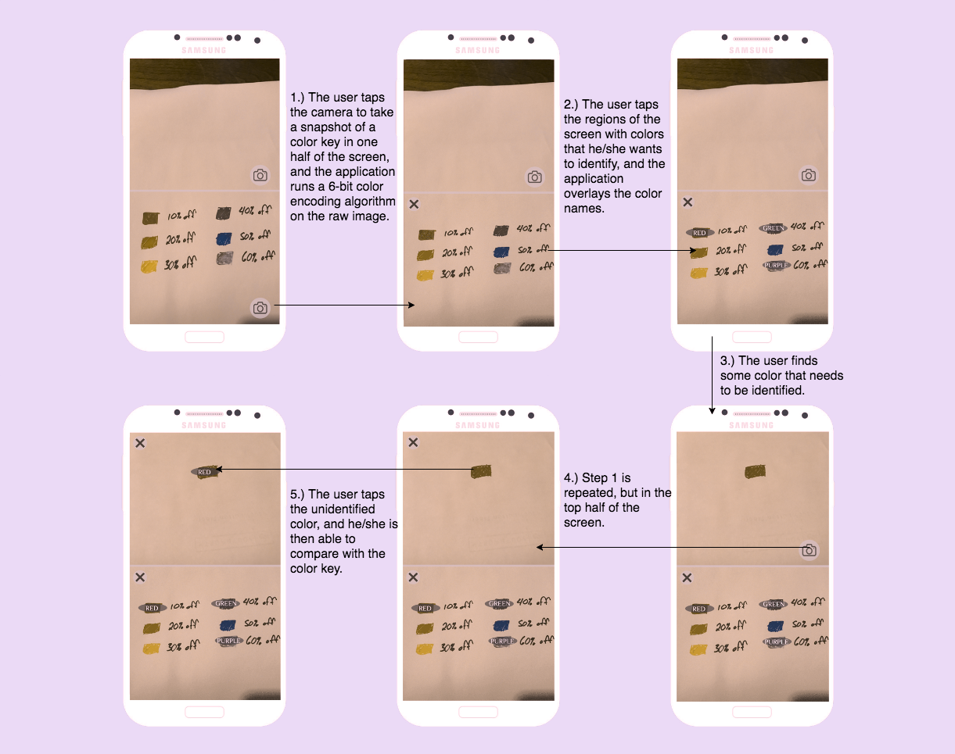
Color Helper
Calvin Barker
This app is meant to help people identify and compare colors.
A user will be able to load two different images on one screen that go through a color-encoding algorithm, tap colors that need to be identified, and then compare between the two pictures.
Technologies/Topics: Intents (camera,) image and color encoding, multithreading
Simulated usage case for someone with deuteranopia (a form of red-green color blindness)

