Slide 1

Who are the luckiest teams in the Champions League?

Slide 2
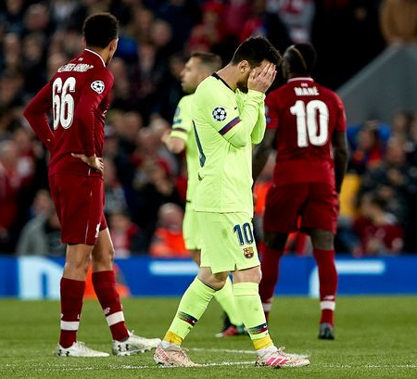
Losing hurts 😤
https://www.liverpool.com/liverpool-fc-news/features/liverpool-barcelona-news-lionel-messi-18616414

Slide 3
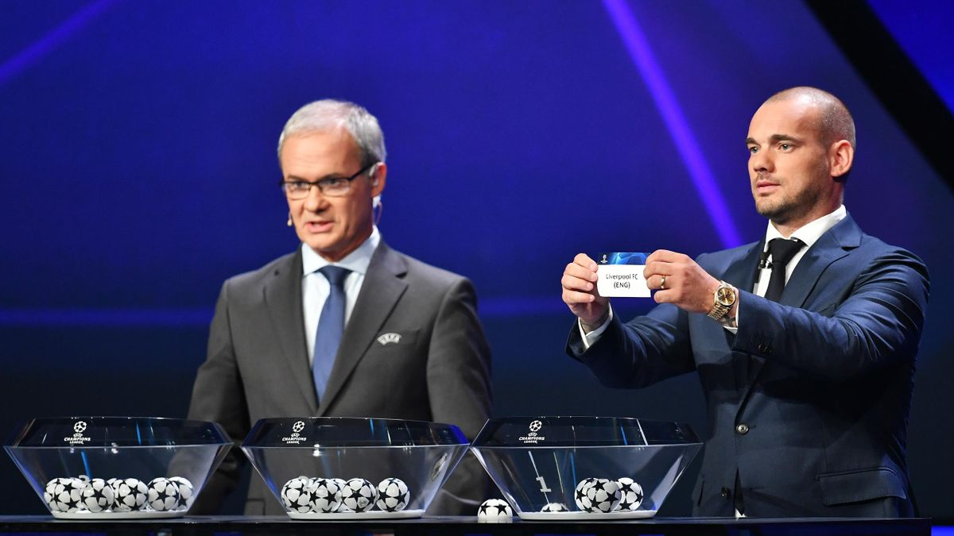
What does lucky mean?
Wesley Sneijder draws out the name of Liverpool FC during the UEFA Champions League Draw, part of the UEFA European Club Football Season Kick-Off 2019/2020 at Salle des Princes,
Grimaldi Forum on August 29, 2019 in Monaco, Monaco.
Image credit: Getty Images

Slide 4
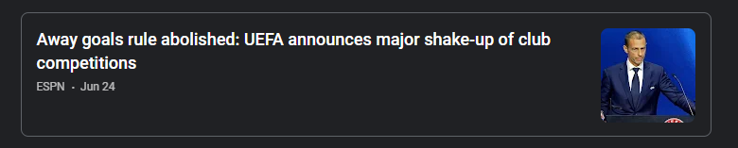
Is the Away goal rule a good tie breaker?
Google News

Slide 5
Is it harder to score an away goal?
58.7%
goals scored are home goals
59.2%
goals scored (where teams were closely matched)
are home goals

Slide 6
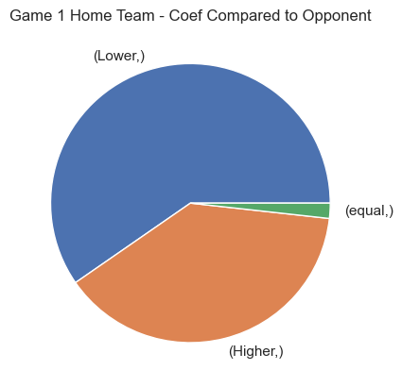
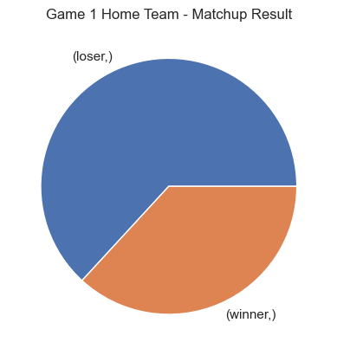
Home team for Game 1*
*Quarters and Semis
https://www.uefa.com/uefachampionsleague/news/0263-10f40a367baa-d393e355b55a-1000--last-16-draw-all-you-need-to-know/

Slide 7
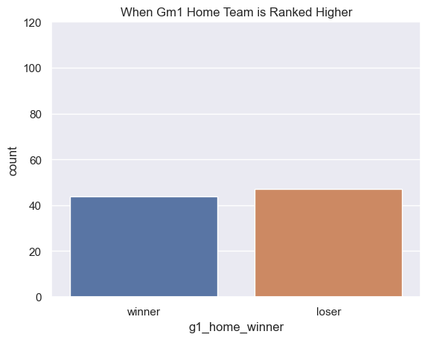
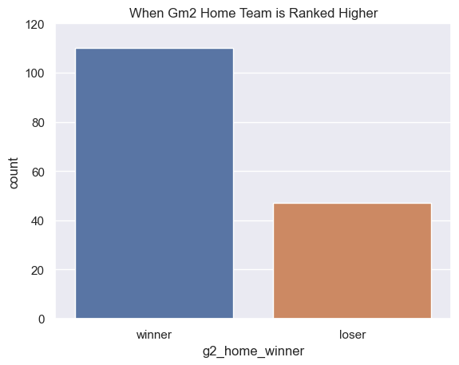
Winning when Coefficient is Higher

Slide 8
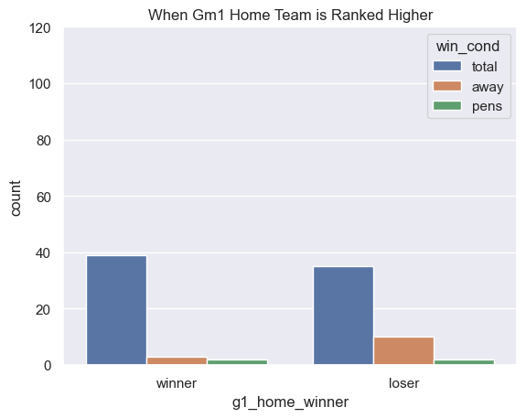
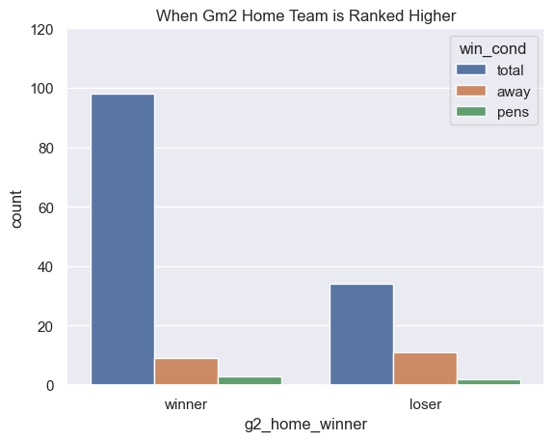
Away goal wins seem to take up a similar amount of for Game 1 Home Teams and Game 2 Home Teams

Slide 9
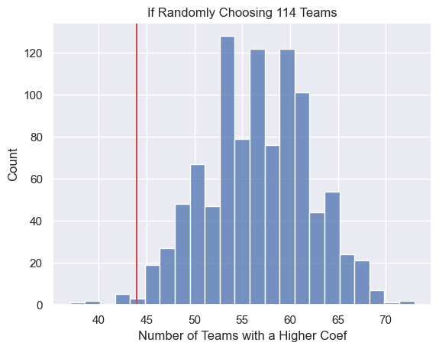
Number of lower ranked teams who play at home first
🤔

Slide 10
Close Game 1 High Scoring Game 1 Uneven Game scores

Slide 11
Close Game abs(difference in score) < 2 High Scoring Game total goals > 3 Uneven Game Score One Game is High scoring, the other isn’t

Slide 12
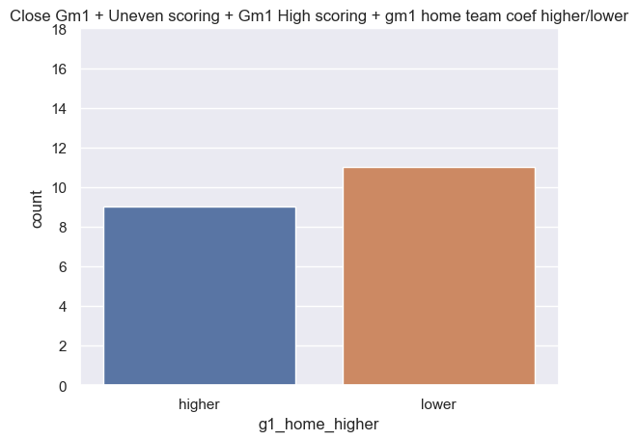
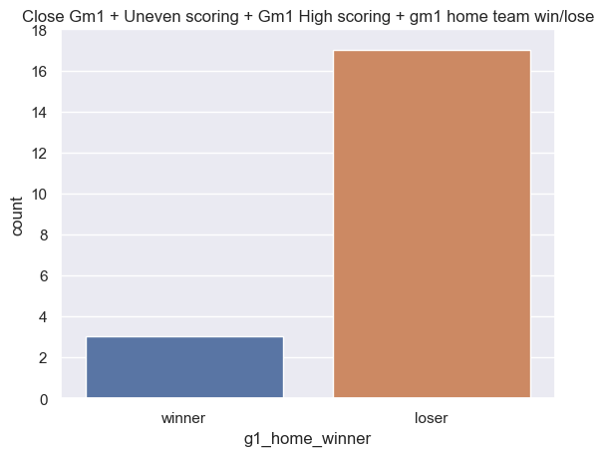
Close Gm1, High Scoring Gm1, Uneven goal totals between games

Slide 13
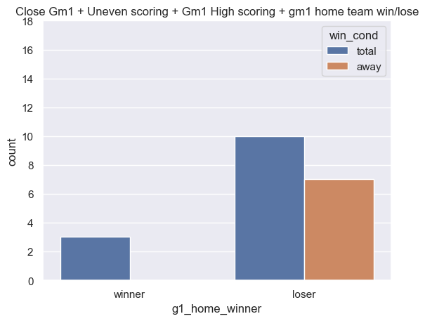
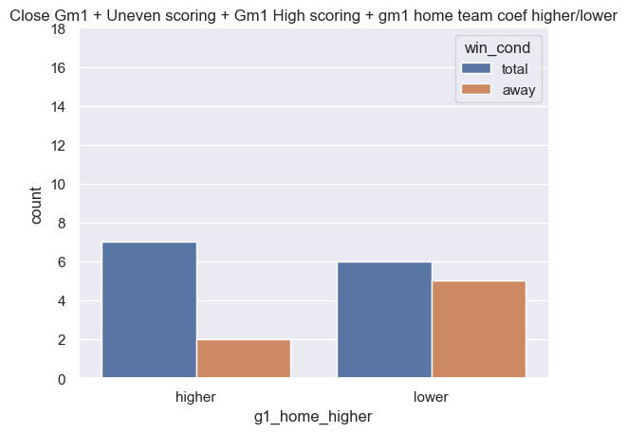
With Win Condition

Slide 14
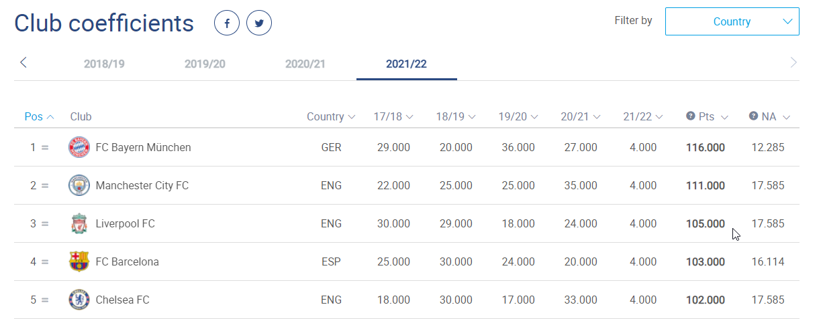
UEFA Club Coefficients

Slide 15
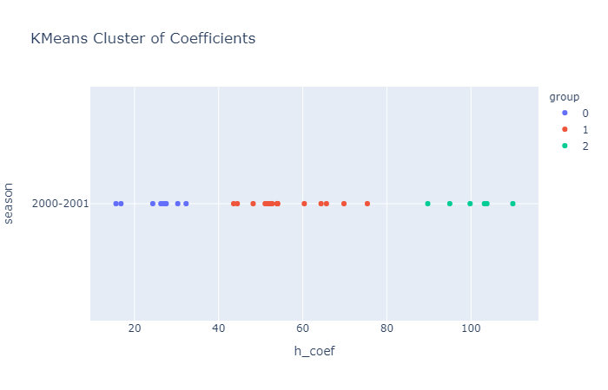
Ranks 0, 1, 2

Slide 16

Rank Score
$$\frac{Rank0∗1 + Rank1∗2 + Rank2∗3}{Total Game Played}$$

Slide 17

Example
In 2016-2017 Real Madrid played 4 games against a rank0, 5 games against a rank1, and 4 against rank2
$$\frac{4∗1 +5∗2 +4∗3}{13}$$
Rank Score = 2

Slide 18
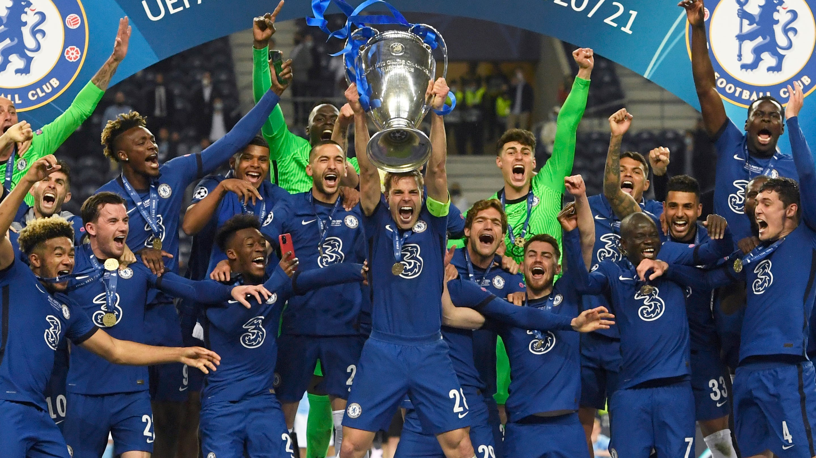
Champions
Pierre Philippe Marcou, AP

Slide 19
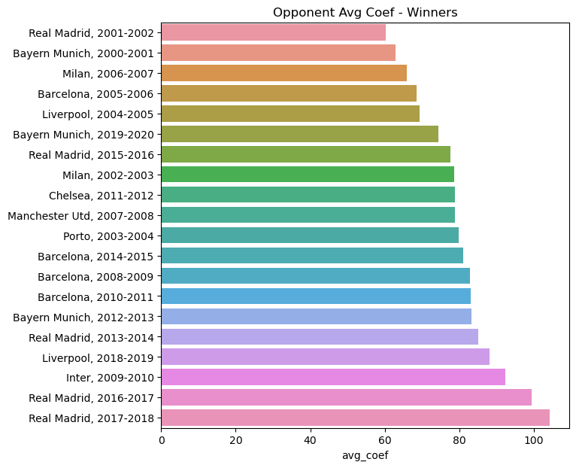
Average Opponent Coefficient in a Season

Slide 20
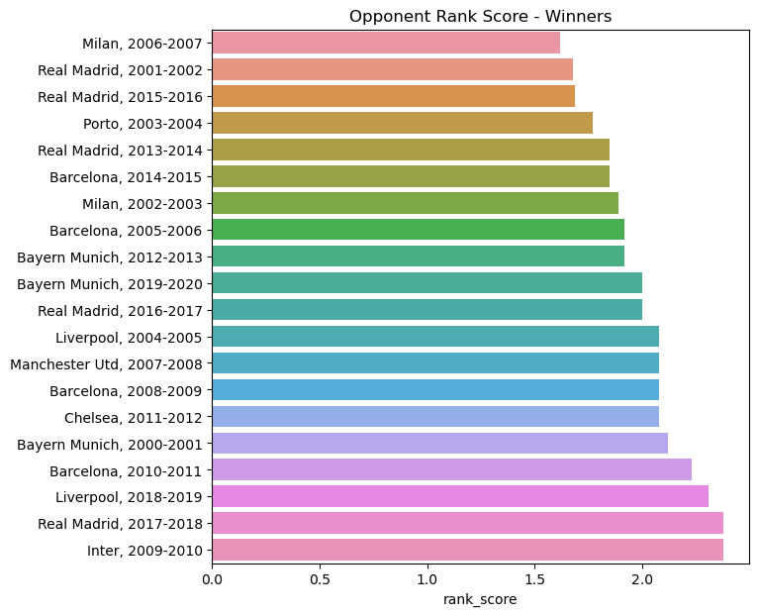
Rank Score

Slide 21
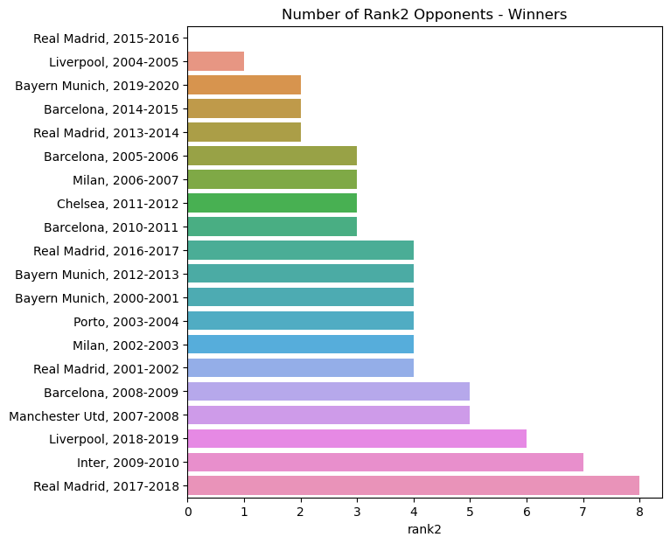
Number of Rank2 Opponents

Slide 22
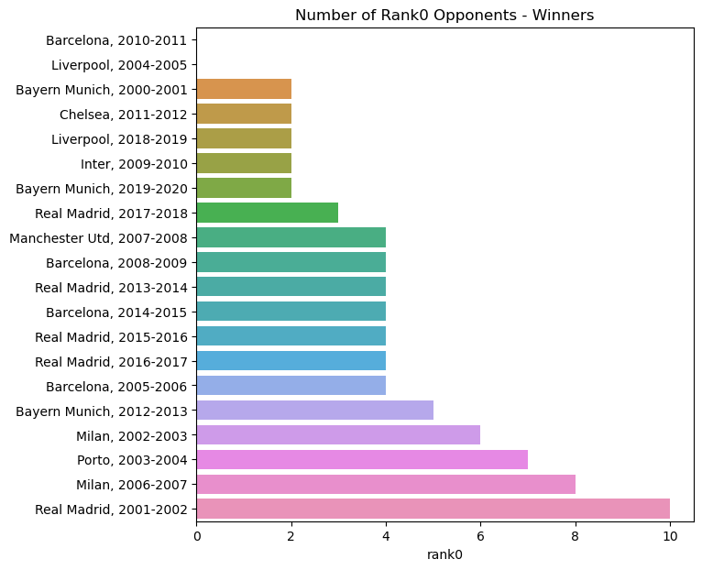
Number of Rank0 Opponents

Slide 23
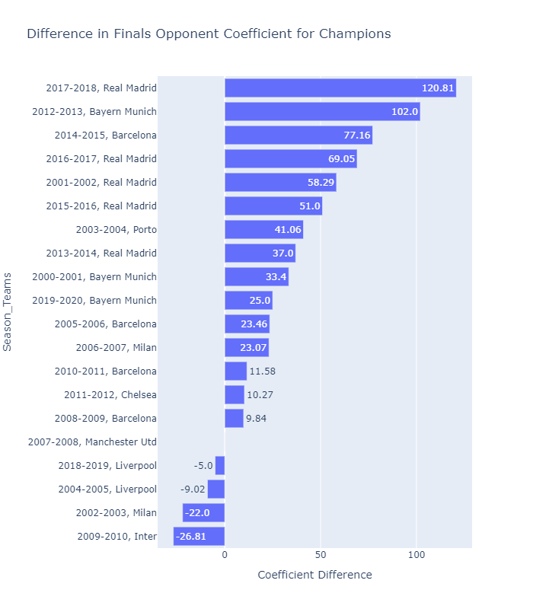
Biggest Coefficient Difference in Finals

Slide 24
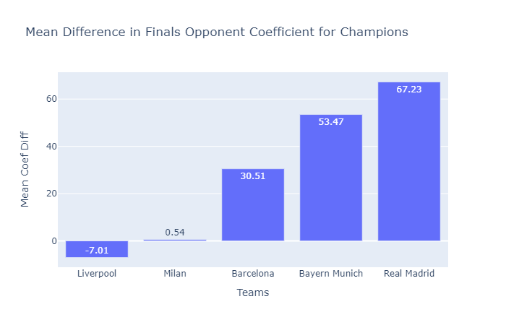
Mean Coefficient Difference in Finals for Multi-Time Winners

Slide 25
Toughest and Easiest for All teams

Slide 26
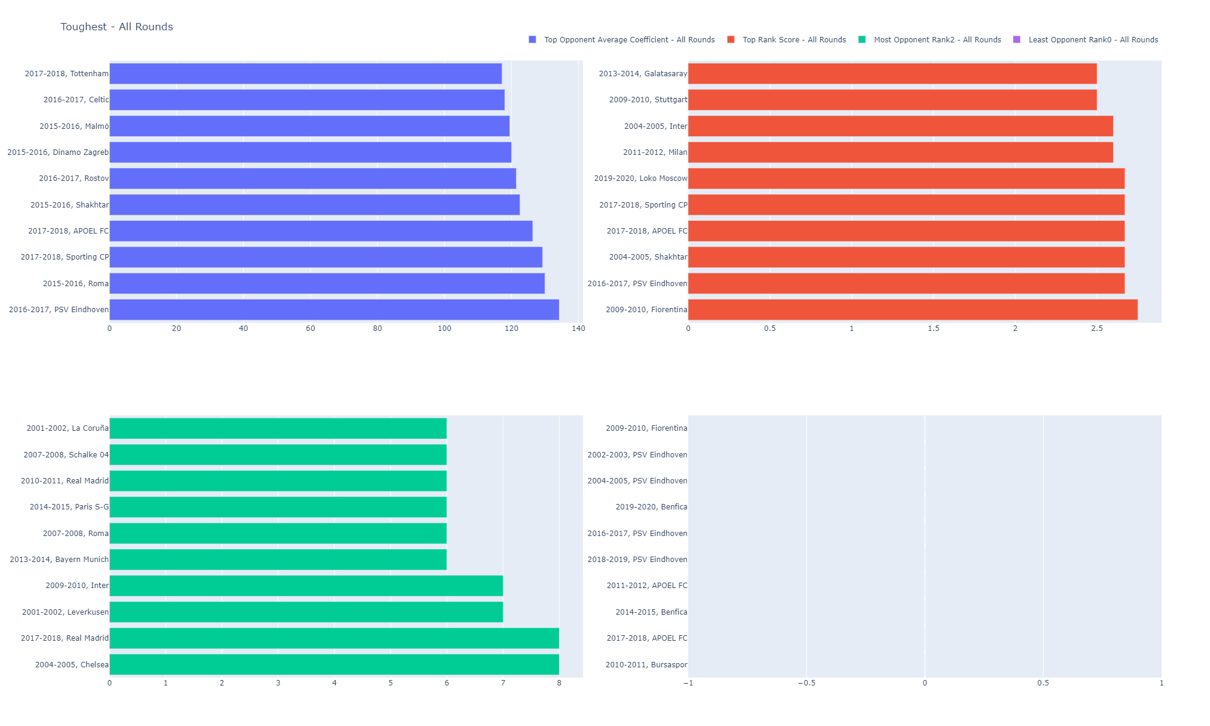

Slide 27
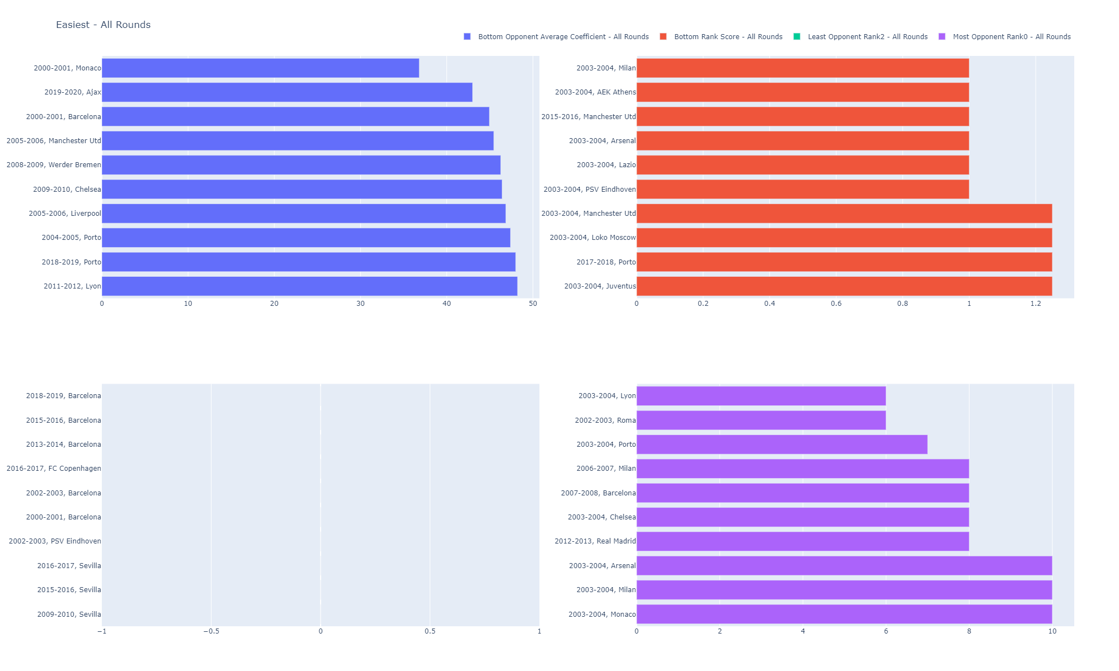

Slide 28
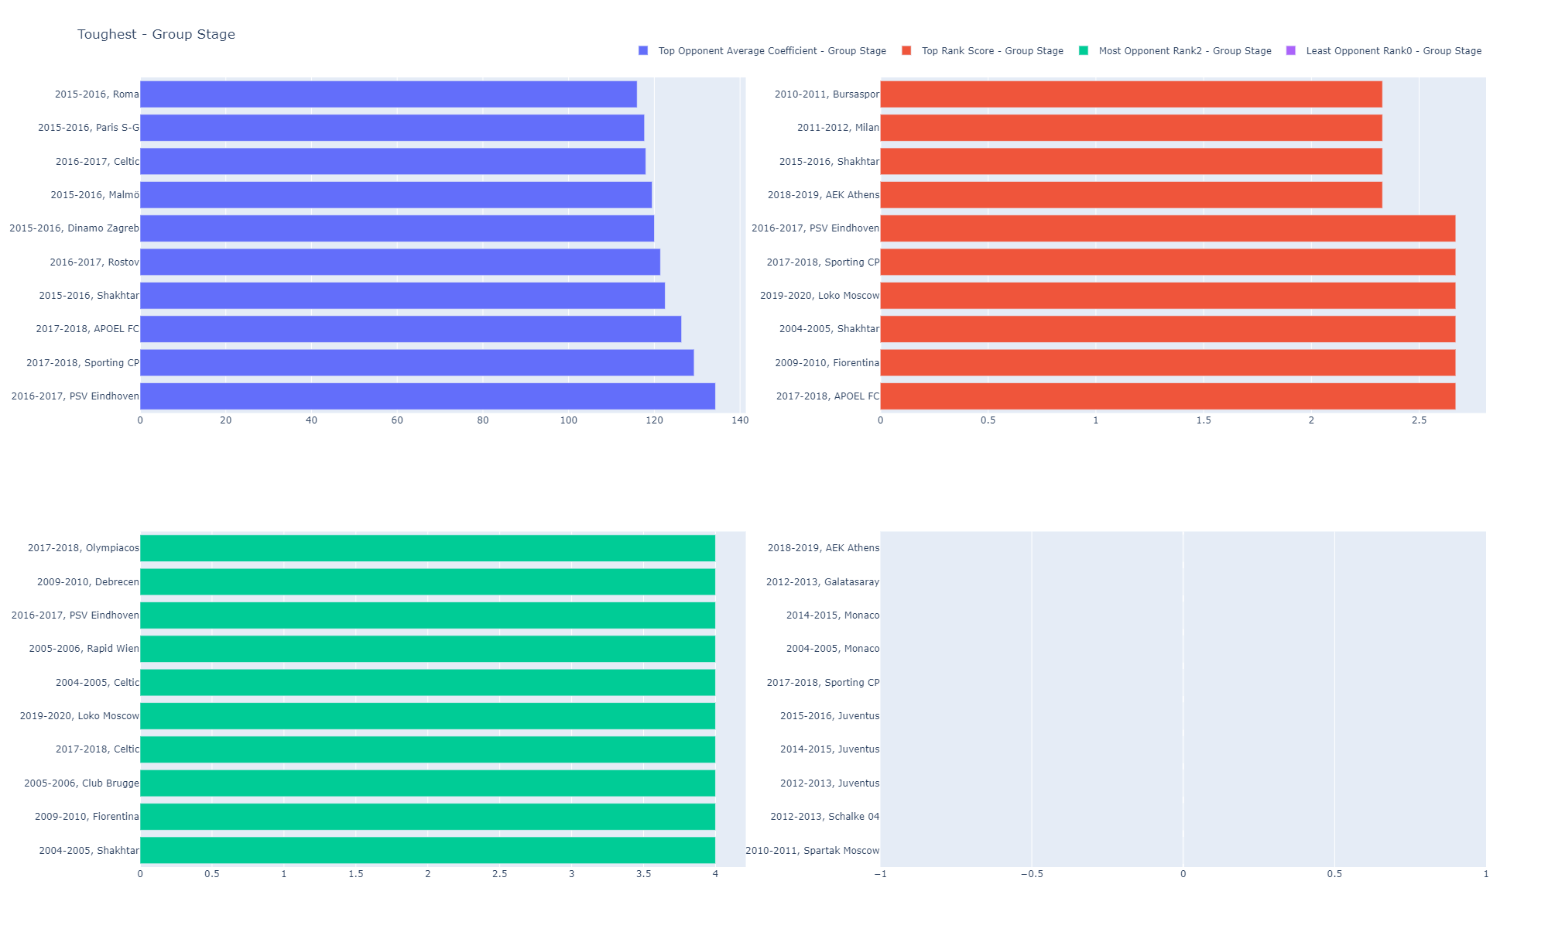

Slide 29
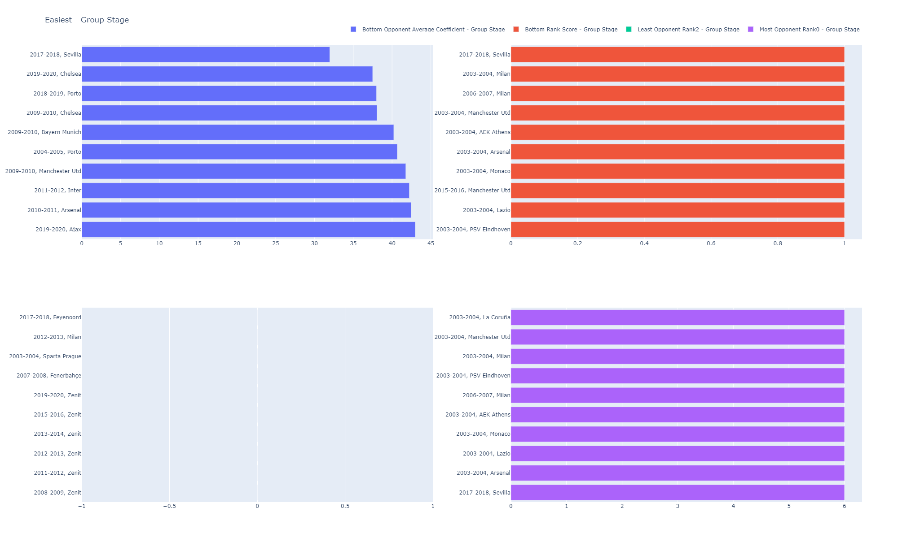

Slide 30
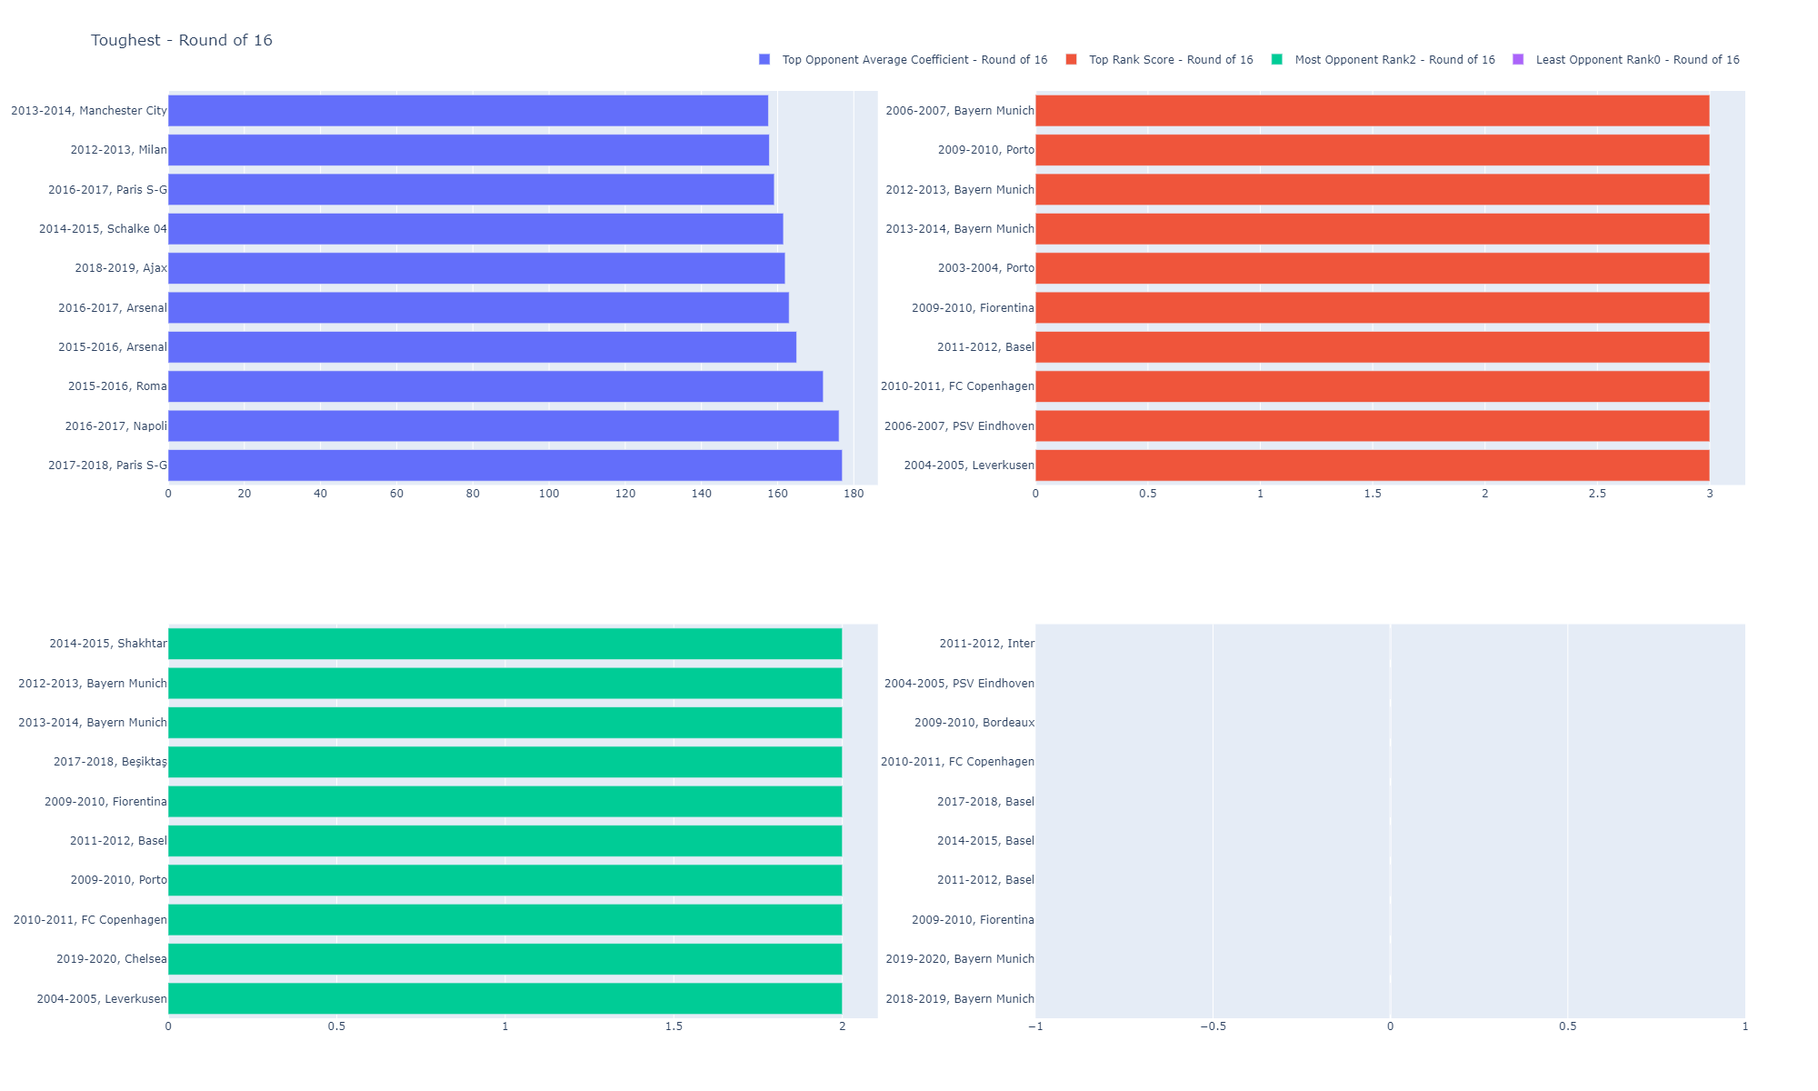

Slide 31
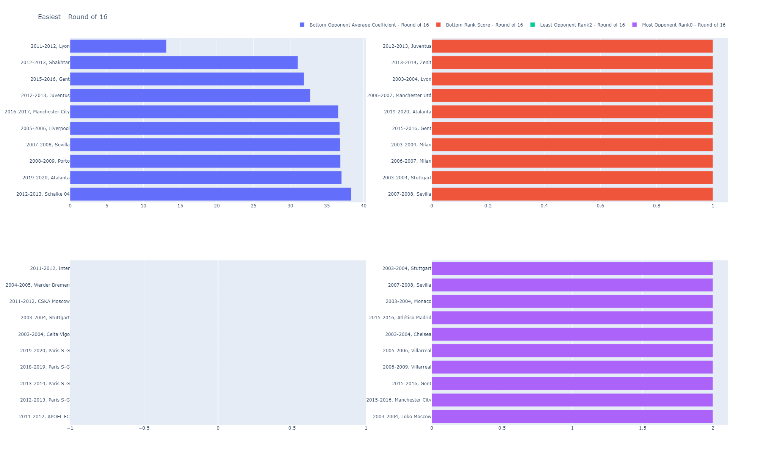

Slide 32


Slide 33
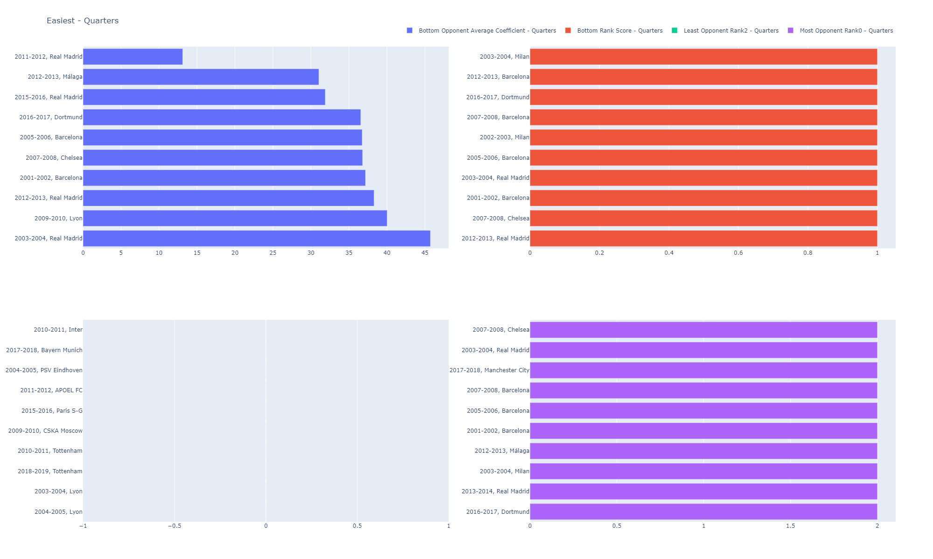

Slide 34


Slide 35
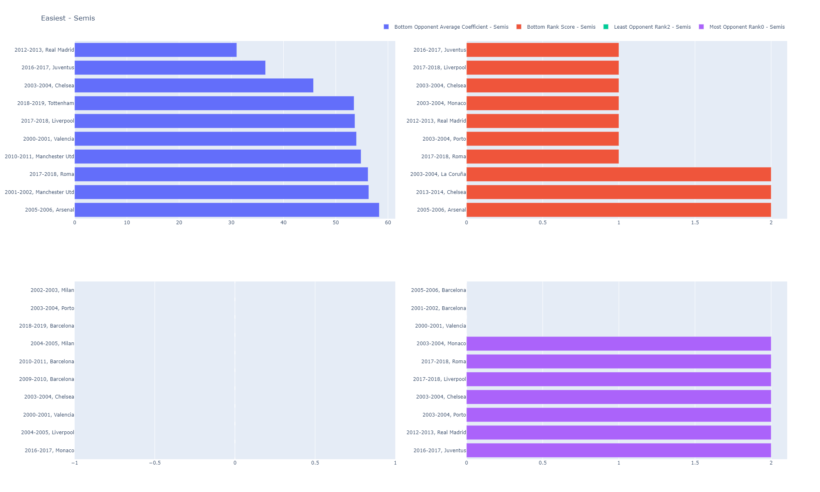

Slide 36
Liverpool and Real Madrid

