Slide 1
HTML Lists & Nested Lists
Lists are used to organize the content on the webpage.
The unordered list element “ul” creates a list where each element begins with a bullet symbol.
Browsers render each list element “li” with a new line along with a bullet.
Nested Lists are used to represent hierarchical relationships.
A browser indents each nested list to indicate a hierarchical relationship.

Slide 2
HTML Lists
<html>
<head>
<meta charset = “utf-8”>
<title>Links</title>
</head>
<body>
<h1>My Favorite Sites</h1>
<p><strong>Click on a name to go to that page</strong></p>
<ul>
<li><a href=http://www.youtube.com>YouTube</a></li>
<li><a href=“http://www.amazon.com”>Amazon</a></li>
<li><a href=http://www.linkedIn.com>LinkedIn</a></li>
</ul>
</body>
</html>

Slide 3

HTML Links

Slide 4
HTML Nested Lists
<html>
<head>
<meta charset = “utf-8”>
<title>Lists</title>
</head>
<body>
<h1>Best Features Of Internet</h1>
<ul>
<li>You can meet people from countries around the world</li>
<li>You have access to new media as it becomes public: <ul>
<li>New Games</li>
<li>New Applications
<ol>
<li>For Business</li>
<li>For Pleasure</li>
</ol>
</li>

Slide 5
HTML Nested Lists
<li>Around the clock news</li>
<li>Search Engines</li>
<li>Shopping</li>
<li>Programming
<ol>
<li>XML</li>
<li>Java</li>
<li>HTML5
</ol>
</li>
</ul>
</li>
<li>Links</li>
<li>Keep in touch with old friends</li>
</li>It’s the technology of the future</li>
</ul>
</body>
</html>

Slide 6
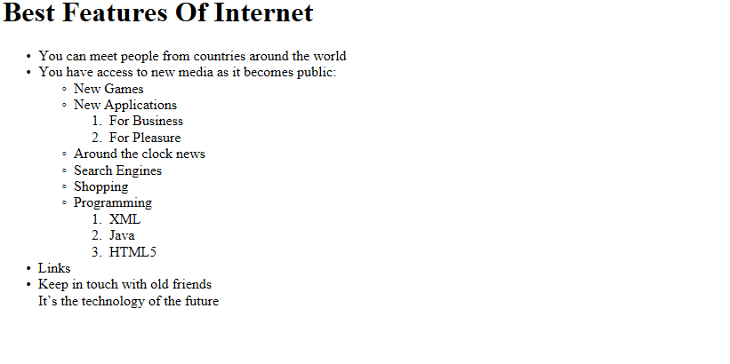
HTML Nested Lists

Slide 7
HTML Tables
Tables are used to organize data in rows and columns.
Tables are defined with “table” element.
The “border” attribute of a specifies the border to be placed by browser around table cells.
“caption” element of a table specifies tables “title”.

Slide 8
HTML Tables
<html>
<head>
<meta charset = “utf-8”>
<title>Tables</title>
</head>
<body>
<h1>Tables spanning Rows and Columns</h1>
<table border=“1”>
<caption>A more complex sample table</caption>
<thead>
<tr>
<th rowspan=“2”>
<img src=“camel.png” width=“205” height=“167” alt=“Picture of camel”>
</th>
<th rowspan=“4”>
<strong>Camlid comparison</strong><br>
Approximate as of 10/2011
</th>
</tr>

Slide 9
HTML Tables
<tr>
<th># of humps</th>
<th>Indigenous region</th>
<th>Spits</th>
<th>Produces Wool</th>
</tr>
</thead>
<tbody>
<tr>
<th>Camels </th>
<td>2</td>
<td>Africa/Asia</td>
<td>Yes</td>
<td>Yes</td>
</tr>

Slide 10
HTML Tables
<tr>
<th>Llamas </th>
<td>1</td>
<td>Andes Mountains</td>
<td>Yes</td>
<td>Yes</td>
</tr>
</tbody>
</table>
</body>
</html>

