Slide 1


Slide 2

Course : T0074 – Computer Graphics
Year : 2012
Session 19-20
Achromatic and chromatic Illumination or lighting
TASK By:
Calvin Sugianto - 1501163565
Rama Adithya - 1501164340
Agung Wijayakusuma - 150116464864
Antonius Tirta Surya - 1501166213
Christian - 1501166693

Slide 3
The task of meeting 19 and 20
A. Individual work
Learn the material contained in "http://glprogramming.com/red/Chapter04.html", learn what is meant by RGBA mode and color-index-mode
B. task Group
Compile and Run "smooth.c", observe what happens when glShadeModel parameter () of GL_FLAT (default) to GL_SMOOTH
C. Task Forum (group)
Discuss in the forum what you know with digital halftoning techniques? What modifications are required when an image is to be in dither color images.
Bina Nusantara University

Slide 4
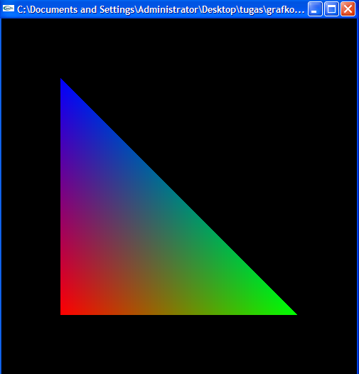
B.Compile result of smoot.h
Bina Nusantara University

Slide 5
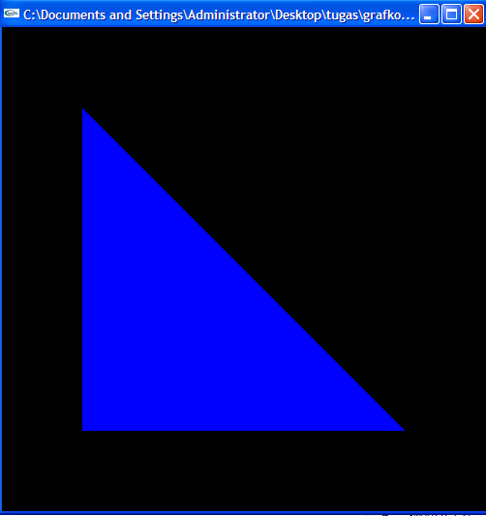
Compile result of glShadeModel (GL_FLAT); instead of glShadeModel (GL_SMOOTH);
Bina Nusantara University

Slide 6
Explanation
Flat shading selects the computed color of just one vertex and assigns it to all the pixel fragments generated by rasterizing a single primitive. In either case, the computed color of a vertex is the result of lighting if lighting is enabled, or it is the current color at the time the vertex was specified if lighting is disabled.
With flat shading, the color of one particular vertex of an independent primitive is duplicated across all the primitive's vertices to render that primitive. With smooth shading, the color at each vertex is treated individually. For a line primitive, the colors along the line segment are interpolated between the vertex colors. For a polygon primitive, the colors for the interior of the polygon are interpolated between the vertex colors
Bina Nusantara University

Slide 7
C. Haftoning Techniques
Many image rendering technologies only have binary output, For example, printers can either “fire a dot” or not.
Halftoning is a method for creating the illusion of continuous tone output with a binary device.
Effective digital halftoning can substantially improve the quality of rendered images at minimal cost.
Bina Nusantara University

