Slide 1
Tensorboard and Pretraining

Slide 2
Managing Training

Slide 3
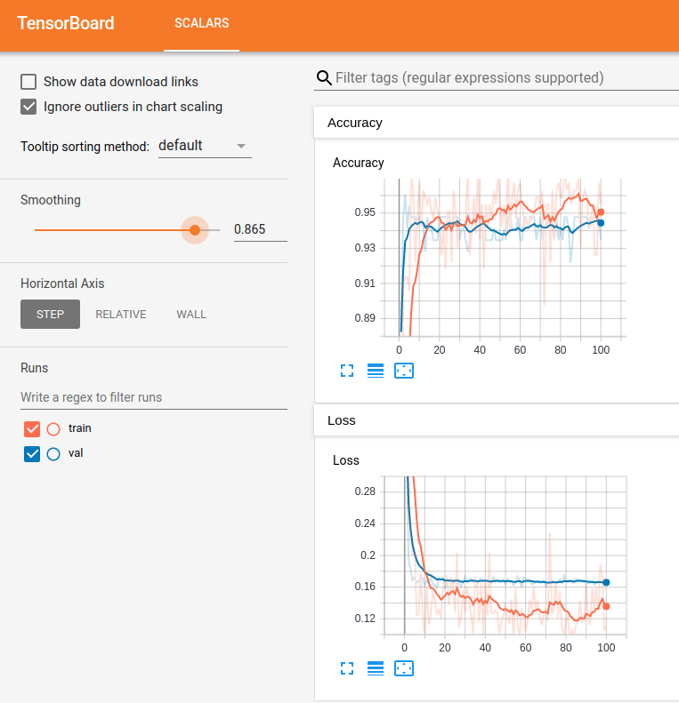
Tensorboard Monitoring
We are used to using several tools to monitor network results.
Epoch by epoch text printouts.
Plotting of loss from history.
Tensorboard is a tool from Keras that makes this process nicer.
We can use Tensorboard to get a “modern” dashboard to monitor training results.

Slide 4
What does Tensorboard Offer?

Slide 5
Launching Tensorboard
There is a vscode tensorboard plugin that allows tb to load in a tab.
The data displayed in the tensorboard pages comes from log files.

Slide 6
Using Tensorboard

Slide 7
CNN Optimizations
CNN networks can use the same optimization approaches as other networks.
There are some details that are very image-specific though.

Slide 8
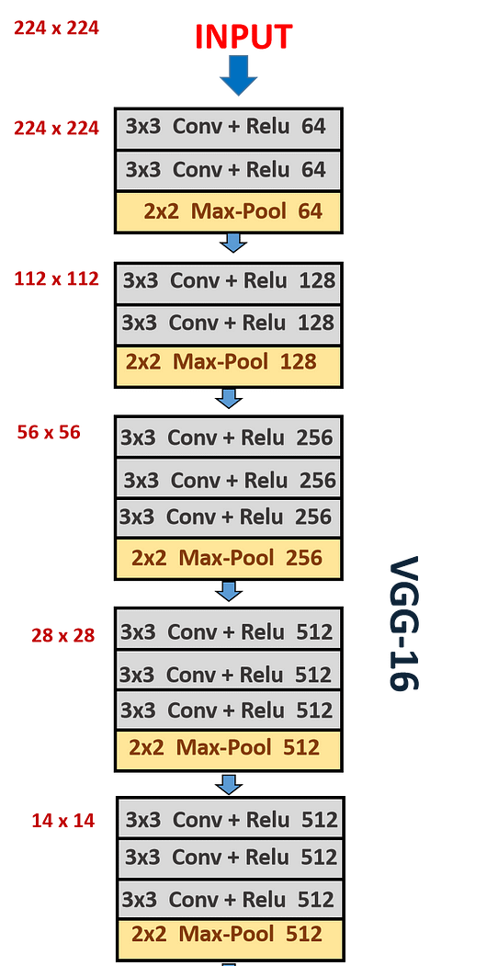
CNN Structure Notes
In general, the number of filters increases as we add layers.
The initial layers start with a higher definition (width vs. height).
Lower layers have a lower definition, due to the pooling layers.
The number of filters typically increases to continue capturing information through layers.
(Roughly, not literally) each layer ‘breaks’ a high-definition image into more lower definition images.

Slide 9
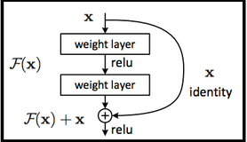
Complex Image Models
More advanced image recognition models can have more complex architectures.
Some are built to allow ‘skipping’ of layers, like the ResNet ones.
Data can be passed around some layers.
Allows the model to learn which ‘level’ of representation matters, and use that.
I.e. if a representation at some Conv level is good, it can be passed forward directly.
Other models also employ the other techniques in more ways.
E.g. different strides, padding, or pooling. These can be more useful as these models can better blend what the less common options find, with what the more common ones do.
Good, complex models are slow to train, and are generally based on extensions of what has worked previously. Catching up to large image/language/etc… models is near impossible.

Slide 10
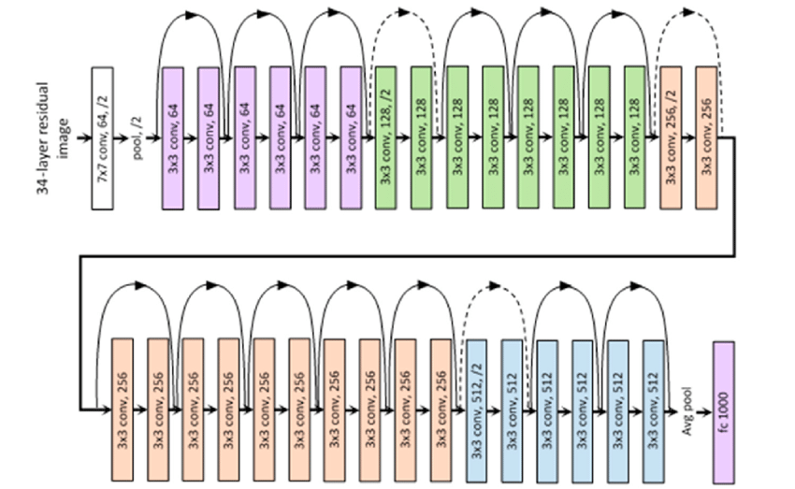

Slide 11
How and Why?
This mitigates vanishing/exploding gradients if the model is quite deep.
The concept of “holding some data from earlier, and combining it with new” is seen elsewhere.
RNN networks, that are the basis of NN time series and text models use it.
Transformer models like ChatGPT et.al. also do it, but differently.
Attempts to keep what matters as data is processed, and selectively drop what doesn’t.
‘What matters’ doesn’t necessarily happen only after the last layer, it can be uncovered at multiple points in the network. If the model finds something useful, it is ideal to just hand onto that data.

Slide 12
Data Augmentation
Data augmentation is the creation of synthetic training data.
This sounds insane, but works more often that you’d think.
Data augmentation is actually simpler and easier with images, in most cases.
We generally want to do some variety of image recognition.
The things we want to recognize can ‘move around’ in an image, and the data is still good.
When using data augmentation for image data, it allows us to increase data size, without actually collecting and maintaining large datasets.
We can instead create generators – things that make data for the model, on demand.
These generators can apply data augmentation on the fly to make variations of images.

Slide 13
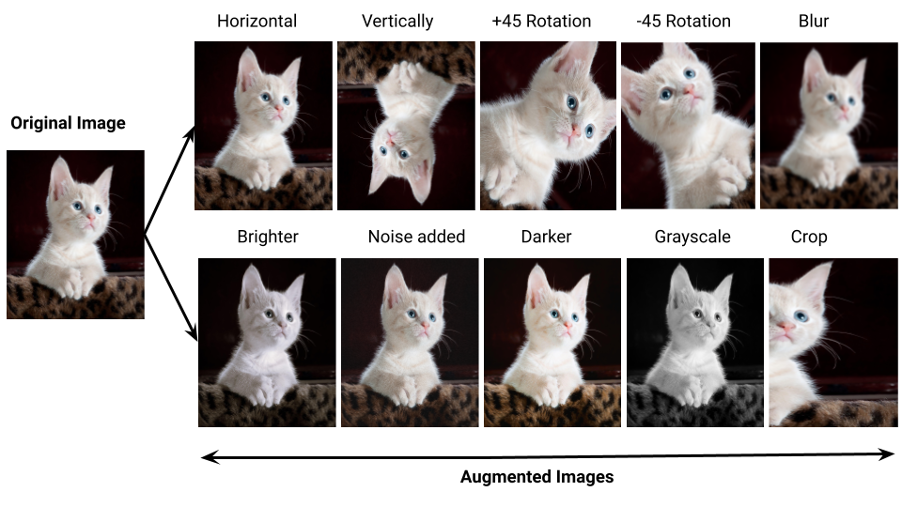

Slide 14
Non-Image Augmentation
We can generate data for non-image models as well.
Other data, like structured data, tends to not respond quite as well.

Slide 15
TensorFlow Datasets
We can use tensorflow networks with regular array/dataframe data and it works.
When we have larger amounts of data, this stops making sense.
Arrays and dataframes exist in memory – our training data might be larger than that.
Loading all data into a dataframe/array, and doing operations, can be slow, and a bottleneck.
Some operations can cause memory usage to explode, which is risky.
Neural networks use specialized datasets to manage data and resources.
Can use large amounts of data without needing to load it to memory.
Can manage where actions (data prep) happens, to better manage resource usage.
There are several types of dataset-ish things that we can create.

Slide 16
Generators
Generators are a generic concept.
They are an object that we can ask for something, like data, and they produce it on demand.
For datasets, they generally read from disk as a chunk of data is needed.
We don’t pass the data to the model, we pass the generator.
Every time the fit/evaluate/score needs data, like a batch, the generator provides it.
Where the data comes from is up to the generator (usually read from disk).
Can also be used with actual ‘generation’, like data augmentation steps.

Slide 17
TensorFlow Datasets
Probably more commonly than generators, we see TF datasets.
TF datasets are an object that does three things:
Take the source data from it’s location into the program.
Apply transformations and preprocessing.
Iterate over the data as it is required.
They allow for a dataset to be larger than memory.
They are built to allow for optimization of where/when operations happen, to build an efficient pipeline for training a model.
For images, this is reasonably simple, for other stuff it may be weird.

Slide 18
Conclusion

