Slide 1
Images and Convolutional Networks

Slide 2
Detour 1 – Sequential vs Functional
Sequential models work sequentially – one layer after the other.
Start with an input layer. End with an output
Functional neural network types allow for that rule to be broken:
Slicing and concatenating parts of a model.
Multiple inputs and/or multiple outputs.
Image processing – examine different portions of an image differently.
Generally allows for task specific adaptation of the model to the data.
Imagine stock price predictions:
Multiple inputs for book info, market analysis, and time-series of tech. info.
Output of price projection and buy/sell/hold recommendation.

Slide 3
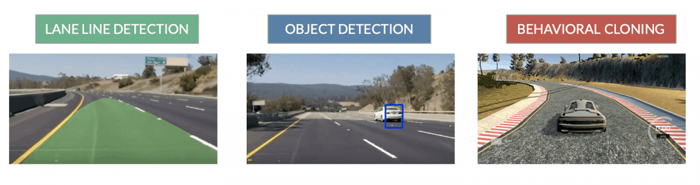
Detour 1 - Functional Models
Functional models allow for flexibility in the structure of the network.
Imagine a self driving car, and a model that generates the action to take.
Segment the image into foreground and background.
Foreground processing:
Identify object in front.
Determine if it is moving.
Background processing:
Identify lane boundaries.
Identify stop light signals.
Combine results:
If a car is in front of us, it is moving, and light is green, maintain speed.
If a car is in front of us, it is just starting to move, light is green, slow down.
If a toddler is in front of us, it is walking, light is green, stop.

Slide 4
Detour 2 - Loss Measures
Cross entropy is the most common way to measure classification losses.
Binary cross-entropy:
Used when we have a true/false classification.
Categorical cross-entropy:
Used when we have a multiclass classification.
Assumes y values are 1-hot - i.e. output of the “to_categortical” function.
Sparse categorical cross-entropy:
Used when we have a multiclass classification.
Assumes y values are integers.
Categorical and sparse are separated by the encoding of the target. Easy to confuse.

Slide 5
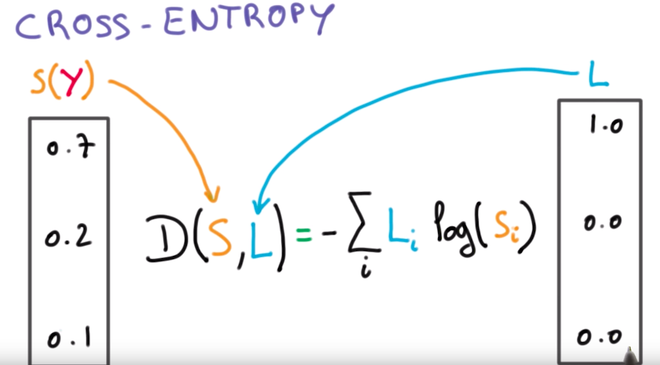
Detour 2 - Cross-Entropy
Cross entropy measures how close our prediction is to the true class.
More specifically, how close our confidence was to the real class.

Slide 7
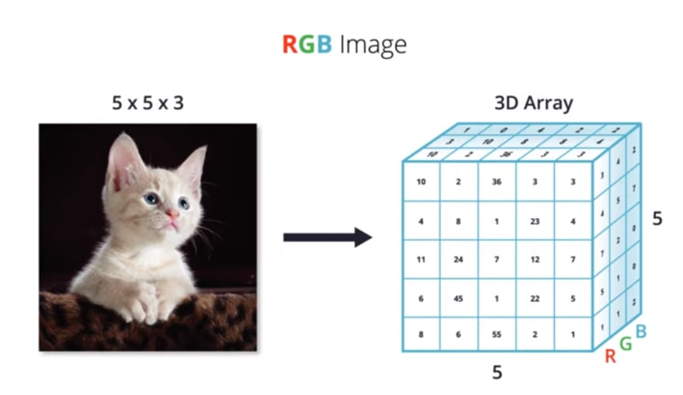
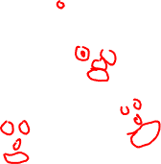
Image Basics
Images and image recognition is more simple than it appears:
Images are an array of pixels.
E.g. a 1080p image is 1920 x 1080 pixels. (greyscale)
Color images are the same, just slightly more complex:
Rather than a depth of 1 color, color images have a depth of (normally) 3.
Red, Green, and Blue are each a layer.
E.g. a 1080p image is 1920 x 1080 x 3 – one layer per color.

Slide 8

Images in Neural Networks
We can adapt our Keras based models to 3D images relatively easily.
We still (for now) want to flatten the image into a 1D array.
The flattening can happen in a layer – Flatten.
Recall – input shape is one record, for us an image.
Flatten will auto-flatten it down, so we don’t need to worry more about it.
From here, we can proceed as we are used to.
Note: may be easier to specify layers in terms of input.
E.g. img_size_pixels = 32 * 32 * 3.

Slide 9
Images in Neural Networks
Image recognition is one of the big leaders in modern neural networks.
Can be far more accurate, especially in big data.
Images have spatial relationships not well represented in linear arrays:
E.g. a bike has two wheels, and a triangle in between.
It doesn’t matter where in an image this object is, only the location relative each other.
Convolutional neural networks are able to examine images in a way that captures spatial relationships.
The deep networks from last time that do well at image recognition are CNNs.

Slide 10
Convolutional Neural Networks (CNN)
A CNN is a different variation of neural network that does well with images.
Until now we’ve used “standard” dense neural networks. Feed-forward.
CNN is based on the concept of “convolution”, a mathematical technique:
Convolution is a mathematical operation on two functions that produces a third function that expresses how the shape of one is modified by the other.
For our purposes CNN has a small window (kernel/filter) that looks at one section of an image (e.g. 3 x 3), transforms that for an output, and slides pixel by pixel (stride) over the entire image.
Convoluted definition, simple idea to visualize…

Slide 11
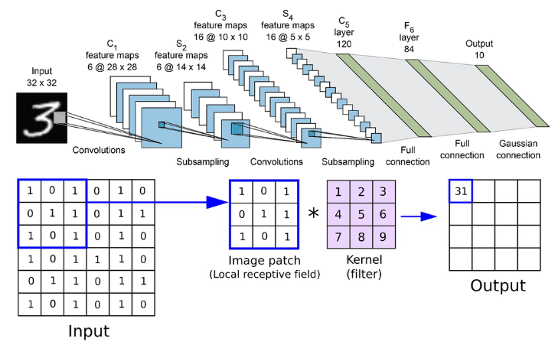

Slide 12
BUT First… Basic CNN Parts
CNN have different types of layers than the Dense we are used to:
Convolutional layers – do the convolution step just mentioned.
Pooling Layers
“Normal” neural network layers – take the data processed by the convolutional parts and do a “standard” prediction.
First, we’ll look at the convolutional layer part.
Simple parts:
The stride is how many pixels the filter slides, we have 1 in the example.
The filter/kernel size is the dimension of the pixels being looked at.

Slide 13
Stop Being so Convoluted!
Convolutional neural networks are able to capture spatial relationships in data.
I.e. where certain features (pixels) are in relationship to others.
Rather than processing the data as a set of features, CNNs take 2D ‘windows’.
This means that an area of an image can be represented in the translated data.
For example, the model can “see” an edge of a lane or a face, irrespective of the exact features (pixels) that make it up.
The initial layers of a CNN translate the images into features, using these 2D windows.
Those features are eventually fed into a regular network for final prediction.

Slide 14
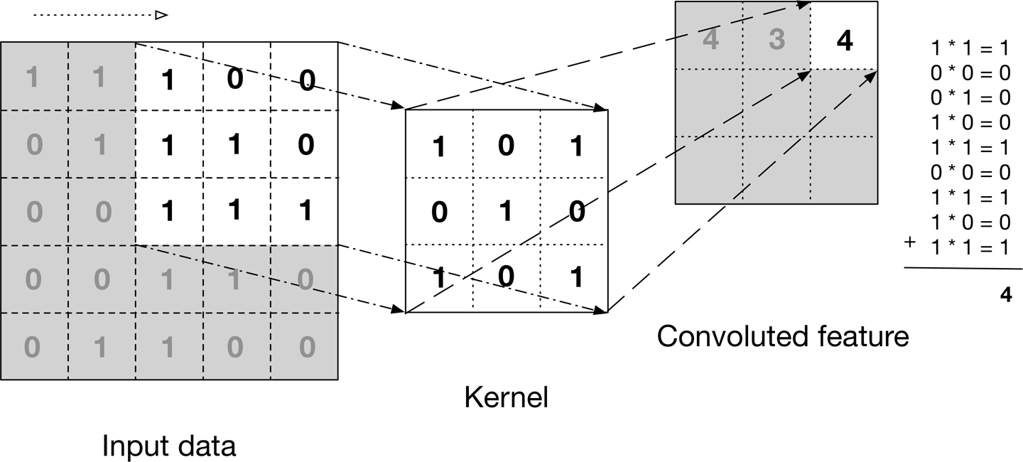

Slide 16


What is Happening?
The filter or kernel looks at each tiny “window” of the image.
The data is transformed through the filter into the output.
This process is able to identify patterns in the data:
In image data, those patterns correspond to features – edges, lines, shapes, etc…
For example, a 3 x 3 filter that can “see” vertical lines:
If a vertical line is in the image it will have data that is vertical.
When transformed, that data get’s “weighted”. The weights are learned.
Multiplied by the 1s, not the 0s.
Things that have vertical lines “get transferred” to the next layer.
The network can “see” those lines as features.

Slide 17
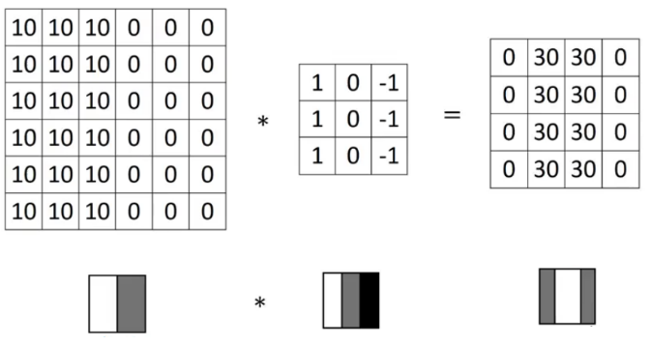
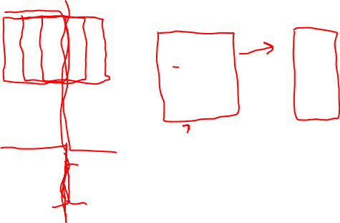
Edge Detection
Taking the vertical line example a bit further, here’s a real type of filter.
In images, higher value = more white, lower = black.

Slide 18
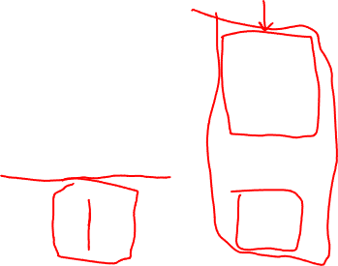
Edge Detection
Taking the vertical line example a bit further, here’s a real type of filter.
In images, higher value = more white, lower = black.

Slide 19
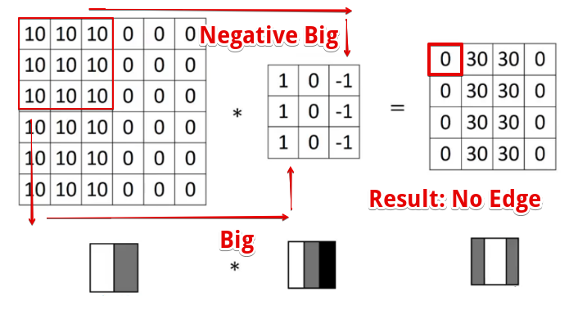
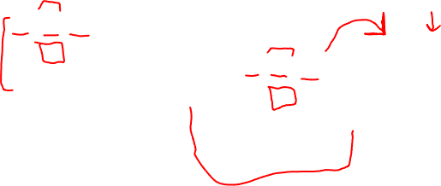
First Slice
Top left 9 pixels are multiplied by the filter and added.
All pixels are white (big number) so they end up cancelling each other.

Slide 20
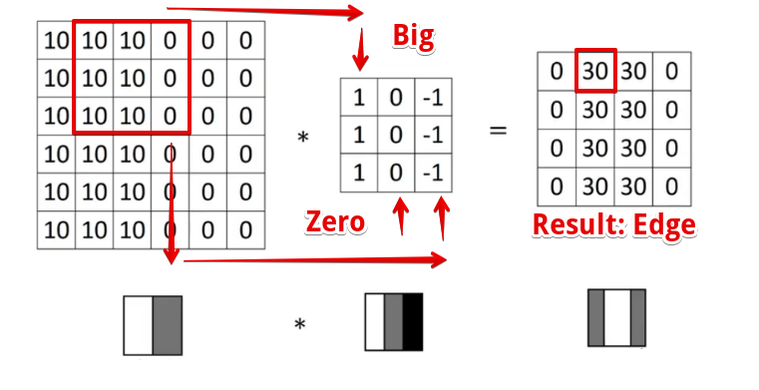
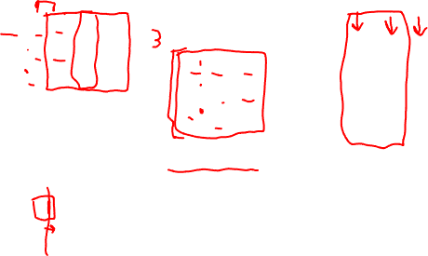
Second Slice
Range of window slides 1 pixel (stride length) to the right.
Left pixels are white (big number), right pixels are black (small number).
When added this means all except left are 0, so we have a big number as a result.
We found an edge!!
The output ”sees” vertical edges.

Slide 21
Filters in Practice
Like other layers in a NN, the filters in a convolutional layer learn during fitting.
Each filter learns to identify some aspect of the image.
E.g. a model trained to differentiate cars from trucks might identify the horizontal rectangle shape of a truck bed. Another filter might recognize the slope of a car rear window.
The convolutional filters have a couple of key benefits for image processing.
Translation invariant – patterns (edges, curves, etc…) can be found anywhere, once identified.
Hierarchical – the layered representations allow real world things in images to be composed of smaller items. A face is made up of eyes, nose, and mouth, all smeared on an oval.

Slide 23
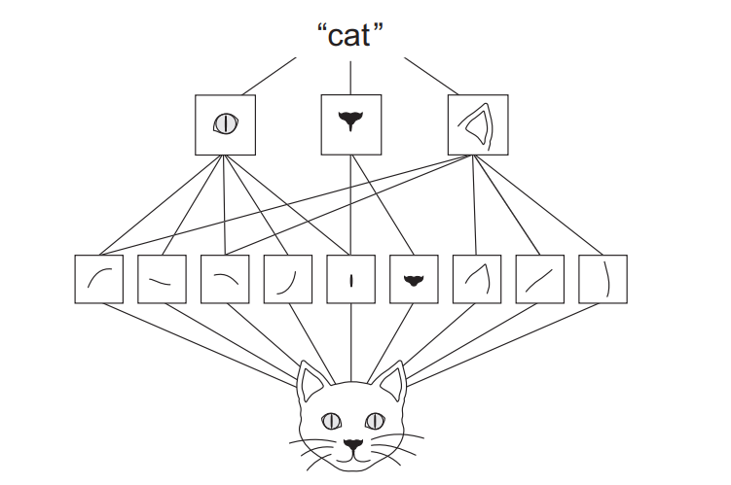

Slide 24
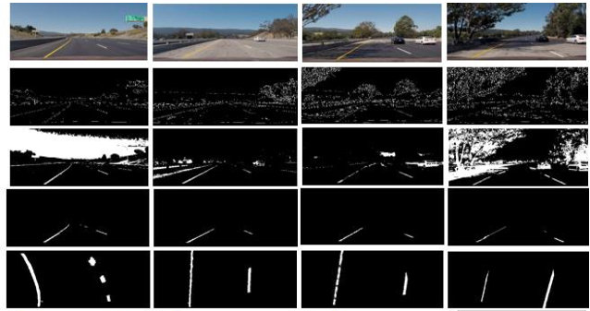
Example – Self Driving Car
Its possible to build a self driving car that will stay between lanes using a mini-PC.
The car is controlled by a model that takes in images and outputs control signals.
Imagine a simplified version that only returned a turn amount to stay in lane.
The filters in the convolutional layers would learn to do edge detection.
The loss is “did it stay in lane”, so the model tries to minimize it.
The weights that trained via BP are the things defining the filters.
The filters that can detect edges are likely to have the lowest loss attributed to them. The ones that don’t have more.
The model will learn in that direction: detect edge->stay in lane->less loss. And the inverse, less lane-y things likely have more loss.

Slide 25
Pooling
The other new type of layer is a pooling layer.
Pooling layers “down sample” the images passed to them.
I.e. Reduces the resolution of the image.
Reduces amount of data to process, which can be large.
Makes features seen in the convolutional layer more generalizable:
E.g. every edge won’t look exactly the same, but they’ll resemble each other.
Intuitively, think of a sharp images of two people, it is easy to differentiate them. Now think of blurrier pictures (e.g. they are in the background of a photo) – the differences fade and they look more similar.
The above is the goal – identify edges, circles, head shapes, etc… in their general form.

Slide 26
Pooling
Pooling down samples, or transforms the data into a lower pixel representation.
Reduces the resolution (# of pixels) of the data, making processing easier.
Makes the characteristics found in the images more generalizable.
The filter learns to identify some characteristic.
We want to be able to identify said characteristic in other images.
The pooling makes it into a lower definition representation, removing details.
Our characteristic is now more tolerant to small changes.
I.E. a very HD photo of a bike wheel will allow you to identify spokes, rim thickness, etc…
A lower definition one will just look like a circle – this is what we (generally) want.

Slide 27
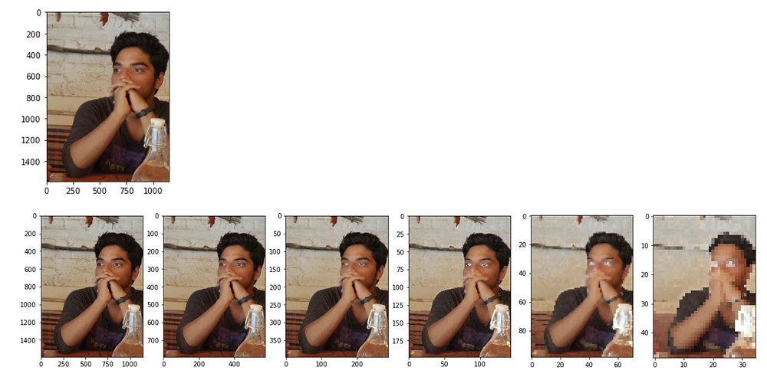
Higher def -------→ Low def

Slide 28
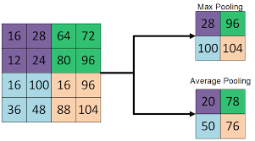
Pooling Types
Pooling is a simple concept – we take a set of pixels and reduce it to one pixel.
Pooling size defaults to 2 x 2.
Common pooling techniques:
Max pooling – the output value is the max of the pool values.
Average pooling – the output value is the mean.
What’s the difference?
Max – better at extracting contrast, e.g. foreground/background.
Average – smooths sharp features. Captures more info across the entire image.
Max is used the majority of the time.

Slide 29
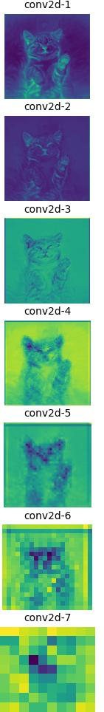
Stacking Layers
As data goes through layers, each one gets a ‘lower level’ representation.
Pooling layers will collapse a square of (usually) 4 pixels into one pixel.
Each layer “extracts a summary” of the layer above it.
At lower layers, the things are the same. These feed the DNN layers as the features.
Each set of filters will tend to learn different ‘objects’ in the image, and feed it to the DNN.
Objects can be made up of the several different low-level ‘objects’ found.
Some filters may end up learning to detect circles for the wheels.
Some filters may detect the edges for the body.
Lower-level filters may combine multiple objects in one – two wheels and some edges.
None of this is prescribed, but if a model has low loss by detecting a car, and cars are best detected by these characteristics, that’s where the model will eventually head.

Slide 30
CNN Back end
After the convolutional parts of a CNN have extracted features, it is time to predict.
We flatten the data down and use a normal dense network at the end.
Overall structure:
CONVOLUTIONAL STUFF
Convolutional layer
Pooling layer
Repeat
DENSE NETWORK
Flatten layer
Other stuff (hidden, dropouts, etc… If needed)
Output layer

Slide 31
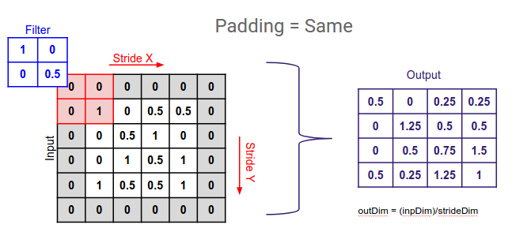
Padding
Padding determines what happens at the edge of an image.
The filter window can either:
Stop at the edge. Reduces dimension. Valid padding.
Go over the edge, filling in a border of 0s. Maintaining dimension. Same padding.
Padding does what we’d expect, better maintains information in the corners. (Border effects).

Slide 32
Batch Normalization
Batch normalization is a common step used in CNNs.
Standardizes the data between layers.

Slide 33
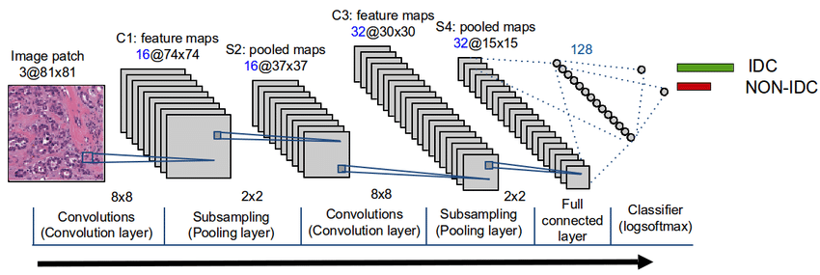
Convolutional Portion
The convolutional parts of a CNN normally repeat this through several layers:
Convolutional layer finds component image features.
Pooling layer generalizes.

Slide 34
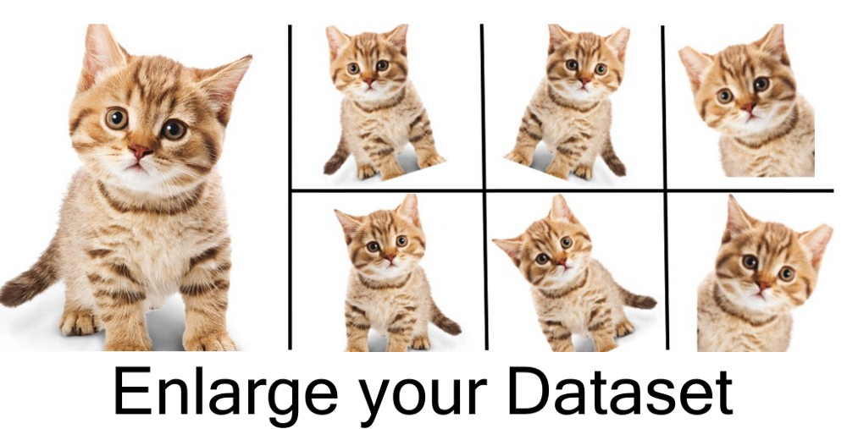
Data Augmentation
Recall the #1 rule of better predictions – get more data.
Images make it easy to generate more data for training.
Flip images.
Shift a window to parts of an image.
Easy to do when constructing a dataset.

Slide 35
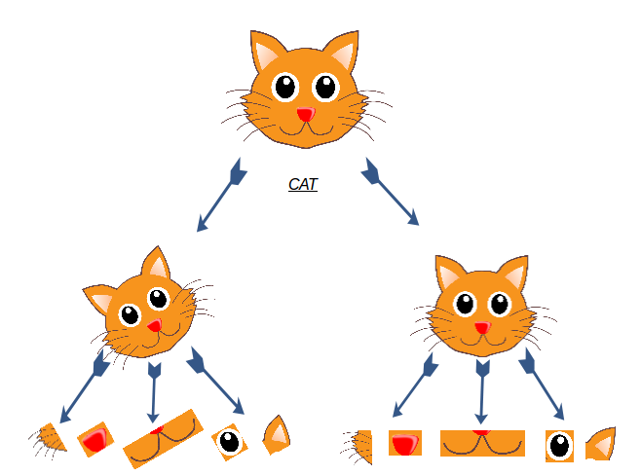

Slide 36
Real Life CNNs
CNN models are the way that image processing is done in most cases.
Modern image recognition models are very good, complex, and large.
Typically far beyond what is possible to train on consumer equipment.
Massive datasets are needed to train very large/complex models.
There are very few scenarios where training a model from scratch will win.
Only if the image data is very specialized, and we have a lot of it.
We typically want to borrow and adjust a pretrained model if we want performance.
The generalized parts of “seeing” are common enough to transfer between problems.
We can repurpose the features found with convolution with our own classifier…

Slide 37
Pretrained Models and Transferred Learning
On common practice with images is to use a pretrained model.
Images are large, datasets can be huge, processing is demanding.
Common filtering is built in, since it has been trained with a lot of data.
E.g. for navigation edge detection is very important. Edges are a common feature that is extracted with image processing.
Since CNNs can find characteristics anywhere in an image, it is very transferable.
Since features are common across images in general, not just ours, we can borrow that learning!
We’ll look at this more in ~2 weeks (2024 – time dependent).

Slide 38
CNNs and Images
Convolutional networks will generally perform better on image data.
The spatial awareness of the convolutional layers are able to ‘see shapes’ in a far better suited way than a flattened model.
Convolutional networks often benefit from depth.
Each layer extracts a different set of features from the data, pooling summarizes.
Multiple representations allow for the network to identify components in an image.
Tuning is a more open-ended and larger challenge.
Structure of the network can be far more variable.

