Slide 1
Housekeeping
Today:
Tensorflow part 2.
Making and basic tuning of models - callbacks, results, evaluation.
Assignment on neural network regression should be doable after this – it isn’t too complex.
Next time(s):
Images in neural networks – CNNs.
Processing image data in a smart way.
Overall – we’ll do some image stuff next, which is important. There are a few workbooks on NN-time series (RNN/LSTM/Transformers) that deal with sequences/NLP/text generation. Those are useful things, but we won’t get all the way through them.

Slide 2
Cluster Assignment - Results
The basic steps needed are:
Cluster the original data to break the numbers into similar groups. (k-means, other…)
Manually add a label – each group is similar, but we don’t know what it is a group of.
Now you have labeled groups of digit images.
Train 10 (or more) GMMs, one that ‘knows’ each number from the data used to train it.
When asked for a printout, ask the right GMMs for a digit each, assemble.
Overall, the images tend to be OK at best, some improvements:
Number of clusters can be >10, to capture different digit variations. GMMs can as well.
Some cleaning/processing (PCA, feature selection, etc..) may help, requires much tuning.

Slide 3
Cluster Assignment
Common issues:
Assorted mix-ups applying labels to clusters.
Training GMM timing/location.
Adding labeling:
This feels weird to lots of people, but it isn’t really all that rare. (LLMs and gen models).
The clusters are able to be ‘pure’ on their own, but we need to add the label info ourselves.
This could be supplemented by other models – e.g. manually label enough, then use classifier.

Slide 4
Tensorflow and Keras Optimizations

Slide 5
Neural Network Configuration
We’ve seen that neural networks offer a large amount of flexibility in their configuration.
How do we determine the optimal structure?
Generally, the true answer is to grid search it.
We can use some guidelines to get started in a reasonable and smart way.
This is largely getting used to keras and making adjustments there.
Play around with some models, get used to syntax, try some different models.

Slide 6
Network Size
The first thing to look at is the network size, or capacity.
The more neurons a network had, the higher the capacity.
In general, larger networks need larger amounts of data, to find more complex relationships.
We can examine the two metrics of size:
Neurons per layer (width)
Number of layers (depth)

Slide 7
Width vs Depth
When we make a neural network, should we favor width or depth?
In theory one hidden layer can approximate any function.
Universal approximation theorem – one layer can in principle learn anything.
In general, depth is preferred more often. Why?
Wider networks are more prone to overfitting.
Deep networks can find representations of data with each transformation (see in CNNs next)
We can apply regularization on or between layers to counter overfitting.
Deeper networks can provide a kind of feature selection as less significant features are minimized.
Deep networks have shown greater performance recently.

Slide 8
Example: ImageNet
Imagenet is a dataset developed in the late 2000s to help computer vision.
Thought – better dataset leads to better models.
Nested set of 3.2 million (initially) to over 13 million (now) images with labels.
Labeled largely through Mechanical Turk service.
Hierarchical labels – e.g. a chair is a type of furniture, a dog is an animal.
Became benchmark of image recognition accuracy.
From ~2012-2013 to ~2015-2016 networks got deeper and losses fell.
In addition to use of CNN architecture – next time.
Improved GPU speed and utilization drove success.
Why GPU? The multidimensional tensor operations are similar calculations to 3D space.

Slide 9
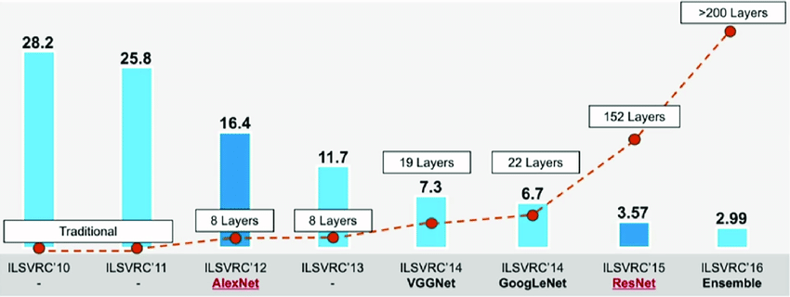

Slide 10
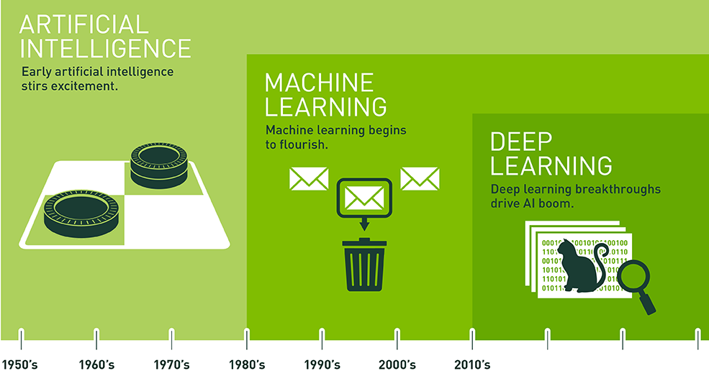
Deep Learning
For modern usage most/all of the “cool things” that AI can do is due to deep networks.
Reasons:
Layers can extract different representations of data. (More on this next time).
Opportunities to regularize.
Less overfit prone than wide models.
Practical evidence is that deep models are generally better.

Slide 11
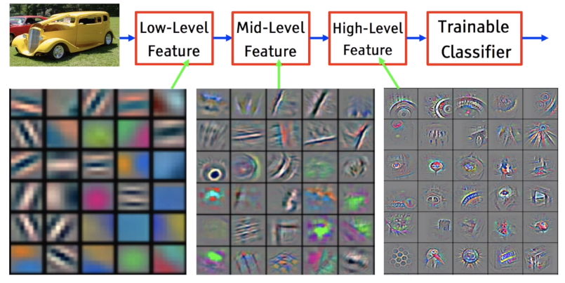

Slide 12
So how big do I make it?
See more specific guidelines in workbook.
Start with 1 to 3 layers the same size as the input (or ~512-768 if input is huge).
Add layers to overfit.
Add regularization to cut overfitting.
Try with layer size “funneled” down layer by layer.
Prune network.
A real answer is grid search, this should get us close enough to start with.

Slide 13
Epochs and Batches
Epochs and batches are both things that are new to us with neural networks.
Each epoch is an execution of one fp/bp through all of the data.
Easiest method is to set early stopping and let the computer figure it out.
Really big models might only have one epoch through the data total.
Batches are how many records to process before updating weights.
Just like regular gradient descent – higher is more stable, smaller more erratic.
Limited at the top end by memory capacity.
Large vs small is still a matter of debate and varies by data.
Generally, smaller batches (as small as 2 -32) seems to offer better generalizable models.
Big batches may process far faster – better HW utilization and fewer weight updates.
Think – weight matrix per layer is input_size * output_size. 512 * 512 = ~250k updates

Slide 14
Optimizer
The optimizer is the algorithm used for gradient descent.
We’ll leave this aside for the most part.
Adam is the most common and is a good choice:
Converges efficiently.
Computation and memory efficient.
Different algorithms are more critical with very large datasets where the computation differences on the specific data add up to substantial time.

Slide 15
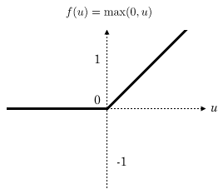
Activation Functions (Hidden Layers)
Activation functions “squish” the linear combination in a neuron into an output.
They provide the non-linearity that neural networks need.
No activation function = giant, complex, linear regression.
ReLU – Rectified Linear Unit has been our default.
Efficient computations, converges quickly.
Can suffer from “Dying ReLU” – if inputs are negative functions can get “stuck” at 0.
Some neurons may “die”, and never change from returning 0.
Results in sparse outputs.

Slide 16
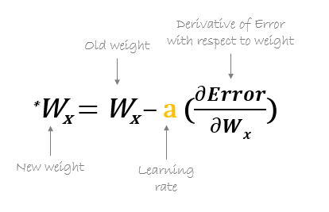
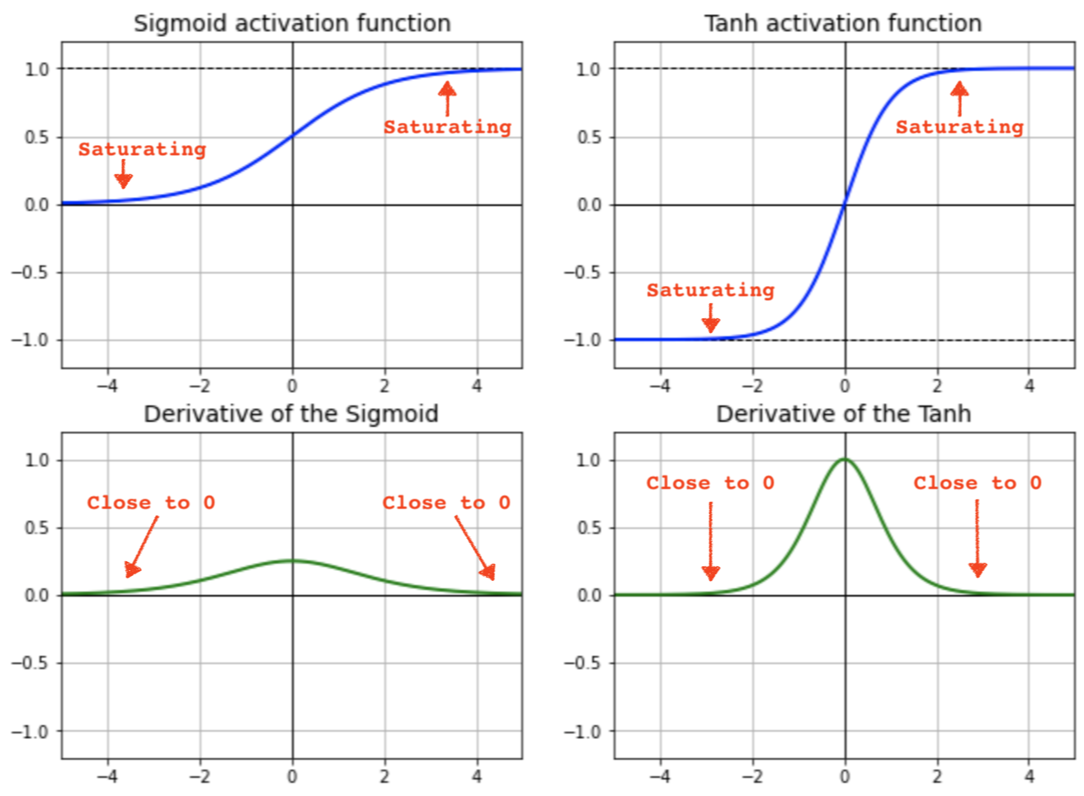
Weight Updates

Slide 17
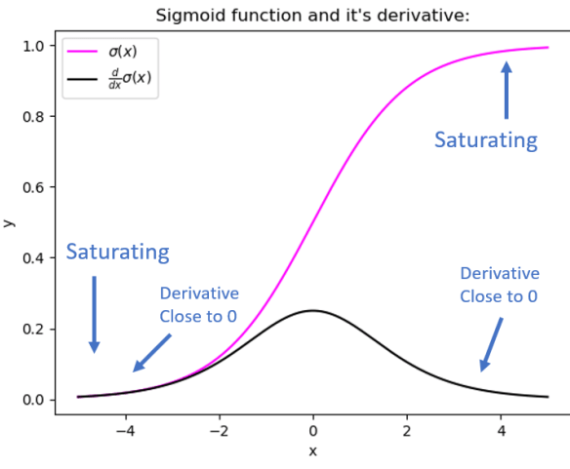
Vanishing (or Exploding) Gradients
Recall – gradient descent attributes error to different weights using the gradient (slope of the cost cure w.r.t. that weight).
Recall some neural network training facts:
They have many weights.
Propagate loss back through all layers, and there can be many.
Often train over many rounds, and get very accurate.
We can encounter a problem that small changes to small numbers from small error split many ways yields tiny values.
The gradient can “vanish” if it is too small for the GD to work.
This can lead to ‘dead’ models, that can’t keep learning.

Slide 18
Keeping Gradients Graded
There are several things that can combat this problem.
Activation functions – the sigmoid gradients can flatten more than others.
Normalization.

Slide 19
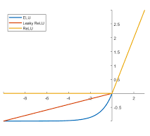
Activation Functions – Relu Variations
To address those issues with ReLU, alternatives were created:
Notably – Leaky ReLU and ELU (exponential linear).
Each removes that 0-value range of the derivative.
Removes the Dying ReLU issue, so gradients don’t vanish as much.
Can help speed training, or even allow convergence at all.
ReLU or a variation on it are our defaults, and normally good.
If using ReLU – reducing LR can also combat the dying issue.

Slide 20
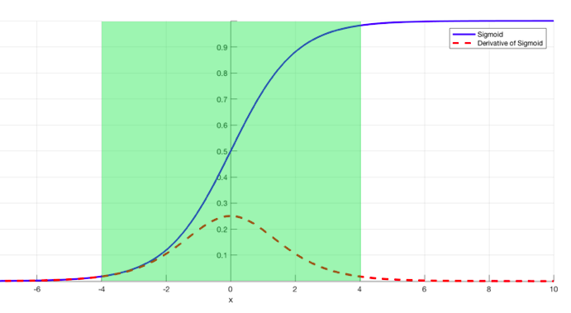
Batch Normalization
Another gradient maintaining technique is batch normalization.
Batch normalization will shift the distribution back to “the middle”, where gradients exist.
“Flat” gradients may vanish – near 0/1 here.
Usually applied after dense layer, but can vary.
Can often allow higher learning rates to work.
It isn’t fully understood yet, weirdly.

Slide 21
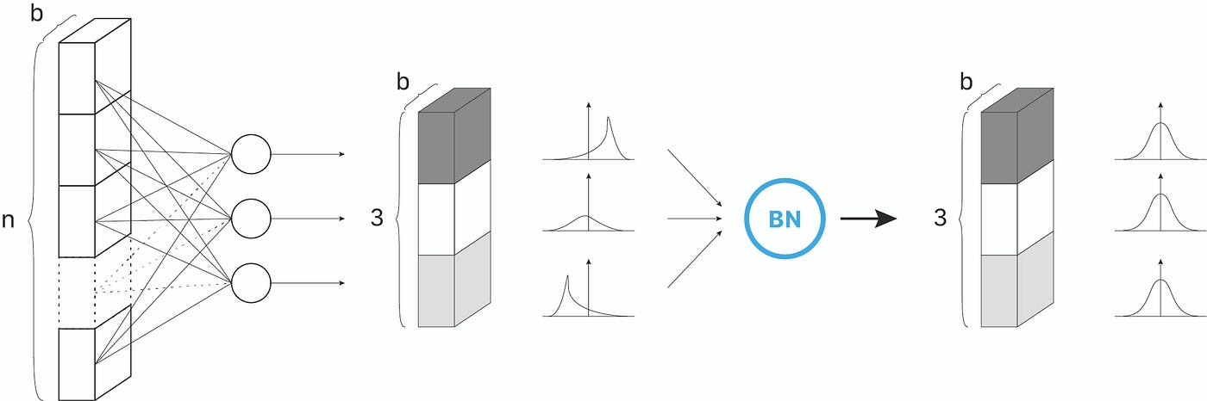

Slide 22
Initialization
Initialization controls how the weight and bias values start.
Can be controlled via a parameter for each layer:
Weight initialization is by default is “glorot_uniform” – a variety of random.
Bias initialization defaults to 0.
We won’t delve into the details of initialization much – lots of math, not practical.
Imbalanced data – the data has a “bias” to start with.
Set bias on output layer to the bias in the data.
Network doesn’t need to learn the massive shift in bias.
Faster convergence and more accuracy.

Slide 23
Other Tuning - Optimization
There are a huge number of things that can be changed to tune a neural network model.
We are focusing mainly on the ‘structure’ type of things.
Network size, layers, type, hyperparameters, regularizing (and similar) layers like normalization.
We are not really focusing on the optimization part - loss/gradient descent specific things.
Learning rates, momentum, optimizers.
This matters, but is more theoretical in theory, and scenario dependent in practice.
Optimization is critical as problems get larger – converging quickly, or at all, can be hard.
For our usage, we can try other optimization options, but we’ll mostly ignore it.

Slide 24
Pruning
Neural networks can get very large!
Like a tree, a trained network may contain parts that aren’t super critical in making predictions.
As an example, think of “dying relu” neurons.
Pruning can trim a network back by making it more sparse.
Can potentially improve generalization – just as tree pruning does.
Allows networks to be used for prediction with fewer computations.
Predictions on a computer: one forward propagation, relatively simple.
Predictions on a phone/raspberry pi/Roomba/drone, can be challenging.
Pruned models require less processing and less memory, can be used on more devices.

Slide 25
Conclusion
There are many variables in making a good neural network model.
Size – we need to make the model big enough to learn the data.
Structure – different model structures may perform better (we’ll see this next, more).
Regularization – L1/L2, dropout, batch normalization.
Training Parameters – learning rate, optimizer, etc…
For us, we can settle on getting close, then letting things train.
Real model tuning becomes impractical at a larger scale, we don’t need to obsess.
There’s not one solution for what model will work.

