Slide 1
Housekeeping
Today (008 and 010 – some small edits today, so pull again if yours is old):
Larger dimensions of input data and the Curse of Dimensionality.
Multiclass classification and softmax via logistic regression.
Using image data in models.
Support Vector Machines + decision boundaries, dimensionality, kernel tricks. (Dep. On time)
ML Exam - March 14 (Unless there’s some issue with that??).
Basic concepts of ML – train/test, accuracies, errors, model types, gradient descent, etc…
Theory behind different models – regression, trees, SVMs, clusters.
Other stuff – PCA, pipes and grids, plotting, etc…
It’s not really hard, this stuff is mostly hands-on, it’s a pretty simple quiz.

Slide 2
Logistic Regression and Images

Slide 3
Logistic Regression – What’s New?
Regularization
Multiple Classification

Slide 4
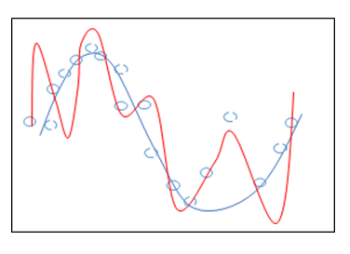
Regularization
Logistic regression is a linear model.
Recall the internal regression of logit.
Regularization penalizes growth of the model’s weights.
Regularization is (generally) applied to linear models by default.
We can define the type with the HP: penalty
Logistic regression has L2 as default.

Slide 5
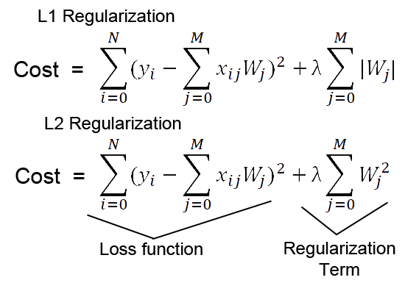
Regularized Cost penalizes Weight Size as Well as Error

Slide 6
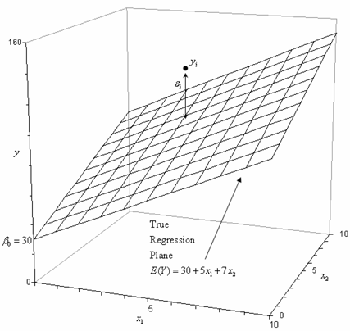
Regularization in Effect (W/ Bonus Normalization)
Recall:
In a regression, the prediction is just y=mx+b calculated.
Scaled data to have Xs that all in the range. ~0-1(or norm.)
Regularization limits the growth of the m. (Weights)
B (intercept) is purely corrective, added at the end to shift.
In regression we’d have scaling and reg. limiting [mx] terms.
I.e. the model is less “reactive” or variant in its predictions.
In large models, with many terms, this limits overfitting.
“Blunts” the impact of any one factor.
Weight determines X’s influence on Y, overweighting is penalized.

Slide 7
What about Classification…

Slide 8
What if There Are More than 2 Classes?
Classification models have defaulted to binary so far.
Classes are (or can be understood as) True and False.
Output is the probability something is true, translated into a T/F for a final prediction.
Loss function (binary cross entropy) is built on the difference from the correct answer.
Trees and Bayes can handle more than 2 output classes by default, linear models can’t.
We can modify these models to handle more than one class, in several ways.
One vs One – make a classifier for each pair of possible outputs.
One vs Rest – make a classifier for each class vs not that class.
This can be forced in Sklearn, but is generally invisible. SVM uses OvO, other linear use OvR, and tree or Bayes models can do multiple classes directly.

Slide 9
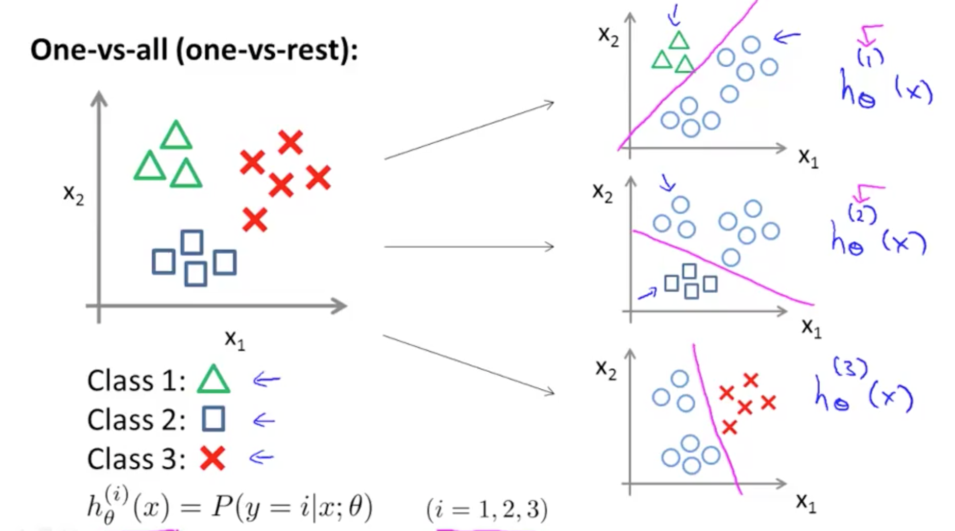
Multiple Classification
We can also predict things into multiple classes.
Sklearn does this by default by doing 1 vs rest.
Build 1 classifier per class, making a yes/no for that class.
We get the probabilities of the above prediction.

Slide 10
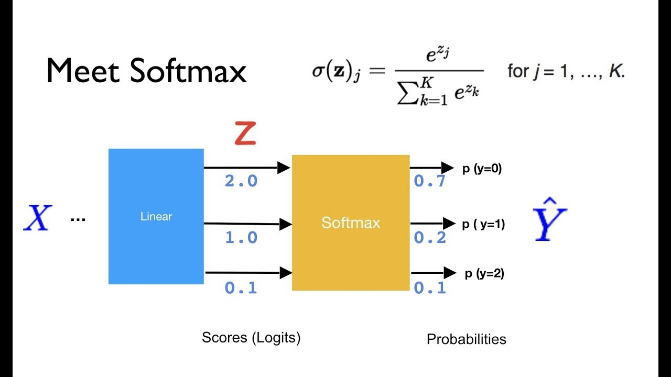
Softmax
Softmax allows us to directly predict class probabilities with one classifier.
The output of Softmax is a probability (0 to 1) that the instance is in that class.
Softmax can:
Take in the logits, or the output of the regression models internally.
Change those into probabilities per class, which is what we need!

Slide 11
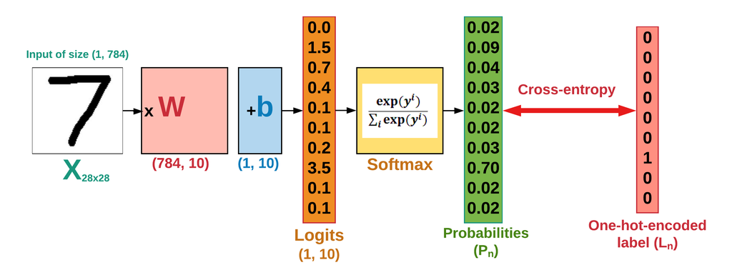
Cross Entropy
Cross Entropy (non-binary kind) is a common cost function for classification.
Cross entropy translates the softmax probabilities into a label, and calculates the cost.
Like binary cross entropy, this measures the “distance from” the correct prediction.

Slide 12
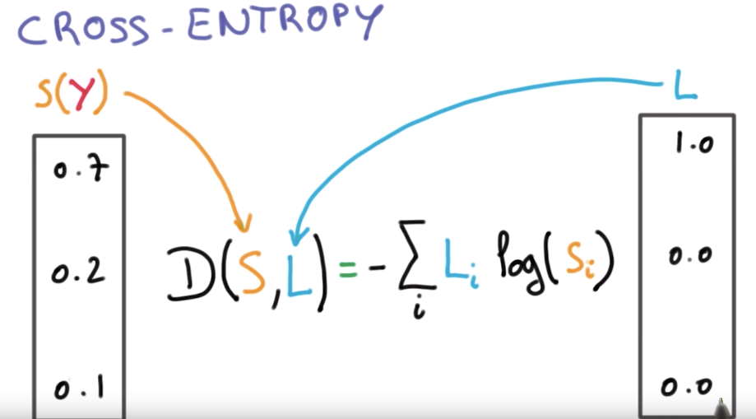

Slide 13
Gradient Descent and Multiclass Models
The gradient descent process is the same, the cross-entropy generates loss, the gradient is taken on the loss curve w.r.t. each feature, the weights are adjusted, and repeat…
As long as something can be structured as “loss” and ”things to adjust”, G.D. is the same.
Regularization is applied by default in sklearn.
Multiclass classification is commonly used on things like image recognition, where there are lots of potentially classes, so limiting overfitting is good.

Slide 14
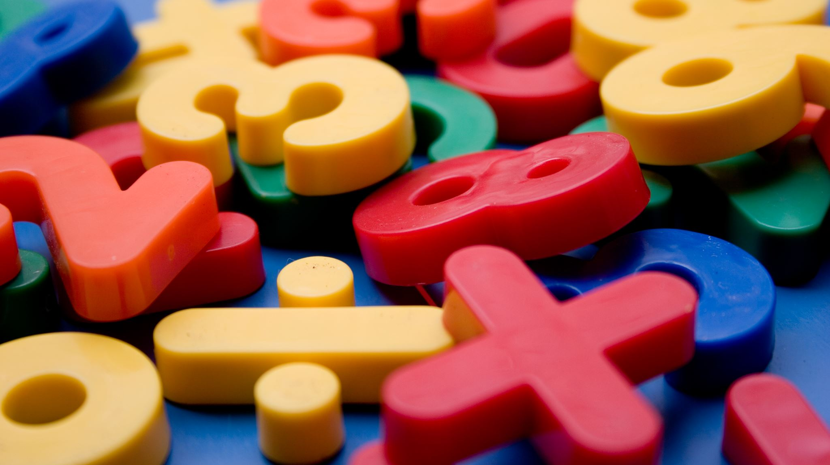
Multi-class Classification - Images

Slide 15

Images
Images are basically 2D (for now) grids of pixels.
Your 1080p screen is 1920 x 1080 pixels.
Each pixel is an integer value.
0-255 for darkness
Images are normal data, and we can treat them like any other data.
This allows us to, pretty easily, do image recognition!

Slide 16
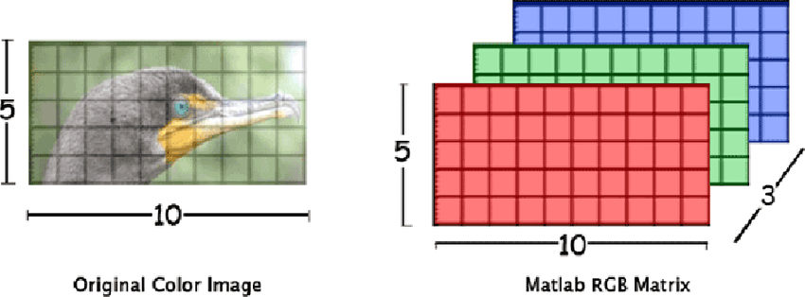
Better Images
Our images are simple – 1 color.
No depth - we only need an array with depth of 1.
More complex images add pixels and additional layers for more color.
These are tensors – multidimensional arrays.

Slide 17
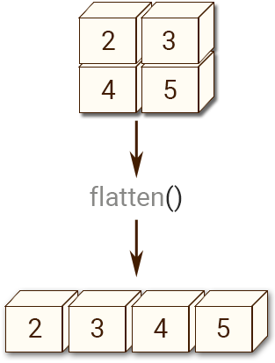
Classifying Digits
We can create a model to classify digits into 10 classes.
Our image data – we will interpret it like “normal” data:
Each digit is an image of pixels – either 64 (8x8) or 748 (28x28).
There’s only one color, so each pixel can be between 0 and 255 for “darkness”.
Our target is the label, the actual number that the pixel is.
We can flatten the 2D representation of pixels into one row, then use normal models.
Each pixel will now just be one feature, in order. (We can reshape back to get original)
We lose the spatial part of the data – our flat representation doesn’t “understand” 2D.
With images, and other things that are analog, we create a representation to use.
There are better ways to process image data that keep spatial awareness, we’ll see later.

Slide 18
Data Representations
For structured data (numbers, classes, Booleans) the data values we use are pretty set.
Our models calculate numbers, so we are just converting to different numbers.
Our predictions are based on getting as close as possible to whatever the value is.
For unstructured data, that can’t really happen.
An image, sound, or paragraph doesn’t really have a ’value’ in the same sense.
We need to generate a representation of the data to use in a mathematical model.
Here, that is a simple rearranging of the pixel layout.
In more advanced image processing models, we can look at 2D ‘hunks’ (or edges, or…)
Soon, for free text, we’ll need to do something similar – generate an embedding.
Performance depends both on the model, and how good the numeric representation of reality is.

