Slide 1
Housekeeping
There’s a test next time! Guide online. Ask away if there are questions.
Today:
Review of text processing basics.
Spatial data – geopandas, spatial data for predictions. Easy and simple.
Next week:
Time series models – if there’s anything from your project stuff, we can look at that.
Boosting – ensemble models part 2 and modern non-NN models.
Then… neural networks!!!!!!!

Slide 2
Review – NLP Basics
We last looked at using free text in our predictions – natural language processing.
We can use text as a feature set to mainly (mainly) classification models:
Predicting spam or not spam.
Classifying potential customers into groups.
We can also cluster with the language data.
Grouping employee surveys into similar clusters.
These projects all rely on translating the free text data into a feature set.
I.e. the X data is text, the y data is something else, usually a class.
These types of models are not suited to text generation – they don’t capture sequence.

Slide 3
Text Representations
Like with any other unstructured data (images, text, etc…), we must create a representation for our text in a structured format, so it can be used by our models.
First step is tokenization – breaking text into “terms”, usually 1 word, but possibly more.
Several methods exist to transform text into a numeric representation – vector:
Count vectorization – features are common tokens, values are frequency counts.
TF-IDF – features are common tokens, values are calculated from frequency.
LSA – features are ‘topics’, values are ‘topic scores’, generated from PCA-ish transformation.
Word2Vec – features are embedding dimensions, values are scores, generated from NN.
This representation will highly impact the quality of models that use the data.

Slide 4
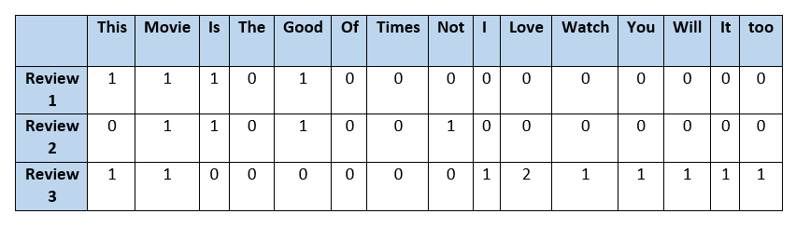
We need a numeric representation
What the features are can vary – there’s no inherent correct answer.
Each vector should capture the “meaning” of the text, as well as possible.
We use the vector just like any other X dataset.

Slide 5
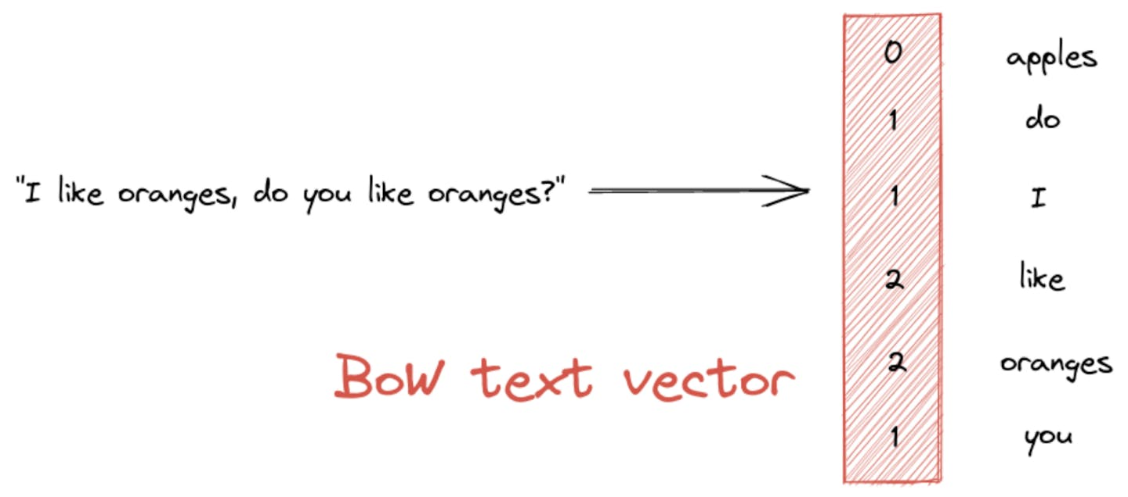
Count Vectorization
Simple language, low nuance, low variance of terms, able to simplify with stem/lem all make this more likely to work well.
Generates a “Bag of Words”

Slide 6
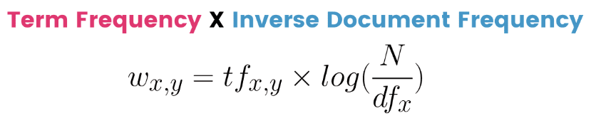
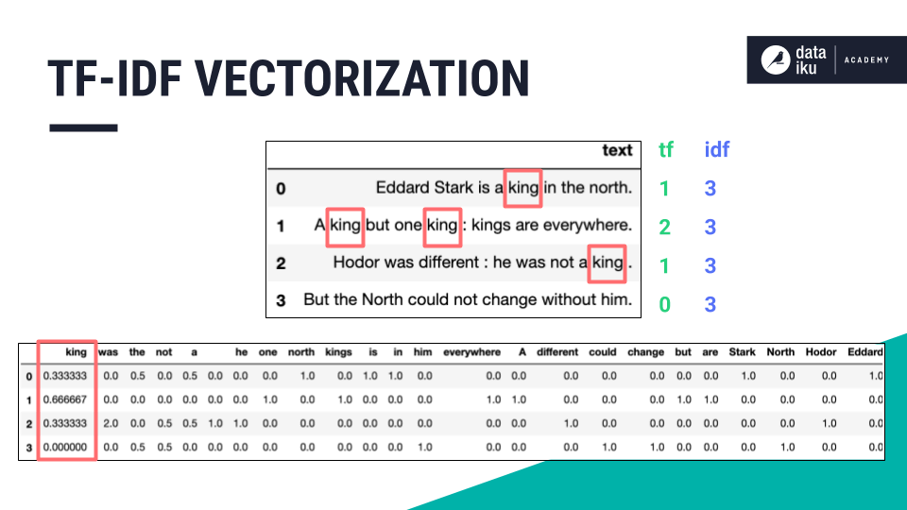
TF-IDF Vectorization
Adds frequency calculations to weight significant tokens.
Frequent words are less important to meaning.
Super rare words are less important to meaning.
“Smarter” than just using the straight count.

Slide 7
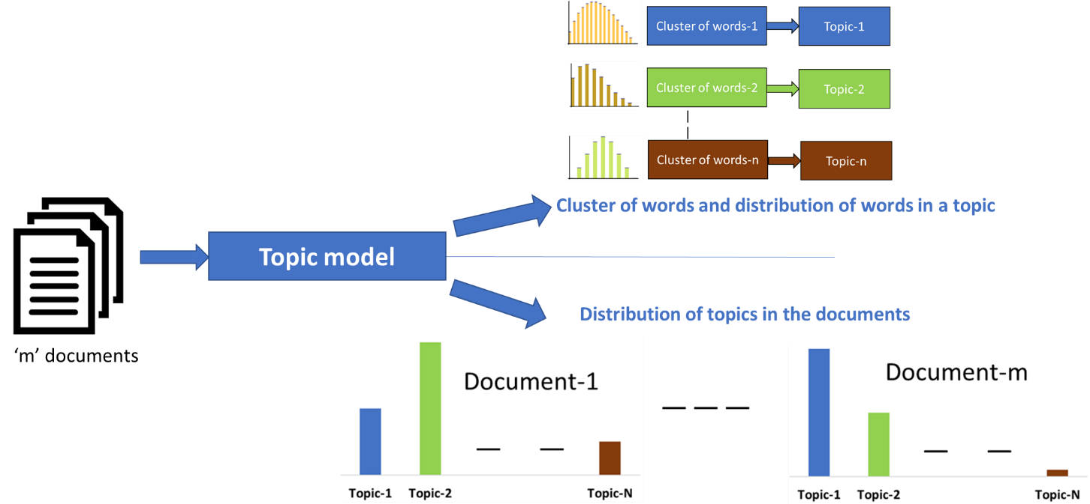
Latent Semantic Analysis (w/ Truncated Singular Value Decomposition)
Uses linear algebra decomposition, similar to PCA, to generate ‘topics’.
Like PCA components.
These topics are ‘latent’ – they are not seen in the raw data directly.
Scores on different topics are the features.
Given enough data, these topics can be quite relevant to the meaning.
Can reduce noise by ‘focusing’ on topics.

Slide 8
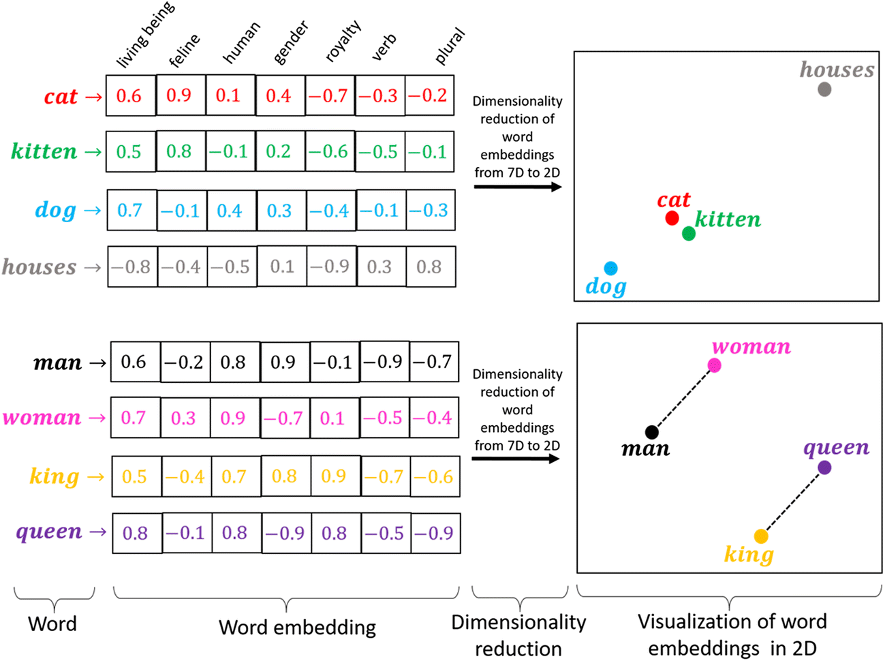
Word2Vec Embeddings
Word2Vec provides a more elaborate representation.
Able to capture some sequence data.
A model learns ‘meaning’ by training on lots of text, and generates an N-dim ‘space’.
Word meanings are the N-dim position of each token in space. GPT is apx 1500d now (was larger).
Similar terms are close (thought the number of dimensions makes this harder to picture).
We need to condense these scores down to use in our model (MVE function in example).
Capturing the ‘real’ data requires more/different work and models – padding, multi-dim, etc…

Slide 9
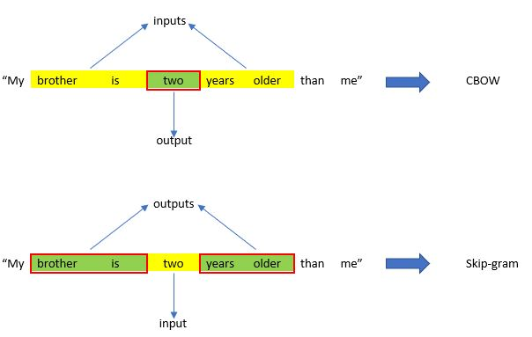
Word2Vec Differences
Word2Vec is more complex and elaborate, the vector it returns isn’t based on simple counts.
The model learns (internally) based on word sequence as well.
The approaches Continuous Bag of Words and Skip-gram are alternate approaches.
They each use surrounding words (the window) to add context to help with meaning.
Result is a vector representation that considers statements as a whole (or larger parts).
There’s also a doc2vec, that does docs natively.

Slide 10
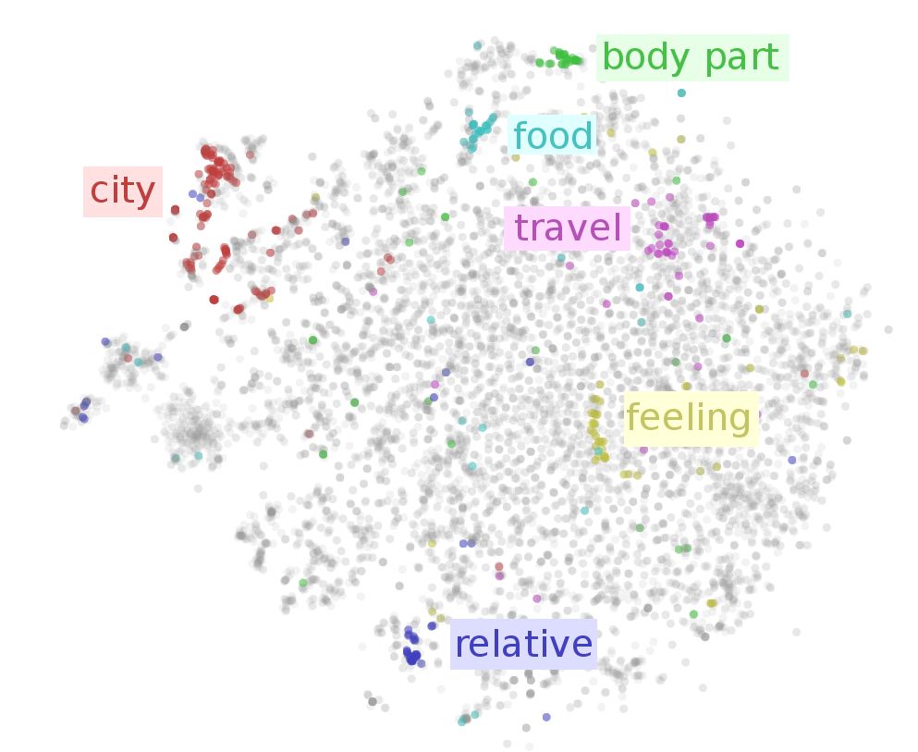

Slide 11
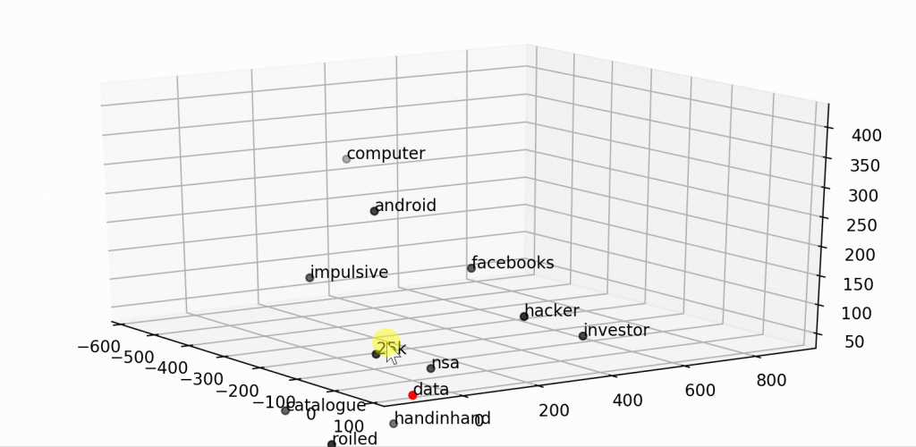
Word2Vec Embedding Space
The space in which tokens are placed are determined through the model’s training.
~ the dimensions that define meaning.
We can supply our own corpus, or use external:
Own – the ‘meaning’ of tokens will match their use in our text. Need more data. Better with specialized language.
Other – the meaning of tokens will be determined from pre-established “embedding space”. Built with lots of data. Better if words mean what they mean in this corpus.

Slide 12
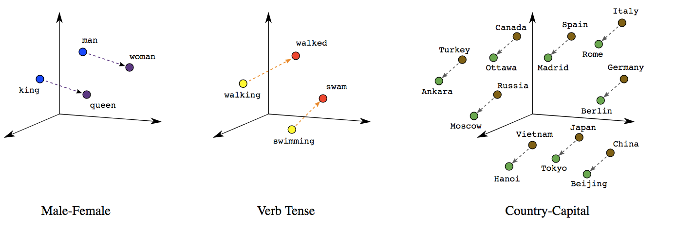
Embedding Based Representations
Embedding representations are the most complex of the options.
A model learns ‘meaning’ by training on lots of text, and generates an N-dim ‘space’.
Word meanings are the N-dim position of each token in space. GPT is apx 1500d now (was larger).
Similar terms are close (thought the number of dimensions makes this harder to picture).
We need to condense these scores down to use in our model (MVE function in example).

Slide 13
In any Case…
The ’representation’ step is where most of the work is with free text.
As long as we have a vector representation, we can use that as the X dataset.
I.e. each feature set (text) is represented by a N-dimension vector (set of nums.)
The target is the value we want to predict from the text.
The quality of that representation, for our problem, is key. The vector captures meaning.
Vectorization choice, number of features/dimensions, and data size.
Processing stemming, lemmatization, n-gram size, and stop word filters.
There isn’t a guarantee that the most sophisticated will be best, especially with small data.
Other models (RNN, transformers) can handle text better using the sequence of tokens.

Slide 14
Tools along the Way
Gridsearch, or smarter gridsearch alternatives, may help narrow down search space.
Adapting the custom transformers in the example may also help, if you want to automate swapping more options.
If processing takes forever, a sample may help, or other dataframe libraries.
Also, consider trying some of the other HP options for the models.
Different models may give very different performance, particularly since there may be very non-linear relationships in the underlying data.
Plotting embedding data reduced down to 2D with PCA (or tsne) is common.
May or may not be actually useful, but it is a fun demonstration.
We are mainly classifying the text, but clustering also works similarly… Or both…

Slide 15
Spatial Data

Slide 16
Mapping Stuff
Some data has a spatial component.
I.e. location or area data that we could map.
‘Region’ data – city, state, country, province.
‘Point’ data – specific latitude and longitude.
We can use this data like any other data, with some special features.
We can use libraries to take advantage of what we know about spatial data.
Area, distance, intersection…

Slide 17
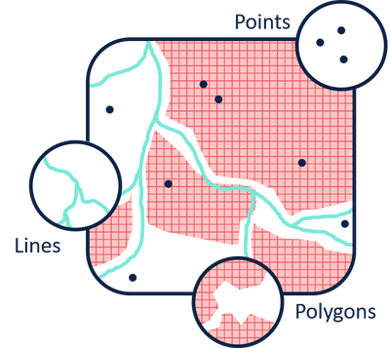
Spatial Data
Spatial data is basically data about geography, or the stuff on a map.
Spatial files.
Define the boundaries of some area (e.g. neighborhood).
E.g. the spatial file for Edmonton neighborhoods defines the “outline” of each neighborhood.
We need to join with our structured data to do something useful.
The structured data has some attribute denoting an area (e.g. neighborhood).
The spatial file has two (important) columns – that attribute and the “geometry”
The geometry defines an outline of each area, in latitude and longitude coordiantes.

Slide 18
Spatial Functions
Once the data is properly setup, we can do lots of useful things quite easily.
GIS – geographical information systems are a family of SW that do this for real.
In Python, we can use a library called GeoPandas to deal with spatial data.
Works mostly like a regular dataframe.
Has some special abilities to deal with mappable data.
Most things that you might measure on a map – is something in here, distance, intersection, etc.. Can be generated from geopandas.

Slide 19
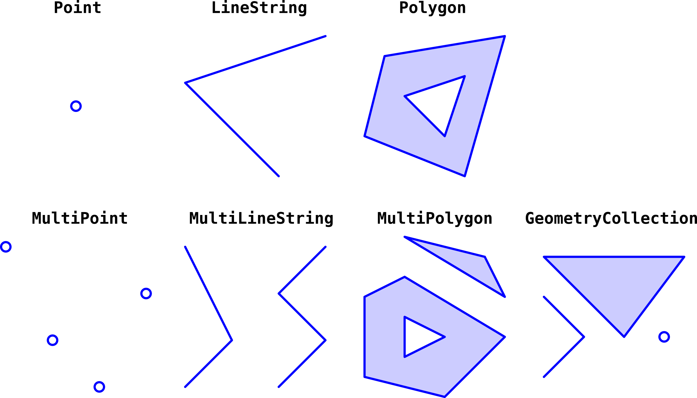
Spatial Data Types

Slide 20
Spatial Areas
The geometry field is basically the outline of some region or space on a map.
Once we have the areas defined, we can easily calculate with them:
Is there intersection of two areas?
Is a point in an area?
How large is an area?
These calculations can be done near automatically with geopandas.

Slide 21
Points
Points in spatial data are, well… points on a map.
Points are a special datatype that are constructed from lat/lon:
We can make a point with the Makepoint function if we have latitude and longitude.
The point data type is basically lat/lon + a ”type” that we don’t care about.
Points allow all the other spatial functions like distance to work correctly.

Slide 22
Lines
Lines are paths that connect two spatial points.
Math using points, such as distance, will automatically figure out earth curvature.
E.g. flight path data.
Geopandas can generate distance/length for lines or between points/areas.
Often useful as a feature if things are related.
E.g. if we have points that are related, we can calculate distance as a feature.
Credit card purchases can have “distance from last purchase”, which may be useful for fraud predictions.

Slide 23
Spatial Joins
We can also join two spatial files together using spatial joins.
Spatial joins do a join, just like SQL, but the “join on” condition differs.
Geopandas will determine intersection of points and areas or areas and areas to do the join.
Allows us to relate points to where they happened.
Map traffic accidents to regions, homes to neighborhoods, etc…
Can also connect areas.
Where regions overlap or intersect.

Slide 24
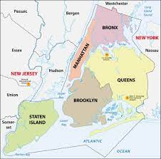
Predicting with Spatial Data
We commonly use spatial data and joins to make predictions in certain scenarios.
It is common to use a spatial join to add a label to point data.
What city/neighborhood/ward did something happen in?
Use that area as a feature, rather than raw lat/lon.
Likely better than lat/lon in most real world cases.
We could also predict what region something happens in, if useful.

Slide 25
Addressees
We may often want to use addresses as a source of location data.
Addresses can be converted into latitude and longitude by geocoding.
Geocoding translates address into a point.
Requires some external service/library to do the work.
Generally paid, at least for large volumes. (Google and others give some free).
No way to do the conversion directly, we need some middleman to do it.
In practice, some part of a data pipeline would do this.
Data comes in with its original address data.
Some step (pipeline transformer, or other) translates that into lat/lon for the model.

Slide 26
Geospatial Data
We can use spatial data for anything involving geographical data.
We likely need to do some work to construct feature/target from spatial info.
E.g. distance, density, # of things in an area, what region is this in, etc…
It is unlikely that the raw geographical data is super relevant in predictions.
Using tools like geopandas, we can leverage any spatial action.
Intersections, “is in”, distance, etc…
Spatial data can be mapped, along with what we generate for display.

