Slide 1
Recurrent Neural Networks

Slide 2
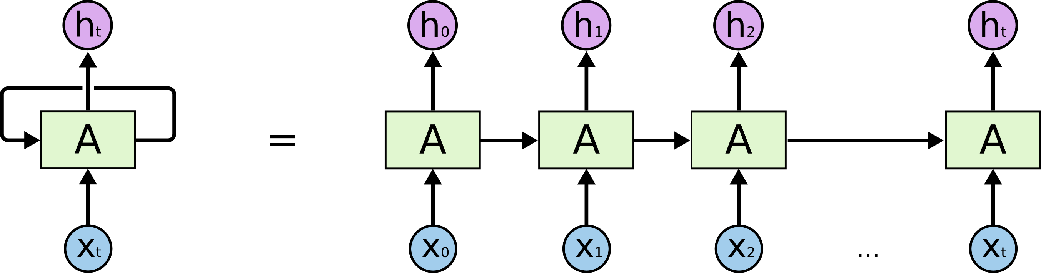
RNN Basics
In looking at a CNN we saw a neural network that can deal with spatial relationships.
RNNs can handle temporal relationships – looking through time.
Time-series and text are well suited to this structure of model.

Slide 3
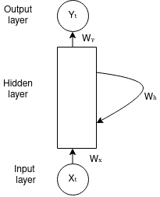
Recurrent Neural Networks
RNNs are able to ”save” some information from earlier steps.
There are several different varieties of RNN models. (Which we’ll mostly ignore).
RNNs maintain a memory by keeping the output of one step as part of the input to another.
This allows things at different time steps to be considered at once.
A ‘regular’ model would have each time step as independent rows.

Slide 4
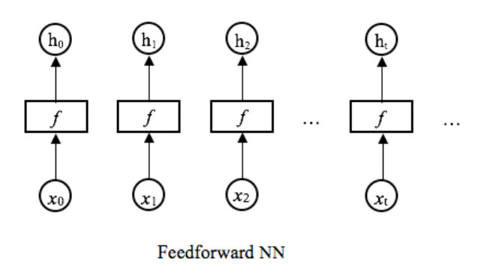
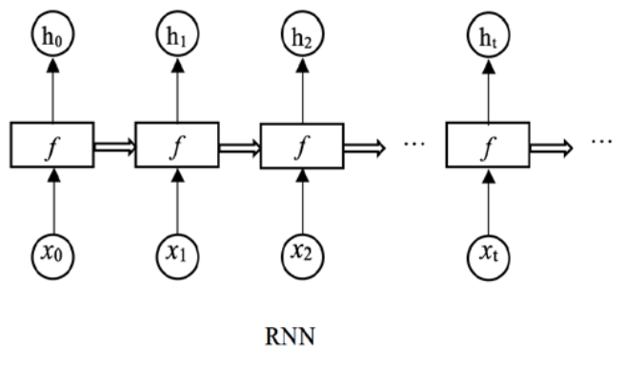
RNN Depiction
We can picture this by contrasting to a regular (feed forward) network.
In a normal network, each prediction is independent.
In a RNN, each informs the next.
If dealing with time series data, this makes sense.

Slide 5
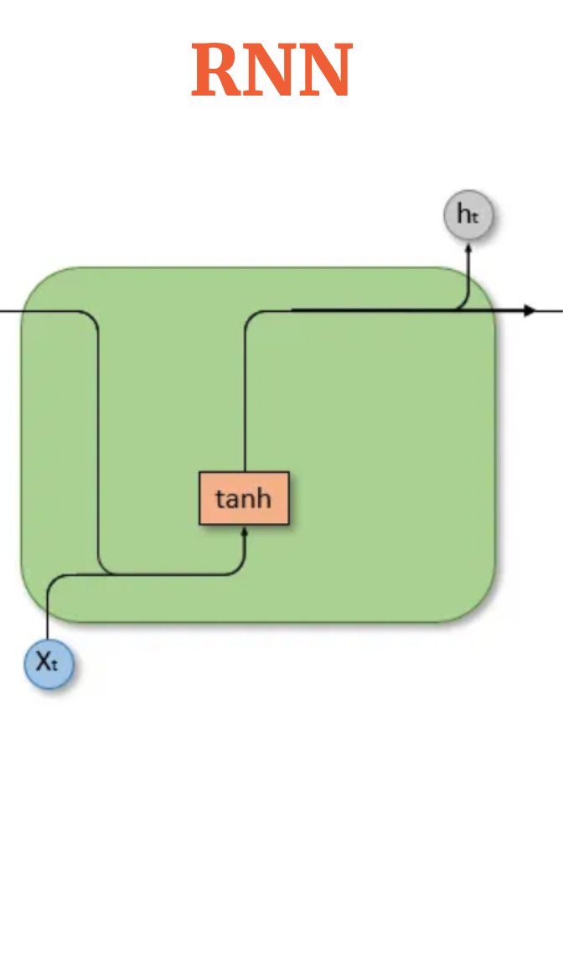
RNN Basic Structure
The basic idea of an RNN is that there is some sort of State that holds memory.
The network can have information from earlier held in its state.
The new record can bring in its features (as normal).
The model can use both to make a prediction.
We refer to this as a ‘unit’ in a RNN layer.
Roughly equivalent to a neuron, though more complex and we have fewer.
The top line is the state, that is what is passed on from before.
The bottom line is the feature set for this record.

Slide 6
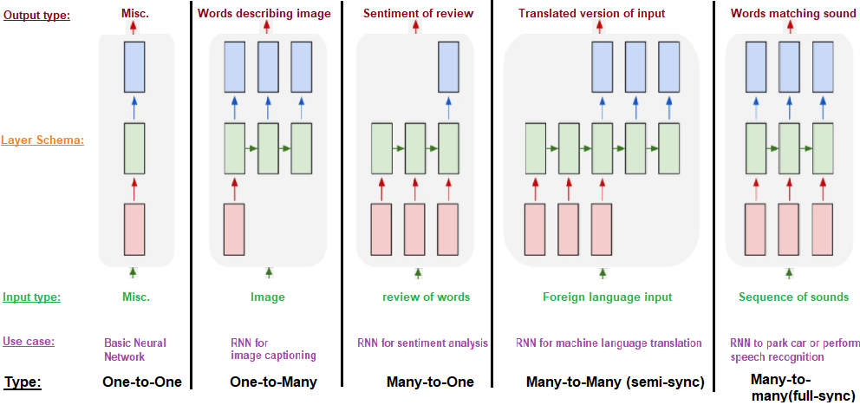
Applications
The ability to keep state allows for RNNs to excel any time we have a sequence.
We can have arbitrary number of input and output lengths.

Slide 8
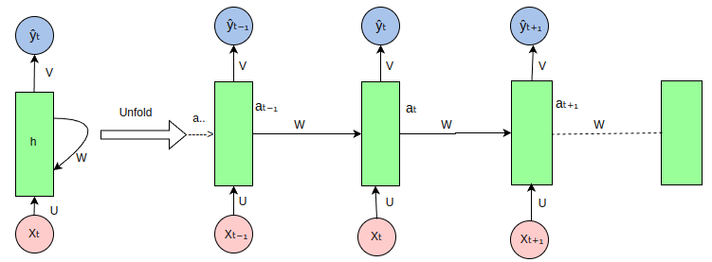

Slide 9
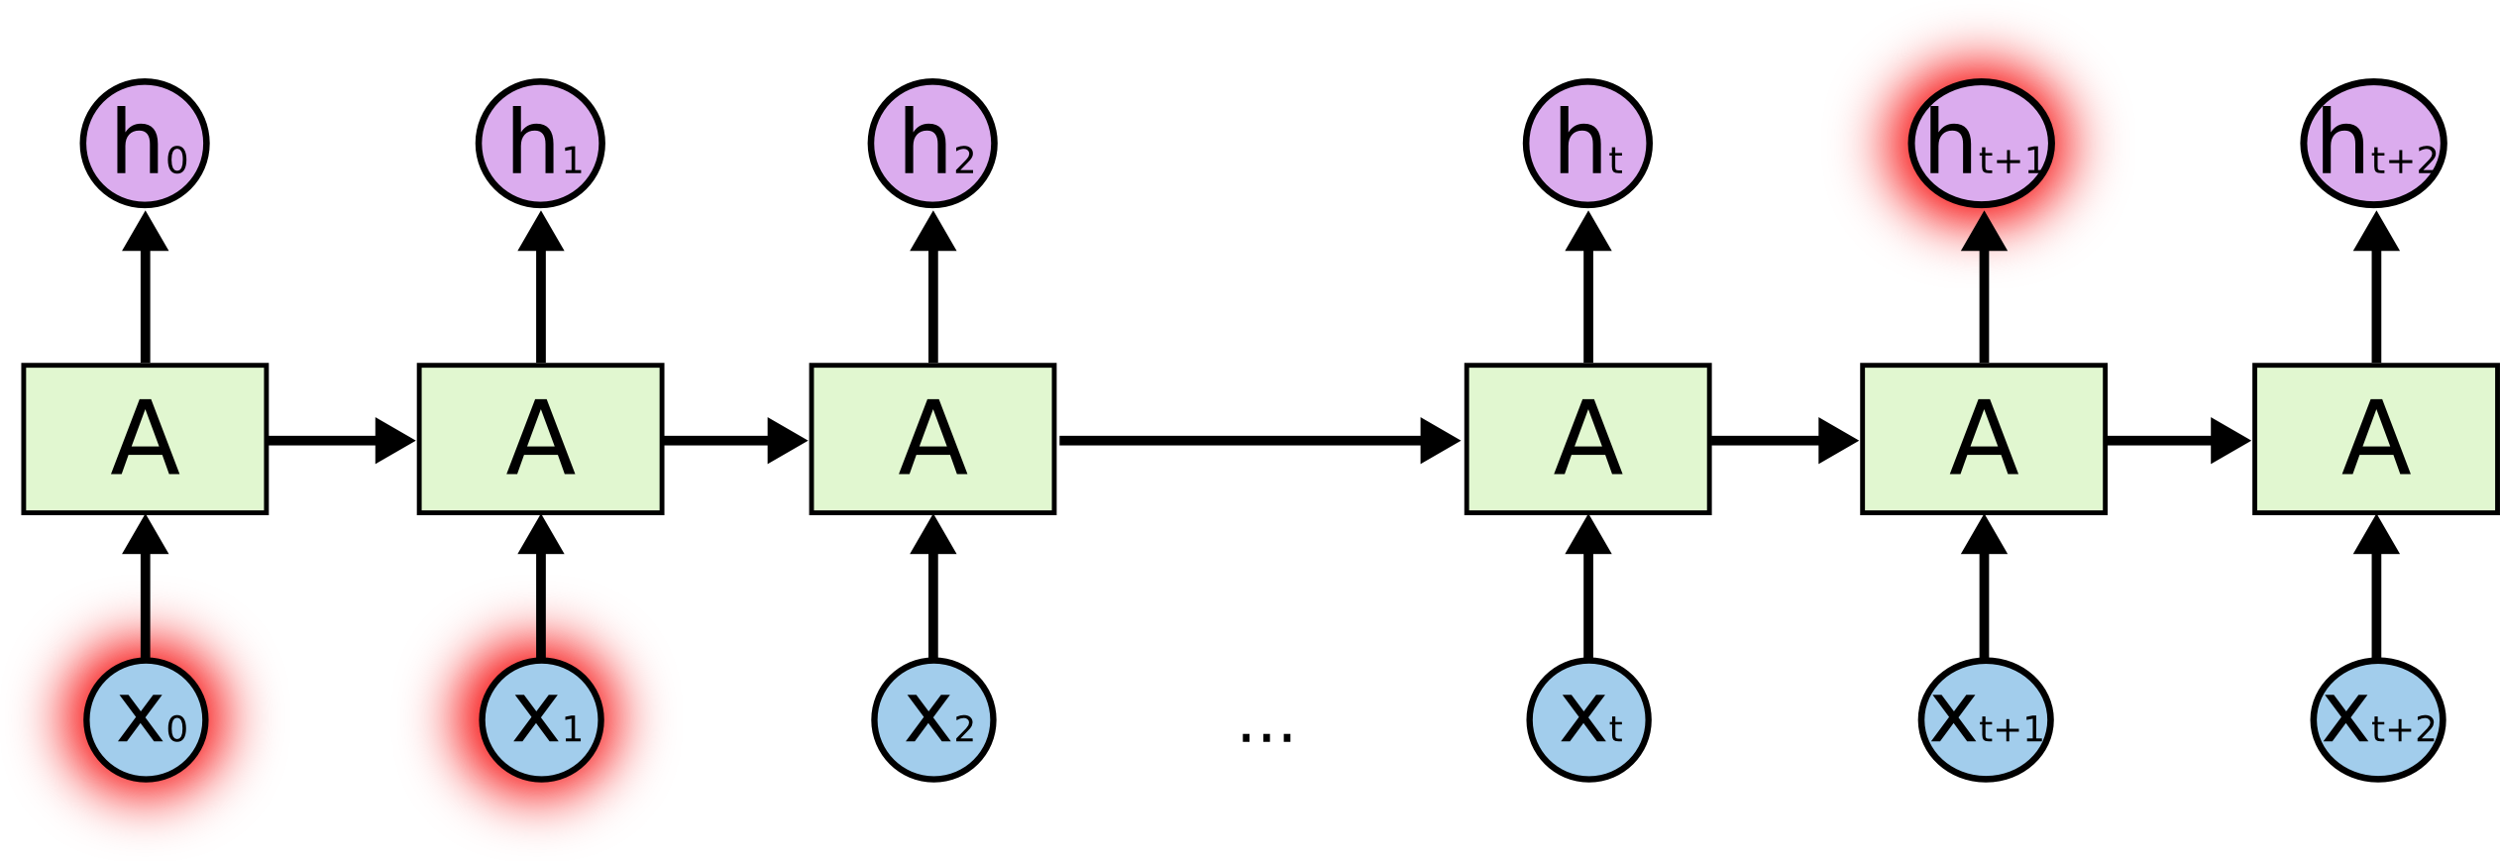
Mo’ Gradients, Mo’ Problems
RNNs can run into issues with the gradients getting too large or too small.
Exploding or vanishing gradients.
Vanishing gradients commonly occur with deeper models.
The longer the memory, the more risk of vanishing.
As gradients get extremely small, learning updates stop.
Solution – Long Short-Term Memory

Slide 10
Long Short-Term Memory
LSTM models are a commonly used type of RNN.
LSTMs can avoid the gradient issues.
LSTMs retain a bunch of data – their long memory.
“Look back” period of N previous records.
At a basic level, the output of an LSTM at a particular point in time is dependent on three things:
The current long-term memory of the network — known as the cell state.
The output at the previous point in time — known as the previous hidden state.
The input data at the current time step.
https://towardsdatascience.com/illustrated-guide-to-lstms-and-gru-s-a-step-by-step-explanation-44e9eb85bf21

Slide 11
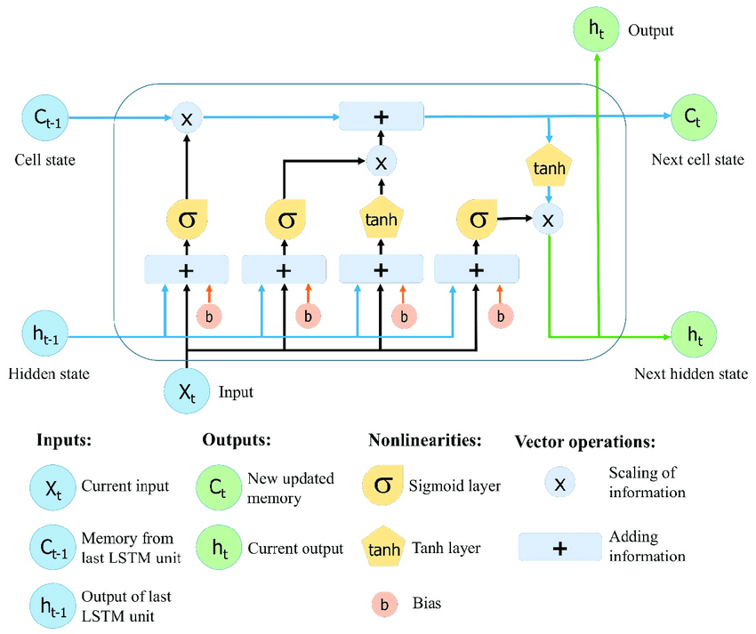

Slide 12
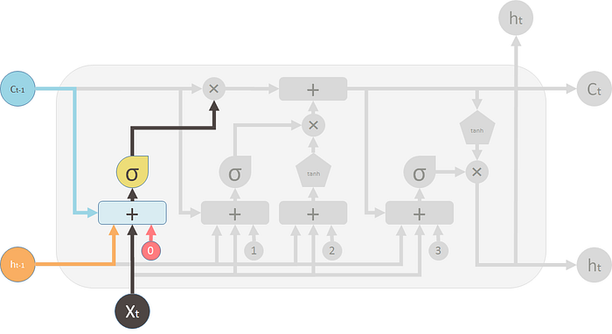
Forget Gate
The forget gate decides what information should be thrown away or kept.
Information from the previous hidden state and information from the current input is passed through the sigmoid function.
Values come out between 0 and 1. The closer to 0 means to forget, and the closer to 1 means to keep.

Slide 13
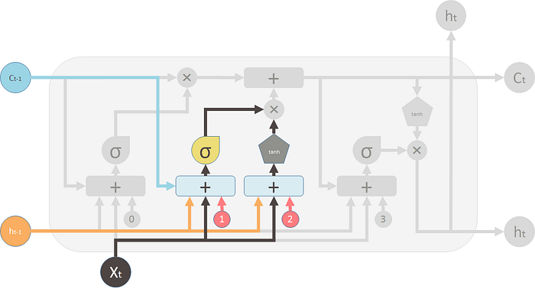
Input Gate
To update the cell state, we have the input gate.
We pass the previous hidden state and current input into a sigmoid function.
Decides which values will be updated by transforming the values to be between 0 and 1.
Also pass the hidden state and current input into the tanh function to squish values between -1 and 1 to help regulate the network.
Multiply the tanh output with the sigmoid output. The sigmoid output will decide which information is important to keep from the tanh output.

Slide 14
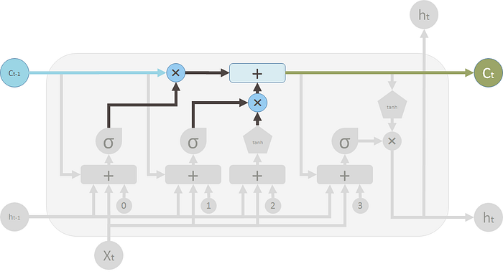
Cell State
The forget and input results are combined to generate a current state.

Slide 15
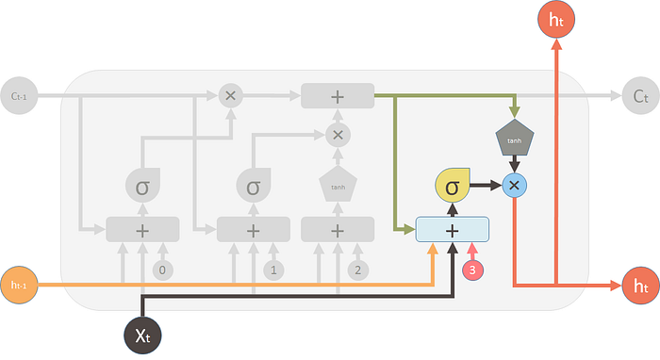
Output Gate
Output gate decides what the next hidden state should be.
Pass the previous hidden state and the current input into a sigmoid function.
Pass the newly modified cell state to the tanh function.
Multiply the tanh output with the sigmoid output to decide what information the hidden state should carry.
The output is the hidden state.

Slide 16
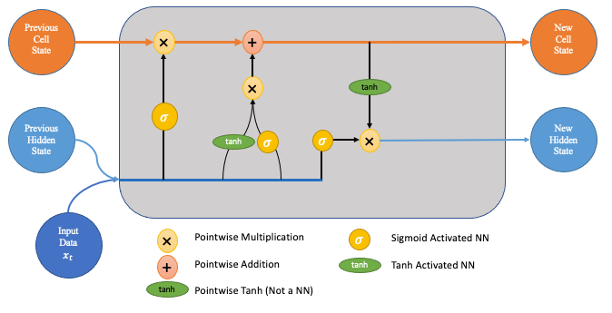
State it Clearly
The LSTM units have two different lanes for state – cell and hidden.
The hidden state acts as a short-term memory – more impacted by recent events.
The cell state acts as long-term memory – more able to hold things from earlier.
The cell state flows from itself, and new stuff is only added after passing a gate.
The hidden state flows from the last prediction and the new input.

Slide 17
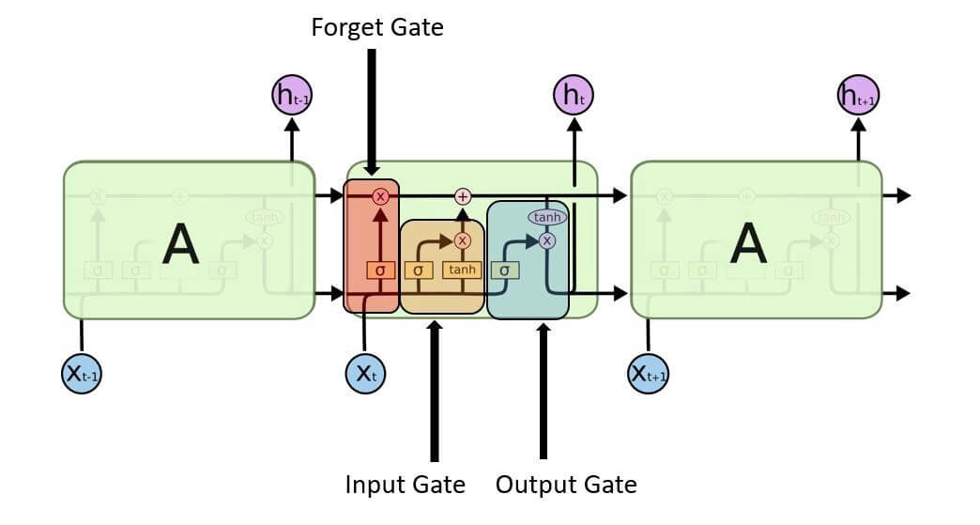
Data flows through, in order…

Slide 18
LSTM in Parts
The LSTM layers use this design to better deal with sequential data.
The state (top) part of the model remembers information from previously.
The forget/memory gates try to keep the important stuff in the memory.
The output provides a prediction, as normal.
Each of those predictions depends on two things:
The new data in this record - this is exactly what we are used to.
The data from the state, what the model remembers – this is the new part.
The ‘features’ extracted in the top layers are made by combining info from different steps.
Just as the ‘features’ extracted in a CNN are made by combining different pixels.

Slide 19
LSTM In Effect
LSTM can “hold” information from the past.
During training, the model keeps things that are useful and forgets things less useful.
Important previous information is held.
Temporal awareness!
LSTMs are very good at many scenarios:
Time series applications.
Speech and NLP applications – e.g. translation, Google’s phone answer AI, chatbots.
Generative models (think GMM) – creating text from a model.
Transformers have often surpassed these in practice – better able to manage state over time.

Slide 20
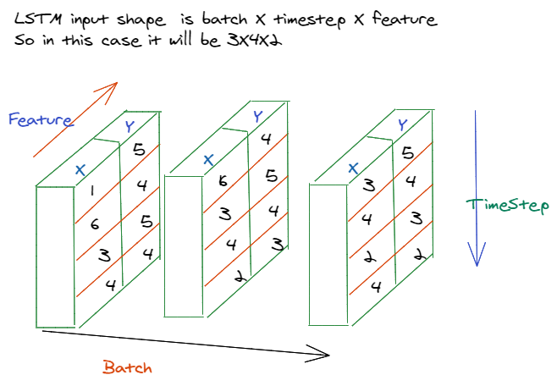

Slide 21
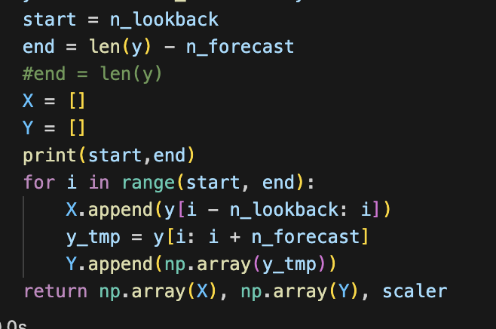
LSTM Data
Using an LSTM model requires that we deal with some complex shapes in our data.
Using “normal models”, each instance is one row of data.
In an LSTM, each instance contains several past features and several future inputs.
The shape of the data going into the model will generally be:
X data - (Batch_size, length_of_lookback, number_of_features).
Y data – number of predictions ahead.
For most data, we’ll need to construct a dataset to look like this.
We’ll probably need a function to take our data, loop through the rows, and assemble all values from different rows into multi-dimensional data for us.

Slide 22
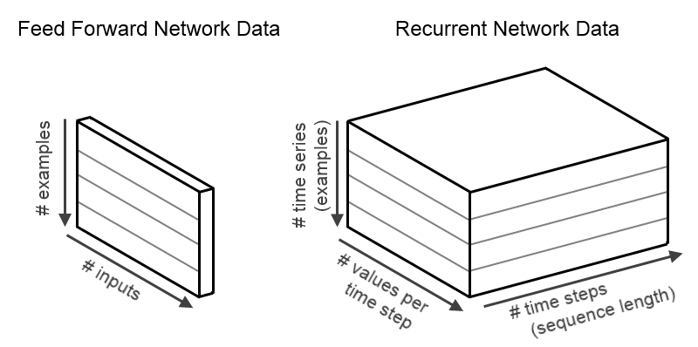

Slide 23
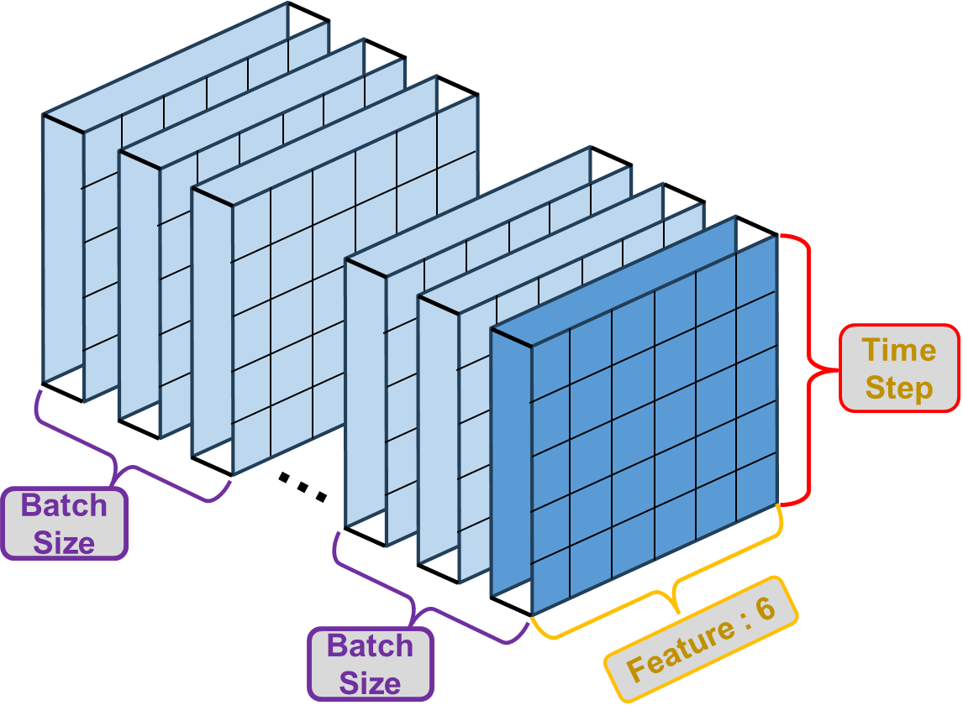

Slide 24
LSTM in Keras
LSTM layers can be added just like any other layer.
When there’s more than one LSTM layer, we need to enable ‘return_sequences’.
The output normally has one node per prediction, no activation.
Making multiple predictions into the future is one place where custom loss is useful.
Could weight the value of errors for the next prediction vs the one 10 instances later.
Differing considerations could make accuracy at different time steps matter more.
LSTM layers are often/usually paired with a dropout.
We can add it as a parameter to the layer directly.

Slide 25
Tuning LSTM Models
Like other models, we generally want to have a larger model for a larger problem.
Estimate - Units = samples in training data / ((# input neurons + # output neurons) * alpha)
Unstructured problems are more likely to benefit from more layers, each with fewer units.
Structured problems (sales or stock prices) may benefit from fewer, larger layers.
Hyperparameter tuning is back on the menu, boys!
LSTM models can be determined via the Keras Tuner – layers, units, drop, other options…
Bayesian or Hyperband may help with time, as might sampling (smartly) the data.
LSTM models often employ a dropout for regularization, it performs well.
Large numbers of epochs are often helpful, possibly with small batches (~8-96).
Batch size is more important than average here, small batches may be good, but slow training.

Slide 26
Being BI is in… if it Performs better
Bidirectional LSTM layers feed the previous sequence bot forwards and backwards.
Common in NLP applications.

Slide 27
Generative Models
LSTMs can be used to generate things, like text.
Text generation is simpler than it sounds at first glance.
Train a model to be able to predict the next word (or token) from text.
Generate text by taking in the previous text, and predict the next word.
The ‘previous text’ + ‘predicted word’ is then the source for the next prediction.
We can treat it as 1 word tokens, large LLMs may have different splits – it varies.
E.g. predict a root word, then the correct suffix: run to running or runner.
2+ grams for thinks like ‘downhill skiing’ and ‘oven glove’.

Slide 28
Got the Right Temperature
Generative models usually utilize a parameter called temperature.
Temperature basically introduces randomness to a prediction.
A model will default to try to predict the correct (most likely) next token.
People don’t really speak like that, especially if writing one piece of prose.
Normal sounding text will use synonyms an alternate terms to avoid sounding robotic.
Temperature makes the actual prediction probabilistic.
The ‘correct’ answer is most likely, but we are choosing from all likely predictions.
Sometimes we want to return a word that is not optimal, but reasonably likely.
The higher the temperature is, the more likely we are to choose an imperfect option.
Multiple implementations of this idea can exist.

Slide 29
Conclusion
Sequential problems are common – prices of anything traded, weather, “life stuff”, etc…
Highlight an example of real-world challenge for analysts – defining the type of solution.
Classification/regression are relatively simple in their structure, or they can be.
We have a target to predict, features we can use, and we can make a model to predict y from X.
Sequential models bring ambiguity to the forefront more – how far in advance can we predict? Should we use any other features? Can we use our predictions to feed other predictions?
Many time series (esp. long term) problems inherently involve ‘features’ we (likely) don’t have.
Commodity prices, climate trends, or product sales are often highly impacted by things like laws, regulations, or decisions from other actors that are hard or impossible to capture in data.
Large and complex models can ‘learn around’ this, but with limits. ‘More data’ often not as useful.

