Slide 1
Transfer Learning

Slide 2
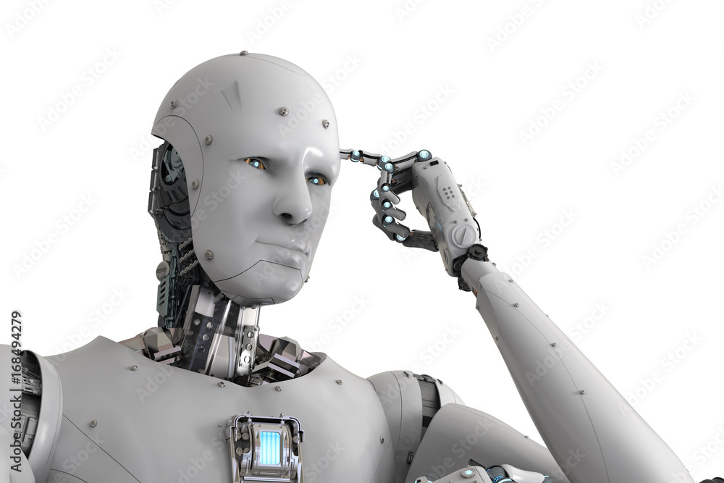
Model Training
As we’ve seen, training models can be time consuming.
For something like image recognition or language processing the dataset of stuff is immense.
Training state of the art models isn’t possible without serious resources.
Most people, including us, don’t have that.
What to do?

Slide 3
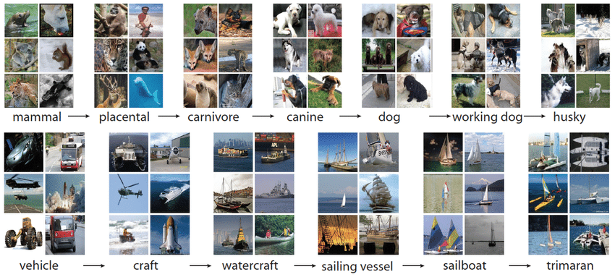
Big Data - Imagenet

Slide 4
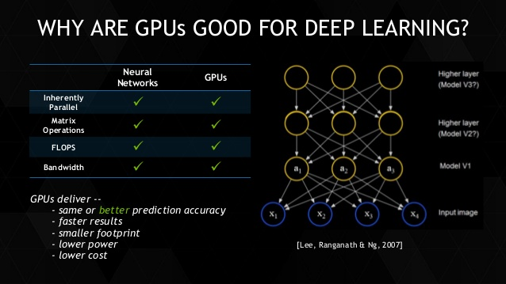
Big Processors

Slide 5
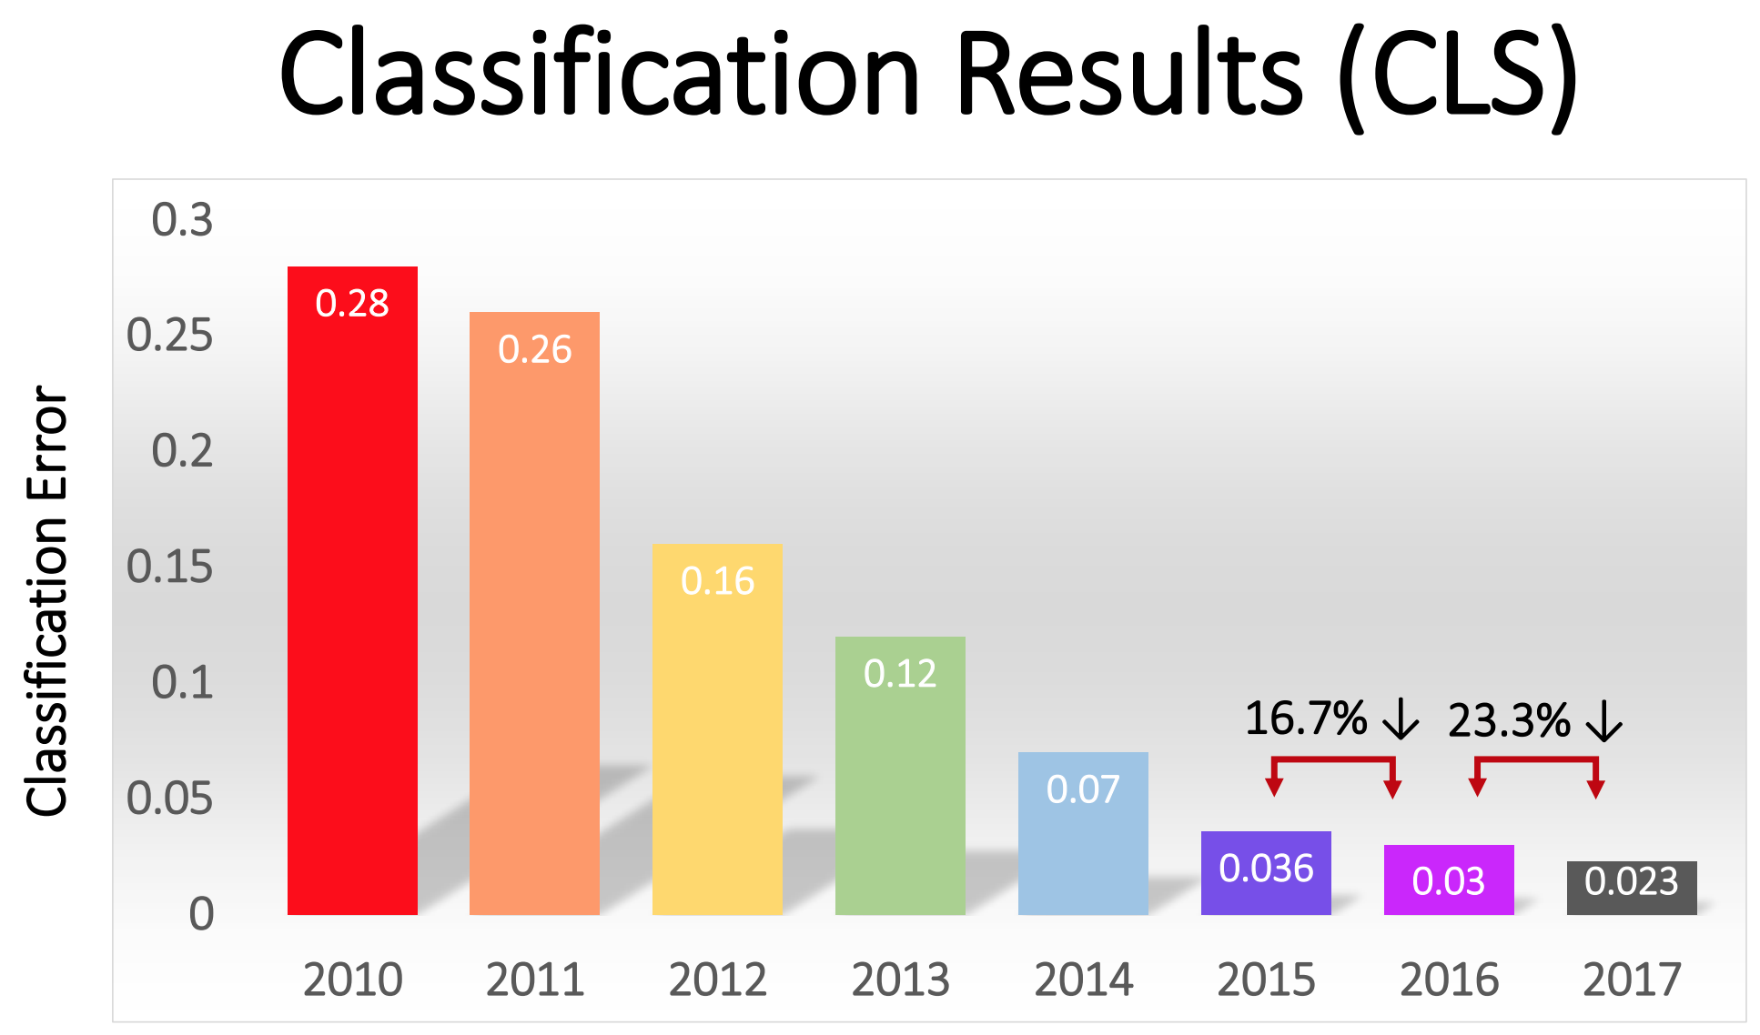

Slide 6
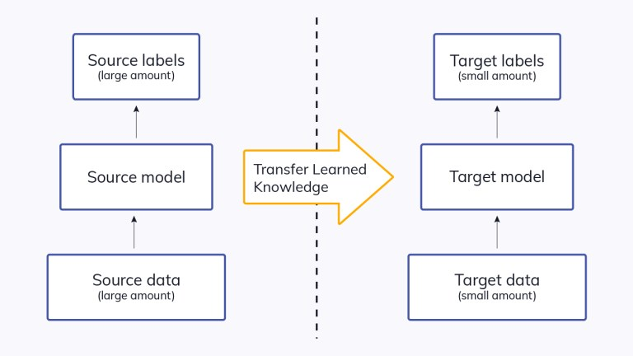
Transfer the Learning
Enter transfer learning!
We can use the training of other models and borrow those models for our applications.
Idea – many tasks are very similar, if a model is good at one thing, it will probably be good at something similar.
In the real world – I could ski before I could waterski. The idea of carving on an edge, balancing, weight transfer all help learning to water ski.

Slide 7
Pretrained Image Models
Image recognition models are trained on large datasets like ImageNet, which has over 1000 classes.
Massive dataset + large model + fast processor = accurate model.
“Seeing” objects is what the model is trained to do.
We can repurpose it to use those skills for other types of objects.
Keras packages many pretrained models that we can download and use.
The pretrained model’s abilities to extract features are well developed through training.
We aim to combine that feature detection with our specific challenge.

Slide 8
When does it work (or not)?
To no one’s surprise, the more similar the datasets, the better the transfer.
Common use cases are image recognition and language.
Natural Language Processing:
Language structure, word meanings, etc... are all very generalizable to other problems.
Word2Vec was a transfer learning application.
Image Processing:
Multiple pretrained models in tensorflow.
Datasets and complexity make training a model like this at home impractical.
Allows us to leverage similar scenarios to learn more quickly – like real life!

Slide 9
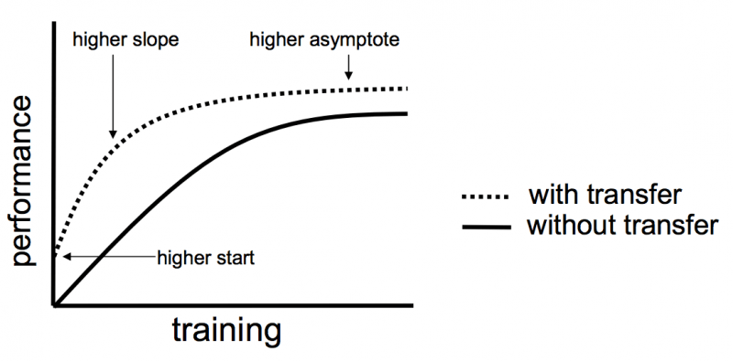

Slide 10
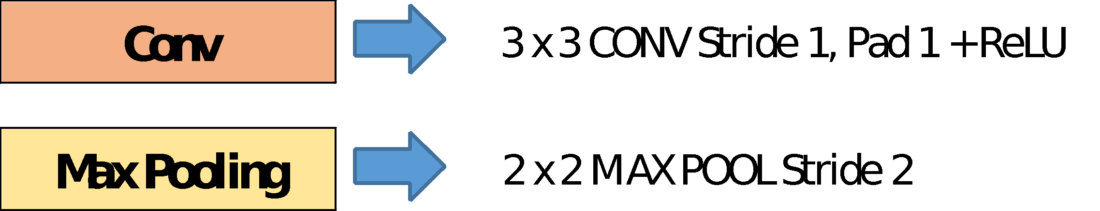
VGG16
VGG 16 patterned the general form of the models we typically use.
Contains 16 (“real”) layers.
Larger models, with 100s of layers, have surpassed in accuracy.
Trained on the very large Imagenet database.

Slide 11
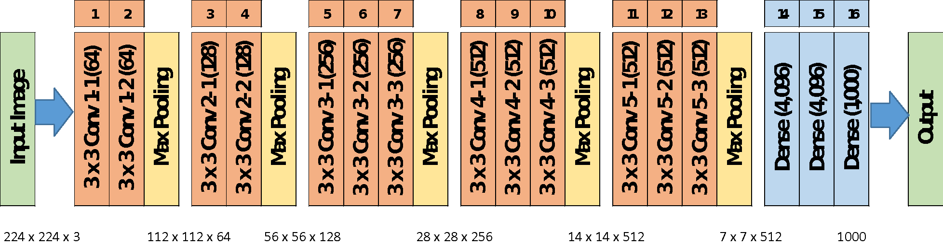
VGG16

Slide 12
Implementing Transfer Learning
Using transfer learning is relatively simple:
Load the pretrained model.
Remove the classification layer.
Download the pretrained weights for the model.
Set the layers to not be trained.
Adapt data, if needed, in preprocessing.
Attach our own classification layers.
Output layer + preceding dense layers.
Train on our data.
Only the added layers learn in training.
Optional – unlock and retrain to fine tune.
Gently adjust the model to more closely match our data.

Slide 13
Implementing Transfer Learning
Load pretrained model:
There are many well trained image recognition models that are shared, vgg is one.
When loading it we need to ensure we load the old weights.
We remove the “top” and set the model to not update its weights.
Add our own classifier:
The imagenet data is classified into ~1000 classes.
Our data has 5 classes.
After the trained model does the feature extraction, we want to classify those features into one of 5 classes.
This part does get trained – it learns how to use VGG’s features to make classifications.

Slide 14
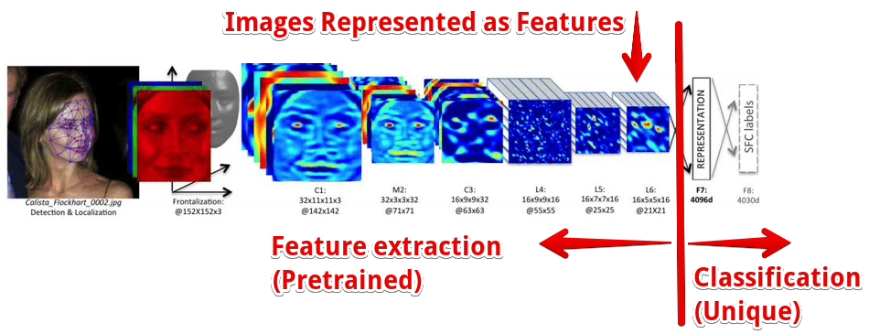

Slide 15
Fine Tuning
The fine-tuning step needs a bit more exploration.
When we initially use our transfer model we end up with:
Convolutional layers that are trained on the pretrained data.
Classification layers that have trained on our data.
Fine tuning updates the entire model to fit our data better:
Unlock the entire model, so it all learns in training.
Set the learning rate extremely low.
Retrain on all the data.
Result is that the entire model is slightly adjusted through some small training.

Slide 16
More Retraining
In addition to just removing the output bits, we can allow for retraining of other layers of the network.
This removes some of the existing training, making the model adapt more to our data.
If our dataset is more different from the original, this may help.
I.e. use the pretrained layers to extract image features at a higher level.
Train layers ourselves to bend the model towards our data.
We are removing some of the pretrained intelligence:
If our training set is small, we might end up behind where we started.

Slide 17
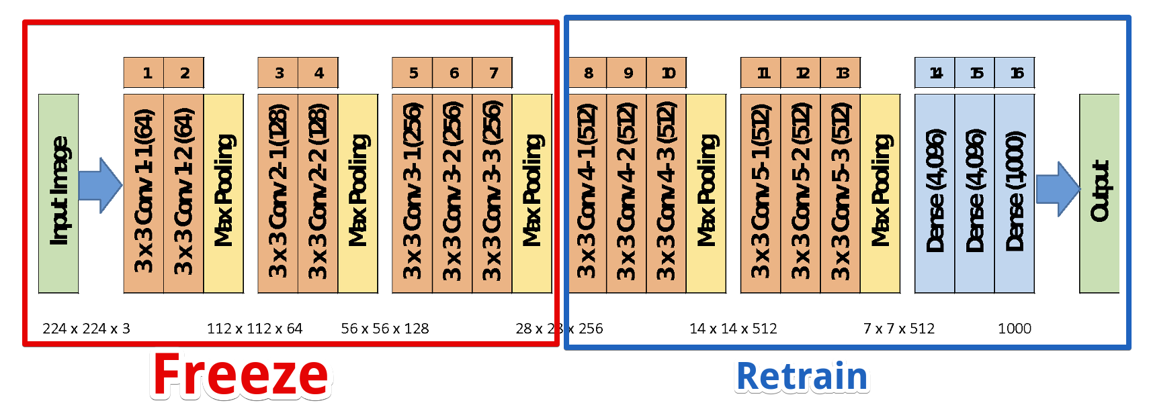
E.g. Freeze Part, retrain Part

Slide 18
Practical Applications
Transfer learning can help in many real-world scenarios.
Many problems are similar – image recognition, text processing.
Other problems are very large – self driving car.
In either of these scenarios, being able to build on the learning of other models can both speed and improve performance.

Slide 19
NLP - Word2Vec
Word2Vec is an example of transferred learning.
Takes in some unstructured data, returns a feature set for a model.
Other NLP models such as Glove do similar things.
Utilizes pretrained models on massive amounts of text.
Google’s News dataset has over 100 billion words.
Language is pretty repetitive, so models can learn on massive sets of training data.
This super smart model can help us by applying that knowledge:
Better understanding of language, so better vectorization.
Ability to evaluate sentiment or similarity based on large dataset of training.

Slide 20
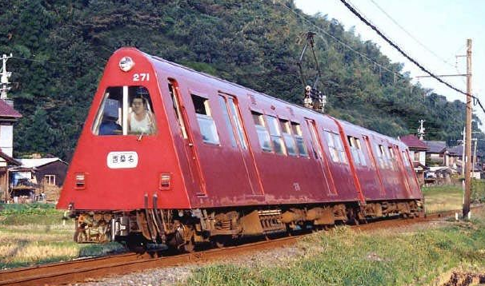
Image recognition
Image recognition is a massive application of transfer learning.
Images are large, so the processing required for accurate models is massive.
There is a large amount of transferability of skill.
E.g. you can recognize a dog you’ve never seen before as a dog.
You can recognize a weird train car as a train, and as a method of transport.
The CNN models used in images act to extract features, then predict based on those features.
Inherently splitable.
Kreas pretrained models: https://keras.io/api/applications/

Slide 21
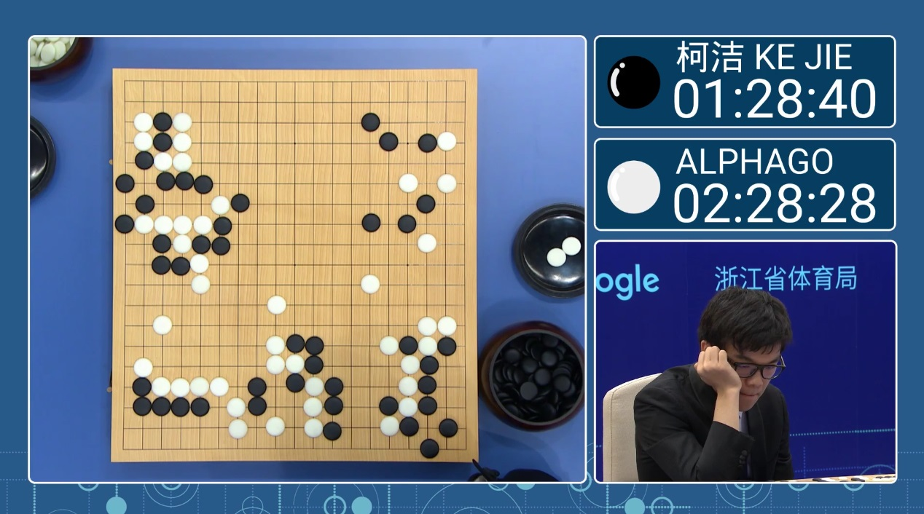
Gaming
A classic and old way to train game AI is to have it play itself.
Early machine learning was an IBM guy training a checkers machine.
One application of transfer learning is video gaming.
Watch AlphaGo: https://www.youtube.com/watch?v=WXuK6gekU1Y
The learning from one game can be applied to others.
Researchers are teaching AI system to learn games, based on other games:
https://www.wired.co.uk/article/deepmind-atari-learning-sequential-memory-ewc
"Previously, DQN had to learn how to play each game individually," the paper says. "Whereas augmenting the DQN agent with EWC allows it to learn many games in sequence without suffering from catastrophic forgetting."

Slide 22
Modern Transfer Learning
In the last couple of years, the focus on repurposing models is expanding.
Training a new model that is as good as an LLM or image model is impossible.
The data needs are not realistic for consumers.
The amount of training GPU power would cost millions.
Creating one large model can cost 10s of millions, or more.
The number of ways that we can adapt trained models has been expanding.
Large models have very high capacity, so they can learn lots of different stuff.

Slide 23
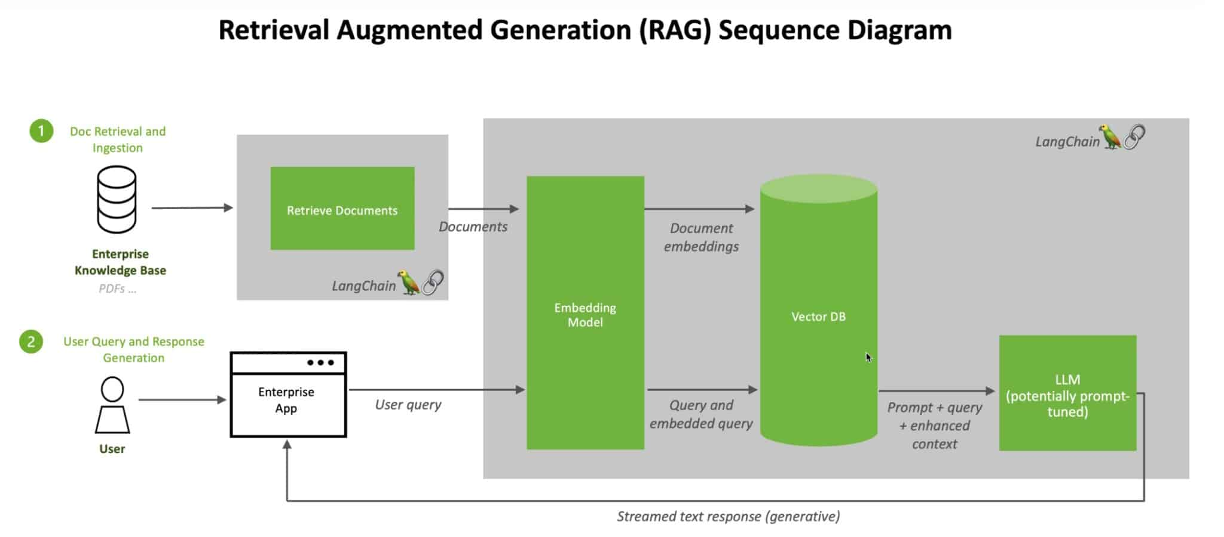
Language Models
Retrieval-Augmented Generation (RAG) can be used to tailor language models.
Provide a scenario-specific context to a trained model for that prediction.
Kind of like “answer this, given this body of knowledge”.

Slide 24
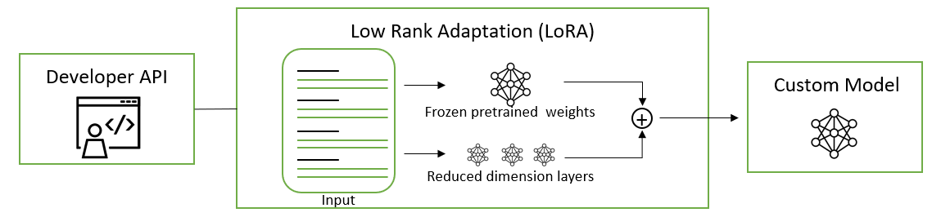
Parameter Efficient Fine Tuning (PEFT)
PEFT is a strategy to lock most weights, and only allow some to update.
If the important stuff updates, the model will learn.
The less is updated, the quicker it will go.
There are several strategies, which are mathematically different.
Generally involves adding/changing something to limit training to certain areas.
This is commonly seen with people reusing LLMs from places like HuggingFace.

Slide 25
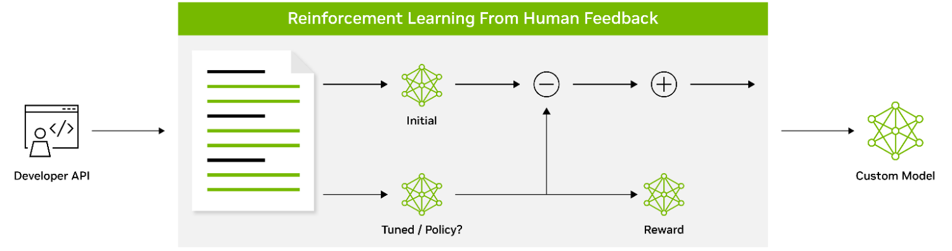
Reinforcement
Especially for generative models, we can use reinforcement.
Reinforcement learning is the domain of making models that learn in response to ‘grading’.
If the result is good, the model gets a ‘reward’, if not, a ‘penalty’.
This feedback is used by the model to tune its weights.
Often seen with humans or AI as the decider – generate 2 sentences, human picks best.

Slide 26
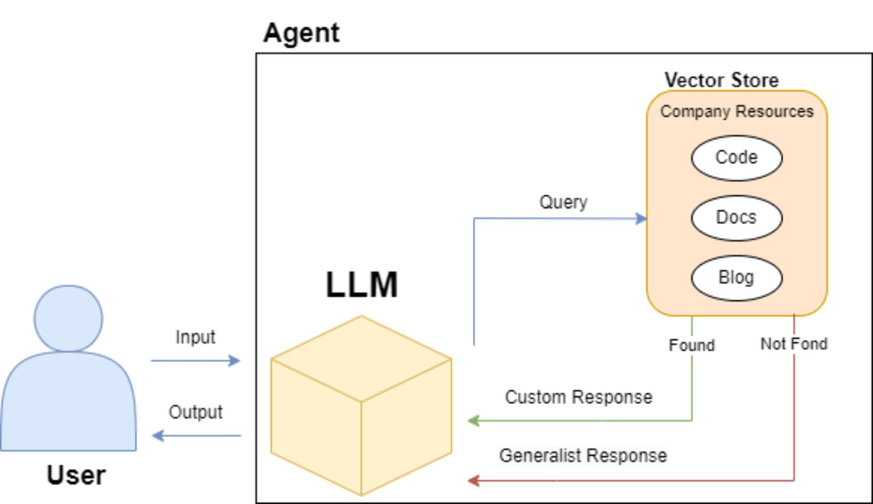
AGENTS
Agents wrap a model (usually an LLM) in a structure for a specific domain.
The model is pretrained.
The ‘wrapper’ can:
Provide context like RAG.
Translate inputs or outputs.
Augment queries, etc…
Search in specific locations for info.

Slide 27
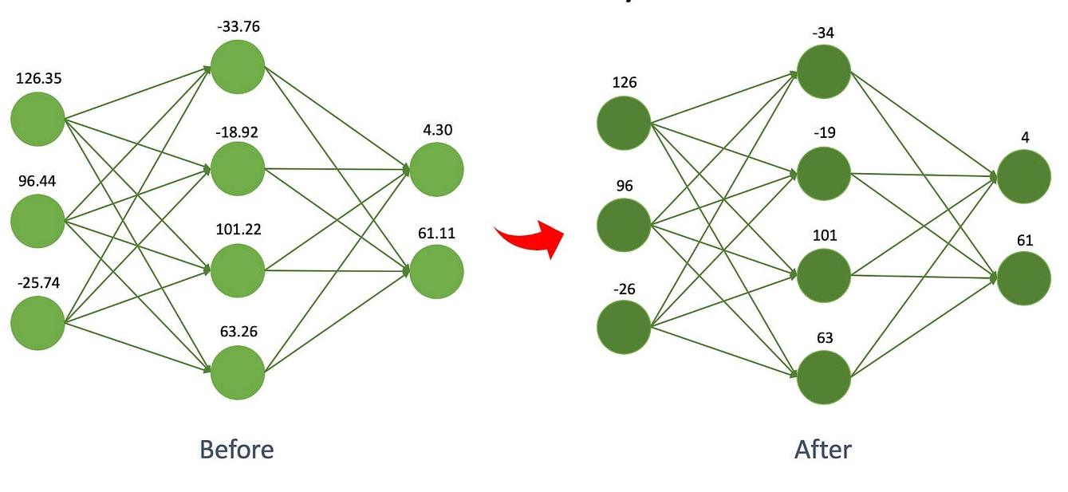
Quantization
Quantization is reducing the precision of the numbers in the model.
There are lots of very long numbers, they need to be calculated regularly.
If these numbers get smaller (in size, not value), those calculations are quicker.
Large models are usually ‘quantized’ if being released to the public, so they work on normal GPUs.
Quality can be kept high, while size drops.
More quantizing, worse model.
Smaller models are trainable on more systems.

Slide 28
Tuning models for Fun and Profit

