Slide 1
Tensorboard and Pretraining

Slide 2
Managing Training
Training neural network models can take a long time and involve lots of resources.
Large models (GPT scale) can train for weeks on tens of thousands of GPUs.
One person probably doesn’t want to sit there and make sure it runs.
If someone pulls the plug, we don’t want to start over.
There are remote monitoring tools to help:
”Real” model training will happen on servers/clusters elsewhere.
We can interact through a web page instead of the computer itself.
We can start training, leave it be, and monitor it via a webpage.

Slide 3
Generators
Generators are another variety of datasets that we can use.
Generators “generate” data when demanded, automatically.
The easiest way to understand them is reading from disk:
We pass the generator instead of the data itself to a function.
Every time data is needed, the generator reads some part off of the hard drvie and provides it.
To the model/fit, the generator is just the data. To the system, it only demands the resources needed for that ‘bit’ of work to happen.

Slide 4
Generator Madness
Since a generator provides data on-demand, we can add transformations, if needed.
The generator can provide variations of data each time it is asked.

Slide 5
Datasets
Most useful neural networks are trained on large amounts of data.
The larger the data, the more the capabilities of neural networks become useful.
These datasets are not as easy to manage as a dataframe with small amounts.
Data will often exceed the memory of the computer or GPU.
“Swapping” (using a HD as ‘extra’ memory, like Windows does) is impractical here.
If we exceed the memory of the system, we are done.
We can create special purpose datasets that are smarter for neural networks.
Able to manage data that is larger than the available memory.
Able to manage some of the preparation work on their own to help efficiency.

Slide 6
Tensorflow Datasets
Tensorflow datasets are a container that hold data for TF models.
For our purposes, these will replace a dataframe.
The TF datasets are generally made by ‘aiming at’ data, not by ‘giving them’ data.
For images, we will point it at the directory on disk.
For other stuff, like text, video, databases, we’d use an equivalent.
The datasets are “smart” in some ways.
They can manage some work to maximize resource utilization.

Slide 7
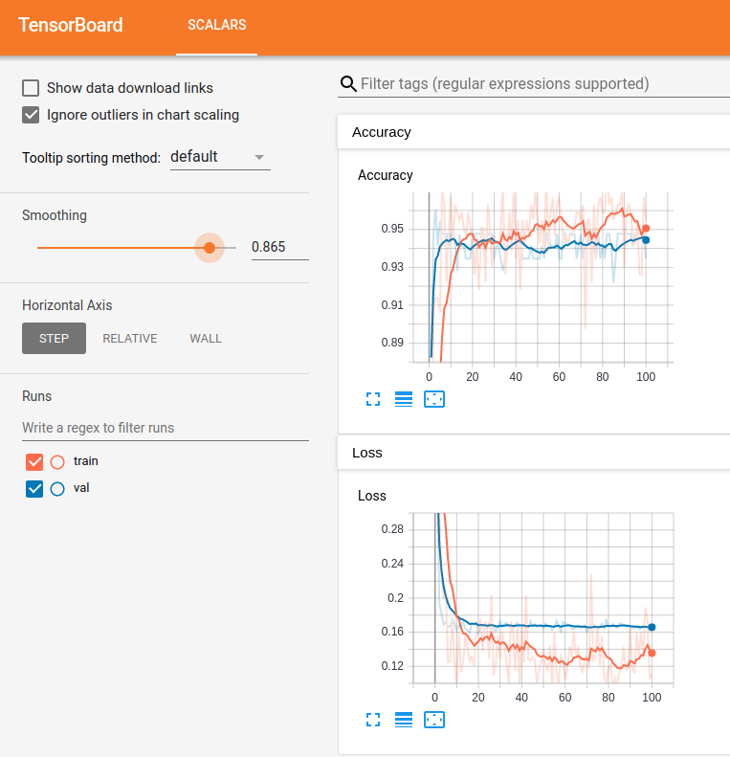
Tensorboard Monitoring
We are used to using several tools to monitor network results.
Epoch by epoch text printouts.
Plotting of loss from history.
Tensorboard is a tool from Keras that makes this process nicer.
We can use Tensorboard to get a “modern” dashboard to monitor training results.

Slide 8
Tensorboard
Tensorboard can show lots of stuff and is largely customizable.
There are lots of examples of how to put things into it online.
We’ll use it for the basic monitoring mostly.
Key usage:
Start training on the server you’re using.
Launch tensorboard to monitor it.
Connect to the web page remotely while the server works.
Works mainly by monitoring log files.
We set a log file directory to monitor, and write logs there via callbacks.

Slide 9
Keras Tuner
Keras Tuner is a framework for tuning optimal neural networks.
Analagous-ish to a grid search in sklearn.
We can setup a search for the optimal hyperparameters and structure of a model:
Hyperparameters like the activation function or optimizer.
Structure like number of neurons, number of layers, or optional layers (e.g. dropout).
The idea is the same as a grid search optimization.

Slide 10
Keras Tuner Tools
The Keras tuner process is a little more involved than a gridsearch.
Model builder function:
We create a model building function that returns a compiled model.
This function has options built into it to create different models.
HP objects:
The tuner is based on a family of “hp” objects.
These function like a grid-searched value – we specify the type of choice and the options.
The object automatically changes options when we run a search.

Slide 11
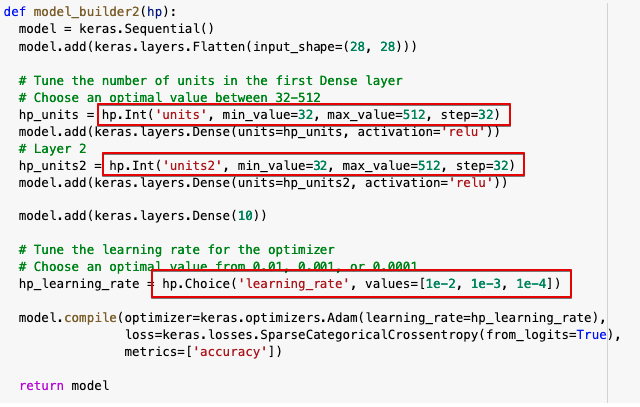
Hypermodel
The building function is a hypermodel.
The hp.STUFF items will automatically swap values when the search is done, and the function will return different models.
This one will try:
Different # of neurons in the two layers.
Different learning rates.
Anything that returns a model will work.
Adding varying layers (in workbook).
Complex conditions – e.g. really wide vs. really deep.

Slide 12
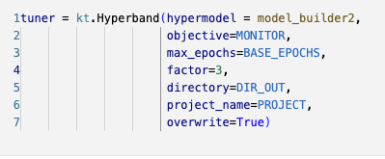
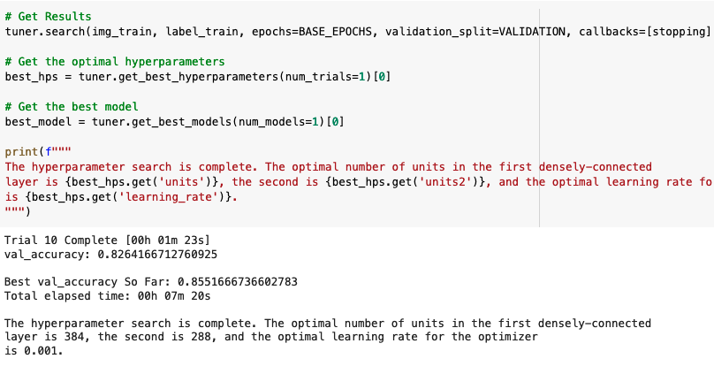
Running a Search
To find the best model configuration we define a “tuner”.
This is similar to a gridsearch object.
We set the tuner to have a hypermodel, along with options.
We replace “fit” with “search” and then get the results.
We have different search options:
Random – randomly pick a set of HP options for each model.
Bayesian – “smart” targeting of best combinations.
Hyperband – uses early stopping to identify the best HPs.
Works like a grid search with a cool output.

Slide 13
Making a Winner
After searching is done, we generally want to train a new model with:
All the data.
The optimal options that we just found.
The search process can take forever if the search space is too large.
We want to narrow the options prior to starting.
The Bayesian or Hyperband options will help a more efficient search.
We can still incorporate early stopping in the search.

Slide 14
Checkpoints
Another thing we can do with long training processes is to set checkpoints.
Checkpoints record the weights at specified points.
Usually as a callback each epoch.
Write the weights only if the current performance is the best we’ve seen.
We can load the saved weights and pickup training there.
If the process is interrupted, we don’t loose everything.
Note – on colab the environment is temporary, lasting data would be written elsewhere.
It will be fine for trying it now, but what you write won’t be permanent for eternity.
Google drive is an option, accessing it can be slightly annoying, we won’t do this.
On your machine, they’d be as permanent as anything.

Slide 15
Writing and Reading Checkpoints
We looked at saving models previously.
Saving weights can be far (orders of magnitude) smaller than saving a model.
To restore a model from weights we have to:
Create a model with the same structure – layers and # of neurons.
Load the weights into that model.
Things like the optimizer settings are not kept.
We can use this to predict, or we can train more starting with current weights.
The new training process already has better-than-starting weights.
We should progress from roughly the last epoch (with some variation).

Slide 16
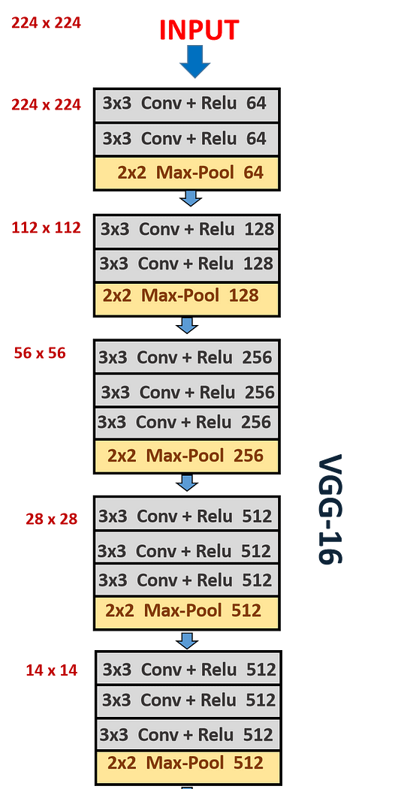
CNN Structure Notes
In general, the number of filters increases as we add layers.
The initial layers start with a higher definition (width vs. height).
Lower layers have a lower definition, due to the pooling layers.
The number of filters typically increases to continue capturing information through layers.
(Roughly, not literally) each layer ‘breaks’ a high-definition image into more lower definition images.

Slide 17
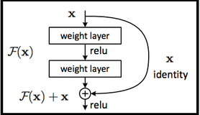
Complex Image Models
More advanced image recognition models can have more complex architectures.
Some are built to allow ‘skipping’ of layers, like the ResNet ones.
Data can be passed around some layers.
Allows the model to learn which ‘level’ of representation matters, and use that.
I.e. if a representation at some Conv level is good, it can be passed forward directly.
Other models also employ the other techniques in more ways.
E.g. different strides, padding, or pooling. These can be more useful as these models can better blend what the less common options find, with what the more common ones do.
Good, complex models are slow to train, and are generally based on extensions of what has worked previously. Catching up to large image/language/etc… models is near impossible.

Slide 18
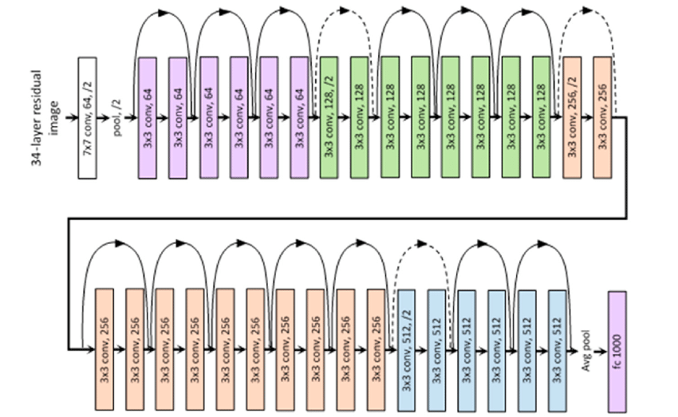

Slide 19
How and Why?
This mitigates vanishing/exploding gradients if the model is quite deep.
The concept of “holding some data from earlier, and combining it with new” is seen elsewhere.
RNN networks, that are the basis of NN time series and text models use it.
Transformer models like ChatGPT et.al. also do it, but differently.
Attempts to keep what matters as data is processed, and selectively drop what doesn’t.
‘What matters’ doesn’t necessarily happen only after the last layer, it can be uncovered at multiple points in the network. If the model finds something useful, it is ideal to just hand onto that data.

Slide 20
Data Augmentation
Data augmentation is the creation of synthetic training data.
This sounds insane, but works more often that you’d think.
Data augmentation is actually simpler and easier with images, in most cases.
We generally want to do some variety of image recognition.
The things we want to recognize can ‘move around’ in an image, and the data is still good.
When using data augmentation for image data, it allows us to increase data size, without actually collecting and maintaining large datasets.
We can instead create generators – things that make data for the model, on demand.
These generators can apply data augmentation on the fly to make variations of images.

Slide 21
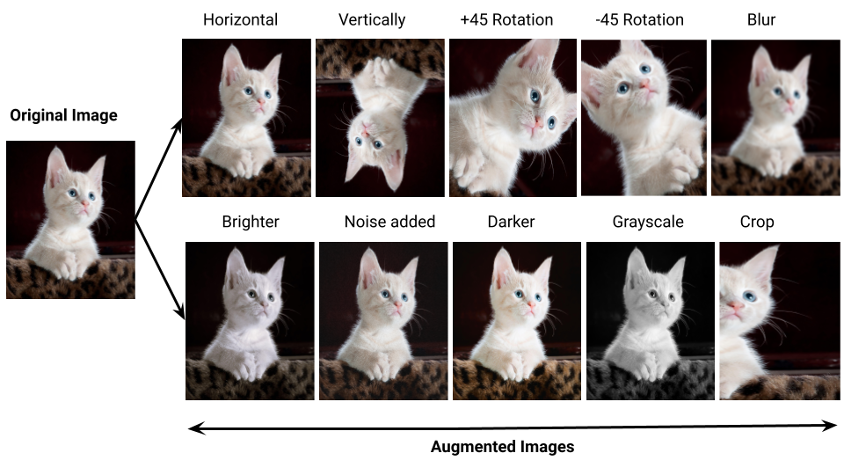

Slide 22
Non-Image Augmentation
We can generate data for non-image models as well.
Other data, like structured data, tends to not respond quite as well.

Slide 23
TensorFlow Datasets
We can use tensorflow networks with regular array/dataframe data and it works.
When we have larger amounts of data, this stops making sense.
Arrays and dataframes exist in memory – our training data might be larger than that.
Loading all data into a dataframe/array, and doing operations, can be slow, and a bottleneck.
Some operations can cause memory usage to explode, which is risky.
Neural networks use specialized datasets to manage data and resources.
Can use large amounts of data without needing to load it to memory.
Can manage where actions (data prep) happens, to better manage resource usage.
There are several types of dataset-ish things that we can create.

Slide 24
Generators
Generators are a generic concept.
They are an object that we can ask for something, like data, and they produce it on demand.
For datasets, they generally read from disk as a chunk of data is needed.
We don’t pass the data to the model, we pass the generator.
Every time the fit/evaluate/score needs data, like a batch, the generator provides it.
Where the data comes from is up to the generator (usually read from disk).
Can also be used with actual ‘generation’, like data augmentation steps.

Slide 25
TensorFlow Datasets
Probably more commonly than generators, we see TF datasets.
TF datasets are an object that does three things:
Take the source data from it’s location into the program.
Apply transformations and preprocessing.
Iterate over the data as it is required.
They allow for a dataset to be larger than memory.
They are built to allow for optimization of where/when operations happen, to build an efficient pipeline for training a model.
For images, this is reasonably simple, for other stuff it may be weird.

Slide 26
Image Datasets
We can create datasets directly from folders of images on disk.
Image data folder structure is semi-standardized.
The parameters define some of the rules on how the data works.
E.g. batch size, validation split.
This is a common concept – the data knows/does part of how to process itself.
The dataset will automatically read and provide batches during training.
It manages the file reading, splitting, labeling, etc….

Slide 27
Conclusion

