Slide 1
LBU PIMS
Construction Management Department
Training Course
Reveron Consulting Sdn Bhd

Slide 2
Objective & Content
Objective:
A Train the Trainer (TTT) course prepared for Construction Management (CMT) Department based on the LBU PIMS Implementation Requirement Specification Document. The targeted trainees will be from CMT Department. Trainees will be introduced to the ProjectWise Construction Management (PWCM) module in the LBU PIMS and learn about the basic functions and operations of the system.
Content:
To familiarize the functions of the PWCM solution module
To learn about To-Do items in PWCM
To learn about Storing Construction Related Document
To learn about how to Request for Information (RFI)
To learn about Issuing Site Direction
To learn about Method Statement (MS)

Slide 3
Agenda
No. | Session | Course
1. | 9.00am – 9.45am | Introduction to LBU PIMS
2. | 9.45am – 11.00am | To Do Items
3. | 11.00am – 11.15am | Break
4. | 11.15am – 12.30pm | Storing Document, RFI
7. | 12.30pm – 2.00pm | Lunch break
8. | 2.00pm - 4.00pm | Issuing Site Direction, Method Statement (MS)
9. | 4.00pm – 4.30pm | Q & A

Slide 4
Introduction to LBU PIMS System

Slide 5
Overview & Objectives
Chapter Overview:
This chapter aims to provide an introduction of the LBU PIMS to Construction Management Users. As Construction Management user will be using ProjectWise Construction Management, this chapter will provide insight on the components and features of the solution module.
Chapter Objectives:
The objectives of this chapter are as follow: -
To familiarize with the PWCM solution module

Slide 6
Overview of LBU Project Information Management Solution (PIMS) System
ProjectWise Construction Management (PWCM) Solution Module
The solution module provides more project insight, allows management and construction team to share information and permits work flow in document process based on team members contractual obligation. The ProjectWise Construction Management (PWCM) enable the user from Construction Management Department to:
Submit
Man Power Record,
Machinery Record Sheet and
Weekly Monitoring Work Done.
Store construction related document
Request for Information (RFI)
Issue site direction and
Conduct Method Statement (MS)

Slide 7
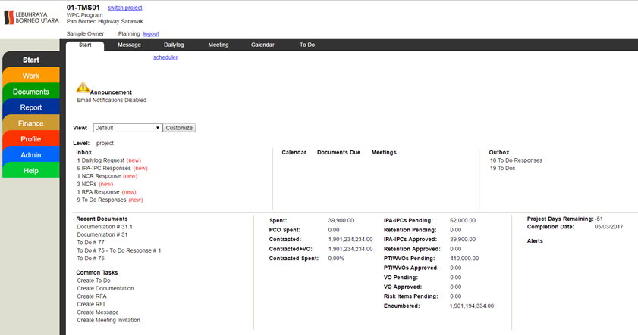
Overview of LBU Project Information Management Solution
(PIMS) System
2
Tabs
1
Modules

Slide 8
TUTORIALS
Tutorial 1: LBU PIMS First Time Login (PWCM Solution Module)

Slide 9
To-Do Items

Slide 10
Overview & Objectives
Chapter Overview:
This chapter aims to provide better understanding of To-Do items in the LBU PIMS. The To Do tab is part of Start module, it allows user to create a To Do request and assigning the task to another user. Every document starts with a request created by a user in LBU PIMS. The request is then submitted to a user who can then send the document to another user or create a response. After there are no more responses to be added to a document, the request is closed. Revised documents can only be created after a document is closed.
Chapter Objectives:
The objectives of this chapter are as follow: -
To learn about To-Do items in PWCM solution module.
To submit the report based on request in To-Do tab.

Slide 11
Access Rights in ProjectWise Construction Management
Users in the system are given with specific access right to act on the project document used in the system. The access right is assigned at 2 levels, namely at organization and user level.
In general, the To Do document has 6 access rights, namely: Create, View, Close, Submit, Respond and App/Rej access right. Every user is assigned with the sufficient access rights to allow them to perform their tasks in the system.
The access to the documents also depends on the document’s flow. You will not see the document in your To-Do interface, if the document is not submitted or forwarded to you.

Slide 12
Sending Options in ProjectWise Construction Management
Send to an organization
Sending a request to an organization means sending to all the persons registered under an organization. For example, if you select Sample Owner which is in PIMS LBU, all the persons that registered under LBU organization will receive the request. You can add another organization by clicking the Add button.
Send to an individual user
Sending a request to an individual user means sending to a particular person. You can add another user by clicking the Add button. If you just need to assign to one user and another user to keep on the request loop, check on the assign for related user which is responsible for the task.
Send to group
Send to group means sending the request to a group of users. This group of users can be only created by the System IT. If you need to create a user group, you can make a request to the System IT.
Email to someone outside eadoc
You can send the request to a user outside of LBU PIMS by inserting their email. However, this user cannot respond directly to the request in the system. The email will contain the summary and cover letter of the request. The user will be able to reply by email.

Slide 13
TUTORIALS
Tutorial 1 : Initiating Document Submission
Tutorial 2 : Receiving the Response Which Include Document Submission for Review
Tutorial 3 : Forwarding Submission for Approval
Tutorial 4 : Approving or Rejecting Document Submission Response
Tutorial 5 : Approving or Rejecting Request that have been Raised
Tutorial 6 : Closing the Request and Ensure No Pending Responses on Request.

Slide 14
Storing Document

Slide 15
Overview & Objectives
Chapter Overview:
This chapter aims to provide better understanding of storing construction related documents in ProjectWise Construction Management solution module. The document can be uploaded and stored in the PIMS for sharing purposes
Chapter Objectives:
The objectives of this chapter are as follow: -
To upload and store documents into PIMS

Slide 16
Document Concept Overview
The Documentation tab allows for the storage of miscellaneous project information. This information, once it is uploaded and published, can be used by the organizations and users on the project as backup and reference material for all of the various documents created on the project.

Slide 17
Document Status
Click on the icon to open the Browse box if its not already open. All of the documents under this tab will be located under the draft or published folders in the Browse Box. The definition of these states are as follows:
Draft Documents
Documents that have been created and saved. These documents are only available to members of the organization of the user who created the document.
Published Documents
Documents that have been published will automatically be shared with all users on the project that have permission to view this tab.

Slide 18


Searching for Documents and Content
On the upper right side of the screen are the search icons. Clicking on these icons allow the user to search the contents of the currently selected Tab in one of three ways.
: Clicking on this icon will open up the search window. From within this window the the user can search for specific content by a key word or number. If multiple pages of results are found the user can navigate between the pages by clicking on the numbers at the bottom of the search window.
: Clicking on this icon will open up a window showing the contents of the tab in alpha numeric order. If multiple pages of results are found the user can navigate between the pages by clicking on the numbers at the bottom of the search window.
: Clicking on this icon will show all of the deleted items in this Tab.
When you are finished searching clicking the Close button in the lower left of the search window will close the search window.

Slide 19
Tutorials
Tutorial 1: Uploading Document into PIMS

Slide 20
Request for Information

Slide 21
Overview & Objectives
Chapter Overview:
This chapter aims to provide better understanding of Request for Information (RFI) in ProjectWise Construction Management solution module. The RFI tab is where users create RFIs or Requests for Information. An RFI is created by a project participant who is requesting information from another participant. To expedite the RFI process users can create links to specification sections or drawings stored in the documents group so that the reviewing user has access to all of the information needed to answer the question posed by the RFI.
Chapter Objectives:
The objectives of this chapter are as follow: -
To enable RFI process in PIMS

Slide 22
Standard Document Overview
Standard Document links
There are several blue links that will be present on almost every document. These links are always displayed in the upper left of the document viewing area. The links are:
inbox
Clicking on this link will take the user back to the inbox of the Tab the user is currently in.
request
This link will appear if the user is viewing a response to a document. Clicking on this link will take the user back to the response's original request document.
history
Clicking on this link will take the user to a display of every action taken on the document being viewed. Each action entry shows who performed the action, when they performed the action, and what type of action was taken.

Slide 23
Standard Document Overview
links
Clicking on this link will take the user to a display of every item linked to the document being viewed. The user can click on any of the displayed linked items and be taken directly to that item within EADOC.
print
Clicking on this link will open up the print window. From here the user can select the print format and what portions of the document and it's responses the user wants printed.
back
Clicking on this link will take the user back to the previous page.
summary
Clicking on this link will take the user to a summary screen for the tab being viewed. The contents of the summary screen are specific to the Tab being viewed

Slide 24
Tutorials
Tutorial 1 : Raising RFI in PIMS
Tutorial 2 : Receiving and Responding to RFI
Tutorial 3 : Receiving and Merging Responses
Tutorial 4 : Forwarding the RFI
Tutorial 5 : Approving the RFI
Tutorial 6 : Rejecting RFI
Tutorial 7 : Closing RFI
Tutorial 8 : Reopen RFI
Tutorial 9 : Revising RFI

Slide 25
Issuing Site Direction

Slide 26
Overview & Objectives
Chapter Overview:
This chapter aims to provide better understanding of Site Direction process in the LBU PIMS. The Site Direction tab is where users create the Site Direction. Site Direction is created by a project participant to give direction or an order to change something.
To expedite the site direction process, users can create links to specification sections or drawings stored in the documents tab so that the reviewing user has access to all of the information needed to implement the site direction correctly.
Chapter Objectives:
The objectives of this chapter are as follow: -
To gives understanding to the user on Site Direction process

Slide 27
Tutorials
Tutorial 1 : Issuing Site Direction
Tutorial 2 : Receiving and Responding to RFI
Tutorial 3 : Reviewing and Approving the Site Direction
Tutorial 4 : Sharing the Site Direction Status

Slide 28
Method Statement

Slide 29
Overview & Objectives
Chapter Overview:
This chapter aims to provide better understanding of conducting method statement in LBU PIMS. The RFA tab is used to conduct the method statement for Construction Management department, where users can create and submit RFAs for review and approval by the owner prior to the construction of the items covered by the RFA. This process ensures that the methods used by the contractor comply with the project drawings and specifications.
Chapter Objectives:
The objectives of this chapter are as follow: -
• To conduct digital approval process for conducting Method Statement in PIMS.

Slide 30
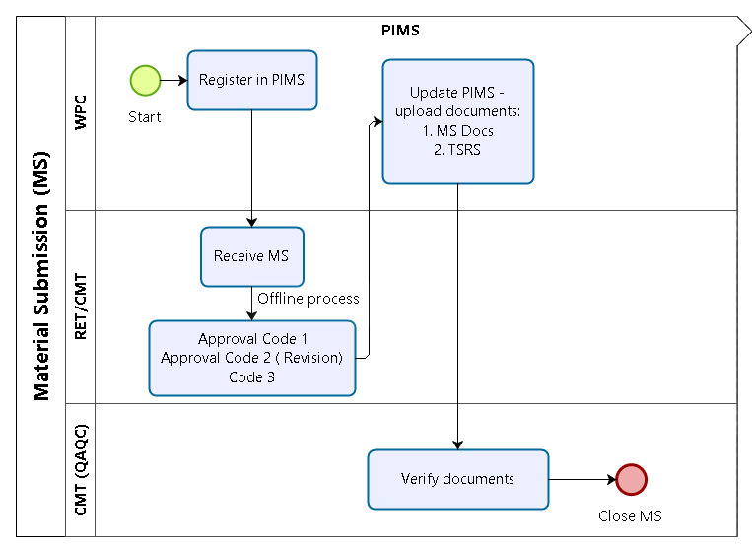
Method Statement Workflow

Slide 31
Tutorials
Tutorial 1 : Creating Method Statement Request
Tutorial 2 : Receiving and RFA for Review
Tutorial 3 : Merging the Responses
Tutorial 4 : Approving or Rejecting Method Statement Request
Tutorial 5 : Closing the Request and Ensure No Pending Responses on Request

