Slide 1
Goal and Scope Definition
Olivier Jolliet, PhD

Slide 2


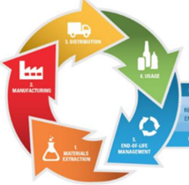
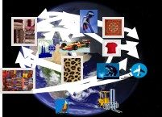
Healthy and Sustainable Foods and Products
Table of contents 3.2 Goal and scope defintion
MAIN FACTORS IMPACTING SUSTAINABILITY AND HEALTH
HEALTHY AND SUSTAINABLE FOODS
LIFE CYCLE IMPACTS OF PRODUCTS (LCA)
3.1 Introduction to LCA
3.2 Goal and scope definition
3.2.1 LCA goal definition
3.2.2 Function and functional unit
3.2.3 Building the product system and process tree
3.2.4 System boundaries
3.3 Life cycle inventory
3.4 Life cycle impact assessment
3.5 Interpretation
3.6 Impacts of fine particulate and chemicals in products
4. SUSTAINABLE CONSUMPTION

Slide 3
Goal and Scope Definition Part A Defining LCA goal and actors
Olivier Jolliet, PhD

Slide 4
Goal and Scope Definition
GOAL & SCOPE DEFINITION
INVENTORY OF EXTRACTIONS & EMISSIONS
INTERPRETATION
IMPACT ASSESSMENT

Slide 5
Learning Objectives
Define the goal and scope of an LCA, in particular:
Identify the intended use and user of the LCA
Identify the decision context situation
Define the intended audience

Slide 6
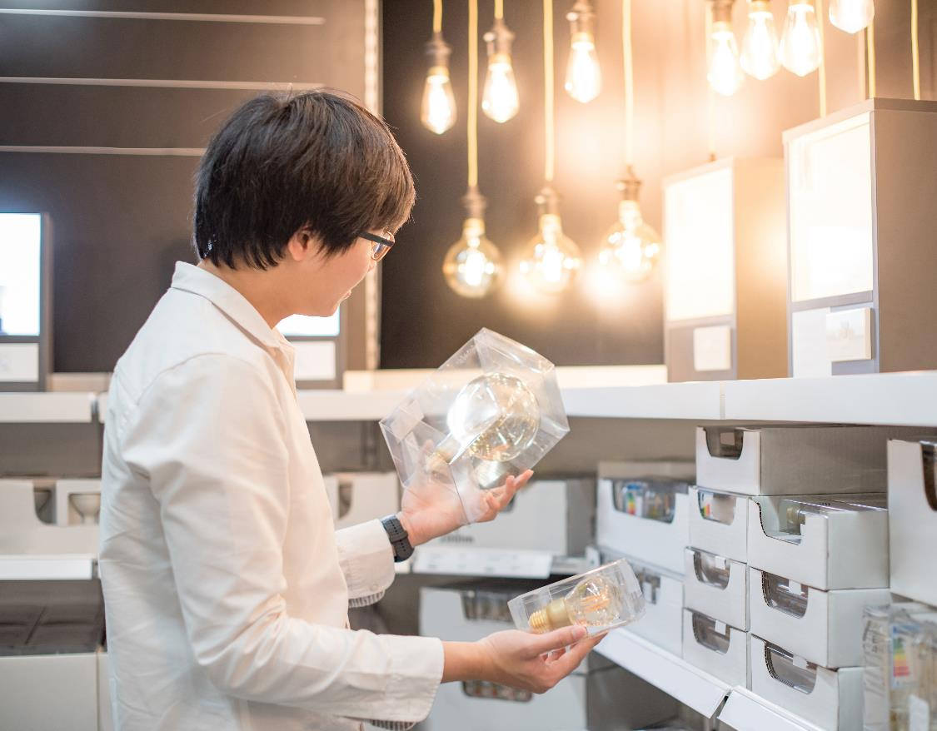
Goal: Type of Application, Intended Audience, and Stakeholders
According to ISO 14044 (section 4.2.2), in defining the goal of an LCA, the following items shall be unambiguously stated:
The intended application,
The reasons for carrying out the study,
The intended audience i.e., to whom the results of the study are intended to be communicated, and
Whether the results are intended to be used in comparative assertions intended to be disclosed to the public.

Slide 7
Goal definition
INTENDED APPLICATION
DIFFERENT TYPES OF LIGHT BULBS
Overall objective/reason: (product information/development, policy/strategy, regulation)
Target audience: (internal/consumer/ governmental body)
Actors: (sponsors, authors, advisory board & stakeholders, peer reviewers)

Slide 8

LCA actors
The identity and addresses of the main stakeholders should be provided:
Sponsors: e.g. consumer association
Authors & analysts: e.g. EHS672 consultant
Optional advisory board: a group of “knowledgeable and open-minded” experts representing the sponsor and the main stakeholders to provide advice on main choices and hypotheses as the LCA develops: e.g. representatives from bulb manufacturer, electricity company, EPA and consumer
Optional peer reviewers: independent LCA expert selected by the sponsor and the study authors
If the intended audience is external, the credibility of the LCA is increased by having the LCA commissioners, analysts, and peer reviewers all be independent entities.

Slide 9
Goal and Scope Definition Part B Peer review and scope definition
Olivier Jolliet, PhD

Slide 10

Peer review and peer reviewers
The critical or peer review ensures that the interpretations reflect the identified limitations and goals of the study and that the study report is transparent and consistent.
It is optional but an external review becomes necessary for an ISO-compatible study involving a comparative assertion.
Needs to be planned and budgeted from the start (5%–10% of the total LCA cost).
It is preferable to involve the reviewers as soon as possible, to be able to take their comments into account as the project develops, and not just at the end of the project.

Slide 11
Scope definition
The scope of an LCA must take into account and clearly describe ISO 14044, Section 4.2.3.1:
The product system to be studied
The function of the system
The functional unit (FU)
The system boundary
Allocation procedures
Life cycle impact assessment (LCIA) methodology and impacts
Interpretation to be used
Data requirements
Assumptions
Value choices and optional elements
Limitations
Data quality requirements
Type of critical review, if any
Type and format of the report required for the study

Slide 12
Scope: Screening approach
We recommend to carry out the LCA in two steps, with approximately equal effort in each step:
1
A first screening phase covering the whole LCA and assessing orders of magnitude of the emission inventory and impacts
A detailed analysis to improve the assessment for most important impacts
2

Slide 13
Summary
The goal and scope definition phase of an LCA defines the main hypotheses and methods used in the LCA
It is a crucial steps to ensure the study consistency
It requires discussions between
the client/sponsor (consumer, contractor, government),
the analyst/scientist
The potential stakeholders
the “independent” peer reviewer

Slide 14
Goal definition
INTENDED APPLICATION
DIFFERENT TYPES OF LIGHT BULBS
Overall objective/reason: (product information/development, policy/strategy, regulation)
Provide product information to select the most suitable type of light bulb
Target audience: (internal/consumer/ governmental body)
Consumers
Actors: (sponsors, authors, advisory board & stakeholders, peer reviewers)
Independent entities as far as possible to enhance study credibility

Slide 15
Healthy and Sustainable Foods and Products
Table of contents 3.2 Goal and scope defintion
MAIN FACTORS IMPACTING SUSTAINABILITY AND HEALTH
HEALTHY AND SUSTAINABLE FOODS
LIFE CYCLE IMPACTS OF PRODUCTS (LCA)
3.1 Introduction to LCA
3.2 Goal and scope definition
3.2.1 LCA goal definition
3.2.2 Function and functional unit
3.2.3 Building the product system and process tree
3.2.4 System boundaries
3.3 Life cycle inventory
3.4 Life cycle impact assessment
3.5 Interpretation
3.6 Impacts of fine particulate and chemicals in products
4. SUSTAINABLE CONSUMPTION

Slide 16
Function and functional unit
Part A – Function
Shanna Shaked, PhD & Olivier Jolliet, PhD

Slide 17
Learning Objectives
Define function and functional units as a basis for consistent comparison of products or services
Select the functional unit for multiple types of applications to reflect the product function and service offered to its user
Determine reference flows as what is needed to be purchased per functional unit
Qualitatively identify key environmental factors that are essential to product performance

Slide 18


System function and functional unit
LCA relates the environmental impacts to a product function.
Products or systems can only be compared on the basis of a similar function.
Are there differences in the secondary function between scenarios?

Slide 19
Function and functional unit
Part B - Functional unit and reference flows
Shanna Shaked, PhD & Olivier Jolliet, PhD

Slide 20
Incandescent versus fluorescent bulbs: Function of a bulb
PRODUCTS
MAIN FUNCTION
SECONDARY FUNCTION & OTHER PERFORMANCES
SCENARIO 1
SCENARIO 2
PRODUCTS OR SYSTEM
FUNCTIONAL UNIT (service offered)
REFERENCE FLOWS (what is purchased)
KEY ENVIRONMENTAL PARAMETERS (linking reference flows to functional unit)
SCENARIO 1
SCENARIO 2
What do you need or need to buy to fulfill the main illumination function?
The functional unit needs to be quantified → also quantify the corresponding reference flows
What are the key factors that determine the reference flows, i.e. what needs to be purchased per FU?
Notes:
Faculty Note:
Please use this area to provide notes to our design team about the content contained on the slide. Notes can include instructions on how content will be presented; types of imagery needed or desired; plan on how to describe visuals; etc.
Content slides come in two options depending upon what is needed – Content slide with title / Content slide without title. All content slides have a faded line and light gradient at the bottom of the slide which is meant to be empty space to display subtitles and the Michigan logo. Please keep all information out of this bottom gradient area.

Slide 21
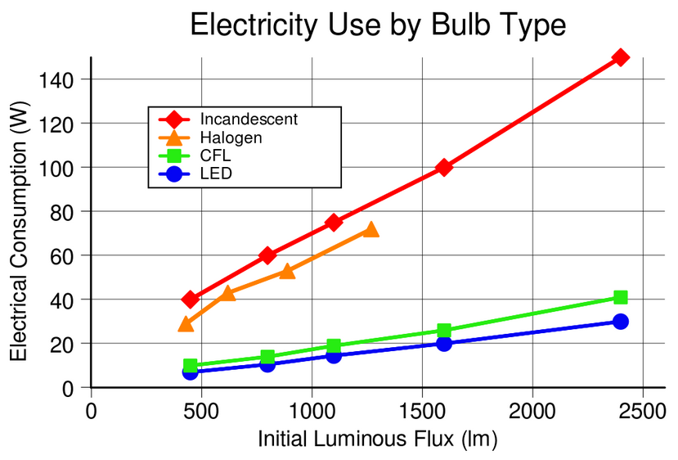
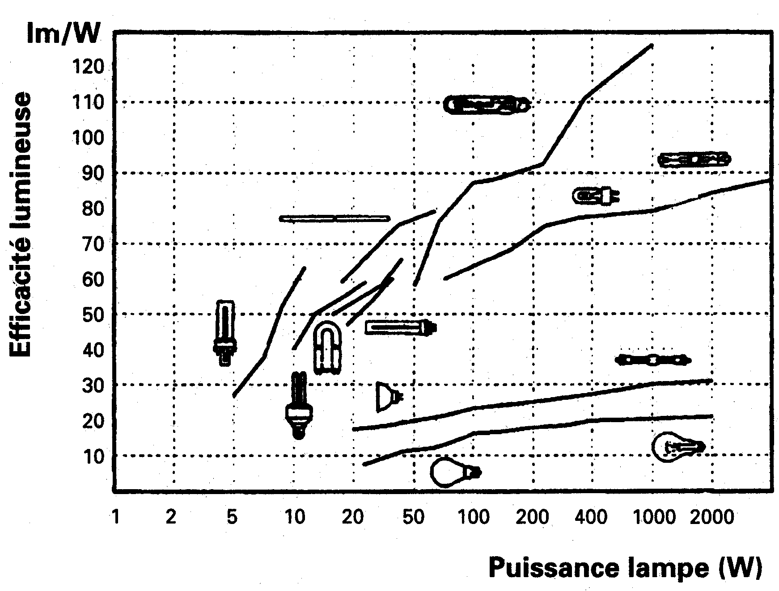
Light efficiency according to different sorts of bulbs
Light efficiency
Bulb power (W)

Slide 22
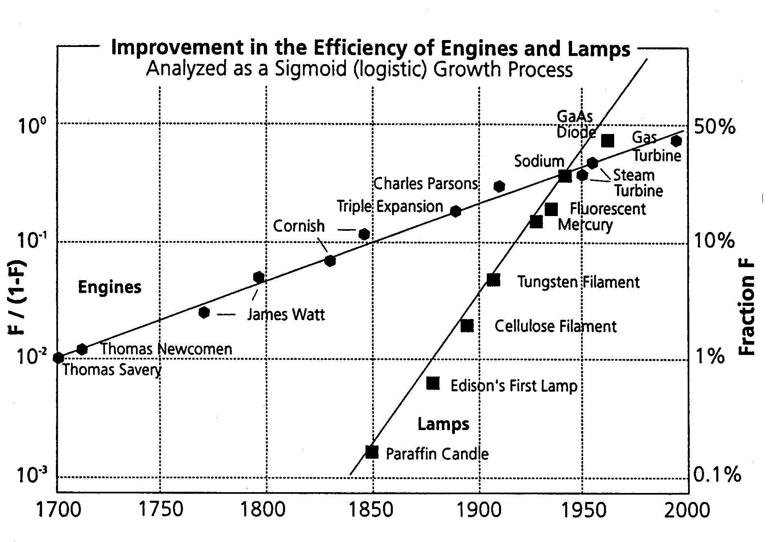
Technological improvement needs time!

Slide 23
Reference flows
PRODUCTS OR SYSTEM
FUNCTIONAL UNIT (service offered)
REFERENCE FLOWS (what is purchased)
KEY ENVIRONMENTAL PARAMETERS (linking reference flows to functional unit)
SCENARIO 1
5000h/FU x 60 W
=300 kWh electricity/FU
Efficiency: Lumen / W (use stage)
Bulb lifespan (manufacturing stage)
Amount and type of materials per bulb (material extraction and manufacturing stages)
800 lumen
for a duration of 5000 hours
5 incandescent bulbs/FU
1/6 fixture/FU
SCENARIO 2
5000h/FU x 13 W
=65 kWh electricity/FU
1 fluorescent bulb/FU
1/6 fixture/FU
The problem is that the fluorescent bulbs are more expensive… are they?

Slide 24
Function and functional unit
Part C - Life cycle Costing and overview
Shanna Shaked, PhD & Olivier Jolliet, PhD

Slide 25
Life Cycle Costing: LCC NOT LCA
The reference flows: what needs to be purchased to ensure the function!
This is also the basis for a life cycle costing, combining the quantities and the price of the purchased goods
PRODUCTS OR SYSTEM
FUNCTIONAL UNIT (service offered)
REFERENCE FLOWS (what is purchased)
KEY ENVIRONMENTAL PARAMETERS (linking reference flows to functional unit)
SCENARIO 1
300 kWh/FU electricity
800 lumen
for a duration of 5000 hours
5 incandescent bulbs/FU
SCENARIO 2
65 kWh/FU electricity
1 fluorescent bulb/FU

Slide 26
Functional unit
It is the same for all scenarios
It is a quantified and additive value, NOT a ratio!
If a component is studied (e.g. plane engine), FU generally refers to the overall function (the plane)
You can arbitrarily select the amount of functional unit you fix as a reference for comparison
When what you need to buy per functional unit changes as the service duration is extended, you need to make the service duration explicit in the functional unit
Some functional units already implicitly account for the duration of the service (e.g. 1kWh)
\
The functional unit is the common unit representing the function of the system (the offered service), providing the basis for scenario comparison. In the inventory, emissions are calculated per functional unit.

Slide 27
Reference flows and environmental key parameters
\
The key parameters for environmental optimization are multiplicative factors that relate the functional unit to the reference flows. Impacts may be directly proportional to these factors:
product lifetime
number of uses
consumption
The reference flow (what you buy) provides for each scenario the basic product quantities needed per functional unit. It provides a flow per functional unit and need to be quantified
It differs for each scenario.

Slide 28
Life Cycle Costing: LCC NOT LCA
The reference flows: what needs to be purchased to ensure the function!
This is also the basis for a life cycle costing, combining the quantities and the price of the purchased goods
PRODUCTS OR SYSTEM
FUNCTIONAL UNIT (service offered)
REFERENCE FLOWS (what is purchased)
LIFE CYCLE COSTS (combining quantities with prices)
SCENARIO 1
300 kWh/FU electricity
300 kWh/FU • $0.1/kWh = $30/FU 5 • $0.5 = $2.5/FU TOTAL = $32.5/FU
800 lumen
for a duration of 5000 hours
5 incandescent bulbs/FU
SCENARIO 2
65 kWh/FU • $0.1/kWh = $6.5/FU 1 • $2 = $2/FU TOTAL = $8.5/FU
65 kWh/FU electricity
1 fluorescent bulb/FU

Slide 29
Healthy and Sustainable Foods and Products
Table of contents 3.2 Goal and scope defintion
MAIN FACTORS IMPACTING SUSTAINABILITY AND HEALTH
HEALTHY AND SUSTAINABLE FOODS
LIFE CYCLE IMPACTS OF PRODUCTS (LCA)
3.1 Introduction to LCA
3.2 Goal and scope definition
3.2.1 LCA goal definition
3.2.2 Function and functional unit
3.2.3 Building the product system and process tree
3.2.4 System boundaries
3.3 Life cycle inventory
3.4 Life cycle impact assessment
3.5 Interpretation
3.6 Impacts of fine particulate and chemicals in products
4. SUSTAINABLE CONSUMPTION

Slide 30
Building of product system and process tree
Part A Theory
Olivier Jolliet, PhD

Slide 31
Learning Objectives
Build the product system and process tree, more specifically
Define the product system on a functional basis
Identify intermediary and elementary flows
Build the system process tree, composed of unit processes linked by intermediary flows

Slide 32
Product system definition: Function-based
A product system is a collection of unit processes (UP) which perform one or more defined functions.
ECONOMY
ENVIRONMENT
Input=0
Product system
Resource extraction (minerals, land, water, etc.)
The essential property of a product system is characterized by its function and cannot be defined solely in terms of the final products.
Ideally, the product system contains all processes required to achieve the system function (0 input from economy).
Emission (to air, water and soil; of substances, noise, etc.)
Product function
System boundary

Slide 33
Unit process: Illustration
The product system can be disaggregated into unit processes (UP).
The unit processes are linked by intermediary flows that connect the different processes.
In addition, each UP can have inputs or extractions from the environment (consumption of resources, energy, etc.) and outputs or emissions to the environment (to water, air, soil, etc.), called elementary flows.
Unit process
Intermediary product flow
Input elementary flows (extractions from the environment)
Exiting elementary flows
(emissions to the environment)
Unit process
Intermediary product flow
Unit process
The inventory of environmental flows is by definition the quantification of elementary flows crossing the system boundaries, to and from the environment

Slide 34
Unit process: Shoe Example
Intermediary flows are flows of products used as an input such as rubber, leather and electricity.
Elementary flows are flows of ores such as phosphate ores or raw natural gas directly extracted from the environment and emissions to air, water, soil such as methane, carbon dioxide, fine particulates or dyes.
Mass and energy balances can be performed to verify that the unit processes and the global system respect conservation laws.
Phosphate ore
Farm
CH₄ to air
Leather
Rubber
CO₂ to air
PM_{2.5} to air
Natural gas raw
Shoe manufacturing
Dye to freshwater
Electricity

Slide 35


Unit process
Intermediary and elementary flows Aluminum primary liquid
ecoinvent LCI database v.2.2
Aluminum oxide 1.93 kg
Aluminum,
primary,
liquid
1 kg
Benzo(a)pyrene 1.30 mg
Carbon dioxide, fossil 1.50 kg
Anode, aluminum electrolysis 0.448 kg
Carbon monoxide, biogenic 91.7 g
Cathode, aluminum electrolysis 0.0181 kg
Hydrogen fluoride 539 mg
Aluminum electrolysis plant 1.54·10⁻¹⁰ p
Nitrogen oxides 63.9 mg
PAH 45.7 mg
Electricity mix, aluminum industry 15.9 kWh
Particulates, < 2.5 µm 2.61 g
Heat, light fuel oil 0.089 MJ
Sulfur dioxide 8.83 g
Heat, natural gas 0.084 MJ
Heat, waste 56.0 MJ
Transport, transoceanic freight ship 3.8 tkm
Disposal, filter dust Al electrolysis 2.00 g
Disposal, redmud from bauxite digestion 1.36 kg
Take one minute to look at the flows of the unit process “aluminum primary liquid”: What are the intermediary and the elementary flows?

Slide 36
Unit process
Intermediary and elementary flows Aluminum primary liquid
ecoinvent LCI database v.2.2
Aluminum oxide 1.93 kg
Aluminum,
primary,
liquid
1 kg
Benzo(a)pyrene 1.30 mg
Carbon dioxide, fossil 1.50 kg
Anode, aluminum electrolysis 0.448 kg
Carbon monoxide, biogenic 91.7 g
Cathode, aluminum electrolysis 0.0181 kg
Hydrogen fluoride 539 mg
Aluminum electrolysis plant 1.54·10⁻¹⁰ p
Nitrogen oxides 63.9 mg
PAH 45.7 mg
Electricity mix, aluminum industry 15.9 kWh
Particulates, < 2.5 µm 2.61 g
Heat, light fuel oil 0.089 MJ
Sulfur dioxide 8.83 g
Heat, natural gas 0.084 MJ
Heat, waste 56.0 MJ
Transport, transoceanic freight ship 3.8 tkm
Disposal, filter dust Al electrolysis 2.00 g
Disposal, redmud from bauxite digestion 1.36 kg
For a given unit process, elementary and intermediary flows are direct inputs to or outputs from this process
For resource inputs only ores or raw materials in ground are elementary flows
The waste flows sent to disposal are intermediary NOT elementary flows

Slide 37
Main life cycle stages and group of processes in a product system
SYSTEM BOUNDARIES
Waste disposals and treatments are included in the system boundaries and are intermediary NOT elementary flows.
The level of detail required to achieve the study goals determines the number of UPs considered and their boundaries.
For a given product function, the system is best built by designing a process tree or flow chart / flow diagram.
Infrastructure, transportation
Manufacturing
Recycling
Resources
extraction
Mining & transformation
Use
Reuse
Disposal, Waste treatment
Emissions to air, water, soil

Slide 38
Building of product system and process tree
Part B Steps and application to aluminum
Olivier Jolliet, PhD

Slide 39
Process tree design
Start from your functional unit and the Tier 1 related reference/intermediary flows needed to be purchased per functional unit. Draw one box per reference flow.
Follow the upstream and downstream intermediary flows of Tier 1 to identify the Tier 2 processes and draw the Tier 2 boxes.
Repeat this step until you reach processes further covered by an LCA database.
Design the process tree of all unit processes involved in the system (“up to database”), both upstream and downstream from these reference flows.
For each unit process (each box), follow the intermediary flows to document in each box the amount needed per FU.
1
Tier 2
2
3
Tier 1
4
FU
Tier 1
5

Slide 40
Tier 0
1
Identify reference flows from primary aluminum → create 1 box per flow
i.e. the intermediary flows of previous figure
ecoinvent LCI database v.2.2
Aluminum oxide 1.93 kg
Aluminum,
primary,
liquid
1 kg
Benzo(a)pyrene 1.30 mg
Carbon dioxide, fossil 1.50 kg
Anode, aluminum electrolysis 0.448 kg
Carbon monoxide, biogenic 91.7 g
Cathode, aluminum electrolysis 0.0181 kg
Hydrogen fluoride 539 mg
Aluminum electrolysis plant 1.54·10⁻¹⁰ p
Nitrogen oxides 63.9 mg
PAH 45.7 mg
Electricity mix, aluminum industry 15.9 kWh
Particulates, < 2.5 µm 2.61 g
Heat, light fuel oil 0.089 MJ
Sulfur dioxide 8.83 g
Heat, natural gas 0.084 MJ
Heat, waste 56.0 MJ
Transport, transoceanic freight ship 3.8 tkm
Disposal, filter dust Al electrolysis 2.00 g
Disposal, redmud from bauxite digestion 1.36 kg

Slide 41
Design of process tree: Tier 1
1
Start from your functional unit and the Tier 1 related reference/intermediary flows
Disposal, redmud from bauxite digestion
Aluminum, primary, liquid
Disposal, filter dust Al electrolysis
1.93 kg_{Al oxide} / kg_{Al liquid}
Aluminum oxide
Anode, aluminum electrolysis
Cathode, aluminum electrolysis
Electricity mix
Follow intermediary flows of Tier 1 to get Tier 2
Heat,
light fuel oil
Transport, transoceanic freight

Slide 42
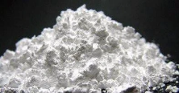
Elementary and intermediary flows of Tier 1 Aluminum oxide Unit Process
2
Follow intermediary flows of Tier 1 to get Tier 2 → create 1 box for each Tier 2 flow
ecoinvent LCI database v.2.2
Aluminum hydroxide 1.53 kg
Aluminum,
oxide
1 kg
Aluminum oxide plant 2.5·10⁻¹ p
Electricity mix medium voltage EU 0.0105 kWh
Heat, light fuel oil 1.94 MJ
Heat, natural gas 0.507 MJ
Heat, waste 0.038 MJ

Slide 43
Design of process tree: Tier 2
3
Repeat this step, following intermediary flows of Tier 2 to get Tier 3
Disposal, redmud from bauxite digestion
Aluminum, primary, liquid
Disposal, filter dust Al electrolysis
1.93 kg_{Al oxide} / kg_{Al liquid}
Aluminum oxide
Anode, aluminum electrolysis
Cathode, aluminum electrolysis
Electricity mix
1.53 kg_{Al hydroxide} /kg_{Al oxide}
Aluminum hydroxide
Petroleum coke
Heat,
light fuel oil
Transport, transoceanic freight
Natural gas

Slide 44
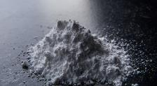
Elementary and intermediary flows of Tier 2 aluminum hydroxide Unit Process
3
Repeat this step following intermediary flows of Tier 2 to get Tier 3 → create 1 box for each Tier 3 flow
ecoinvent LCI database v.2.2
Aluminum,
hydroxide
1 kg
Water (1.05E-5 m³)
Heat, waste (0.503 MJ)
Bauxite at mine 1.4 kg
Sodium, ion (1.28 g)
Electricity, medium voltage (0.14 kWh)
Suspended solids (0.17 g)
Heat, light fuel oil (3.59 MJ)
Total Organic Carbon (18 mg)
Transport, transoceanic freight ship (7.11 tkm)
Redmud from bauxite digestion (0.47 kg)

Slide 45
Design of process tree: Tier 3
4
Design the process tree of all unit processes involved in the system (“up to database”)
Use intermediary flows to fill each box with the amount of process used per FU
Disposal, redmud from bauxite digestion
Aluminum, primary, liquid
Disposal, filter dust Al electrolysis
5
1.93 kg_{Al oxide} / kg_{Al liquid}
Aluminum oxide
Anode, aluminum electrolysis
Cathode, aluminum electrolysis
Electricity mix
1.53 kg_{Al hydroxide} /kg_{Al oxide}
Aluminum hydroxide
Petroleum coke
1.4 kg_{Bauxite} /kg_{Al hydroxide}
Bauxite
Heat,
light fuel oil
Transport, transoceanic freight
Natural gas

Slide 46
Design of process tree: Fill in each box with the process amount per FU
5
Use intermediary flows to fill each box with the amount of process used per FU
Disposal, redmud from bauxite digestion
1.36 kg
Disposal, filter dust Al electrolysis
2.00 g
Aluminum, primary,liquid
1 kg
1.93 kg_{Al oxide} / kg_{Al liquid}
Aluminum oxide
1.93 kg
Anode, aluminum electrolysis
0.449 kg
Cathode, aluminum electrolysis
0.0181 kg
Electricity mix
57.4 MJ
1.53 kg_{Al hydroxide} /kg_{Al oxide}
kg_{Al hydroxide}
Aluminum hydroxide
2.96 kg
Petroleum coke
0.292 kg
1.93 x 1.53 = 2.96
kg_{Al liquid}
1.4 kg_{Bauxite} /kg_{Al hydroxide}
Bauxite
4.14 kg
Heat,
light fuel oil
14.9 MJ
Transport, transoceanic freight
34.1 tkm
Natural gas
3.19 MJ

Slide 47
Design of process tree: Fill in each box with the process amount per FU
5
Use intermediary flows to fill each box with the amount of process used per FU
Disposal, redmud from bauxite digestion
1.36 kg
Disposal, filter dust Al electrolysis
2.00 g
Aluminum, primary,liquid
1 kg
1.93 kg_{Al oxide} / kg_{Al liquid}
Aluminum oxide
1.93 kg
Anode, aluminum electrolysis
0.449 kg
Cathode, aluminum electrolysis
0.0181 kg
Electricity mix
57.4 MJ
1.53 kg_{Al hydroxide} /kg_{Al oxide}
kg_{Al hydroxide}
Aluminum hydroxide
2.96 kg
Petroleum coke
0.292 kg
1.93 x 1.53 = 2.96
kg_{Al liquid}
1.4 kg_{Bauxite} /kg_{Al hydroxide}
kg_{Bauxite}
Bauxite
4.14 kg
Heat,
light fuel oil
14.9 MJ
Transport, transoceanic freight
34.1 tkm
Natural gas
3.19 MJ
2.96 x 1.4 = 4.14
kg_{Al liquid}

Slide 48
Summary
A product system description includes unit processes, intermediary product flows within the system and, elementary flows from and to the environment as well as the product and its function crossing the system boundaries to the economy.
The process tree is built starting from the references flows (what was purchased to obtain the product function) and moving through the different tiers of processes.
The process tree is documented using intermediary flows to calculate the total amount of each process per functional unit.

Slide 49
Building of product system and process tree: Part C - Practice
Olivier Jolliet, PhD

Slide 50
Learning Objectives
Build the product system and process tree, more specifically
Design the process tree of the incandescent light bulb system
Determine amount of each process per functional unit

Slide 51
Process tree design
Start from reference flows needed to be purchased per functional unit. Draw one box per reference flow.
Follow the upstream and downstream intermediary flows until you reach processes further (likely to be) covered by an LCA database.
Design the process tree.
For each unit process, document in each box, the amount needed per FU.
1
2
3
4

Slide 52

Elementary and intermediary flows of Tier 1 Aluminum oxide Unit Process
From functional unit lecture:
Illumination
800 lumen
During 5000 h
PRODUCTS OR SYSTEM
FUNCTIONAL UNIT (service offered)
REFERENCE FLOWS (what is purchased)
Incandescent light bulb 5 p
Electricity 300 kWh
SCENARIO 1
800 lumen
for a duration of 5000 hours
5000h/FU x 60 W
=300 kWh/FU electricity
5 incandescent bulbs/FU
Design the process tree for illumination with incandescent light bulb

Slide 53
Process Tree: illuminating with incandescent bulbs
1
Start with reference flows at Tier 1, draw one box per reference flow
5 Incandescent bulbs
Illumination
800 lumen
During 5000 h
Electricity
300 kWh

Slide 54

Elementary and intermediary flows of an incandescent bulb
2
Use the bulb intermediary flows to design the Tier 2 processes
1 incandescent bulb at retail
35.7g
20 g glass
15 g aluminum
0.7 g tungsten
1 bulb & 10g packaging to landfill
0.38 MJ primary energy
10g packaging paper
3,200 km truck
10,000 km transoceanic freight

Slide 55
Process Tree: illuminating with incandescent bulbs
3
Design the process tree
Transportation
Truck 3200 km
Glass
5 Incandescent bulbs
Transportation
Oceanic freight 10,000 km
Illumination
800 lumen
During 5000 h
Bulbs to
Landfill
Aluminum
Tungsten
Paper packaging
Electricity
300 kWh
Energy

Slide 56
Process Tree: illuminating with incandescent bulbs
4
For each unit process, document in each box, the amount needed per FU.
5 bulbs/FU x 20g Glass/Bulb
= 100g Glass/FU
Transportation
Truck 3200 km
Glass
5 Incandescent bulbs
Transportation
Oceanic freight 10,000 km
Illumination
800 lumen
During 5000 h
Bulbs to
Landfill
Aluminum
Tungsten
Paper packaging
Electricity
300 kWh
Energy
5 bulbs/FU x 0.38MJ primary Energy/Bulb
= 1.9 Energy/FU MJ primary

Slide 57
Process tree – illuminating with incandescent bulbs
Also calculate the transportation flows per FU in kg∙km (kg transported over a km)
Transportation
Truck 3200 km
kg∙km
Glass to landfill
100g
Glass
100g
Aluminum to landfill 75g
5 Incandescent bulbs
Transportation
Oceanic freight 10,000 km
2,285 kg∙km
Illumination
800 lumen
During 5000 h
Aluminum
75g
Tungsten to landfill
3.5g
Tungsten
3.5g
Paper packaging
50g
Electricity
300 kWh
Paper packaging
50g to recycling
Energy
1.9 MJprimary
TOTAL WEIGHT = 100g + 75g + 3.5g + 50g
= 0.229kg

Slide 58
Process tree – illuminating with incandescent bulbs
TRANSPORTATION = 0.229kg x 3200km
= 731 kg∙km
Transportation
Truck 3200 km
731 kg∙km
Glass to landfill
100g
Glass
100g
Aluminum to landfill 75g
5 Incandescent bulbs
Transportation
Oceanic freight 10,000 km
2,285 kg∙km
Illumination
800 lumen
During 5000 h
Aluminum
75g
Tungsten to landfill
3.5g
Tungsten
3.5g
Paper packaging
50g
Electricity
300 kWh
Paper packaging
50g to recycling
Energy
1.9 MJprimary
TOTAL WEIGHT = 100g + 75g + 3.5g + 50g
= 0.229kg

Slide 59
Summary
The process tree is an efficient way to visualize the product system.
The intermediary flows enable us to determine the amount of each process used per function unit, in the unit required by the LCI database.
This will serve as the basis to then determine the resource extraction and emission elementary flows of the Life Cycle inventory.
What are the ultimate system boundaries and how to define them consistently?

Slide 60
Healthy and Sustainable Foods and Products
Table of contents 3.2 Goal and scope defintion
MAIN FACTORS IMPACTING SUSTAINABILITY AND HEALTH
HEALTHY AND SUSTAINABLE FOODS
LIFE CYCLE IMPACTS OF PRODUCTS (LCA)
3.1 Introduction to LCA
3.2 Goal and scope definition
3.2.1 LCA goal definition
3.2.2 Function and functional unit
3.2.3 Building the product system and process tree
3.2.4 System boundaries
3.3 Life cycle inventory
3.4 Life cycle impact assessment
3.5 Interpretation
3.6 Impacts of fine particulate and chemicals in products
4. SUSTAINABLE CONSUMPTION

Slide 61
System Boundaries
Part A – Fastfood counter example
Olivier Jolliet, PhD

Slide 62
Learning Objectives
Define consistent system boundaries based on the product service and function, more specifically
Identify potential biases in system boundaries
Determine rules for good practice in defining system boundaries
Check whether and under which conditions processes common to different scenarios can be excluded from the boundaries

Slide 63
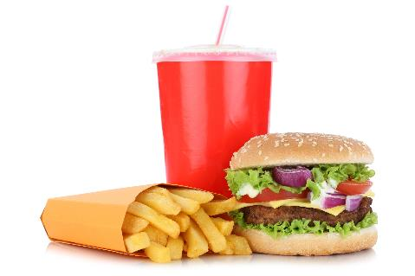




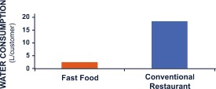


Fastfood (counter-) example
According to a consultant working for a main fast food company “Fast food take-away restaurant
proves to be environmentally friendlier compared to a conventional restaurant”
6x less energy
7x less water
5x less waste

Slide 64
Potential biases or flaws
System boundaries were chosen as the walls of the restaurant, only accounting for the processes that occur within the restaurant.
Geographical rather than functional system boundary, does not cover the same functional reality in both scenarios
The type of waste was not differentiated, most waste for the traditional restaurant being compostable, whereas packaging dominates for the fast food.
In addition part of fast food waste is taken away and not all collected inside the restaurant
The function of a fast-food restaurant is different from that of a traditional one → rather compare two fast food one with dishes vs take away

Slide 65
Comparison of Food Preparation Steps
FAST-FOOD RESTAURANT
CONVENTIONAL RESTAURANT
Agricultural production chain
Agricultural production chain (same as fast-food)
Geographical/business-based rather than functional system boundary, thus excluding preparation and packaging for the fast-food system, but not for the conventional restaurant
Packaging production and waste management occur outside of the restaurant, and thus were not included for either system, whereas dishwashing is included
Transport
Transport (same)
Production chain for plastic tableware (knives, forks, cups, etc.)
Production chain for reusable dishes
Initial preparation and packaging of food (preparation of burgers, salads, etc.)
Preparation of food and cooking
Final cooking
Cleaning, heating, and lighting of restaurant
Cleaning, heating, and lighting of restaurant (same)
Clean reusable dishes
Management of food and packaging waste
Management of food and packaging waste
Note: Items in italic were not included in the system boundary of the original study.

Slide 66
System boundaries for fast food
SYSTEM BOUNDARY
Raw material extraction
Water treatment
Energy supply
Other researchers addressed these biases in an alternative more consistent study
Materials
Water
Energy
System boundaries:
account for the
same reality
Production
Transport
Restaurant
Food
Food
Food preparation
Heating
Lighting
Ventilation
Cooling
Cleaning
Dishes
Dishes
Dish washing
Packaging
Packaging
Used water
Waste
Waste water treatment
Waste treatment
LEGEND
Effluents
Landfills
Process
Intermediary product
Excluded from system
Water flow
Other flow
Water
Air
Soil
(adapted from Lang et al., 1994)

Slide 67
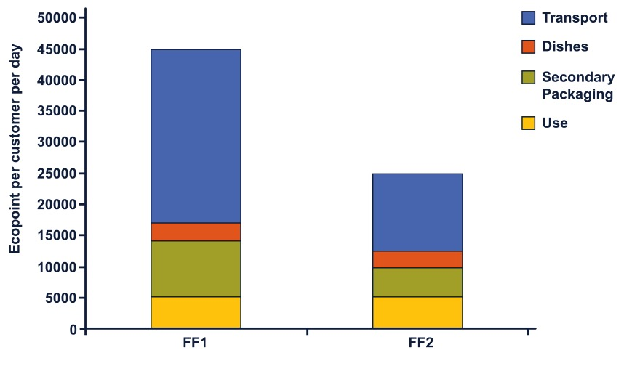
System boundaries for fast food restaurants: Take away vs. reusable dishes
Compared another fast-food restaurant with dishes rather than packaged food.
When re-counting the number of customers, the fast food customers had been over-estimated.
The fast-food restaurant FF2 with reusable dishes is more environmentally friendly!
(study by Swiss federal institute of Zürich, Lang et al., 1994)

Slide 68
System Boundaries
Part B – Rules for good practice
Olivier Jolliet, PhD

Slide 69
System boundaries: rules for good practice
System boundaries include all the necessary processes to assure the desired function.
RULE 1:
System boundaries should cover the same functional reality in all scenarios (functional boundaries, not geographical boundaries)
RULE 2:
Only processes contributing to more than x% of the energy or emissions are retained. The % depends on the level of detail of the study!
In practice, this cut-off criteria is applied as a minimum inclusion requirement, ensuring that all processes contributing to more than the cut-off are included. All existing processes available in databases or collected data on new processes are usually kept, even if they contribute to less than the cut-off.
RULE 3:
Identical processes in different scenarios can only be excluded if the intermediary flows affected by these processes are strictly equal. Still interesting to include these identical processes to identify key production steps and respective shares.

Slide 70
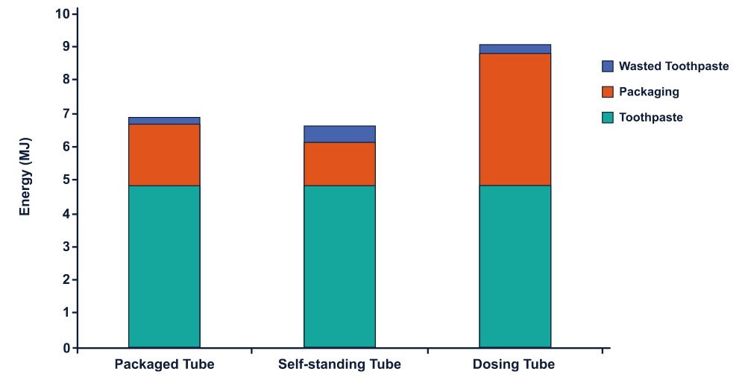
Energy needs: toothpaste
Can we exclude from the boundaries the toothpaste itself since the amount is identical?
EXAMPLE: TOOTHPASTE
When comparing three kinds of toothpaste packaging (Haydock 1995) a standard tube in cardboard packaging, a self-standing tube not needing the outer box, and a dosing toothpaste pump, can we exclude from the boundaries the toothpaste itself since the amount is identical?

Slide 71
Energy needs: toothpaste
Be cautious with indirect impacts, when excluding identical processes
No, because the fraction of toothpaste wasted changes with the packaging.
What could you easily modify in a toothpaste packaging to make the toothpaste environmentally friendlier?

Slide 72
Herbicides A and B: treatment of 1 ha
Ploughing 20L Diesel
Ploughing 20L Diesel
EXAMPLE: HERBICIDES
When comparing the use of two herbicides, A and B, for the harvest of a given quantity of corn, can we exclude the gasoline required for ploughing the field and other wheat cultivation steps that must occur in both scenarios?
Application Herbicides A
10kg A, 5L Diesel
Application Herbicides B
0.2kg A, 2L Diesel
Yield 5,000 kg corn = 5t corn
Yield 4,000 kg corn
= 4t corn

Slide 73
Herbicides A and B: treatment of 1 ha
Labor 20L Diesel
Intermediary
flows per FU
4L Diesel/t
Labor 20L Diesel
Intermediary
flows per FU
5L Diesel/t
Even if the two ploughing processes are the same,
the intermediary flows are different due to the difference in yield
→ Ploughing operation cannot be excluded if the herbicide affects the yield
Application Herbicides A
10kg A, 5L Diesel
Application Herbicides B
0.2kg A, 2L Diesel
2kg A/t
1L Diesel/t
0.05kg B/t
0.5L Diesel/t
Yield 5t
TOTAL 5L Diesel/t
Yield 4t
TOTAL 5.5L Diesel/t

Slide 74
Summary
RULE 1 The system boundaries must cover the same functional reality in all scenarios (no geographical or business-based boundaries).
RULE 2 Cut-off criteria for the inclusion of processes in the system boundary must be clearly described, including assumptions, reasoning and effects on study results. Processes can only be excluded if they contribute less than the cut-off percentages (i.e. 1%) to the mass of the product, the energy consumption of the system, or the environmental impacts (i.e. emissions of a given pollutant) [ISO 14044, 2006]. These cut-off criteria are fixed in advance.
RULE 3 Processes that are identical in the different scenarios can only be excluded if the intermediary flows affected by these processes are strictly equal (i.e. the same quantity of each process is required per functional unit for the different scenarios).

