Slide 1
Activity Functional unit
Comparison of alternatives for drying hands
Olivier Jolliet, PhD
Notes:
Faculty Note:
Enter lecture title, and subtitle if present, in the text box above. Enter name and credentials on the second line as shown. The slide background graphic for this introduction slide can be replaced with an alternate image more suited to the topic or department (this step will be handled by our graphics team in the production phase).

Slide 2
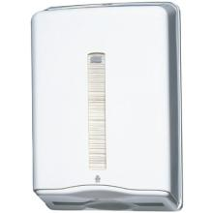
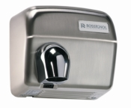
Function, functional unit and reference flows
In public restrooms, different types of hand dryers exist. What is the best type of hand dryer?
Objective: Compare two types of hand drying: A. The paper towel B. The air-dryer with hot air
Method:
1. describe the function of the system (slide 2);
2. choose the functional unit that represents the function of the system (including a number that qualify the FU) – slide 2;
3. for each scenario, and using the data on slide 4, list the reference flows corresponding to the selected functional unit. Do provide for each reference flow the QUANTITY used per functional unit.

Slide 3
Function and functional unit
1. describe the function of the system by filling the table below (For each scenario, find a secondary function that might save energy beyond the main hand drying function)
PRODUCTS
MAIN FUNCTION
SECONDARY FUNCTION & OTHER PERFORMANCES
Paper towel
xxx
xxx
Air dryer
2. choose the functional unit that represents the function of the system
(including a number that qualify the FU)
Selected functional unit : xxx
Notes:
Faculty Note:
Please use this area to provide notes to our design team about the content contained on the slide. Notes can include instructions on how content will be presented; types of imagery needed or desired; plan on how to describe visuals; etc.
Content slides come in two options depending upon what is needed – Content slide with title / Content slide without title. All content slides have a faded line and light gradient at the bottom of the slide which is meant to be empty space to display subtitles and the Michigan logo. Please keep all information out of this bottom gradient area.

Slide 4
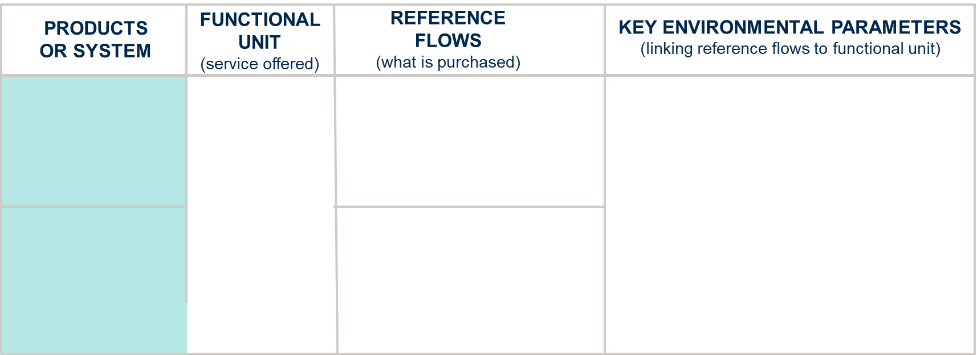
Reference flows and key environmental parameters
To make your life easier to compare with the answer keys, I have now selected a functional unit of 1 pair of dried hands
Paper towel
XXX towels
XXX 2
XXX plastic distributors
XXX 1
XXX 2
XXX 3
1 pair of dried hands
Air dryer
XXX 1
XXX 2
XXX 3
3. for each scenario, and using the data on slide 5, list the reference flows corresponding to the selected functional unit. Do provide for each reference flow the QUANTITY used per functional unit. Then add the key parameters that affect the amount of reference flows per FU
Notes:
Faculty Note:
Please use this area to provide notes to our design team about the content contained on the slide. Notes can include instructions on how content will be presented; types of imagery needed or desired; plan on how to describe visuals; etc.
Content slides come in two options depending upon what is needed – Content slide with title / Content slide without title. All content slides have a faded line and light gradient at the bottom of the slide which is meant to be empty space to display subtitles and the Michigan logo. Please keep all information out of this bottom gradient area.

Slide 5
Hand Dryers – Intermediary Flows
For all systems:
50 uses per day
Hot air hand-dryer
The device is made out of cast iron with white coating (no need to go in the detail of the device composition at this stage; for the reference flows – just give the number of devices per FU).
The air dryer is handled by a press button that is regulated for a 30 s usage.
Paper towel
Assume 1.5 towel used on average per hands drying
 | Hot air hand dryer
Weight | 12 kg
Carcass | 8 kg Cast iron
Base | 4 kg steel
Device Life time | 20 years
Electricity rate | 1800 W
Drying time | 30 s
Transport | 100km truck
 | paper towel
Towel weight | 3.58 g
Weight of towel container | 3 kg plastic
Device life-time | 10 years
Transport | 100km truck

