Slide 1
Hands drying
Process tree answer keys
Olivier Jolliet, PhD
Notes:
Faculty Note:
Enter lecture title, and subtitle if present, in the text box above. Enter name and credentials on the second line as shown. The slide background graphic for this introduction slide can be replaced with an alternate image more suited to the topic or department (this step will be handled by our graphics team in the production phase).

Slide 2
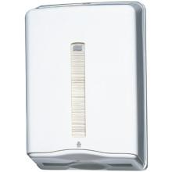
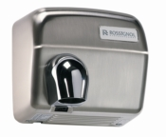
Hands dryer
In public restrooms, different types of hand dryers exist. What is the best type of hand dryer?
Objective: Compare two types of hand drying: A. The paper towel B. The air-dryer with hot air
Method:
1. describe the function of the system (slide 2);
2. choose the functional unit that represents the function of the system (including a number that qualify the FU) – slide 2;
3. for each scenario, and using the data on slide 4, list the reference flows corresponding to the selected functional unit. Do provide for each reference flow the QUANTITY used per functional unit.

Slide 3
Function and functional unit
1. describe the function of the system by filling the table below (For each scenario, find a secondary function that might save energy beyond the main hand drying function)
PRODUCTS
MAIN FUNCTION
SECONDARY FUNCTION & OTHER PERFORMANCES
Paper towel
Dry hands after washing
Clean up a spill
Blow nose
Take to eat food in car
Noise level
Dry wet hair or clothes
Heat the building in Winter
Air dryer
2. choose the functional unit that represents the function of the system
(including a number that qualify the FU)
Selected functional unit : 1 pair of dried hands
Notes:
Faculty Note:
Please use this area to provide notes to our design team about the content contained on the slide. Notes can include instructions on how content will be presented; types of imagery needed or desired; plan on how to describe visuals; etc.
Content slides come in two options depending upon what is needed – Content slide with title / Content slide without title. All content slides have a faded line and light gradient at the bottom of the slide which is meant to be empty space to display subtitles and the Michigan logo. Please keep all information out of this bottom gradient area.

Slide 4
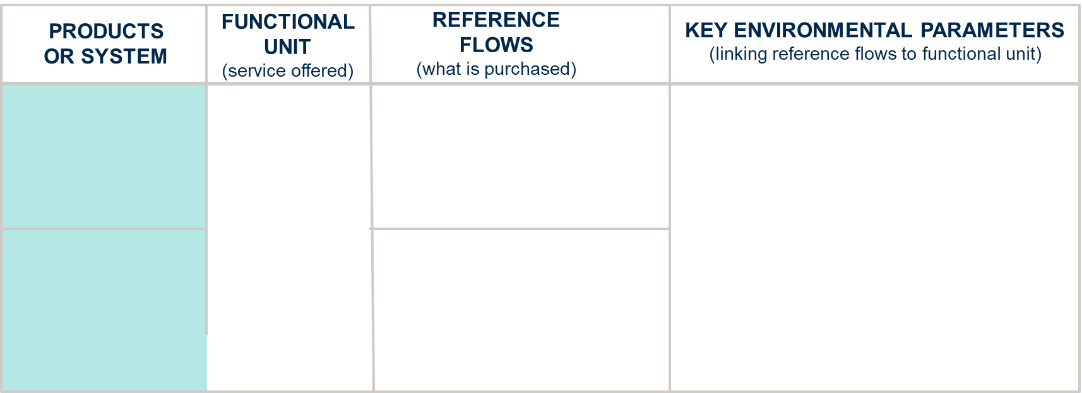
Reference flows and key environmental parameters
To make your life easier to compare with the answer keys, I have now selected a functional unit of 1 pair of dried hands: keep your reference flows simple, only what you directly buy!
Paper towel
1.5 towels /FU
1/(365*10*50)/FU =
(1/182500) plastic distributor/FU
Number of towels used to dry 1 pair of hand: According to a screening survey at our Swiss University, 1 towel/pair of dry hands in the men bathroom, 2 towels/pair of dry hands in the women bathroom, thus 1.5 on average)
Weight of a paper towel (material extraction and manufacturing)
Lifespan of the devices and amount and type of materials per device, plastic or iron (material extraction and manufacturing stages: whereas the fraction is so low that it does not really matter much)
Duration of the air drying (use stage: newer dryers with high flow only need 10s)
1 pair of dried hands
Air dryer
1800 W ∙ 30s/FU = 54000 J (or W∙s)
= 54000 W∙s /(3600 s/h) / (1000 W/kW)
= 0.015 kWh/FU electricity
1/(365*20*50)/FU =
(1/365000) air dryer device /FU
Notes:
Faculty Note:
Please use this area to provide notes to our design team about the content contained on the slide. Notes can include instructions on how content will be presented; types of imagery needed or desired; plan on how to describe visuals; etc.
Content slides come in two options depending upon what is needed – Content slide with title / Content slide without title. All content slides have a faded line and light gradient at the bottom of the slide which is meant to be empty space to display subtitles and the Michigan logo. Please keep all information out of this bottom gradient area.

Slide 5
Hand Dryers – Intermediary Flows
For all systems:
50 uses per day
Hot air hand-dryer
The device is made out of cast iron with white coating (no need to go in the detail of the device composition at this stage; for the reference flows – just give the number of devices per FU).
The air dryer is handled by a press button that is regulated for a 30 s usage.
Paper towel
Assume 1.5 towel used on average per hands drying
 | Hot air hand dryer
Weight | 12 kg
Carcass | 8 kg Cast iron
Base | 4 kg steel
Device Life time | 20 years
Electricity rate | 1800 W
Drying time | 30 s
Transport | 100km truck
 | paper towel
Towel weight | 3.58 g
Weight of towel container | 3 kg plastic
Device life-time | 10 years
Transport | 100km truck

Slide 6
Process tree design
1
Start from reference flows needed to be purchased per functional unit. Draw one box per reference flow.
Follow the upstream and downstream intermediary flows until you reach processes further (likely to be) covered by an LCA database.
Design the process tree.
For each unit process, document in each box, the amount needed per FU.
2
3
4

Slide 7
Hand Dryers – Build the process tree
On the next slides, starting from the FU and the reference flows of slide 4, and using all the information on slide 5,
follow the steps of slide 6 to draw on slides 8 and 9 the process tree for each of the two scenarios until you are able to link to databases.
In each unit process box, indicate the amount of this process used per FU (e.g kg of paper/FU).
Hints: 1) All the information you need is available on slide 5
2) Look at the slides and videos on “Building of Product System and Process Tree” and imitate the process for the hands drying

Slide 8
Process Tree: Hands drying - paper towel
xxx
xxx
xxx
1 pair of dried hands, paper towel
xxx
Notes:
Faculty Note:
Please use this area to provide notes to our design team about the content contained on the slide. Notes can include instructions on how content will be presented; types of imagery needed or desired; plan on how to describe visuals; etc.
Content slides come in two options depending upon what is needed – Content slide with title / Content slide without title. All content slides have a faded line and light gradient at the bottom of the slide which is meant to be empty space to display subtitles and the Michigan logo. Please keep all information out of this bottom gradient area.

Slide 9
Process Tree: Hands drying - air dryer
xxx
xxx
xxx
1 pair of dried hands, air dryer
xxx
Notes:
Faculty Note:
Please use this area to provide notes to our design team about the content contained on the slide. Notes can include instructions on how content will be presented; types of imagery needed or desired; plan on how to describe visuals; etc.
Content slides come in two options depending upon what is needed – Content slide with title / Content slide without title. All content slides have a faded line and light gradient at the bottom of the slide which is meant to be empty space to display subtitles and the Michigan logo. Please keep all information out of this bottom gradient area.

