Slide 1
Life Cycle Analysis of Wallpaper & Wall Paint
Team Members: Alextia A., Nan Y., & Bu Z.

Slide 2
Background
Personalizing one’s home is the most important “aspect of home decoration”(Freshhome.com). While the main medias used for covering a wall varies, wall paint and wallpaper are one of the most commonly used.
PAINT: Generally, Wall paint is the most used option because it is more simplistic in application (QCDesignSchool). However, the longevity of the paint after application is rather short. For example, painted walls can suffer some wear and become either damaged, or old, like dull-looking or suffer color change due to smoking in a household (Freshhome.com). Repainting the wall then becomes a hassle when adding the coating to the wall.
WALLPAPER: Although the popularity of wallpaper has declined over the years, it is slowly making a comeback. Recent wallpaper manufacturers are producing both stylish and highly durable wallpaper that can be easily cleaned without destroying the paper. The application of it is less messy than that of paint, and most wallpaper release less VOCs. Unfortunately, since wallpaper is applied with an adhesive, high moisture bathrooms and kitchens may cause wallpaper to peel away from the wall.

Slide 3
Objectives
In this case study, we will be composing a LCA for Wall Paint and Wallpaper. We hope to discern how much energy and resources are needed to manufacture, use and dispose these products. At the end of this study, we would like to conclude which product and process would have the least impact on the environment.

Slide 4
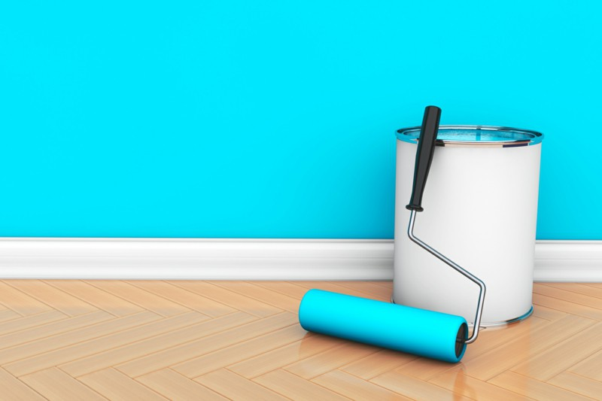
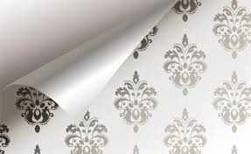
Description of the Function
Products | Main Function | Secondary Function/Performances
Scenario 1: Wall Paint | Home Improvement-Decoration, Aesthetics & Surface Protection | Reusable, Therapeutic function in application
Scenario 2: Wallpaper |  | Heat, if burned

Slide 5
Functional Unit
Product System | Functional Unit | Reference Flow | Environmentla Key Parameters
Wall Paint | 100 m^2 of wall protected for 20 years | 30 Liters of Paint (41.1kg) 1 roller 6 Paint buckets (2.5 kg) 1/600 Ladder | Amount of paint/paper applied per square meter Lifetime of Paint/Paper Category of Paint/Paper (Water based, Oil, Plant based, etc.)
Wallpaper |  | 32.9 rolls of 1kg wallpaper (32.9 kg) 1 roller 1 Concentrated Adhesive 1/600 ladder

Slide 6
Assumptions
The average lifetime of ladder is 5 years and the painting process will take 3 days for both wallpaper and wall paint.
The lifetime of wallpaper and wall paint are both 20 years.
The properties of solid ingredients in wall paint are chosen as the largest one in their feasible range.
The wall paint, steel bucket and packaging cardboard are produced in the same factory.
The standard roll size of wallpaper from Graham & Brown’s collection was 32.80ft by 20.47 inches.

Slide 7
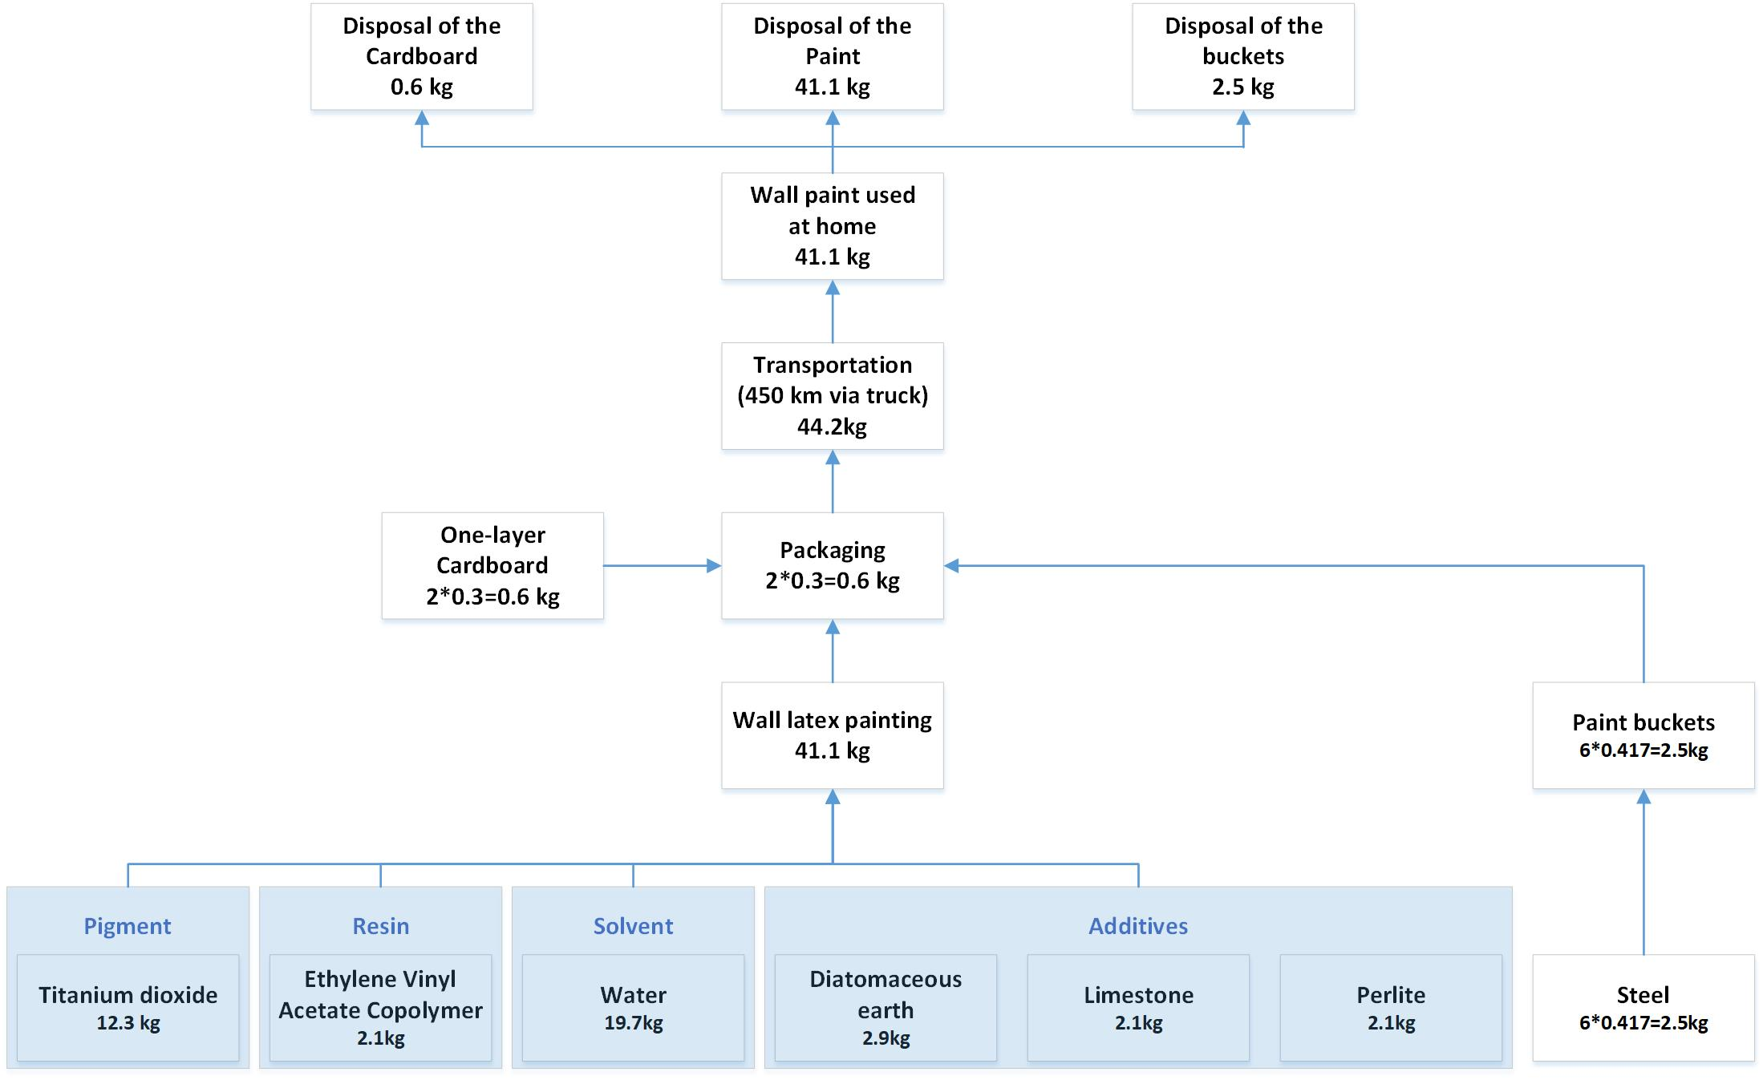
Process Tree with Intermediary Flows (Wall Paint)

Slide 8
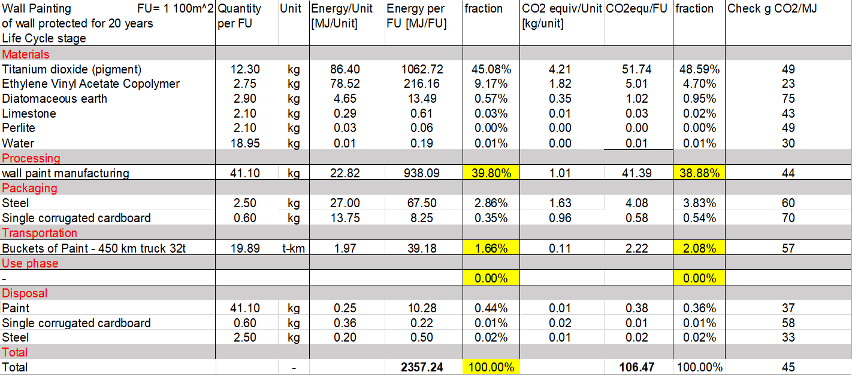
Final Results: Excel Chart (Wall Paint)

Slide 9
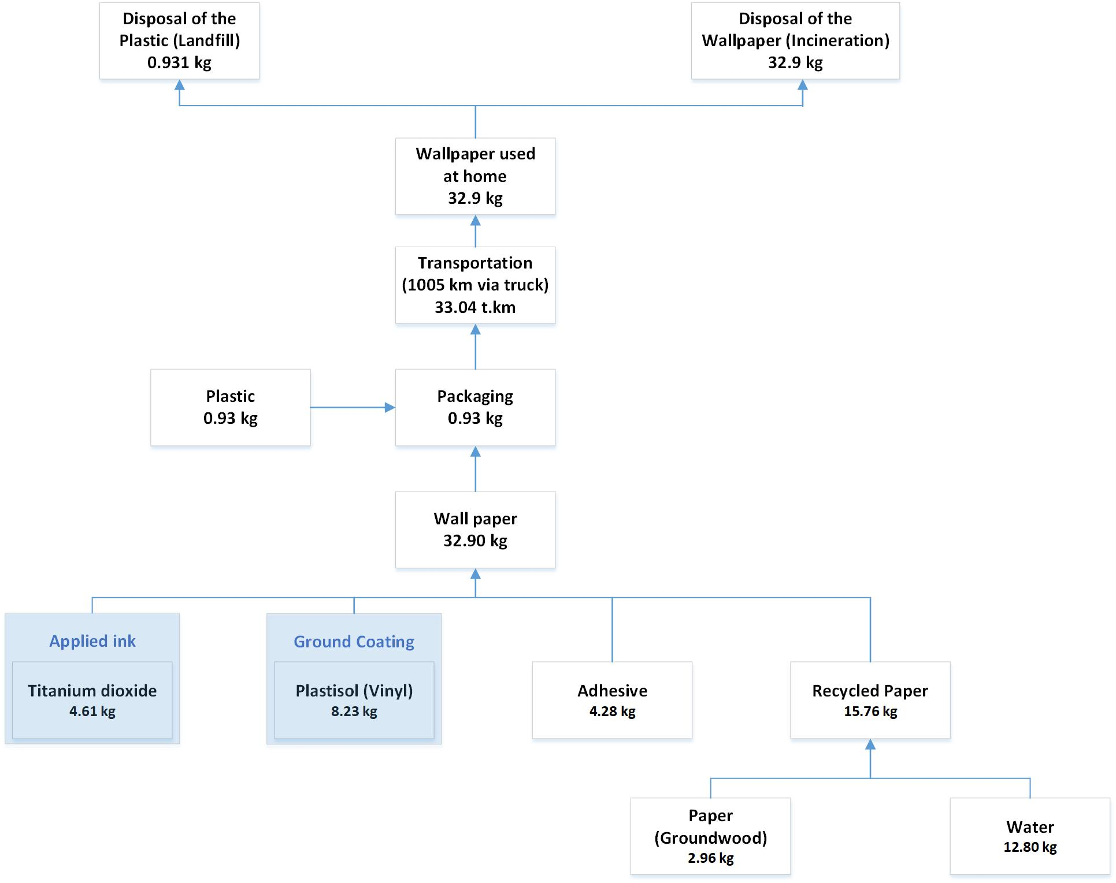
Process Tree with Intermediary Flows (Wallpaper)

Slide 10
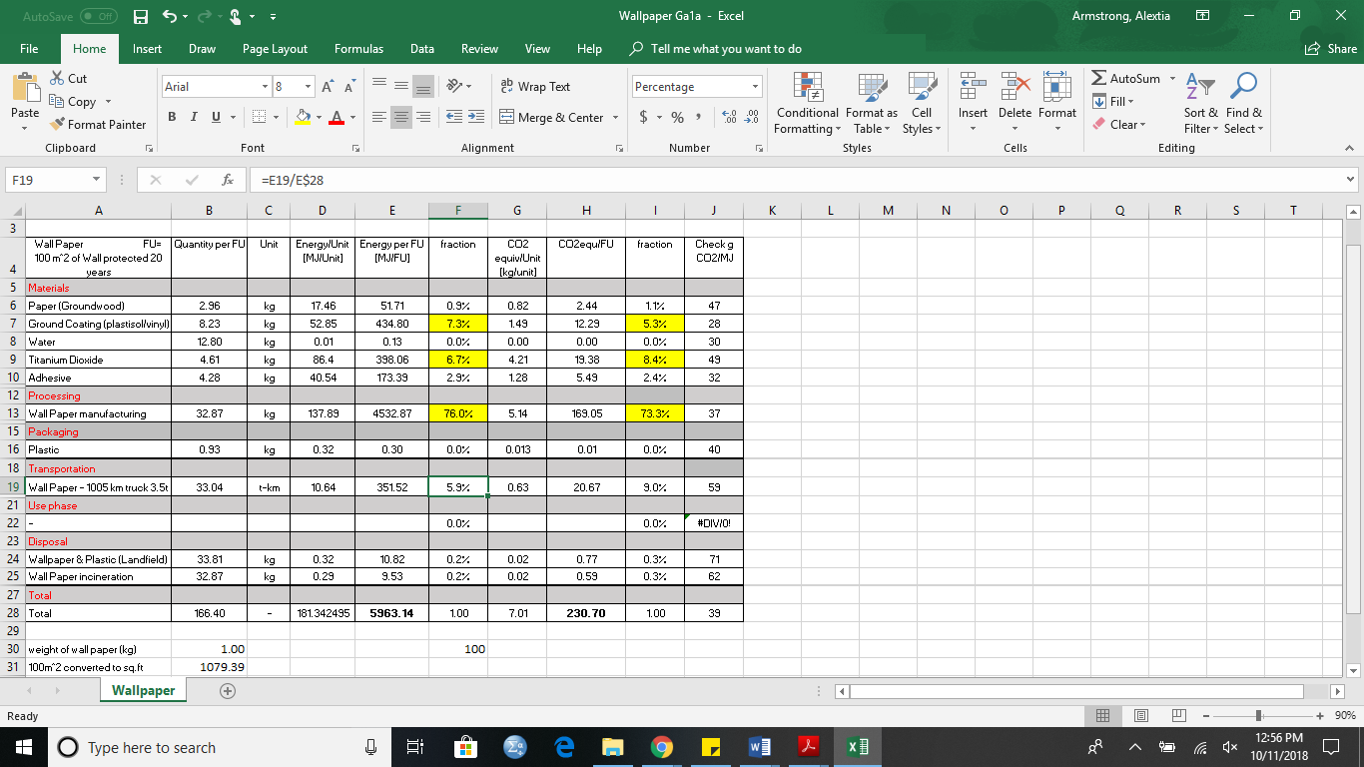
Final Results: Excel Chart (Wallpaper)

Slide 11
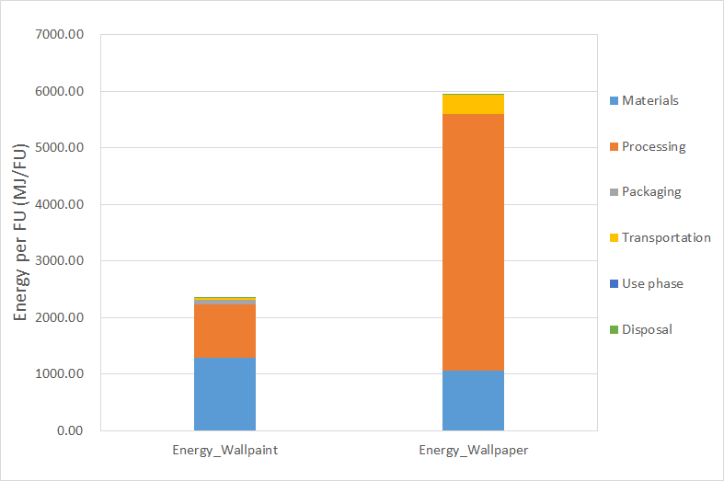
Energy-Use Comparison

Slide 12
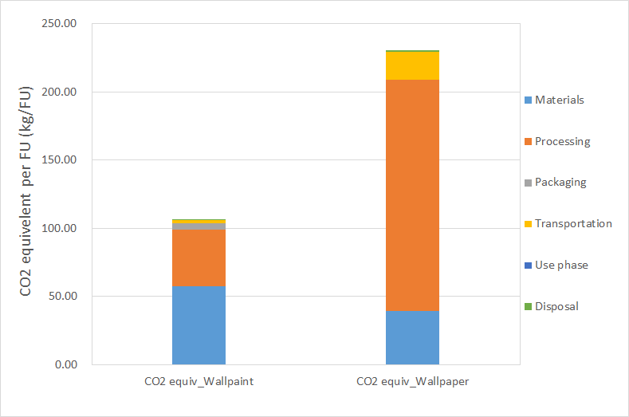
CO₂ Emissions Comparison

Slide 13
What type of products do you have in term of passive/active and fixed/mobile. What are the priorities to improve it from an environmental perspective?
Both wallpaper and wall paint produced (1) 100m^2 covered wall. This would make the product passive and fixed (Material intensive without much transportation).
The priorities to improve from an environmental perspective would be finding possible alternative material for wallpaper such as (recycled paper instead of cutting down new trees), biodegradable plastics for packaging and energy efficient machinery for the production process. To improve the wall paint, the possible use of natural or organic material instead of chemicals such as titanium dioxide should lower the energy consumption associated with the material’s extraction and refinery.

Slide 14
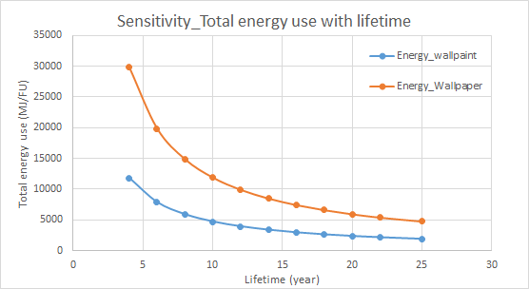
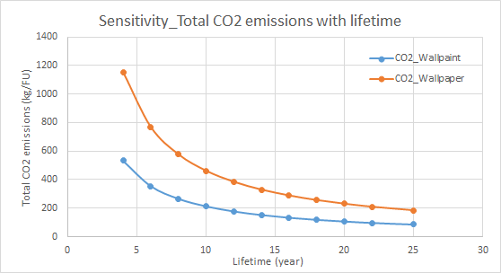
Sensitivity of energy and CO2_Lifetime
With the longer lifetime of wall paint and wallpaper, the total energy use and CO2 emissions will decrease.

Slide 15
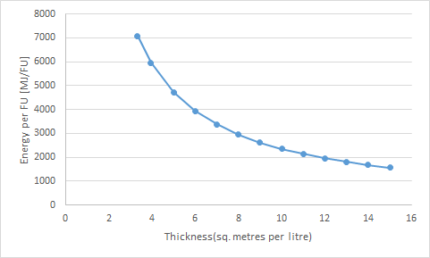
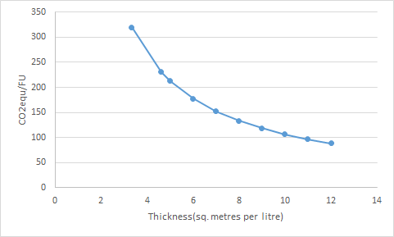
Sensitivity of energy and CO2_Thickness
Scenario 2 (Wallpaper)
Scenario 2 (Wallpaper)
With the increase of the thickness (less sq. metres per litre can paint), the total energy use and CO2 emissions will increase. And the maximum thickness is 3.33 sq. metres per litre, the minimum thickness is 15 sq. metres per litre. If the thickness reached 3.95 or less, the wallpaper may have a better energy performance.

Slide 16
Conclusion
● Wall Paint is around 50-60% better at energy and CO2 performance.
● Wall Paint: Material (55%), Manufacturing process (40%).
● Wallpaper: Material (18%), Manufacturing process (76%).
● Lifetime and thickness would affect the total energy use and CO2 emissions.
Next Steps:
Provide additional details on the dominant processes or stages that are the processing and the materials
Look for further data on the range of realistic lifetime of these materials

Slide 17
References
“Wallpaper.” How Products Are Made, © 2018 Advameg, Inc., www.madehow.com/Volume-3/Wallpaper.html
“Paint.” How Products Are Made, © 2018 Advameg, Inc., http://www.madehow.com/Volume-1/Paint.html
India, Ultrawalls. “Wallpaper Manufacturing Industry: Introduction, History, and Process.” Medium, Medium, 6 Apr.
2018,medium.com/@ultrawallsindia/wallpaper-manufacturing-industry-introduction-history-and-process-50f564594a8d.
“Wallpaper.” Design Life-Cycle, www.designlife-cycle.com/vinyl-wallpaper/.
“Wallpaper vs. Paint.” Brewster, Brewster Home Fashions, www.brewsterwallcovering.com/wallpaper-vs-paint.
“Dulux X-Pert.” Dulux, www.dulux.ca/diy/products/interior-paint/dulux-x-pert.
“Paint vs. Wallpaper: An Interior Decorator's Guide.” QC Design School, 24 Sept. 2018,
www.qcdesignschool.com/2017/06/paint-vs-wallpaper-interior-decorators-guide/.
“The Pros of Cons of Painting vs. Wallpapering.” Freshome.com, 29 Dec. 2010,
freshome.com/2010/12/29/the-pros-of-cons-of-painting-vs-wallpapering/.
“Wallpaper, Wall Art.” Wallpaper Designs | Wall Coverings | Graham & Brown, www.grahambrown.com/us/.

