Slide 1
Primary energy and CO₂ emissions from processes & materials: Part A Primary, final and useful energy
Olivier Jolliet, PhD

Slide 2
Learning Objectives
Define primary, final and useful energy
Compare aggregated primary energy and CO2 for various materials and processes

Slide 3
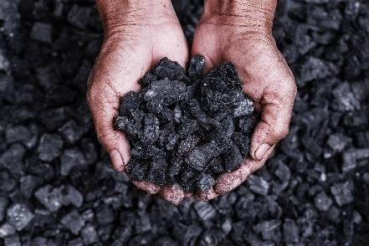
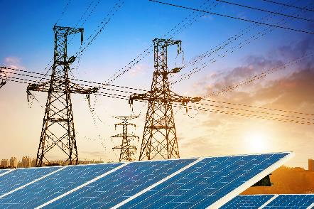

Primary energy definition
Primary energy is defined as the energy contained in the energy carriers at the point of extraction from the environment, including the upstream energy usage for extraction, preparation, and distribution.
The final energy is the energy purchased by the consumer and delivered to him.
The useful energy is the portion of final energy which is actually available after final conversion to the consumer for the respective use.

Slide 4
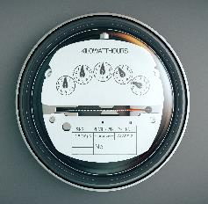

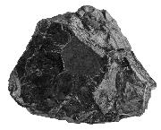
Energy: definitions
Primary energy = including extraction and preparation
Final energy = bought
Useful energy = used
Gas
MJ prim
1 MJ final
MJ useful
MJ prim
1 MJ final
MJ useful
Electricity
Extraction and preparation
Efficiency

Slide 5
Energy: definitions
Primary energy = including extraction and preparation
Final energy = bought
Useful energy = used
Gas
1.25 MJ prim
1 MJ final
0.95 MJ useful
3.4 MJ prim
1 MJ final
1 MJ useful
Electricity
1 kWh final = 3.6 MJ final
1 kWh useful
Extraction and preparation
Efficiency

Slide 6
Energy: definitions
Primary energy = including extraction and preparation
Final energy = bought
Useful energy = used
Gas
1.25 MJ prim
1 MJ final
0.95 MJ useful
3.4 MJ prim
1 MJ final
1 MJ useful
Electricity
12.1 MJ prim
1 kWh final = 3.6 MJ final
1 kWh useful
Extraction and preparation
Efficiency

Slide 7
From ores to primary energy: Net calorific values
Density, gross and net calorific value of energy carriers
Ecoinvent documentation

