Slide 1
Primary energy and CO₂ emissions from processes & materials: Part B Data for processes and materials
Olivier Jolliet, PhD

Slide 2
Non-renewable primary energy and CO₂ aggregated inventory flows
Non-renewable primary energy (MJ per unit)
CO₂ (kg per unit)
gCO₂/MJ ratio
Energy Carriers
1 kWh electricity (Europe)
1 kWh electricity (USA)
1 kWh electricity (Japan)
1 kWh electricity (Switzerland)
1 kWh electricity (China)
1L gasoline (no combustion)
1L gasoline (with combustion)
1 kg light oil (42.7 MJ final)
10.5
12.1
11.5
7.9
10.4
42.9
42.9
56.8
0.49
0.71
0.53
0.11
0.98
0.49
2.88
3.71
47
59
46
13
94
11
65
65
Transport
1,000 km kg transport 16-32 ton Lorry
1 pers • km by train (Intercity)
1 pers • km by plane (Intercontinental)
1 pers • km by car
2.6
0.98
3.28
3.0
0.15
0.06
0.19
0.17
58
58
60
57

Slide 3
Non-renewable primary energy and CO₂ Aggregated inventory flows
Non-renewable primary energy (MJ per unit)
CO₂ (kg per unit)
gCO₂/MJ ratio
Materials
1 m³ concrete
1 m³ water
1 kg steel, low alloy
1 kg copper
1 kg primary aluminium
1 kg recycled aluminium
1 kg gold
1 kg paper newsprint
1 kg glass
1 kg polyethylene HDPEs
1,381
5.55
27.4
31.2
160.4
22.4
269,000
24.3
11.5
76.4
257
0.30
1.63
1.86
9.55
1.32
16,500
1.22
0.63
1.56
186
54
59
60
59
60
61
50
55
20
Material processing
1 kg plastic film extrusion
1 kg injection moulding
9.25
27.1
0.50
1.24
54
46
End of life
1 kg landfilled steel
1 kg landfilled aluminium
1 kg incinerated municipal solid waste
1 kg incinerated polyethylene
0.197
0.521
0.43
0.22
0.00657
0.02010
0.50
2.99
33
39
1,161
13,606

Slide 4
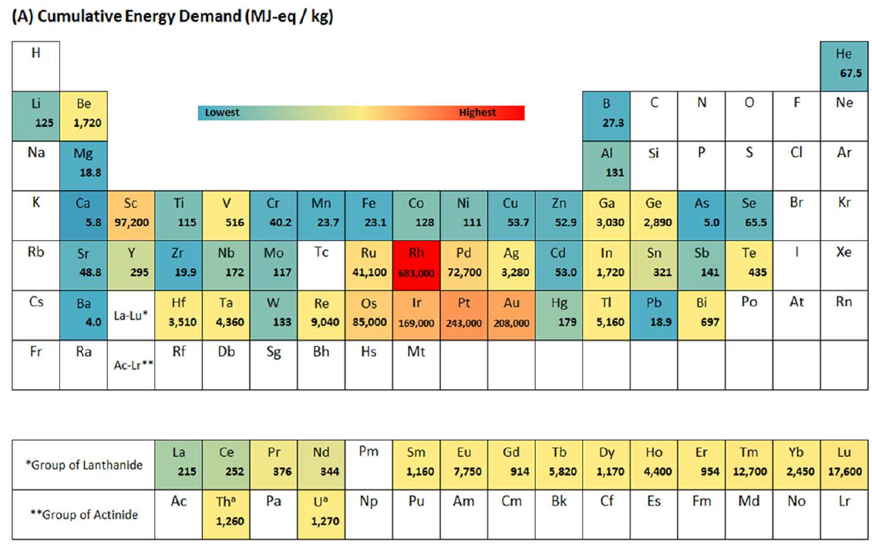
Metals cumulative energy demand
(Nuss and Eckelman, 2014 Plos one)

Slide 5
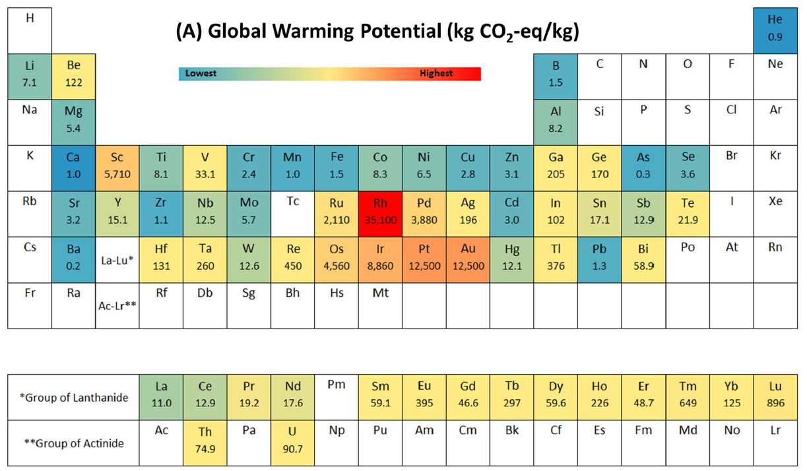
Metals carbon footprint
(Nuss and Eckelman, 2014 Plos one)

Slide 6
Summary
The ratio between final energy and primary energy defines the energy efficiency of the supply chain.
A part of the primary energy is nonrenewable, which means that the basic resource of this energy is non-replaceable or is replaced very slowly through natural processes
There are large differences of several orders of magnitude between the energy and the CO2 emission per kg of different materials. These cannot be directly compared.

