Slide 1
Primary energy and CO₂ balance: Part B data check gCO₂ per MJ primary energy
Olivier Jolliet, PhD

Slide 2
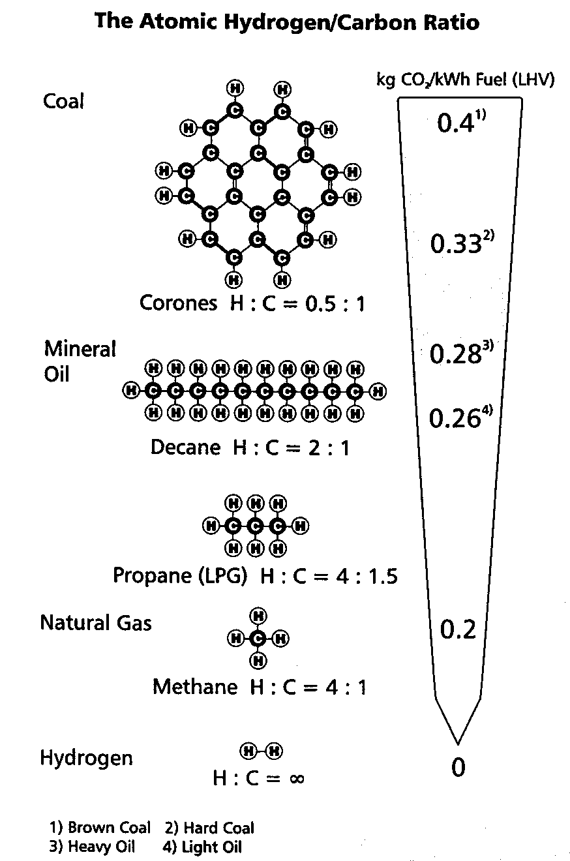
H:C ratio and CO₂ emissions
4
Energy content is associated with the number of H - liaisons
Carbon emissions is associated with the number of C atoms
The ratio of CO₂emission/MJ energy is associated with the ratio of H to C

Slide 3
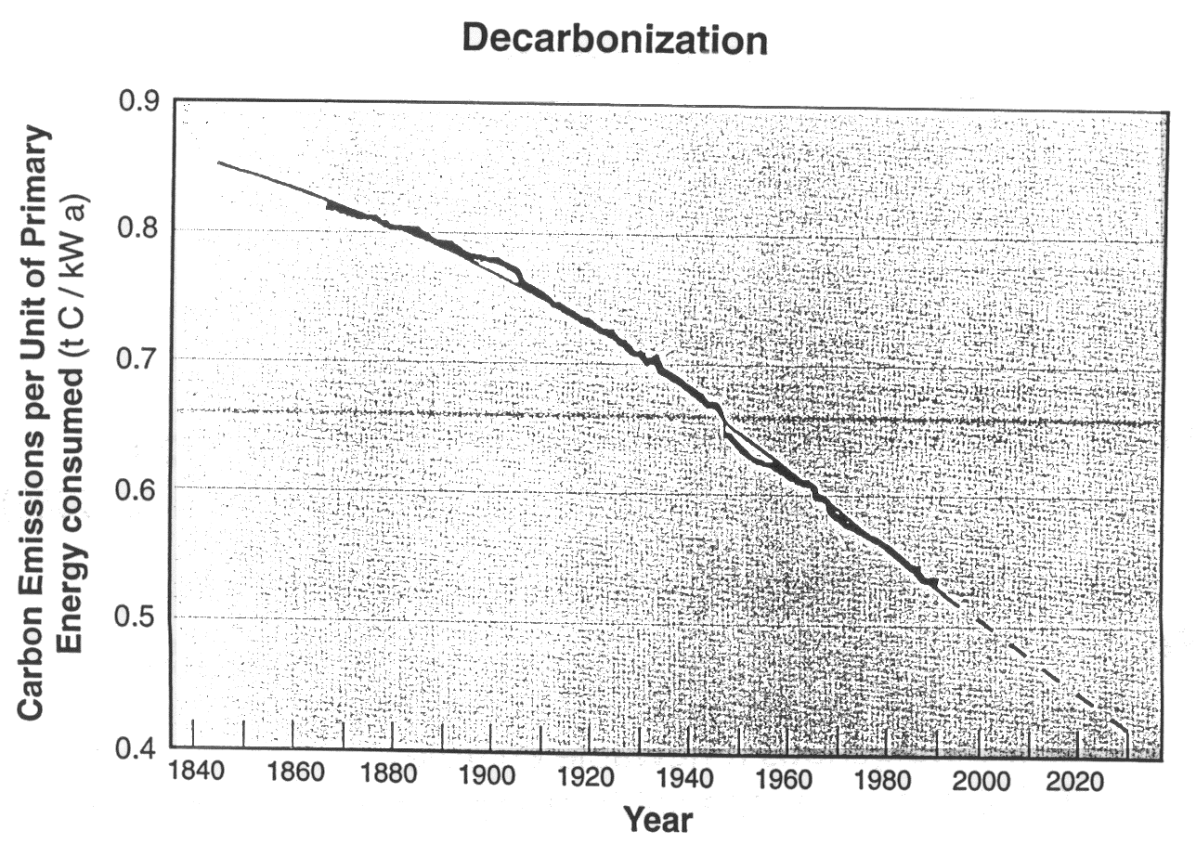
Carbon emissions per unit energy consumption
Source: Nakicenovic, N. and John, A. (1991)

Slide 4
Checking your data: g CO₂ per MJ non renewable primary energy
_{Cement}
_{Concrete}
_{Mortar}
Emissions [g CO2 / MJ non renewable]
_{Bio-based materials}
_{Coal}
_{Hydraulic}
_{Oil}
_{Ship}
_{Metals}
_{Oil-based materials}
_{Glass}
_{Road}
_{Plane}
_{Gas}
_{Wood}
_{Fuels without combustion}
_{Nuclear}
Extracted from ecoinvent 2.2 by Jolliet et al., 2016

Slide 5
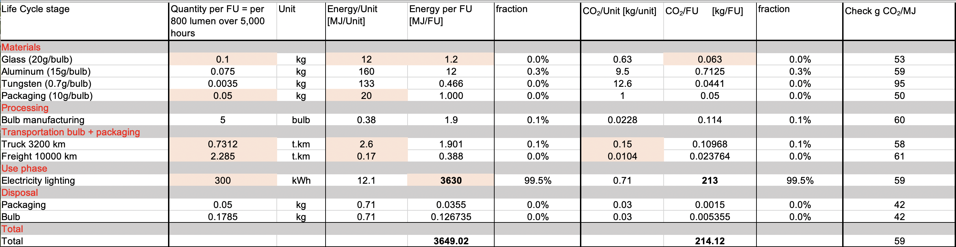
Energy and CO₂ balance: light bulb example
1
2a
2b
4
3a
3b

Slide 6
Check data: interpreting the ratio of g CO₂ per MJ non-renewable primary energy
4
Fossil fuels (transport + heat):
Oil, diesel, petrol, kerosene
Natural gas
Coke
Electricity US
Electricity Europe
Electricity Switzerland
57-70 gCO₂/MJ (incl. 10g pre-combustion) 50 gCO₂/MJ
74-94 gCO₂/MJ
59 gCO₂/MJ
47 gCO₂/MJ
13 gCO₂/MJ
Materials
Fossil materials: plastics, etc.
Metals: depends on % electricity and mix
Concrete
Cement
Wood, cardboard, renewable energy
60 gCO₂/MJ (30g manufacturing, 30g elimination) Env. 50 gCO₂/MJ
192 gCO₂/MJ
227 gCO₂/MJ
Also about 65 gCO₂/MJ non-renewable fixation not considered: only fossil CO₂
Problem detection:
If diesel, oil around 10 gCO₂/MJ: combustion is not considered
If plastics around 30 gCO₂/MJ, end-of-life (EOL) incineration emissions have been neglected or plastic is deposited in landfill.
If renewable negative, EOL not considered, only fixation of non-fossil CO₂

Slide 7
Summary
The primary energy balance and inventory of CO₂ emissions is calculated by multiplying the amount of each database process of the process tree by the aggregated emission per unit of this process.
Energy content and carbon are related for fossil fuels
The ratio of g_{CO2}/MJ_{non renewable primary energy} can be used to check the consistency of inventory data
Crucial to account for additional releases during use phase (e.g. combustion emissions) and disposal (e.g. incinerator emissions)

