Slide 1
Activity 15 – see indications slide 8
Hands drying: CO₂ and energy balance
Olivier Jolliet, PhD
Notes:
Faculty Note:
Enter lecture title, and subtitle if present, in the text box above. Enter name and credentials on the second line as shown. The slide background graphic for this introduction slide can be replaced with an alternate image more suited to the topic or department (this step will be handled by our graphics team in the production phase).

Slide 2
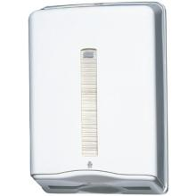
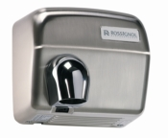
Hands dryer: Activity answer key
In public restrooms, different types of hand dryers exist. What is the best type of hand dryer?
Objective: Compare two types of hand drying: A. The paper towel B. The air-dryer with hot air
Method:
1. describe the function of the system (slide 2);
2. choose the functional unit that represents the function of the system (including a number that qualify the FU) – slide 2;
3. for each scenario, and using the data on slide 4, list the reference flows corresponding to the selected functional unit. Do provide for each reference flow the QUANTITY used per functional unit.

Slide 3
Function and functional unit
1. describe the function of the system by filling the table below (For each scenario, find a secondary function that might save energy beyond the main hand drying function)
PRODUCTS
MAIN FUNCTION
SECONDARY FUNCTION & OTHER PERFORMANCES
Paper towel
Dry hands after washing
Clean up a spill
Blow nose
Take to eat food in car
Noise level
Dry wet hair or clothes
Heat the building in Winter
Air dryer
2. choose the functional unit that represents the function of the system
(including a number that qualify the FU)
Selected functional unit : 1 pair of dried hands
Notes:
Faculty Note:
Please use this area to provide notes to our design team about the content contained on the slide. Notes can include instructions on how content will be presented; types of imagery needed or desired; plan on how to describe visuals; etc.
Content slides come in two options depending upon what is needed – Content slide with title / Content slide without title. All content slides have a faded line and light gradient at the bottom of the slide which is meant to be empty space to display subtitles and the Michigan logo. Please keep all information out of this bottom gradient area.

Slide 4
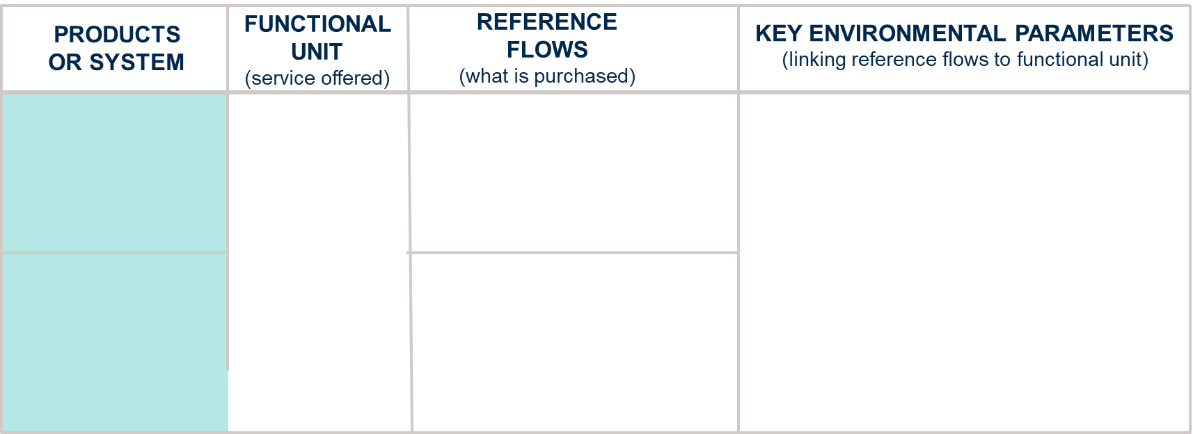
Reference flows and key environmental parameters
To make your life easier to compare with the answer keys, I have now selected a functional unit of 1 pair of dried hands: keep your reference flows simple, only what you directly buy!
Paper towel
1.5 towels /FU
1/(365*10*50)/FU =
(1/182500) plastic distributor/FU
Number of towels used to dry 1 pair of hand: According to a screening survey at our Swiss University, 1 towel/pair of dry hands in the men bathroom, 2 towels/pair of dry hands in the women bathroom, thus 1.5 on average)
Weight of a paper towel (material extraction and manufacturing)
Lifespan of the devices and amount and type of materials per device, plastic or iron (material extraction and manufacturing stages: whereas the fraction is so low that it does not really matter much)
Duration of the air drying (use stage: newer dryers with high flow only need 10s)
1 pair of dried hands
Air dryer
1800 W ∙ 30s/FU = 54000 J (or W∙s)
= 54000 W∙s /(3600 s/h) / (1000 W/kW)
= 0.015 kWh/FU electricity
1/(365*20*50)/FU =
(1/365000) air dryer device /FU
Notes:
Faculty Note:
Please use this area to provide notes to our design team about the content contained on the slide. Notes can include instructions on how content will be presented; types of imagery needed or desired; plan on how to describe visuals; etc.
Content slides come in two options depending upon what is needed – Content slide with title / Content slide without title. All content slides have a faded line and light gradient at the bottom of the slide which is meant to be empty space to display subtitles and the Michigan logo. Please keep all information out of this bottom gradient area.

Slide 5
Hand Dryers – Intermediary Flows
For all systems:
50 uses per day
Hot air hand-dryer
The device is made out of cast iron with white coating (no need to go in the detail of the device composition at this stage; for the reference flows – just give the number of devices per FU). The device is landfilled at the end of its life.
The air dryer is handled by a press button that is regulated for a 30 s usage.
Paper towel
Assume 1.5 towel used on average per hands drying
Paper towel are incinerated once used. When incinerated, paper towel produces 18 MJ/kg, of which 25% is recovered as useful electricity and substitute electricity. The plastic dispenser is landfilled at the end of its life
 | Hot air hand dryer
Weight | 12 kg
Carcass | 8 kg Cast iron
Base | 4 kg steel
Device Life time | 20 years
Electricity rate | 1800 W
Drying time | 30 s
Transport | 100km truck
 | paper towel
Towel weight | 3.58 g
Weight of towel container | 3 kg plastic
Device life-time | 10 years
Transport | 100km truck

Slide 6
Process Tree: Hands drying - paper towel : Activity answer key
1.5 x 3.58 = 5.37 g paper towel
Incinerated paper towel (5.37 g)
3 kg x 1000 / 18250 = 0.0164 g plastic
1/182500 plastic distributor
transportation - truck (0.0164 g + 5.37 g) x 100 / 1000 = 0.54 kg.km
1 pair of dried hands, paper towel
landfilled plastic distributor (0.0164 g)
Notes:
Faculty Note:
Please use this area to provide notes to our design team about the content contained on the slide. Notes can include instructions on how content will be presented; types of imagery needed or desired; plan on how to describe visuals; etc.
Content slides come in two options depending upon what is needed – Content slide with title / Content slide without title. All content slides have a faded line and light gradient at the bottom of the slide which is meant to be empty space to display subtitles and the Michigan logo. Please keep all information out of this bottom gradient area.

Slide 7
Process Tree: Hands drying - air dryer: Activity answer key
0.022 g cast iron to landfill
Cast iron
8 kg x 1000 / 365000 = 0.022 g
1/365000 device
Transportation - Truck (0.022 g + 0.011 g) x 100 / 1000 = 0.0033 kg.km
1 pair of dried hands, air dryer
Steel
4 kg x 1000 / 365000 = 0.011 g
Electricity
0.015 kWh
0.011 g steel to landfill
Notes:
Faculty Note:
Please use this area to provide notes to our design team about the content contained on the slide. Notes can include instructions on how content will be presented; types of imagery needed or desired; plan on how to describe visuals; etc.
Content slides come in two options depending upon what is needed – Content slide with title / Content slide without title. All content slides have a faded line and light gradient at the bottom of the slide which is meant to be empty space to display subtitles and the Michigan logo. Please keep all information out of this bottom gradient area.

Slide 8
Activity 15 Part 2 Hand Dryers – Energy and CO2 balance
Given
The hand dryer scenarios discussed in previous exercise (see slide 2 to 5 above, including end of life (EOL) scenarios on slide 5)
The intermediary flows and the process tree from activity 3.3.2C on slides 6 and 7
The energy use and emissions factor of database processes on slide 9
Find in the ecoinvent database - file EHS672_Activity 3.3.2 Ecoinvent Energy and CO2 data 1a.xlsx the primary energy and CO₂ for the two transport processes defined in the table of slide 4 (lorry 3.5-7.5t, EURO4, and , lorry >32t, EURO3) as well as disposal of Polypropylene (PP).
Estimate the energy used and CO₂ emissions due to the two different hand drying scenarios, by completing the excel template “EHS672_Activity_3.3.3_Energy and CO2 balance Hands drying template 1a.xlsx”.
Briefly discuss the results, identifying for each scenario the dominant contributions and ranking between the two scenarios, filling in your answer in cells B39-B41 of the excel sheet.
Discuss in cell B42 whether the ratios gCO2/MJ in column J make sense, and what you learn from them
(a bit more difficult) Try to complete cell B18 to calculate for the hand scenario the reduction in primary energy and CO2 obtained by incinerating the hand towel (18 MJ/kg, of which 25% is recovered as useful electricity - hint convert this to kWh) via heat recovery and production of electricity, which substitute US electricity mix. Discuss in cell B43 the importance of this heat recovery and electricity substitution compared to the primary energy consumed and CO2 emitted per FU.
Upload your excel file under EHS672_Activity_3.3.3 part 2.

Slide 9
IN CLASS EXERCISE: Hand dryers – Energy and CO2 data
Database process | Unit | Energy [MJ/unit] | CO2 [kg_{CO2}/unit]
Electricity mix | 1 kWh | 12.1 | 0.71
PP (plastic) | 1 kg | 74.6 | 1.67
Cast iron | 1 kg | 24.5 | 1.35
Steel | 1 kg | 27.5 | 1.63
Paper towels | 1 kg | 19.4 | 1.03
Truck transport paper towel | 1 t-km | Look in Ecoinvent file EHS672_Activity 3.3.2 Ecoinvent Energy and CO2 data 1a.xlsx | Under process transport, lorry 3.5-7.5t, EURO4
Truck transport dispenser / dryer | 1 t-km | Look in Ecoinvent file EHS672_Activity 3.3.2 Ecoinvent Energy and CO2 data 1a.xlsx | Under process transport, transport, lorry >32t, EURO3
Landfilled steel | 1 kg | 0.32 | 0.011
Landfilled PP | 1 kg | Look in Ecoinvent file EHS672_Activity 3.3.2 Ecoinvent Energy and CO2 data 1a.xlsx | Disposal, polypropylene, 15.9% water, to sanitary landfill
Incinerated paper | 1 kg | 0.29 | 0.018
Notes:
SIMAPRO PROCESSES TAKEN FROM SIMAPRO DEMO VERSION (i.e. pre Ecoinvent 2.0):
Electricity, production mix DE (Ecoinvent) [originally, Electricity mix W-D U (ETH-ESU 96), but that didn’t work anymore]
PP ETH U (ETH-ESU 96)
Cast iron ETH U (ETH-ESU 96)
Steel low alloy ETH U (ETH-ESU 96)
Paper ETH U (ETH-ESU 96)
Transport, lorry 16t/RER U (Ecoinvent unit processes)
Disposal, polypropylene, 15.9% water, to sanitary landfill/CH S (Ecoinvent system processes)
Disposal, steel, 0% water, to inert material landfill/Ch U (Ecoinvent unit processes)
Disposal, paper, 11.2% water, to sanitary landfill/CH U (Ecoinvent unit processes)
Disposal, paper, 11.2% water, to municipal incineration/CH U (Ecoinvent unit processes)

