Slide 1
Life Cycle Inventory Databases Where to find consistent and high quality LCI data?
Olivier Jolliet, PhD

Slide 2
Learning Objectives
Describe the different life cycle inventory (LCI) databases
Illustrate the data format of the ecoinvent database
Recognize the different types of data and energy-based inventory flows, and use them adequately
Identify sources for guidance for direct LCI data collection

Slide 3
Main LCI database
Two types of modeling, answering different questions
ATTRIBUTIONAL:
CONSEQUENTIAL
“What are (the environmental impacts related to) the allocated shares of the activities that have contributed to the production, consumption, and disposal of the product?”
→ use average electricity mix
“What are the environmental impacts related to those activities that are expected to change when producing, consuming, and disposing of the product?”
→ identify the marginal production (e.g. gas power plant or coal powerplant)

Slide 4
LCI Data
Finding appropriate LCI data will rely on:
1
Existing databases for all background processes, ensuring consistency between data – A lot of data are available!
2
Adapting existing data to the product or service, technology and country or region studied.
3
Collection of new LCI data, especially for the foreground system. Hard work and requires to be very systematic.

Slide 5


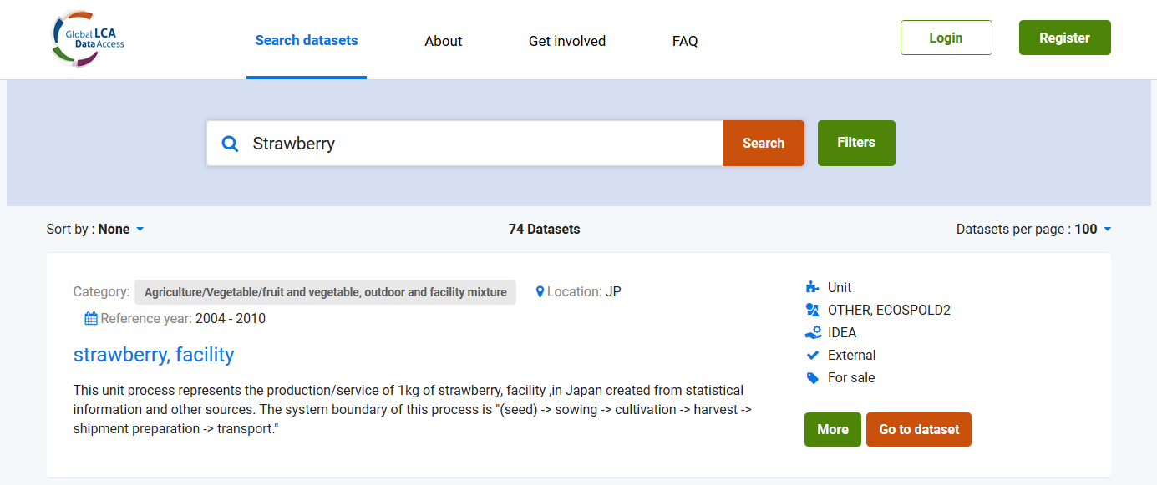
Global LCA Data Access network (GLAD)
1

Slide 6



Main LCI databases
Ecoinvent database developed by research institutions for the Swiss government
European Platform on Life Cycle Assessment – Product Environmental Footprint (PEF) select data from either node or database – some are free
US databases
Input-output data: 400+ sectors for US – Access via SIMAPRO
Sector specific databases (e.g. agriculture and foods)
Agrifootprint database – access via Simapro World Food database: Quantis – access via EU platform – node Agribalyse – Access via the GLAD network
LCA commons - access to USDA LCI data sets
Other available databases in Japan, Korea, China, Australia

Slide 7
The Ecoinvent database
The broadest Unit Process level database worldwide
Energy systems - non renewable & renewable
Materials and building
Chemicals and metals
Transports
Packaging
Waste treatment
Agriculture
400 Inventory flows for 4000 unit processes

Slide 8
Aggregated or unit processes in databases
The ecoinvent database provides all intermediary and elementary flows both
for direct emissions and extractions at unit process level (U=UP level), and
for aggregated inventory emissions and extractions of a given product, summed up over the entire supply chain from “cradle to gate” (S=system level)
Many other databases only provide aggregated flows

Slide 9
Life cycle inventory database
Life cycle databases provide either:
The direct intermediary and elementary flows at the Unit Process level
The aggregated flows at the System level, accounting for the entire supply chain of the considered process
OR
1
Find the direct emission and extraction factors of each unit process
2
Identify the amount of each Unit process per FU
3
Calculate the elementary flows of each UP per FU
4
Calculate the aggregated inventory flows of the total system per FU

Slide 10
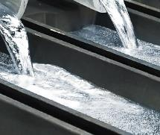
Direct intermediary and elementary flows at Unit Process level
These are the direct intermediary flows and emission or extraction from the considered process, i.e. the direct elementary flows per unit of this UP
1
Aluminum oxide 1.93 kg
Aluminum,
primary,
liquid
1 kg
Benzo(a)pyrene 1.30 mg
Carbon dioxide, fossil 1.50 kg
Anode, aluminum electrolysis 0.448 kg
Carbon monoxide, biogenic 91.7 g
Cathode, aluminum electrolysis 0.0181 kg
Hydrogen fluoride 539 mg
Aluminum electrolysis plant 1.54·10⁻¹⁰ p
Nitrogen oxides 63.9 mg
PAH 45.7 mg
Electricity mix, aluminum industry 15.9 kWh
Particulates, < 2.5 µm 2.61 g
Heat, light fuel oil 0.089 MJ
Sulfur dioxide 8.83 g
Heat, natural gas 0.084 MJ
Heat, waste 56.0 MJ/kg Al primary liquid
Transport, transoceanic freight ship 3.8 tkm
Disposal, filter dust Al electrolysis 2.00 g
Disposal, redmud from bauxite digestion 1.36 kg

Slide 11
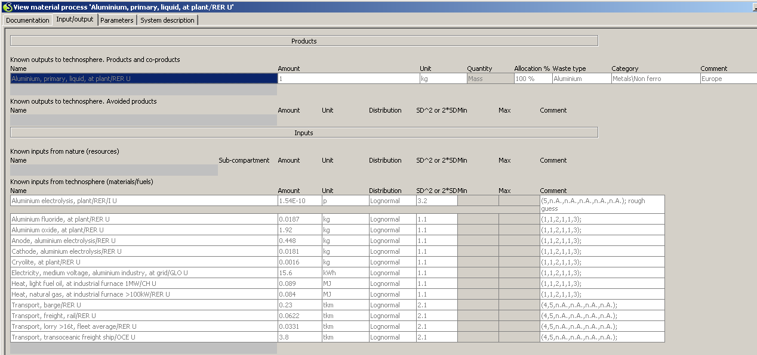
Unit Process data: aluminum liquid, ecoinvent in Simapro
Product output
Direct Resource extractions
Disposal intermediary processes

Slide 12
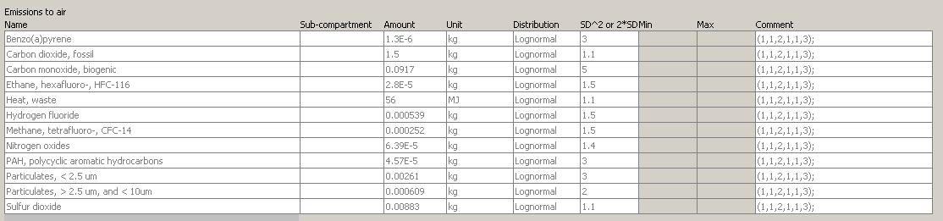
Unit Process data: aluminum liquid, ecoinvent in Simapro
Data uncertainty
Data quality pedigree
1=best, 5=worst
Direct emissions to air
Disposal intermediary processes
Data uncertainty: For a lognormal distribution, an SD² of 3 means that the 95% confidence interval is between amount/3 and amount × 3

Slide 13

Aggregated inventory at system level: aluminum primary liquid
4
Aluminum,
primary,
liquid
1 kg
Heat, waste 66.6 MJ
Natural gas in ground 525 dm³
Arsenic 1.88 mg
Brown coal in ground 1.20 kg
Arsenic, ion 44.0 mg
Benzo[a]pyrene 2.74 mg
Hard coal in ground 2.01 kg
Carbon dioxide, fossil 9.40 kg
Crude oil in ground 1.18 kg
Carbon monoxide, biogenic 91.8 g
Uranium in ground 58.3 mg
CFC-14 252 mg
Aluminum in ground, 24% in bauxite, 11% in crude ore 1.16 kg
Dioxins 1.74 ng
HFC-116 28.2 mg
Hydrogen fluoride 676 mg
Occupation, forest, intensive 0.101 m2a
Methane, biogenic 51.7 mg
Nitrogen oxides 19.6 g
PAH 88.7 mg
Particulates, ,2.5$μ$m 4.95 g
Sulfur dioxide 38.0 g
These are ALL elementary flows since by definition the aggregated inventory is the sum of all elementary flows per FU of all unit processes

Slide 14
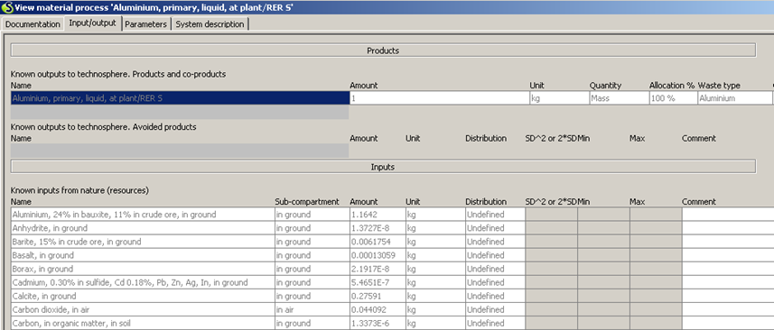
Aggregated system data: aluminum liquid, ecoinvent in Simapro
Aggregated Resource extractions from environment

Slide 15
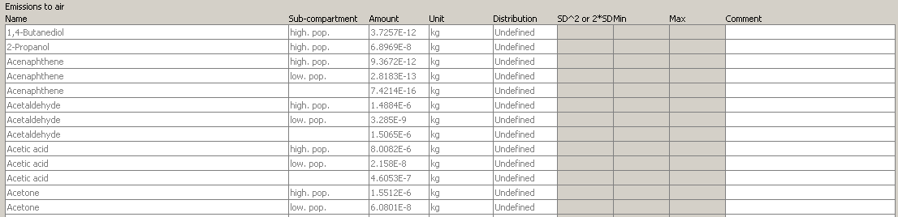
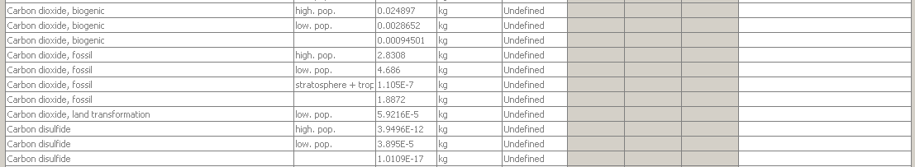
Aggregated system data: aluminum liquid, ecoinvent in Simapro
Aggregated emissions to air

Slide 16
Use of ecoinvent: tips for good use – be careful
Data in energy sector available in three forms:
Energy data per fuel unit quantity, e.g. per kg oil or liter gasoline: without combustion,
Energy per MJ final (bought) energy: "burned" = with combustion Use the net calorific values to convert back to fuel quantities (kg oil, m³ gas or liter gasoline)
Energy per MJ useful (delivered) energy: "heat" = with combustion
ELECTRICITY: select the mix corresponding to each scenario
Medium voltage for industrial use, Low voltage for household use
TRANSPORT: beware the load rate
(includes 40% empty trips for trucks)
Be sure to include end-of-life process & only use fossil CO₂, not biogenic CO₂. Avoid to use heavy metal uptake by crops.

Slide 17
Use of ecoinvent: Air emissions interpretation
Benzene emissions are reported under “benzene” rather than “aromatic hydrocarbons” or “non-methane volatile organic compounds” (NMVOCs).
Particulate emissions classified between PM_{2.5} (particles less than 2.5 µm in aerodynamic diameter) , PM₁₀-PM_{2.5} and TPM-PM₁₀ (greater than 10 µm).
For CO₂, CO, and CH₄, a distinction is made between fossilized sources and biogenic sources in that case CO₂ fixed during biomass growth is accounted for → special care to ensure that the corresponding combustion of CO₂ is also taken into account during use or product end-of-life (e,g, incineration, landfill). A pragmatic solution to ensure reliability is to only account for fossil (non-biogenic)
For the polycyclic aromatic hydrocarbons (PAHs), benzo[a]pyrene emissions are separate.
The dioxin and furan emissions are expressed as equivalent 2,3,7,8-trichloro-dibenzodioxine (TCDD) emissions.

Slide 18
New features of ecoinvent 3
Modelling of water flows
Updated datasets for electricity production (>20 additional countries worldwide), wood sector, recycling activities, chemicals, fruit and vegetables.
Different modelling strategies: attributional, cut-off and consequential modeling.
At present recommended to use the cut-off version (called “recycled content unit option”). In the cut-off model, the primary producer does not receive any credit for the provision of any recyclable materials. As a consequence, recyclable materials are available burden-free to recycling processes.
In the future, allocation at the point of substitution could be of interest… but if separation first applied

Slide 19
Collecting LCI data
The following options for data collection exist, as data collection procedures or sources:
Primary data can include
interviews, questionnaires or surveys, bookkeeping or enterprise, resource planning (ERP) system, data collection tools (online, offline) and on-site measurements.
Secondary data can include
interviews, statistics and literature
Data generation can include
calculations (e.g., missing emission factors from input data) and estimates.
See Sonneman et al., 2.2.3.1 Global guidance principles

Slide 20
Data collection: focus on the foreground system
Whenever possible, primary data shall be collected for all foreground processes and significant background processes under the financial control or operational control of the company undertaking the product inventory. For all other processes, data of the highest quality shall be collected.
This can be achieved by extrapolation, adapting a similar (but not representative) process to match the considered process, or by simply using a similar process as a proxy.
As suggested by the greenhouse gas protocol (WRI and WBCSD 2011, appendix C), it may be useful to establish a management plan,
identifying all unit processes,
collecting screening data for all processes, and
refining the data collection for the processes contributing most to the Life Cycle Impacts.
Sonnemann and Vigon (2011) provide additional guidance on how to collect data for a given unit process.

Slide 21
Summary
Availability of LCI data has made the realization of an LCA substantially easier, enabling the practitioner to focus on the foreground system
Consistency between background data (e.g. electricity mix) is key when comparing different products
Care must be take when using ecoinvent data to recognize what type of energy and resource use is has been modelled for a given process
Direct LCI data collection is hard work!

