Slide 1
Full Life Cycle inventory: Car case study Part A Matrix-based inventory calculation
Olivier Jolliet, PhD

Slide 2
Learning Objectives
Elaborate a full inventory for a simple case study
Illustrate the determination of inventory flows based on aggregated results from database
Perform a sensitivity study on a key uncertain use stage parameter

Slide 3
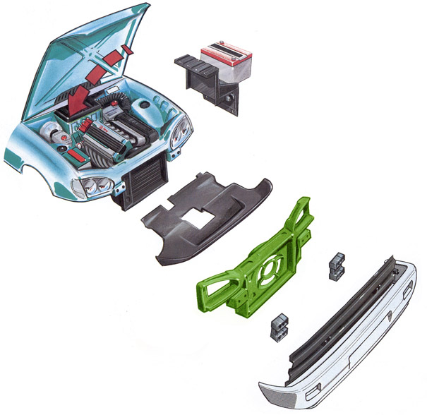
Car front-end panel
Function:
transport over car lifetime (200,000 km).
Functional Unit:
1 front-end panel of equivalent rigidity for a 200,000 km service.
System boundaries:
Overall life cycle, including raw material extraction, use stage, end of life treatment.
Front-end panel

Slide 4
Function and functional units
PRODUCTS OR SYSTEM
FUNCTIONAL UNIT
REFERENCE FLOWS
KEY ENVIRONMENTAL PARAMETERS
SCENARIO 1
Steel
Steel
Raw material (kg): 10
Required gasoline (L): 80
Final weight of the front end-panel (steel 10kg, SMC 7kg, aluminum 3.8 kg) that directly reflects in the gasoline consumption
Resource consumption per kg of each material
The assumption of 200,000 km over car lifetime
1 front-end- panel of equivalent rigidity for 200,000 km
SMC
Raw material (kg): 7
Required gasoline (L): 56
SCENARIO 2
SMC
SCENARIO 3
Aluminum
Aluminum
Raw material (kg): 5.9
Required gasoline (L): 30.4
*200,000 km, additional consumption of 0.00004 L / kg-km

Slide 5
Automobile component: System boundaries
SYSTEM BOUNDARIES
Infrastructure, inputs, transportation
Manufacturing
Recycling
Energy extraction & preparation, raw materials
Resources
Use
Waste Treatment
Emissions to air, water, soil

Slide 6
Reference Flows and Main Intermediary Flows
Reference Flows and Main Intermediary Flows for a Front-End Panel Transported over 200,000 km
Unit
Steel
Composite
Virgin Aluminum
Recycled Aluminum
Materials
Final weight
kg
10.0
7.0
3.8
3.8
Manufacturing
Electricity
Oil
kWh
kg
19.7
2.3
4.7
0.56
15.2
1.8
15.2
1.8
Use
Gasoline
L
80.0
56.0
30.4
30.4
End of Life
Incineration
Controlled landfilling
Landfilling for inert materials
kg
kg
kg
–
–
10.0
7.0
–
–
–
3.8
–
–
–
–
*200,000 km, additional consumption of 0.00004 L / kg-km

Slide 7
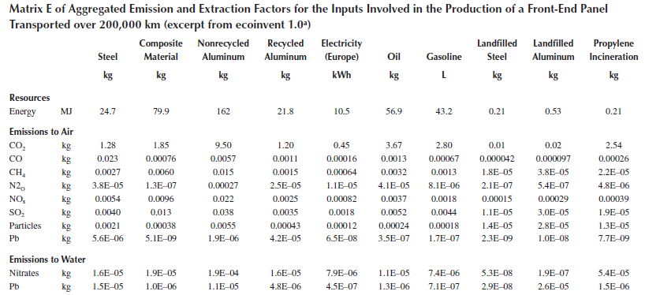
Aggregated inventory matrix E

Slide 8
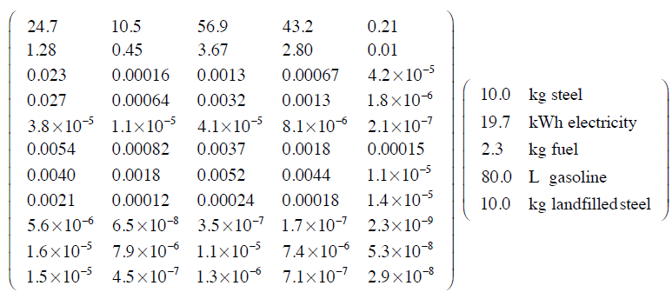
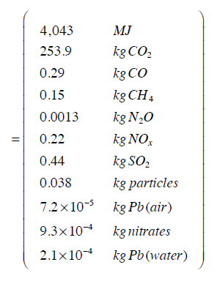
Inventory calculation
Steel
Electr.
Oil
Gasoline
Steel disp.
Steel Front end panel
E · y = u
What is the highest contribution to the primary energy?
→ Calculate the respective contributions to the total

