Slide 1
Life Cycle Impact Assessment in practice Car application: Part D Weighting
Olivier Jolliet, PhD

Slide 2
Learning Objectives
Define what is weighting in LCA
Provide guideline for good practice in determining weighting factor
Apply weighting to the damage scores of the car case study
Determine and interpret weighted impact scores
Understand what can and cannot be summed up

Slide 3
Weighting – IMPACT World+
5
Weighting: Weight and compares the damage results based on social, political, and ethical values
Total damage in $/FU
Total damage human health $/FU
Total damage ecosystem $/FU
Single score
$/FU
No official weights for ImpactWorld+: may use the weights from Stepwise for the different damage categories
(Weidema et al., 2009)
Total damage natural resources $/FU

Slide 4
Weighting
Social values attributed to the different damages (endpoints) considered:
A) Monetary methods (willingness to pay): transform impacts in costs
B) Methods involving expert panels or interest groups
C) Distance to target: Comparison to political objectives
The way to set the problem is crucial: Much easier to weight a damage than a pollutant quantity or the present level of a given effect; - Always define the absolute value of the damage you are comparing. - Provide panel members with explicit references they can relate to (like total world impact → will weight normalized score – not the raw scores)

Slide 5
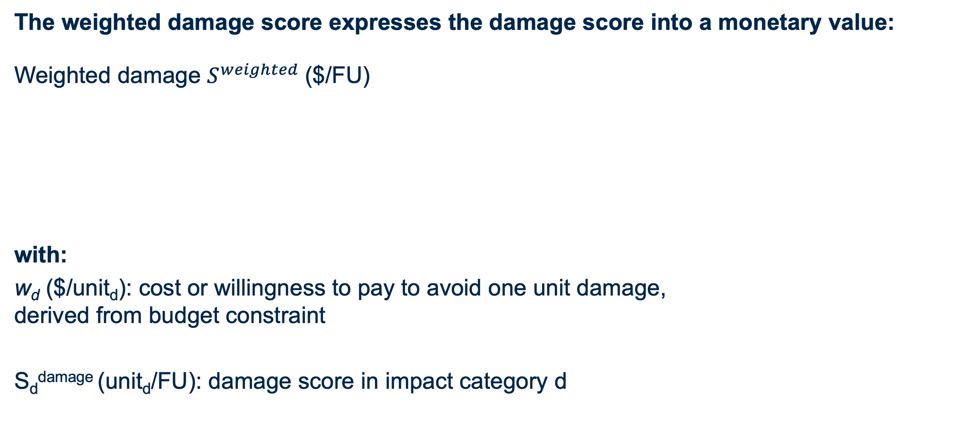
Monetarization: How weighted damage scores are calculated
The weighted damage score expresses the damage score into a monetary value:
Weighted damage $S^{weighted}$($/FU)
with:
w_{d} ($/unit_{d}): cost or willingness to pay to avoid one unit damage, derived from budget constraint
S_{d}^{damage} (unit_{d}/FU): damage score in impact category d
Also possible to keep the score for each impact category m or d separate (do not sum over m or d)
$S^{weighted}=\sum_{d}{w_{d}{∙S}_{d}^{damage}}\left(e.g. \frac{\$}{DALY}∙\frac{DALY}{FU}=\frac{\$}{FU}\right)$

Slide 6
Monetarization: Stepwise weighting factors (Weidema, 2009)
Stepwise weighting factors are compatible with IMPACT World+, derived from budget constraint
Weighting factors w_{k}
Units
Human health
Ecosystem quality
Resources
74000
0.14
0.0043 or 0.86
Euro/DALY
Euro/PDF.m².yr
Euro/MJ or Euro/$
1 DALY on human health, equivalent to 74,000/0.14 = 530,000 pdf m² year on ecosystems
The total human damage score for the steel panel was 0.00113 DALY/FU
Calculate the weighted damage score for human health for the steel panel, with its units
$$S^{weighted}=$$

Slide 7

Monetarization: Stepwise weighting factors (Weidema, 2009)
Stepwise weighting factors are compatible with IMPACT World+, derived from budget constraint
Weighting factors w_{k}
Units
Human health
Ecosystem quality
Resources
74000
0.14
0.0043 or 0.86
Euro/DALY
Euro/PDF.m².yr
Euro/MJ or Euro/$
1 DALY on human health, equivalent to 74,000/0.14 = 530,000 pdf m² year on ecosystems
The total human damage score for the steel panel was 0.00113 DALY/FU
Calculate the weighted damage score for human health for the steel panel, with its units
$$0.00113\frac{DALY}{FU}∙74000\frac{Euro}{DALY}=84 \frac{Euro}{FU}$$
$$S^{weighted}=$$

Slide 8
Weighted score per impact category m - Front end panel
LCIA does not necessary lead to a single score, but aims to make apple and elephants comparable

Slide 9
IMPACT World+ & Stepwise weighting - Front end panel
Error bars: Final scores when including impacts occurring after 100 years

Slide 10
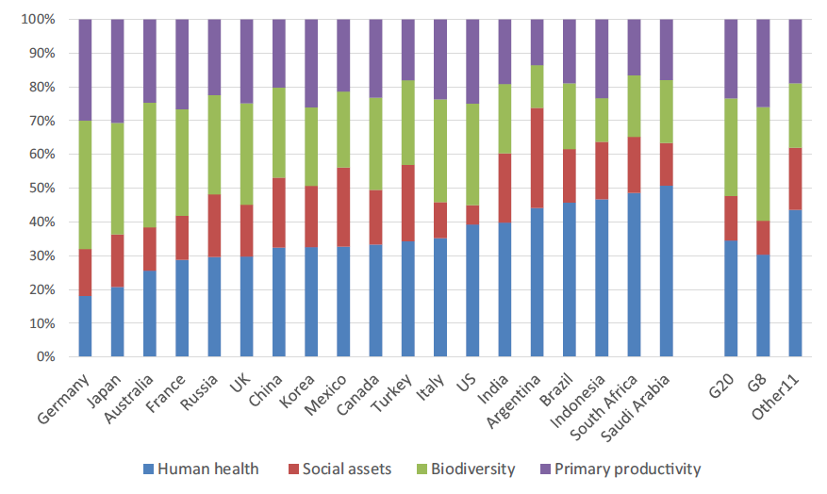
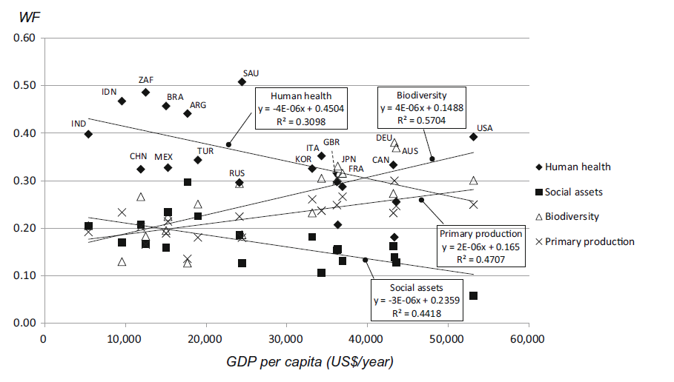
Variation in relative weighting across AoP for 19 countries
Weighting of the Japanese method LIME 3 will be of high interest once available at world level. Inhabitants of developed country tend to give more weight to ecosystem impacts, developing countries to human health.
The comparison of
weighting factors normalized to ensure the total sum of 1 using conjoint analysis
= resources & fuels
Itsubo et al., 2018

Slide 11
Grouping
ISO also allows “Grouping” as a qualitative or semi-quantitative process that helps prioritize results by sorting or ranking, and can be done in several ways.
Impact categories can be grouped according to
area of protection,
the types of emissions/resources,
or by spatial scale (global, regional, or local).
Impact categories can also be ranked based on a predefined hierarchy; for example, high, medium, and low priority. This second procedure is based on value choices that reflect the importance given by society or the user to a particular category.

Slide 12
Summary
Weighting enables comparison results across areas of protection, based on e.g. monetarization and conjoint analysis
Not necessarily needs to arrive to a single score, can keep impacts separate per impact category, prioritizing the high impacts.
The Life Cycle Initiative develops default consistent weights at midpoint & damage

