Slide 1
Overview of LCIA Methods Part A Comparison of LCIA method
Olivier Jolliet, PhD

Slide 2
Learning Objectives
Define the latest LCIA framework and work in progress
Identify the characteristics of main LCIA methods
Compare results of different damage level LCIA methods for the global normalization inventory

Slide 3
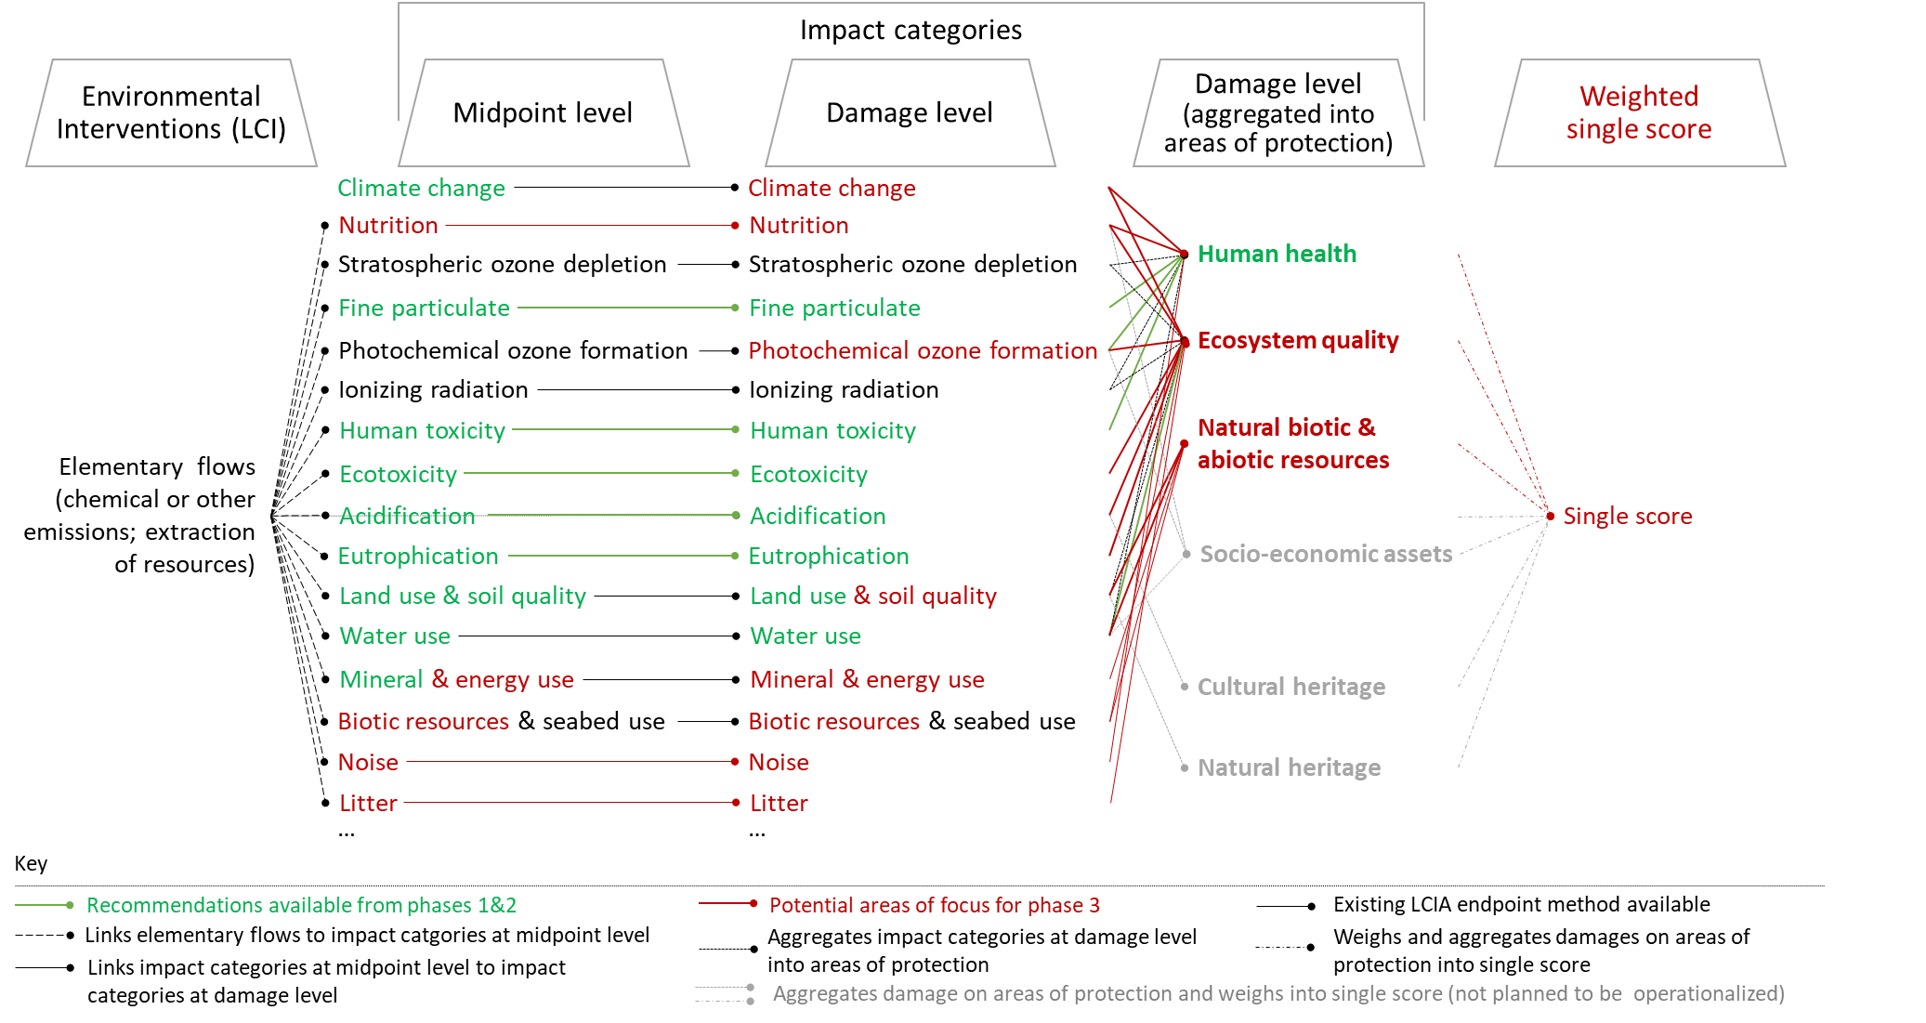
LCIA framework
Developed impact category versus Ongoing work to extend category coverage

Slide 4
Comparison of LCIA Methods
Midpoint type
Midpoint-Damage type
Weighted type
Eco-scarcity CH 1990
1990
CML LCA guide 1992
EPS S 1992
Nordic guide 1995
Ecoindicator 95
Eco-scarcity CH 1997
EDIP 1997
2000
EPS S 2000
$
CML guide 2002
EDIP 2003
IMPACT 2002+
Ecoindicator 99
Eco-scarcity CH 2006
TRACI 1 US 2003
Dist. to target
ReCiPe 2008
LIME 1 J 2005
2010
TRACI 2 US 2011
Eco-scarcity CH 2013
LIME 2 J 2009
PEF 2012
GLAM 1 2016
ReCiPe G 2016
LIME 3 G 2015
$
Eco-scarcity CH 2018
PEF 2019
GLAM 2 2018
IMPACT WORLD+ G 2019
2020
Dist. to target
GLAM 3 G 2023
LC IMPACT G 2020
Adapted from Itsubo, 2013. Geographical scope: No mention =Europe, CH=Switzerland, S=Sweden, J=Japan, US=USA, G=Global

Slide 5
Comparison of recent LCIA methods: damage categories
METHODS: |  | Ecological scarcity [Frischknecht et et al., 2008 & 2013] |  | TRACI [Bare et al., 2003] | IMPACT 2002+ [Jolliet et al., 2003] | LIME [Itsubo et Inaba, 2003] | ReCiPe [Goedkoop et al., 2008] |  | IMPACT World+ [BULLE et al, 2019]
Evaluation level: |  | Policy objectives |  | Midpoint | Midpoint & damage | Midpoint & damage | Midpoint & damage |  | Midpoint & damage
Normalization and weighting: |  | Normalization and weighting |  | Normalization of damage for USA | Normalization of damage Weighting up to user | Normalization and Japanese weighting | Normalization and weighting |  | World normalization.Weighting of stepwise
Covered midpoint categories | Climate change | X |  | X | X | X | X |  | X
 | Oceanic acidification |  |  |  |  |  | ? |  | X
 | Stratospheric ozone depletion |  |  | X | X | X | X |  | X
 | Human health of particulate and toxics | X |  | X | X | X | X |  | X
 | Indoor & worker impacts |  |  |  |  |  |  |  | X
 | Accidents
 | Ionizing radiation | X |  |  | X |  | X |  | X
 | Photo-oxidant formation | X |  | X | X | X | X |  | X
 | Acidification | X |  | X | X | X | X |  | X
 | Eutrophication | X |  | X | X | X |  |  | X
 | Ecotoxicity | X |  | X | X | X | X |  | X
 | Usage of soil and habitat loss | X |  |  | X | X | X |  | X
 | Energy use | X |  | X | X | X | X |  | X
 | Mineral extraction |  |  |  | X | X | X |  | X
 | Usage of water resources | X |  |  | X |  |  |  | X
 | Soil quality |  |  |  |  |  |  |  | X
 | Usage of biotic resources |  |  |  |  | X |  |  | (X)
METHODS: |  | Ecological scarcity [Frischknecht et et al., 2008 & 2013] |  | TRACI [Bare et al., 2003] | IMPACT 2002+ [Jolliet et al., 2003] | LIME [Itsubo et Inaba, 2003] | ReCiPe [Goedkoop et al., 2008] |  | IMPACT World+ [BULLE et al, 2019]
Evaluation level: |  | Policy objectives |  | Midpoint | Midpoint & damage | Midpoint & damage | Midpoint & damage |  | Midpoint & damage
Normalization and weighting: |  | Normalization and weighting |  | Normalization of damage for USA | Normalization of damage Weighting up to user | Normalization and Japanese weighting | Normalization and weighting |  | World normalization.Weighting of stepwise
Covered midpoint categories | Climate change | X |  | X | X | X | X |  | X
 | Oceanic acidification |  |  |  |  |  | ? |  | X
 | Stratospheric ozone depletion |  |  | X | X | X | X |  | X
 | Human health of particulate and toxics | X |  | X | X | X | X |  | X
 | Indoor & worker impacts |  |  |  |  |  |  |  | X
 | Accidents
 | Ionizing radiation | X |  |  | X |  | X |  | X
 | Photo-oxidant formation | X |  | X | X | X | X |  | X
 | Acidification | X |  | X | X | X | X |  | X
 | Eutrophication | X |  | X | X | X |  |  | X
 | Ecotoxicity | X |  | X | X | X | X |  | X
 | Usage of soil and habitat loss | X |  |  | X | X | X |  | X
 | Energy use | X |  | X | X | X | X |  | X
 | Mineral extraction |  |  |  | X | X | X |  | X
 | Usage of water resources | X |  |  | X |  |  |  | X
 | Soil quality |  |  |  |  |  |  |  | X
 | Usage of biotic resources |  |  |  |  | X |  |  | X
METHODS: |  |  |  |  |  |  | PEF-footprint JRC, 2018 | GLAM [LCinitiative Frischnecht & Jolliet 2016/8] | LC IMPACT [VERONES et al, 2020]
Evaluation level: |  |  |  |  |  |  |  | Midpoint + some damage | Midpoint & damage
Normalization and weighting: |  |  |  |  |  |  |  |  | World normalization.Weighting of stepwise
Covered midpoint categories | Climate change |  |  |  |  |  | X | X | X
 | Oceanic acidification
 | Stratospheric ozone depletion |  |  |  |  |  | X |  | X
 | Human health of particulate and toxics |  |  |  |  |  | X | X | X
 | Indoor & worker impacts
 | Accidents
 | Ionizing radiation |  |  |  |  |  |  |  | X
 | Photo-oxidant formation |  |  |  |  |  | X |  | X
 | Acidification |  |  |  |  |  | X | X | X
 | Eutrophication |  |  |  |  |  | X | X | X
 | Ecotoxicity |  |  |  |  |  | X | X | X
 | Usage of soil and habitat loss |  |  |  |  |  | X | X | X
 | Energy use |  |  |  |  |  | X | X
 | Mineral extraction |  |  |  |  |  | X
 | Usage of water resources |  |  |  |  |  | X | X | X
 | Soil quality |  |  |  |  |  |  | X | X
 | Usage of biotic resources

Slide 6
Comparison of recent LCIA methods: damage categories
METHODS: |  | Ecological scarcity [Frischknecht et et al., 2008 & 2013] |  | TRACI [Bare et al., 2003] | IMPACT 2002+ [Jolliet et al., 2003] | LIME [Itsubo et Inaba, 2003] | ReCiPe [Goedkoop et al., 2008] |  | IMPACT World+ [BULLE et al, 2019]
Evaluation level: |  | Policy objectives |  | Midpoint | Midpoint & damage | Midpoint & damage | Midpoint & damage |  | Midpoint & damage
Normalization and weighting: |  | Normalization and weighting |  | Normalization of damage for USA | Normalization of damage Weighting up to user | Normalization and Japanese weighting | Normalization and weighting |  | World normalization.Weighting of stepwise
Covered damage categories | Human health |  |  | X | X | X | X |  | X
 | Natural biotic env. ecosystems |  |  | X | X | X | X |  | X
 | Natural abiotic resources |  |  | X | X | X | X |  | X
 | Natural biotic resources e.g. tuna |  |  |  |  | X |  |  | X
 | Man-made biotic resources e.g.crops |  |  |  |  | X
 | Man-made abiotic resources e.g. buildings
METHODS: |  |  |  |  |  |  | PEF-footprint JRC, 2018 | GLAM [LCinitiative Frischnecht & Jolliet 2016/8] | LC IMPACT [VERONES et al, 2020]
Evaluation level: |  |  |  |  |  |  |  | Midpoint + some damage | Midpoint & damage
Normalization and weighting: |  |  |  |  |  |  |  |  | World normalization.Weighting of stepwise
Covered damage categories | Human health |  |  |  |  |  |  | X | X
 | Natural biotic env. ecosystems |  |  |  |  |  |  | X | X
 | Natural abiotic resources |  |  |  |  |  |  |  | X
 | Natural biotic resources e.g. tuna
 | Man-made biotic resources e.g.crops
 | Man-made abiotic resources e.g. buildings

