Slide 1
Overview of LCIA Methods Part B Short description of individual methods
Olivier Jolliet, PhD

Slide 2
LCIA Impact 2002+
e.g. IMPACT 2002+, Int J LCA 8 (6), 324-330, Int J LCA 9 (6), 394-404

Slide 3
Original features from IMPACT World+
Based on IMPACT 2002 which was the first midpoint-endpoint: Midpoint (kgeq) and Endpoint (DALY).
Provides factors for each continent and allows to regionally assess any emission/resource use.
The USEtox model for toxic impacts (Rosenbaum et al., 2008) and water use impacts are included for the first time in a full midpoint-damage LCIA method.
Major modeling improvements for land use, water and mineral resource use with an extraction-consumption-competition-adaptation approach.
Acidification and eutrophication with world atmospheric and hydrological fate models.
Respiratory effects with new intake fractions and epidemiologically derived factors.
For damage, optional reporting on climate change and water use.

Slide 4
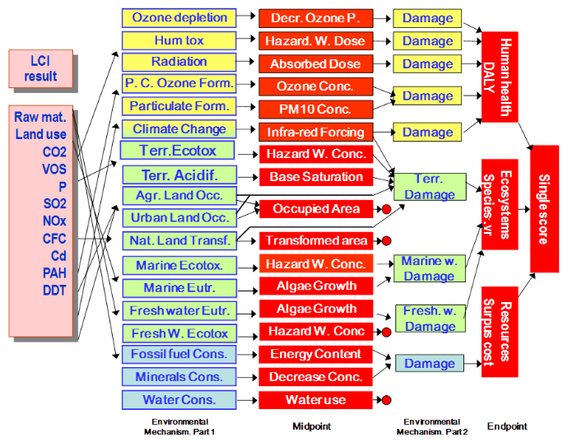
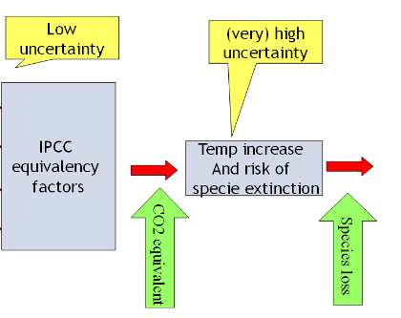
ReCiPe Consistent midpoint – endpoint, GW overvalued

Slide 5


TRACI: US-EPA: Official US Midpoint only
TRACI: Tool for Reduction and Assessment of Chemical and Other Environmental Impacts
…
Impact Categories
Ozone Depletion
Ozone Depletion
Global Warming
Acidification
Cancer
Noncancer
Criteria
Eutrophication
Smog Formation
Ecotoxicity
Fossil Fuel Use
Land Use
Water Use
Global Warming
Inventory of Stressors
Characterization
(e.g., Cancer)
Cancer
Land Use
Chemical Emissions
Water Use
Fossil Fuel Use

Slide 6
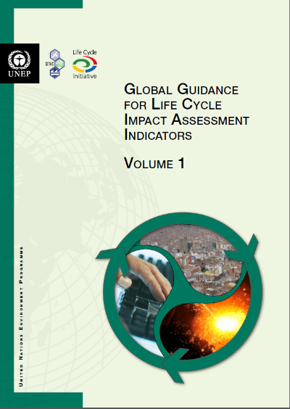
LCIA guidance – UNEP-SETAC Life Cycle Initiative
Topic
Task Force Leaders
Pellston workshop
Greenhouse gas emissions and climate change impacts
Annie Levasseur, Francesco Cherubini
X
Particulate matter emissions and respiratory effects
Peter Fantke, Tom Mc Kone, Olivier Jolliet
X
Water use related impacts; water scarcity and human health effects
Anne-Marie Boulay, Stephan Pfister
X
Land use related impacts
on biodiversity
Asumpcio Anton, Ottar Michelsen
X
Overall framework and cross-cutting issues
Francesca Verones, Olivier Jolliet, Rolf Frischknecht
X
Footprint indicators
Brad Ridoutt
Frischknecht and Jolliet, 2016 & 2018

Slide 7
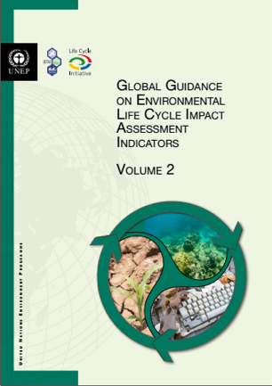
LCIA guidance – UNEP-SETAC Life Cycle Initiative
TF
Topic
Task Force Leaders
1
Overall framework and cross-cutting issues
Francesca Verones, Olivier Jolliet, Rolf Frischknecht
2.1
Acidification & Eutrophication
Andrew Henderson
2.2
Ecotoxicity
Michael Hauschild
3
Human toxicity (including indoor)
Tom Mc Kone & Peter Frantke
4
Ecosystem services, soil quality
Tim Grant
5
Mineral primary resources
Markus Berger & Thomas Sonderegger
6
Water use ecosystem damage indicator
Anne-Marie Boulay & Stephan Pfister
7
Footprint indicators
Brad Ridoutt
Frischknecht and Jolliet, 2016 & 2018

Slide 8
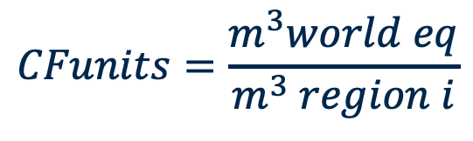
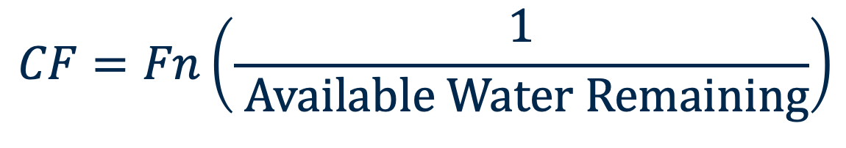
AWARE Characterization Factor
$$CF=Fn\left(\frac{1}{ Available Water Remaining}\right)$$
Note: CF/100 m³ world eq expresses the water scarcity level in the watershed as a fraction of maximum
Available Water Remaining = AVAILABILITY – DEMAND = AMD
UNDERLYING ASSUMPTION: The more water remaining per area, the lower the potential to deprive another user.
$$CFunits=\frac{m^{3}world eq}{m^{3} region i}$$
$${CF}_{i}=\frac{{AMD}_{worldavg}}{{AMD}_{i}}=\frac{0.0136m^{3}world/m^{2}month}{(Availability−Human Consum−EWR)/m^{2}month}$$
Note: equation valid for CF between cutoffs of 0.1 and 100
Environmental Water Requirements

Slide 9
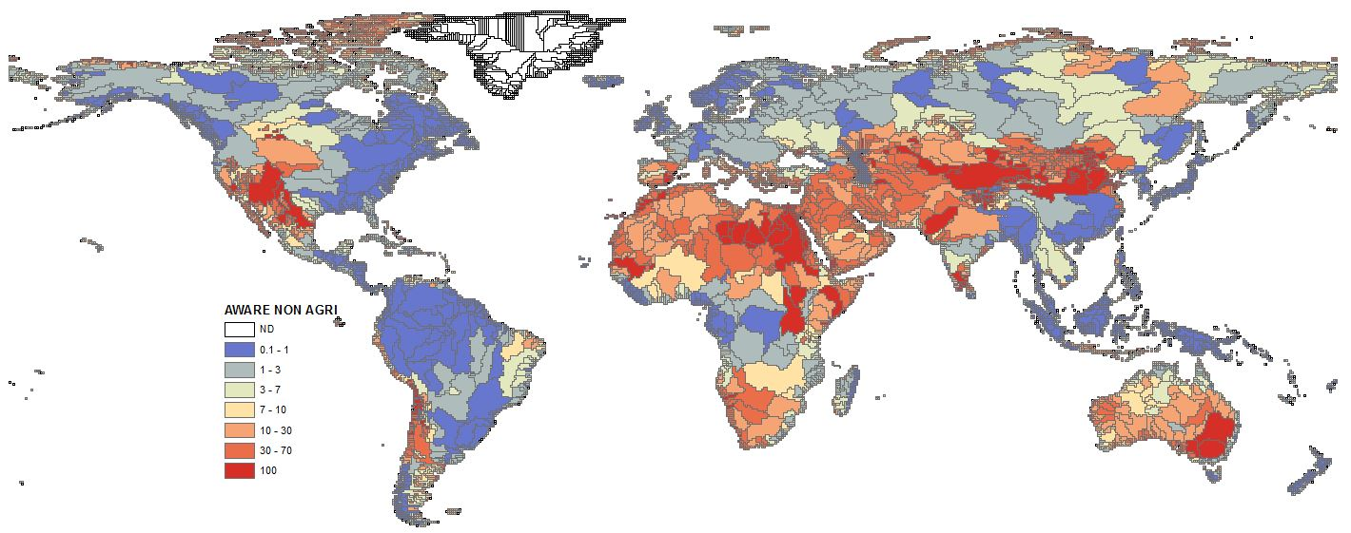
AWARE
Characterization Factors from 0.01 to 100 m³ _{average world eq} / m³_{region r}

Slide 10
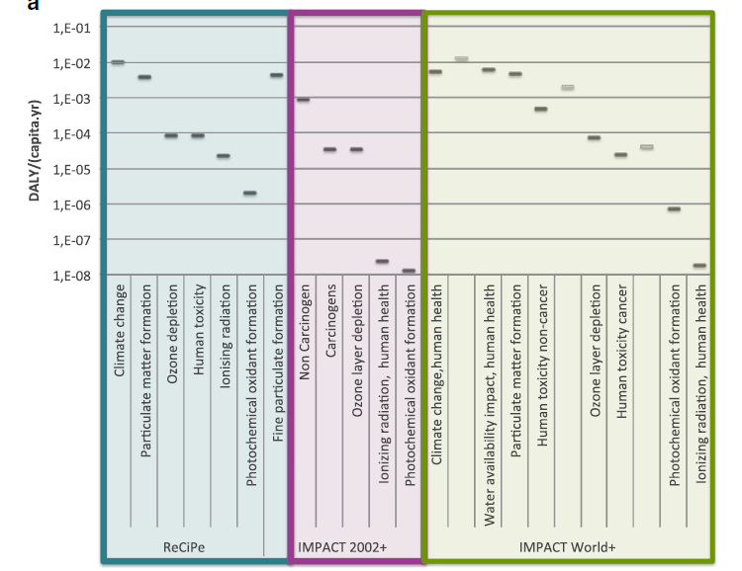
Method comparison Worldwide impacts on human health
Bulle et al 2019, + Lime

Slide 11
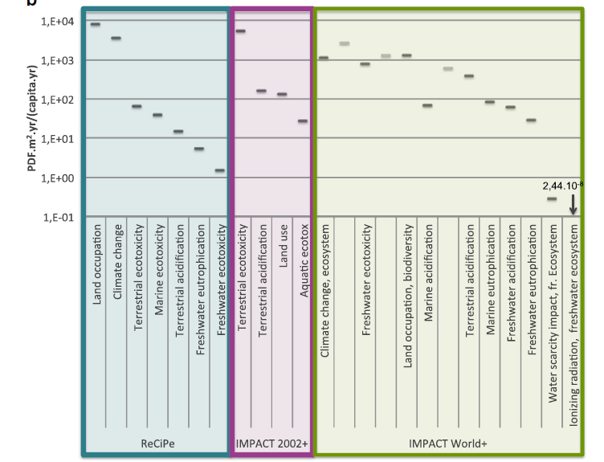
Method comparison Ecosystem quality, for world normalization flows
Bulle et al 2019, + Lime

Slide 12
First signs of maturity as a scientific area, still improving rapidly
In the field of toxicity, LCIA is fully part of a collaborative effort with scientists from multimedia model, risk assessment, indoor air pollution and LCIA to defined intake fraction (Bennett et al. 2002).
Adaptations from risk assessment to the comparative LCIA framework are bringing innovative developments back for comparative risks.
LCIA are also published in the best environmental journals such as Environmental Science and Technology, Environment international.
International Journal of LCA, the Journal of Industrial Ecology and the Journal of Cleaner Production are now in the Science Citation.
2009: Int J LCA Index 1.7, 60 out of 160 env. journals.
2013: Int J LCA Index 2.8, 48 out of 209 env. journals.
2019: Int J LCA Index 4.3, 26 out of 350 env. journals

Slide 13
Summary
At least include main information on effect (e.g intrinsic toxicity) and fate (tranport, dilution and degradation).
So far: use several (typically three) impact assessment methods in parallel, e.g. IMPACT World+, ReCiPe, TRACI, IMPACT2002+, or LC Impact in coming years.

