Slide 1
Life Cycle Analysis of Wallpaper & Wall Paint
Team Members: Alextia A., Nan Y., & Bu Z.

Slide 2
Background
Objectives
Personalizing one’s home is the most important “aspect of home decoration”. While the main medias used for covering a wall varies, wall paint and wallpaper are one of the most commonly used.
In this case study, we will be composing a LCA for Wall Paint and Wallpaper. We hope to discern how much energy and resources are needed to manufacture, use and dispose these products. At the end of this study, we would like to conclude which product and process would have the least impact on the environment.

Slide 3
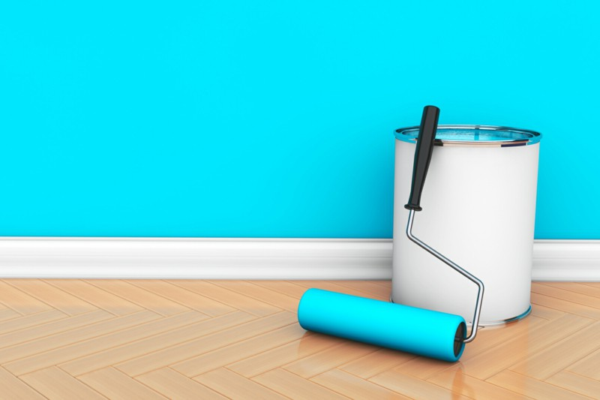
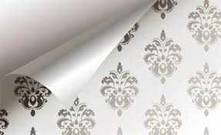
Functional Unit
Product System | Functional Unit | Reference Flow | System boundaries | Environmental Key Parameters
Wall Paint | 100 m² of wall protected for 20 years | 30 Liters of Paint (41.1kg) 1 roller 6 Paint buckets (2.5 kg) 1/600 Ladder | Overall life cycle including raw material extraction, use phase, end of life treatment | Amount of paint/paper applied per square meter Lifetime of Paint/Paper
Wallpaper |  | 32.9 rolls of 1kg wallpaper (32.9 kg) 1 roller 1 Concentrated Adhesive 1/600 ladder |  | Category of Paint/Paper (Water based, Oil, Plant based, etc.)

Slide 4
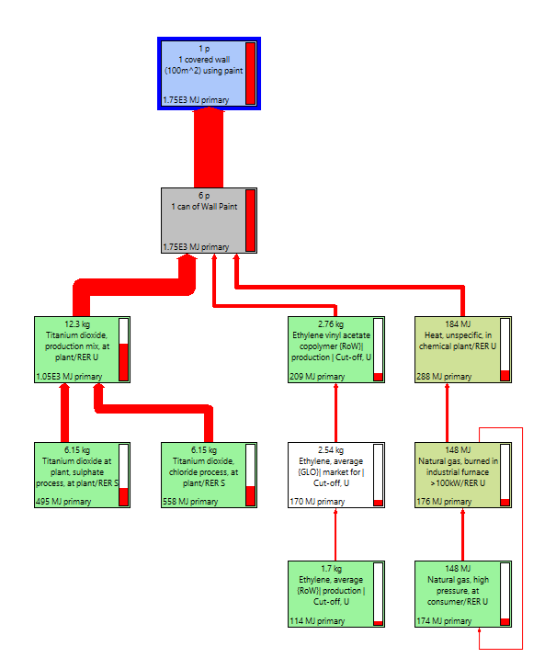
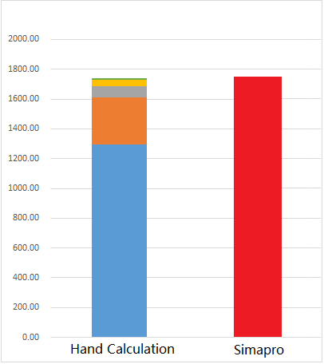
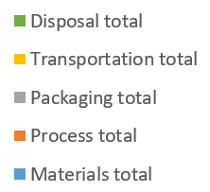
Wall Paint’s Non-renewable energy process tree
Cut-off: 4%
1738.9 MJ/FU 1753 MJ/FU
Titanium dioxide production
61.1%
EVAC production
12.4%
Heat
16.5%
Notes:
Difference between hand calculation and Simapro: due to data precision. We round the number of process data in simapro

Slide 5
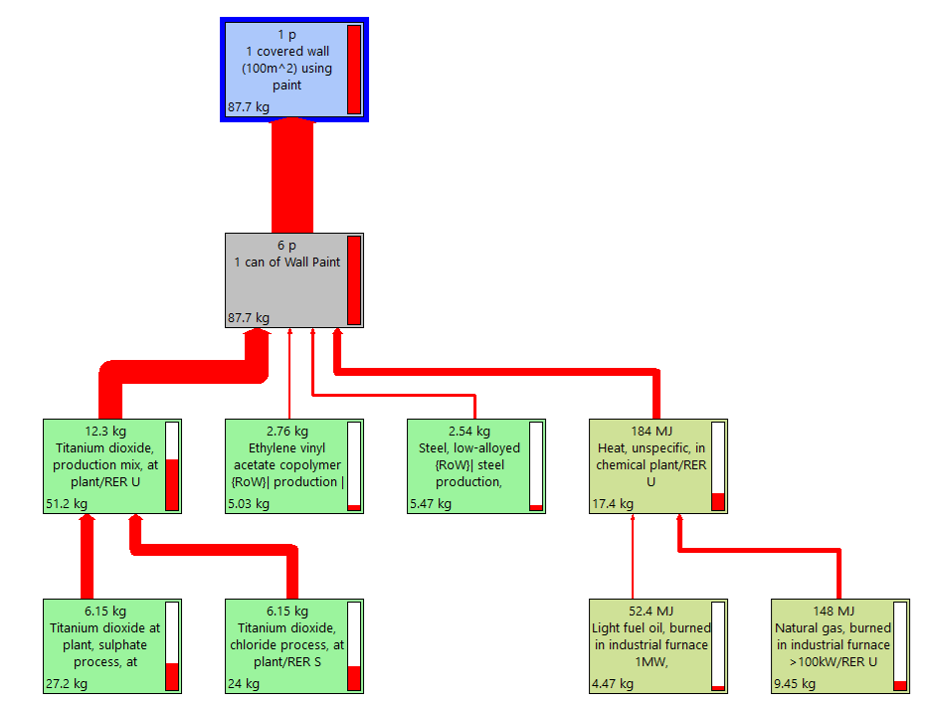
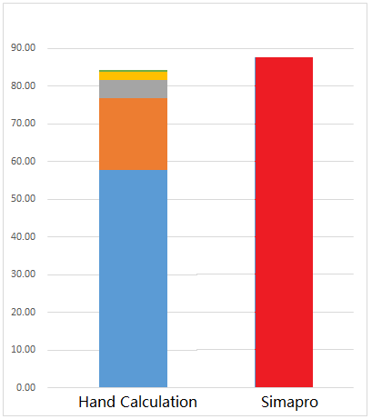
Wall Paint’s CO2 process tree
Cut-off: 4%
84.3 kg/FU 87.7 kg/FU
Titanium dioxide production
61.4%
Steel production
4.9%
Heat
20.5%
EVAC production
5.9%
Notes:
Difference with non-renewable energy: Steel production 4.9%

Slide 6
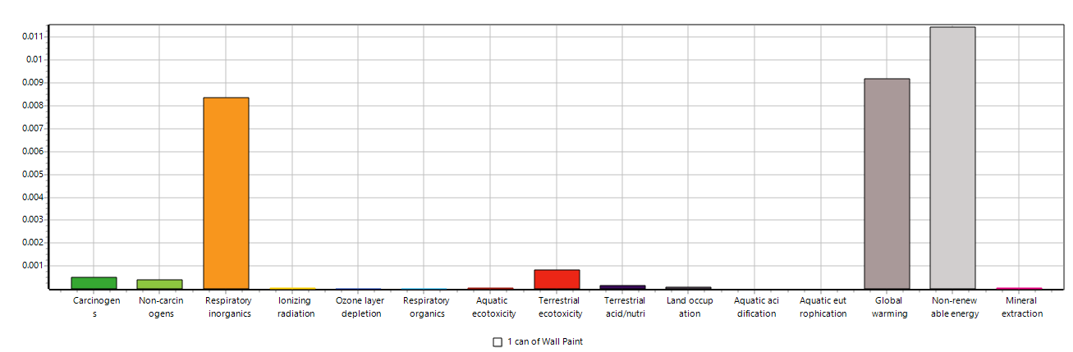
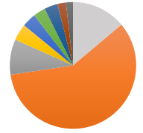
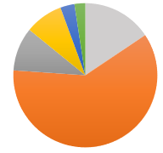
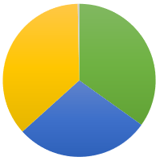
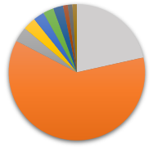
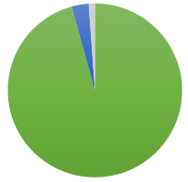
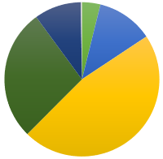
Normalized midpoint results (Wall paint)
SO2 36.4%
NOx 34.9%
TiO2 60.5 %
TiO2 61.1 %
TiO2 58.8 %
PM2.5, 28.5%
Oil 27.5%
CO2 fossil 95.7%
Gas 46.8%
Respiratory
inorganics
Global
warming
Non-renewable
Energy
Highest contribution to the damage is Titanium production in the categories of Respiratory Inorganics (61.1%) , Global Warming (58.8%), Non-renewable energy (60.5%).

Slide 7
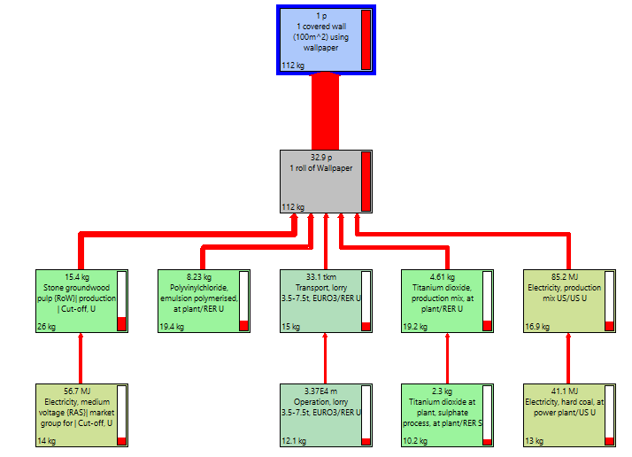
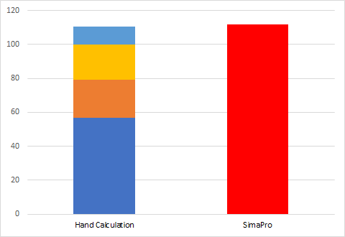
Wallpaper’s CO2 process tree
110.70 kg/FU
112 kg/FU
Cut off: 8.03%
Stone Groundwood: 23.2%
PVC: 17.3%
TiO2: 17.1%
Electricity: 15%
Transport: 13.39%
Notes:
Stone Ground CO2 equ in hand calc was 12.73(11.5% CO2 came from Materials-Stone Ground Wood)
PVC CO2 HC was 19.14(17.3%)
Transport CO2 was 20.69(18.7%)
TiO2 was 19.38(17.5%)
Electricity was 16.8 (15.2%)

Slide 8
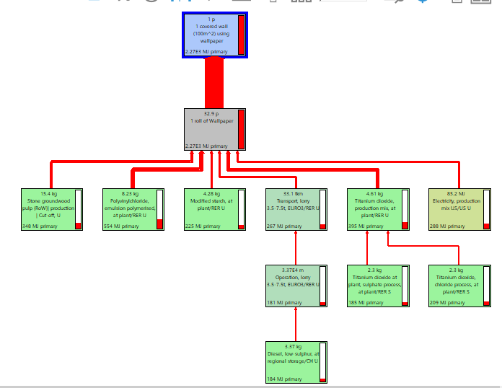
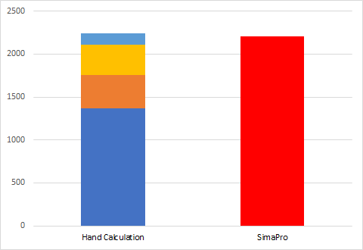
Wallpaper’s Non-renewable energy process tree
Cut off: 8.03%
2241.38 MJ/FU
2207 MJ/FU
Stone Groundwood: 15.3%
PVC: 24.4%
Transport: 11.8%
Electricity: 12.7%
TiO2: 17.4%
Starch: 9.91%
Notes:
Stone-->12.04%(269.77)
PVC→23.4%(525.06)
Starch→7.74%(173.43)
Transport→0.16%(351.81)
TiO2→17.76%(398.06)
Electricity→ 12.77%(286.3)

Slide 9
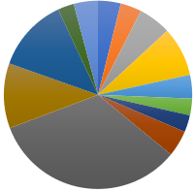
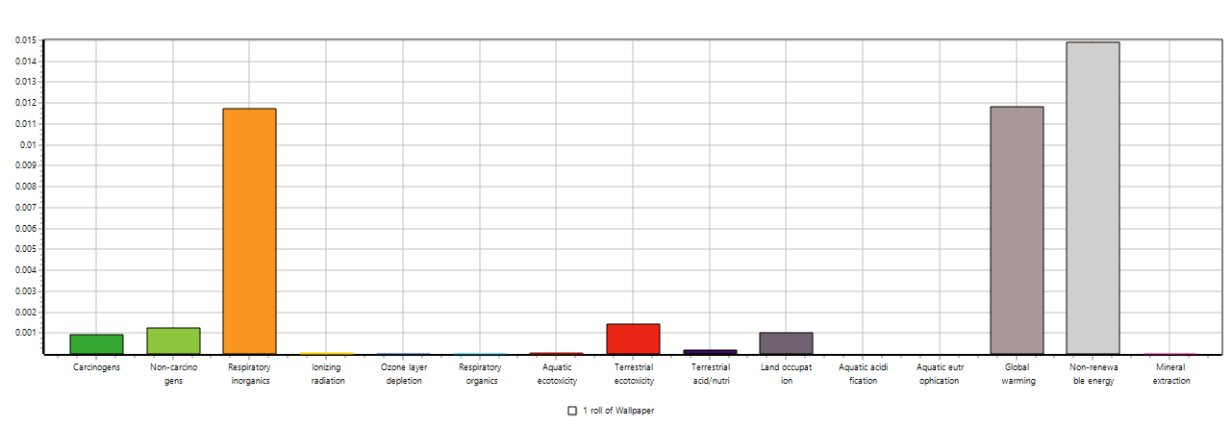
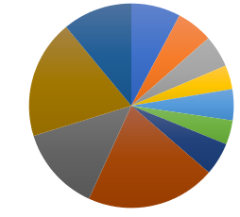
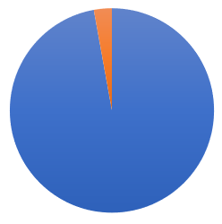
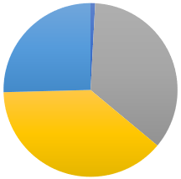
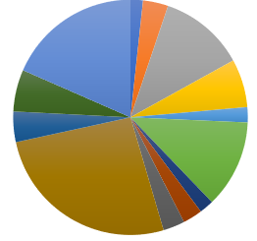
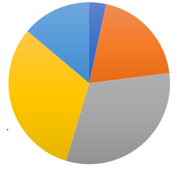
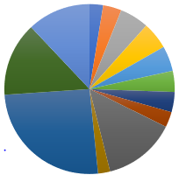
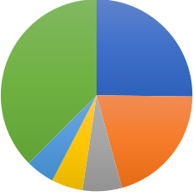
Normalized midpoint results (Wallpaper)
PVC33%
CO2(Fossil)
97%
Lorry 3.5-7.5t
20%
SO2
25%
NOx
35%
Coal, Hard
20%
U
14%
PM 2.5
39%
Lorry 3.5-7.5t
26%
Oil,
crude
31%
Al
(air)
25%
Gas, Natural
31%
Zn
(soil)
37%
PVC26%
Al (soil)
21%
Respiratory
Inorganic
Terrestrial Global Non Renew-
Ecotoxicity Warming able Energy
Highest damage in the categories of Respiratory Inorganics (20% Operation, lorry 3.5-7.5t, EURO3/RER U) , Global Warming (26% Polyvinylchloride, emulsion polymerised at plant/RER U), Non-renewable energy (33% Polyvinylchloride, emulsion polymerised at plant/RER U), and Terrestrial ecotoxicity (26% Operation, lorry 3.5-7.5t, EURO3/RER U).

Slide 10
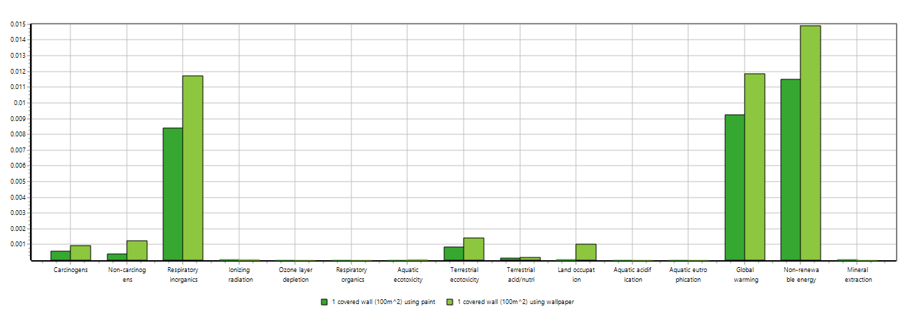
Comparison of Wall paint vs. Wallpaper
0
In this normalized damage assessment, Wallpaper has a significantly higher impact (28.5%) which is almost a 30% difference in the respiratory inorganic, global warming and non-renewable energy categories. For the toxicity, our result shows no significant difference between these two scenarios.

Slide 11
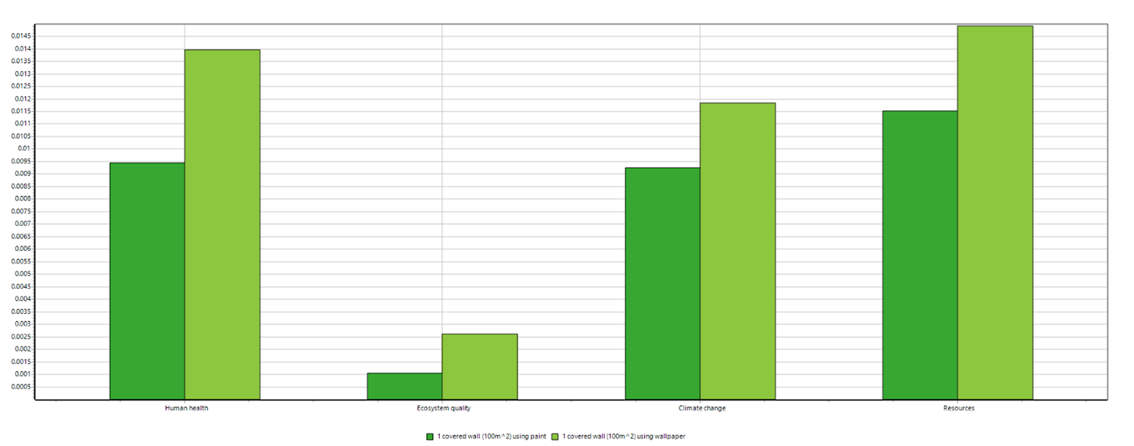
Results
CO2 emissions
Wall paint: 87 kg CO2/FU
Wallpaper : 112 kg CO2/FU
Based on the normalized damages:
Wallpaper has a higher impact on human health than wall paint.
Wallpaper has a higher impact on Ecosystems quality than wall paint.
Wallpaper has a higher impact on Climate change than wall paint.
Wallpaper has a higher impact on Resources than wall paint.
According to the normalized damage comparison chart(per category), the use of Wallpaper causes high damages in the categories of respiratory inorganics, global warming, non-renewable energy, non-carcinogens, carcinogens and terrestrial toxicity.

Slide 12
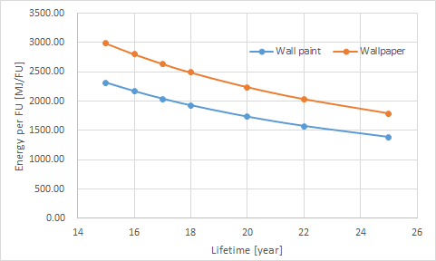
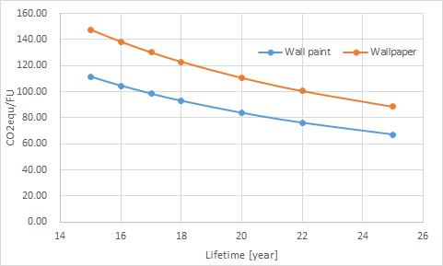
Sensitivity of energy and CO2_Lifetime
With the longer lifetime of wall paint and wallpaper, the total energy use and CO2 emissions will decrease.
Notes:
Due to the Environmental key parameters we identified before. We conducted a sensitivity analysis for both Wall paint and wallpaper. As we can see from the previous results, material and manufacturing phases are always the dominant processes. Thus, we first conduct a sensitivity analysis about the lifetime. It can be easily seen from the figure above, with the longer lifetime, the total energy use and CO2 emissions will decrease. Although the two scenarios with the same lifetime only have very slight difference. In the real life, in consideration of the factors, such as the beauty, it is hard to reach the whole lifetime for both of the wall paint and wallpaper. Thus, the real energy and co2 performance can vary significantly due to the different lifetime.

Slide 13
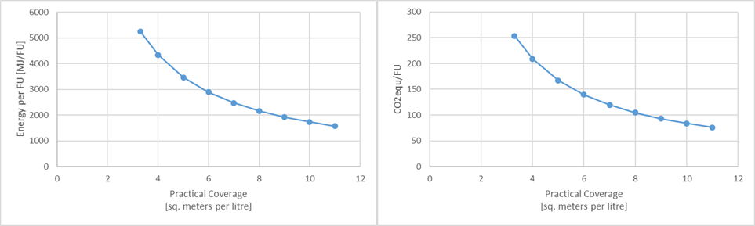
Sensitivity of energy and CO2_Coverage
Standard coverage: 8.5-11 sq. meters per litre
Scenario 2 (Wallpaper)
Scenario 2 (Wallpaper)
7.73
With the increase of the coverage, the total energy use and CO2 emissions will decrease. And the maximum coverage is 3.33 sq. metres per litre. If the coverage reached 7.73 or more, the wall paint may have a better energy performance.
Notes:
The second parameter we considered is the coverage. Here, the unit of the coverage is sq. meter per liter which means the thicker, less sq.meter can be painted. The standard coverage is between 8.5-11. According to our result, If the coverage reached 9.62 or more, the wall paint may have a better energy performance.

Slide 14
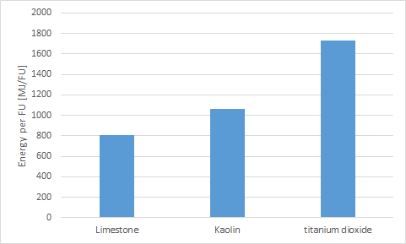
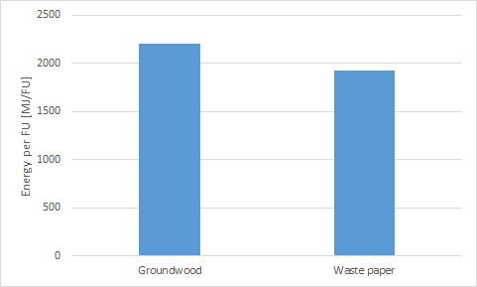
Sensitivity of energy_Material
12.6%
38.9%
53.5%
Due to the replacement of dominant material, the total energy use can reduce up to 53.5% and 12.6% in the two scenarios.
Notes:
As we found from the process tree, titanium dioxide contribute to more 60% of the total energy use. Thus, we try to replace the titanium dioxide with more eco friendly materials. Here, we found two substitutes, limestone and kaolin. However, the cannot perfectly replace the tio2, as these paints are not as white and flat as the tio2 based paint. But the results showed that due to the replacement of titanium dioxide, the total energy use can reduce 53.5% and 38.9% in the limestone and kaolin based paint.
With the replacement of Stone Groundwood Pulp to Waste paper,mixed from public collection, there is a significant decrease in the categories of respiratory inorganics and global warming.

Slide 15
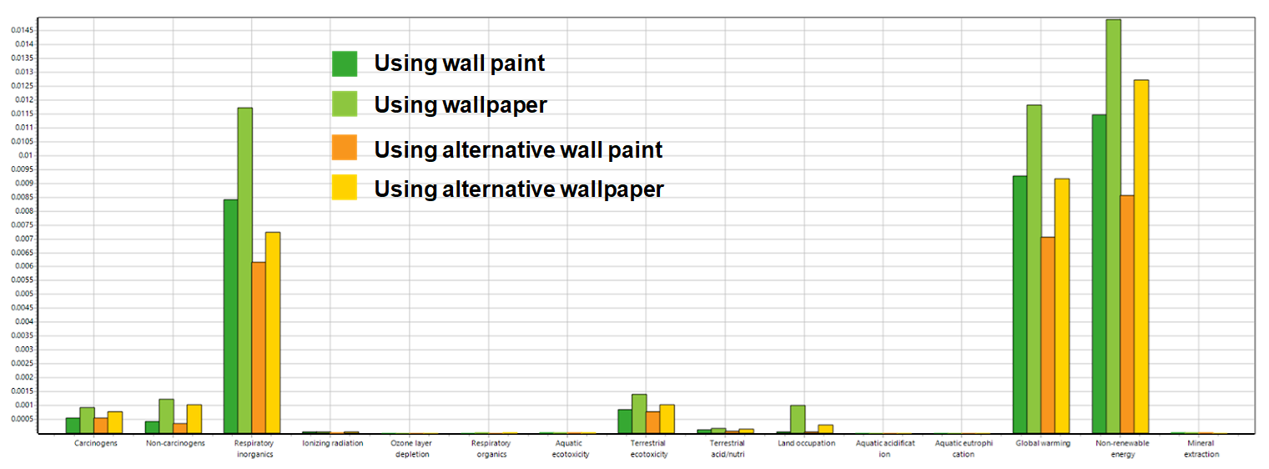
Alternative scenarios
The alternative paint scenario has the best environmental performance while the original wallpaper scenario is the worst.

Slide 16
Strategies for product improvement
•1. Reduce use phase consumption, e.g. reducing the thickness of wall paint ( while still in a standard thickness).
•2. As the material extraction and production phase are always the dominant processes, thus it is essential to increase product lifetime and reuse of parts, e.g. use the recycled paper and prolong the lifetime of wall paint and wallpaper.
•3. Dematerialize: obtain more service from a similar or reduced materials quantity, e.g. use kaolin or limestone to replace titanium dioxide.

Slide 17
Conclusion
● Wall paint has a kind of significantly lower environmental impact in comparison to wallpaper.
● Change of the raw material can significantly improved the environmental performance for both products.
● Results is based on strong hypothesis, further study related to the uncertainty analysis need to be conducted.
Notes:
Based on our results, we determined that wall paint has a significantly lower impact on human health, ecosystem health, climate change and resources in comparison to wallpaper. Only when we change the materials that goes into the production of wallpaper(i.e. Paper type) we observe a noticeable reduction in these categories.

Slide 18
References
“Wallpaper.” How Products Are Made, © 2018 Advameg, Inc., www.madehow.com/Volume-3/Wallpaper.html
“Paint.” How Products Are Made, © 2018 Advameg, Inc., http://www.madehow.com/Volume-1/Paint.html
India, Ultrawalls. “Wallpaper Manufacturing Industry: Introduction, History, and Process.” Medium, Medium, 6 Apr.
2018,medium.com/@ultrawallsindia/wallpaper-manufacturing-industry-introduction-history-and-process-50f564594a8d.
“Wallpaper.” Design Life-Cycle, www.designlife-cycle.com/vinyl-wallpaper/.
“Wallpaper vs. Paint.” Brewster, Brewster Home Fashions, www.brewsterwallcovering.com/wallpaper-vs-paint.
“Dulux X-Pert.” Dulux, www.dulux.ca/diy/products/interior-paint/dulux-x-pert.
“Paint vs. Wallpaper: An Interior Decorator's Guide.” QC Design School, 24 Sept. 2018,
www.qcdesignschool.com/2017/06/paint-vs-wallpaper-interior-decorators-guide/.
“The Pros of Cons of Painting vs. Wallpapering.” Freshome.com, 29 Dec. 2010,
freshome.com/2010/12/29/the-pros-of-cons-of-painting-vs-wallpapering/.
“Wallpaper, Wall Art.” Wallpaper Designs | Wall Coverings | Graham & Brown, www.grahambrown.com/us/.

