Slide 1



git-drs
walsbr@ohsu.edu
https://ellrottlab.org/
Sept 2026

Slide 2
AnVIL + Terra meets git-drs
Git keeps
DRS resolves
▮
references
⚿
fresh access
References
in Git,
resolution
at access
↶
history
✓
checksums
▰
paths
●
provider auth
Git versions stable references; DRS supplies authorized, verified access to the bytes.

Slide 3
git-drs
“Clone the references. Hydrate the data. Reproduce the dataset."
Data Consumer
Clone a lightweight repository that versions stable DRS references to your dataset.
Authenticate to the data provider and hydrate the files you need—on demand.
🔒
Secure by Design
◷
Reproducible
●●●
Collaborative
⇩
On-Demand Access
✓
Storage Agnostic
Authorization and tokens
are resolved when data
is accessed—never stored
in Git.
Git versions the dataset
structure and references
so results can be reliably
reproduced.
Share the same dataset
layout with your team
without duplicating data.
Hydrate only the files
you need, when you
need them.
Works with any DRS-
enabled data repository
or cloud backend.
The git-drs Data Consumer Workflow
Clone Repository
Configure Terra Remote
Hydrate Files
★
Why git-drs?
1
2
3
Get the dataset references
(not the data).
Set up local access to
AnVIL data.
Download and validate the files
you are authorized to use.
✓
Scales to any size
Reference large datasets without moving them.
gcloud auth application-default login
git clone https://github.com/org/
ANVIL_1000G_PRIMED_data_model.git
git drs remote add anvil terra
--checkout hydrate
git drs pull -I "*.tsv"
# or
git drs pull -I "sample.tsv"
Always up to date
✓
Fresh metadata and access at the time of use.
✓
Integrity guaranteed
▱
▤
☁
🔒
▤
git-
drs
▤
Size and SHA256 verified before use.
Your repository contains DRS
pointers, not data.
Authentication via
Google ADC
DRS resolves, downloads,
verifies, and hydrates.
✓
Fits your workflow
Git for versioning; git-drs for access.
Clone the references. Hydrate the data. Reproduce the results.
Notes:
Frame the data-consumer value proposition:
For researchers and data analysts who need to work with large, distributed, or controlled-access datasets, git-drs is a Git-based data access tool that lets them clone a lightweight repository and hydrate the data they need on demand. Unlike copying datasets, maintaining manifests, or embedding storage-specific URLs in workflows, git-drs versions stable DRS references in Git while resolving authorization and data access at the time the data is used.
Tighten it further:
Elevator pitch
git-drs lets researchers use Git to share and reproduce datasets without putting the data in Git. Clone the repository, authenticate to the data provider, and hydrate the files you need. Git versions the references and dataset structure; DRS provides authorized access to the bytes.
And an even shorter tagline that connects nicely to your producer/consumer slides:
Clone the references. Hydrate the data. Reproduce the dataset.

Slide 4

DRS: object metadata + live access
Git repo
DRS registry
Access layer
▤
stable reference
live resolution
Git stores a stable
reference to a DRS object.
DRS records describe object
identity, metadata, and
access methods.
Clients resolve fresh access
and verify before use.
Reference schema work: GA4GH DRS schemas and the writable DRS upload prototype branch.
Git stores a stable reference to a DRS object, not the bytes.
DRS records describe object identity, metadata, and live access methods.
Clients resolve a fresh access URL at read time and validate size/checksum before hydration.
https://github.com/ga4gh/data-repository-service-schemas
02

Slide 5
git-drs
publish datasets with Git - without publishing the data to Git.
Data Producer
Add local or existing data once, and git-drs records stable DRS references, checksums,
and dataset structure. Then use ordinary Git to commit, version, and share the dataset
definition—while the bytes remain in the right data repository.
🔒
Safe & Responsible
⌘
Versioned & Reproducible
●●●
Shareable
☁
Repository Agnostic
✓
Integrity by Design
Data stays in approved
repositories with proper
access controls.
Git versions the dataset
structure and references,
so every release can be
reproduced.
Share a lightweight repo,
not the data. Collaborators
hydrate with their own
access.
Works with any DRS-
enabled repository or
cloud backend.
References include size
and SHA256. Consumers
verify before using.
The git-drs Data Publisher Workflow
★
Why publish with git-drs?
1
Add Data
2
Commit & Version
3
Push & Share
Add local files or existing DRS
objects to the repository.
Git versions the references and
dataset structure.
Push to your remote and share
like any other Git repository.
✓
Lightweight to share
Share a small repo, not terabytes.
git drs add data/
# or add existing DRS URIs
git drs add-ref drs://drs.anv...
dataset.tsv
git add .
git commit -m "Add 1000G dataset"
git tag v1.0.0
git push origin main
git push origin v1.0.0
✓
Built for data scale
DRS handles secure, scalable data access—Git handles everything else.
✓
Future-proof
⌘
☁
DRS references are stable and portable across platforms and time.
▤
git-
drs
{}
▤
✓
Fits your workflow
Files become DRS references
with size and SHA256.
Every commit captures exactly
which data, and which version.
Collaborators clone the repo
and hydrate with their own access.
Use Git for versioning, review, automation, and releases.
Notes:
the pitch parallel to the consumer pitch:
git-drs lets researchers publish versioned datasets with Git without putting the data in Git. Add local or existing DRS-backed data to a repository, and git-drs records stable DRS references, checksums, and dataset structure. Then use ordinary Git to commit, version, and share the dataset definition while the bytes remain in the appropriate data repository.
For a presentation, I’d tighten that to:
Elevator pitch
git-drs lets you publish datasets with Git without publishing the data to Git. Add the data once, commit stable DRS references, and push with ordinary Git. Your collaborators get a versioned, reproducible dataset they can clone and hydrate using their own authorized access.
And a tagline parallel to the consumer message:
Add the data. Version the references. Share the dataset.

Slide 6
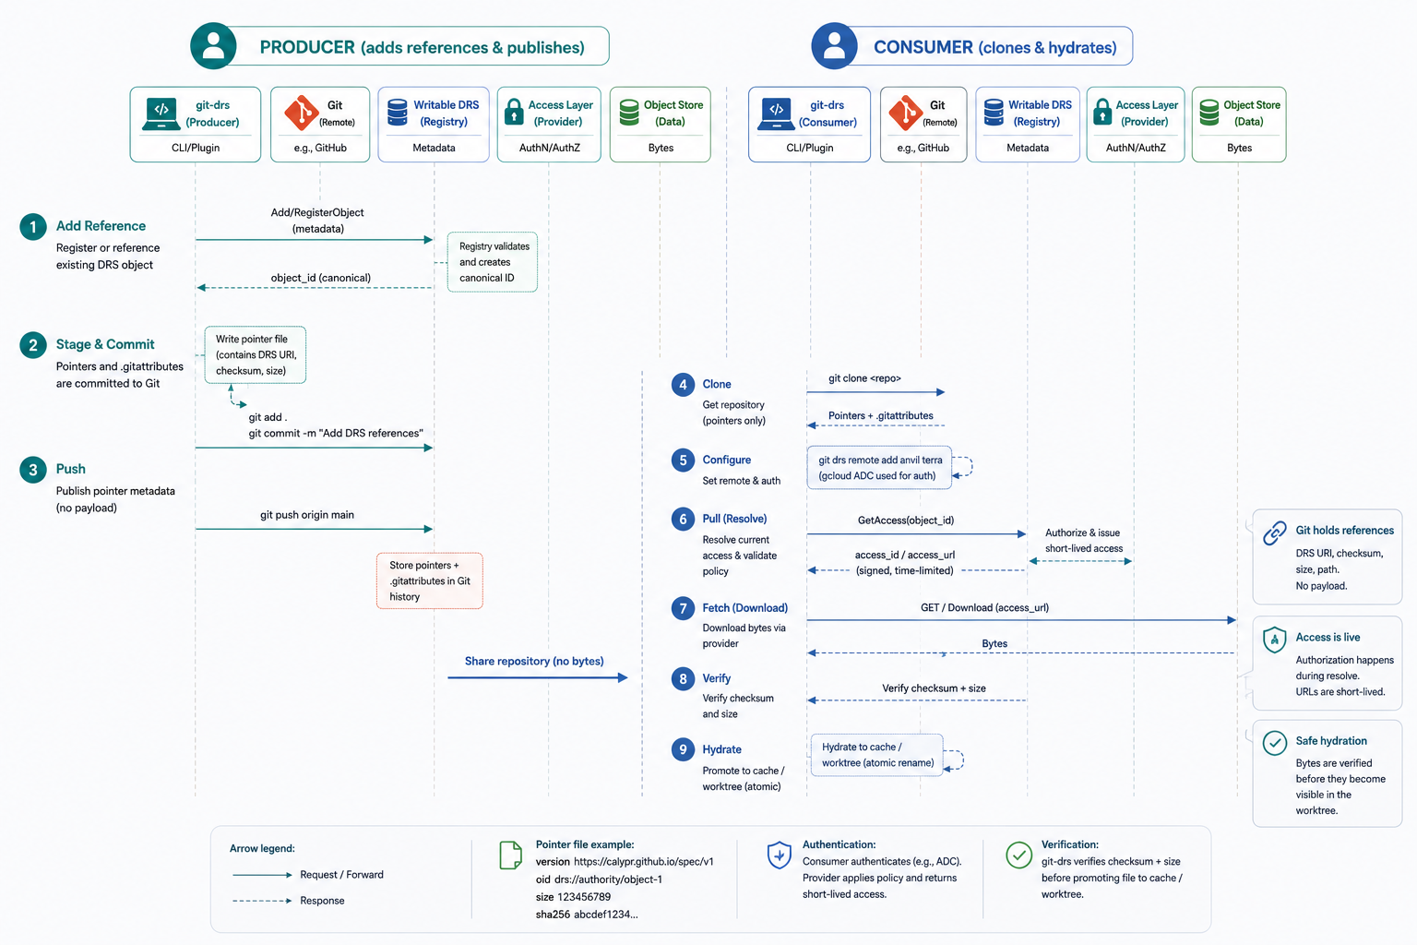
Writable DRS: register, update, and resolve
https://github.com/ga4gh/data-repository-service-schemas/tree/feature/issue-416-drs-upload
03
Notes:
Writable DRS adds lifecycle operations: register objects, update metadata, add access methods, resolve a fresh access URL, and verify bytes before materialization.

Slide 7
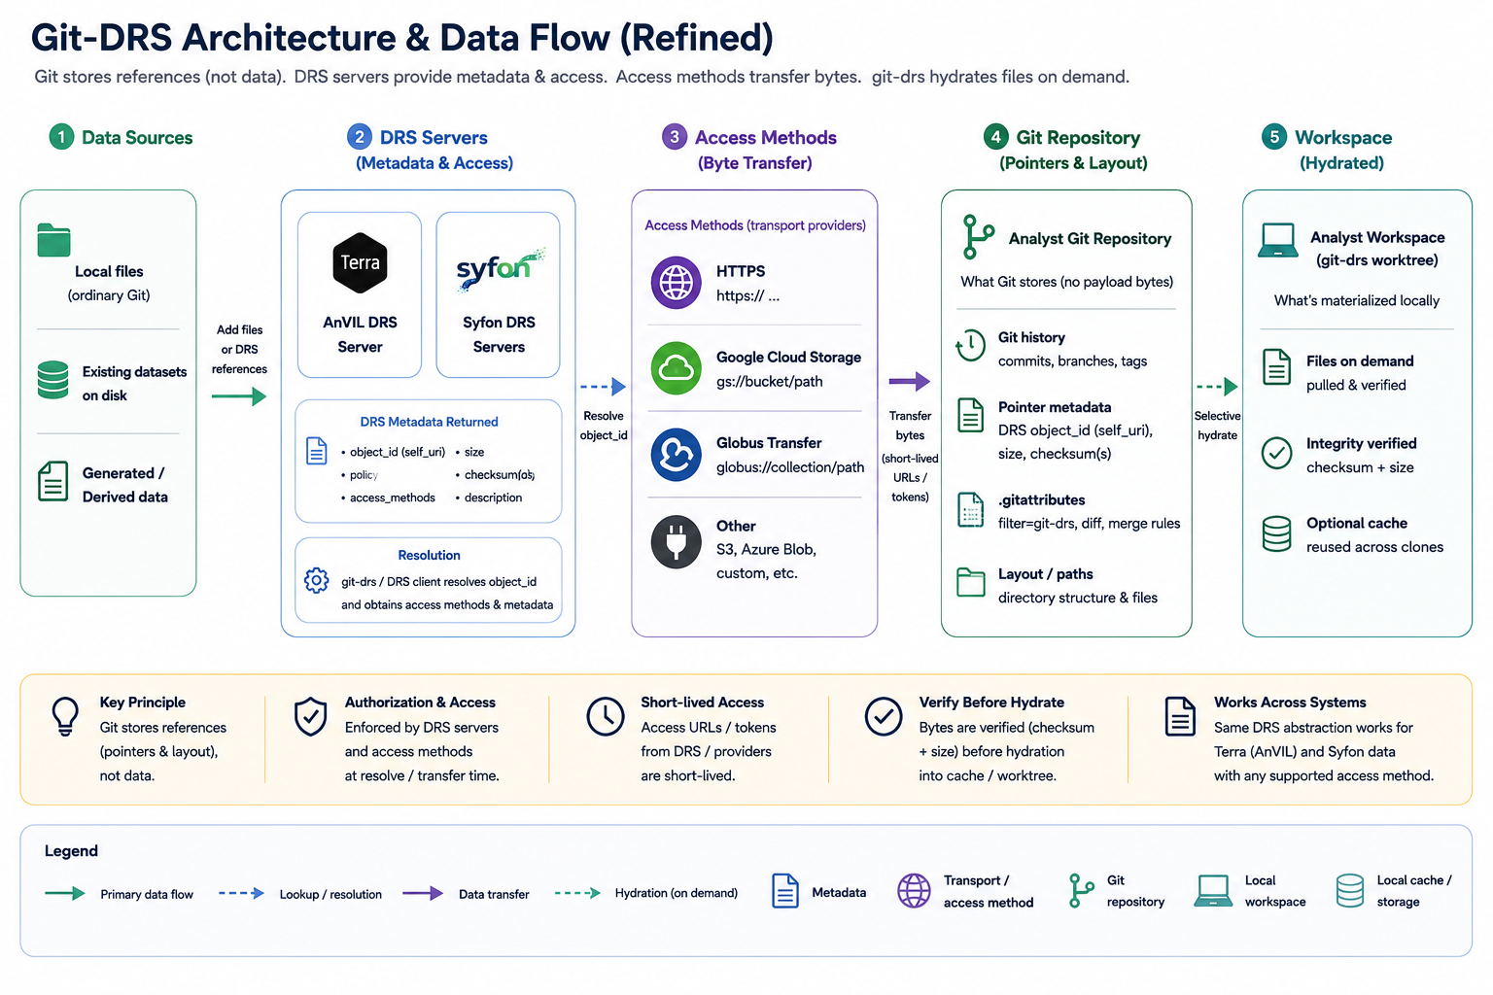
Analyst-facing Git repo with DRS-backed local, AnVIL, and Globus data
04

Slide 8

Configure once. Work with ordinary Git.
What this does
# standard anvil credentials
gcloud auth application-default login
# Create and initialize git repository
mkdir my-anvil-repo
cd my-anvil-repo
git init
git drs init
# Configure the default drs remote
git drs remote add anvil terra
1
Authenticate to AnVIL
Uses your standard
AnVIL credentials.
2
Create repo
Start a new Git repository
and initialize git-drs.
3
Terra
Add Terra (AnVIL) as
the default DRS remote
Resolve AnVIL DRS objects
through the Terra provider.
4
Ready to add data
Add files/DRS references
and publish with ordinary Git.
i
Key idea
Git versions stable DRS references; authorized bytes are resolved and hydrated only when needed.
https://github.com/EllrottLab/ANVIL_1000G_PRIMED_data_model

Slide 9
3-Step Workflow
From AnVIL Data Explorer to versioned Git references
1
Select data in AnVIL
2
Add DRS references
3
Commit & publish
Use Data Explorer to find
and select the files you need.
Add the selected objects as
DRS references in your repo.
Commit pointer files and publish
with ordinary Git.
★ AnVIL Data Explorer
# Add selected objects
Table
Graph
Results: 1 – 7 of 7
git add .gitattributes '*.tsv'
git drs add-ref \
Name
File Format
Size
DRS URI
drs://drs.anv0:v2_6d1cf5f0-
A
sequencing_dataset.tsv
tsv
12.4 MB
drs://drs.anv0:...abfe7
99a8-3cd9-b580-01102f3abfe7 \
git commit -m "Add AnVIL
sequencing_dataset.tsv
dataset references"
A
subject.tsv
tsv
78.2 kB
drs://drs.anv0:...4c14
git drs add-ref \
A
sample_info.tsv
tsv
75.0 kB
drs://drs.anv0:...ed8f5
drs://drs.anv0:v2_b6b829f3-
6046-3f29-896f-495a23f24c14 \
git push
A
sample_qc.tsv
tsv
428.5 kB
drs://drs.anv0:...d6d7c
subject.tsv
A
sequencing_metrics.tsv
tsv
0.24 kB
drs://drs.anv0:...9a0ca
A
sequencing_filter.tsv
tsv
1.32 MB
drs://drs.anv0:...0098e
# Or add a manifest
git drs add-ref --manifest \
Your Git repository
A
subject.json
json
78.2 kB
drs://drs.anv0:...d2b9c
my-references.tsv
✓
Git contains the dataset layout and DRS references — not the AnVIL payloads.
Anyone with access can pull and hydrate the bytes when needed.

Slide 10
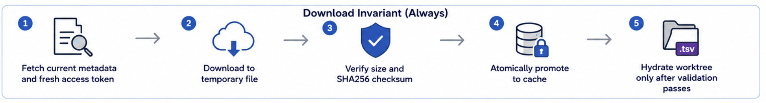
3-Step Consumer Workflow
From Git references to hydrated AnVIL data
1
Clone Repository
2
Configure Terra Remote
(Per Clone)
3
Hydrate Files
Clone the pointer-only repository.
*.tsv files are DRS pointers,
not actual data.
Configure a local Terra remote.
This step is required for every clone.
Download and hydrate files
from AnVIL (fetch metadata and data).
# Set up authentication
# Repository-local remote configuration;
# Download all authorized TSV files
gcloud auth application-default login
# not cloned from origin
git drs pull -I "*.tsv"
# This is the key security boundary:
# Clone the pointer-only repository
# every clone must recreate its own config
# Or hydrate only a specific subset
git clone https://github.com/<user>/
git drs remote add anvil terra --checkout hydrate
git drs pull -I "sample.tsv"
ANVIL_1000G_PRIMED_data_model.git
cd ANVIL_1000G_PRIMED_data_model
⚙
This enables git-drs to:
✓
Resolve DRS URIs via the AnVILResolver
sample.tsv
git-drs
sample.tsv
i
After cloning, *.tsv files are DRS
pointers (not data).
✓
Request fresh access tokens via Google ADC
DRS POINTER
(not data)
HYDRATED
(actual data)
✓
Verify file checksums during download
Terra / AnVIL
DRS
Hydrated files in
your worktree
✓
Security & Integrity by Design:
Every clone recreates its own configuration and obtains fresh tokens. Data is downloaded securely, verified, and hydrated only after validation.

Slide 11
TALKING POINTS: One reference model, four perspectives
Data reference author
Publish a reviewable, versioned dataset layout without downloading payloads.
Data consumer
Clone pointers, authenticate independently, then hydrate everything or selected paths.
Unauthorized reader
Inspect repository history but receive a clear denial when attempting controlled-data hydration.
Repository maintainer
Review deterministic pointers, diagnose provider failures, and run clean-clone acceptance tests.
Out of scope: uploads, record mutation, provider copying, remote GC, and workspace-table sync.
06

Slide 12
A clean clone plus explicit remote setup
gcloud auth application-default login
git clone <git-repository>
cd <repository>
# .git/config is not cloned; recreate public remote settings.
git drs remote add anvil terra --checkout hydrate
# Hydrate every authorized reference
git drs pull
# Or only one dataset slice
git drs pull -I "data/*.cram"
Stage | Action
Git | Clone pointer and .gitattributes
User B | Configure remote; supply ADC; choose paths
Resolver | Fetch current metadata and fresh access
Cache | Download, verify, atomically promote
Worktree | Hydrate only after validation
No data, Git config, token, or signed URL is shared
08

Slide 13
AnVIL manifest to pointer-only GitHub repo
1. Configure and add references
2. Commit, hydrate, and publish
Select the dataset in the AnVIL Data Explorer, then download the manifest.
git init
git drs remote add anvil terra
# Download the TSV from AnVIL Data Explorer first.
manifest=/tmp/anvil-manifest-38dc7537.tsv
scripts/anvil-add-ref-commands.sh "$manifest" > /tmp/add-anvil-refs.sh
cat /tmp/add-anvil-refs.sh
bash /tmp/add-anvil-refs.sh
git add .gitattributes '*.tsv'
git commit -m "Add references to AnVIL data"
# Materialize only TSVs locally.
git drs pull -I "*.tsv"
git status
git branch -M main
git remote add origin https://github.com/bwalsh/ANVIL_1000G_PRIMED_data_model.git
git push -u origin main
Result: the worktree contains hydrated TSV data; GitHub contains only DRS pointers and .gitattributes. Every clone must configure its own Terra remote.
09

Slide 14
Portable pointer + safe configuration
Tracked pointer
version https://calypr.github.io/spec/v1
oid drs://authority/object-1
size 987654321
sha256 8d969eef…
Repository-local Git configuration
git drs remote add anvil terra --checkout hydrate
The DRS URI stays canonical. A checksum describes content; it does not identify the AnVIL record.
Remote metadata lives only in clone-local .git/config; every clone must recreate it. Credentials remain in the ADC provider store.
10

Slide 15
Provider-neutral resolution breaks Syfon coupling
Commands Resolver interface Identities
add-ref · pull · ping -> GetObject · GetAccess -> remote · cache · content
|
+----------+----------+
| |
AnVILResolver SyfonResolver
Google ADC · routing Gen3 · local behavior
Commands depend on one resolver contract.
The configured remote selects the resolver.
Authentication and provider routing stay behind the interface.
There is no user-facing --remote-type switch.
11

Slide 16
Three identities—not one overloaded OID
REMOTE
Canonical DRS URI
Normalized provider record identity. Committed to Git and used for object and access resolution.
LOCAL
Cache OID
Filesystem-safe SHA256 of a versioned prefix plus normalized DRS URI. Never replaces remote identity.
CONTENT
Content SHA256
Durable integrity metadata. Used to verify bytes, not to locate the record.
cache_oid = sha256("git-drs-anvil-ref:v1\n" + normalized_drs_uri)
Download invariant: fresh access → temporary file → verify size/checksum → atomic cache promotion → hydrate worktree.
12

Slide 17
Status: implemented, in flight, and next
IMPLEMENTED
Core DRS + git-drs path
Provider-neutral resolver contract
DRS pointer metadata and checksum validation
Local + AnVIL + Globus mixed-source repo model
Access fallback handling and safer credential checks
IN FLIGHT
Workflow hardening
End-to-end clone/pull acceptance
Globus collection import and auth flows
Retry and refresh behavior for expired URLs
Clean multi-user and denied-user validation
NEXT
Production readiness
Certify GA4GH schema compatibility
Validate upload-oriented writable DRS behavior
Harden concurrency and diagnostics
Generalize to other providers and fixtures
Area | Current state | Evidence
DRS model | Modernized for writable metadata and live access | GA4GH DRS schema work and writable upload prototype
git-drs workflow | Validated for mixed local / AnVIL / Globus usage | Provider-neutral resolver, selective hydration, pointer-based Git repo
Production proof | Still needs end-to-end acceptance work | Clean-clone, denied-user, and credential-isolation checks pending
13

