Slide 1


Comb Inequalities in a Rich Vehicle Routing Problem Practice Research 2
Source: mempraph
Simón Álvarez Ospina – EAFIT
Alejandro Arenas – EAFIT
Juan Carlos Rivera – EAFIT
Maria Gulnara Baldoquin – EAFIT

Slide 3
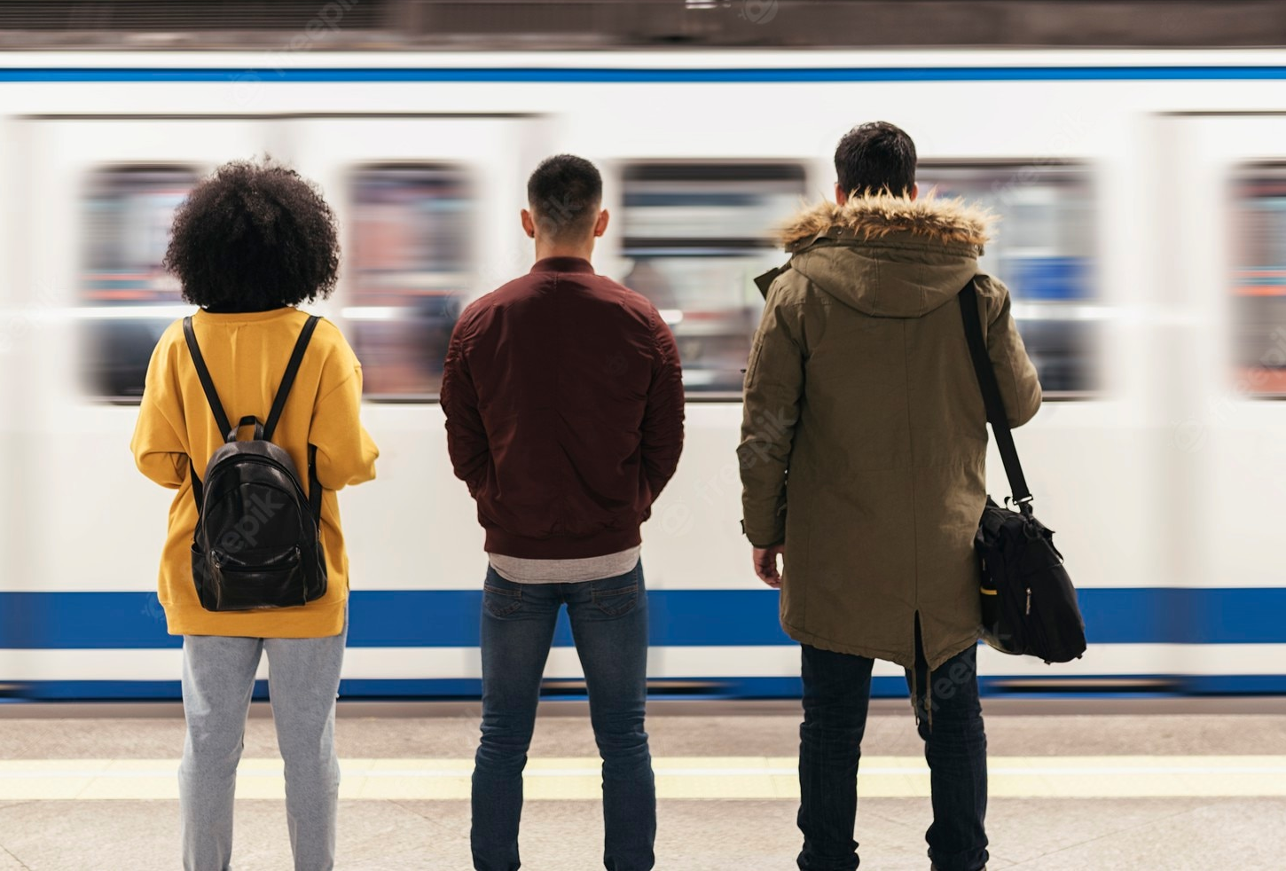
Source: inc.com

Slide 4
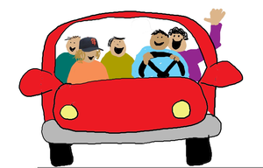
Source: inc.com
Source: sharingsolution.com

Slide 5

$$i$$
Drivers
Students
B
C
EAFIT
EAFIT
A

Slide 6




$$i$$
Drivers
Vehicles
Students
B
C
EAFIT
EAFIT
A

Slide 7
$$i$$
Drivers
Vehicles
Students
B
C
EAFIT
A

Slide 8
$$i$$
Drivers
Vehicles
Students
B
C
EAFIT
A

Slide 9
$$i$$
Drivers
Vehicles
Students
B
C
EAFIT
A

Slide 10



$$i$$
Multiple Drivers (Depots)
Heterogeneous Fleet
Capacitated
[M, W, F]
[T, S]
Periodic
[7:00; 9:15]
[12:45; 16:30]
With Time Windows

Slide 11
Goal
Minimize the time it takes to finish all routes

Slide 12
Goal
Minimize the time it takes to finish all routes
A feasible solution

Slide 13
Goal
Minimize the time it takes to finish all routes
A feasible solution
(Meta)heuristics
Exact methods

Slide 14
Goal
Minimize the time it takes to finish all routes
A feasible solution
(Meta)heuristics
Exact methods

Slide 15
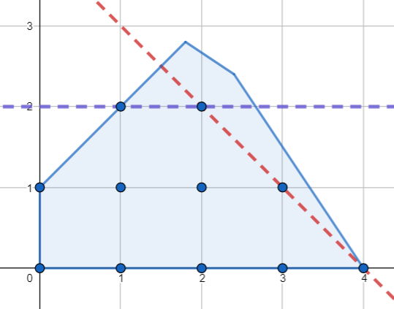
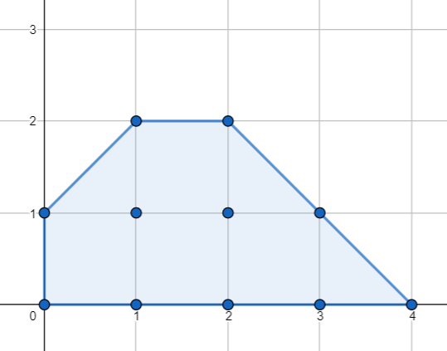
Cuts

Slide 16
Comb Inequalities!

Slide 17
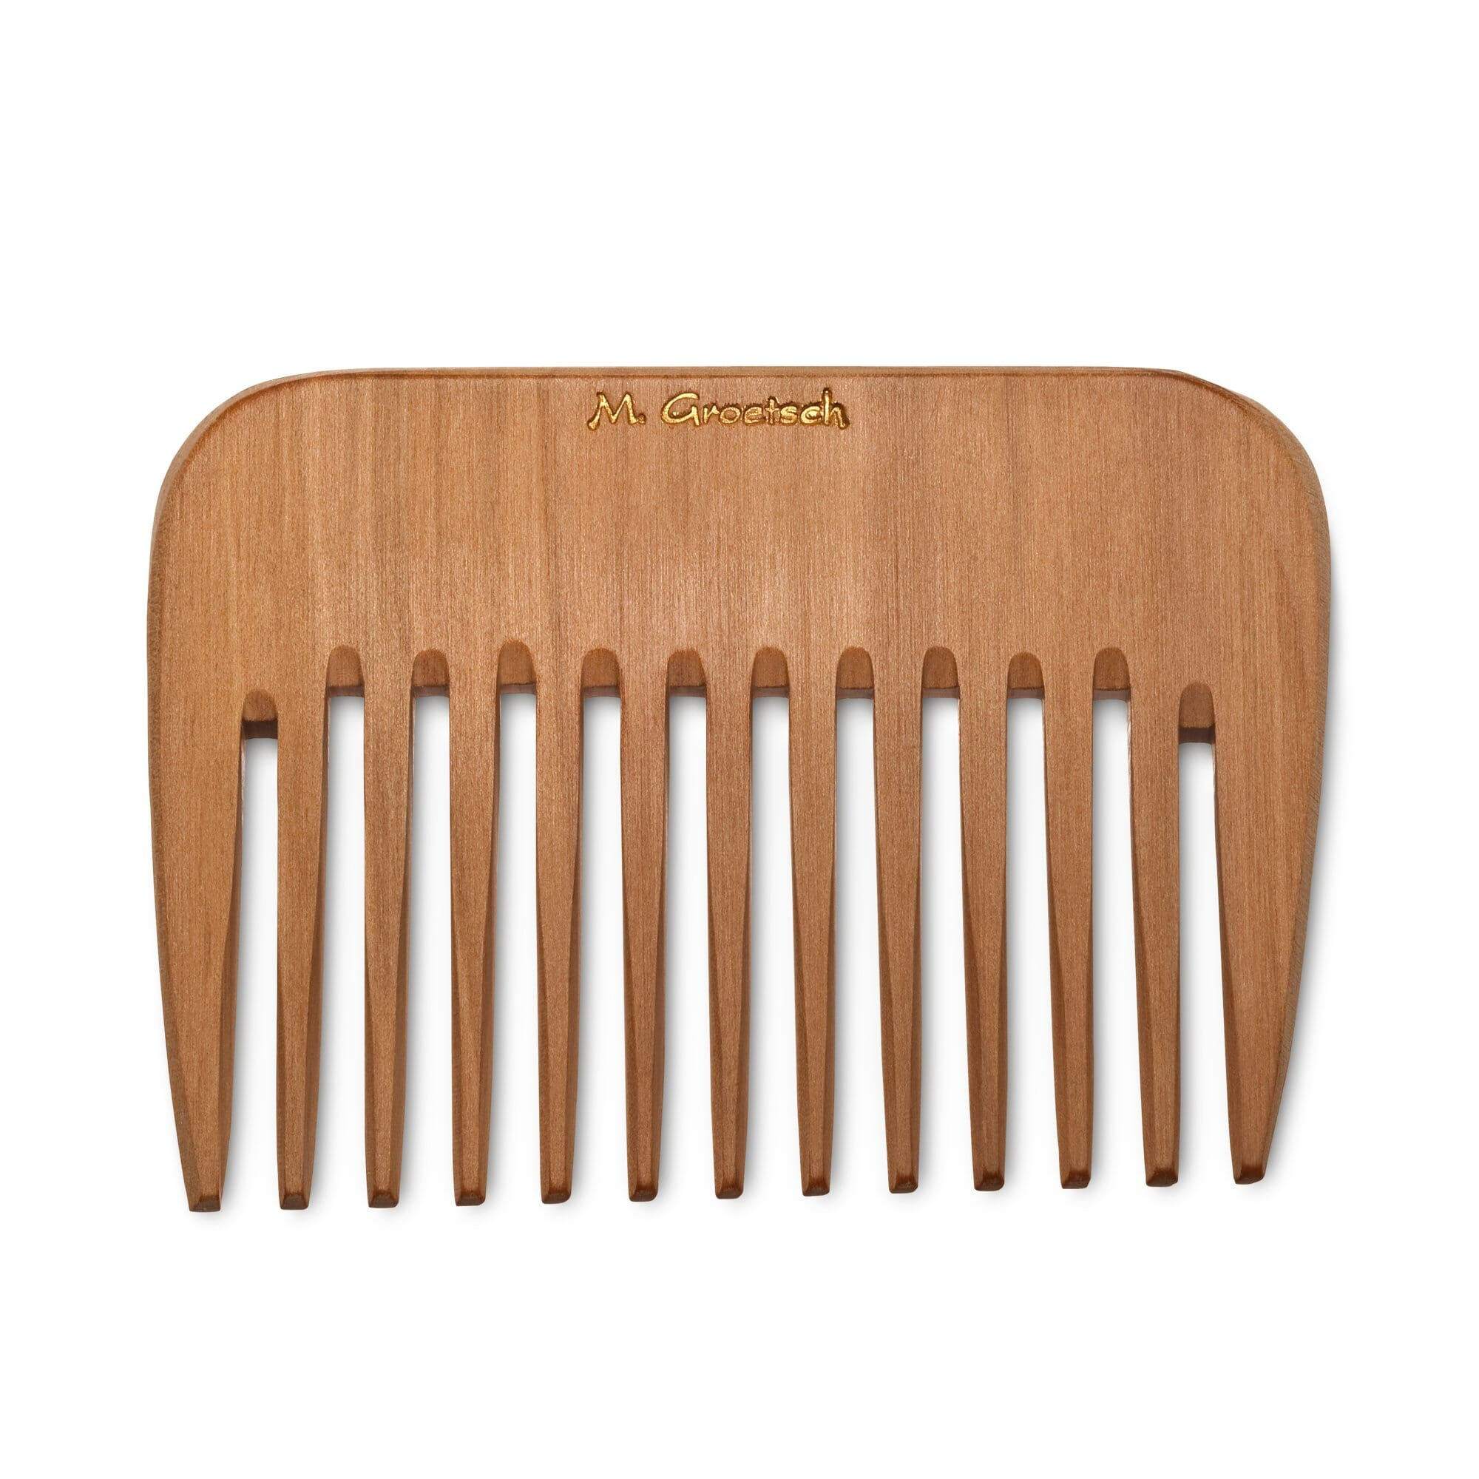
Source: manufactum.com

Slide 18


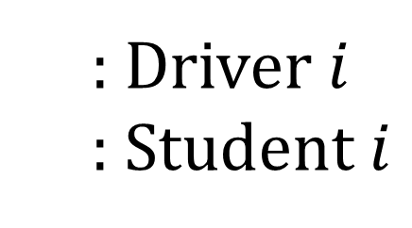


: Driver $i$
: Student $i$
$$D_{i}$$
2
$$i$$
3
6
1
5
7
4
$$D_{1}$$
$$D_{2}$$

Slide 19
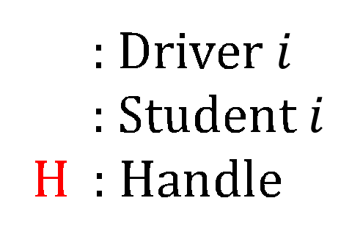
: Driver $i$
: Student $i$
H : Handle
$$D_{i}$$
2
$$i$$
3
6
1
5
7
4
$$D_{1}$$
H
$$D_{2}$$

Slide 20

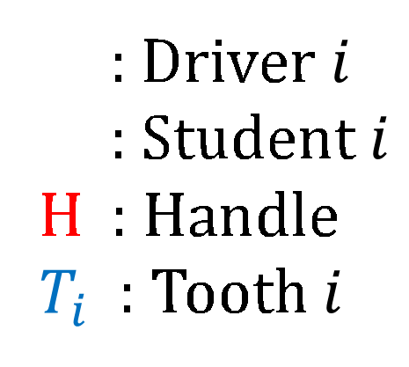


$$T_{1}$$
$$T_{2}$$
$$T_{3}$$
: Driver $i$
: Student $i$
H : Handle
$T_{i}$ : Tooth $i$
$$D_{i}$$
2
$$i$$
3
6
1
5
7
4
$$D_{1}$$
H
$$D_{2}$$

Slide 21

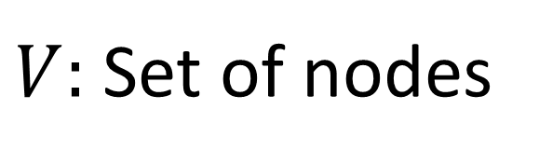
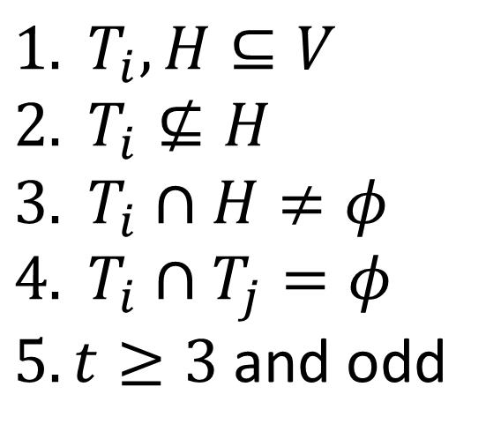
$V:$Set of nodes
$$T_{1}$$
$$T_{2}$$
$$T_{3}$$
: Driver $i$
: Student $i$
H : Handle
$T_{i}$ : Tooth $i$
$$D_{i}$$
$${1. T}_{i},H⊆V \\ 2. T_{i}⊈H \\ 3. T_{i}∩H≠φ \\ 4. T_{i}∩T_{j}=φ$$ $5. t≥3$ and odd
2
$$i$$
3
6
1
5
7
4
$$D_{1}$$
H
$$D_{2}$$

Slide 22

$V:$Set of nodes
$$T_{1}$$
$$T_{2}$$
: Driver $i$
: Student $i$
H : Handle
$T_{i}$ : Tooth $i$
$$D_{i}$$
$$T_{3}$$
$${1. T}_{i},H⊆V \\ 2. T_{i}⊈H \\ 3. T_{i}∩H≠φ \\ 4. T_{i}∩T_{j}=φ$$ $5. t≥3$ and odd
2
$$i$$
3
6
1
5
7
4
$$D_{1}$$
H
$$D_{2}$$

Slide 23

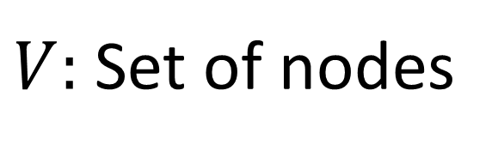




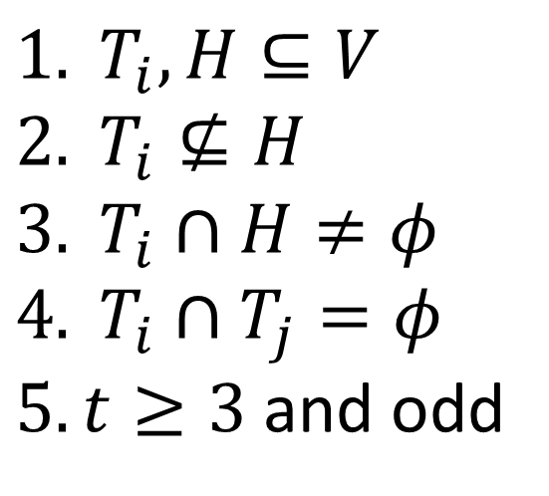
$V:$Set of nodes
: Driver $i$
: Student $i$
H : Handle
$T_{i}$ : Tooth $i$
$$D_{i}$$
$$T_{2}$$
2
3
$$i$$
$$T_{1}$$
1
H
$$D_{2}$$
4
$${1. T}_{i},H⊆V \\ 2. T_{i}⊈H \\ 3. T_{i}∩H≠φ \\ 4. T_{i}∩T_{j}=φ$$ $5. t≥3$ and odd
$$D_{1}$$
5
7
$$T_{3}$$
6

Slide 24
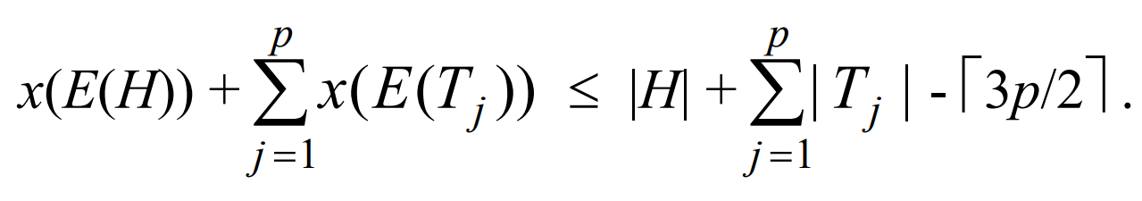
New constraint
t
t
t

Slide 25
Further Work
Apply Comb Inequalities from more general VRPs to our RVRP.
Create a Design of Experiments.
Compare the results with previous research solutions.

Slide 26
References
Caceres-Cruz, J., Arias, P., Guimarans, D., Riera, D., & Juan, A. A. (2014). Rich Vehicle Routing Problem: Survey. ACM Computing Surveys, 47(2). doi: http://dx.doi.org/10.1145/2666003
Doerner, K. F., & Schmid, V. (2010). Survey: Matheuristics for Rich Vehicle Routing Problems. University of Viena, 206–221.
Lahyani, R., Coelho, L. C., & Renaud, J. (2017). Alternative formulations and improved bounds for the multi-depot fleet size and mix vehicle routing problem. OR Spectrum, 40(2018), 125–157. doi: https://doi.org/10.1007/s00291-017-0494-y
Cornuejols, G., & Harche, F. (1993). Polyhedral study of the capacitated vehicle routing problem. Mathematical Programming, 60(1), 21–52.

Slide 27
Comb Inequalities in a Rich Vehicle Routing Problem Practice Research 2
Source: mempraph
Simón Álvarez Ospina – EAFIT
Alejandro Arenas – EAFIT
Juan Carlos RIVERA – EAFIT
Maria Gulnara Baldoquin – EAFIT

