Slide 1
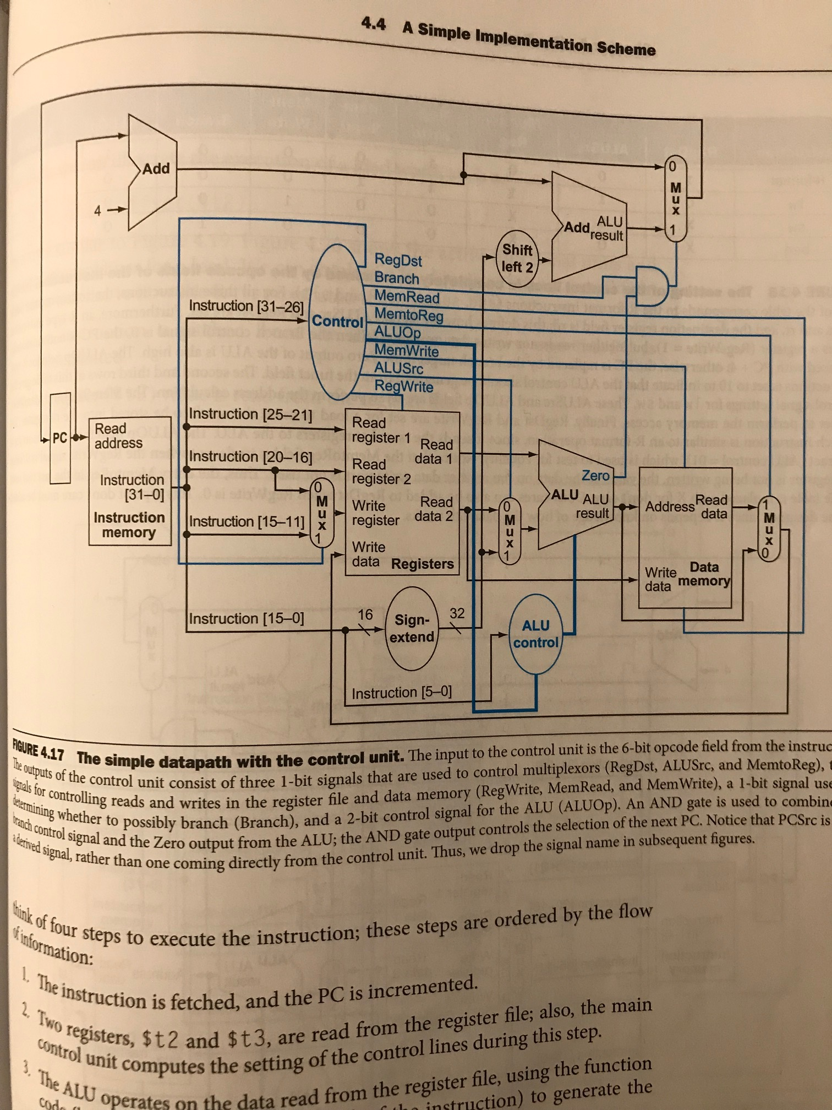
Add_1_out
Add_1_out
branch_mux_out
Add_2_out
branch_mux_sel
Alu_zero
Read_data_1
Read_data_2
Data_mem_out
Pc_out
Alu_result
Ins_mem_out
Mux_write_reg
Mux_read_reg
z
Ext_out

Slide 2
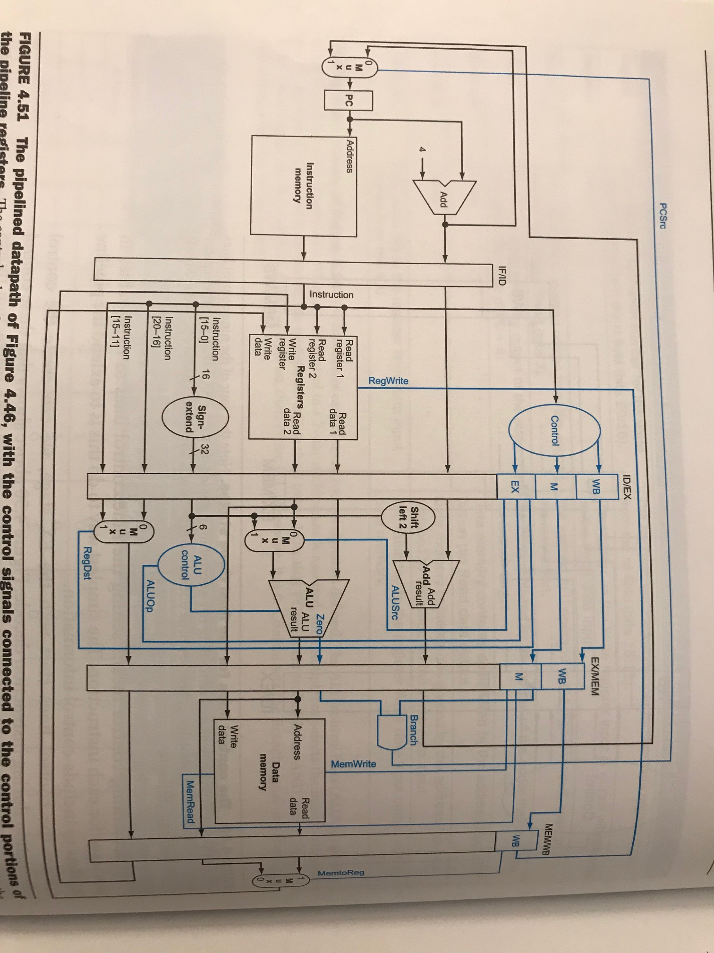
if_id_reg
id_ex_reg
ex_mem_reg
mem_wb_reg
Add_2_out
Ins_mem_out
Add_1_out
Add_2_out
Add_1_out
Add_1_out
Add_2_out
Read_data_1
Read_data_1
Data_mem_out
Pc_out
Read_data_2
z
branch_mux_out
Alu_zero
Alu_result
Ins_mem_out
Alu_result
Mux_read_reg
Mux_write_reg
z
Ins_mem_out[n:m]
ext_out
Mux_write_reg
Mux_write_reg

