Slide 1
Analytical Framework - Taxonomy
Organize the analysis into logical components that can be evaluated quantitatively and assigned a value.
Term Definitions:
We define “consumer willing to purchase” as ….. It includes factors such as....
Prime opportunities for UK MSB Exports
Environment supports transaction
Willing & capable purchaser
Willing & capable supplier
Demand Potential
(individual / aggregate / value chain)
Market Contestability
(financial / regulatory)
Supply Potential
(goods / services)
Consumer willing to purchase
Consumer capable of purchasing
Market barriers
Market structure
Supplier willing to sell
X
Supplier capable of selling
X
Existing market
- volume
- value
Potential market
- UK non-
participation
- Favorable
preconditions
Consumer characteristics
- financial
- human
- social
- cultural
- behavioral
Exposure to & knowledge of product
Fiscal Factors
Size & growth
Concentration ratio
Institutional and infrastructural character
Policy transparency, automaticity, simplicity
Existing products /services
- Quality
- Complementarity
- Substitutability
- Price sensitivity
Anti-export bias (home-market protection)
Existing distribution network
Domestic competition
Market knowledge
Export experience
Supplier characteristics
- financial
- human
- social
- cultural
- behavioral
Cost of production
Productivity
Excess capacity
Innovation
Tariffs
Taxes
Duties
Financing
Exchange rates
Subsidies
Non-fiscal Factors
Regulatory requirements
Quotas / bans
Product standards
Litigation potential
Rules of Origin

Slide 2
Advantages of an ecosystem approach to improving UK SME exports
Big data analytics allow us to make more nuanced assessments of market opportunities
00
Economical & efficient – takes advantage of existing data to inform decision-making.
Complementary & comprehensive – improves efficiency of site visits and local data collection; provides information for use in identifying new exporters and determining which services are required to overcome barriers.
Rigorous – moves beyond anecdotal information (The plural of “anecdote” is not “data”). Produces assessments in quantitative terms, expected ROI at various confidence levels.
Predictive – provides a predictive capability for emerging markets, both in identifying new locations and changes in current markets.

Slide 3
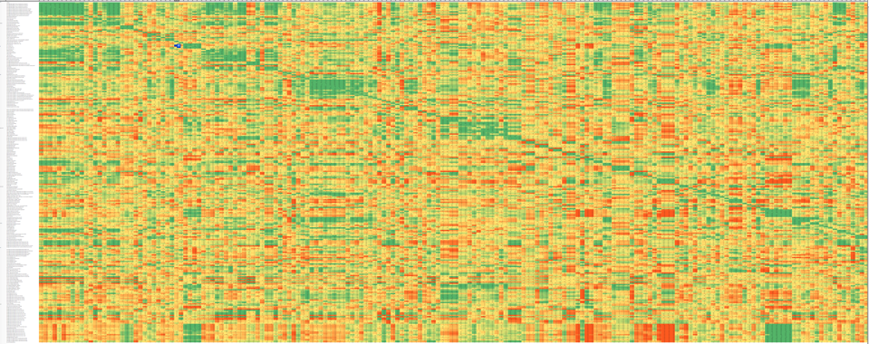
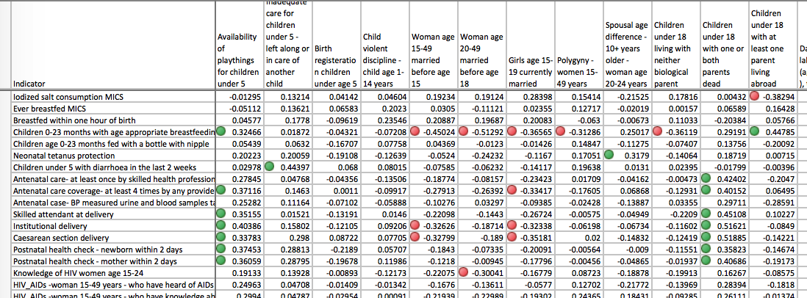
Applying Big Data to Improving UK SME Exports
Strategies can now be optimized for each market’s specific economic and sociocultural landscape
3
Every market has a complex mosaic of characteristics derived from the populations demographics, environmental resources, geographical location, ethnic history, wealth, dialects, income-producing activities, religious sects, access to markets, educational levels, etc.
We consider ALL data to have value. While datasets may be of varying quality and completeness, each has the potential of carrying information that reflects a characteristic of a population, either by itself or, more commonly, through combination with other datasets.
Big data analytics provides a predictive capability that allows us to identify prime opportunities in both current and emerging markets, and to optimize export for each economic and sociocultural landscape. In addition to traditional economic data sources of national trade data, The World Bank, World Trade Organization, etc., we capture and integrate non-traditional data ranging from demographic household data, sociocultural measures, and behavioral data, to infrastructure, transparency, and governance.

Slide 4

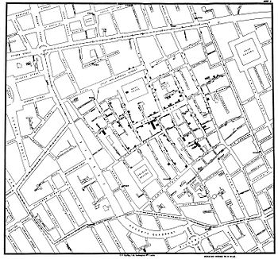


‘Big Data’ Approaches
There are many forms of ‘big data’ (e.g. volume, variety, velocity, veracity, etc.)
4
Weak Signal Analysis
While datasets may be of varying quality and completeness, each has the potential of carrying critical information, either by itself or, more commonly, through combination with other datasets.
Adapting Signal processing methodologies originally developed for such applications as the detection of foreign submarines and clandestine underground nuclear weapons tests, we are able to detect and amplify the “signals” crucial for decision-making among the traditional noise of big data.
Ecosystem Approach
The third cholera pandemic (1852-1860), that resulted in over 1 million deaths, reached London in 1853. Nobody knew what caused cholera.
John Snow took an ecosystem approach. He started analyzing non-traditional data – where people lived, where they worked, etc. His analysis lead him to realize that part of the ecosystem that hosted cholera included the water pump on Broad Street.
In this example, weak signal analysis is used to enhance an image of Saturn. The first image was created by a single picture. The fuzziness is caused by vibrations of the telescope, atmospheric conditions and other variables. The second image was created by ‘stacking’ multiple pictures. When multiple images are “stacked”, the fuzziness, which is caused by random processes gets cancelled out, while the signal remains consistent. As a result, the combination of images is better then the quality of any single image and new features can be seen.
By “stacking” large amounts of data about the multitude of social, environmental, economic, legislative, and financial variables that create a successful and sustainable business, we can identify optimal opportunities for UK SME exports that are not apparent through any other methodology.
He did a chemical and microscopic analysis of the water, but did not uncover any direct evidence. Nevertheless, he had the pump handle removed and successfully ended the cholera epidemic.
While direct data on potential SME export markets are time-consuming and and expensive to obtain, large amounts of indirect data already exist and remain largely untapped. By characterizing the ecosystem supportive of successful UK SME exports, we can predict the ROI in quantitative, probabilistic terms. In addition, we can identify changing markets or emerging markets where UK SME’s can preposition to gain market share.
Notes:
File: WCPFC_Catch
Tab: Species_timeseries
(only data behind graphs)

Slide 5
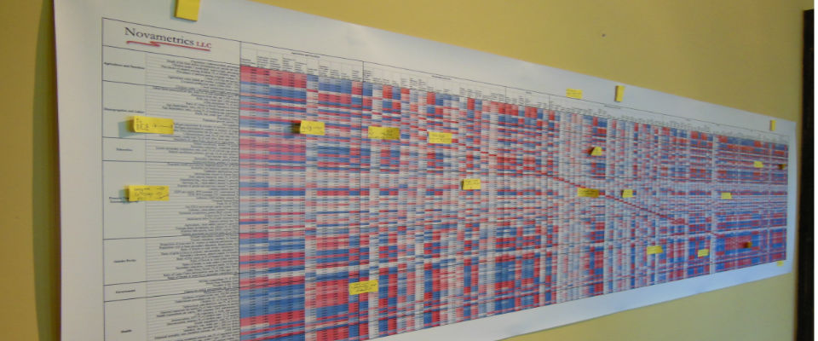
Identifying Prime Opportunities for UK SME Exports
Opportunities can now be optimized for each specific sociocultural and economic landscape
5
We then correlate variables against prevalence of successful outcomes to determine relative weightings by market and sector.
Using a vast array of data sources, we collect hundreds to thousands of indicators (direct and indirect measures) for each market.
Data are normalized, standardized, vectorized and run through statistical analysis for authentication and quality control.
Initial data analysis is reviewed with Subject Matter Experts to confirm all minimum essential requirements are met.
Implementing various Factor Analysis methodologies, we determine the dimensions of the data that account for the variance, and the indicators that are representative within the dimensions.
Variability and weighting, we determine coefficients for each indicator that represent its contribution to outcomes (positive or negative). We weight and combine the coefficient by the determined (scaled) value of each indicator to derive a composite score by product and market.
We check analysis by blind hind-casting to determine confidence levels of predictions and to improve modeling. Example of predictive capability and success rate is included in appendix slides.
Notes:
File: WCPFC_Catch
Tab: Species_timeseries
(only data behind graphs)

