Slide 1
Vivarium Intervention Effect Size Methodology: Breastfeeding Promotion
Zane Rankin
12/10/2018

Slide 2
Outline
Breastfeeding Promotion Model & Results
Breastfeeding Promotion Efficacy Analysis

Slide 3
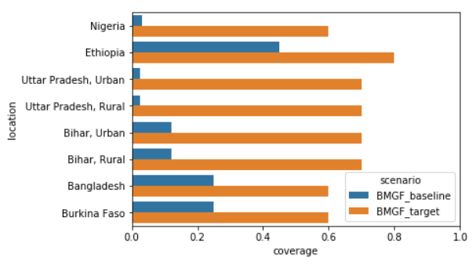
Breastfeeding Promotion (BFP)
BMGF interest: If BMGF programs increase BFP coverage from A to B from 2015-2020, how many lives are saved?
Intervention protocol isn’t clear
The best BFP evidence is on individual counseling through multiple pre- and postnatal sessions

Slide 4
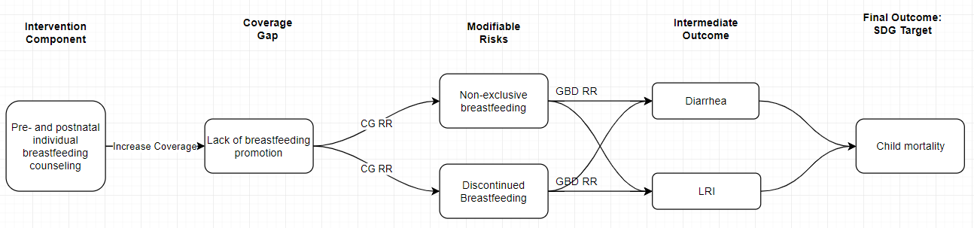
Vivarium Breastfeeding Promotion Model

Slide 5
Breastfeeding Promotion Model
Open cohort
Ages 0-5
n=10,000 at start
Fertility: crude birth rate
100 draws
2015-2020
Counterfactual analysis: compare 2020 risk exposure and disease rates under two scenarios:
Scale-up to BMGF targets
Continued baseline coverage

Slide 6
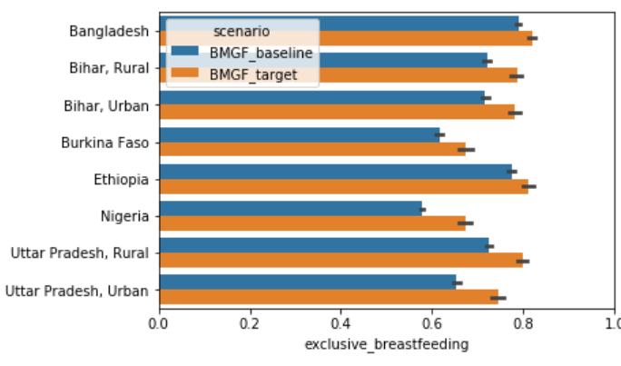
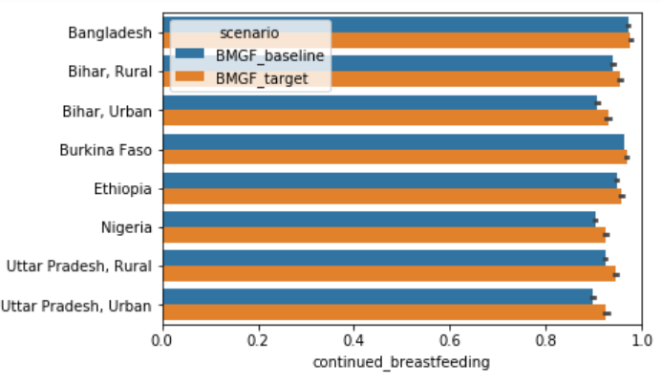
2020 population risk exposure in baseline and intervention
Vivarium’s use of common random numbers allows us to assess effect size isolating input uncertainty from stochastic uncertainty

Slide 7
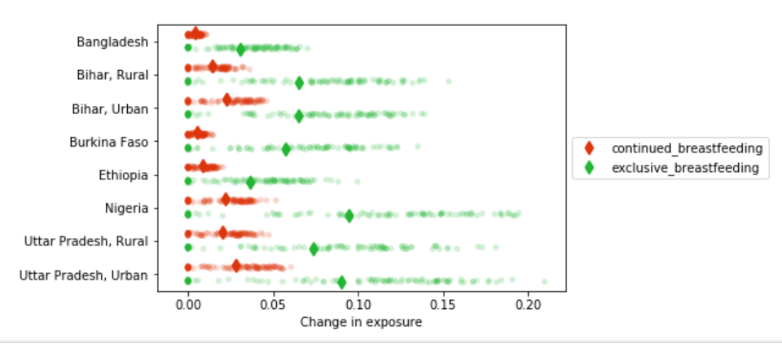
Draw-level comparison

Slide 8
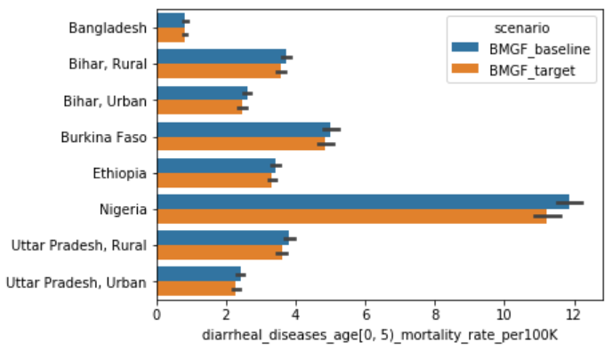
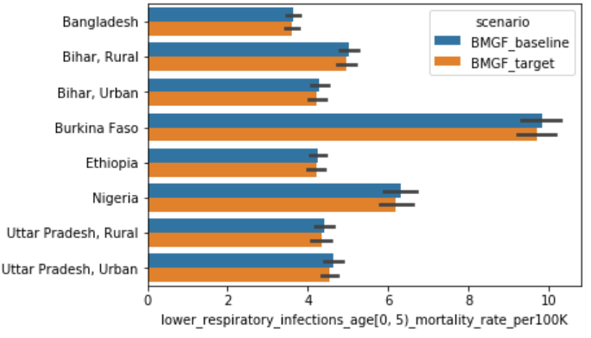
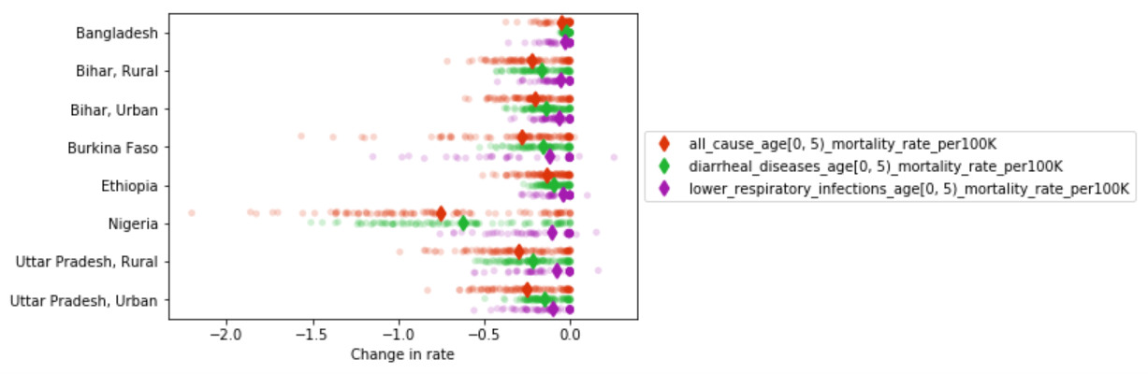

Slide 9
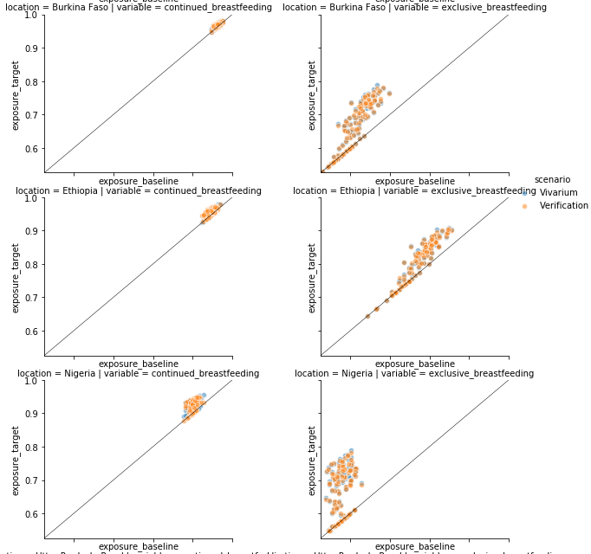
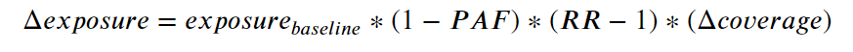
Verification of exposure

Slide 10
BFP Efficacy Analysis
Primary Source Selection
Reviewed the 45 sources from Sinha 2017 (LiST meta-analysis) on Breastfeeding Promotion effect on exclusive breastfeeding
Inclusion criteria: RCTs with ≥ 4 individual counseling visits
14 sources fit inclusion criteria and were extracted

Slide 11

Exemplar study
Control group: standard of care
Intervention: One antenatal breastfeeding peer counselling visit and four post-delivery visits by trained peers.
All mothers were offered at least five visits, starting with a visit in the third trimester. In Burkina Faso, mothers were scheduled to have home visits during the first week postnatally, and thereafter at weeks 2, 4, 8, 16, and 20. In Uganda and South Africa, home visits were scheduled within the first week and thereafter at weeks 4, 7, and 10.

Slide 12
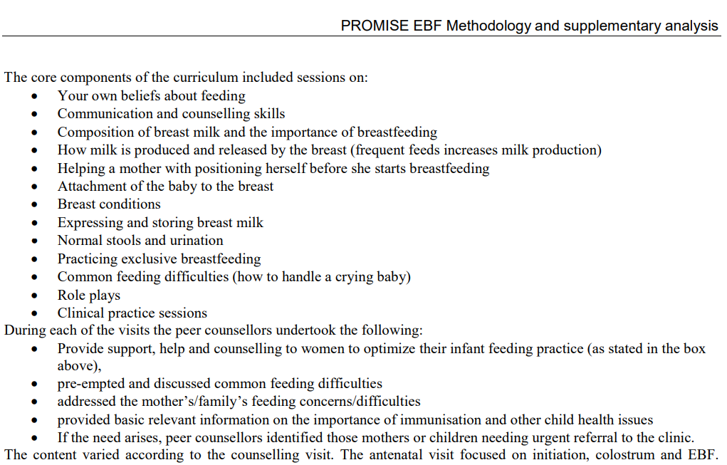

Slide 13
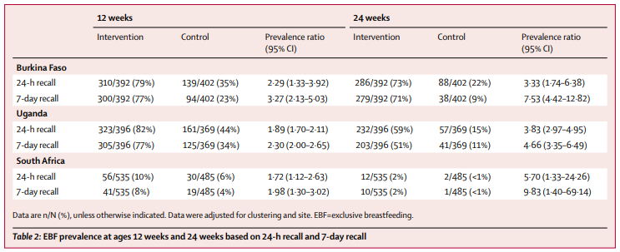
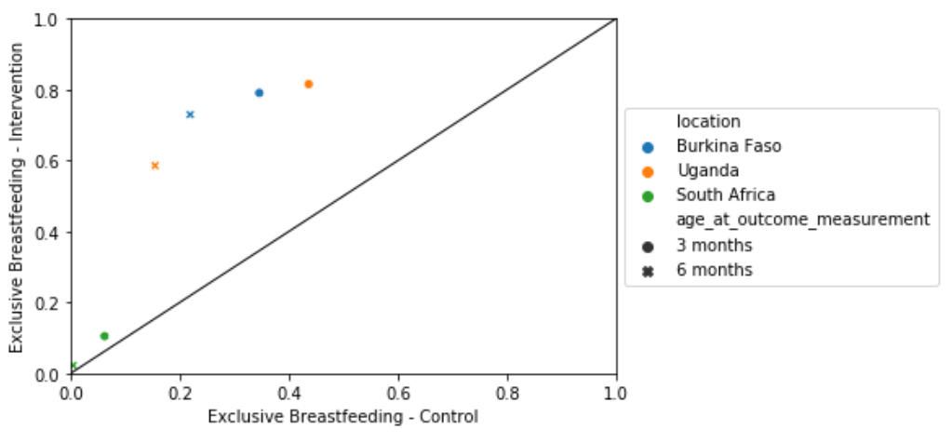

Slide 14
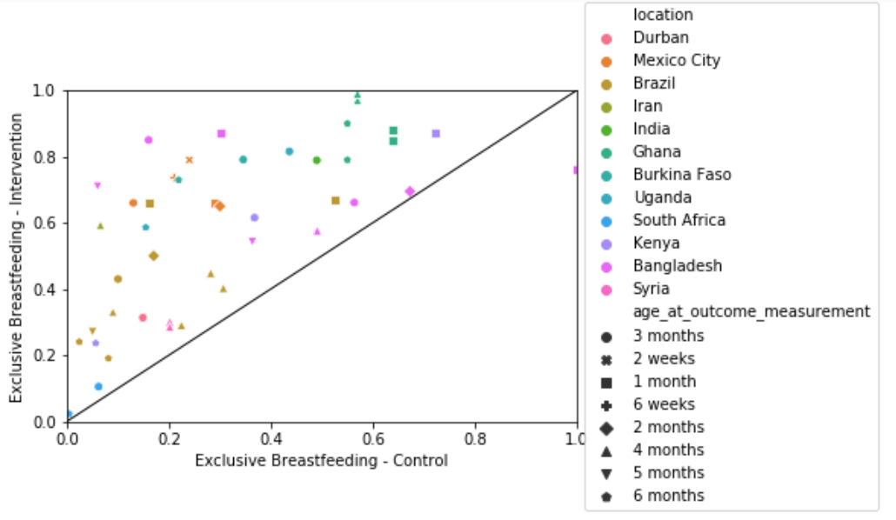
Breastfeeding Promotion RCT data

Slide 15
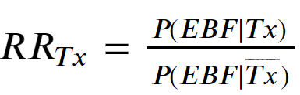
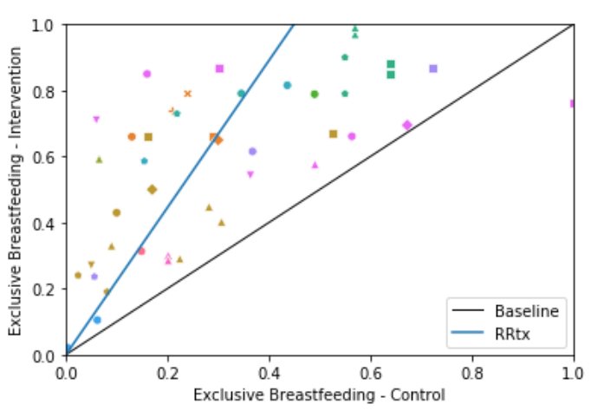
Treatment Relative Risk

Slide 16
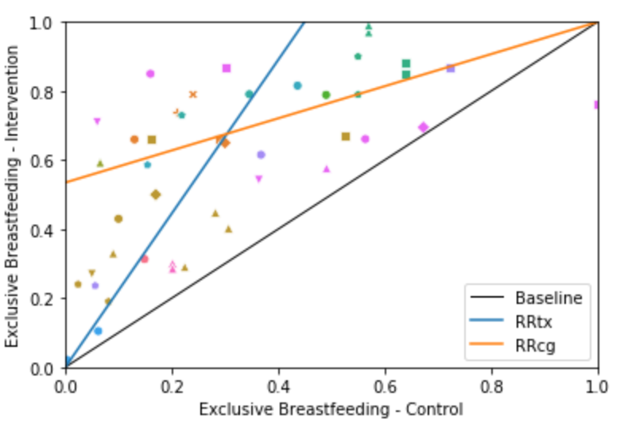

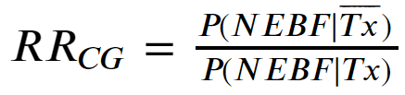


Coverage Gap Relative Risk

Slide 17
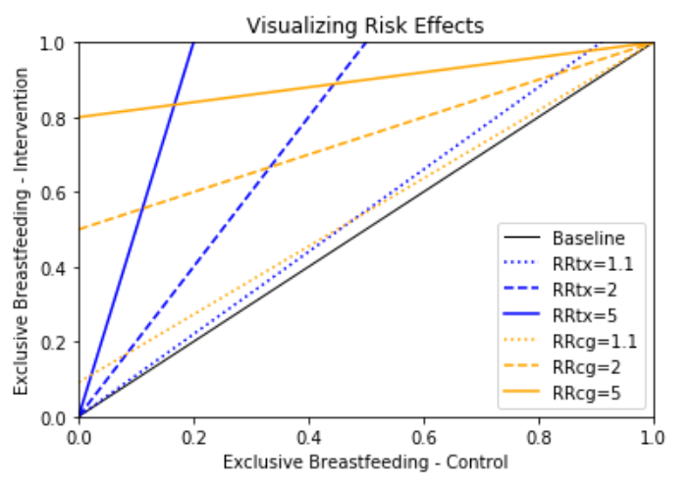
Treatment and Coverage Gap RRs - Logic
RR = 2
Treatment RR: those treated are twice as likely to exclusively breastfeed
Coverage gap RR: those treated are half as likely to be exposed to non-exclusive breastfeeding risk

Slide 18
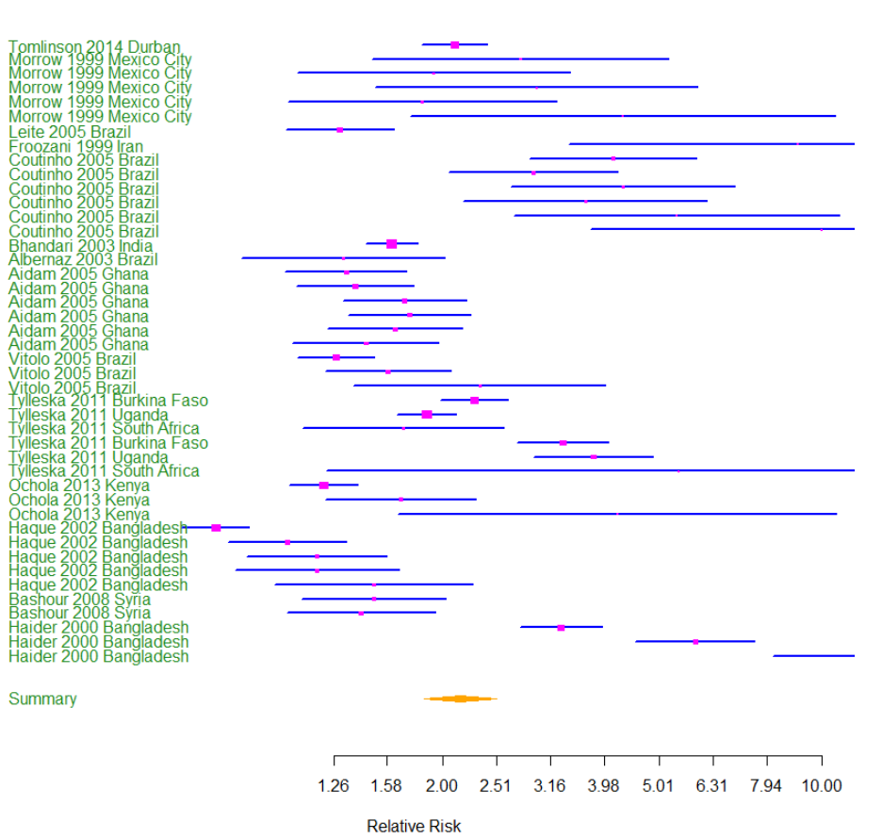
Meta-analysis
Random effects meta-analysis
RR 2.12 (1.84-2.51)

Slide 19
Heterogeneity
Dimensions
Intensity of intervention (e.g. number of visits)
Intensity of standard of care
Provider type
Age at outcome
Does a meta-regression approach help us answer the BMGF question?
If BMGF programs increase BFP coverage from A to B from 2015-2020, how many lives are saved?

Slide 20
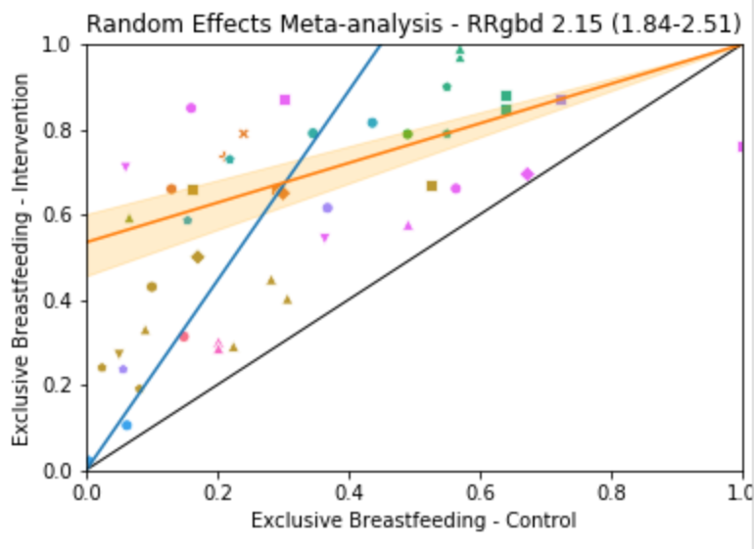
Coverage Gap RR Meta-analysis

Slide 21
Limitations
Non-adjustable intervention intensity
Little to no evidence on individual counseling effect on continued breastfeeding, we’re using the same RR as non-exclusive BF
We don’t (yet) have delivery mechanisms, risk correlations, or other model features that highlight the microsimulation approach
Further discussion needed with BMGF to understand the composition of their programs, and data behind their coverage estimates

Slide 23
Extra Slides

Slide 24
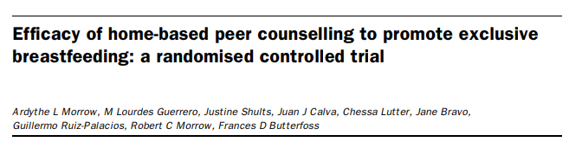
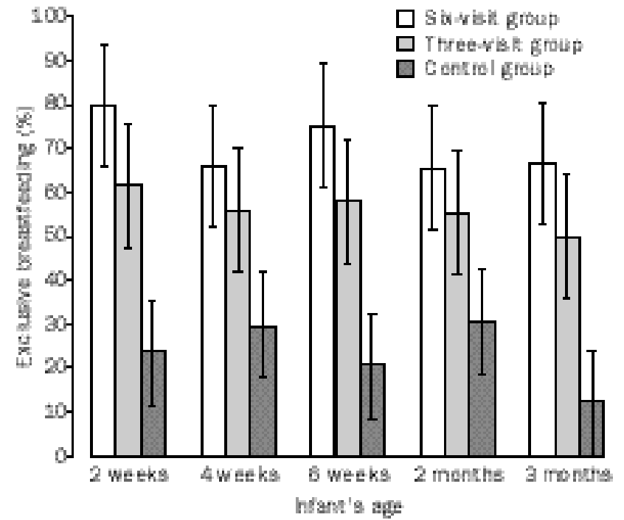
Intervention intensity
Mother-infant pairs in the intervention groups received either six or three home visits from peer counsellors. In the six-visit group, mothers were visited in mid and late pregnancy, in the first week and weeks 2, 4, and 8 post partum. In the three-visit intervention group, mothers were visited in late pregnancy, in the first week, and week 2 post partum.

Slide 25
Coverage Gaps
Coverage Gaps are Vivarium’s mechanism to make interventions fit within the risk factor framework
Example:
Intervention: breastfeeding promotion
Coverage gap: lack of breastfeeding promotion
Exposure = 1 – intervention coverage

Slide 26



Treatment and Coverage Gap RRs
Relative risk: ratio of the probability of an outcome in an exposed group to the probability of an outcome in an unexposed group
Treatment RR (generally what’s reported by RCTs)
Exposure: the treatment
Outcome: exclusive breastfeeding
Coverage gap RR (Vivarium implementation)
Exposure: lack of the treatment
Outcome: non-exclusive breastfeeding

Slide 27
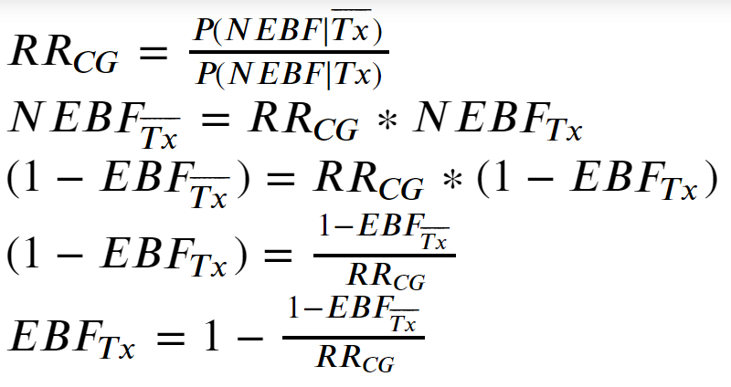
Derivation of EBF given RRcg

Slide 28
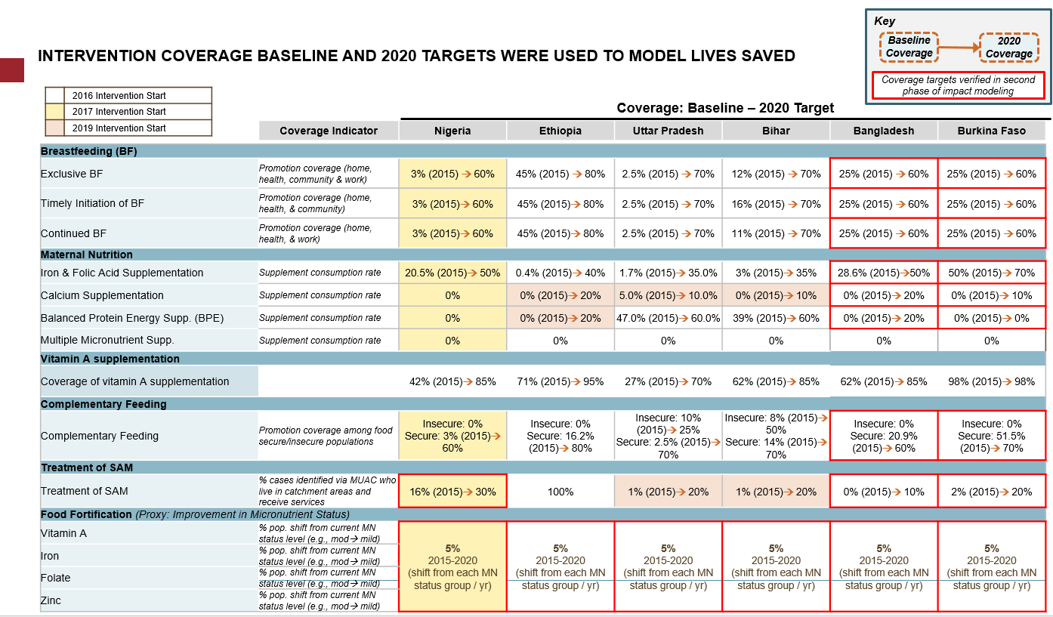

Slide 29
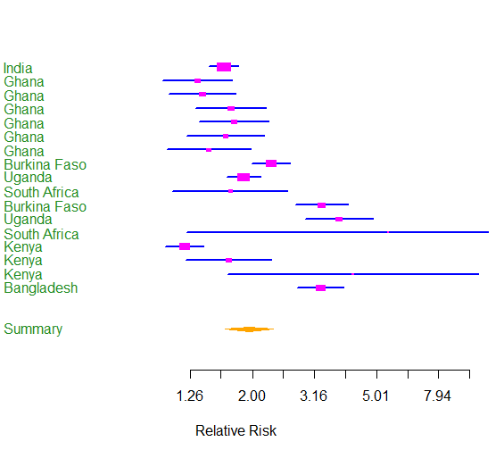
Meta-analysis
Random Effects Meta-analysis
Subset to SSA and two important trials in India and Bangladesh
Random effects meta-analysis
1.95 (1.63 – 2.33)

Slide 30
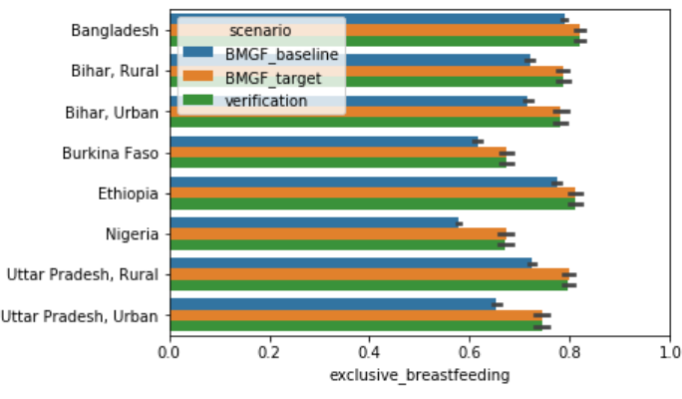
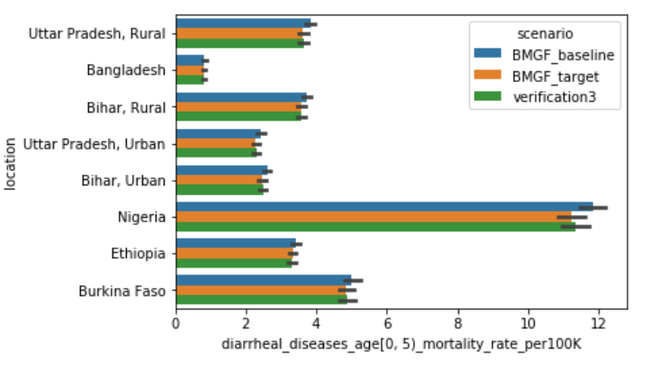
Verification of exposure using RRcg
Verification: using change in exposure and NEBF PAF estimate

Slide 31
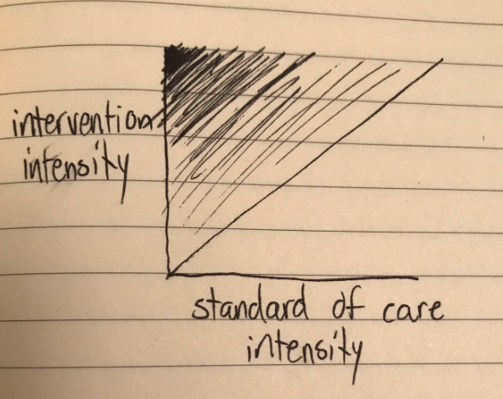

Slide 33
Extra Slides: Vivarium Implementation of Coverage Gaps

Slide 34

Coverage Gap Implementation in Vivarium
Exposure_parameter: the probability that a simulant will be exposed to the risk factor (to be precise, if their propensity is < exposure_parameter, they are exposed to the coverage gap)
Do you understand why exposure_parameter of exposed to a coverage gap is analogous to the following formulation?

Slide 35

Coverage Gap Implementation in Vivarium
Goal: extrapolate the effect size from study populations to a population of interest
Interpretation:
Exposure_parameter: the probability that a simulant will be exposed to the risk factor (to be precise, if their propensity is < exposure_parameter, they are exposed to the coverage gap)
If RR=2, a simulant is twice as likely to be exposed to the risk factor if they are exposed to the coverage gap.
Study population (e.g. RCT)
Population of interest (Vivarium)
Assumptions

Slide 36
Coverage Gap Implementation in Vivarium
Goal: extrapolate the effect size from study populations to a population of interest
Interpretation:
Exposure_parameter: the probability that a simulant will be exposed to the risk factor (to be precise, if their propensity is < exposure_parameter, they are exposed to the coverage gap)
If RR=2, a simulant is twice as likely to be exposed to the risk factor if they are exposed to the coverage gap.
Study population (e.g. RCT)
Population of interest (Vivarium)
Probability of exposure in counterfactual population with no coverage gap exposure
Note that if CGi = 1, this expression reduces to RRcg
Assumptions
Conditional probability of exposure in treatment group of the study population

Slide 37

Caveats
Assumes RR_tmrel = 1 (I’m not sure when this is violated)
As stated in the previous slide, the following extrapolation has several assumptions about how the population of interest matches the study population (e.g. from the RCT), including that there’s no correlation between risk exposure and treatment propensity
I don’t fully understand the implications of correlation.
I don’t fully understand how this approach compares to mediation (see later slide for details)

Slide 38
Implications of using coverage gap RRs
Treatment effect in the literature (and meta-analyses) report RRtx, NOT coverage gap RR.
If the outcome is a disease rate or risk (e.g. preterm birth or nutritional deficiency), you can convert using 1/RRtx
If the outcome is the lack of the risk (e.g. exclusive breastfeeding), we will likely need to use primary data
This is much more involved than it seems, as there is extreme heterogeneity in study design, etc. The numbers to extract are not always clear. It’s basically as much work as doing the whole meta-analysis over again minus the title/abstract screen.
I think it is possible to implement coverage gaps to properly use RRtx (basically, by reversing the direction of exposure_parameters), but I think the earlier plot shows the fallacy of RRtx for dichotomous outcomes.

Slide 39
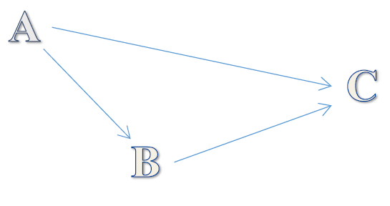
Meditation on Mediation
Disclaimer: these claims are my current understanding but are NOT verified with GBD experts
What is risk factor mediation?
If part of the effect of A is through B, a mediator, we do not adjust the effect of A for B. For example, we do not adjust the RR of BMI for cholesterol as cholesterol lies in the biological pathway between BMI and cardiovascular outcomes (GBD 2016 RF appendix)
(The only mediation of GBD risk factors is the metabolic RFs which are not relevant to CONIC)
Mediation is a tool for descriptive epidemiology to handle causal relationships without fully describing the causal relationship. For example, while sugar sweetened beverages (SSB) are fully mediated through BMI, that doesn’t say what the effect of SSB is on BMI.
Mediation as a way to aggregate PAFs up the risk hierarchy (ie, you can’t just add the PAFs of SSB and BMI)
The coverage gap framework can be thought of as handling mediation by explicitly describing the causal relationship, which is necessary for simulation modelling.
Other considerations for mediation:
To use a mediation approach, you would treat lack of BFP as a risk factor. That means you’d need the effect of BFP on the final outcome (e.g. diarrhea and LRI incidence), which would be rather hard to come by (and would likely not pass GBD causal criteria).
While mediation has the benefit of already being in the GBD framework (“coverage gaps” affecting risks is a novel concept), I think Vivarium needs the causal relationship not provided by mediation

Slide 42
OLD SLIDES TO DELETE

Slide 43
Coverage Gaps
Coverage Gaps are Vivarium’s mechanism to make interventions fit within the risk factor framework
Example:
Intervention: breastfeeding promotion
Coverage gap: lack of breastfeeding promotion
Exposure = 1 – intervention coverage

Slide 44
Treatment and Coverage Gap RRs
Relative risk: ratio of the probability of an outcome in an exposed group to the probability of an outcome in an unexposed group
We must be very precise with defining outcome & exposure

Slide 45
Treatment and Coverage Gap RRs
Relative risk: ratio of the probability of an outcome in an exposed group to the probability of an outcome in an unexposed group
Treatment RR (generally what’s reported by RCTs)
Exposure: the treatment
Outcome: desired behavior (ie, lack of risk)
Coverage gap RR (Vivarium implementation)
Exposure: lack of the treatment
Outcome: the GBD risk factor

Slide 46
Treatment and Coverage Gap RRs
Relative risk: ratio of the probability of an outcome in an exposed group to the probability of an outcome in an unexposed group
Treatment RR (generally what’s reported by RCTs)
Exposure: the treatment
Outcome: desired behavior (ie, lack of risk)
Coverage gap RR (Vivarium implementation)
Exposure: lack of the treatment
Outcome: the GBD risk factor

Slide 47
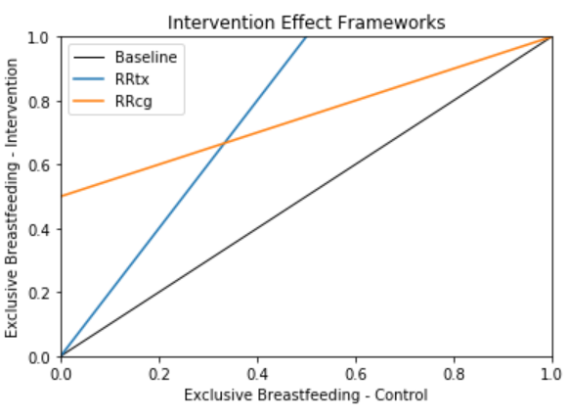
Treatment and Coverage Gap RRs - Logic
RR = 2
Treatment RR: those treated are twice as likely to exclusively breastfeed
Coverage gap RR: those treated are half as likely to be exposed to non-exclusive breastfeeding risk
Treatment RR
Exposure: the treatment
Outcome: desired behavior (ie, lack of risk)
Coverage gap RR
Exposure: lack of the treatment
Outcome: the risk factor

Slide 48
So how do we estimate Coverage Gap RR?
First, we look at published meta-analyses for the intervention
Key insight: Across interventions, the outcome reported in Relative Risk estimation is different

Slide 49
Treatment and Coverage Gap RRs – 3 situations
Situation
Example
Outcome is a rate
Rotavirus vaccination & diarrhea incidence
Outcome is the risk exposure
Iron supplementation & preterm birth
Outcome is absence of risk
Breastfeeding promotion & exclusive breastfeeding

Slide 50
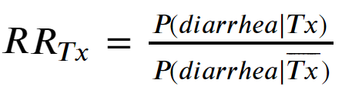
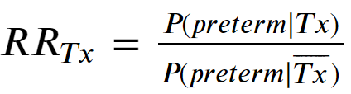
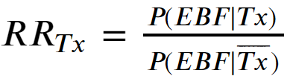
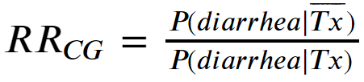

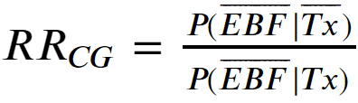

Treatment and Coverage Gap RRs – 3 situations
Situation
Example
RRtx formulation
RRcg formulation
Conversion
Outcome is a rate
Rotavirus vaccination & diarrhea incidence
Outcome is the risk exposure
Iron supplementation & preterm birth
Outcome is absence of risk
Breastfeeding promotion & exclusive breastfeeding
No summary measure conversion

Slide 51
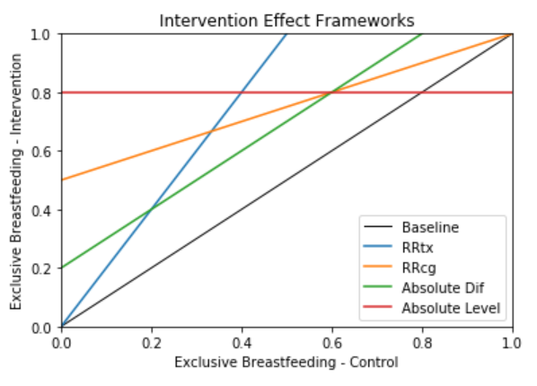
Breastfeeding Promotion Efficacy Data
As the treatment efficacy RR summary measure cannot be converted to coverage gap RR, we need to extract primary sources
This data may elucidate the proper risk effect framework

Slide 52
Primary Source Selection
Reviewed the 45 sources from Sinha 2017 (LiST meta-analysis) on Breastfeeding Promotion effect on exclusive breastfeeding
Inclusion criteria: RCTs with multiple visits of individual counseling
14 sources fit inclusion criteria and were extracted

Slide 53

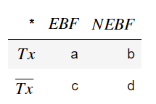


Data extraction

Slide 54
Meta-analysis
Random effects meta-analysis
RR 2.12 (1.84-2.51)

Slide 55
Meta-analysis
Random Effects Meta-analysis
Subset to SSA and two important trials in India and Bangladesh
Random effects meta-analysis
1.95 (1.63 – 2.33)

Slide 56
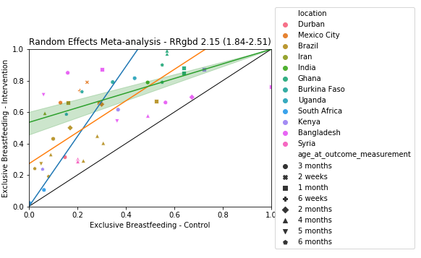

Slide 57
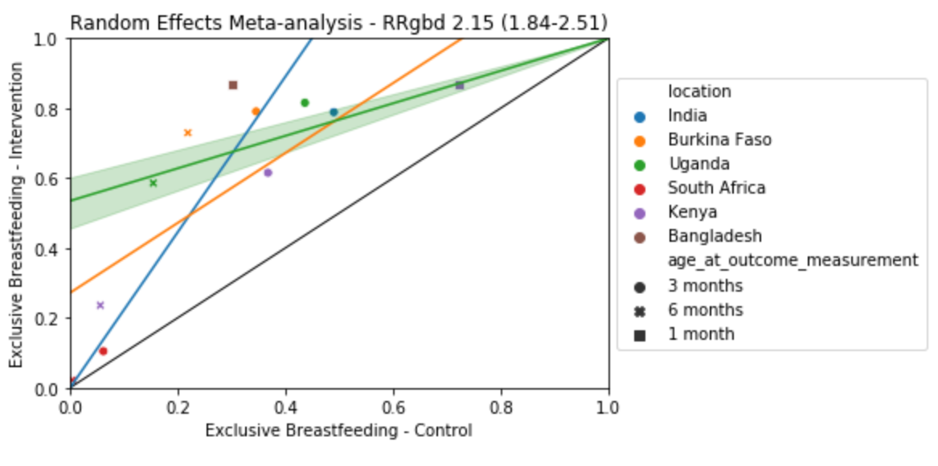

Slide 58
Limitations
Cannot really get important subgroups (healthcare worker vs peer, home vs facility, age at outcome) if we want this level of study design consistency
These studies only report non-exclusive breastfeeding. There are <10 citations for discontinued breastfeeding, and they don’t match our intervention (individual BF counseling)
For now, we will use the non-exclusive BF RR
Discontinued BF PAF is 5-10X smaller than non-exclusive BF

Slide 59
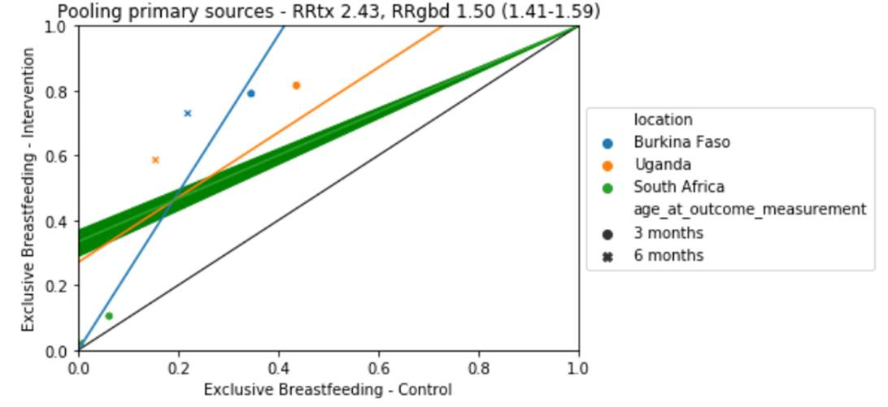

Slide 60
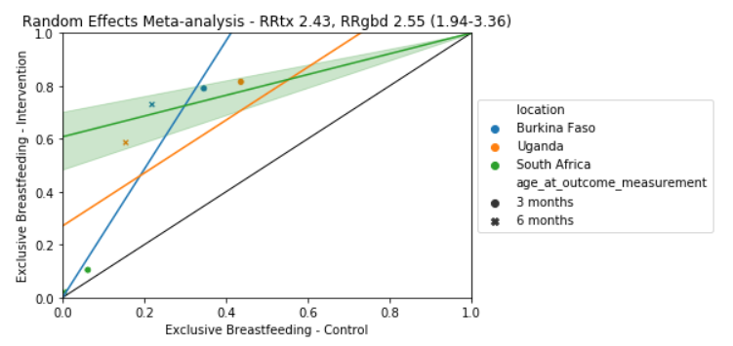
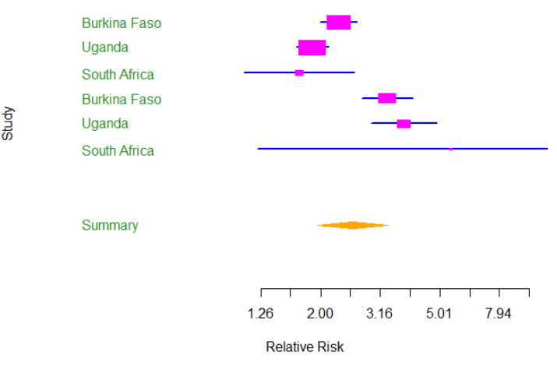

Slide 62
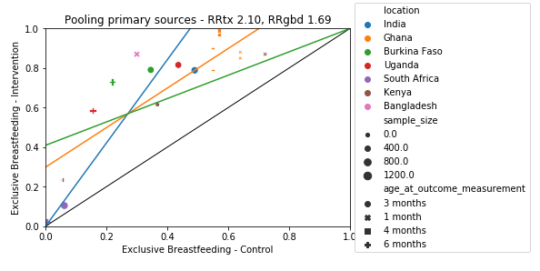

RRtx
Absolute dif
RRgbd

Slide 63
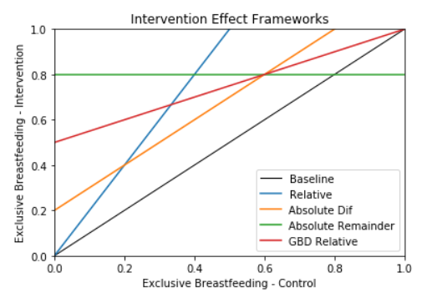
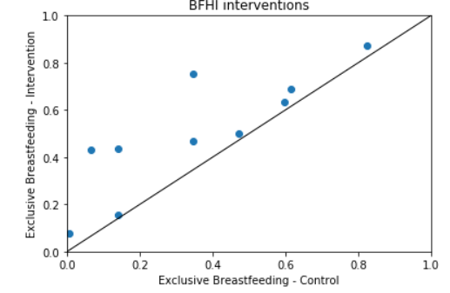
Which risk framework is appropriate?
We need to be careful how we account for study design heterogeneity!

Slide 64
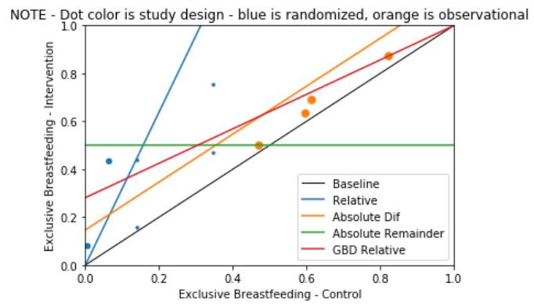
Baby Friendly Hospital Initiative Efficacy
BFHI sources (n=3) from Sinha 2017
Simple mean, NOT proper meta-analysis
Dot size is sample size
Dot color is study design
A meta-analysis would weight on sample size but not study design
There are many more studies for BFP counseling, if we are to do that

Slide 67
Intervention Protocol
Often, BMGF teams have specific protocols they want to estimate impact of, rather than our current approach of estimating baseline coverage.

Slide 69
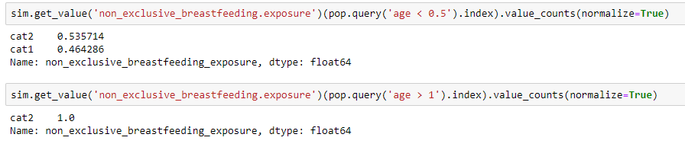
Breastfeeding Promotion in Nigeria
`MagicWandBFP` manually sets coverage level (to either a specified level, or ‘baseline’)
Allows comparison to either our estimates for baseline coverage, or an arbitrary counterfactual
`FinalExposureObserver` records exposure of categorical risks for specified categories for specified age groups in the final population table
Be careful!!!
Remember re-binning!
Exposures for ages outside the age range are inconsistent!

Slide 70
Interventions
To match the effect size and coverage of breastfeeding promotion, it was proposed we could either
Have a “step-down” of the trial efficacy to match the standard-of-care BFP
Crosswalk “coverage” to “effective coverage”, e.g. some proportion of ANC4/8
I propose we avoid that rabbit hole, and make simplifying assumptions for two (or more) interventions that match the meta-analysis effect sizes
Intensive interventions (e.g. 1:1 counseling, support groups) that are not standard of case – assume 0 coverage (sensitivity: use some fraction of ANC4/8)
Baby-friendly hospital initiative (BFHI) – the WHO has reported coverage (% of births in these facilities) that seem plausible, we could scale up to in-facility birth proportion

Slide 71
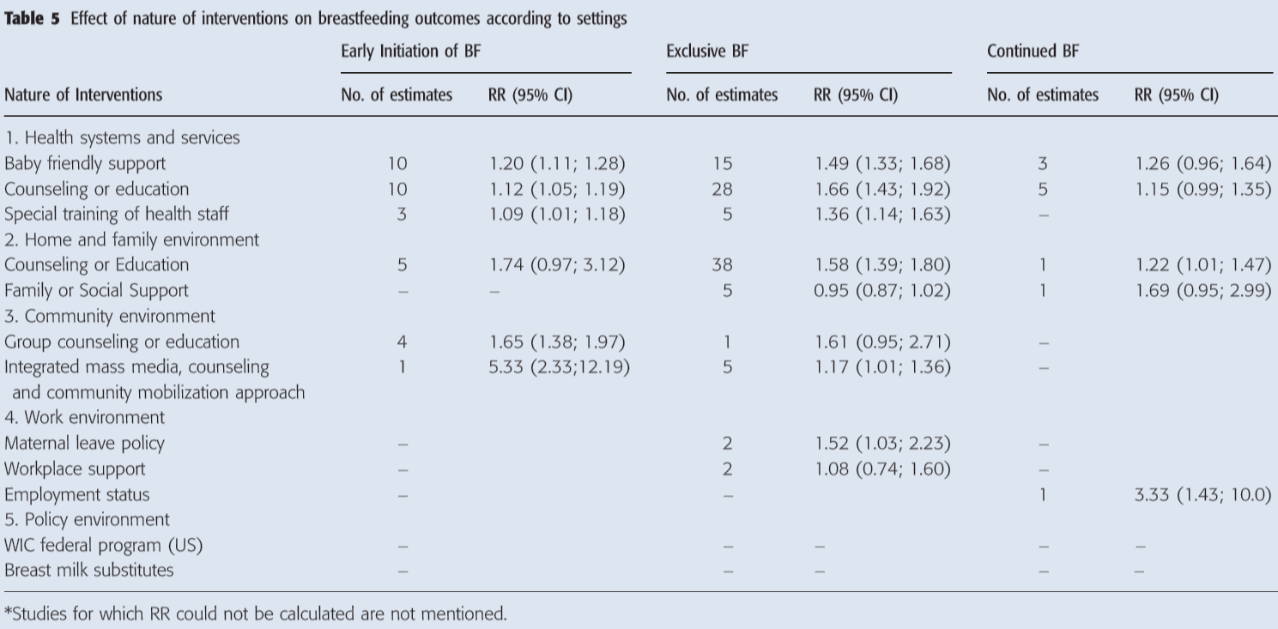

Slide 72
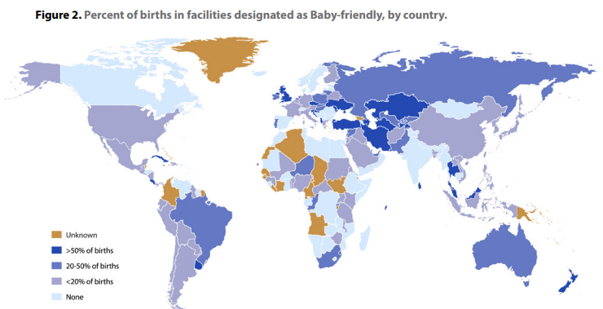
BFHI coverage

