Slide 1
CDM Group Project​
CDM Group Project
15 December 2022
Group 2: Cameron Appel, Kate Cheng, Emily Lui, David Ensor ​
Notes:
Hello,
Thank you for having us come to speak to you today.
We are group 2 and we are here to present our methods for data privacy sharing of data

Slide 2



Background
CDM Group Project
15 December 2022
Notes:
We have been asked by the CEO of I insure you 123 to review customer information database.
She would like to understand if she can increase the policy fee for customers with a particular gene variant gene DRD4 also known as the wunderlust gene.
Her hypothesis is that customers with this gene variant travel more - and consequently are at greater risk - than those that don’t have this variant.
She has asked her researchers to investigate the data and aid justification for this policy increase, but would like help from imperial university with analysis
she is also collaborating with the government on a larger insurance project and wants to share her data with the government.
so that it can be shared between a research group at Imperial and also with government and ensure that data privacy is maintained in the data sharing whilst allowing for sufficient granularity for data analysis.

Slide 3
CDM Group Project
15 December 2022
Aims for Researchers and Government Use of Data
Researcher​
Aim to explore relationship between DRD4 gene variant and propensity to travel​.
Exposure: DRD4 gene variant​
Outcome: Travel​
Data must be anonymised in order to protect customers privacy for data sharing​.
Government​
Aim to understand if people with this DRD4 gene variant have anything in common from an educational or geographical perspective. ​
Data would be publicly available.​
Notes:
The research group has different requirements

Slide 4
Concerns for Sharing Data: Legal Concerns
CDM Group Project
15 December 2022
The Data Protection Act 2018 (1) states that personal data must be:
"handled in a way that ensures appropriate security, including protection against unlawful or unauthorised processing, access, loss, destruction or damage"
"used for specified, explicit purposes"
"used in a way that is adequate, relevant and limited to only what is necessary"
"Controller"
"determines the purposes and means of the processing of personal data"
Must comply with the UK GDPR, which includes a set of responsibilities, regulations and incursion of data protection fees.
Notes:
Ref: Data Protection Act 2018, which is the UK's implementation of General Data Protection Regulation (GDPR)
https://www.legislation.gov.uk/ukpga/2018/12/contents/enacted
Under the data protection act the controller is the insurance company and determines the purpose and means of processing. It is the company repsonsibility

Slide 5
Concerns for Sharing Data: Privacy Concerns
CDM Group Project
15 December 2022
Aims | Concerns
Research
Requires granularity | Risk of identification of individuals Risk of exposing sensitive information
Control for possible confounders: requires more attributes in the dataset | Risk of exposing different types of sensitive data
Government
Data made public | Risk of identification

Slide 6
Anonymisation
CDM Group Project
15 December 2022
Information Commissioner's Office (2021) states that:
"...anonymous information is no longer ‘personal data’ and is not subject to data protection requirements."(2)
ICO defined anonymised data as:
"does not relate to an identified or identifiable individual; or
is rendered anonymous in such a way that individuals are not (or are no longer) identifiable." (2)
Notes:
GDPR sets out regulations on how personal data should be handled, and defined personal data as ‘any information relating to an identified or identifiable living individual’ , thus the ICO states that when data is anonymised in a way that individuals are not identifiable, then it is no longer personal data and is not subject to data protection requirements.
Ref: Introduction to Anonymisation draft guidance document

Slide 7
Definitions
CDM Group Project
15 December 2022
Direct identifier​
An attribute that can be used alone to identify an individual
Quasi-identifier​
An attribute that can be combined with other quasi-identifiers to identify an individual
Sensitive attributes
Sensitive information which cannot be used to directly identify an individual, but may cause harm to the individual if exposed
Notes:
To carry out anonymisation, we first categorised the variables in our dataset into 3 categories
Note: sometimes direct identifiers are called sensitive PII and Quasi-identifiers are called non-sensitive PII, these are not the same as the sensitive attributes we are talking about here.
Ref: k-ANONYMITY:A MODEL FOR PROTECTING PRIVACY LATANYA SWEENEY

Slide 8
CDM Group Project
15 December 2022
Direct identifiers
Given name, surname, phone number, national insurance number, bank account number
Quasi-identifiers
Gender, birthdate, education level, postcode, country of birth current country
Sensitive data
cc status, number of countries visited, blood group, weight, height, average number of drinks/cigarettes per week

Slide 9
Data Exploration
CDM Group Project
15 December 2022
 | Overall
n | 1000
Gender = M (%) | 50.1
Education level (%)
Primary | 6.1
Secondary | 45.8
Bachelor | 20.9
Masters | 11.2
PhD | 5.2
Other | 10.8
Current country = United Kingdom (%) | 100.0
cc status = 1 (%) | 4.7
Notes:
Then we looked at the distributions of variables in our dataset. We can see that gender is evenly distributed; we have 6 categories for education level; all customers are currently living in the UK and 4.7% of the customers have the gene.

Slide 10
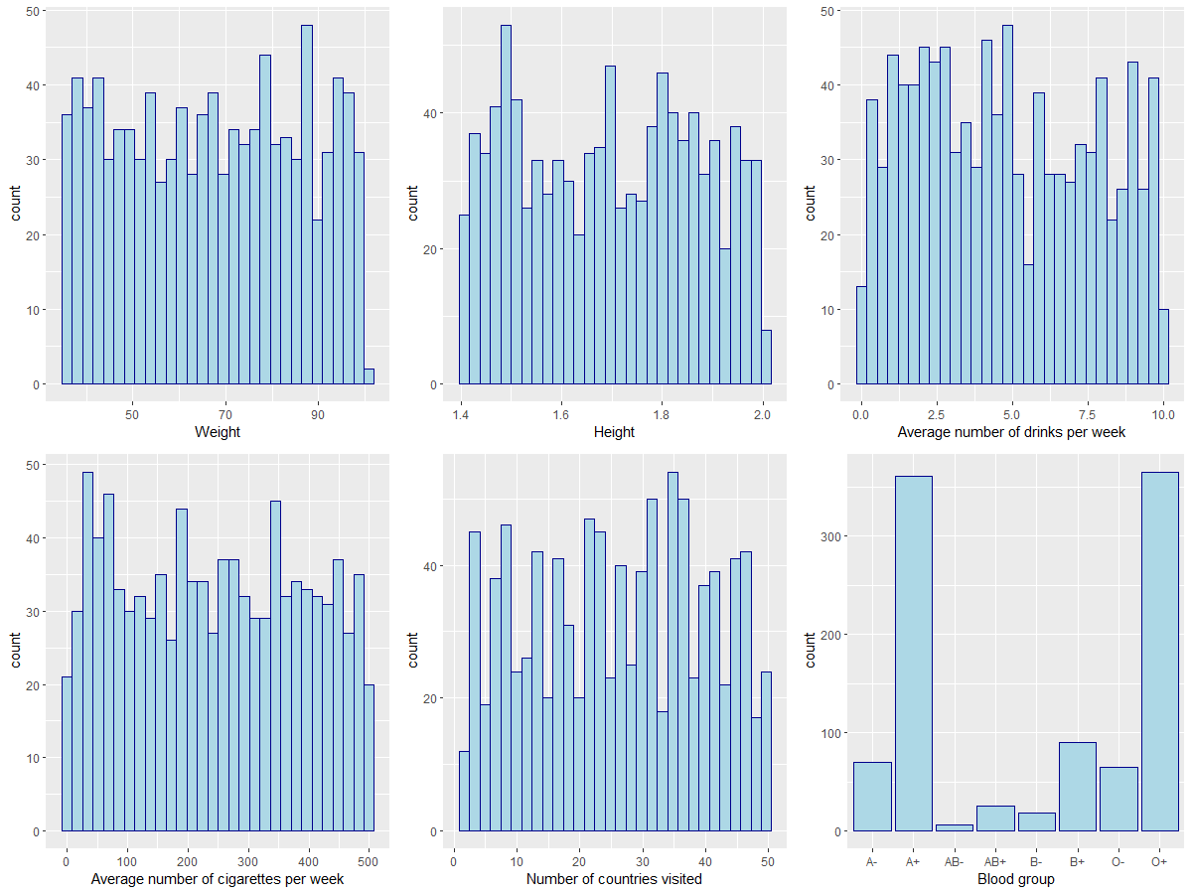
Data Exploration
Notes:
For the continuous variables, they are all uniformly distributed. And for blood group, we have 8 categories.

Slide 11
Method
CDM Group Project
15 December 2022
Direct identifiers
Removal of attribute
Generalisation
Banding​
Suppression​
Variable coded with random digits (Pseudonymisation)​
Standardization​
Issues: reduces quality of data​
Quasi-identifiers
Sensitive attributes
Notes:
After looking at our data, we decided on the following methods of anonymisation. We will remove the direct identifiers. We will apply banding, coding with random digits or standardisation for quasi-identifiers and sensitive attributes.

Slide 12
Researcher Data Set – Direct Identifiers
CDM Group Project
15 December 2022
Variable​ | Anonymisation method​ | Reasoning​
Given name​ | Removed​ Replaced with randomly generated unique identifier​ | Allow local re-identification after analysis​
Surname​
Phone number ​ | Removed​ | Not required for analysis​
National insurance number​
Bank account number​
Notes:
We decided to generate two different datasets for researchers and government collaborators. For the researchers, we removed the direct identifiers and replaced them with a randomly generated unique id which will allow us to re-identify customers after the analysis, if needed.

Slide 13
Researcher Data Set – Quasi-identifiers
CDM Group Project
15 December 2022
Variable​ | Anonymisation method​ | Reasoning​ | Details​
Gender​ | Coded | ​Cannot generalise further | F[0], M[1]
Birthdate​ | Convert to age Banding​ | ​Reduce identifiability | 4 categories by quartiles​
Education level ​ | Banding​ Coded | ​Reduce identifiability | 3 categories​: School [b], College [a], Other [c]
Postcode​ | Remove​d | ​Not required for analysis | ​
Country of birth​ | Generalised to continent Remove​d | No longer meaningful​ for analysis | ​
Current country | Removed | redundant
Notes:
For the quasi-identifiers, we coded gender with 0 and 1. We converted birthdate to age and then banded it into 4 categories by quartiles. We banded education levels into 3 categories: combining 'primary' and 'secondary' as 'School'; 'bachelor', 'masters' and 'PhD' as 'College', and left the 'other' category as it is. We then coded them using letters. We removed the other quasi-identifiers because they are not required for the analysis.

Slide 14
Researcher Data Set – Sensitive Data
CDM Group Project
15 December 2022
Variable​ | Anonymization Method​ | Reasoning​
Weight ​ | Suppressed by standardisation​ | ​Intend to keep granularity while removing the true values
Height​
Average number of drinks per week​
Average number of cigarettes per week​
Number of countries visited​
Blood group​ | Coded using alphabet letters | ​Cannot generalise further
cc status​ | Unchanged​ | ​Cannot generalise further
Notes:
For the continuous sensitive attributes, we standardised them, with the aim of retaining granularity while removing the true values. We recorded down the mean and standard deviations so that we can find the true values back when needed. Blood groups are coded using alphabet letters with no particular orders. And we left cc status unchanged.

Slide 15
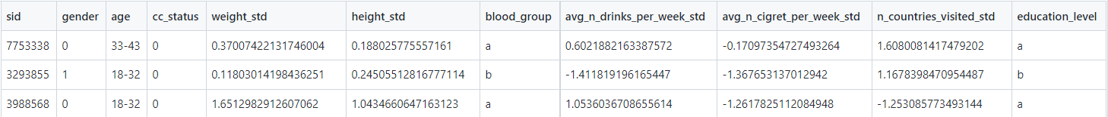
Dataset for Research
CDM Group Project
15 December 2022
Notes:
This shows a sample of our resulting dataset.

Slide 16
Government Data Set – Direct Identifiers
CDM Group Project
15 December 2022
Variable​ | Anonymisation method​ | Reasoning​
Given name​ | Removed​ Replaced with unique identifier​ | Allow local re-identification if needed
Surname​
Phone number ​ | Removed​ | Not required for the analysis​
National insurance number​
Bank account number​
Notes:
For the dataset given to the government collaborators, we did the same for direct identifiers.

Slide 17
Government Data Set – Quasi-identifiers
CDM Group Project
15 December 2022
Variable​ | Anonymisation method​ | Reasoning​ | ​Details
Postcode​ | Generalised to UK region | ​Reduce identifiability | ​5 categories: England, Scotland, Wales, Northern Ireland, Overseas territories
Country of birth | Generalised to continent |  | 7 categories: Africa, Antarctica, Asia, Europe, North America, South America, Oceania
Education level ​ | Generalised to fewer groups |  | 4 categories: School, Undergraduate, Postgraduate, Other
Gender​ | Removed | ​Not required for the analysis
Birthdate​
Current country |  | redundant
Notes:
For the quasi-identifiers, we generalised postcode to UK regions, country of birth to continent, and banded education level to 4 categories, so, compared to the researchers dataset, we have separated 'bachelor' out as its own category.

Slide 18
Government Data Set – Sensitive Data
CDM Group Project
15 December 2022
Variable​ | Anonymization Method​ | Reasoning​
Weight ​ | Removed | Not required for the analysis
Height​
Average number of drinks per week​
Average number of cigarettes per week​
Number of countries visited​
Blood group​
cc status​ | Unchanged​ | ​Cannot generalise further
Notes:
For the sensitive attributes, we only kept cc status because the others are not required for the analysis. And we have left it unchanged.

Slide 19
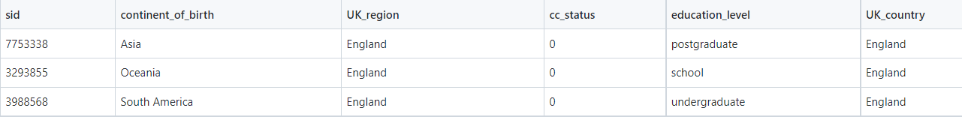
Dataset for Government Use
CDM Group Project
15 December 2022
Notes:
This shows a sample of our resulting dataset

Slide 20




Delivery of Datasets
CDM Group Project
15 December 2022
Anonymisation methods produce an anonymised data set​
`coding.json` is necessary to de-anonymise data set​
Data file protected by password
Added layers of security against hackers​
Notes:
The next step is to ensure the secure delivery of the datasets to the relevant stakeholders
For both stakeholders, our methods produce CSVs of anonymised data, as well as random 5-character strings saved in txt files and a decoding json file for the researchers, which I will elaborate on later

Slide 21
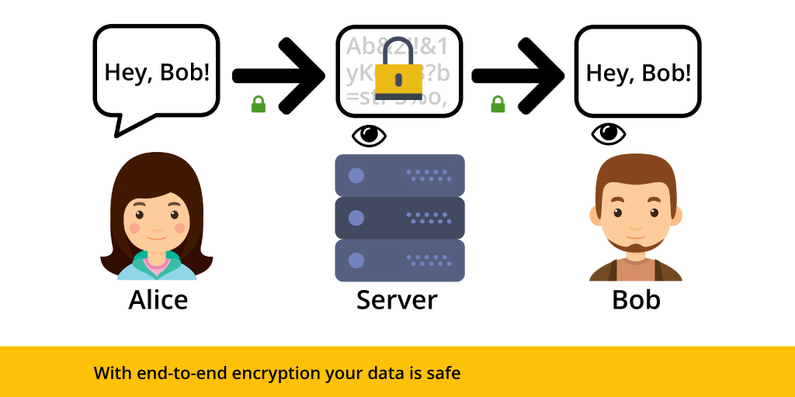
Delivery of Data Sets
CDM Group Project
15 December 2022
Method of file transfer​
End to end file transfer with multiple channels​
Signal (open source)​ (4)
Proton mail (open source) (5)
Multiple channels reduce risk of interception
Notes:
We deliver datasets using Proton mail
Proton mail has a feature that allows password protection of emails
These passwords are sent by Signal
Both are end-to-end file transfer channels that use end-to-end encryption

Slide 22


Delivery of Data Set
CDM Group Project
15 December 2022
Researchers​
Total of 3 files each sent separately to department head
CSV file (password protected)
Proton mail
Coding.json (contains instructions)
Proton mail
Password.txt
Signal messenger
Notes:
For the researcher dataset, we applied standardisation and pseudonymisation to sensitive data
Our methods produce a coding.json file that contains the instructions, as well as the values that can be used to decode and de-standardise the data

Slide 23
Delivery of Data Set
CDM Group Project
15 December 2022
Government
Total of 2 files each sent separately to department head
CSV file (password protected)
Proton mail
Readme.txt (contains password to CSV file)
Signal messenger
Ask the government collaborators to remove 'sid' before publishing the dataset
Notes:
For the government dataset, only CSV and Readme.txt files are produced, again sent using ProtonMail and Signal.
The readme.txt includes instructions in which the government collaborators are asked o remove the 'sid' column before published the dataset

Slide 24
K-anonymity (3)
CDM Group Project
15 December 2022
The number of individuals that can be identified using a combination of quasi-identifiers
Researcher Dataset​
Quasi-identifiers used in calculation:​
Age, gender, education level​
k = 9
k = 108 if only gender and age considered (without coding information)​
Government Dataset​​
Quasi-identifiers used in calculation:​​
Education level, UK region, continent of birth
Removal of 27 records (k=1) to protect customers
k = 2​
Notes:
After our inhouse team of data anonymisation and security experts have applied the relevant methods
We calculate the respective k-anonymity scores to ensure that we adhere to the data privacy laws outlined previously
K-anonymity is the number of individuals that can be identified using a combination of quasi-identifiers, as defined by Kate in the previous section
For the researchers dataset, we calculated 2 scores due to multiple layers of security, which we will explain shortly
Access to only the CSV file yields a k-score of 87, meaning that the minimum number of individuals that can be identified using any given permutation of the data set is 87
Access to both the CSV and the secure encoding file reduces this number to 9, which is still good
The government dataset involved a trade-off between anonymity and granularity of information for analysis
No combination of anonymisation techniques could yield a k-score greater than 1
As such, we decided to remove the 27 rows for which k = 1. 977 records remained

Slide 25
Limitations
CDM Group Project
15 December 2022
Removal of records: potential bias
Removal and banding of attributes: loss of information
Added layers of security: inconvenient and less efficient
L-diversity (6)
Number of distinct values of each sensitive attribute for each group of records with identical quasi-identifier values
Addressed by further generalisation
Notes:
As records are removed from the government dataset, this could introduce bias.
Removal and banding of attributes also lead to information loss.
Moreover, the added layers of security cause inconvenience.
L-diversity could be considered as an extension of k-anonymity.
L-diversity is the number of distinct values of each sensitive attribute for each set of records with the same quasi-identifier values.
It could be addressed by further generalisation with wider bands.

Slide 26
L-diversity
CDM Group Project
15 December 2022
Continent of birth | UK Region | Education level | cc status | count
Africa | Scotland | Postgraduate | 0 | 5
The attacker knows for sure that people in this group doesn't have the gene.
Continent of birth | UK Region | Education level | cc status | count
Africa | Scotland | Postgraduate | 0 | 2
Africa | Scotland | Postgraduate | 1 | 3
The attacker doesn't know if a particular person in this group has the gene or not.
Notes:
Consider these two tables, the top one is taken from our government dataset and the bottom is a hypothetical scenario.
Both datasets have a k value of 5.
However, if the top dataset got attacked, the attacker would know for sure that people in this group do not have the gene variant even without re-identifying them individually.
Whereas for the bottom table, the attacker would not know the cc status of a particular person in the group.

Slide 27
Conclusion
CDM Group Project
15 December 2022
Anonymisation is essential when sharing personal data
Techniques should suit the stakeholder's aim and regulations
Trade-off between security and information quality
Trade-off between security and transfer efficiency
Explore more efficient and secure methods

Slide 28
References
CDM Group Project
15 December 2022
Great Britain. Data Protection Act 2018. Available at: https://www.legislation.gov.uk/ukpga/2018/12/contents/enacted.
Information Commissioner's Office. Introduction to anonymisation. 2021. Available at: https://ico.org.uk/media/about-the-ico/consultations/2619862/anonymisation-intro-and-first-chapter.pdf [Accessed: 14 December 2022]
Sweeney L. K-anonymity: a model for protecting privacy. International journal of uncertainty, fuzziness, and knowledge-based systems. 2002; 10 (5): 557-570.
Signal. How do I know my communication is private? Available from: https://support.signal.org/hc/en-us/articles/360007318911-How-do-I-know-my-communication-is-private-. [Accessed: 14 December 2022]
Proton. What is end-to-end encryption and how does it work? Available from: https://proton.me/blog/what-is-end-to-end-encryption. [Accessed: 14 December 2022]
Machanavajjhala A, Gehrke J, Kifer D, Venkitasubramaniam M. L-diversity: privacy beyond k-anonymity. 22nd International Conference on Data Engineering (ICDE'06) : IEEE; 2006. pp. 24.

