Slide 1
Network Contract Lifecycle Management
(N‑CLM)
Infosys Limited
Contributors: @abd-abhisek | @bishnu-infy | @vijaymurthyn | @hemantagogoi-infy |
pawan.7.kumar@bt.com

Slide 2
Background — Network Contract Lifecycle Management (N‑CLM)
The Problem
– SLA governance for network services today is manual, portal-driven, and operator-specific.
– There is no standard API to bind SLA policies directly to live network service instances (QoD sessions, Dedicated Networks) and evaluate compliance in real time.
– Developers have no programmatic way to know when a network service is violating its SLA — they rely on operator tickets or manual monitoring.
– Contracts exist only as commercial agreements in BSS systems, with no developer-accessible lifecycle or event model.
What N‑CLM Solves
– A developer-facing API layer that binds measurable SLA policies to running CAMARA service instances.
– Continuous real-time evaluation of network metrics against those policies.
– Instant breach notification via CloudEvents — no polling, no manual intervention.
– Programmatic policy lifecycle: bind, amend thresholds, close — all via REST.
Business Scenario
Critical enterprise applications — financial trading, healthcare telemetry, autonomous logistics — depend on guaranteed network parameters. Today those guarantees are invisible to the application layer. N‑CLM makes them programmable.
Scope Clarification
N‑CLM is Service-Management, not BSS. It governs developer-visible SLA commitments on live service instances — not billing, pricing, or order-to-cash.

Slide 3
N‑CLM API: High Level Description
N‑CLM is not traditional BSS contract management (billing, pricing, order-to-cash). It is a network-aware, real-time programmatic API that binds measurable SLA parameters directly to a live CAMARA service instance and evaluates compliance continuously.
What N‑CLM Is NOT
– BSS/commercial contract management
– Network assurance or telemetry collection
– A DeviceLocation or QoS enhancement
– A duplication of CQM — it consumes CQM metrics; it does not replace them
– Free-floating contracts with no service binding
Core Capabilities
Bind: Attach an SLA policy (latency, bandwidth, availability thresholds) to a specific CAMARA service resource via its resource ID.
Evaluate: Continuously compare live network metrics against the bound policy in real time, using operator telemetry (e.g. CQM).
Notify: Send an instant CloudEvent to the developer on breach — includes metric name, threshold, actual value, and timestamp.
Amend: PATCH thresholds mid-term without re-provisioning the underlying service.
Close: DELETE the policy when the SLA governance period ends.

Slide 4
User Story
Item | Details
Summary | As an application developer or enterprise customer, I want to bind measurable SLA policies (latency, bandwidth, availability) to a live CAMARA network service instance — and receive an instant, programmatic notification when any parameter is breached — so that my application can react autonomously without manual monitoring or operator intervention.
Roles, Actors and Scope | Roles: Enterprise Customer, Application Developer Actors: Application developers, enterprise platform teams, network operations teams, industry customers (financial services, healthcare, autonomous logistics, critical infrastructure) Scope: Policy bind (POST /policies) — Attach a multi-metric SLA policy to a running CAMARA service instance (QoD session or Dedicated Network reservation) Breach notification (CloudEvent webhook) — Receive SLA_BREACH events with metric, threshold, actual value, and timestamp Policy amend (PATCH /policies/{policyId}) — Tighten or relax thresholds mid-term without re-provisioning the underlying service Policy close (DELETE /policies/{policyId}) — Terminate the SLA governance period
Activities / Steps | Starts when: The developer application server makes a POST /policies request — including the CAMARA serviceInstanceId, one or more metric thresholds, and an optional webhook URL — to the N‑CLM API, which validates the service binding and activates continuous compliance evaluation. During: N‑CLM continuously compares live operator telemetry (via CQM) against the bound policy. On any threshold breach, it emits a CloudEvent SLA_BREACH to the registered webhook with full breach context. Optionally: The developer PATCHes the active policy to amend thresholds at any point in the policy lifecycle without service interruption. Ends when: The developer sends DELETE /policies/{policyId}, or the policy reaches its configured expiry time.

Slide 5
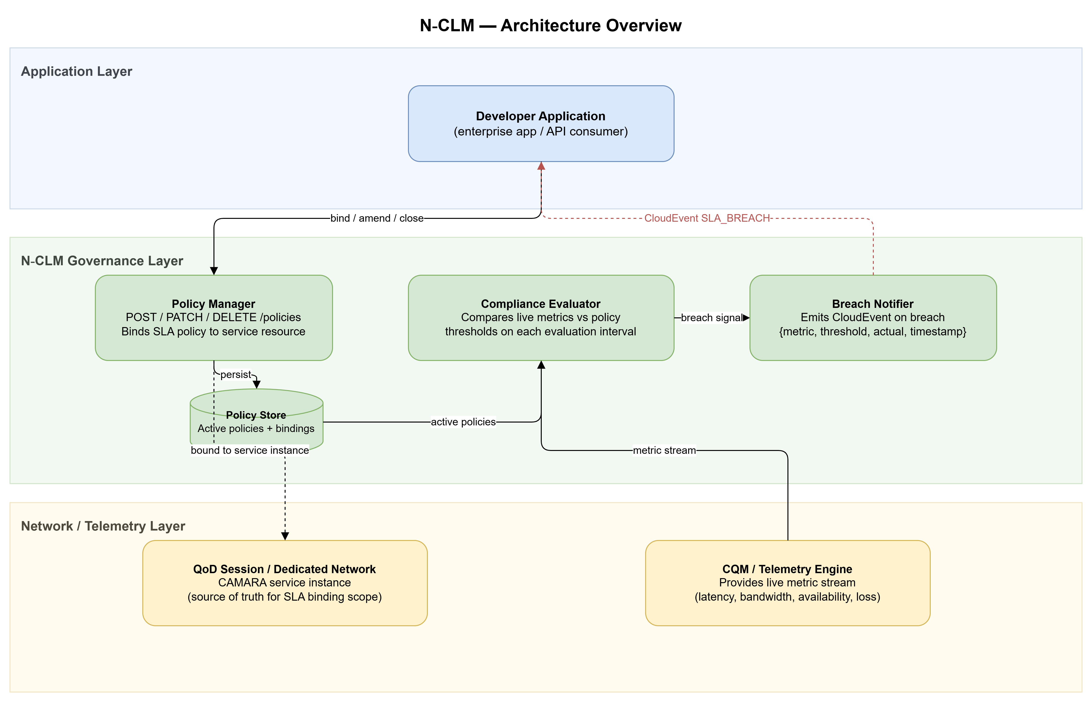
Architecture

Slide 6
Novelty Gap — N‑CLM vs Existing CAMARA APIs
QoD requests quality. CQM observes quality. N‑CLM governs quality.
Capability | QoD / Dedicated Networks | CQM | N‑CLM
Request a QoS level for a session | Yes | No | No
Observe live network metrics / telemetry | No | Yes | Consumes only
Bind a multi-metric SLA policy to a service instance | No | No | Yes
Continuous compliance evaluation against that policy | No | No | Yes
Breach notification (metric + threshold + timestamp) | No — no SLA verdict | No — raw data, no policy | Yes — CloudEvent
Amend thresholds mid-term without re-provisioning | No — reprovision needed | Not applicable | Yes — PATCH
Cross-operator portable SLA definition | No — per-session, per-operator | No | Yes — normative model
None of the existing APIs provide the closed-loop policy → evaluate → notify → amend cycle. N‑CLM is an orthogonal governance layer, not a replacement for any of them.

Slide 7
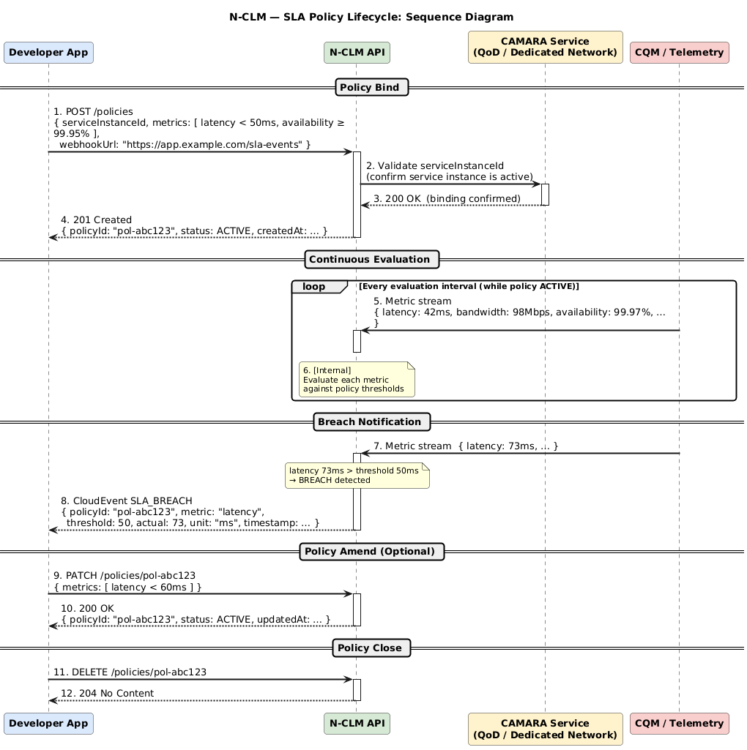
Sequence Diagram

Slide 8
Use Cases
UC1 — Latency SLA on a QoD Session
A fintech application sets an SLA requiring latency < 50 ms on an active QoD session.
N‑CLM evaluates the latency metric continuously against the bound policy.
When latency climbs to 73 ms, N‑CLM sends a CloudEvent (SLA_BREACH) to the app's webhook.
The app receives {metric: latency, threshold: 50, actual: 73, timestamp} and immediately initiates a traffic failover — no manual monitoring needed.
UC2 — Availability SLA on a Dedicated Network
An enterprise binds an availability ≥ 99.95 % policy to a Dedicated Network reservation.
Mid-term, after a network improvement, the enterprise tightens the threshold to 99.99 % via PATCH — without re-provisioning the underlying Dedicated Network.
N‑CLM updates the active policy and continues evaluating against the new threshold immediately.
UC3 — Multi-metric SLA for Autonomous Logistics
A logistics platform binds a combined policy (latency < 30 ms AND availability ≥ 99.9 % AND packet-loss < 0.1 %) to a network slice.
Any single metric breach triggers a CloudEvent. The platform uses the breach context to re-route vehicle telemetry to a backup slice.

Slide 9
API Deliverables Status
Deliverable Required/Optional (R/O) Current status
API Specs | R | In Progress
API documentation | R | TBD
User stories | R | Available
Test cases | R | TBD
Implementation | O | TBD

Slide 10
Addressing Backlog Review Feedback
Responses to questions raised during backlog review (Feb 2026)
Question | Response
Who produces the breach measurements? Is this assurance/monitoring in disguise? | N‑CLM does NOT collect metrics itself. It relies on an existing telemetry source (e.g. CQM) for the raw numbers. N‑CLM’s only job: receive a metric value → compare it against the agreed threshold → send a notification if the threshold is crossed. The measurement pipeline stays entirely outside N‑CLM.
What is the enforcement mechanism? Which CAMARA service does the SLA attach to? | Every N‑CLM policy is bound to a specific, already-running CAMARA service instance (e.g. an active QoD session ID or Dedicated Network reservation ID). N‑CLM does not reconfigure the network — it watches whether that live service is meeting the SLA. Think of it as an SLA auditor attached to a specific service instance. This makes it Service-Management, not Operate/Assurance.
How will the normative model ensure cross-operator portability? | The spec will define: • A fixed metric vocabulary (latency, bandwidth, availability, error-rate) • Standard breach-severity levels • Standard evaluation-window semantics All as normative YAML/JSON schemas, so the same policy means the same thing on any operator.
Why not just extend CQM or Dedicated Networks? | CQM tells you what the network is doing. N‑CLM tells you whether the network is keeping its promise. Mixing policy governance into CQM would conflate observation with adjudication. The cleaner design: a dedicated governance layer that sits on top of existing telemetry.

