Slide 1
IoT SMS send
China Telecom
Contacts: chenfr2@chinatelecom.cn

Slide 2

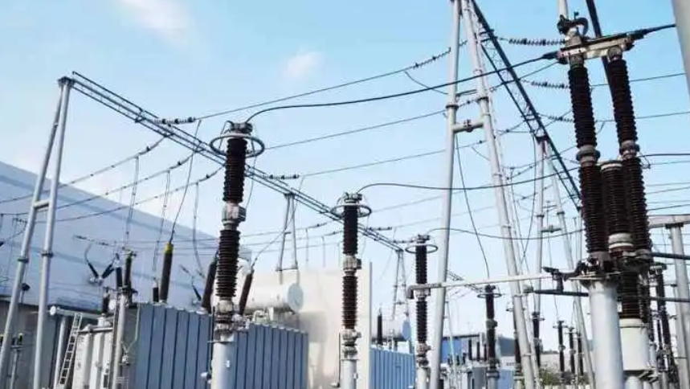


Use Cases
Reason :
In the wide application of the Internet of Things (IoT), customers can easily send control commands to remote devices with the help of the platform, realizing precise control across time and space. In this process, the SMS channel and the data channel go hand in hand. However, due to its unique advantage of not being restricted by network type, SMS channel shows better reliability in complex and changing network environment, especially in old or unstable areas such as 2G and 3G. Therefore, in many scenarios of remote control of IoT devices, IoT SMS is widely adopted for its stability and wide applicability.
Mature Fields
New Potential Valued Fields
Smart Car
Smart Grid
Medical field
Smart City
Smart car users can call TSP service by APP to realize keyless unlocking of car doors, remote control of air conditioning switch and other operations. TSP realizes this function by calling operator's API to send SMS control instructions.
Smart grid equipments are generally in complex environments, with urgent needs for remote control and stable and reliable command channels. IoT SMS, with its low network environment requirements and excellent transmission reliability, meets this need very well, and has become a reliable choice for remote control of smart grids.

Slide 3
Statement of operations
API Integration
The IoT SMS send API is registered to the public service application of China Telecom's API gateway.
Customer applies for APPKEY and APPSECRET of the gateway API, then calls the IoT SMS send API via HTTP/HTTPS to carry out the sending operation of IoT SMS.
Revenue Model
Monthly statistics on the number of SMS successfully sent by customers during the month's billing period, generating SMS bills for billing.
Current Scale
Currently, China Telecom has around 540 customers using SMS value-added services. These include the head enterprises of the smart car industry, Toyota, Dongfeng Honda, etc.and the customers of the electric power industry, such as State Grid Zhejiang Power, etc. The number of customers using SMS VAS through China Telecom is around 540. There are about 1 million IoT SMS sent through China Telecom's platform every day.

Slide 4
The API definition proposal
API Name | IoT SMS send API
Description | This API allows customers to send SMS messages to their IoT SIM cards to remotely wake up and operate end devices, providing a convenient and efficient tool for remote device management.
Input Parameters | device(Device)：The developer can choose to provide the below specified device identifiers: ipv4Address, ipv6Address, phoneNumber,networkAccessIdentifier.
 | content(String)：Content of the SMS to be sent
 | statusCallback(string): Callback address for SMS status
 | returnSMSCallback(string)：Callback address for uplink SMS
 | format(string): Format of SMS
Return Results | code(string): Returns the result identifier message(string): return result description result (object): return data

