Slide 1
Release Process Update Using the Automated Release Process
Release Management Working Group, March 5, 2026

Slide 2
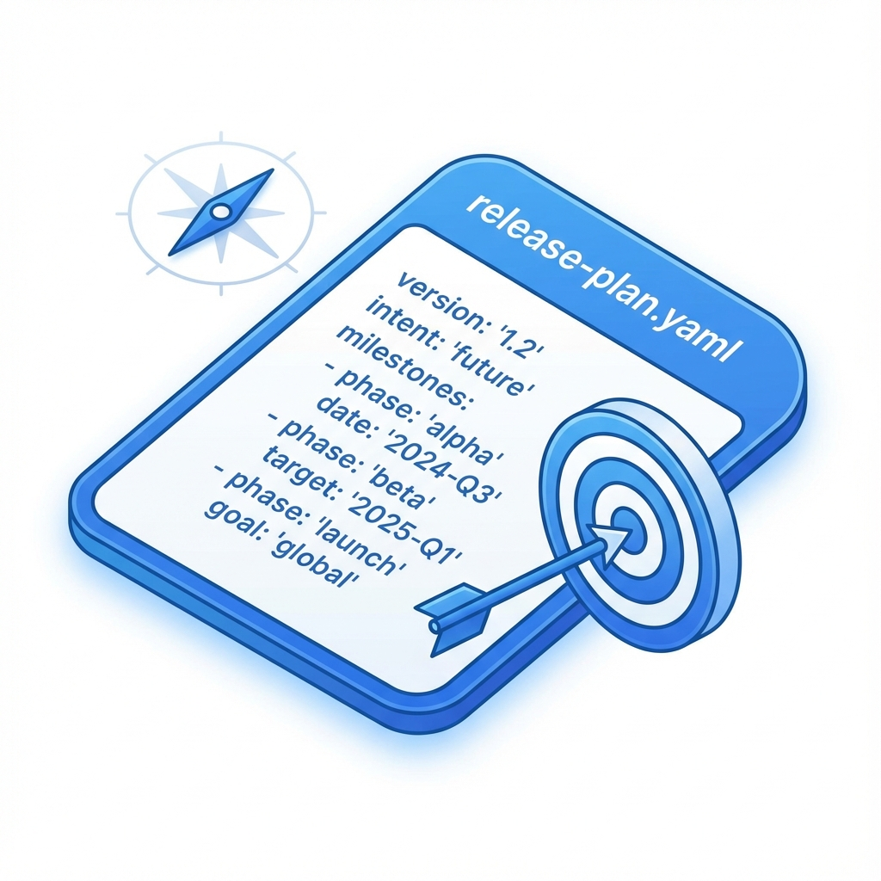
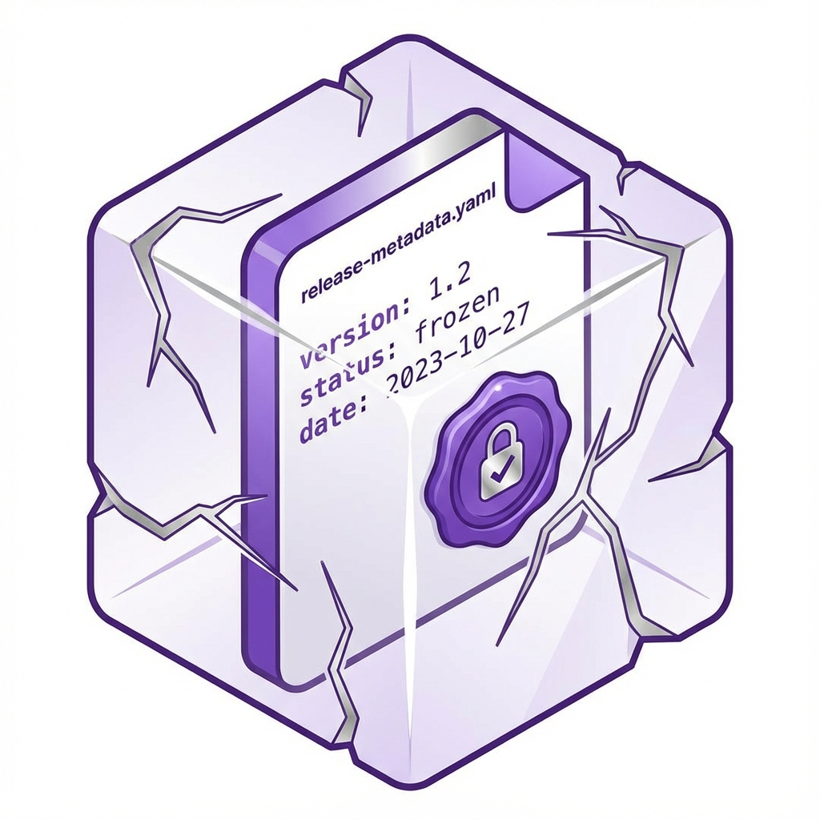
release-plan.yaml the baseline for automation
https://github.com/camaraproject/ReleaseManagement/tree/main/documentation/metadata
release-plan.yaml (the intent)
Where: On main branch.
Who Edits: Codeowners.
Purpose: tells automation what to do
release-metadata.yaml (the record)
Where: On release tags.
Who Edits: Automation.
Purpose: historical record of release
repository:
release_track: meta-release (or independent)
meta_release: Sync26
release_tag: r3.2
target_release_type: pre-release-rc (or none, …)
dependencies:
commonalities_release: r3.4
identity_consent_management_release: r3.3
apis:
- api_name: my-example-api
target_api_version: 1.0.0
target_api_status: rc (or draft, alpha, public)
main_contacts:
- @contact1
- @contact2
repository:
repository_name: ExampleRepository
release_tag: r3.2
release_date: "2026-09-30T10:00:00Z"
release_type: pre-release-rc
src_commit_sha: 7f3a9b2c8e1d4f6a0b5c7e9d3f8a1c4e6b9d2f5a
release_notes: "Public release of ..."
dependencies:
commonalities_release: r3.4 (0.6.1)
identity_consent_management_release: r3.3 (0.4.0)
apis:
- api_name: my-example-api
api_version: 1.0.0-rc.2
api_title: "Quality On Demand"

Slide 3
Release Issue steering the release process
Declare release intent in release-plan.yaml (→ triggers Release Issue creation or update)
Release Issue #xxx
Readiness checklist: ☑
/create-snapshot → creates snapshot branch & Release PR
Release PR: review, update as needed, get approvals & merge
/publish-release → creates GitHub release with planned tag
Release asset checklist:
Release Plan
Scope Issue
API Definition(s)
Commonalities compliance
API Documentation
User Stories
Test Cases (basic)
Test Cases (enhanced)
API Description
SNAPSHOT ACTIVE

Slide 4



Release Process in a Nutshell
https://github.com/camaraproject/ReleaseManagement/blob/main/documentation/release-process/lifecycle.md
PROCESS | BEFORE | AFTER
Development (on main with wip)
API Release Tracking of intent & status | Manual Wiki pages | release-plan.yaml in repository (on main) + Release Issue (with release progress status)
PR checking | Time consuming manual checks at release time | Automated validation of each PR, and of planning and readiness assets (*)
API Readiness checklist | Manual update in .md file | Tick off asset availability in Release Issue & Review PR
Release (Release Issue + snapshot branch + release review branch + Release PR)
Versioning in yaml, feature files and README | Manually decided & committed | Calculated and automatically committed from release-plan.yaml + release history
CHANGELOG | Manually written release notes | Automatically gathered input for the release – manual editing still needed but focused on content
Branches | Ad-hoc or strict GitFlow | Automated snapshot, release review and release/rX.Y branches
(*) Validation will be extended over time, currently basic rules

Slide 5
Release automation commands Quick guide
Release Issue Command | Meaning | Allowed in State | Resulting State
/create-snapshot | Validate current HEAD, create snapshot branch + release-review branch + Release PR | PLANNED | SNAPSHOT ACTIVE (on success)
/discard-snapshot <reason> | Discard the active snapshot | SNAPSHOT ACTIVE | PLANNED
(Release PR merged) | Release is approved and GitHub draft release is created | SNAPSHOT ACTIVE | DRAFT READY
/delete-draft <reason> | Delete GitHub draft release | DRAFT READY | PLANNED
/publish-release --confirm <tag> | Publish GitHub draft release + create reference tag + merge-to-main PR | DRAFT READY | PUBLISHED
https://github.com/camaraproject/ReleaseManagement/blob/main/documentation/README.md

Slide 6
Status and next steps for API Teams
1. Bulk PRs with release-plan.yaml were created in all API repositories last week
merging this PR is the prerequisite for being able to integrate the automation workflow to the repository
you can merge the release-plan.yaml for now unchanged (no plan yet), but see below
2. Release automation workflow roll-out to repositories (in waves)
first wave ongoing: beta testing with four voluntary repositories
next wave: roll out to all repositories that
merged the release-plan.yaml AND
have updated it with planned next (pre-)release information (independent or Sync26 meta-release)
these repositories will see a PR "[bulk] Enable release automation process", the description explains the next steps
further waves will follow for other repositories

Slide 7
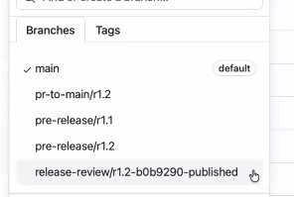
Q&A how/when to cleanup branches or tags
Branches (and tags) that need to be kept for release history reasons are protected and cannot be deleted,. For example,
PROTECTED BRANCH: no deletion possible: a public release branch « release/r1.3 »
BRANCH DELETION: OK for intermediary branches
pre-release/rX.Y
release-review/rX.Y-xxx-published (will be done by automation later)
pr-to-main/r1.2 after PR is merged
TAGS:
release tag deletion is not allowed, e.g. r1.1
older snapshot tags deletion is allowed, e.g. source/r1.1
The recommended clean-up time for intermediary branches: after the public release in the release cycle rX.

Slide 8
Q&A
DEMO

