Slide 1
Release Process Update
Introduction to the Automated Release Process
Release Management Working Group, December 2025

Slide 2
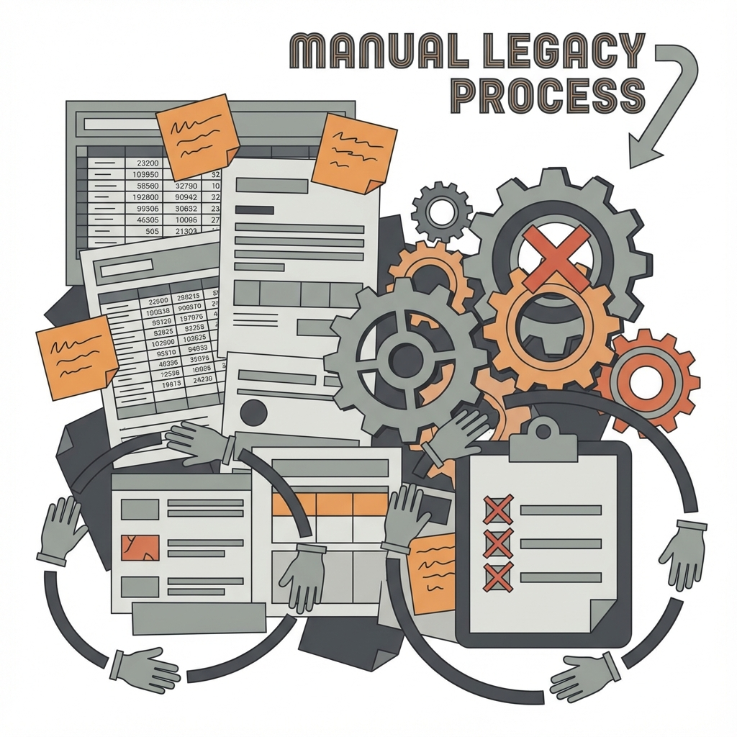
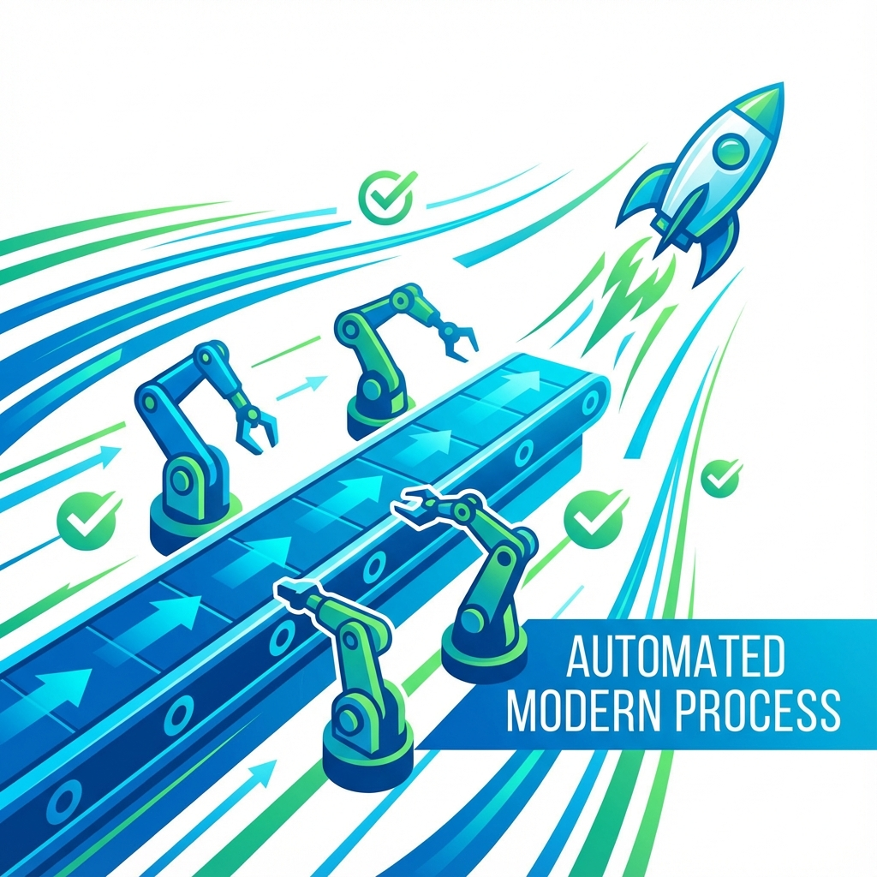
Context & Motivation
Current Challenges:
  Manual Overhead: Time-consuming release trackers, checklists,
  release notes, reviews and tagging.
  Inconsistency: Varying artifacts & quality across APIs.
  Versioning Errors: Manual SemVer mistakes, overseen replacements
Objectives of the New Process:
  Automation: Generate artifacts (Changelog input, checklist, versioned files, …)
  Consistency: Uniform structure across repositories.
  Reliability: Strict SemVer & release readiness standards.

Slide 3
Legacy vs. New Process
Feature | Legacy Process (Wiki/Manual) | New Process (Metadata/Automated)
Tracking | Manual updates in Wiki, duplication of data | Plan living in repository: release-plan.yaml
Versioning | Manually decided & committed | Calculated from plan + git history
Artifacts | Manually written release notes | Auto-generated release-metadata.yaml & release notes (later phase)
Branching | Ad-hoc or strict GitFlow | Automated release/rX.Y branches
Validation | Time consuming manual checks at release time | CI checks planning & readiness continuously
https://github.com/camaraproject/ReleaseManagement/blob/main/documentation/
SupportingDocuments/CAMARA-Release-Workflow-and-Metadata-Concept.md

Slide 4
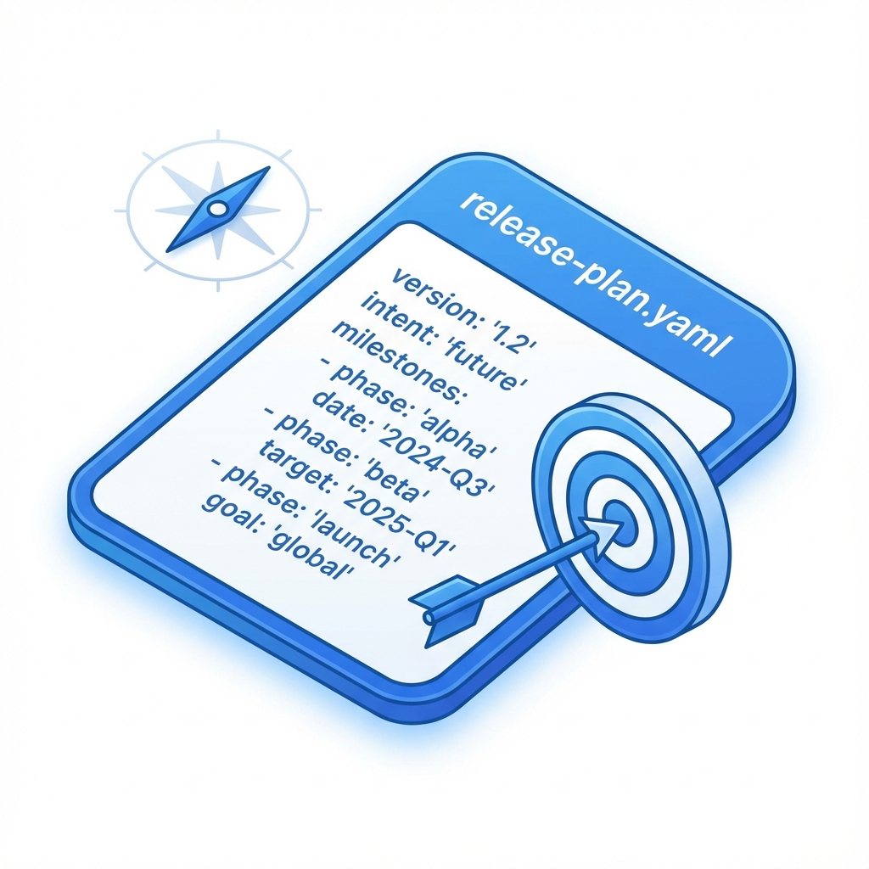
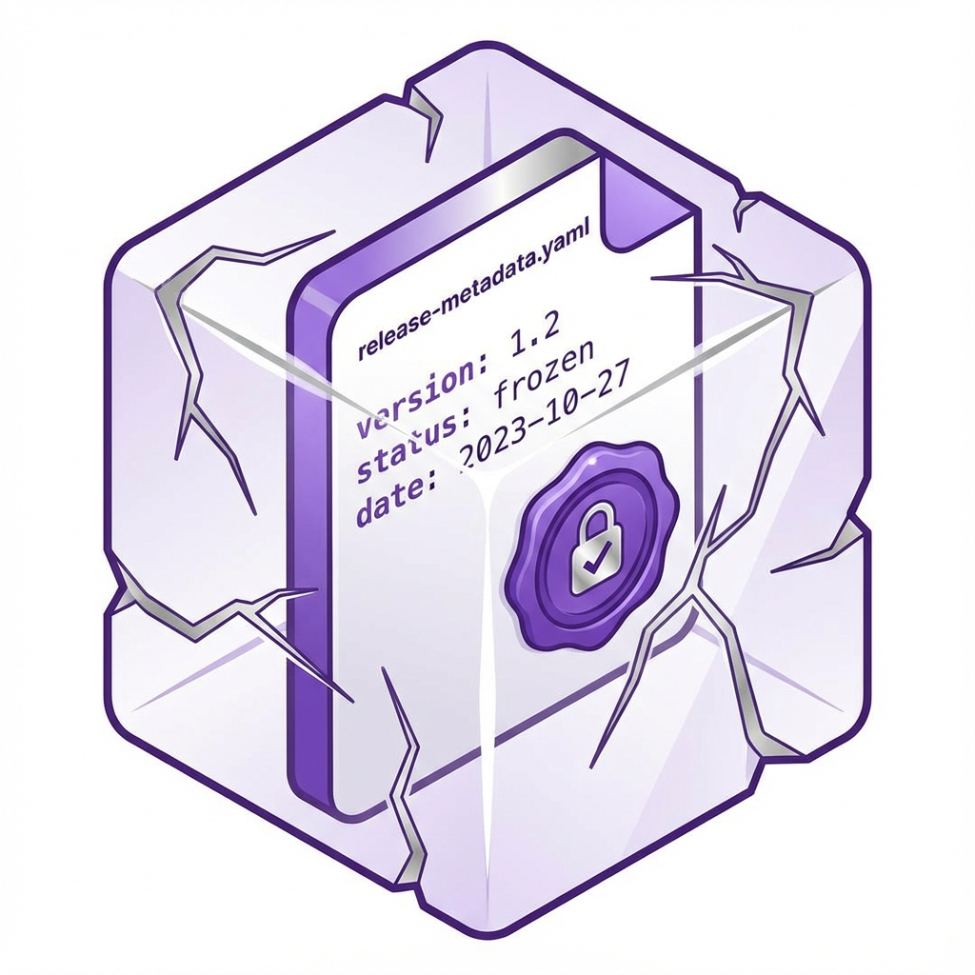
Key Concept: The Control Files
release-plan.yaml (The Intent)
Where: On main branch.
Who Edits: Codeowners.
Purpose: Tells automation what to do next.
release-metadata.yaml (The Record)
Where: On release tags.
Who Edits: Automation (Robot).
Purpose: Frozen historical record.
Example:
repository:
release_track: meta-release
meta_release: Fall26
release_tag: r3.2
target_release_type: pre-release-rc
dependencies:
commonalities_release: r4.4
identity_consent_management_release: r4.3
apis:
- api_name: my-example-api
target_api_version: 1.0.0
target_api_status: rc
main_contacts:
- @contact1
- @contact2
Example:
repository:
repository_name: ExampleRepository
release_tag: r3.2
release_date: "2026-09-30T10:00:00Z"
release_type: pre-release-rc
src_commit_sha: 7f3a9b2c8e1d4f6a0b5c7e9d3f8a1c4e6b9d2f5a
release_notes: "Public release of ..."
dependencies:
commonalities_release: r4.4 (1.0.1)
identity_consent_management_release: r4.3 (1.0.0)
apis:
- api_name: my-example-api
api_version: 1.0.0-rc.2
api_title: "Quality On Demand"
https://github.com/camaraproject/ReleaseManagement/pull/339

Slide 5
The New Release Workflow & Details
1. Continuous Developing & Planning
2. Trigger a Release, & Automated Preparation
Development happens on main branch
Codeowners update
release-plan-yaml on main
Codeowner or Maintainer will dispatch a workflow or add a label to an issue (e.g. “trigger-release”)
CI will validate plan & content of repository at each PR
4. Review Release PR
Automation creates dedicated release branch (e.g. release/r4.4) ...
... calculates the version from plan + Git history ...
Main branch kept always as “wip”
5. Approve & Publish
... Creates a PR against the release branch with:
generated release-metadata.yaml
Updated API and Test definition files with concrete versions (replacing “wip”)
a generated CHANGELOG.md entry
Maintainers, Codeowners, and Release Manager review & adapt it
Once Release Prep PR is merged, the release branch gets tagged, artifacts build, GitHub Release created
A PR is automatically created back to main to:
Append the new entry to CHANGELOG
Update README.md with links to new release
Patch versions will be developed on maintenance branches (all the rest is the same)
If correction are needed: delete branch, fix in main, retrigger release
release-plan.yaml will not be reset. Reflects last release until new plan is created. By the team

Slide 6
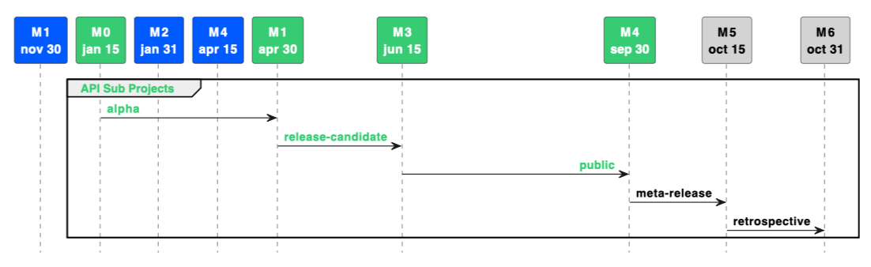
Release Tracks
Independent or Meta-Release
Not all APIs move at the same speed.
1. Meta-Release Track (Coordinated)
  Aligned with CAMARA-wide
  Spring/Fall releases.
  Strict deadlines (Code Freeze).
  Good for mature and stable APIs.
2. Independent Track (e.g. Sandbox Repositories)
  For experimental or new APIs.
  Release whenever you want.
  Good for rapid iteration and feedback.

Slide 7
Next Steps
Status:
  New process defined, implementation in progress.
  First step is the roll-out of release-plan.yaml to all API repositories in January
  Will immediately replace Release tracker pages in Wiki – win/win for ReleaseManagement and Codeowners
Pilot Phase:
  Testing begins in January 2026.
  Selected repositories will pilot the automation first.
Rollout:
  Feedback from pilot will refine tooling.
  Gradual rollout to all sub-projects in Q1 2026.
Action:
  Codeowners should start familiarizing with release-plan.yaml concepts.

Slide 8
Q&A

