Slide 1
Release Process Update
Maintenance releases and the refactored release automation
Release Management Working Group, October 27, 2026
Notes:
Update for API codeowners and Release Management: what changes with the refactored release automation, and how a maintenance release on a maintenance/rX branch works. Builds on the March 2026 deck.

Slide 2
What changes for you overview
Unchanged
same commands, same flow
release-plan.yaml
Release Issue
/create-snapshot
/discard-snapshot
/delete-draft
/publish-release
Release PR on the snapshot branch
planned → snapshot-active → draft-ready → published
1
Maintenance releases on a branch
2
CHANGELOG per cycle
3
Clearer feedback, built-in recovery
4
Under the hood
Patch a released cycle while main moves on
maintenance/rX, created by the automation
One Release Issue per line, side by side
Validation knows the line (P-041, P-042)
Only CHANGELOG/CHANGELOG-rX.md, no root file
Compare base follows the release type
Maintenance release: compared to the patched release
Unchanged APIs are listed as unchanged
Every run writes a step summary
/sync-issue replies with a result
Common-file sync PR per line, with comments
Failed post-release steps: /sync-issue repeats them
Four jobs: plan, snapshot, act, finalize
Logic in tested Python modules
Tooling checkout follows the workflow commit
Fewer cancelled or skipped runs
Status: on the tooling branch release-automation-refactor (tag ra-v1-rc2), tested on ReleaseTest2, then pilot repositories, then main → all repositories via @v1-rc
Notes:
One-slide overview. Lead with what stays the same, then the four changes. Details follow slide by slide.

Slide 3
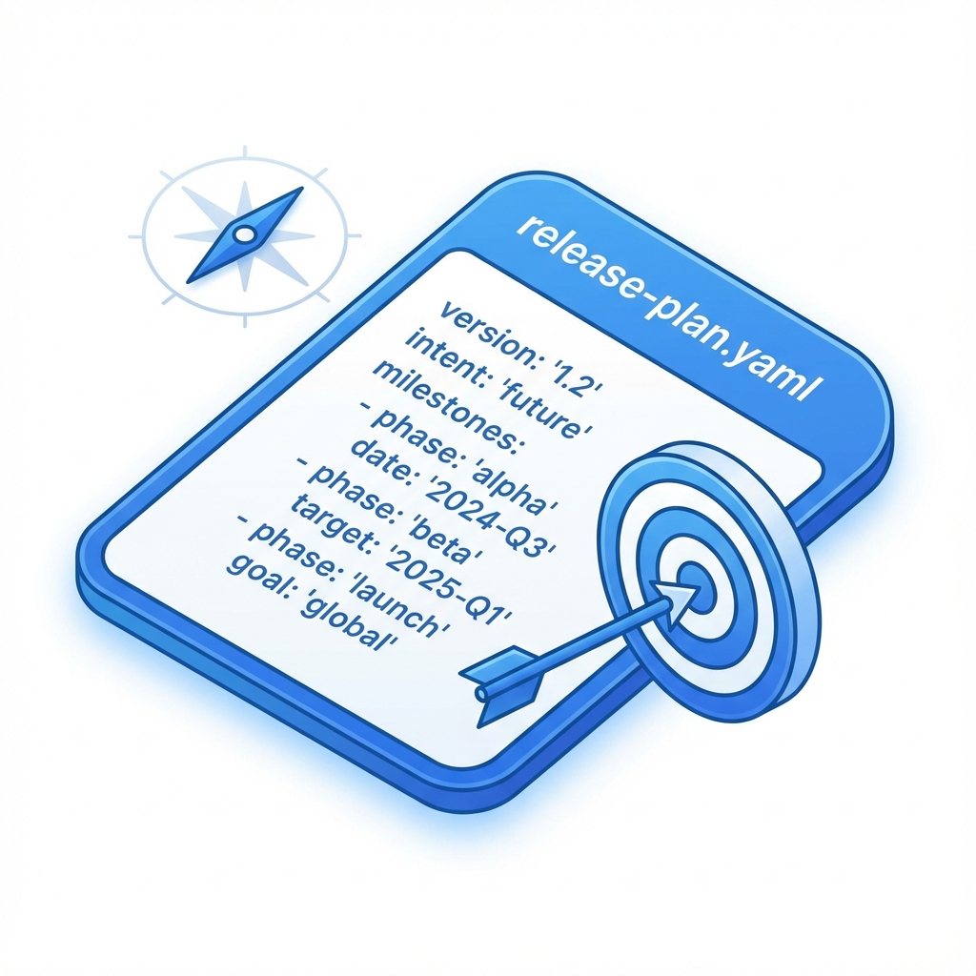
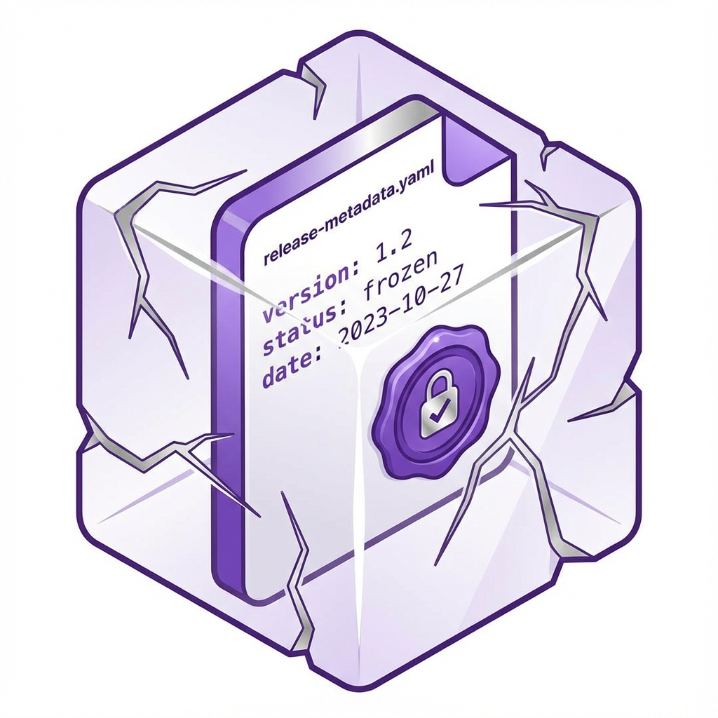
release-plan.yaml the baseline for automation
https://github.com/camaraproject/ReleaseManagement/tree/main/documentation/metadata
release-plan.yaml (the intent)
Where: main or maintenance/rX.
Who Edits: Codeowners.
Purpose: tells automation what to do
release-metadata.yaml (the record)
Where: On release tags.
Who Edits: Automation.
Purpose: historical record of release
new
repository:
release_track: meta-release (or independent)
meta_release: Sync26
release_tag: r3.2
target_release_type: pre-release-rc (or none, …)
dependencies:
commonalities_release: r3.4
identity_consent_management_release: r3.3
apis:
- api_name: my-example-api
target_api_version: 1.0.0
target_api_status: rc (or draft, alpha, public)
main_contacts:
- @contact1
- @contact2
repository:
repository_name: ExampleRepository
release_tag: r3.2
release_date: "2026-09-30T10:00:00Z"
release_type: pre-release-rc
base_branch: maintenance/r1
src_commit_sha: 7f3a9b2c8e1d4f6a0b5c7e9d3f8a1c4e6b9d2f5a
release_notes: "Public release of ..."
dependencies:
commonalities_release: r3.4 (0.6.1)
identity_consent_management_release: r3.3 (0.4.0)
apis:
- api_name: my-example-api
api_version: 1.0.0-rc.2
api_title: "Quality On Demand"
new
Notes:
Mostly unchanged. New: release-plan.yaml also lives on a maintenance branch (one plan per line); release-metadata.yaml records base_branch, the branch the snapshot was created from (main or maintenance/rX).

Slide 4
Release flow and commands on main and on a maintenance line
/create-snapshot
merge the Release PR
/publish-release --confirm rX.Y
planned
snapshot-active
draft-ready
published
/discard-snapshot <reason>
/delete-draft <reason>
Release Issue
Snapshot + Release PR
Draft release
Published
created or updated from release-plan.yaml
on push to main or to the line
readiness checklist, valid actions
snapshot branch, release-review branch
CHANGELOG-rX.md section drafted
review, edit, approve, merge
GitHub draft release with release-metadata.yaml
versions and files finalised
publish or delete the draft
tag rX.Y, source/rX.Y, release/rX.Y
post-release sync PR(s), codeowner merge
Release Issue closes
/sync-issue (any state, also as workflow dispatch) re-syncs the Release Issue of its line and replies with the result; after a publication whose post-release steps failed, it runs them again and closes the issue.
Notes:
Replaces the earlier Release Issue and command table slides. The commands, the states and the Release PR are unchanged; on a maintenance line the same flow runs on the line's Release Issue. /sync-issue is new as a visible command.

Slide 5
Maintenance release from main (A) or from the line (B)
Case A release from main, as usual
A public release of cycle rX needs a patch
bug fixes only, same APIs
Plan rX.(N+1) as maintenance-release (or pre-release-rc first)
Same Release Issue on main, same commands
Works as long as main holds no changes meant for the next cycle
ReleaseTest2: r1.7 and r1.8 patched r1.6 this way
no
Has main moved on?
release-plan.yaml on main targets a later cycle, a later cycle has already released, or main already holds changes for the next cycle
Case B release from maintenance/rX
yes
Create the line once: workflow dispatch create-maintenance-branch
Plan on the line by PR; the merge creates the line's Release Issue
Same commands on that issue; main keeps planning the next cycle
ReleaseTest2: r1.9 to r1.11 on maintenance/r1, next to r2.1, r2.2 and r3.1
In both cases the patched release is the newest public or maintenance release of the cycle; the new tag is the cycle's next tag (P-041)
Same API set, patch bumps only; a minor bump is the exception for x ≥ 1 when a later cycle already published a higher major (P-042)
Once maintenance/rX exists, main must not plan rX.* any more; an rc of the cycle is finished or discarded from main before the branch is created
Notes:
Decision: as long as main has not moved on, patch from main (case A). Once main plans or has released a later cycle, create maintenance/rX and patch there (case B). Validation rule P-041 tells codeowners which case applies.

Slide 6
Two release lines side by side the ReleaseTest2 example
Latest
r1.6
public
r1.7
maintenance
r1.8
maintenance
r2.1
rc
r2.2
public
r3.1
alpha (planned)
main
new cycles, case A patches
CHANGELOG-r1.md
synced into main by PR
create-maintenance-branch
set-up commit on the branch
maintenance/r1
branched at r1.8, case B patches
r1.9
rc
r1.10
maintenance
r1.11
maintenance
public / maintenance release
pre-release (alpha, rc)
Latest stays with r2.2 although r1.10 and r1.11 were published later; the automation restores it if GitHub moved it.
Each line has its own release-plan.yaml and Release Issue; CHANGELOG compare base: r1.9 and r1.10 against r1.8 (r1.9 is an rc), r1.11 against r1.10.
r1.7 and r1.8 were released from main (case A) before r2.1 existed.
Notes:
Real history of camaraproject/ReleaseTest2 (October 2026). Compare bases: r1.9 as first rc on the line is compared to the patched release r1.8; r1.10 (maintenance) to the patched release r1.8 as well, since r1.9 is an rc; r1.11 to r1.10.

Slide 7
Case B, step 1 create the maintenance line
Actions › CAMARA Release Automation › Run workflow
1
Preconditions
main's release-plan.yaml targets a later cycle (any type, even none; a cycle-X tag blocks, also when published)
the cycle's newest release is public or maintenance, not an rc
maintenance/rX does not exist yet
Use workflow from
Branch: main
action
2
The automation creates the branch
create-maintenance-branch
at the source commit of the patched release (r1.8)
one set-up commit: caller workflows from main, CHANGELOG/CHANGELOG-r1.md of r1.8, release-plan.yaml parked at r1.9 with type none
no PR, no Release Issue yet; the step summary names the next step
cycle
r1
Run workflow
from main; codeowners only
3
Plan the first release by PR into the branch
target_release_type: maintenance-release (or pre-release-rc), patch versions
the merge creates the line's Release Issue: “Release r1.9 (rc) on maintenance/r1”
r1.6
r1.7
r1.8
main
maintenance/r1
set-up commit
chore: set up maintenance/r1 from r1.8
first PR
chore: plan r1.9 (rc) on maintenance/r1
Release Issue
Release r1.9 (rc) on maintenance/r1
Notes:
Preconditions are checked by the automation; if one fails the run fails and the step summary says why. Branch protection: maintenance/** is created only by the automation; all later changes go by PR with codeowner review.

Slide 8
Case B, step 2 release and sync on the line
Release r1.11 (maintenance) on maintenance/r1 #147
release-issue
release-state:published
one Release Issue per line; a command on this issue acts on maintenance/r1 only
Plan
/create-snapshot
Draft
Published
Sync PRs
PR into maintenance/r1
tag r1.11, type maintenance-release
merge → Release Issue
snapshot + Release PR
CHANGELOG-r1.md section, compared to r1.10
edit, approve, merge
merge creates the draft release
/publish-release --confirm r1.11
tag r1.11
source/r1.11 on the line
release/r1.11 pointer branch
Latest unchanged (r2.2)
#149 into maintenance/r1
#150 into main
CHANGELOG only, no README change
issue closes when both exist
Afterwards
Next fix on the cycle: plan r1.12 by PR on the line; the line's next release builds on the synced CHANGELOG
Retire the line: set target_release_type: none, close the issue, an admin deletes maintenance/r1; release/r1.Y branches keep every release reachable
Branch protection: maintenance/** is created and deleted by the automation (admins for retirement); changes go by PR with codeowner review
Notes:
Same commands as on main. Differences: the Release Issue names the line, the reference tag source/r1.11 sits on the line, and there are two post-release PRs (into the line and into main) that carry only CHANGELOG-r1.md.

Slide 9
Validation on a maintenance line rules that know the line
Rule | What it checks | Where
P-041 plan fits its line | A cycle with a public release gets only maintenance-release or pre-release-rc, with the cycle's next tag On maintenance/rX only rX.*; main must not plan rX.* once the branch exists or a later cycle has released | PRs on main and on the line
P-042 API versions are patches | Same API set as the patched release, no major change, patch bumps only 0.y.z: always patch only; x ≥ 1: a minor bump only if a later cycle published a higher major | PRs on the line (and case A on main)
P-035 published history | Plan stays consistent with the published releases of its own line | scoped to the line
P-033 active release | release-plan.yaml changes are blocked only while a release of the same line is active (snapshot or draft) | a release on the other line does not block
What a codeowner sees on the PR (messages name the branch and the patched release)
❌ [P-042] on 'maintenance/r1', which maintains release cycle r1 from r1.10: API 'sample-service' changes '0.1.3' in r1.10 to '0.2.0'; for 0.y.z versions the minor version is breaking, so a maintenance line allows only patch versions.
Suggestion: Keep '0.1.3' or raise only its patch version for a maintenance release of r1.10; a new minor or major version of 'sample-service' is released from main in a later release cycle (r2.y).
❌ [P-041] release 'r2.2' is already published in a later cycle, so main can no longer release in cycle r1; maintenance releases of r1 need the branch 'maintenance/r1'.
Suggestion: Create 'maintenance/r1' from main: Actions → CAMARA Release Automation → Run workflow, action create-maintenance-branch, cycle r1. Then plan 'r1.9' there, or plan a later release on main.
Notes:
P-041 and P-042 are new. P-033 and P-035 existed and are now scoped to the line of the PR's base branch. The message texts are the real ones from the validation rules (mock-up composed from the ReleaseTest2 history).

Slide 10
CHANGELOG and Latest what the automation writes
CHANGELOG
Latest on GitHub
The automation writes one file per cycle: CHANGELOG/CHANGELOG-rX.md. An existing root CHANGELOG.md stays, but is not maintained by it.
Candidate changes come from the release's own branch; an API released at its earlier version is listed as unchanged.
r2.2
public, main
Latest
Release type | Compared to
alpha | previous release of any type
first rc of a cycle | previous public release; on a maintenance line the patched release
later rc | previous rc of the cycle
public | previous public release
maintenance | patched release (newest public or maintenance release of the cycle)
r1.11
maintenance, published later
not Latest
A patch of an older cycle never takes Latest from a later cycle's public or maintenance release.
It takes Latest only while the later cycle has pre-releases alone.
GitHub marks every published release Latest; the automation sets it back when needed.
Pointers as before
source/rX.Y on the line's branch
release/rX.Y or pre-release/rX.Y pointer branch
“Previous” is ordered by tag version (cycle, then number), not by date.
After publication the section goes by PR into the line and into main (case B), or into main with the README block (from main).
Notes:
CHANGELOG: per-cycle files only; the compare base follows the release type and is ordered by tag version. Latest: a maintenance release of an older cycle stays behind the newer cycle's public release.

Slide 11
Better feedback, built-in recovery and what to do if a step fails
On every run
In the Release Issue
If a step fails
The step summary says what the run saw and did
Actions › the run › Summary
Replies follow the real state
/sync-issue answers with a result, no more “Processing”
the valid-actions list matches the state
texts on a maintenance line name the line
Common files (Commonalities cache)
stale cache → one sync PR per line, with a comment when it is created and when the cache is in sync again
while stale, /create-snapshot is blocked and the valid actions point to the sync PR
Release published, but a post-release step failed
e.g. the sync PR could not be created; the release itself is fine
the Release Issue stays open and names the retry
comment /sync-issue, or dispatch sync-issue on the line's branch: the steps run again and the issue closes
A dispatch was refused
the run fails and the step summary says which precondition was not met
A command was rejected
the reply lists the actions valid in the current state
Trigger
push to maintenance/r1 (release-plan.yaml)
Line
maintenance/r1
State seen
planned, Release Issue #147
Action
Release Issue synced
Answers “why did nothing happen?”: a push that changed nothing, a dispatch on the wrong branch, a precondition that failed
Fewer noise runs: the bot's own issue writes no longer trigger runs; concurrency at job level
🔁 Post-release steps run again — State: published
Post-release sync PR: #149 and #150 into main (requires codeowner merge). This issue is closed.
bot reply after /sync-issue repaired a publication (ReleaseTest2 #147)
Notes:
Three situations: the step summary on every run; replies and common-file sync in the Release Issue; and recovery with /sync-issue when a post-release step failed. Fewer noise runs because the bot's own writes no longer trigger.

Slide 12
Under the hood one slide for the curious
Reusable workflow
four jobs instead of a dozen; logic in tested Python modules, not inline scripts
the state is derived once (plan) and passed on as a document
Tooling checkout
follows the exact commit of the called workflow; no override input
Caller workflow
push on maintenance/**, dispatch actions sync-issue and create-maintenance-branch
retired v0 linting workflows removed
snapshot
/create-snapshot: validation, snapshot branch, Release PR
plan
trigger, line, state, common cache, command policy, one response
finalize
sync PRs, common sync, Release Issue, result comment, step summary
act
discard, delete-draft, publish, draft on merge, auto-reopen, create line
push, dispatch, sync-issue, issue close: no action, straight to finalize
Notes:
Internals in one slide. Codeowners do not need this to use the automation.

Slide 13
Rollout and open points status as of the presentation date
done
done
now
next
then
Tooling branch
release-automation-refactor
tag ra-v1-rc2
ReleaseTest2
end-to-end tests of both lines
Pilot
repositories on the independent track
Maintenance branch needed
every repository that needs one next
Merge into main
all repositories via @v1-rc
Not yet decided or in progress
Topic | Where
Publish mode of maintenance releases | ReleaseManagement#675
README release information: describe the release on its tag, not the repository state | ReleaseManagement#730
Which release lines count as supported | ReleaseManagement#459
ReleaseManagement documentation for maintenance releases (maintenance-releases.md) | update pending
Repositories outside the pilot stay on the current @v1-rc automation until the merge into main.
Notes:
Check the status before presenting: which pilot repositories, which repositories need a maintenance branch, whether the merge into main happened. Links: https://github.com/camaraproject/ReleaseManagement/issues/675, /730, /459.

Slide 14
Branches and tags keep, delete, retire a line
Keep (protected)
Delete when done
Retire a line
release/rX.Y pointer branches of public and maintenance releases
tags rX.Y: never deleted
maintenance/rX while the line is active; created by the automation, changed by PR
main
pre-release/rX.Y after the public release of the cycle
release-review/rX.Y-…-preserved
pr-to-main/rX.Y, pr-to-maintenance/rX/rX.Y, sync-common/… after their PR merged
older source/rX.Y reference tags
1. set target_release_type: none on the line (by PR)
2. close the line's Release Issue
3. an admin deletes maintenance/rX (ruleset bypass)
every release stays reachable through release/rX.Y and its tag
Branch protection: release-snapshot/* and maintenance/** are rulesets with the automation as bypass actor; humans change them by PR only. Recommended clean-up time for intermediary branches: after the public release of the cycle.
Notes:
Rebuilt from the March slide. New: pr-to-maintenance/rX/rX.Y and sync-common branches, and the retirement steps for a line.

Slide 15
Q&A
DEMO

