Slide 1

356815008
344663000
52040792
312511520
361059264
359477000
377606032
373748880
Telco Global API Alliance – CAMARA
Pathways towards a clear, consistent and transparent process for API onboarding and handling
27.07.2022

Slide 2
CAMARA governance structure
Steering Committee
Responsible for all aspects of oversight
Ways of working definition, creating/removing new/existing WGs, re-prioritization, etc.
Implementation guidelines
Priorities and roadmap
Commonalities WG
API backlog WG
QoD API
Feedback
Edge Cloud API
Feedback
….
”X” API
Governing body
API families
Transversal technical WGs
API WGs (Sub Projects)

Slide 3
Motivation
Problem statement
Decision on creating new Sub Projects to work out specific APIs has not been a major issue up to now.
Every API was more than welcome and new Sub Project was defined accordingly
The reason is that the number of APIs and contributions in CAMARA have been rather limited so far.
However, as CAMARA gains traction and more partners are bringing API proposals into the backlog, the as-is approach is no longer viable – it does not scale.
Additionally, external fora are asking us about the formal procedure to start working on a new API in CAMARA
Call for action
Agree on (and document) a clear, consistent transparent process for API onboarding and handling, that allows tracking the situation of APIs from their introduction in the backlog to their final incorporation to the CAMARA portfolio as technically/commercially available.
Note
The intention is not making the process more complicated or slow it down, but add certainty and transparency, and hopefully speed it up and gain scale (grow quickly the API portfolio) by growing confidence in the participants.

Slide 4
Proposal
https://github.com/camaraproject/WorkingGroups/issues
Commonalities
Github issue #53
Clear, consistent and transparent process for API onboarding and handling
API backlog
Anchor point – Problem statement, call for action and working topics structure
legend
Github issue #57
API proposal pipeline: from API backlog to SteerCo approval
Github issue #12
Change for APIBacklog
Github issue #59
Complete release of an API - checklist
Specify the steps that compose the pipeline.
Elaborate on a template with all the information that a partner should fill out when proposing a new API (family) to CAMARA.
Summary report to be sent to the SteerCo
Work out guidelines for the SteerCo to decide on new Sub Projects.
Consolidate one single table for the API backlog. This backlog shall capture info on APIs that have been already proposed for adoption, and APIs suggested from other sources (OPAG)
Develop a checklist for an "API is ready to use". Which deliverables are necessary for a complete release of an API?

Slide 5
Proposal
https://github.com/camaraproject/WorkingGroups/issues
Commonalities
Github issue #53
Clear, consistent and transparent process for API onboarding and handling
API backlog
Anchor point – Problem statement, call for action and working topics structure
legend
Github issue #57
API proposal pipeline: from API backlog to SteerCo approval
Github issue #12
Change for APIBacklog
Github issue #59
Complete release of an API - checklist
Specify the steps that compose the pipeline.
Elaborate on a template with all the information that a partner should fill out when proposing a new API (family) to CAMARA.
Summary report to be sent to the SteerCo
Work out guidelines for the SteerCo to decide on new Sub Projects.
Consolidate one single table for the API backlog. This backlog shall capture info on APIs that have been already proposed for adoption, and APIs suggested from other sources (OPAG)
Develop a checklist for an "API is ready to use". Which deliverables are necessary for a complete release of an API?

Slide 6
Issue #57 (1/4) Specify the steps that compose the pipeline
As-is (old) workflow
WG (Where?)
API backlog WG
SteerCo
API Sub Project
Do participants see value in the API?
Action (What?)
Provide high-level info on API…
usability (scenarios)
Input params
Output params
Providing comments, asking for clarification or suggesting enhancements
Fill out user story template agreed in Commonalities
Green light to start working on the actual API, and allocates it into a new/existing API Sub Project
API lifecycle mgmt (developm., validation, maintenance,…)
YES
NO
Owner (Who?)
Company ”X”
WG participants
Company ”X”
Head of delegation
Company “X”, all
No go!
Tentative (new) workflow
API backlog WG
SteerCo
API Sub Project
Is the template duly filled out?
Submit API proposal, by filling out a well-defined template (see slide 8)
YES
Each company declares their support/no support to the API proposal
Send the API proposal to SteerCo for approval, with a summary report (see slide 9)
Decide on the allocation of the API proposal into an existing/new API Sub Project, based on well-defined decision criteria (slide 10-11)
API lifecycle mgmt (developm., validation, maintenance,…)
NO
Company ”X”
WG participants
WG coordinator
Head of delegation
Company “X”, all
NOTE 1: There is an exception to this generic workflow (next slide).
NOTE 2: Time window duration == 2 regular meetings
Time window

Slide 7
Issue #57 (1/4) Specify the steps that compose the pipeline
Exception: the API proposal is clearly within the scope of an existing API Sub Project.
Inform ofthe new API proposal, so WG can record it
API Sub Project
API backlog WG
API Sub Project
NO
Enough quorum?
Submit API proposal, filling out a well-defined template (slide 8)
YES
Send API proposal for getting support
Each company declares their support/no support to the API proposal
API lifecycle mgmt (developm., validation, maintenance,…)
YES
Is the API proposal in conflict with an existing one?
NO
Company ”X”
Company “X”, all
Company “X”
WG participants
Company “X”, all
Discarded

Slide 8
Issue #57 (2/4) Elaborate on a template with all the information that a partner should fill out when proposing a new API (family) to CAMARA.
Summary
This template will be used as checklist to decide on including/not including the API proposal in the backlog.
Upload this template into “API backlog /TBD” directory, with this filename: APIproposal_<name>_<owner>.md
Fields | Description
API proposal name | API proposal name
API proposal owner | Company “X”
API summary | High level description of API objective, and 2/3 examples of in-scope business cases
Technical viability | Identify the underlying network/cloud capabilities which are needed for the support of CAMARA API, relating these capabilities them to standards maturity. Example: this API requires the availability of NEF with this Rel-15 “X” feature.
Commercial viability | Specify the availability of commercial (or industrialized open-source) solutions for the identified network/cloud capabilities.
User story | Fill out the user story template agreed in Commonalities with API details
YAML code available? | YES / NO.
Validated in lab/production env? | YES / NO. If YES, specify if it was lab network or production network.
Validated with real customers? | YES / NO. If YES, specify how many customers participated in the evaluation , and their use cases.
Validated with operators? | YES / NO. If YES, specify which operators participated in the evaluation.

Slide 9
Issue #57 (3/4) Summary report to be sent to the SteerCo
After Time Window, the API backlog coordinator sends a summary report to the TSC mailing list at least 1 week prior to the SteerCo meeting where the API proposal will be voted upon.
Example of summary report.
Fields | Description
API proposal name | API proposal name
API proposal owner | Company “X”
API proposal registration date | YYYY/MM/DD
API proposal supporters | Specify the companies that support the API proposal
Checklist (YES/NO) | Technically viable? | Commercially viable? | YAML code available? | Validated in lab/prod env? | Validated with customers? | Validated with operators?

Slide 10
Issue #57 (4/4) Work out guidelines for the SteerCo to decide on new Sub Projects.
Upon receiving the summary report and notification from the API backlog coordinator, SteerCo will study the proposal and vote it on the next SteerCo meeting.
Decision options
No-Go! (>50% companies VOTE NO) -> objecting companies shall provide justifications why.
Go! (<=50% companies VOTE NO) -> see next slide.
Main tenets for SteerCo decision
Tenet #1: Open-source projects are contribution-driven. There should no be guidelines to prevent partners to contribute.
If a partner/customer/OPAG would like to contribute a certain API (which is on priority ”X” in the backlog, not necessarily priority 1) he should be welcome to do it.
Tenet #2: SteerCo shall make sure that APIs belonging together (close topic/content, API families) are developed within the same Sub Project, while ensuring that Sub Projects are not too small (i.e., difficult to track them down) or too big (difficult to be managed).
Tenet #3 There could be situations where API proposal complies with acceptance criteria (template duly filled out), but has not supporters other than the proponent company. What to do in this situation?
Recommendation is to accept the API proposal, and sees how successful will be in terms of industry adoption.

Slide 11
Issue #57 (4/4) Work out guidelines for the SteerCo to decide on new Sub Projects.
If decision == GO!, then the SteerCo shall specify whether the API proposal is to be hosted into a new or existing Sub Project
IBM proposal to Sub-Project template
Content | Available now? | Notes
Sub-project name | YES
Proposed Github repo name | YES
Description of sub-project | YES
Scope | YES | In README.md
How Sub-Project fits into the CAMARA mission & with other sub-projects | NO | Proposal is to include this info in README.md file
Roadmap/Plan (deliverables, releases) | NO | Proposal is to include this info in README.md file
Initial proposed roles: Maintainers (min 2), Codeowner, contributors https://github.com/camaraproject/Governance/blob/main/ProjectStructureAndRoles.md | YES | Needs to be update for QoD and Edge Cloud families
List any dependencies on other open source projects or standards | NO | Proposal is to include this info in README.md file
If any 3P code will be imported, have licensed or trademarks been reviewed? | NO | Proposal is to include this info in README.md file

Slide 12
Proposal
https://github.com/camaraproject/WorkingGroups/issues
Commonalities
Github issue #53
Clear, consistent and transparent process for API onboarding and handling
API backlog
Anchor point – Problem statement, call for action and working topics structure
legend
Github issue #57
API proposal pipeline: from API backlog to SteerCo approval
Github issue #12
Change for APIBacklog
Github issue #59
Complete release of an API - checklist
Specify the steps that compose the pipeline.
Elaborate on a template with all the information that a partner should fill out when proposing a new API (family) to CAMARA.
Summary report to be sent to the SteerCo
Work out guidelines for the SteerCo to decide on new Sub Projects.
Consolidate one single table for the API backlog. This backlog shall capture info on APIs that have been already proposed for adoption, and APIs suggested from other sources (OPAG)
Develop a checklist for an "API is ready to use". Which deliverables are necessary for a complete release of an API?

Slide 13
Issue #12 (1/2) Change for API backlog
As-is approach
We keep different API backlogs, with no apparent relationship across them.
Original CAMARA backlog (2021Q4), with some proposals for refinement (2022Q1)
OPAG backlog (2022Q2), with a list of APIs sorted out in terms of priorities.
Actual CAMARA backlog, capturing the proposals received from companies since API backlog WG kick-off.
New approach
It is suggested to keep all the information in one single table.
Easy to be managed
One single entry point for external community.
This table is to be called “API backlog.md”, and it is to be allocated to “APIBacklog/TBD” directory.

Slide 14
Issue #12 (2/2) Change for API backlog
Once a partner/customer/OPAG submits the API proposal with the filled-in template in slide 7, a new entry is added to “API backlog.md”.
API backlog.md file structure.
API proposal name | API proposal owner | Market value (customer priority) & technical feasibility | API proposal registration date | Status | API proposal supporters | Link to the filled-in template
Name 1 | Company “X” | NOTE 1 | YYYY/MM/DD | NOTE 2 | Company “A”, “B” | NOTE 3
Name 2 | Company “A” | NOTE 1 | YYYY/MM/DD | NOTE 2 | Company “C” | NOTE 3
… | …. | …. | …. | ….. | ….
Name N | OPAG | NOTE 1 | YYYY/MM/DD | NOTE 2 | Company “A”, “B”,… | NOTE 3
NOTE 1: We need to agree on how this should be filled out, e.g. with tags (short-term, medium-term, long-term) and who should fill it out (proposal is the API backlog WG) NOTE 2: Not submitted and no subproject exists; not submitted but subproject exists; Submitted (before time window 1); under evaluation (time window 1); seeking for supporters (time window 2); ready for SteerCo approval (after time window 2); NOTE 3: URL where the filled-in template (slide 7) for API proposal has been submitted. If no URL is specified, it is assumed that no submission has been done yet; in such a case, the API is captured in the backlog for guidance/reference for future submissions.

Slide 15
Proposal
https://github.com/camaraproject/WorkingGroups/issues
Commonalities
Github issue #53
Clear, consistent and transparent process for API onboarding and handling
API backlog
Anchor point – Problem statement, call for action and working topics structure
legend
Github issue #57
API proposal pipeline: from API backlog to SteerCo approval
Github issue #12
Change for APIBacklog
Github issue #59
Complete release of an API - checklist
Specify the steps that compose the pipeline.
Elaborate on a template with all the information that a partner should fill out when proposing a new API (family) to CAMARA.
Summary report to be sent to the SteerCo
Work out guidelines for the SteerCo to decide on new Sub Projects.
Consolidate one single table for the API backlog. This backlog shall capture info on APIs that have been already proposed for adoption, and APIs suggested from other sources (OPAG)
Develop a checklist for an "API is ready to use". Which deliverables are necessary for a complete release of an API?

Slide 16
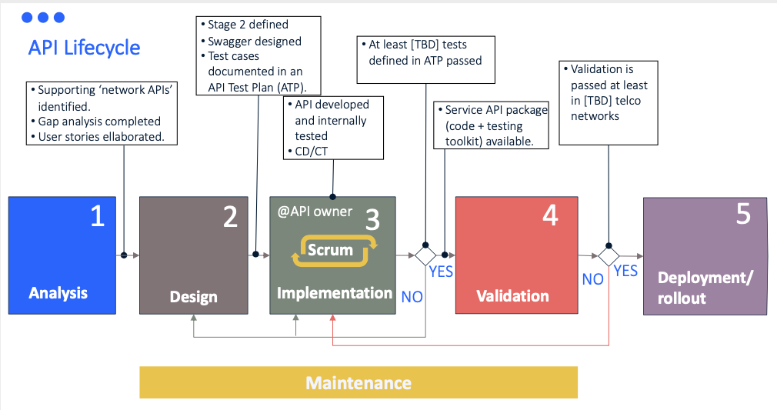
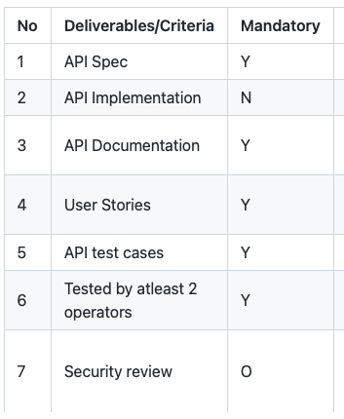
Issue #59 Complete release of an API - checklist
After offline discussion, the proposal is to use API-Readiness-Checklist as a basis (see right-side table). However, some clarifications shall be made:
Within the API lifecycle, clarify that the API-Readiness-Checklist captures the conditions that allows marking an API as CAMARA validated, stable, and therefore available for deployment/rollout in production environments.
The description of security review (no.7) shall be clearer, without any vague interpretation. For example, make use of Auth2.0 protocol for AuthN/Z together with OpenID connect. See discussions on issue #62.
CAMARA deliverable for an API:
Clarify that API spec (no.2), API documentation (no.3) and API test cases (API Test Plan, no.5) will be packaged into this deliverable.
Clarify whether user stories (no.4) will be included in this deliverable, or kept internal.
We don't yet have template for API Test Template. We shall start working on it.
Another topic that came into discussion in this issue #59 is API versioning. The following conclusions are drawn:
API versioning will be using 3-digit format (version x.y.z).
The usage of the 3-digit will be captured in the new version of 'guidelines' (see comments in issue #32)
The versioning and release timing will be handled and agreed per API family. This information will be captured in the README.md file included in each API Sub-Project.

Slide 17

Q&A

